Slide 1
GroceryFly
Web based/ native app development
Confidential and only intended for those allowed by the appcropshop this document is not to be forwarded or emailed to any other person or persons without a confidentiality agreement or prior permission from Jeremy Chen the owner and CEO of the appcropshop.

Slide 2
1.Consumer places an order of groceries using a desktop or mobile device.(tablet, cell phone)
2. Data(shopping list, consumer’s address, payment method, and drop off time) is transferred to Dispatcher. Dispatcher confirms order by calling client. Once confirmed, Dispatcher sends data to Supplier(gatherers) and Delivery(drivers)
5.Driver drops food with consumer which completes the order and attends to the next order.
4.Driver receives shopping list via email and text and is notified with pickup time. Driver goes to grocery store where he picks up the assigned order to him or her, and is ultimately responsible for making sure items are on board. Driver then confirms order with dispatcher and heads to the consumer’s household.
3. Supplier(gatherer) receives shopping list via fax, admin app, email, and order history data base. Gatherer then preps the order by placing requested items in delivery box for driver AND scanning the upc code( with admin application) of every item which will inventory costs and insure that every item is on board.

Slide 3
Introduction to front end
Groceryfly is a concept to deliver groceries to a consumer using a web based ordering system. This web based system will have two different interfaces that a user(consumer) will use to order his or hers food.
The two interfaces consist of a web based site and a native application built for both android and ios platforms.

Slide 4
Consumer Interface one(Website)
The website will be designed similar to a point of sale system that inventories the groceries from a supplier. This requires photo of product and upc code from manufacturer. This becomes very important for the navigation of the items so the consumer can shop the items based on category and add items to a shopping cart for checkout. Once a customer browses the site he or she will be asked to enter their zip code. Depending on location of supplier they may or may not be available for delivery.
Enter zip code
44139
Once they are a recognized zip code that we deliver to they are navigated to the directory of items that are provided by supplier.

Slide 5
User sees following categories to shop
Produce
Meat and seafood
Deli
Dairy
Beverages
Bakery
Frozen
Grains pasta and beans
Baking and cooking needs
Condiments and sauces
Soups and canned goods
Snacks
Breakfast and cereal
Alcoholic beverages
Laundry, paper and cleaning
Office home and garden
Health and beauty
Baby and childcare

Slide 6
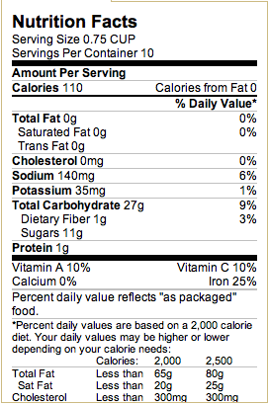
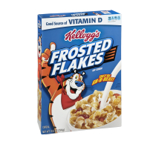

User then browses and adds items to a cart
The items will be inventoried with photograph, nutrition facts, and price.
After they add the items to cart they start developing a list. Consumers must spend a $50 minimum to qualify for delivery.
Price 3.50
2

Slide 7

Consumers see their checkout list in real time and at all times. Shopping lists and checkout page will available on every page and will be found in the upper right hand corner of webpage.
Products
Quantity
Price
Total
Kellogg's frosted flakes
Frozen Chicken
Green onion
Bananas
Dozen Donuts
24 pk Bud Light
2
3
4
2lb
2
2
7.00
26.00
4.00
4.00
12.00
26.00
84.53

Slide 8
Consumer now presses checkout
If a first time consumer checks out, the consumer will be required to fill out information that is stored in our database and used for future login. Name, Address, Phone number, Email, create username and password and then asked to review the order receipt. At this point, the consumer is 100% responsible for the items he or she selected and will be required to check a box that re- confirms the order. The system will then ask the consumer which payment method he or she would like to use.
Quantity price
2 Kellogg’s frosted flakes 7.00
3 Frozen Chicken 26.00
green onion 4.00
2lbs Bananas 4.00
Dozen donuts 12.00
2 24 pk Bud light 26.00
Total + Tax 84.53
Delivery Charge 6.99
Gratuity 11.85
GRAND TOTAL 103.87
John Doe
2135 Crestwood avenue
Solon Ohio 44139
Is your order 100% accurate? Have you read and reviewed your order details? Yes
No
Which form of payment will you Using?
Cash Credit
Estimated delivery time: 5pm

Slide 9
Consumer pays for groceries
If consumer chooses credit: they will navigate to a secured page where they can checkout via PayPal, MasterCard, visa, American express, discover etc.
If consumer chooses cash: consumer pays delivery driver on arrival of groceries.
A confirmation # is posted and emailed to that consumer immediately upon checkout.
DATA is now sent to Dispatcher

Slide 10
Consumer interface two(native app)
Along with the website there will be a mobile website where a user can browse and shop for groceries online and have the exact same functionality as the desktop website. However, the application for tablets and handheld devices should not be confused nor taken as the same thing. Although a mobile website and an application both have similar features and settings… The application will be built for download with “native content” which allows a user to have various functions that the mobile website does not have. The mobile website and the application are one in one, because they will interact with the same supplier database and the appearance of the grocery items will have similar CSS settings. The mobile website will be designed to make the desktop site easier to browse from mobile devices, but the native application will be available for download from both Android and iPhone markets. In the next slide I will discuss the different features of the application we will provide to consumers, but please be assured that the mobile website will have enough functionality to complete a checkout from start to finish as well. Which means a consumer can browse GroceryFly with or without the native application.

Slide 11
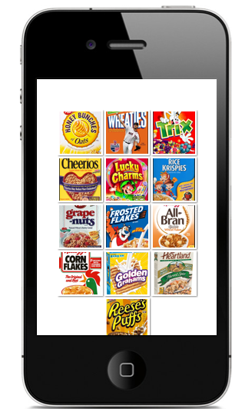
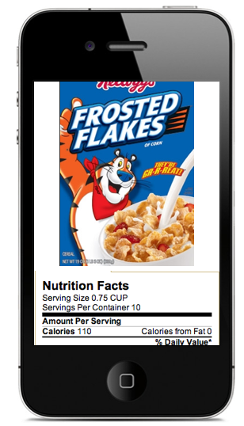

Slide 12
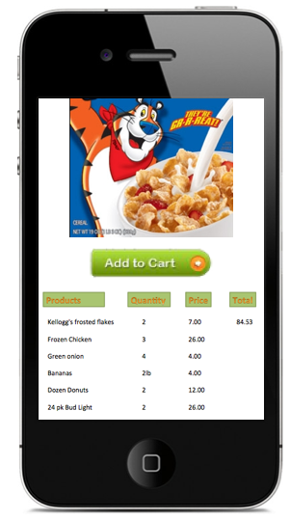
This is an example of how the desktop site and the mobile site will function exactly the same but just have different CSS settings with sizing and navigation.
The application will be very similar in regards to size ratio and checkout functionality but will offer a few more features that the mobile website cannot offer alone. Thus, the reason for the application.

Slide 13
What can the native app do that the mobile website cannot?
Brand itself in the application market
Scan barcode items and add item to cart
Find gps location for delivery
Offer display advertisements from other companies
Receive coupons by push notifications(real time)
Promote printed advertisements of goods with upc code attached for scanning.(shopping on the go)
Allows supplier to control products in market

Slide 14
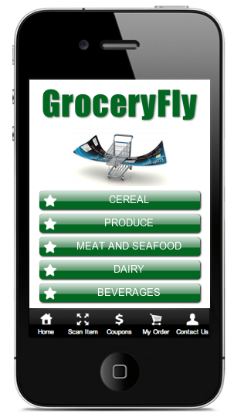
The application will have five major function
Buttons. The app and mobile website look
will be uniform. However, the application
For consumer will have these additional
functionalities.:
SCAN ITEM: allows user to scan barcode of
Any of supplier’s goods and lookup price
and add to cart directly from scan.
COUPONS: offered from push notifications
that are either from supplier or third party
companies.
MY ORDER: allows client to see real time
Orders purchased and has a gps locator
inside which will give a consumer his or her
location. Consumer will also be able to see
the status of delivery of driver in route.
CONTACT US: will have click to call, Live ordering
&customer help

Slide 15
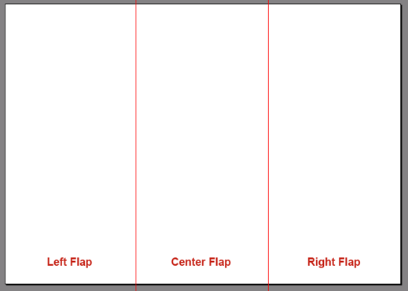

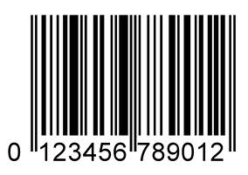
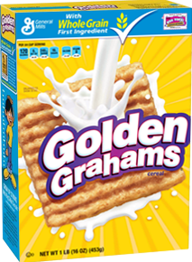
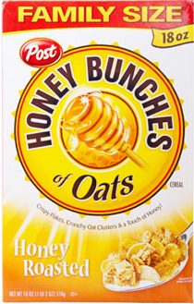

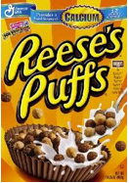
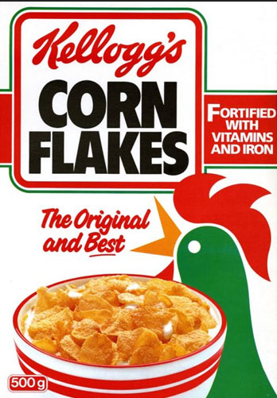
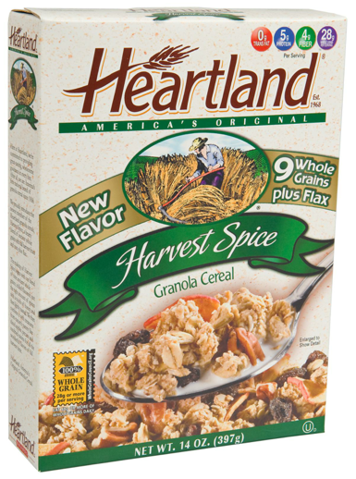
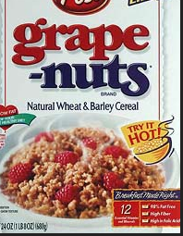
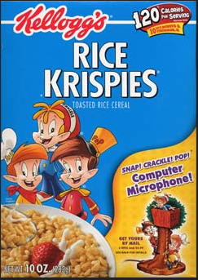
So let’s say a supplier provides a Brochure of goods they offer

Slide 16
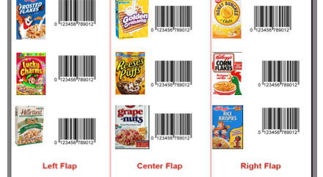
User scans item with phone or tablet

Slide 17
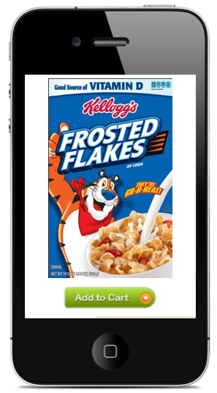
And we return to point “A”
Interacting with exact same database and website as previously discussed

Slide 18
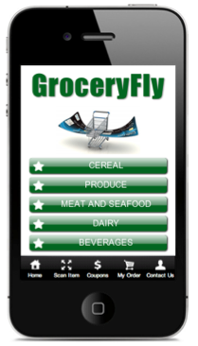
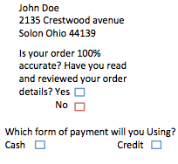
They
Choose
Cash or Credit and ultimately the data is now sent to Dispatcher

Slide 19
Dispatcher distributes data to supplier
Data from consumer
Supplier receives data
What does supplier see exactly?
(next page)

Slide 20
Supplier
The supplier will be built it’s own personal administration backend that co-exists with supplier’s “checkout application”
The supplier’s administration will consist of financial reports, employee I.D.’s responsible for ringing up items, real time data from dispatcher, and access to the upc inventory which is linked directly to the consumers application.
Access to the upc inventory is important in the case that supplier is “out of stock” with an item or multiple items.
A custom application will be built for supplier that co-exists with the supplier’s and dispatcher’s admin panels.
This is very different from the consumers application because the sole purpose of this particular application is to insure the logistics of supply, delivery, inventory, quality, and shelf stock.
*note* supplier will also receive a fax and email notifying the gatherer of order.

Slide 21
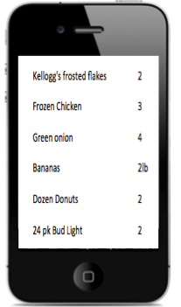
Supplier application
Once dispatcher receives data from dispatcher the supplier’s application will show a list of groceries that consumer ordered. Furthermore, The list is viewable from both supplier and dispatcher admin panels if needed.
To insure that the item’s will be packed on board the gatherer(employee responsible for assembly) must scan the item in order to remove an item off the list.
This process not only insures that items are on board but will also act as the point of sale software which tracks for both supplier and groceryfly’s admin financial reports.

Slide 22
Supplier (continued)
This could seem impractical from a glance, but this process will track the items on board, cost of items, items coming off shelf, inventory of items sold, check off grocery list, calculates amount owed to supplier, amount owed by grocery fly, confirms order for consumer, and insures that gatherer is with the item at time of eliminating an item off a list. This increases the quality for all parties and acts as the point of sale software needed to tether all three (consumer, dispatcher, supplier) and confirms sale for all three parties involved.

Slide 23



Slide 24
Once items are all scanned the order is confirmed and data is re-circulated to dispatcher(groceryfly) and supplier’s admin. Where both can view the order and confirm that items have not only been purchased but are ready for delivery.
supplier
Confirmed order is now re-circulated to both admin panels
dispatcher

Slide 25
Dispatcher now notifies driver
Once confirmed items are packed and ready for delivery… driver is notified of pickup time, delivery address, customer info etc.
Dispatcher
driver
Via text
Or phone call
Example text:
Alert message: pick up order #345 is now ready for delivery Jon.
Copy that. On my way

Slide 26
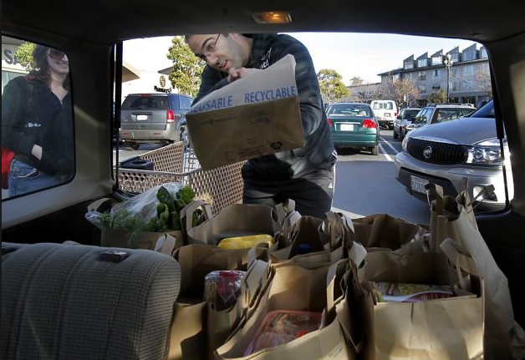
Driver arrives to supplier and packs groceries in vehicle

Slide 27
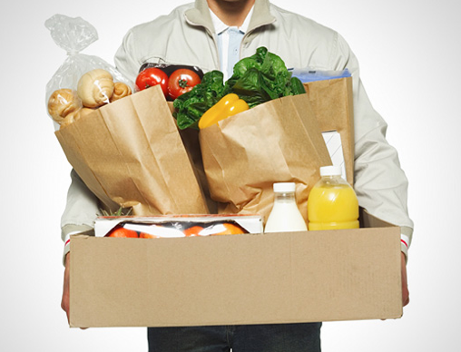
Driver drops groceries off to consumer

Slide 28
Groceryfly is an application designed by Jeremy Chen, the owner and point guard, of the appcropshop. The appcropshop has created mycity247 for android and iphone, it has also created point of sale software for the deluxewash carwashes in Cleveland Ohio. The appcropshop currently has created over 100+ websites and is doing work with casinos in West Virginia, Pennsylvania, and Columbus. Jeremy Chen currently has projects primarily based in the U.S. but also has projects branching out to Jakarta Indonesia, India and Bangkok Thailand. The primary focus of the appcropshop is to advance technology while giving back to the communities around the world. This is an innovative project that will take the cooperation of many people and will provide a service that is greatly appreciated. The appcropshop focuses on the positive aspects of business and only hopes to inspire others. Jeremy Chen is dedicated to his craft and is currently looking for suppliers to fulfill his dreams.
For more information please visit www.groceryfly.com or www.appcropshop.com
you can reach Jeremy Chen @ 1-216-258-7433 by email- appcropshop@gmail.com

