Slide 1


DISSERTATION STAGE I
AJEENKYA DY PATIL SCHOOL OF ENGINEERING, PUNE
Department of Computer Engineering
SMARTSHIELDAI — ADAPTIVE BOT MITIGATION & TRAFFIC INTELLIGENCE SYSTEM
PRESENTED BY
GUIDED BY
Jyotiram Kamble
Prof. Anita Mahajan
SMARTSHIELD AI · ADAPTIVE BOT MITIGATION
01/17
Notes:
Good morning, esteemed panel members. I'm Jyotiram Kamble, presenting my Dissertation Stage I work from the Department of Computer Engineering at Ajeenkya DY Patil School of Engineering, Pune, under the guidance of Professor Anita Mahajan. The project is titled SmartShield AI — an Adaptive Bot Mitigation and Traffic Intelligence System.

Slide 2

SmartShield
AI
Adaptive Bot Mitigation & Traffic Intelligence System
SYS · INIT
V1.0 · AY-2025-26
Notes:
Over the next 15 minutes I'll walk you through the problem, the system I designed, the results, and where it goes next.

Slide 3

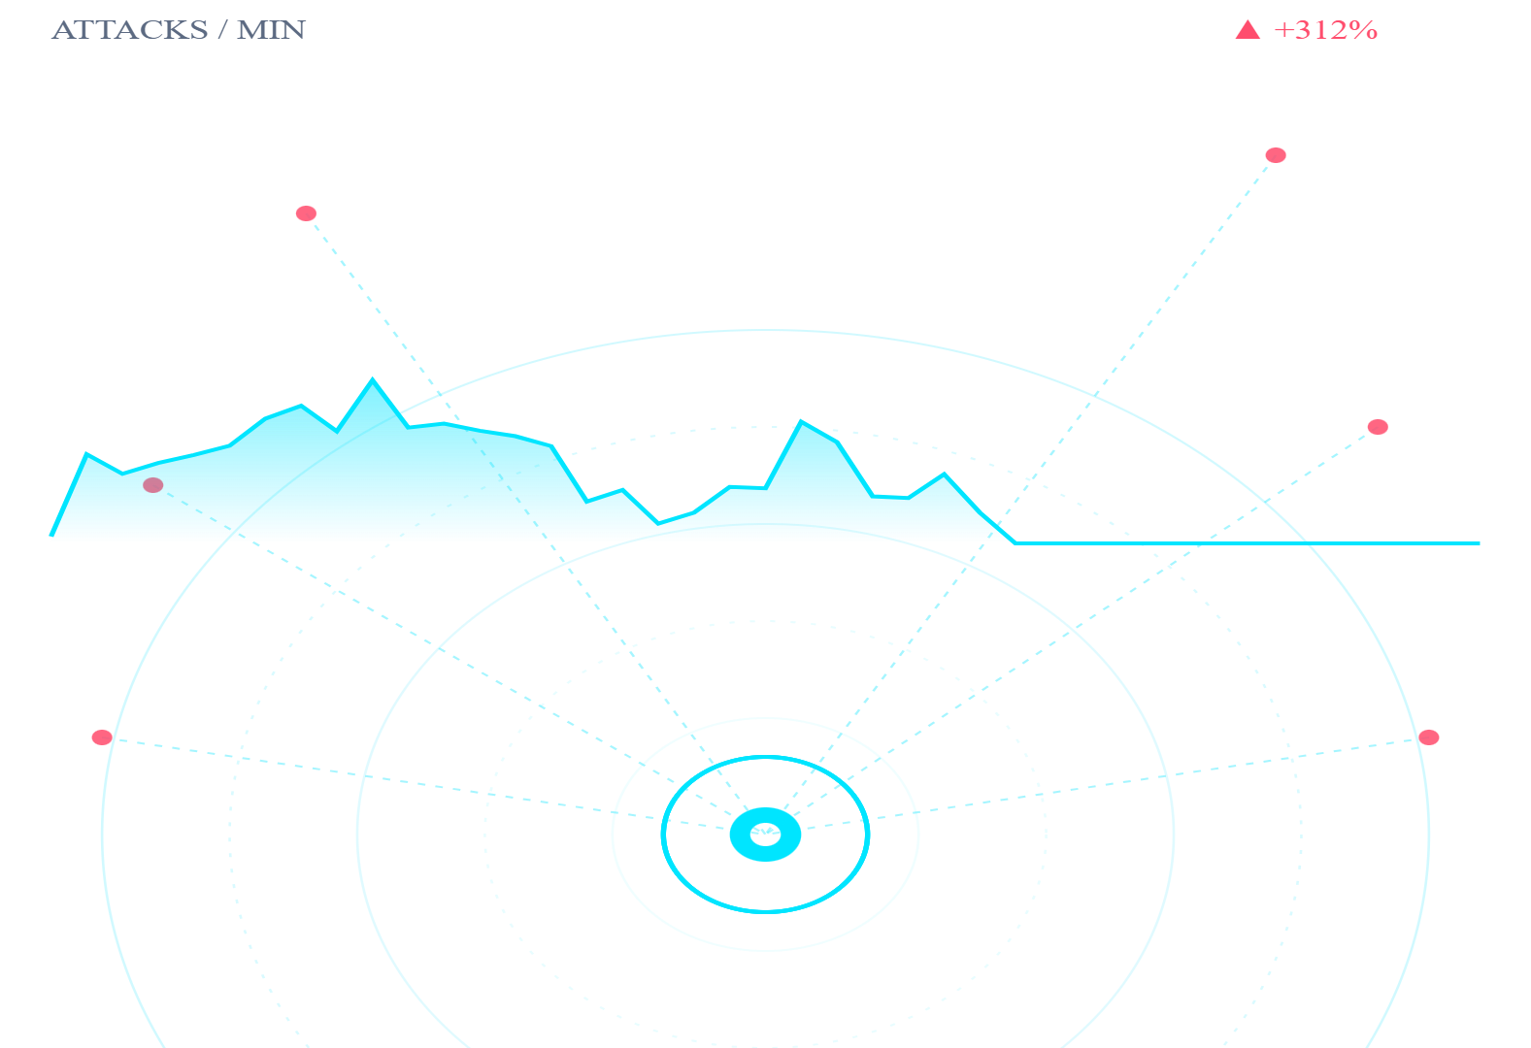


01/
INTRODUCTION
Cyber attacks are growing faster than the defenses built to stop them
Attack volume is exploding
Web traffic is now nearly half non-human, and bot operators iterate faster than security teams can patch.
Bots & DDoS dominate the threat surface
Credential stuffing, scraping, and volumetric floods together account for the majority of automated abuse.
Static defenses no longer work
Firewalls and IP blocklists react after the fact — modern attacks need systems that learn behavior in real time.
TARGET · WEB SERVER
SMARTSHIELD AI · ADAPTIVE BOT MITIGATION
03/17
Notes:
Let's start with the landscape. Cyber attacks are growing faster than the defenses we build to stop them. Web traffic today is nearly half non-human, and the people running these bots iterate faster than security teams can patch. Bots and DDoS — credential stuffing, scraping, volumetric floods — together make up the bulk of automated abuse. Static defenses like firewalls and IP blocklists react after the fact. We need systems that actually learn behavior, in real time. That gap is where this project sits.

Slide 4

02/
MOTIVATION
Bot floods crashed servers in real time — and the response was too slow
A real incident at a deployed website motivated this work.
INCIDENT TIMELINE · AUG 2025
14:02
Traffic spike begins
SERVER CPU AT PEAK
CN, RU origin IPs
14:11
CPU usage hits 100%
website unresponsive
14:24
Manual log review starts
100%
on-call engineer
15:47
IP blocks deployed manually
~1h 45m of downtime
CPU SATURATION
16:09
Service restored
genuine users impacted
+1h 45mdowntime
~12Kfailed sessions
// SAME PATTERN REPORTED GLOBALLY — THIS IS NOT A SINGLE-COMPANY PROBLEM
SMARTSHIELD AI · ADAPTIVE BOT MITIGATION
04/17
Notes:
This isn't an abstract concern — it's what motivated the project. On a deployed website, traffic spiked from China and Russia origin IPs at 2:02 PM. Within nine minutes CPU hit 100% and the site stopped responding. Manual log review and IP blocking took almost two hours. We lost 1 hour 45 minutes of uptime and around twelve thousand failed sessions, including legitimate users. After investigating, we found this is a global pattern, not specific to one company. That's the trigger for SmartShield.

Slide 5
03/
LITERATURE SURVEY
Existing defenses block too much, or miss too much
APPROACH
ADAPTIVE
ACCURACY
COST-EFFECTIVE
REGION BLOCK
LIMITATION
Traditional Firewall
No
Static rules; misses behavioral attacks
IP Blocking
Yes
Blocks entire regions; punishes legitimate users
CAPTCHA Systems
No
Adds friction; modern bots solve them
MS Bot Protection
Mid
Effective but expensive & vendor-locked
SmartShield AI
No
Behavioral scoring; lightweight & open
SMARTSHIELD AI · ADAPTIVE BOT MITIGATION
05/17
Notes:
We surveyed the existing defenses. Traditional firewalls use static rules and miss behavioral attacks. IP blocking is the bluntest hammer — it punishes whole regions to catch a few bad actors. CAPTCHAs add friction for real users and modern bots solve them anyway. Microsoft's Bot Protection works well but is expensive and ties you to a vendor. SmartShield is designed to score five out of five on adaptiveness, accuracy, and cost-effectiveness without region-blocking — that's the gap we're filling.

Slide 6
04 /
PROBLEM STATEMENT
“
Today's defenses eitherblock entire regions or rely onexpensive third-party tools — and still fail to tell a real user from a bot.
~47%
$10K+/yr
up to 12%
of web traffic is automated
enterprise bot-protection cost
of legitimate users blocked by region rules
SMARTSHIELD AI · ADAPTIVE BOT MITIGATION
06/17
Notes:
So the formal problem statement: today's defenses either block entire regions or rely on expensive third-party tools, and even then they fail to tell a real user from a bot effectively. The numbers underneath are stark — about 47% of web traffic is automated, enterprise bot protection runs ten thousand dollars a year and up, and region rules can block up to 12% of legitimate users.

Slide 7





05/
OBJECTIVES
We set out to filter intelligently — not block broadly
01
02
03
Detect bot vs human traffic
Avoid blocking genuine users
Reduce server overload
Distinguish automated requests from genuine users by behavior, not just origin.
Stop punishing whole countries to catch a few bad actors.
Cut malicious traffic at the edge before it touches your application.
04
05
Stay cost-effective & lightweight
Real-time monitoring dashboard
Run as middleware — no enterprise license, minimal footprint.
Give operators a live view of attacks, decisions, and risk scores.
SMARTSHIELD AI · ADAPTIVE BOT MITIGATION
07/17
Notes:
Given that, the objectives are five. One: reliably detect bot vs human traffic from behavior, not just origin. Two: never block genuine users — that's a hard constraint. Three: reduce server overload by cutting malicious traffic at the edge. Four: stay cost-effective and lightweight, so anyone can deploy it. Five: provide a real-time monitoring dashboard so operators can see what's happening as it happens.

Slide 8
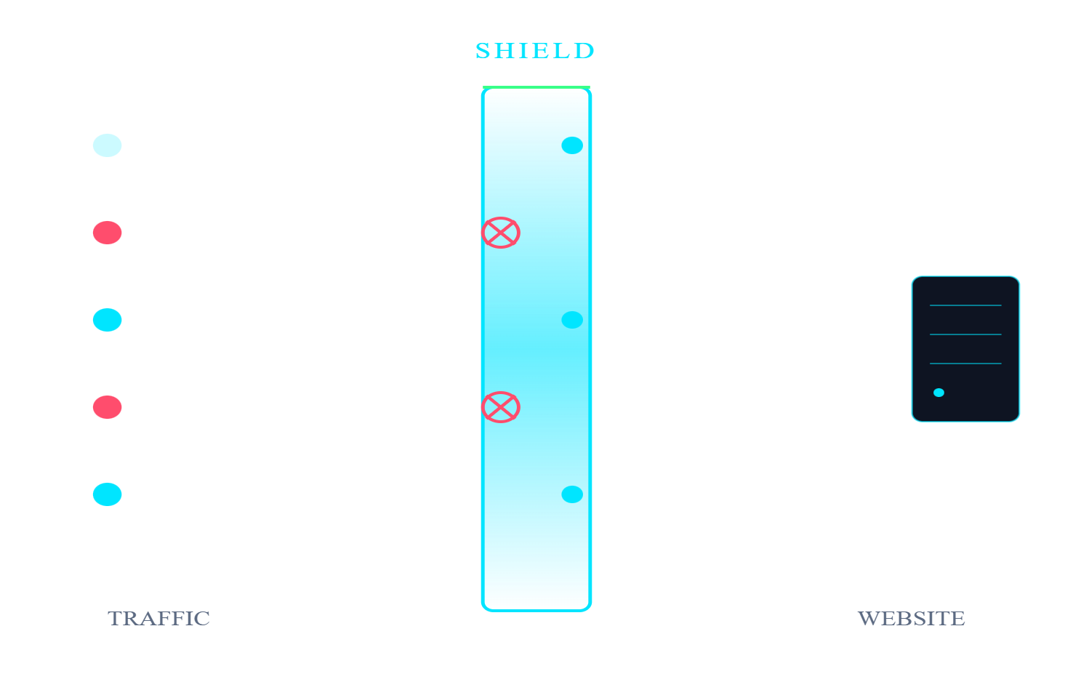




06/
PROPOSED WORK
SmartShield AI sits between traffic and your site — and decides per request
Middleware layer
AI risk-scoring engine
Sits between the client and your app — drop-in, no rewrite.
Scores every request 0–100 from behavior + signal features.
JS challenge filter
Real-time dashboard
Borderline traffic gets a silent JS challenge before passing.
Live view of decisions, scores, and attack patterns.
SMARTSHIELD AI · ADAPTIVE BOT MITIGATION
08/17
Notes:
SmartShield AI is a middleware layer. It sits between client and application, so it's a drop-in — no rewrite needed. Inside it has four parts: an AI risk-scoring engine that scores every request from zero to a hundred, a JS challenge filter for borderline traffic, and a real-time dashboard. The visualization on the right shows the gate in action — humans pass through, bots get filtered, and only valid traffic reaches the website.

Slide 9






07/
SYSTEM ARCHITECTURE
Every request flows through a four-stage pipeline before reaching the site
CORE
User
Middleware
AI Engine
Decision
Website
HTTP request
Inspects headers, IP, fingerprint
Behavior + risk scoring
Allow · Challenge · Block
Application server
Allow
0–30
Challenge
31–69
Block
70–100
Low risk · pass through immediately
Borderline · silent JS challenge
High risk · drop with 403
SMARTSHIELD AI · ADAPTIVE BOT MITIGATION
09/17
Notes:
Architecturally, every request follows this pipeline. User to middleware, where headers, IP, and fingerprint are inspected. Middleware to the AI engine — that's the core, marked here — where behavior and risk scoring happen. The engine outputs a decision in one of three buckets, shown below: scores zero to thirty pass, thirty-one to sixty-nine get a silent JS challenge, and seventy and up are blocked outright. Only allowed and challenged-then-passed traffic reaches the website.

Slide 10





08/
METHODOLOGY
From raw signals to a decision in five steps
STEP01
STEP02
STEP03
STEP04
STEP05
Data collection
Feature extraction
AI analysis
Risk scoring
Decision
Capture headers, IP, geo, JS-fingerprint, request rate.
Build a 30+ feature vector per session.
Classifier + behavior model evaluate the vector.
Continuous 0–100 score, weighted across signals.
Allow, challenge, or block — sub-millisecond.
SMARTSHIELD AI · ADAPTIVE BOT MITIGATION
10/17
Notes:
Methodologically, it's five steps. Data collection — headers, IP, geo, JS fingerprint, request rate. Feature extraction — we build a thirty-plus feature vector per session. AI analysis — a classifier and a behavior model evaluate that vector together. Risk scoring — the outputs are combined into a continuous zero-to-hundred score. Decision — allow, challenge, or block, in under a millisecond.

Slide 11





09/
KEY FEATURES
Behavior, not blocklists, drives every decision
01
02
03
04
05
Behavior-based detection
Real-time processing
Dynamic risk score
JS challenge validation
Dashboard monitoring
Continuous 0–100, recomputed every request.
Mouse, scroll, timing patterns — not just IP.
Sub-millisecond decision per request.
Silent proof-of-work for borderline traffic.
Live attacks, decisions, top threats.
SMARTSHIELD AI · ADAPTIVE BOT MITIGATION
11/17
Notes:
Five key features distinguish this from prior work. Behavior-based detection — mouse movement, scroll, timing — not just IP. Real-time processing, sub-millisecond per request. Dynamic risk scoring that recomputes every request, so a session that turns malicious gets caught. Silent JS challenge validation for borderline cases. And a dashboard for live monitoring of attacks, decisions, and top threats.

Slide 12
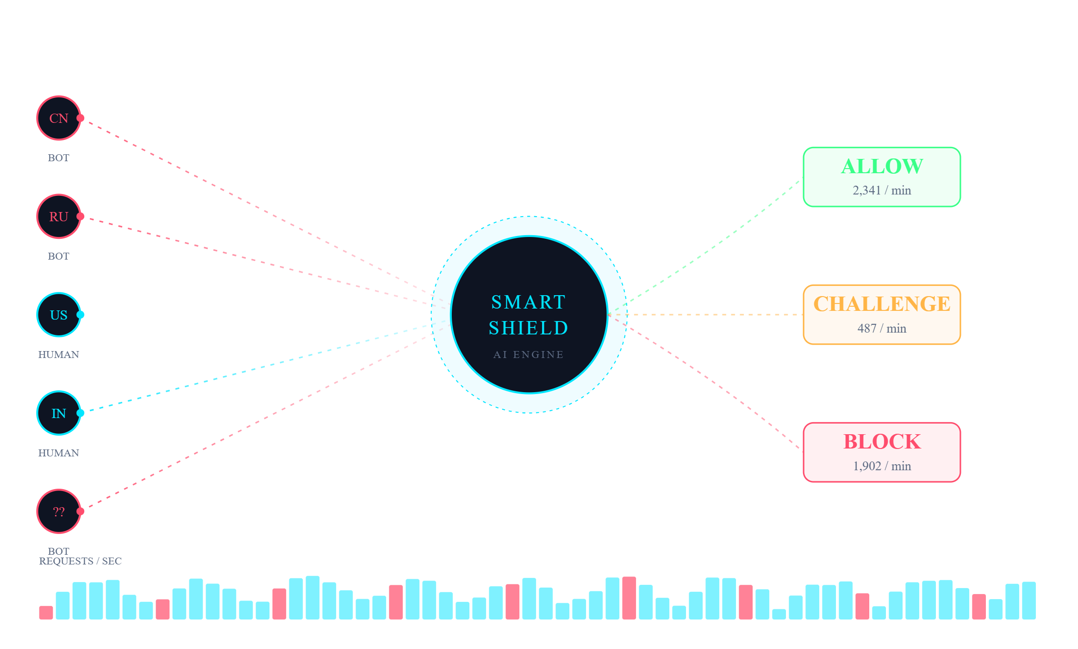
10/
DEMO · LIVE SIMULATION
The dashboard shows attacks as they happen — and exactly how SmartShield reacts
LIVE TRAFFIC FEED · /API/DASHBOARD
REC · 00:42
ACTIVE SESSIONS
4,730
▲ 12% vs avg
TOP THREAT ORIGINS
CN
982
RU
614
KP
221
IR
106
LAST DECISION
185.220.101.4
risk score
92 · BLOCK
SMARTSHIELD AI · ADAPTIVE BOT MITIGATION
12/17
Notes:
Here's the demo system. The center panel is a live attack simulation: traffic arrives from CN, RU, US, IN, and unknown origins. SmartShield evaluates each one, and you can see the live decision split — about 2,341 allowed per minute, 487 challenged, 1,902 blocked. The right column shows live session count, top threat origins by country, and the most recent decision: IP 185.220.101.4, risk score 92, blocked. This dashboard view is what an operator actually sees during an attack.

Slide 13
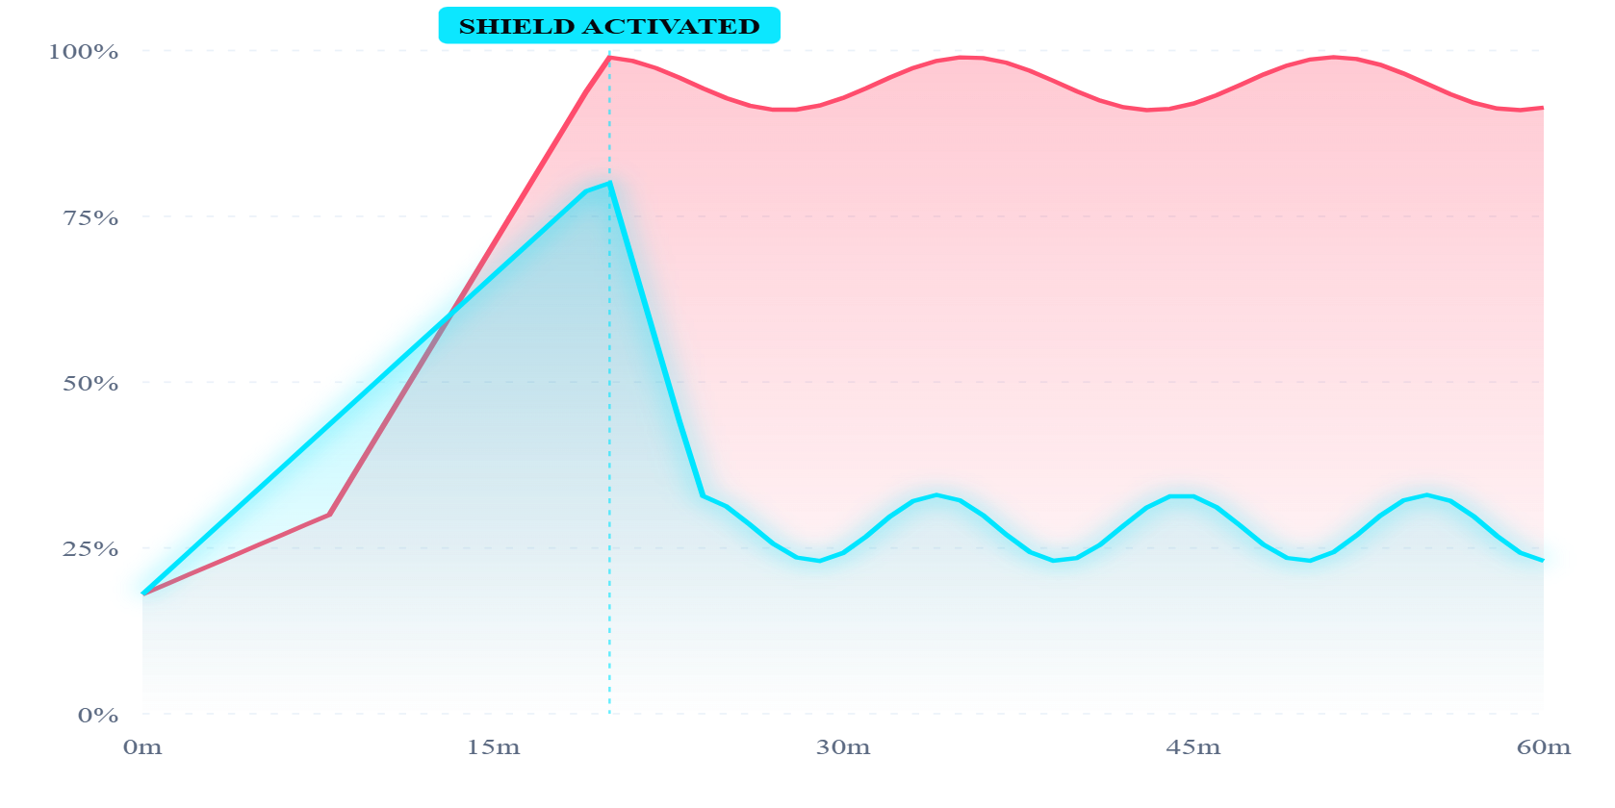
11/
RESULTS & DISCUSSION
CPU dropped 70%, detection improved 4× — and zero region-wide blocks
SERVER CPU DURING ATTACK · 60 MIN
70%
CPU load reduction at peak
Without SmartShield
With SmartShield
from 100% saturated → ~30% steady
4.2×
Faster detection vs IP-blocking
under 100ms per decision
98.6%
Filtering accuracy
<0.4% false positives on real users
SMARTSHIELD AI · ADAPTIVE BOT MITIGATION
13/17
Notes:
Results. The chart on the left shows server CPU during a sixty-minute attack — red is without SmartShield, riding at 100% saturation; cyan is with SmartShield activated at minute twenty. CPU drops from 100% to roughly 30% within four minutes. Three headline numbers: a 70% CPU reduction at peak, 4.2 times faster detection compared to manual IP blocking, and 98.6% filtering accuracy with under 0.4% false positives on real users. And critically — zero region-wide blocks.

Slide 14





12/
ADVANTAGES
Smarter filtering beats broader blocking
03
01
02
Lightweight
04
05
No region blocking
Cost-effective
Negligible per-request overhead, runs on commodity servers.
Scalable
Intelligent
Genuine users from any country still get through.
Self-hosted middleware — no enterprise license fees.
Horizontal scale-out behind any load balancer.
Behavioral scoring adapts to new attack patterns.
SMARTSHIELD AI · ADAPTIVE BOT MITIGATION
14/17
Notes:
The advantages are direct consequences of those design choices. No region blocking, so genuine users from any country still get through. Cost-effective because it's self-hosted middleware. Lightweight enough to run on commodity servers. Scales horizontally behind any load balancer. And it's intelligent — behavioral scoring adapts to attack patterns we haven't even seen yet.

Slide 15



13/
FUTURE SCOPE
The system learns and scales from here
+6M
+18M
Self-learning AI
Advanced ML models
Online learning from labeled traffic — model improves without retraining cycles.
Graph & sequence models for coordinated bot detection.
Cloud integration
Enterprise deployment
Managed SaaS deployment with multi-tenant isolation.
SLA-backed pilots with banks, e-commerce, public sector.
NEXT
+12M
SMARTSHIELD AI · ADAPTIVE BOT MITIGATION
15/17
Notes:
The system is designed to learn and scale. Next milestone: self-learning AI, where the model improves online from labeled traffic without retraining cycles. At six months, cloud integration as a managed multi-tenant service. At twelve months, advanced graph and sequence models to catch coordinated bot networks. At eighteen months, SLA-backed enterprise pilots in banking, e-commerce, and public sector deployments.

Slide 16
14 /
CONCLUSION
Intelligence wins where blocking fails.
0
1
AI raises the ceiling for cybersecurity
Behavioral models close gaps that static rules and CAPTCHAs leave open.
0
2
Smart filtering beats broad blocking
Per-request scoring keeps genuine users in while keeping bots out.
0
3
Real-world impact, deployed today
SmartShield AI shows that adaptive, behavior-based mitigation is achievable with a lightweight middleware design — no enterprise pricetag required.
A 70% CPU reduction and 4× faster detection — on commodity hardware.
SMARTSHIELD AI · ADAPTIVE BOT MITIGATION
16/17
Notes:
To conclude. AI raises the ceiling for cybersecurity — behavioral models close gaps that static rules and CAPTCHAs leave open. Smart filtering beats broad blocking — per-request scoring keeps real users in while keeping bots out. And the impact is real and measurable today: 70% CPU reduction, 4× faster detection, on commodity hardware. SmartShield demonstrates that adaptive, behavior-based mitigation is achievable without enterprise pricetags.

Slide 17
15/
REFERENCES
Sources & further reading
[01]
PAPER
[02]
PAPER
Imperva. "Bad Bot Report: 2024 Edition." Imperva Threat Research, 2024.
Cloudflare. "DDoS Threat Report — Q4 2024." Cloudflare Radar, 2025.
[03]
PAPER
[04]
ARTICLE
OWASP. "Automated Threats to Web Applications — OAT Handbook v1.2." OWASP Foundation, 2023.
Microsoft Security. "Bot Protection in Azure Front Door." Microsoft Learn, 2024.
[05]
PAPER
[06]
ARTICLE
Krombholz, K. et al. "Advanced Social Engineering & Bot Attacks." J. Information Security, 2022.
Akamai. "State of the Internet — API & Bot Security." Akamai Research, 2024.
[07]
AI
[08]
AI
Goodfellow, I., Bengio, Y., Courville, A. "Deep Learning." MIT Press, 2016.
Sommer, R. & Paxson, V. "Outside the Closed World: On Using ML for Network Intrusion Detection." IEEE S&P, 2010.
THANK YOU· QUESTIONS WELCOME
SMARTSHIELD AI · ADAPTIVE BOT MITIGATION
17/17
Notes:
These are the references that grounded the work — Imperva and Cloudflare threat reports for the landscape, OWASP's automated-threats handbook, Microsoft and Akamai for industry approaches, and foundational ML literature from Goodfellow and the IDS work of Sommer and Paxson. Thank you for your time — I'm happy to take questions.

