Slide 1



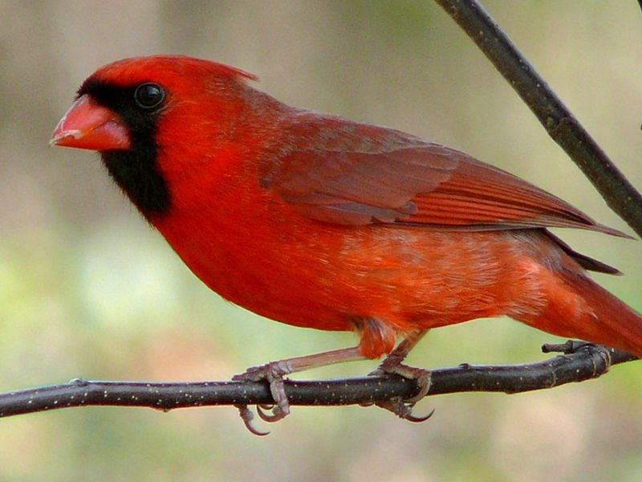
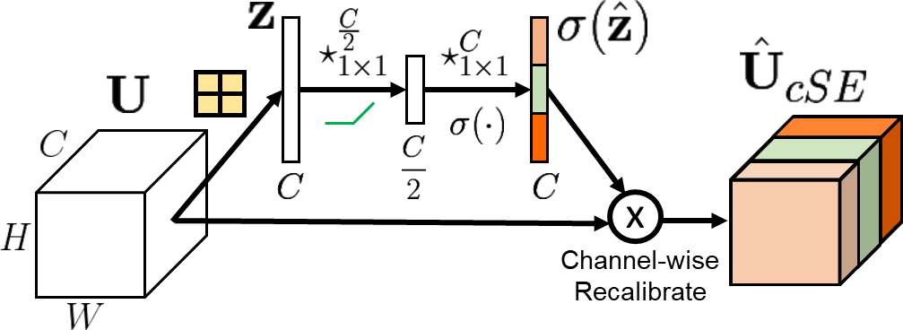
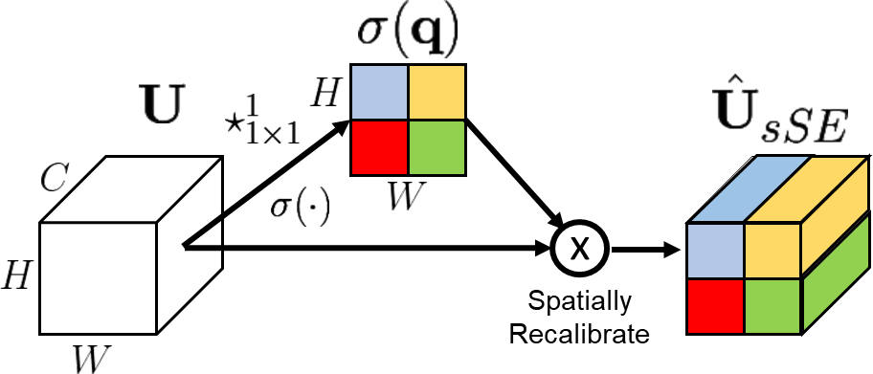
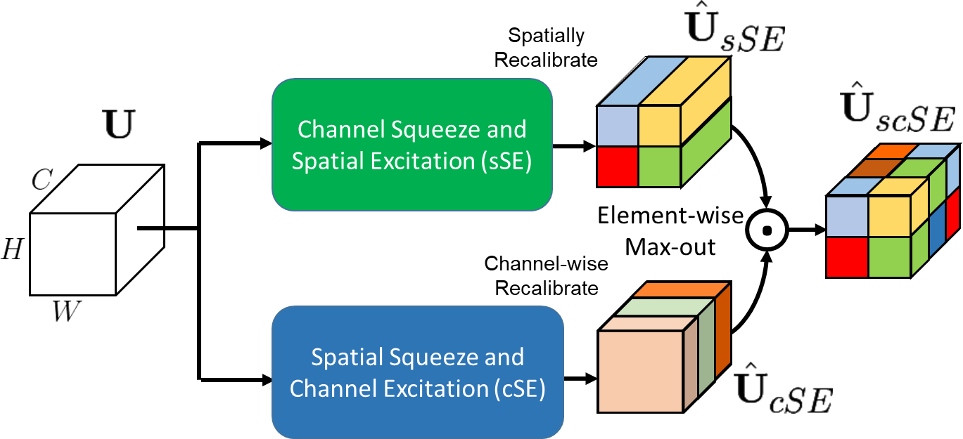
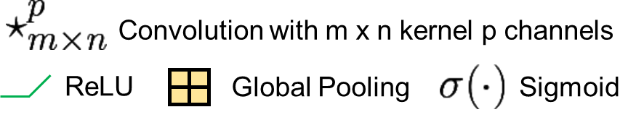
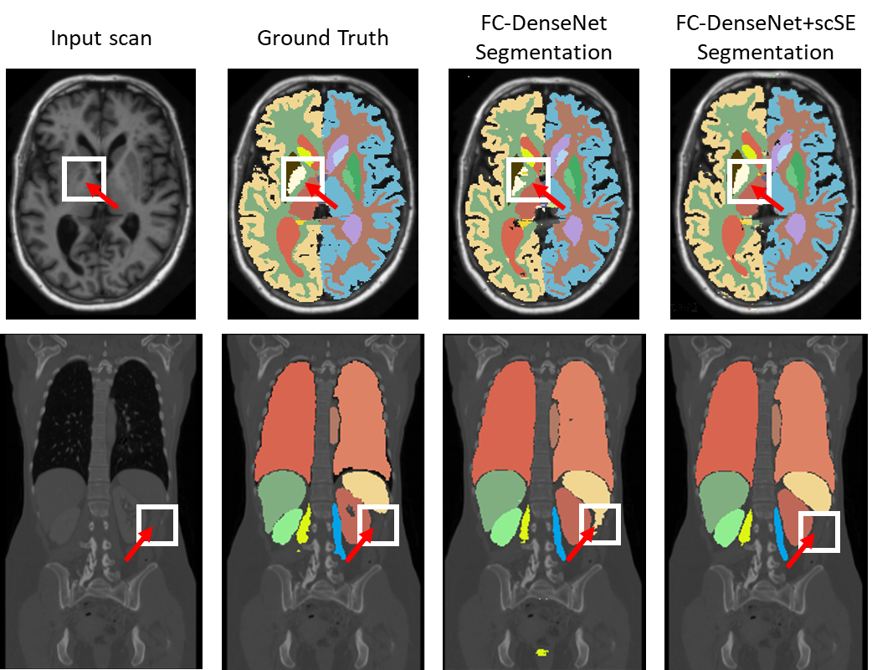

Concurrent Spatial and Channel ‘Squeeze & Excitation’ in Fully Convolutional Networks
Abhijit Guha Roy^{1,2}, Nassir Navab^{2,3}, Christian Wachinger¹
¹Artificial Intelligence in Medical Imaging (AI-Med, www.ai-med.de), KJP, LMU Munich, Germany
²Computer Aided Medical Procedures, TUM, Munich, Germany ³Computer Aided Medical Procedures, Johns Hopkins University, USA
What we propose in this work?
Re-calibration
Enhances Segmentation Performance
Input Feature Map
Conv Layer
Batch Norm
ReLU
Squeeze
& Excite
Output Feature Map
Minimal Additional Parameters
Basic F-CNN architecture
Easy to integrate in any Fully Conv Nets
Why Re-calibration is needed?
Insert SE blocks in F-CNN
1
1 + 2
Some channel dependencies are learnt implicitly
No Association learnt between some channels
2
Second Conv Layer
x
First Conv Layer
x
3
3 + 4
x
4
x
Can we encode channel dependencies explicitly to improve features?
Encoder Blocks
Squeeze & Excitation (SE) Blocks
Decoder Blocks
Classifier Block
Squeeze and Excitation (SE) Blocks
Bottleneck
Soft-max layer
Spatial squeeze & Channel excitation (cSE)
Channel squeeze & Spatial excitation (sSE)
Operates pixel-wise, same receptive field
Adaptive spatial recalibration
Provides Attention mechanism
Emphasizes relevant spatial locations
Global Context
Adaptive Channel recalibration
Explicit encoding of channel dependencies
Emphasizes relevant channels
Hu et al., CVPR, 2018 (ILSRVC winner)
Spatial and Channel squeeze & excitation (scSE)
sSE and cSE are complementary
Jointly emphasizes spatial and channel
Max-out provides inherent selectivity
Experiments and Results
Whole-brain segmentation (Multi-Atlas Challenge Dataset) Whole body segmentation (Visceral Dataset)
Dice Score
Increase in Model Complexity
+6%
1.52%
+7%
0.02%
+9%
1.57%
a
Contributions
SE blocks as light-weight generic component for any F-CNN architecture.
Channel squeeze & spatial excitation
Concurrent spatial and channel SE block using max-out

