Slide 1


Bayesian Neural Networks for Uncertainty Estimation of Imaging Biomarkers
J. Senapati, A. Guha Roy, S. Pölsterl, D. Gutmann, S. Gatidis,
C. Schlett, A. Peters, F. Bamberg, C. Wachinger
Artificial Intelligence in Medical Imaging (AI-Med), KJP, LMU München, Germany
Department of Diagnostic and Interventional Rad., University of Tübingen, Germany
Department of Diagnostic and Interventional Rad., University Freiburg, Germany
Institute of Epidemiology, Helmholtz Zentrum München, Germany
Notes:
Good afternoon everyone, I am Abhijit, a PhD student from the Ludwig Maximilian University of Munich, Germany. Today I will be talking about our recent work titled “Concurrent Spatial and Channel ‘Squeeze & Excitation’ in Fully Convolutional Networks”.

Slide 2
MOTIVATION

Slide 3
MOTIVATION

Slide 4
[1]
[2]
A
[3]
[4]

Slide 5
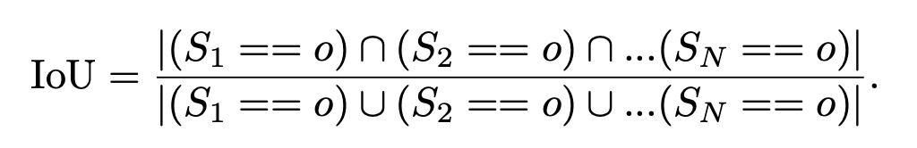
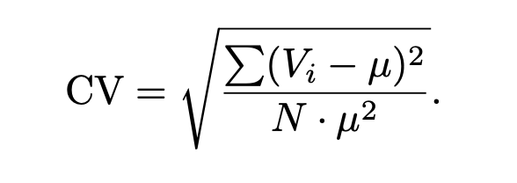
CONFIDENCE MEASURES
Intersection Over Union
[5]
Coefficient of Variation
[6]
[1, 5, 6] Roy, A.G., Conjeti, S., Navab, N., Wachinger, C. and Alzheimer's Disease Neuroimaging Initiative, 2019. Bayesian QuickNAT: Model uncertainty in deep whole-brain segmentation for structure-wise quality control. NeuroImage, 195, pp.11-22.
[2] Kingma, D.P., Salimans, T. and Welling, M., 2015. Variational dropout and the local reparameterization trick. In Advances in Neural Information Processing Systems (pp. 2575-2583).
[3] Kohl, S., Romera-Paredes, B., Meyer, C., De Fauw, J., Ledsam, J.R., Maier-Hein, K., Eslami, S.A., Rezende, D.J. and Ronneberger, O., 2018. A probabilistic u-net for segmentation of ambiguous images. In Advances in Neural information Processing Systems (pp. 6965-6975).
[4] Kohl, S.A., Romera-Paredes, B., Maier-Hein, K.H., Rezende, D.J., Eslami, S.M., Kohli, P., Zisserman, A. and Ronneberger, O., 2019. A Hierarchical Probabilistic U-Net for Modeling Multi-Scale Ambiguities. arXiv preprint arXiv:1905.13077.

Slide 6
Manual
Base
Variable
Instance
Interaction
Statistical Models
Group Analysis
Disease Classification

Slide 7
Experimental Results

Slide 8
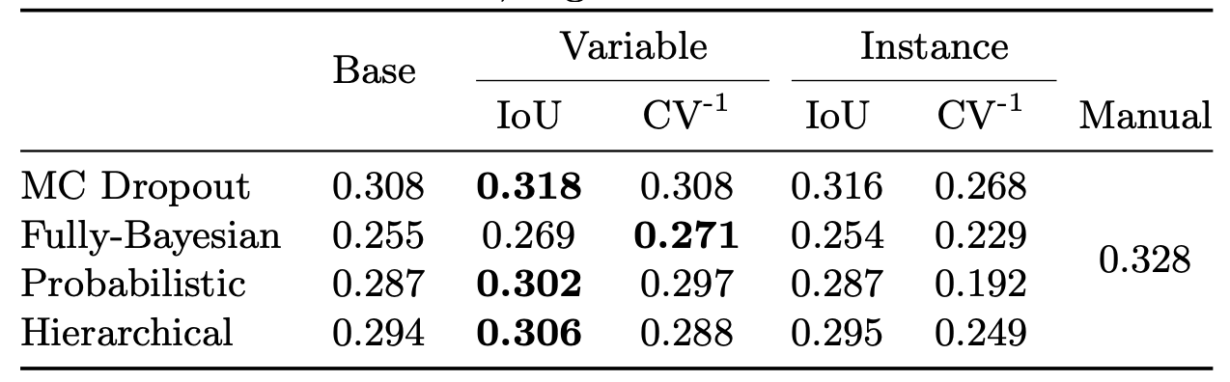
GROUP ANALYSIS
Segmentation Dataset: KORA
Statistical Analysis Dataset: KORA Non-Imaging Features Set

Slide 9
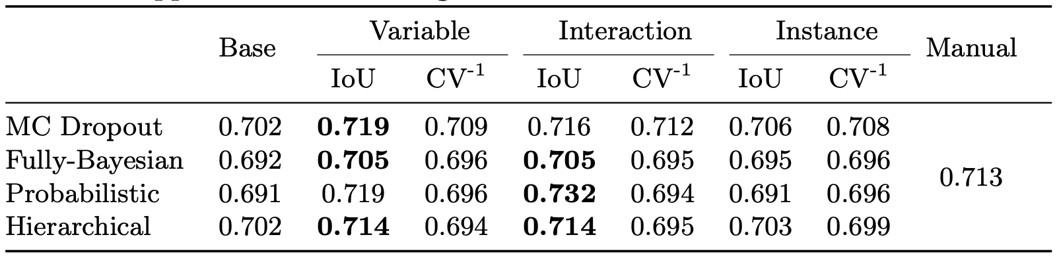
DISEASE CLASSIFICATION

Slide 10
TAKEAWAYS

Slide 11

Thank You! Questions?
Check out our work at www.ai-med.de
Notes:
As conclusion, I would like to give some final takeaways.

Slide 17
Contribution of our work
Fully ConvNets (F-CNNs) are widely used for image segmentation
Basic F-CNN architecture for segmentation
Re-calibration
Input Feature Map
Squeeze
& Excite
Output Feature Map
Conv Layer
Batch Norm
ReLU
Encoder
path
Decoder
path
Enhances segmentation performance
Encoder Blocks
Minimal additional parameters
Decoder Blocks
Classifier Layer
Bottleneck
Soft-max Layer
Easy to integrate in any F-CNNs
Notes:
First, I will brief the main contribution of our work.
Fully ConvNets are the most commonly used tool for segmentation
Any basic F-CNN has a structure like this, with an encoding path, a decoding path, separated by a Bottleneck layer.
Each Encoder or Decoder involves a non-linear mapping of the feature maps, consisting of Conv Layer, Batch Norm, ReLU activations.
In this work, we propose a new computational block, which can be added within the Encoders or Decoders, providing feature re-calibration
Which results in enhanced segmentation performance with minimal additional parameters and can be easily integrated within any F-CNN architecture.

Slide 18
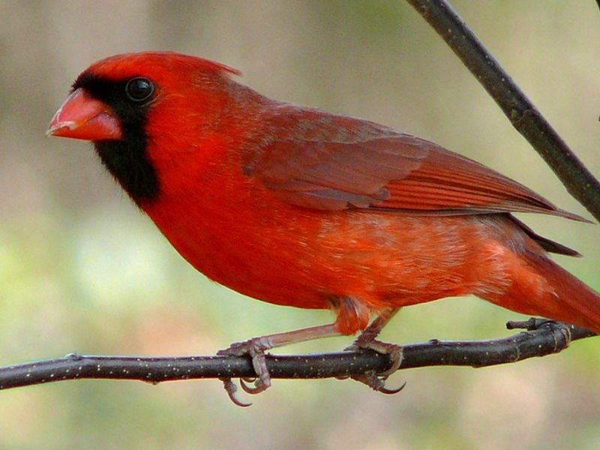
Convolutional Layer
Joint encoding of local spatial and channel-wise information
1
x
Some channel dependencies are learnt implicitly
No association learnt between some channels
2
1 + 2
x
x
Can we encode channel dependencies explicitly to improve features?
3
3 + 4
x
4
Second Conv Layer
(Increased Receptive Field)
First Conv Layer
Notes:
Before going into the details, let us take a closer look at the Convolutional Layer, which is the core component of any CNN.
Given an input image, it learns a joint encoding of local spatial and channel-wise information.
Let us take an example with the image of a bird.
We assume, the first layer of Conv Layers learnt some basic features like beak, neck, feet and tail feature.
In the second conv layer the receptive field increases, and in a hierarchial fashion it learns associations between the feature maps of Conv 1.
The similar encoding continues as depth increases.
Thus, dependencies between the channels are learnt implicitly, for eg: (1+2) and (3+4)
Due to the implicit nature, some associations may be left unlearnt, for eg: (1+3), (2+4) in this example.
Towards this end, we pose the question that, “Can we encode this channel dependencies explicitly to improve the learnt features?”

Slide 19


Spatial Squeeze and Channel Excitation (channel SE)
Adaptively assigns a scalar weight to each channel using global context
Encodes channel dependencies
Emphasizes relevant channels
Winner of ILSVRC 2017
x
Channel-wise Recalibrate
Spatial Squeeze
Channel Excitation
Global Pooling
Conv Layer
Sigmoid
ReLU
Hu, J., Shen, L. and Sun, G. Squeeze-and-excitation networks. In CVPR 2018.
Notes:
Recently, a work was presented at CVPR 2018 this year, which introduces “Squeeze-and-Excitation” computational block for explicit encoding of channel dependencies.
More specific, a spatial squeeze and channel excitation, which we abbreviate as channel SE in the presentation.
Given an input of spatial resolution H and W, with C channels, a global average pooling is used to generate a 1*C vector. This operation is termed spatial squeeze as it factors out spatial dimensions.
Two fully connected layer learns a non-linear relationships among the channels, generating a channel descriptor, which is used to re-scale the channels of the input map. This stage is termed channel excitation.
A scalar value is adaptively assigned to each channel, which is estimated using global context, which average pooling provided.
Thus, channel dependencies are explicitly enforced, emphasizing relevant channels.
This block was the integral part of the winning submission for ImageNet Image Classification Challenge on 2017, indicating its importance for classification.
This is custom made for classification, but we want to modify it for segmentation tasks where spatial information is also relevant.
Now thinking in a parallel direction, for segmentation, a similar importance needs to incorporated spatially.

Slide 20


Channel Squeeze and Spatial Excitation (spatial SE)
Operates pixel-wise, same receptive field
Estimates spatial weights
Provides inherent spatial attention
Emphasizes spatial locations
x
Spatially Recalibrate
Channel Squeeze
Spatial Excitation
Conv Layer
Sigmoid
Notes:
Towards this end, we propose a block termed “Channel Squeeze and Spatial Excitation”, abbreviated as sSE.
Given a similar input with (H*W) spatial dimension with C channels, we a 1*1 conv layer with one output channel followed by a sigmoid layer to learn a spatial map, with a scalar weight for each spatial location. This is termed as Channel squeeze.
This is multiplied with input to spatially re-calibrate it, termed as spatial excitation.
This operates pixel-wise using 1*1 conv, thus doesn’t effect receptive field. Instead for a spatial location learns its relative importance providing an inherent attention map, emphasizing regions for segmentation.

Slide 21
Can we jointly emphasize channel and spatial information ?
Notes:
Now, the two kind of SE blocks i.e. cSE and sSE have complementary properties, cSE emphasizes certain channels using global context, whereas sSE emphasizes certain spatial locations.
This poses the question, “Can we jointly emphasize both channel and spatial information?”

Slide 22

Spatial and Channel Squeeze and Excitation (scSE)
Spatially Recalibrate
Channel Squeeze and Spatial Excitation (spatial SE)
Advantages of Max-out
Competitive nature
Inherent selectivity
No excess parameters
.
Element-wise Max-out
Channel-wise Recalibrate
Spatial Squeeze and Channel Excitation (channel SE)
Notes:
Intuitively one can imagine, as cSE provides global receptive field it is more effective in encoders than in decoders. Similarly, as sSE provides spatial emphasis, which is less prominent near bottleneck where spatial resolution is very low.
It is very difficult to make the decision which SE block is effective in which part of the F-CNN.
For achieving joint adaptive calibration of space and channel, we use Max-out layer to combine them.

Slide 23
Position of SE blocks within F-CNNs
Variants
P1 : Only Encoders
P2 : Only Decoders
P3 : Only Bottleneck
P4 : Only Classifier
P5 : Encoders / Decoders
P6 : Everywhere
Basic F-CNN architecture
P5: Encoders / Decoders
Encoder Blocks
Squeeze & Excitation (SE) Blocks
Decoder Blocks
Classifier Block
Bottleneck
Soft-max layer
Notes:
We performed different experiments to determine the positions within a F-CNN where the SE blocks should be placed.
The optimal position was observed as after every encoder and decoder blocks.

Slide 24
Experimental Results
Notes:
Now, let us take a look at the experimental results.

Slide 25
Whole Brain Segmentation
Dice Score
Model Complexity
+ 6%
+ 1.52%
+ 7%
+ 0.02%
+ 9%
+ 1.54%
Dataset: Multi-Atlas Labelling Challenge Benchmark
[1] Jégou, S., Drozdzal, M., Vazquez, D., Romero, A. and Bengio, Y., 2017, July. The one hundred layers tiramisu: Fully convolutional densenets for semantic segmentation. In Computer Vision and Pattern Recognition Workshops (CVPRW), 2017 IEEE Conference on (pp. 1175-1183). IEEE.
[2] Roy, A.G., Conjeti, S., Sheet, D., Katouzian, A., Navab, N. and Wachinger, C., 2017, September. Error corrective boosting for learning fully convolutional networks with limited data. In International Conference on Medical Image Computing and Computer-Assisted Intervention (pp. 231-239). Springer, Cham.
[3] Ronneberger, O., Fischer, P. and Brox, T., 2015, October. U-net: Convolutional networks for biomedical image segmentation. In International Conference on Medical image computing and computer-assisted intervention (pp. 234-241). Springer, Cham.

Slide 26
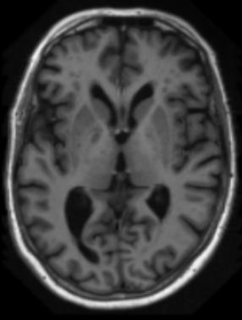
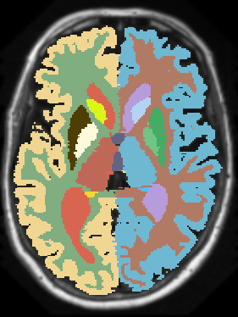
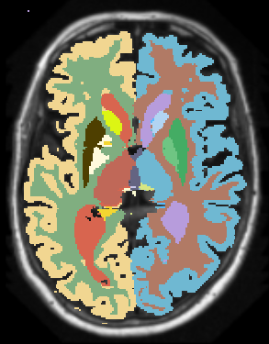
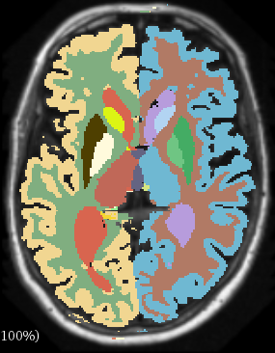
Whole Brain Segmentation
FC-DenseNet Segmentation
FC-DenseNet+scSE Segmentation
Input scan
Ground Truth
Under segmentation
of Left Putamen

Slide 27
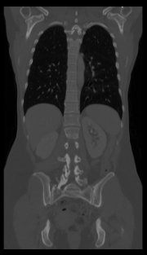
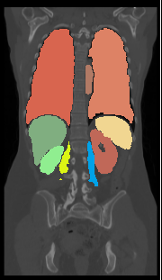
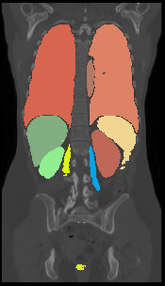
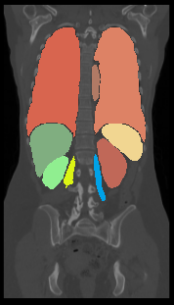
Whole Body Segmentation: Visceral Dataset
FC-DenseNet Segmentation
FC-DenseNet+scSE Segmentation
Input scan
Ground Truth
Over segmentation of Spleen
Notes:
We also conducted experiments on Whole Body segmentation task on Visceral Dataset and observed similar behavior. We show a sample segmentation, with an indicated ROI. We can observe that over segmentation of spleen is rectified using SE blocks along with FC-DenseNets.

Slide 28
SE Block vs. Network Depth
+5% increase in Dice Score +33% increase in model complexity
Deeper F-CNN
Basic F-CNN architecture
+9% increase in Dice Score +1.8% increase in model complexity
Encoder Blocks
Squeeze & Excitation (SE) Blocks
Decoder Blocks
Classifier Block
F-CNN + SE Blocks
Bottleneck
Soft-max layer

Slide 29
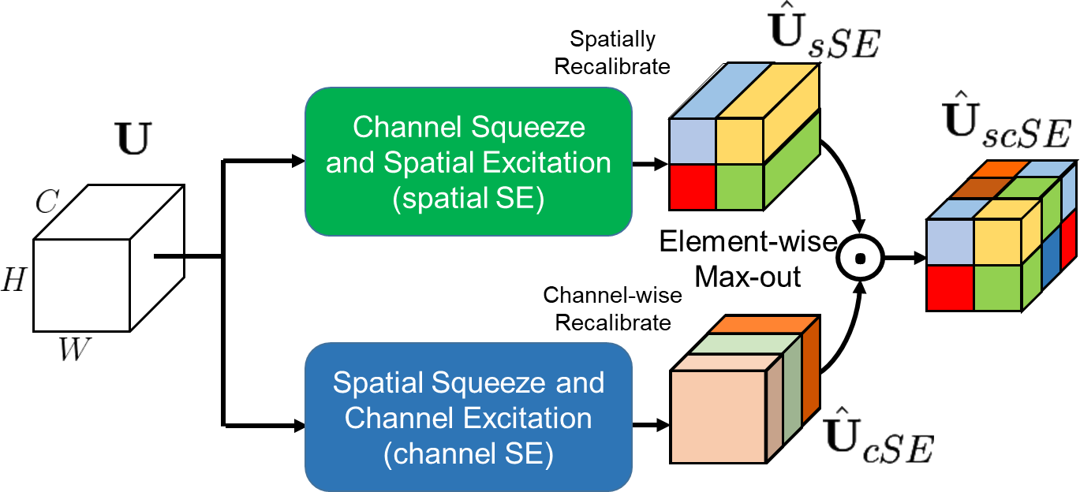
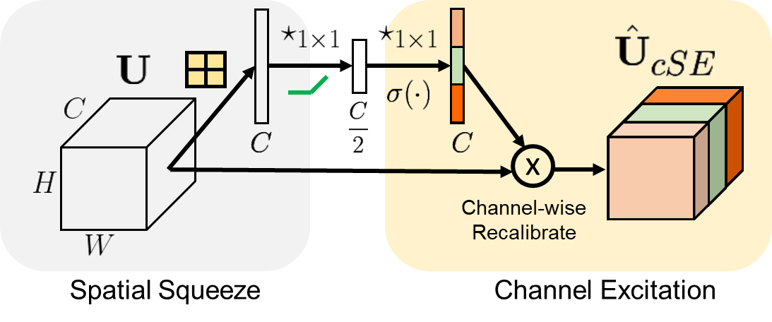
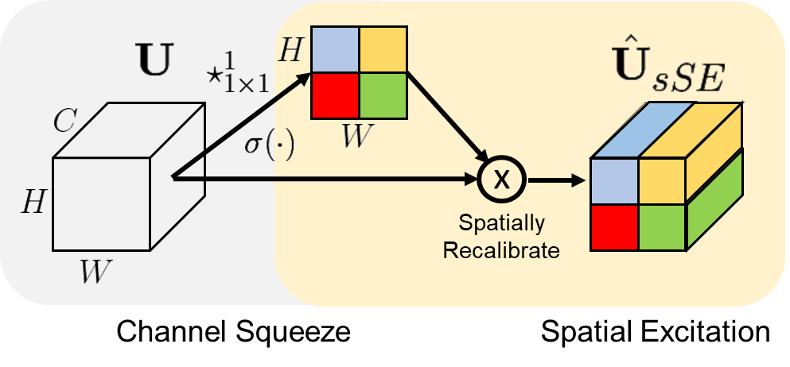
Takeaways
A new variant of ‘Squeeze & Excitation’ blocks for F-CNNs.
Seamless integration within any F-CNN architecture.
Boosts segmentation performance while minimally effecting model complexity.
Recalibration of F-CNNs using SE blocks.
Notes:
As conclusion, I would like to give some final takeaways.

Slide 30


Thank You! Questions?
Check out our work at www.ai-med.de
Visit our Poster (ID: M64)
Notes:
As conclusion, I would like to give some final takeaways.

Slide 31
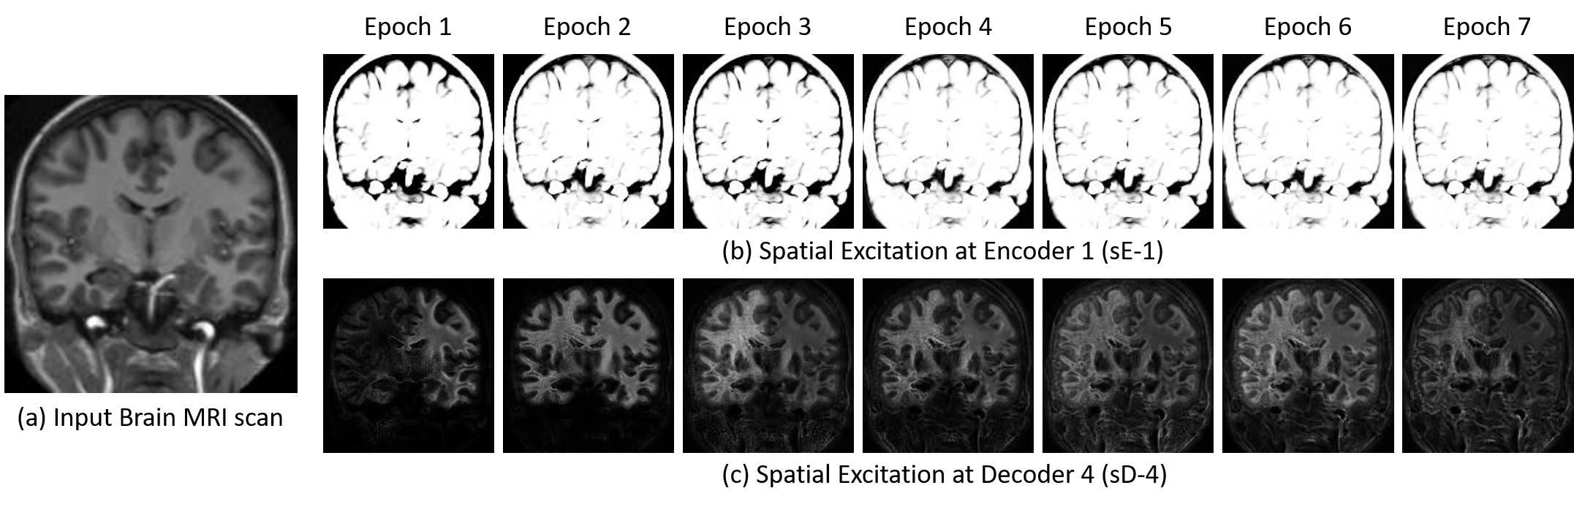
Dynamics of Spatial Excitation
Limited Dynamics.
Global lower level foreground vs. background distinction.
Dynamics shows attention for different structures.

Slide 32
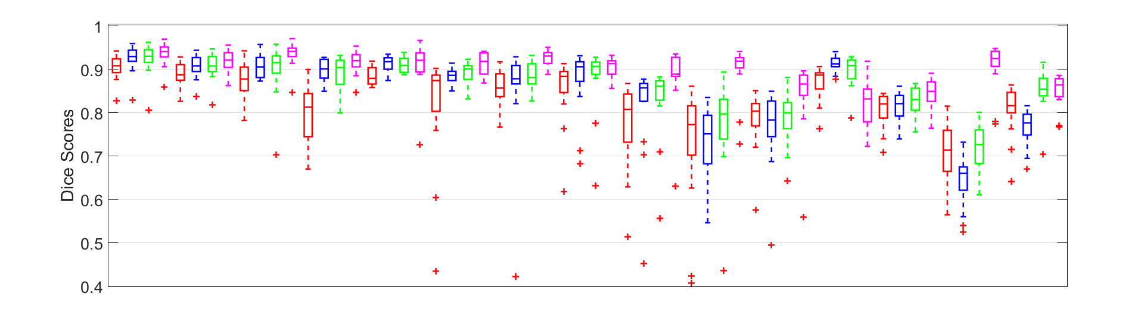
Structure-wise Performance Analysis
FC-DenseNets
FC-DenseNets + cSE
FC-DenseNets + sSE
FC-DenseNets + scSE
WM Left
GM Left
Ventricle Left
Cerebellar WM Left
Cerebellar GM Left
Thalamus Left
Caudate Left
Putamen Left
Pallidum Left
3rd Ventricle
4th Ventricle
Brain Stem
Hippocampus Left
Amygdala Left
Ventral DC Left
sSE and scSE shows a consistent improvement across all structures
cSE degrades performance for small structures (ex: Amygdala)
Notes:
We investigate further into the effect of the three SE blocks per structure or class.
We see the improvement in performance for spatial SE and combined SE is consistent across all the classes.
Whereas, channel SE although provides an overall increase in mean Dice score, degrades performance of some small structures like amygdala.
This again substantiate the importance of joint recalibration.

Slide 33



Concurrent Spatial and Channel ‘Squeeze & Excitation’ in Fully Convolutional Networks
Abhijit Guha Roy, Nassir Navab, Christian Wachinger
Artificial Intelligence in Medical Imaging (AI-Med), Ludwig Maximilian University of Munich
Computer Aided Medical Procedures, Technical University of Munich
Notes:
Good afternoon everyone, I am Abhijit, a PhD student from the Ludwig Maximilian University of Munich, Germany. Today I will be talking about our recent work titled “Concurrent Spatial and Channel ‘Squeeze & Excitation’ in Fully Convolutional Networks”.

Slide 34
Integrating SE blocks into Fully ConvNets
cSE and sSE blocks have complementary properties
cSE: Emphasizes some channels using global context
sSE: Emphasizes certain spatial locations
Where to place the blocks?
cSE less effective in Decoders : Global context
sSE less effective near bottleneck: Low spatial resolution
Can we jointly emphasize channel and spatial information ?
Encoder Blocks
Squeeze & Excitation (SE) Blocks
Decoder Blocks
Classifier Block
Bottleneck
Soft-max layer
Notes:
Now, the two kind of SE blocks i.e. cSE and sSE have complementary properties, cSE emphasizes certain channels using global context, whereas sSE emphasizes certain spatial locations. It is very difficult to make the decision which SE block is effective in which part of the F-CNN.
Intuitively one can imagine, as cSE provides global receptive field it is more effective in encoders than in decoders. Similarly, as sSE provides spatial emphasis, which is less prominent near bottleneck where spatial resolution is very low.
This poses the question, “Can we jointly emphasize both channel and spatial information?”

Slide 35
Effect on Model Complexity
Given a Input Feature Map of ‘c’ channels
Number of Parameters in cSE = c² (Two FC Layers of c²/2)
Number of Parameters in sSE = c
Total Parameters in a scSE Block = c² + c
For Example in U-Net:
cSE Block: 2-5% Global Dice score increase with 1.52% parameter increase
sSE Block: 3-7% Global Dice increase with 0.02% parameter increase
scSE Block: 4-9% Global Dice increase with 1.57% parameter increase

Slide 36
Segmentation Results
Addition of any SE Blocks increases the Dice Performance.
sSE is more effective in F-CNNs than cSE
Joint re-calibration using scSE provides the best results
Margins are more prominent in U-Net and SD-Net than FC-DenseNet
Effective when training is done with limited samples

Slide 37
Segmentation Tasks and Datasets
Whole Brain Segmentation
MRI T1 scans
Challenges
27 cortical and sub-cortical classes
High class imbalance
Limited Training samples
Multi Atlas Labelling Challenge (MALC) Dataset
15 Training volumes
15 Testing volumes
Whole Body Segmentation
Contrast Enhanced CT scans
Challenges
10 abdominal structures
Highly variable anatomies
Visceral Dataset
65 scans from the Silver Corpus
20 scans from the Gold Corpus

