Slide 1

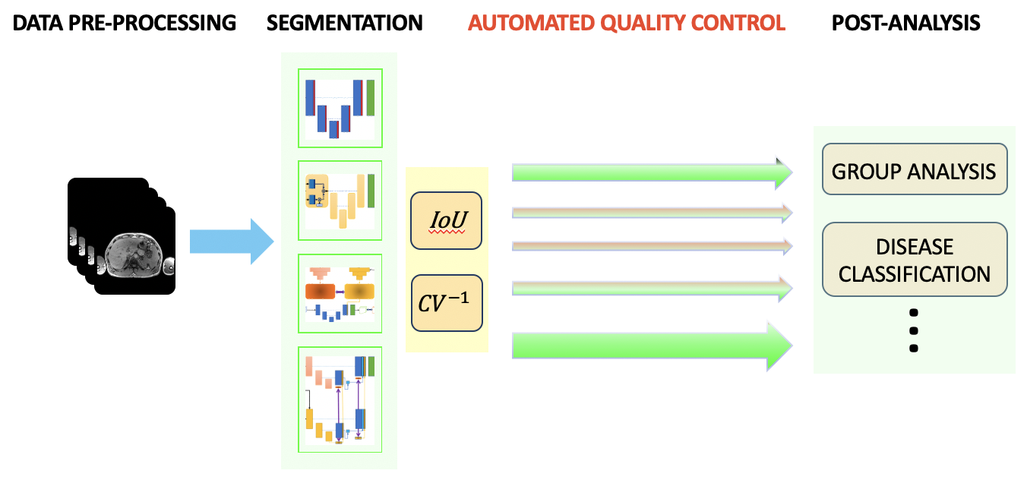

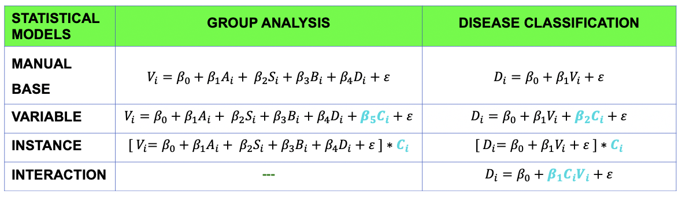
Bayesian Neural Networks for Uncertainty Estimation of Imaging Biomarkers
J. Senapati, A. Guha Roy, S. Pölsterl, D. Gutmann, S. Gatidis, C. Schlett, A. Peters, F. Bamberg, C. Wachinger
Artificial Intelligence in Medical Imaging (AI-Med), KJP, LMU München, Department of Diagnostic and Interventional Rad., University of Tübingen,
Department of Diagnostic and Interventional Rad., University Freiburg, Institute of Epidemiology, Helmholtz Zentrum München, Germany

