Slide 1


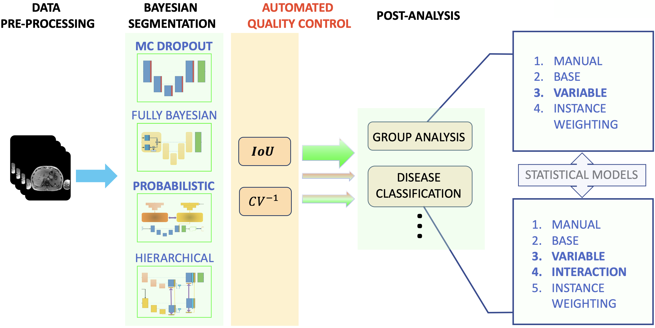
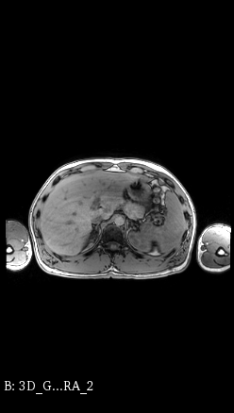
Bayesian Neural Networks for Uncertainty Estimation of Imaging Biomarkers
J. Senapati, A. Guha Roy, S. Pölsterl, D. Gutmann, S. Gatidis, C. Schlett, A. Peters, F. Bamberg, C. Wachinger
Artificial Intelligence in Medical Imaging (AI-Med), KJP, LMU München, www.ai-med.de
University of Tübingen, University Freiburg, Helmholtz Zentrum München,
DATA
PRE-PROCESSING

