Slide 1
AQI India: Station-Level Pollution Intelligence
Multi-Factor Outlier Filtering, Risk Scoring Index & Machine Learning Sandbox
Team: Solaris Lunaris
Members: Krishna Agarwal & Jyotirmay Singh
GitHub: github.com/Krishna-Agarwal04/aqi-india-dashboard

Slide 2
Problem Statement & Motivation
City-Level Aggregation Bias: Standard AQI reports average pollution levels across large municipal zones, which masks local station-level pollution hotspots.
Worst-Pollutant Bias: Standard metrics calculate values on the single worst-performing pollutant, neglecting exceedance range volatility or multi-pollutant spreads.
Calibration Outliers: Sensor malfunctions and calibration spikes frequently bias telemetry data without automated filtering.
Exposure Persistence: Traditional indices fail to incorporate logging duration and persistent exposure factors into station severity ratings.

Slide 3
Project Objectives
Granular Station Analytics: Develop a robust preprocessing pipeline to ingest, clean, and validate CPCB sensor data at the monitoring station level.
Automated Outlier Flagging: Use rolling Interquartile Range (IQR) checks to isolate sensor spikes and calibration malfunctions.
Station Pollution Intelligence Score (SPIS): Build an explainable, multi-factor rating index (0-100) combining averages, volatility, anomalies, and persistence.
Dynamic Sandbox Simulation: Build an interactive Streamlit UI for dynamic data edits, synthetic data injection, and instant ML model retraining.

Slide 4
Pipeline Architecture & Engineering Flow
Schema Validation: Enforces type casting and constraints. Filters out coordinate errors outside India bounding-box.
Robust IQR Outlier Filter: Flags anomalies per pollutant type; isolated 95 logs (3.0%) representing sensor spikes.
K-Means Signature Clustering: Groups cities into 4 distinct pollutant profiles based on multi-criteria footprints.
Random Forest Classifier: Learns risk band patterns from SPIS components to explain pollution drivers.
Data Pipeline Ingestion Flow:
[Raw CPCB Ingestion] │ ▼ [Schema Validation] │ ▼ [IQR Outlier Filter] ──► (Removes sensor spikes) │ ▼ [SPIS Score & Bands] ──► (Calculates 0-100 ratings) │ ▼ [K-Means Clustering] ──► (Profiles city signatures) │ ▼ [Random Forest Model] ──► [Interactive Sandbox UI]

Slide 5
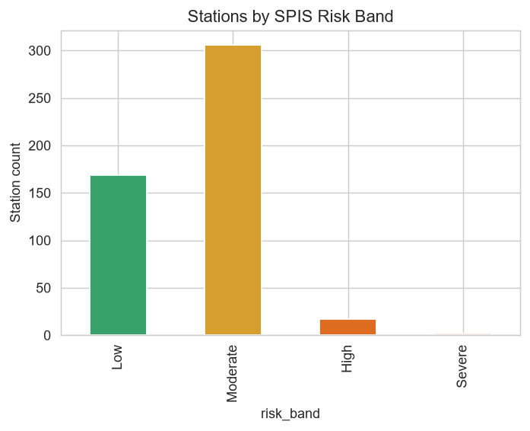
Station Pollution Intelligence Score (SPIS)
Multi-Factor Rating: Scales dynamic pollutant properties into an auditable score from 0 to 100:
40% average load level (`mean_avg`)
25% exceedance spread volatility (`mean_spread`)
20% anomalous readings frequency (`anomaly_rate`)
15% log-scaled update volume (`persistence`)
Severity Risk Bands: Categories defined as Severe (>=75), High (50-74), Moderate (25-49), and Low (<25).
Rourkela (OSPCB) identified as the most critical hotspot with a Severe SPIS score of 92.5.

Slide 6
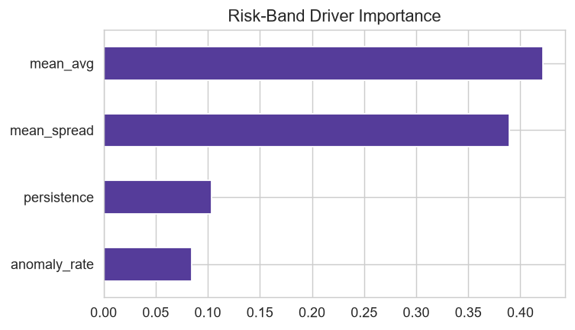
Machine Learning & Risk Drivers
Random Forest Classifier: Trained to evaluate if the SPIS scoring bands are auditable and learnable from component variables.
Outstanding Accuracy: Achieved an overall validation accuracy of 97% on the test split.
High Classification Scores: Precision and recall metrics reached 96-98% for Low and Moderate bands, and 100% for the Severe class.
Key Drivers: Feature importances show that average level (42%) and volatility spread (39%) are the primary risk-band predictors.

Slide 7
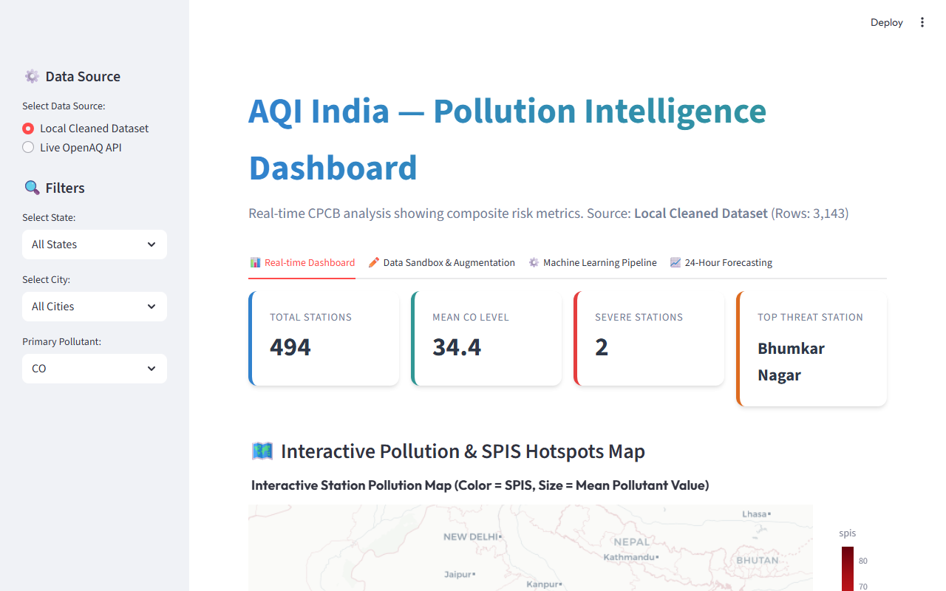
Interactive Streamlit Sandbox Showcase
Live Telemetry Ingestion: Fetches real-time air quality records via OpenAQ APIs for active stations.
Excel-style Grid Editor: Users can edit specific coordinates, names, or pollutant values to simulate custom emissions scenarios.
Data Augmentation: Injects user-specified synthetic rows to test pipeline robustness under noise.
On-the-fly ML Retraining: Users can click to retrain the Random Forest model and instantly update accuracy tables and charts.

Slide 8
Conclusion & Future Work
Reproducible Engineering Pipeline: Built a self-contained, auditable pipeline moving from sensor ingestion to spatial modeling.
Explainable Environmental Scores: SPIS score introduces volatility and logging persistence, offering a fairer severity index.
Continuous Time-Series: Future work targets incorporating LSTM neural networks for multi-day temporal forecasting.
Auto-calibration Checks: Planned features include comparing neighborhood sensors to flag sensor drift automatically.

