Slide 1

Hospital, Patient & Billing Management System
Integrated Excel-Based Healthcare Operations Solution Presented By: Jyotirmoy Mukherjee Swaraj Das Institute: Anudip Foundation

Slide 2
Problems in Traditional Hospital Record Management
• Manual patient tracking • Billing errors • Duplicate records • Slow admission process • Poor reporting systems • Difficulty tracking payments and insurance

Slide 3
Our Proposed Solution
A centralized Excel-based hospital workflow system integrating: • Patient Management • Doctor Management • Admission Workflow • Automated Billing • Insurance Handling • Real-Time Dashboards

Slide 4
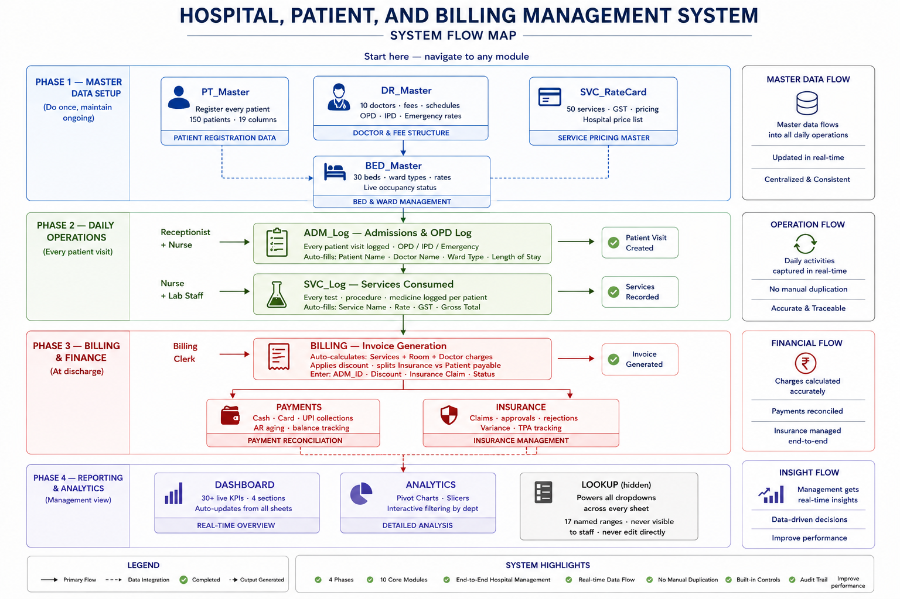
System Flow Architecture
The system is divided into four major phases: 1. Master Data Setup 2. Daily Operations 3. Billing & Payments 4. Dashboard & Reporting

Slide 5
Workbook Structure & Data Modules
Core Modules: • PT_Master • DR_Master • BED_Master • ADM_Log • SVC_Log • BILLING • PAYMENTS • INSURANCE • DASHBOARD

Slide 6
Built-In Data Validation & Quality Control
• Data validation rules • Dropdown-based selection • Duplicate prevention • Conditional formatting alerts • Controlled master references • Removal of blank spaces Prevention-first approach instead of cleanup-first approach.

Slide 7
Automation & Smart Functionalities
• Formula-driven calculations • Lookup systems • Dynamic billing • Macro-enabled operations • Automated summaries • Dashboard integration • Real-time KPI updates

Slide 8
Billing & Financial Tracking
Workflow: Admission → Service Usage → Billing → Payments → Insurance Benefits: • Reduced manual errors • Transparent billing • Faster reconciliation

Slide 9
Real-Time Dashboard & Reporting
Key KPIs: • Total Patients • Revenue Tracking • Pending Payments • Bed Occupancy Status • Department Insights

Slide 10
Challenges During Development
• Managing sheet interconnectivity • Maintaining formula consistency • Preventing invalid data entry • Designing scalable dashboard logic • Structuring workflow in Excel

Slide 11
Future Scope & Expansion
• Multi-user support • SQL database integration • Power BI connectivity • Appointment scheduling • SMS/Email notifications • Inventory management

Slide 12
Project Conclusion
This project transforms Excel into a workflow-driven hospital management platform improving: • Accuracy • Speed • Reporting • Operational efficiency Goal: Create a complete business management solution, not just spreadsheets.

Slide 13
Thank You
Questions & Discussion

