Slide 1
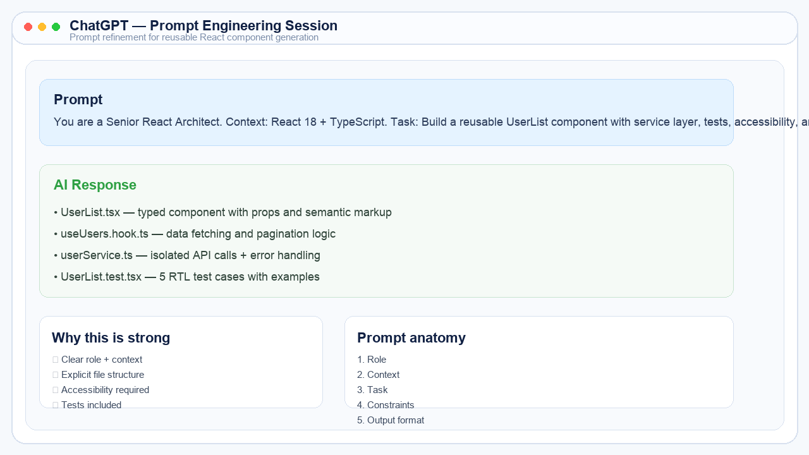
GenAI for Frontend Engineers
A Practical Case Study on AI-Augmented Frontend Development
Prepared by: Jyotir
Homework / Case Study Presentation
Focus Areas
• Prompt engineering • UI/UX ideation • AI-assisted coding • Testing, docs, and CI/CD
Corporate-style deck with screenshot-style visuals and milestone deliverables included.
Notes:
Slide 1: speaker notes can be expanded if needed.

Slide 2
Objective of the Program
Primary Goals
Enable frontend engineers to use GenAI tools effectively
Increase productivity and improve code quality
Accelerate design-to-development workflows
Automate repetitive engineering tasks
Expected Impact
Faster component and CRUD development
Better documentation and test coverage
More consistent accessibility practices
Structured AI-assisted engineering workflow
The objective is systematic AI adoption in frontend engineering — not one-off code generation.
Notes:
Slide 2: speaker notes can be expanded if needed.

Slide 3
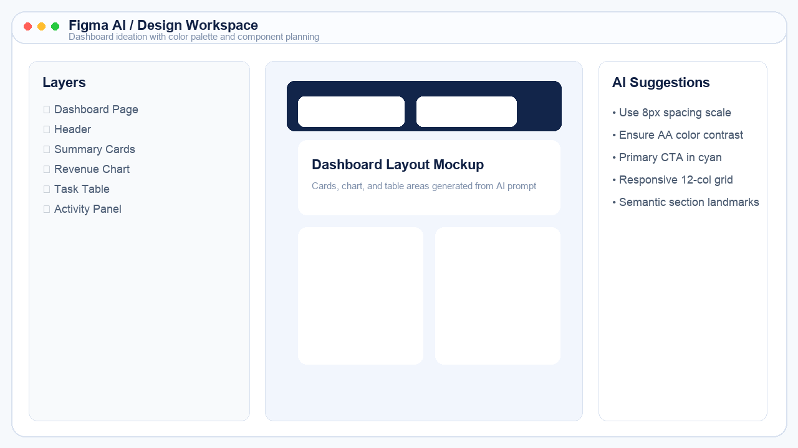
Why Frontend Engineers Need GenAI
Repetitive UI work reduces time for real problem-solving
Debugging APIs, state, and rendering issues is time-intensive
Design handoff to code is often slow or inconsistent
Documentation and testing are commonly delayed
CI/CD setup requires careful manual effort
GenAI helps reduce engineering friction across design, coding, testing, documentation, and delivery.
Notes:
Slide 3: speaker notes can be expanded if needed.

Slide 4
GenAI-Based Solution Overview
Prompt Engineering
Design Ideation
Code Generation
Testing & Docs
CI/CD Support
Structured prompts guide the AI effectively
Design tools help ideate and convert layouts into code
Copilot and chat tools scaffold and refactor code
AI supports tests, docs, performance, and deployment workflows
The workflow spans the full frontend lifecycle from ideation to deployment readiness.
Notes:
Slide 4: speaker notes can be expanded if needed.

Slide 5
Tools Used in the Workflow
Coding AI
ChatGPT
GitHub Copilot
Gemini / Claude
Design AI
Figma AI
Locofy
Uizard / Anima
Quality Tools
Lighthouse
axe DevTools
Mintlify
Delivery
GitHub Actions
Docker tooling
PR automation
Each tool handles a specific part of the workflow; together they create an AI-augmented frontend stack.
Notes:
Slide 5: speaker notes can be expanded if needed.

Slide 6
Milestone 1 — Prompt Engineering Fundamentals
Understand LLM behavior and prompt interpretation
Use context → role → intent → format structure
Add examples and constraints to improve output quality
Iteratively refine prompts instead of relying on one-shot output
Compare direct prompts with chain-of-thought style prompting
This milestone establishes the foundation for all later AI-assisted engineering work.
Notes:
Slide 6: speaker notes can be expanded if needed.

Slide 7
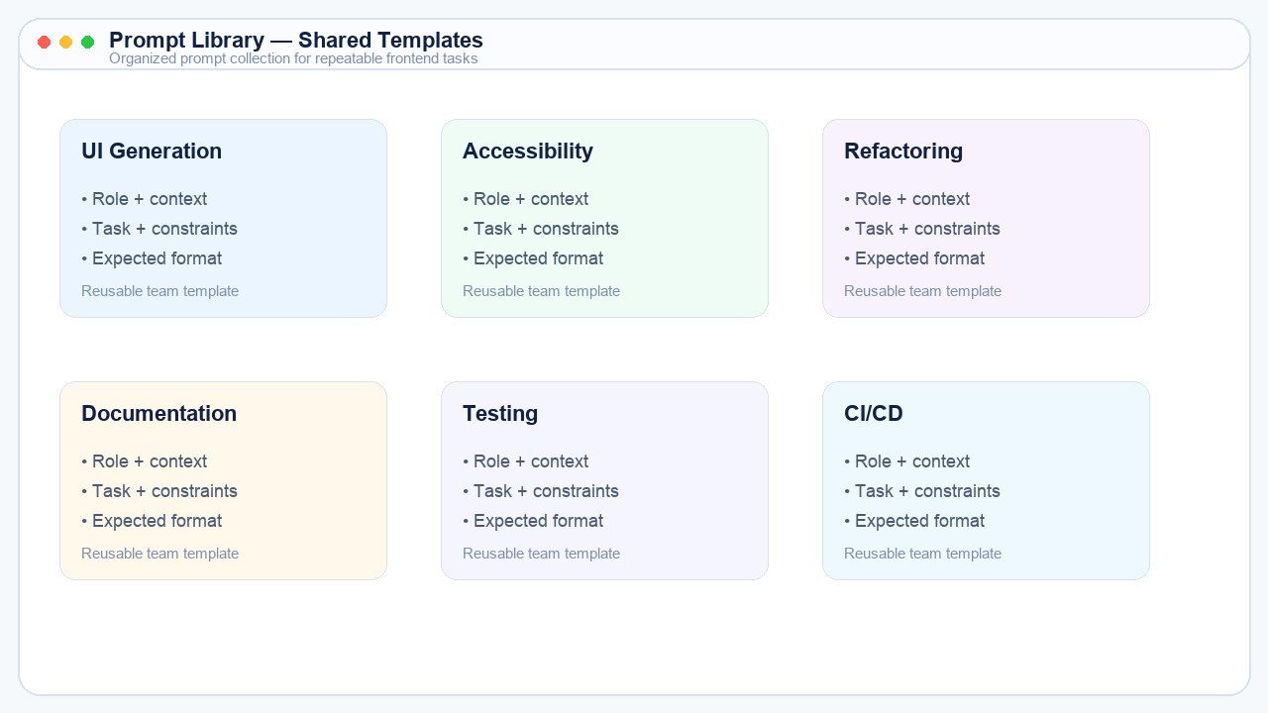
Milestone 1 Deliverable — Shared Prompt Library
20+ prompt templates created for repeatable frontend tasks
Covers UI generation, accessibility, refactoring, docs, testing, and CI/CD
Improves consistency and reduces prompt-writing overhead
Acts as a reusable team asset for AI-assisted development
Deliverable screenshot: organized prompt library used as a shared engineering resource.
Notes:
Slide 7: speaker notes can be expanded if needed.

Slide 8
Milestone 2 — AI for UI/UX Ideation and Frontend Development
Generate dashboard layouts, copy, and color ideas with AI
Convert design descriptions and wireframes into frontend code
Use Copilot to scaffold components and repetitive logic
Refactor generated code into modular, typed files
Keep accessibility and responsiveness as requirements from the start
AI helps compress the design-to-development cycle while keeping engineering constraints explicit.
Notes:
Slide 8: speaker notes can be expanded if needed.

Slide 9
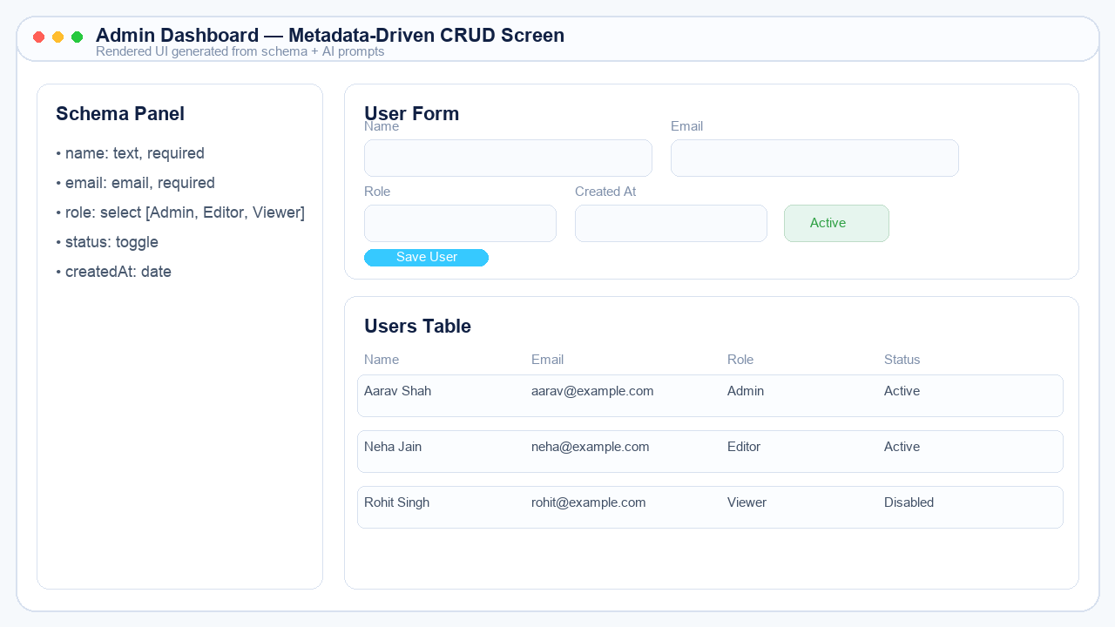
Milestone 2 Deliverable — Metadata-Driven CRUD Screen
Input: JSON schema defining fields, types, labels, and validation
Output: generated form, table, service layer, hooks, types, and tests
Ideal for admin dashboards and internal tools
Demonstrates AI-assisted maintainable frontend architecture
Deliverable screenshot: metadata-driven CRUD UI generated mostly through AI-guided workflow.
Notes:
Slide 9: speaker notes can be expanded if needed.

Slide 10
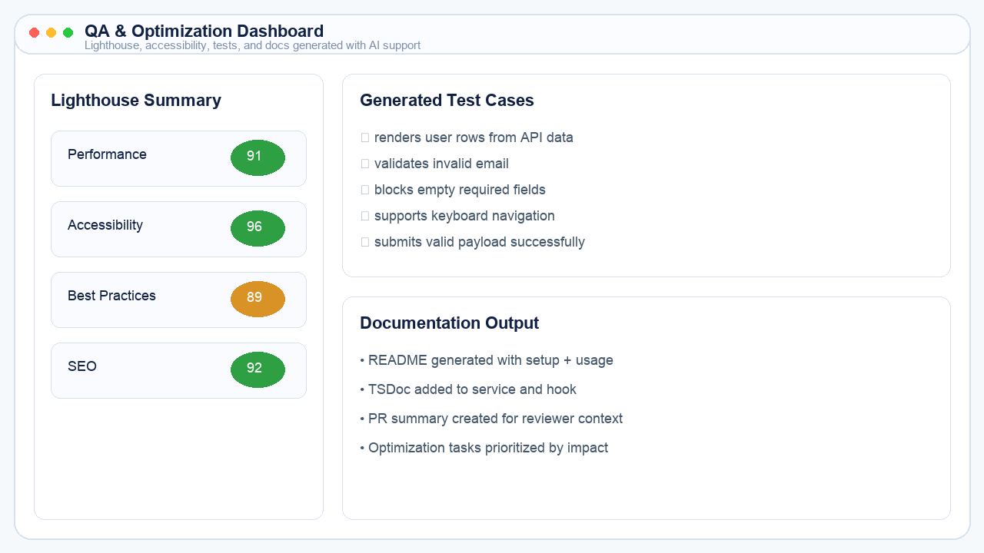
Milestone 3 — Documentation, QA and Optimization
Generate README files, TSDoc/JSDoc, and architecture summaries
Create unit and E2E test cases for frontend flows
Analyze Lighthouse and accessibility findings with AI support
Convert raw reports into prioritized remediation tasks
Milestone focus: quality engineering tasks that teams often delay due to time pressure.
Notes:
Slide 10: speaker notes can be expanded if needed.

Slide 11
Milestone 3 Deliverable — AI-Assisted QA & Optimization Report
Report Includes
Auto-generated test suite
Lighthouse findings + fixes
Accessibility observations
Documentation summary
Prioritized remediation actions
Deliverable screenshot: QA and optimization package generated with AI assistance and human review.
Notes:
Slide 11: speaker notes can be expanded if needed.

Slide 12
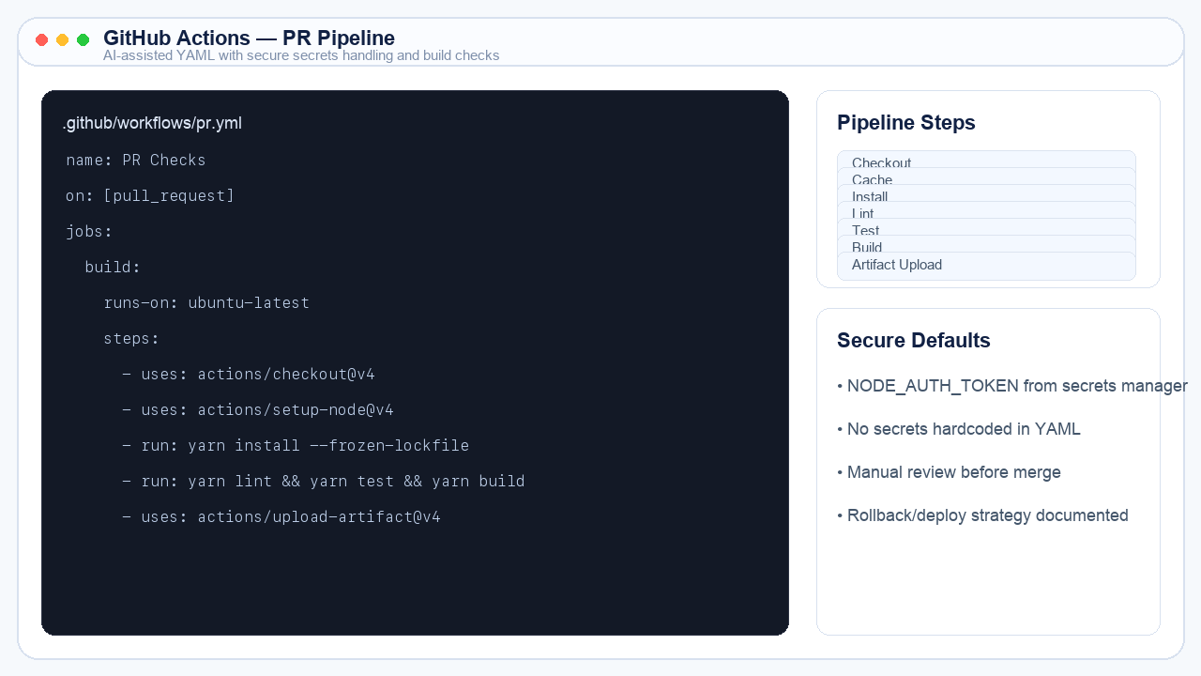
Milestone 4 — DevOps, CI/CD and Continuous Upskilling
Generate GitHub Actions YAML for pull request pipelines
Create Dockerfiles and build scripts with explicit constraints
Use AI for PR summaries, review assistance, and changelogs
Build a personal AI-assisted workflow for continuous learning
AI extends beyond coding into delivery automation and developer productivity workflows.
Notes:
Slide 12: speaker notes can be expanded if needed.

Slide 13
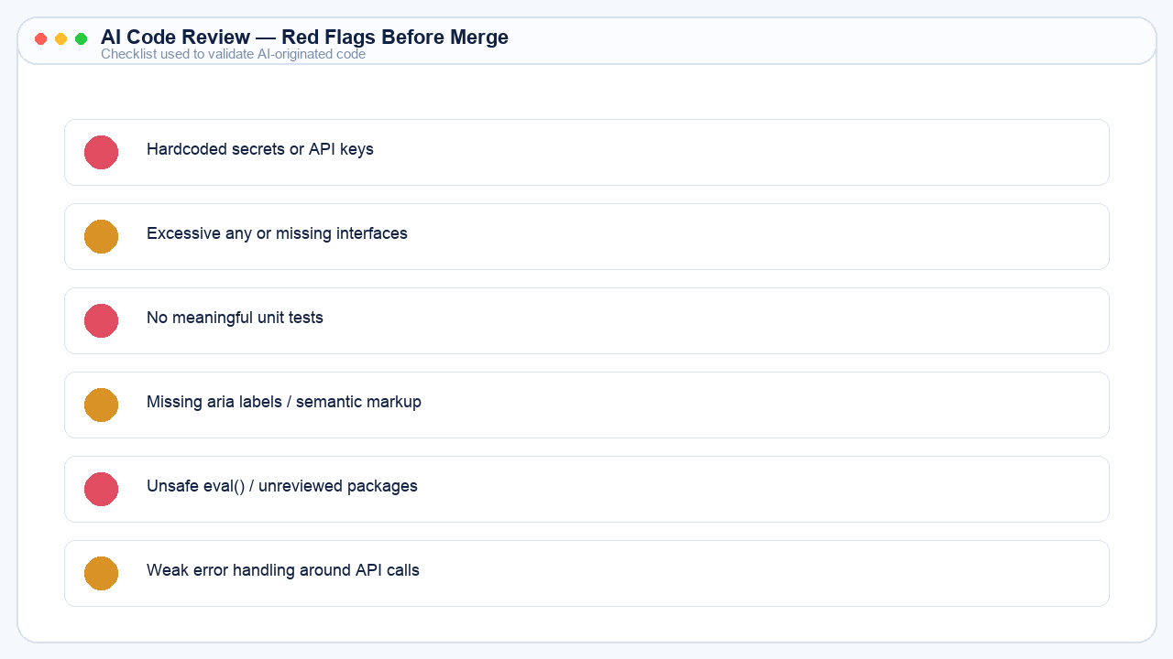
Milestone 4 Deliverable — AI-Augmented Frontend Workflow
Final Workflow Includes
1 code automation use case
1 UI/UX generation task
1 testing / documentation example
1 CI/CD automation prompt
Human review checklist before merge
Deliverable screenshot: workflow output plus review guardrails for safe AI adoption.
Notes:
Slide 13: speaker notes can be expanded if needed.

Slide 14
Best Practices and Program Outcomes
Best Practices
Be explicit about role, context, task, constraints, and output format
Ask for tests, examples, and TypeScript interfaces
Keep prompts scoped to one problem at a time
Review, lint, and test all AI-generated output
Program Outcomes
Faster frontend coding and design execution
Improved documentation and test coverage
Better use of AI in CI/CD and code review
A repeatable AI-augmented engineering workflow
The value comes from disciplined usage patterns, not just access to the tools.
Notes:
Slide 14: speaker notes can be expanded if needed.

Slide 15
Conclusion
GenAI does not replace frontend engineers — it amplifies productivity, quality, and delivery speed when guided by strong prompts and responsible review.
Skilled engineers who can collaborate effectively with AI will build faster, document better, test more thoroughly, and deliver with greater confidence.
End state: an AI-augmented frontend engineer with structured workflows and human-in-the-loop discipline.
Notes:
Slide 15: speaker notes can be expanded if needed.

