Slide 1
Basics of Communication

Slide 2
CONTENTS
What is Communication
Purpose of Communication
Process of Communication
Models/Theory of Communication
Types of Communication
Modes of Communication

Slide 3
What is communication?
The word “communication” is derived from Latin word “communicare”, which means common or to make common. It is a process of exchange of facts, ideas, opinions and a means by which individuals or organizations share the meaning and understanding with one another.
The process of communication is what allows us to interact with other people; without it, we would be unable to share knowledge or experiences with anything outside ourselves. Common forms of communication include speaking, writing, gestures, touch and broadcasting.---Wikipedia
Sharing of experiences on the basis of commonness---Wilbur Schramm
Communication is the process which increases commonality---Mc Quail
Communication is an exchange of facts, ideas, or opinions by two or more persons— Newman & Sumner
It is the exchange of information and transmission of meaning--- Katz & Kahn
Communication is a process of sharing experiences till it becomes a common possession. It modifies the disposition of both parties who partakes it---- John Dewey
Communication is sharing of ideas and feelings in a mood of mutuality---Edgar Dale
Communication is a means of persuasion to influence others so that desired effect is achieved. --- Aristotle

Slide 4
Purpose
Give, get or exchange information
To form or to maintain relationships
Persuade others to think in the way that one does, or to act in the way one wants
Gain, maintain or exert power over others
Make decisions about what we think and do
Express our ideas and ourselves
Make sense of the world and our experience of it

Slide 5
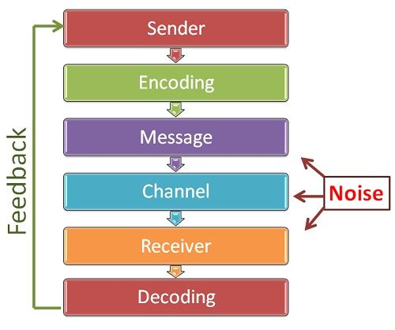
Process of communication
Communication is a dynamic process that begins with the conceptualizing of ideas by the sender who then transmits the message through a channel to the receiver, who in turn gives the feedback in the form of some message or signal within the given time frame.

Slide 6
Models of communication
In order to explain the social process of communication, scholars have developed several models
The three most well-known models for communication are:
Linear
Interactive/Convergence
Transactional

Slide 7
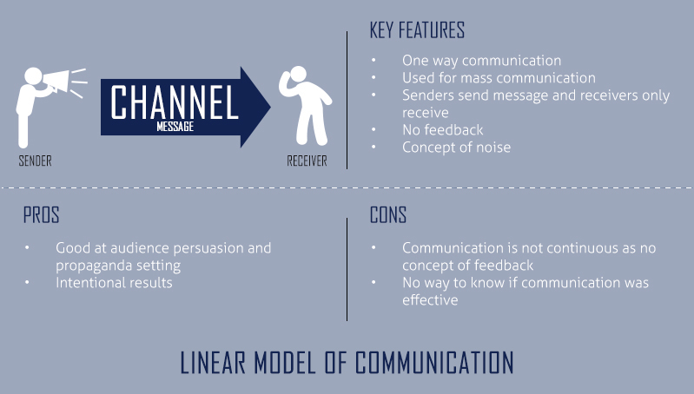
Linear Model of Communication

Slide 8
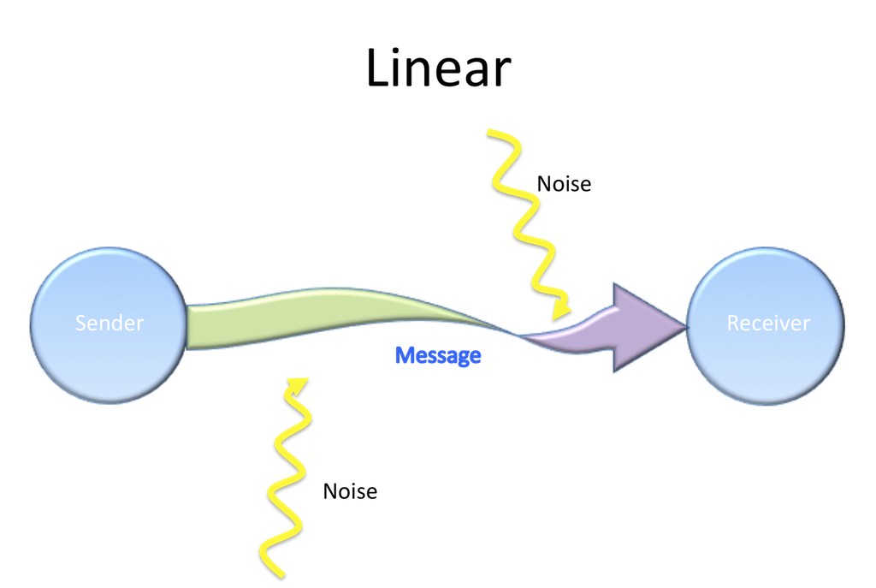
Linear Model of Communication (contd..)
Two widely known linear models of communication are:
Shannon and Weaver Model
Berlo’s SMCR Model
Shannon & Weaver model was mainly meant for the technological (electrical and electronic) purposes and Berlo’s Model was made to understand general human communication.
Berlo described factors affecting the individual components in the communication making the communication more efficient.
In Berlo’s Model, communication depends on many factors: like communication skills, attitude, knowledge, socio-cultural systems, the way in which the message has been sent, the content of the message, senses of the receiver, etc.
Sender
Receiver

Slide 9
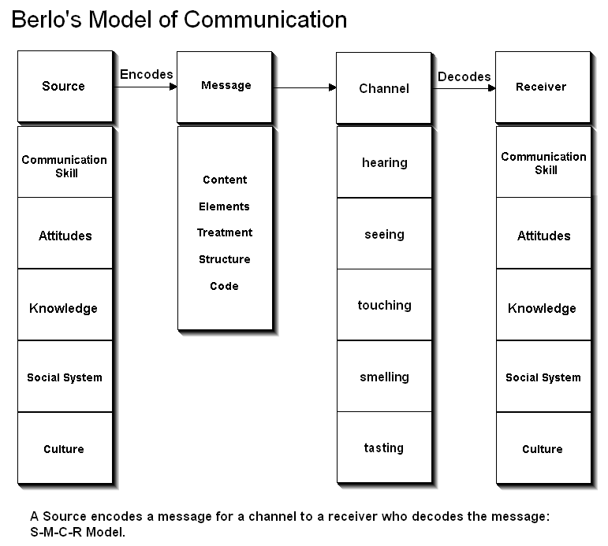

Slide 10
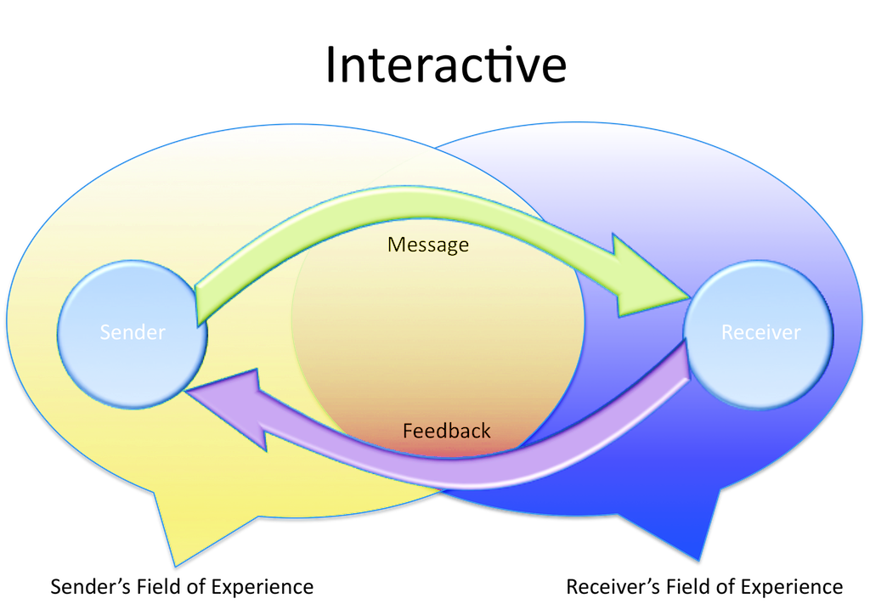
Interactive/Convergence Model
This model is like linear model but has added feedback, indicating that communication is not a one way but a two way process
The sender channels a message to the receiver and the receiver then becomes the sender and channels a message to the original sender
It also has "field of experience" which includes sender/receiver’s cultural background, ethnicity, geographic location, extent of travel, and general personal experiences accumulated over the course of your lifetime
Drawbacks – there is feedback but it is not simultaneous
The communication process take place between humans or machines in both, verbal or non-verbal way
Example- Social media, interactive marketing, ATM machines, online shopping, chat rooms
Sender
Receiver

Slide 11
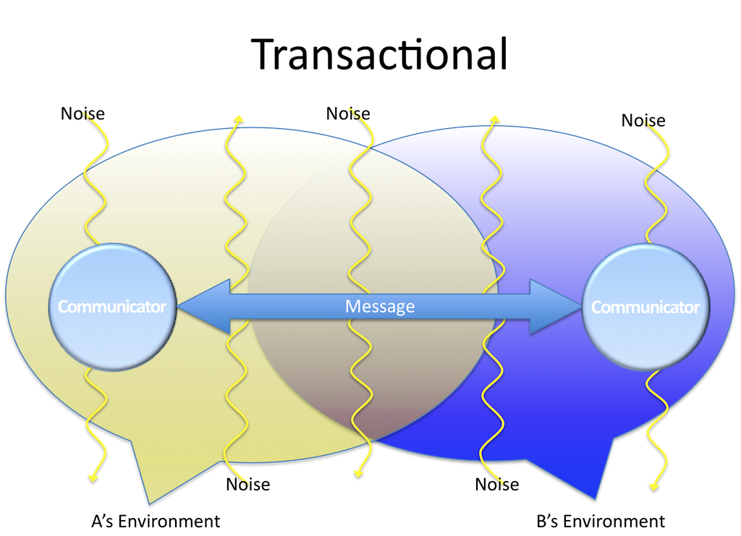
Transactional model
It is the most dynamic of communication models
It is like two linear models staked on top of each other
The exchange of messages happens between sender and receiver where each take turns to send or receive messages
Both sender and receiver are known as communicators and their role reverses each time in the communication process as both processes of sending and receiving occurs simultaneously
This model also places more emphasis on the ‘field of experience’. While each communicator has a unique field of experience, they must also inhabit a shared field of experience
Everyday talk and interactions are a form of transactional model of communication
Communicator
Communicator

Slide 12
Types of Communication
Based on number of people involved, communication can be divided into four types:
Intra-personal communication- when one communicates with one's own self
Inter-personal communication- when at least two people interact
Group communication- when more than two people are involved
Mass communication- when quite large number of people are involved
In an organization, based on hierarchy, communication can be divided into four types
Vertical communication – Upward and Downward
Horizontal communication
Diagonal communication
Grapevine

Slide 13
Modes of communication
There are two basic modes of communication
Verbal Communication
Non-Verbal communication
Verbal Communication
Communication through spoken or written words
Oral communication
Any message or information is shared or exchanged through speech or word of mouth
Face-to-face conversation, telephone, voice-over-internet, public speech, news reading, TV, Radio
Written communication
Any message or information is shared or exchanged through written or printed words
Letters, memos, reports, newspaper, notices, blogs
Non-Verbal Communication
Communication without the use of spoken or written words
Happens through signs, symbols, gestures, facial expressions, body language, graphs, charts
Helps in making verbal communication complete and more effective
Raising eyebrows, shaking head, smiling, raising hand, clapping, crying
The non-verbal cues are Kinesics, Proxemics, Chronemics, Haptics, Paralanguage, Silence and Sign language.

