Slide 1
Leadership-Attitude-Communication

Slide 2
LEADERSHIP SKILLS

Slide 3
What are Leadership Skills?
Leadership skills are skills you use when organizing other people to reach a shared goal.
Leadership skills are the abilities and the capabilities that an individual demonstrates while leading a team, a situation, or life.
These skills help them supervise processes, guide initiatives, and help their employees achieve their goals.
Leadership skills are not just one skills but a combination of a couple of skills.

Slide 4
Leadership Skills
10 most important leadership skills are:
Communication - As a leader, you need to be able to clearly and succinctly explain to your employees everything from organizational goals to specific tasks. Leaders must master all forms of communication, including one-on-one, departmental, and full-staff conversations, as well as communication via the phone, email, video, chat, and social media. Communication skills cover reading skills, writing skills, speaking skills, listening skills.
Motivation - Leaders need to inspire their workers to go the extra mile for their organizations; just paying a fair salary to employees is typically not enough inspiration (although it is important too). There are a number of ways to motivate your workers: you may build employee self-esteem through recognition and rewards, or by giving employees new responsibilities to increase their investment in the company.
Delegating - Leaders who try to take on too many tasks by themselves will struggle to get anything done. These leaders often fear that delegating tasks is a sign of weakness, when it actually can be a sign of a strong leader. Therefore, you need to identify the skills of each of your employees, and assign duties to each employee based on his or her skill set. By delegating tasks to staff members, you can focus on other important tasks.
Positivity - A positive attitude can go a long way in an office. You should be able to laugh at yourself when something doesn't go quite as planned; this helps create a happy and healthy work environment, even during busy, stressful periods. If employees feel that they work in a positive environment, they will be more likely to want to be at work, and will therefore be more willing to put in the long hours when needed.

Slide 5
Leadership Skills
5. Trustworthiness - Employees need to be able to feel comfortable coming to their manager or leader with questions and concerns. It is important for you to demonstrate your integrity— employees will only trust leaders they respect. By being open and honest, you will encourage the same sort of honesty in your employees.
6. Creativity - As a leader, you have to make a number of decisions that do not have a clear answer, so you need to be able to think outside of the box. Many employees will also be impressed and inspired by a leader who doesn't always choose the safe, conventional path.
7. Feedback - Leaders should constantly look for opportunities to deliver useful information to team members about their performance. However, there is a fine line between offering employees advice and assistance, and micromanaging. By teaching employees how to improve their work and make their own decisions, you will feel more confident delegating tasks to your staff. Employees will also respect a leader who provides feedback in a clear but empathetic way.
8. Responsibility - A leader is responsible for both the successes and failures of his or her team. Therefore, you need to be willing to accept blame when something does not go correctly. If your employees see their leader pointing fingers and blaming others, they will lose respect for you. Accept mistakes and failures, and then devise clear solutions for improvement
9. Commitment - It is important for leaders to follow through with what they agree to do. You should be willing to put in the extra hours to complete an assignment; employees will see this commitment and follow your example. Similarly, when you promise your staff a reward, such as an office party, you should always follow through. A leader cannot expect employees to commit to their jobs and their tasks if he or she cannot do the same
10. Flexibility - Mishaps and last-minute changes always occur at work. Leaders need to be flexible, accepting whatever changes come their way. Employees will appreciate your ability to accept changes in stride and creatively problem solve. Similarly, leaders must be open to suggestions and feedback. If your staff is dissatisfied with an aspect of the office environment, listen to their concern and be open to making necessary changes

Slide 6
ATTITUDE

Slide 7
Attitude
An attitude is a negative or positive evaluation of an object which influences human behavior towards that object –MICHEAL HOGG
An attitude is a learned predisposition to respond in a favorable or unfavorable manner toward people, an object, an idea or a situation- MARTIN FISHBEIN
We come across different people, ideas, things and situations. We may from a positive or negative views of them in our mind. For example, if I watch an advertisement saying that junk food is unhealthy at it has high sugar and fats then I might stop consuming junk food. It means I have developed a negative attitude towards junk food consumption.
“Attitude is an evaluation of things in terms of liking or disliking, favored or unfavored, positive or negative, and pro or anti.”
Different people can have different attitude towards a same thing or idea. For example, some people think internet’s use for students as a positive thing that it help students in their studies. But, some others think the use of internet for students as a negative thing as they think it wastes lot of time in useless activities on the internet.

Slide 8
Characteristics of Attitude
Attitude has an object: An attitude has an object which liked or disliked, favored or unfavored; or evaluated as negative or positive. The object a thing, an idea, a person or a situation.
Attitude is learnt: Attitude is not an inborn phenomenon. Attitude are learnt through social interaction and experience. We interact with others, experiences many thing and acquire information about thing which form our negative or positive attitude towards the thing.
Attitude is predisposition: An attitude is a predisposition- a prior determined or learnt or view of a thing or tendency to act in a specific way towards a thing. An individual has view which is already formed in his mind.
Attitude is relatively stable phenomena: An attitude is not a momentary feeling but a long-held view of something. Through attitude can be changed from time to time but It is a relatively stable phenomena which persists for a period of time
Attitude influences human behavior: A positive attitude toward a thing will influence human behavior towards a thing favorably. Similarly, a negative attitude influence human behavior toward a thing unfavorably

Slide 9
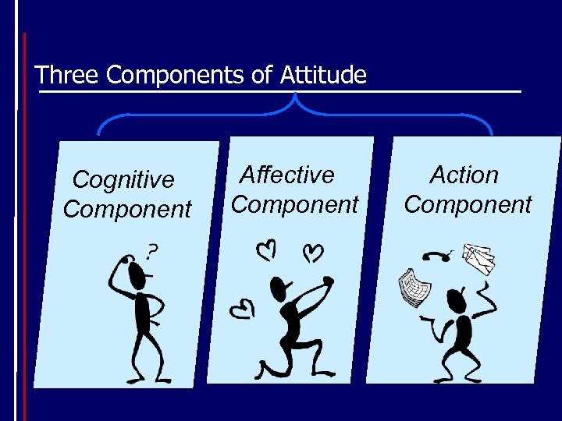
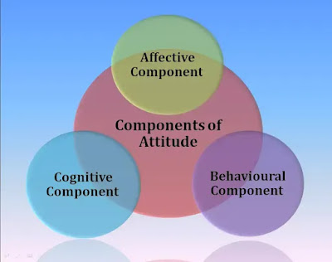
Components of Attitude (ABC Model)
Psychologist such as Rosenber, Eagley and Hovland have given a three components model – ABC model of Attitude. According to this model an attitude has following three components:
Cognitive component
Affective component
Behavioral component

Slide 10

Cognitive Component
Cognitive component is the set of information, facts, ideas and knowledge about an object.
Examples:
An orange is rich in vitamins. It is good for skin. It has a good taste.
LED-bulb consumes less electricity than ordinary bulb. It has a brighter light. It is more durable.

Slide 11

Affective Component
This component consists of emotions and feeling towards an object. It can be liking or disliking, favoring or unfavoring, and positive or negative evaluating toward the object.
Example:
I don’t like orange as it causes sore-throat.
I like LED-bulbs because LED-bulbs are good.

Slide 12

Behavioural Component
It is the tendency to behave towards the object i.e. how the individual acts towards the object depending upon cognitive(facts towards the object) and affective(emotions towards the object) components.
Example:
I eat oranges occasionally.
I buy and use LED-bulbs in my home.

Slide 13
Types of Attitude
The four types of attitude that are
Positive - A positive attitude is the guide to leading a positive life. If you’re falling down in life and having a particularly negative outlook on the way thing are going. Just remember that attitude is everything and a positive attitude will lead you out of the darkest of time.
Negative - A negative attitude is a disposition, feeling, or manner that is not constructive, cooperative or optimistic.
Neutral - A neutral attitude occurs because a person either hasn’t made up their mind, or may not know situation where they are needed to use an attitude.
Sikken - One of the most dangerous types of attitude. The sikken attitude has the caliber to destroy every image that comes in connection with a positive image. This attitude is more dangerous than negative attitude.

Slide 14
Formation of Attitude
Sources of Attitude Formation
Direct Experience
Influence of Family and Friends
Direct Marketing
Exposure to Mass Media

Slide 15
COMMUNICATION SKILLS

Slide 16
What is Communication?
The word “communication” is derived from Latin word “communicare”, which means common or to make common. It is a process of exchange of facts, ideas, opinions and a means by which individuals or organizations share the meaning and understanding with one another.
The process of communication is what allows us to interact with other people; without it, we would be unable to share knowledge or experiences with anything outside ourselves. Common forms of communication include speaking, writing, gestures, touch and broadcasting.---Wikipedia
Sharing of experiences on the basis of commonness---Wilbur Schramm
Communication is the process which increases commonality---Mc Quail
Communication is an exchange of facts, ideas, or opinions by two or more persons— Newman & Sumner
It is the exchange of information and transmission of meaning--- Katz & Kahn
Communication is a dynamic process that begins with the conceptualizing of ideas by the sender who then transmits the message through a channel to the receiver, who in turn gives the feedback in the form of some message or signal within the given time frame.

Slide 17
Purpose of Communication
Give, get or exchange information
To form or to maintain relationships
Persuade others to think in the way that one does, or to act in the way one wants
Gain, maintain or exert power over others
Make decisions about what we think and do
Express our ideas and ourselves
Make sense of the world and our experience of it

Slide 18
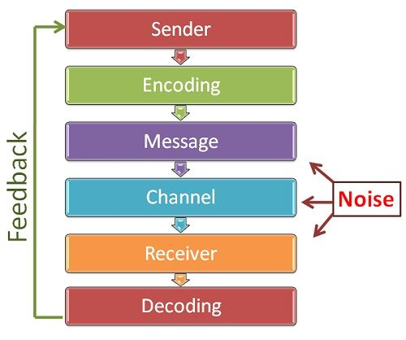
Process of Communication
The Sender - The communication process begins with the sender, who is also called the communicator or source. The sender has some kind of information — a command, request, question, or idea — that he or she wants to present to others. For that message to be received, the sender must first encode the message in a form that can be understood, such as by the use of a common language or industry jargon, and then transmit it.
The Receiver - The person to whom a message is directed is called the receiver or the interpreter. To comprehend the information from the sender, the receiver must first be able to receive the sender's information and then decode or interpret it.
The Message - The message or content is the information that the sender wants to relay to the receiver. Additional subtext can be conveyed through body language and tone of voice. Put all three elements together — sender, receiver, and message — and you have the communication process at its most basic.
The Medium - Also called the channel, the medium is the means by which a message is transmitted. Text messages, for example, are transmitted through the medium of cell phones.
Feedback - The communication process reaches its final point when the message has been successfully transmitted, received, and understood. The receiver, in turn, responds to the sender, indicating comprehension. Feedback may be direct, such as a written or verbal response, or it may take the form of an act or deed in response (indirect).

Slide 19
Process of Communication
Other Factors - The communication process isn't always so simple or smooth, of course. These elements can affect how information is transmitted, received, and interpreted:
Noise: This can be any sort of interference that affects the message being sent, received, or understood. It can be as literal as static over a phone line or radio or as esoteric as misinterpreting a local custom.
Context: This is the setting and situation in which communication takes place. Like noise, context can have an impact on the successful exchange of information. It may have a physical, social, or cultural aspect to it. In a private conversation with a trusted friend, you would share more personal information or details about your weekend or vacation, for example, than in a conversation with a work colleague or in a meeting.

Slide 20
Types of Communication
Based on number of people involved, communication can be divided into four types:
Intra-personal communication- when one communicates with one's own self
Inter-personal communication- when at least two people interact
Group communication- when more than two people are involved
Mass communication- when quite large number of people are involved
In an organization, based on hierarchy, communication can be divided into four types
Vertical communication – Upward and Downward
Horizontal communication
Diagonal communication
Grapevine communication

Slide 21
Modes of Communication
There are two basic modes of communication
Verbal Communication
Non-Verbal communication
Verbal Communication
Communication through spoken or written words
Oral communication
Any message or information is shared or exchanged through speech or word of mouth
Face-to-face conversation, telephone, voice-over-internet, public speech, news reading, TV, Radio
Written communication
Any message or information is shared or exchanged through written or printed words
Letters, memos, reports, newspaper, notices, blogs
Non-Verbal Communication
Communication without the use of spoken or written words
Happens through signs, symbols, gestures, facial expressions, body language, graphs, charts
Helps in making verbal communication complete and more effective
Raising eyebrows, shaking head, smiling, raising hand, clapping, crying
The non-verbal cues are Kinesics, Proxemics, Chronemics, Haptics, Paralanguage, Silence and Sign language.

Slide 22
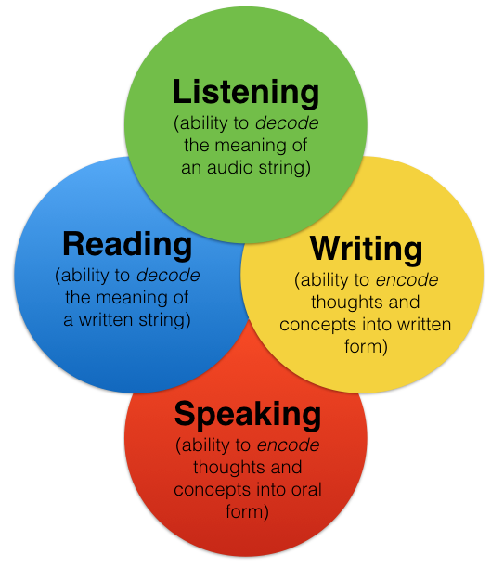
What are communication skills?
Communication skill is the ability to use language to express one’s opinions and any information in a lucid way.
Components of communication skills:
Listening skills
Speaking Skills
Reading Skills
Writing Skills
Listening and Reading are the Receptive skills, means communicator is at the receiving end while listening or reading.
Speaking and Writing are the Productive skills, means communicator is at the transmitting end while listening or reading.

Slide 23
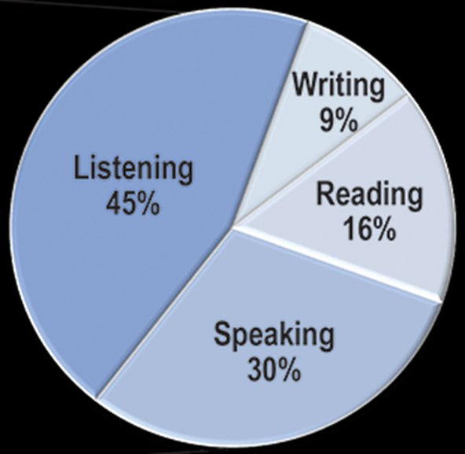
Analysis of communication skills
Listening
Speaking
Reading
Writing

Slide 24
Listening
The process of receiving, constructing meaning from and responding to a spoken and/ or non-verbal message
Listening is the most important communication skill
We probably spend more time using our Listening Skills than any other kind of skill
Like other skills, Listening takes practice
Real Listening is an active process – active listening
Listening requires attention

Slide 25
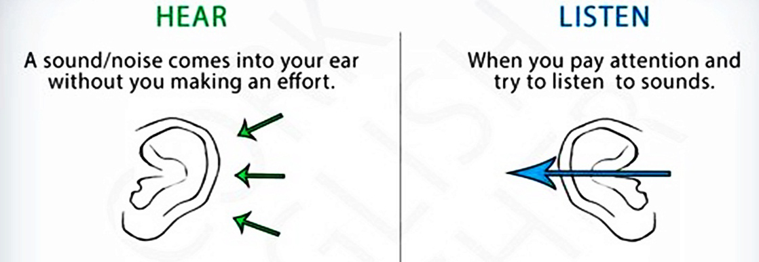
Hearing Vs Listening
Hearing – Physical process, natural, passive, ability. Involves not effort.
Listening – Physical as well as mental process, active, learned process, a skill. Effort is required to be made to listen actively.
https://keydifferences.com/difference-between-hearing-and-listening.html

Slide 26
Active/Effective Listening
Active Listening is the process of analyzing sounds, organizing them into recognizable patterns, interpreting the patterns and understanding the message by inferring the meaning as intended by the speaker/sender.
Active listening involves:
Hearing → Filtering → Comprehending → Remembering → Responding
Many of the problems we experience with people in our daily lives are primarily attributable to ineffective listening or lack of listening.
Active listening requires both deliberate efforts and a keen mind. Effective listeners appreciate flow of new ideas and information.
An attentive listener stimulates better speaking in the speaker
A good listener learns more than an indifferent listener
A good listener can restructure vague speaking in a way that produces clearer meaning
A good listener learns to detect prejudices, assumptions and attitude

Slide 27
Do’s of Effective Communication
Always think ahead about what you are going to say.
Use simple words and phrases that are understood by every body.
Increase your knowledge on all subjects you are required to speak.
Speak clearly and audibly.
Check twice with the listener whether you have been understood accurately or not
In case of an interruption, always do a little recap of what has been already said.
Always pay undivided attention to the speaker while listening.
While listening, always make notes of important points.
Always ask for clarification if you have failed to grasp other’s point of view.
Repeat what the speaker has said to check whether you have understood accurately.

Slide 28
Don’ts of Effective Communication
Do not instantly react and mutter something in anger.
Do not use technical terms & terminologies not understood by majority of people.
Do not speak too fast or too slow.
Do not speak in inaudible surroundings, as you won’t be heard.
Do not assume that every body understands you.
While listening do not glance here and there as it might distract the speaker.
Do not interrupt the speaker.
Do not jump to the conclusion that you have understood every thing.

Slide 29
7 C’s of Effective Communication
Clear: Make the goal of your message clear to your recipient. Ask yourself what the purpose of your communication is.
Concise: Your message should also be brief and to the point. Why communicate your message in six sentences when you can do it in three?
Concrete: Ensure your message has important details and facts, but that nothing deters the focus of your message.
Correct: Make sure what you're writing or saying is accurate. Bad information doesn't help anybody. Also make sure that your message is typo free.
Coherent: Does your message make sense? Check to see that all of your points are relevant and that everything is consistent with the tone and flow or your text.
Complete: Your message is complete when all relevant information is included in an understandable manner and there is a clear "call to action". Does your audience know what you want them to do?
Courteous: Ensure that your communication is friendly, open, and honest, regardless of what the message is about. Be empathetic and avoid passive-aggressive tones.

Slide 30
Barriers to Effective Communication
The Barriers to effective communication could be of many types like linguistic, psychological, emotional, physical, cultural and more.
Linguistic Barriers - The language barrier is one of the main barriers that limit effective communication. Language is the most commonly employed tool of communication. The fact that each major region has its own language is one of the Barriers to effective communication. Sometimes even a thick dialect may render the communication ineffective. Even in the same workplace, different employees will have different linguistic skills. As a result, the communication channels will be affected.
Psychological Barriers - There are various mental and psychological issues that may be barriers to effective communication. Some people have stage fear, speech disorders, phobia, depression etc. All of these conditions are very difficult to manage sometimes and will most certainly limit the ease of communication.
Emotional Barriers - The emotional IQ of a person determines the ease and comfort with which they can communicate. A person who is emotionally mature will be able to communicate effectively. On the other hand, people who let their emotions take over will face certain difficulties. Emotions like anger, frustration, humor, can blur the decision making capacities of a person and thus limit the effectiveness of their communication.
Physical Barriers - They are the most obvious barriers to effective communication. These barriers are mostly easily removable in principle at least. They include barriers like noise, closed doors, faulty equipment used for communication, closed cabins, etc. Sometimes, in a large office, the physical separation between various employees combined with faulty equipment may result in severe barriers to effective communication.

Slide 31
Barrier to Effective Communication
Cultural Barriers - As the world is getting more and more globalized, any large office may have people from several parts of the world. Different cultures have a different meaning for several basic values of society. Dressing, Religions or lack of them, food, drinks, pets, and the general behaviour will change drastically from one culture to another. Hence it is a must that we must take these different cultures into account while communication. This is what we call being culturally appropriate.
Attitude Barriers - Certain people like to be left alone. They are the introverts or just people who are not very social. Others like to be social. Both these cases could become a barrier to communication. Some people have attitude issues, like huge ego and inconsiderate behaviours. These employees can cause severe strains in the communication channels that they are present in. Certain personality traits like shyness, anger, social anxiety may be removable through courses and proper training.
Perception Barriers - Different people perceive the same things differently. This is a fact which we must consider during the process. Knowledge of the perception levels of the audience is crucial to effective communication. All the messages or communique must be easy and clear. There shouldn’t be any room for a diversified interpretational set.
Physiological Barriers - Certain disorders or diseases or other limitations could also prevent effective communication between the various channels of an organization. The shrillness of voice, dyslexia are some examples of physiological barriers to effective communication. However, these are not crucial because they can easily be compensated and removed.

Slide 32
Barrier to Effective Communication
Technological Barriers - Other barriers include the technological barriers. The technology is developing fast and as a result, it becomes difficult to keep up with the newest developments. Hence sometimes the technological advance may become a barrier. In addition to this, the cost of technology is sometimes very high. Most of the organizations will not be able to afford a decent tech for the purpose of communication. Hence, this becomes a very crucial barrier.
Socio-religious Barriers - Other barriers are socio-religious barriers. In a patriarchal society, a woman or a transgender may face many difficulties and barriers while communicating.

