Slide 1

NoSQL Document Database By: Jyoti Sharma, David Amankwah, Tanvi Hindwan

Slide 2

RavenDB Roadmap
Introduction to RavenDB
RavenDB Features
How RavenDB works?
RavenDB Data Model
Transaction Concept
Terminology Comparison with RDBMS
JSON Format
Basic Queries Operations
Advantages
Comparison with other NoSQL Databases
Market Concept and Pricing Model
Drawbacks

Slide 3
What is RavenDB?
Open source, schema-less, document-oriented NoSQL database especially designed for the .NET/Windows platform
Founded by Hibernating Rhinos in 2008 – developed by Oren Eini
Written in C#, .Net
REST Based – REpresentational State Transfer based web service
Uses JSON to store documents
Supported programming languages: .Net, C#, Go, Java, JavaScript, (Node.js), Python, Ruby

Slide 4
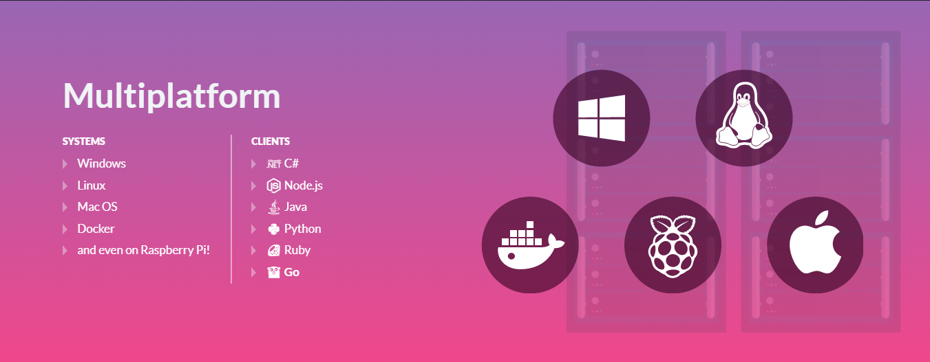

Slide 5
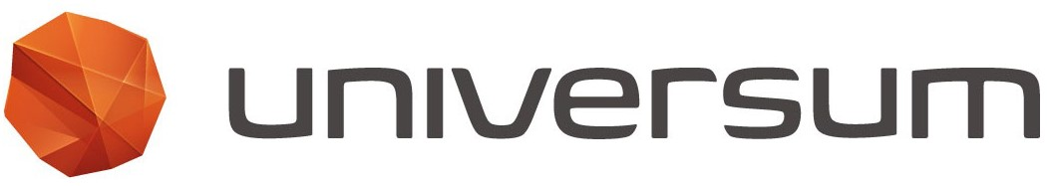
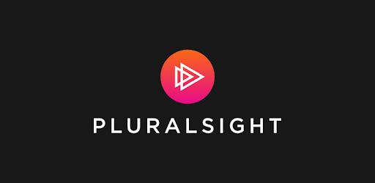

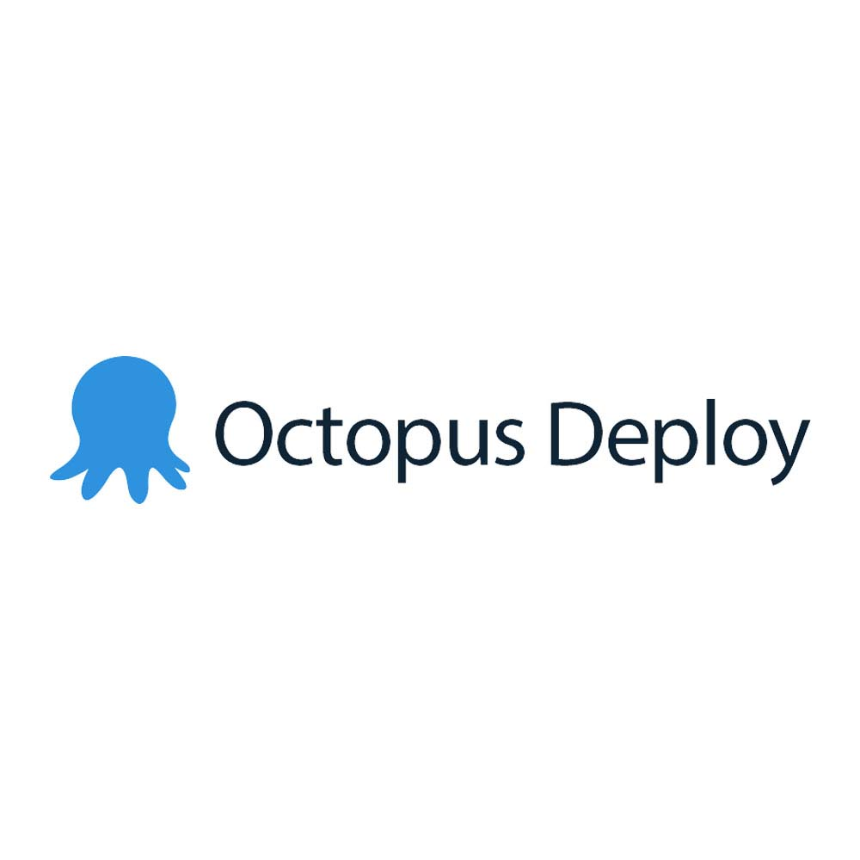
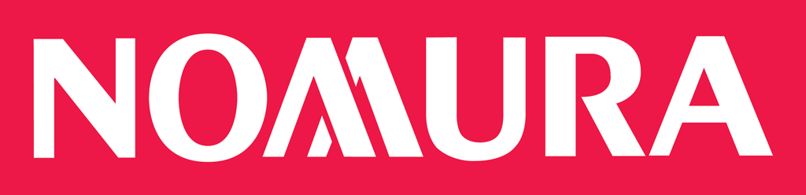
Key Customers

Slide 6
RavenDB Features
Fully Transactional
High Availability
High Performance
Multi-Model Architecture - Sharding
Management Studio
ACID Database
Zero Administration and Self-Optimization
Ease of Use

Slide 7
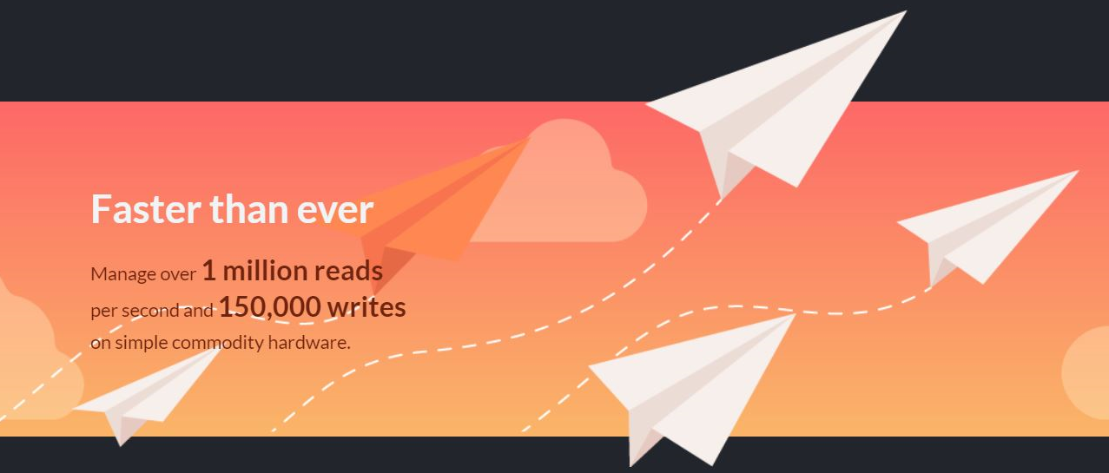

Slide 8
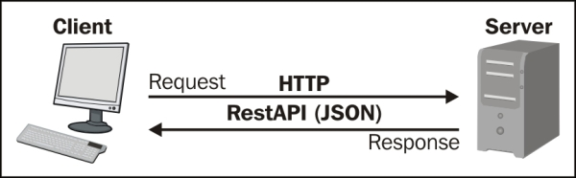
How RavenDB works?
client/server application architecture

Slide 9
How RavenDB works? Conti.
Launch Modes:
Console mode – learning and testing
Hosted by IIS (Internet Information Server) – For production environment
As a Windows Service - build own http server
Embedded mode – in to applications
Authentication:
Windows authentication
OAuth authentication (API Key Authentication)

Slide 10
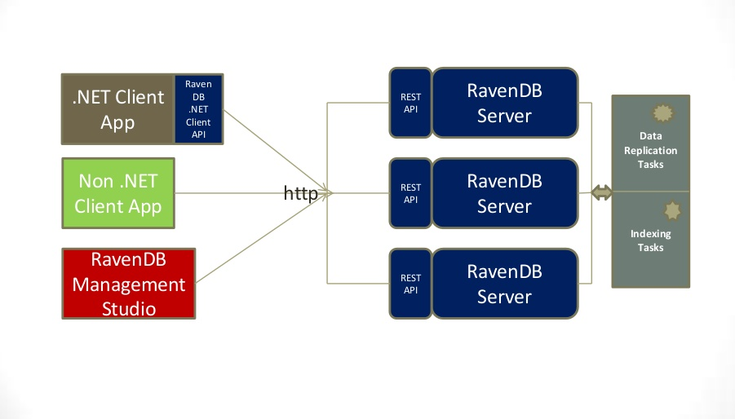
RavenDB Architecture

Slide 11
Transaction Concept
ACID
Atomic
Consistent
Isolated
Durable
BASE
Basically Available
Soft state
Eventual consistency

Slide 12
Transaction Support In RavenDB
All storage operations performed in RavenDB are fully ACID
custom made storage engine called Voron
ACID for document operations
BASE for query operations

Slide 13
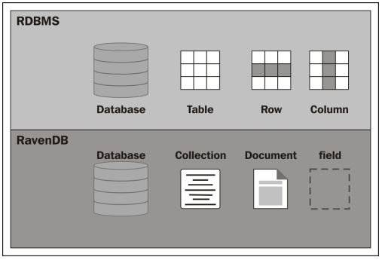
RDBMS VS RavenDB Terminology

Slide 14
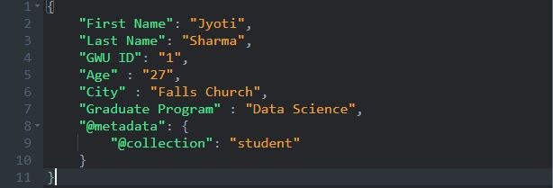
Document Operations: JSON Format
Store collections as JSON

Slide 15



Basic Query Operations
RavenDB use a SQL-like language called "RavenDB Query Language
Queries are always going to use an index

Slide 16
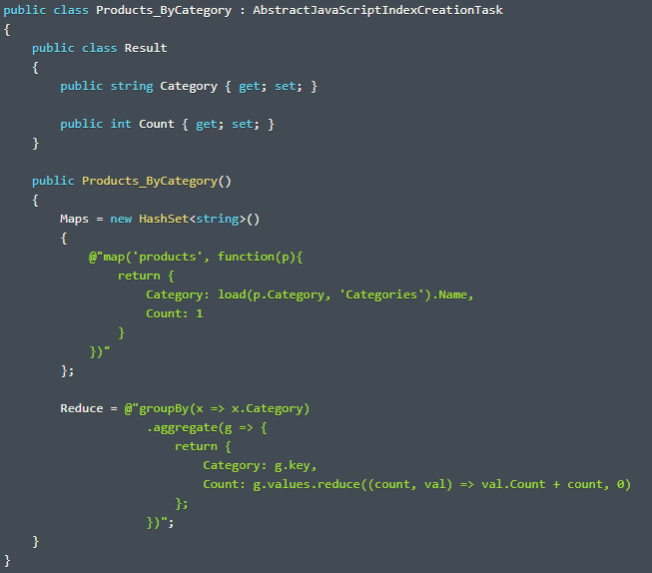

Querying using Map-Reduce Indexes

Slide 17
RavenDB advantages over RDBMS
Collections are schema-less
Non-Relational - No foreign-key concept
No complex JOIN queries
Supports Horizontal Scaling – Sharding
Key-value pairs

Slide 18
RavenDB over NoSQL Database (MongoDB)
Description | MongoDB | RavenDB
Database as a service | Deploy a fully managed cloud database in minutes using MongoDB Atlas | AWS cloud availability using EC2
Implementation language | C++ | C#
SQL | Read-only SQL queries via the MongoDB Connector for BI | SQL-like query language (RQL)
APIs and other access methods | proprietary protocol using JSON | .NET Client API Java Client API Python Client API RESTful HTTP API
Replication methods | Master-slave replication | Cluster Topology with Multi-master replication
Operating Systems | Server operating systems: Linux, macOS, Solaris, Windows | Linux, macOS, Raspberry Pi, Windows
Transaction concepts | Multi-document ACID Transactions with snapshot isolation | ACID, Cluster-wide transaction available
Text Queries | Support full text queries | No support for full text query

Slide 19
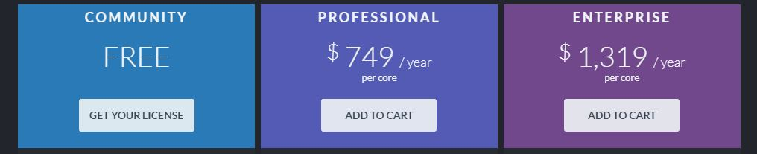
RavenDB Pricing Model

Slide 20
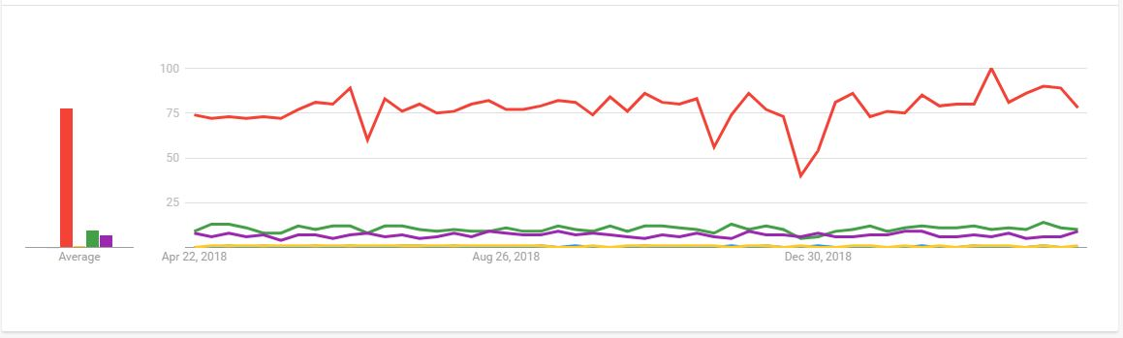
Market Concept

Slide 21
Drawbacks of RavenDB
Reporting
Sometimes reporting requires dynamic data aggregation over large dataset, and that isn't an OLTP (Online Transaction Processing) task, which is what RavenDB was designed for.

Slide 22


