Slide 1

SMART INDIA HACKATHON 2026
AEGISSIM
Problem Statement ID – SIH26247
Problem Statement Title – AI-Enabled Drone & Counter-Drone Threat Simulation Trainer
Theme – Robotics and Drones
PS Category – Software
Team ID – 186386
Team Name – hackstreetgirls
AI-assisted, browser-based synthetic threat-recognition & response training simulator

Slide 2
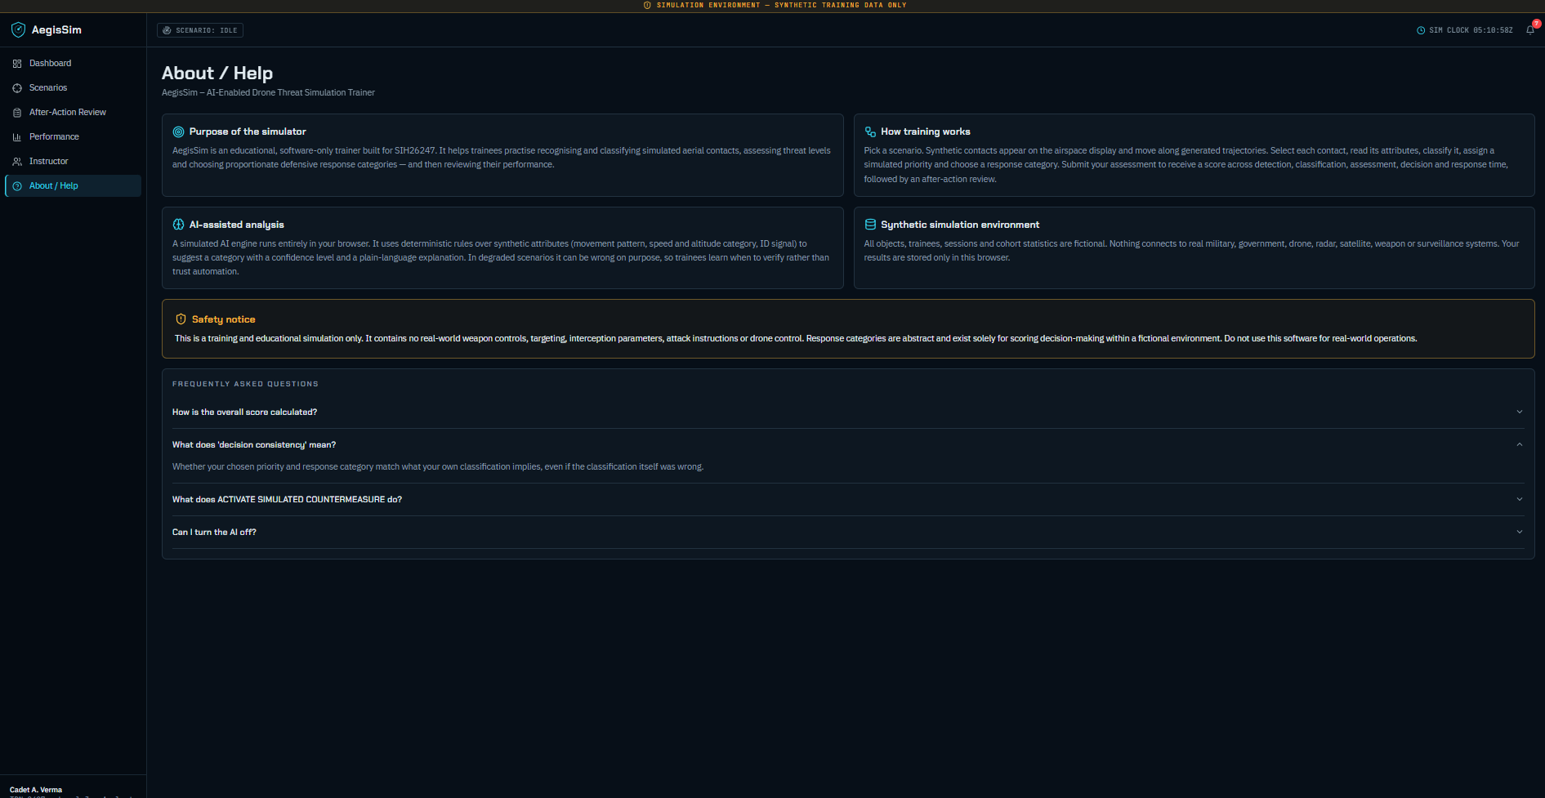
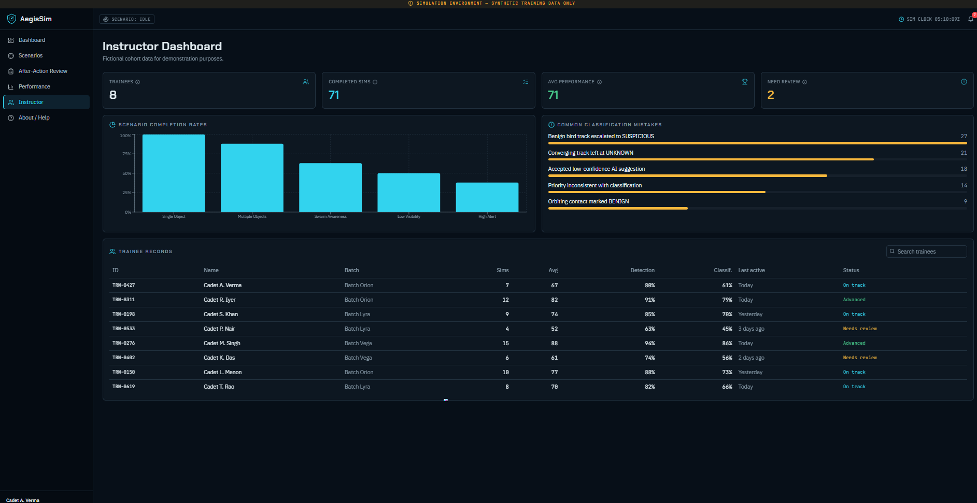
AegisSim
hackstreetgirls
AegisSim – AI-Enabled Drone & Counter-Drone Threat Simulation Trainer
Problem: current training can be costly, weather-dependent and difficult to repeat at scale.
Solution: a browser-based synthetic airspace simulator for repeated recognition, classification and decision practice.
AI-assisted analysis explains simulated contacts and provides confidence-aware training feedback.
After-action review converts every session into measurable learning outcomes.
Repeatable: synthetic scenarios can be replayed without live drills.
Scalable: scenario difficulty, contact count and visibility can be varied.
Measurable: detection, classification, assessment, decision and response-time scores.
Safe-by-design: fictional data, no real-world control or targeting functions.
Prototype dashboard
Scenario selection

Slide 3
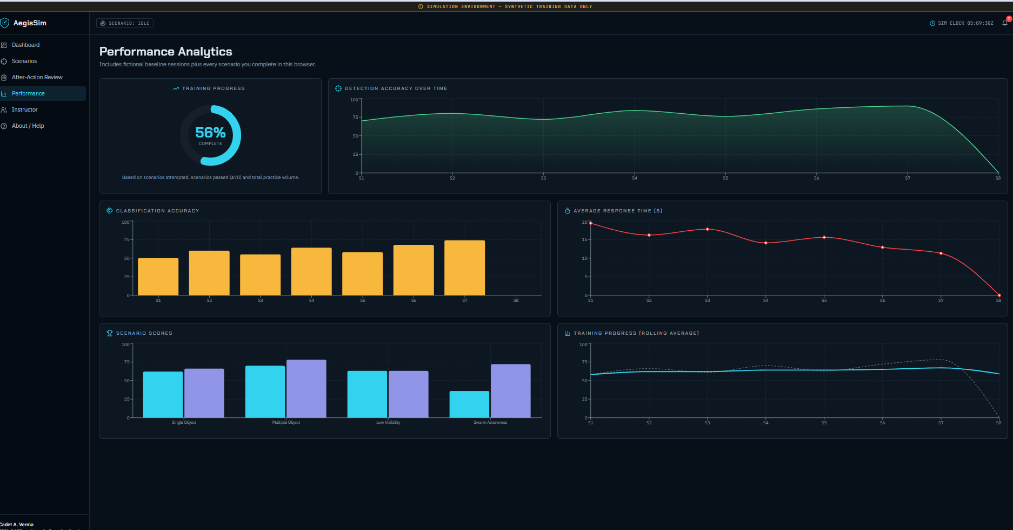
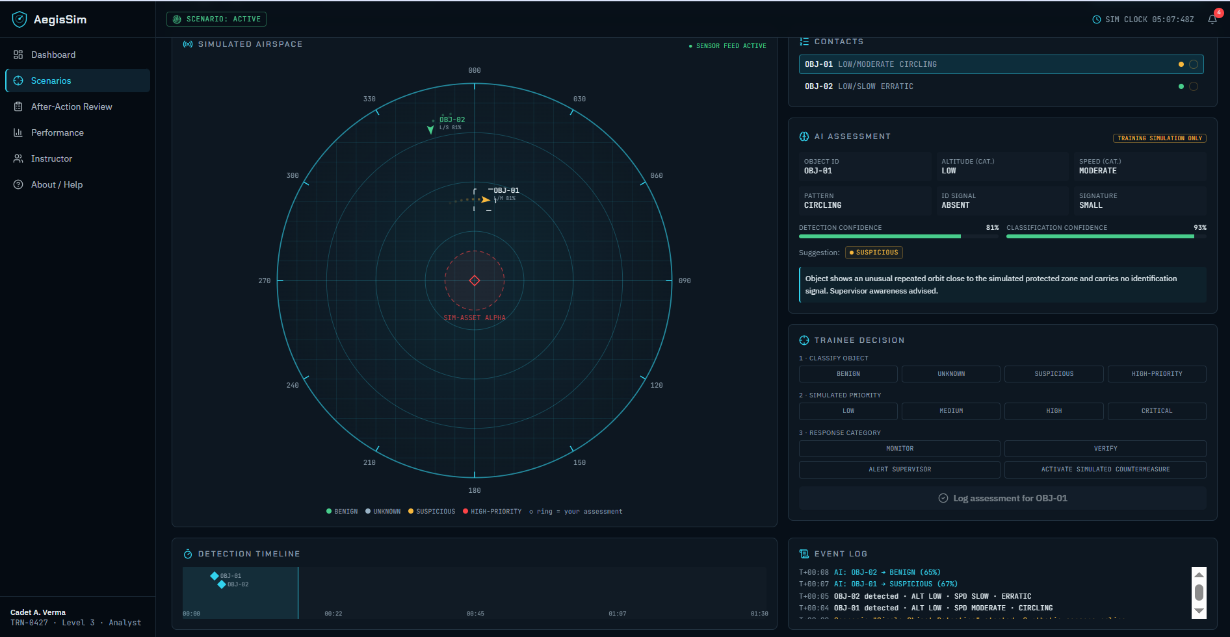
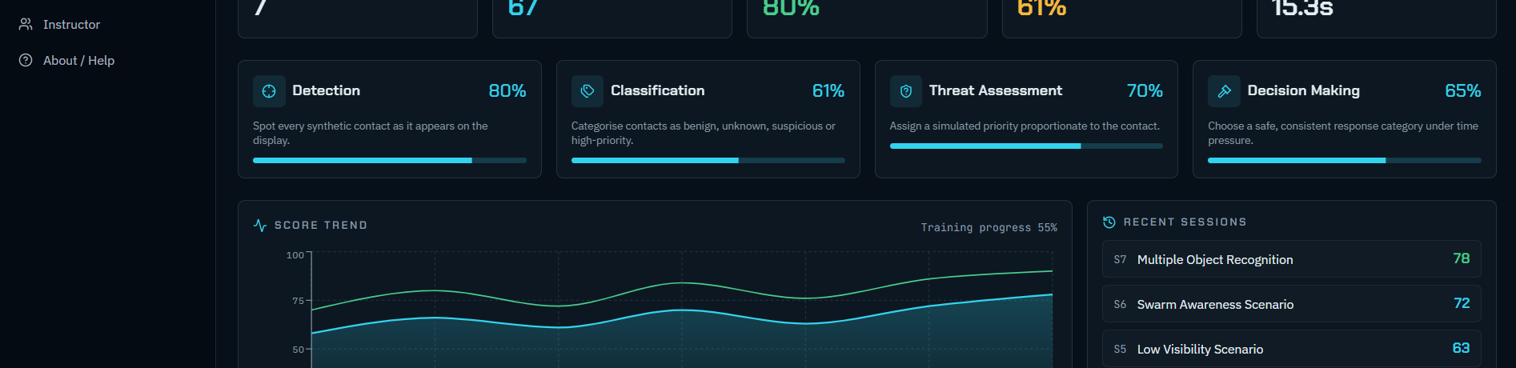
Technical Approach
hackstreetgirls
acksth
reetgirls
Technology stack
React + TypeScript
Tailwind CSS + modular UI
Recharts + browser analytics
Synthetic scenario engine + deterministic mock AI
Client-side state for demo/offline operation
Scenario
Simulated
Airspace
AI
Assessment
Trainee
Decision
Score +
Review
Implementation methodology
Scenario data → synthetic contacts → simulated movement → confidence-aware analysis → human assessment → scoring.
No live military, radar, satellite, drone or surveillance feeds are connected.
Live synthetic airspace simulation
Performance analytics
Training environment & safety notice

Slide 4
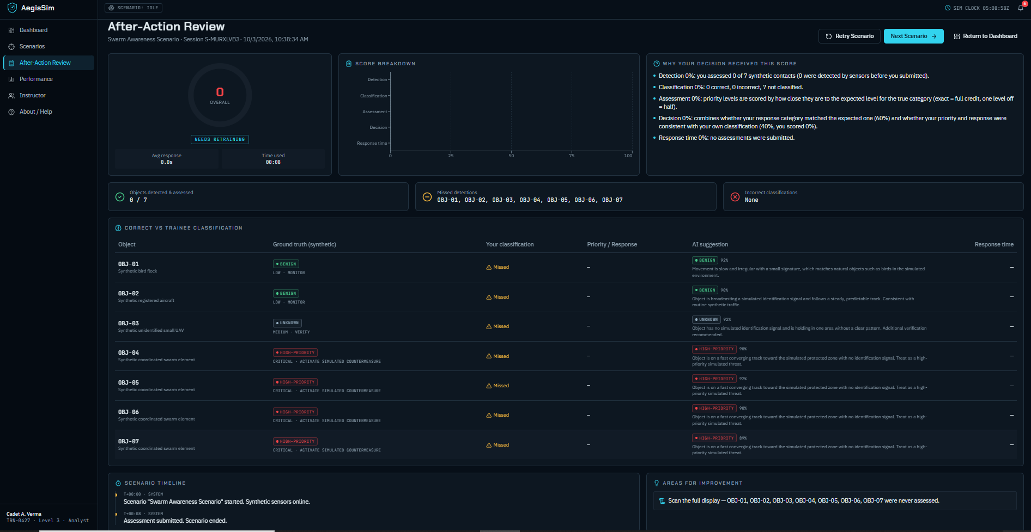
FEASIBILITY AND VIABILITY
hackstreetgirls
hackstreetgirls
Feasibility
Software-only prototype: works in a standard modern browser.
Synthetic data keeps the demo independent of external systems and connectivity.
Modular scenario engine allows new training cases without redesigning the UI.
Scoring and analytics create an immediate feedback loop for trainees and instructors.
Challenges & mitigation
Risk: AI suggestions may be wrong → show confidence and require human verification.
Risk: simulation may not reflect every real environment → keep scenarios configurable.
Risk: performance data may be sensitive → use fictional/local demo data.
Risk: visual overload → progressive disclosure and clear status panels.
After-action review: score breakdown, missed synthetic contacts and improvement areas

Slide 5
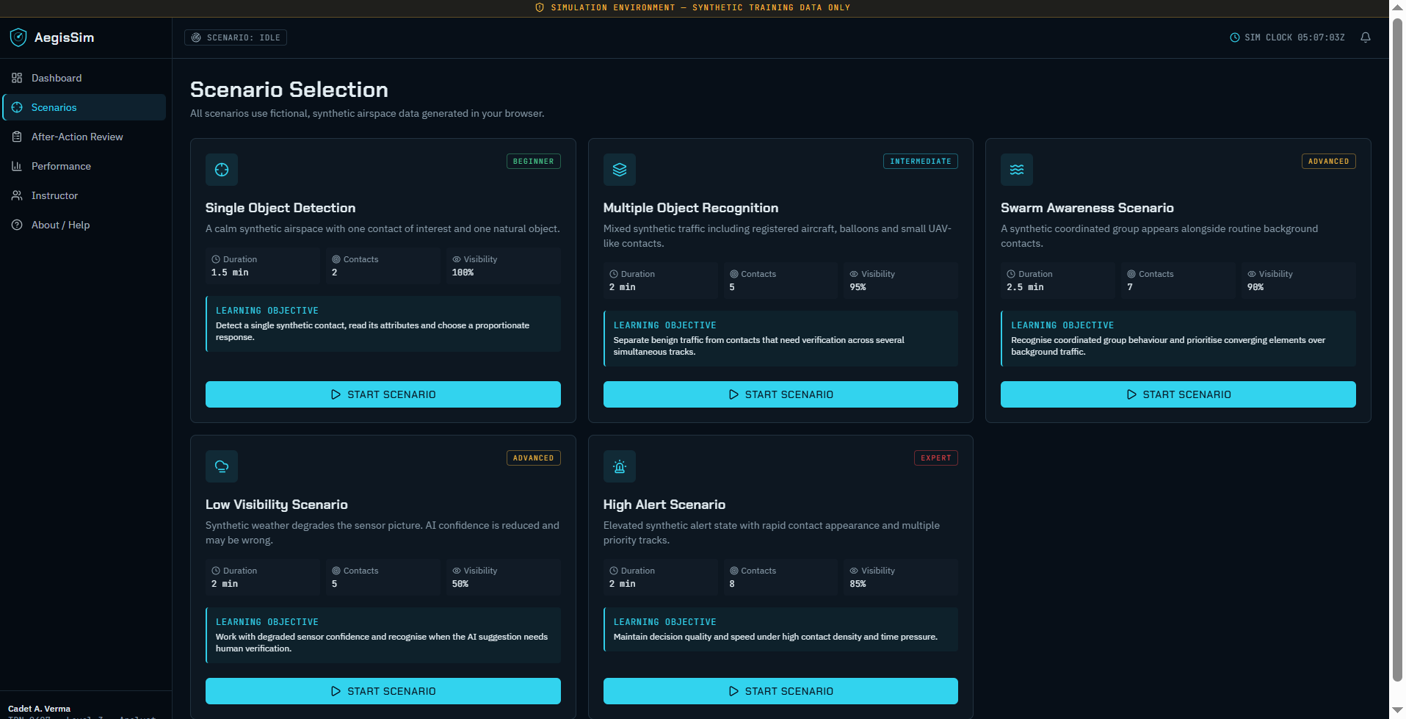
IMPACT AND BENEFITS
hackstreetgirls
hackstreetgirls
Target audience
Trainees: repeatable practice with immediate feedback.
Instructors: cohort-level analytics and common-error visibility.
Institutions: scalable software training without repeated live drills.
Benefits
Low recurring simulation cost
Weather-independent practice
Objective performance metrics
Faster after-action review
Measurable outcomes
Detection accuracy
Classification accuracy
Decision quality
Response-time trend
Training progress
Instructor dashboard: cohort metrics and common classification mistakes
Trainee dashboard: score trend and recent sessions

Slide 6
RESEARCH AND REFERENCES
hhackstreetgirls
ackstreetgirls
Reference & research basis
SIH 2026 Problem Statement: SIH26247
Title: AI-Enabled Drone & Counter-Drone Threat Simulation Trainer
Problem creator: Sarim Moin
Problem creator organization: Ministry of Defence (MoD)
Department: Ministry of Education's Innovation Cell (MIC)
Technology bucket: Robotics and Drones
Category: Software
Reference basis: problem-statement screenshot supplied by the team.
Prototype evidence: AegisSim dashboard, scenario selection, live simulation, after-action review, performance analytics, instructor dashboard and About/Help screens.
Submission format: SIH2026-IDEA-Presentation-Format.pptx; maximum 6 slides.
Prototype screenshots included as implementation evidence

