Slide 1



SMART INDIA HACKATHON 2026
MAUSAM360
• Problem Statement ID – SIH26069
• Problem Statement Title – National Weather Big Data Analytics Platform
• Theme – Disaster Management
• PS Category – Software
• Team ID – 186386
• Team Name – hackstreetgirls
Organization: Ministry of Earth Sciences (MoES) | Department: India Meteorological Department (IMD)

Slide 2
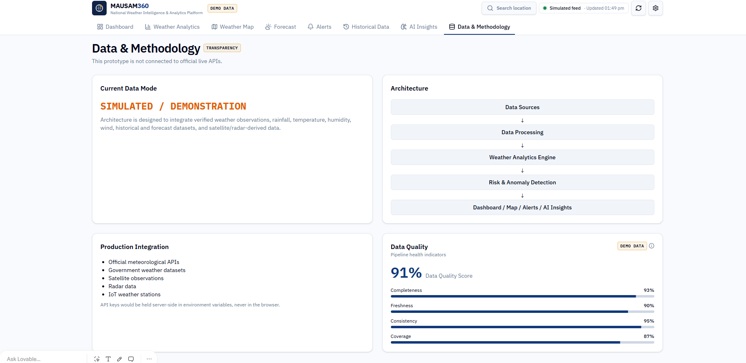
IDEA TITLE — MAUSAM360
hackstreetgirls
Proposed Solution
How it addresses the problem
Innovation & uniqueness
• National weather intelligence platform for unified data ingestion, processing and visualization.
• Combines multi-source weather feeds with AI-assisted anomaly, risk and event analysis.
• Designed as a scalable dashboard for disaster-management decision support.
• Centralizes fragmented weather information into one interface.
• Supports historical analysis, alerts, forecasts and location-wise risk views.
• Creates a clear path from raw data → analytics → actionable insights.
• AI Weather Intelligence for anomaly and extreme-condition detection.
• Verification-ready architecture for future citizen/social reports.
• Transparent demo-data labeling for credible prototyping.
CORE IDEA FLOW
DATA SOURCES
PROCESSING
WEATHER ANALYTICS
RISK / AI
DASHBOARD
→
→
→
→
• Prototype status: simulated/demo data; interface and interactions demonstrated.
• Production path: connect official APIs, public datasets and validated reporting channels.

Slide 3
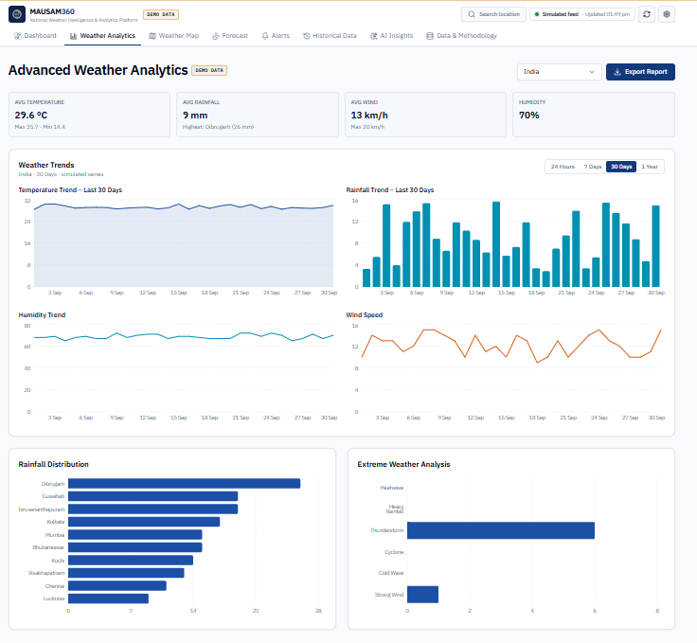
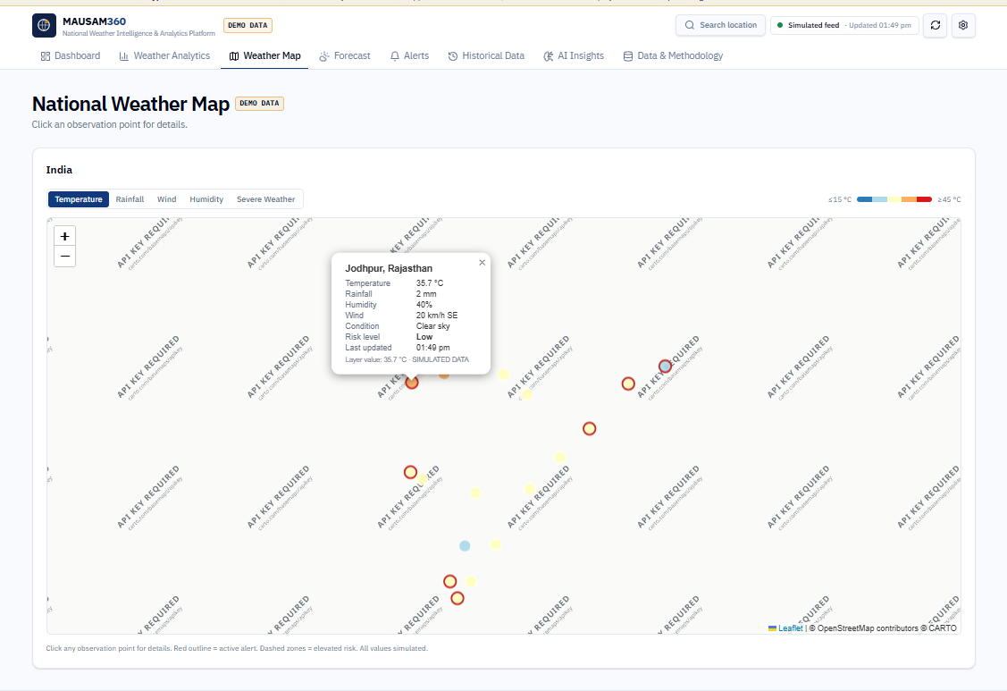
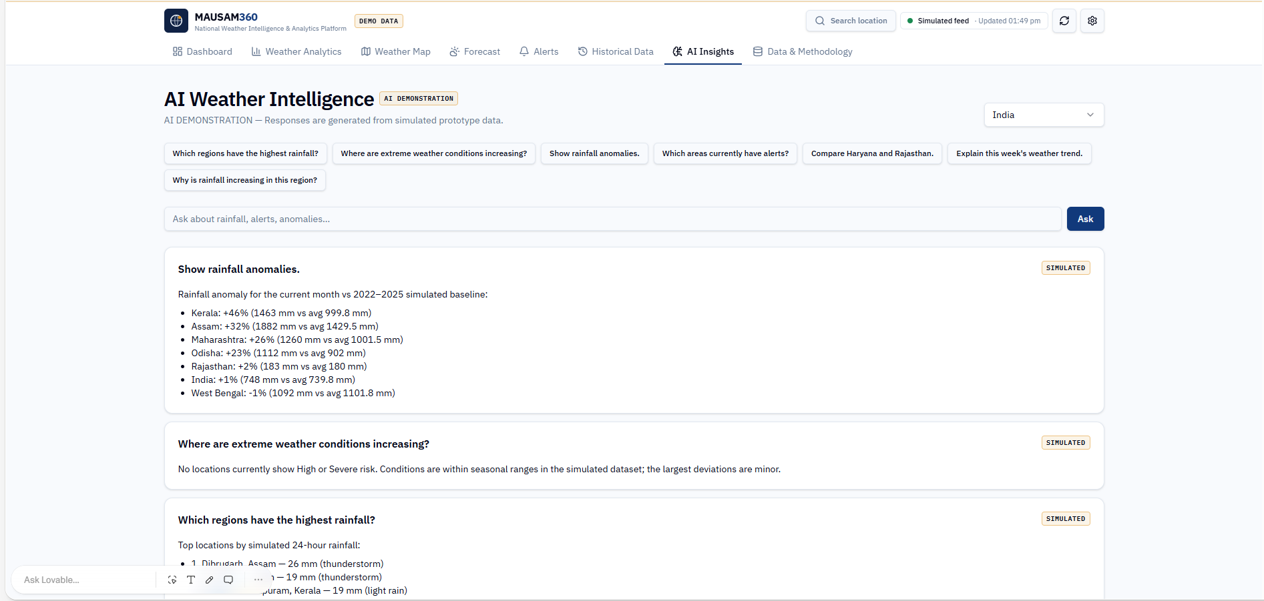
TECHNICAL APPROACH
hackstreetgirls
Technologies to be used
Methodology & implementation
• Frontend: React / responsive web UI
• Data layer: REST APIs, JSON and structured weather datasets
• Analytics: Python-ready data processing + AI/ML modules
• Visualization: interactive charts, national weather map and alert panels
• Production storage: scalable cloud / big-data database architecture
1. INGEST
2. CLEAN
3. ANALYZE
4. DETECT
5. VISUALIZE
→
→
→
→
• Multi-source data → validation/deduplication → event classification → anomaly/risk scoring → dashboard/alerts.
• AI layer can later verify untrusted reports and flag misleading or duplicate information.
Prototype evidence: Advanced Analytics | National Weather Map | AI Weather Intelligence

Slide 4
FEASIBILITY AND VIABILITY
hackstreetgirls
Feasibility
Challenges & risks
Mitigation
Why it is feasible
Key risks
Strategies
• Modular web architecture can start with APIs/datasets and scale later.
• Core dashboard, analytics and alert views are already prototyped.
• Open-source technologies reduce licensing dependency.
• Production components can be deployed incrementally.
• Large data volume and inconsistent formats.
• Duplicate, noisy or misleading reports.
• API availability and real-time latency.
• Map/API keys and production data access.
• Schema validation, deduplication and data-quality scoring.
• AI-assisted verification + human-review workflow.
• Caching, asynchronous processing and scalable storage.
• Fallback datasets and clear demo/production separation.
IMPLEMENTATION ROADMAP
P1 Prototype
→
P2 Live APIs
→
P3 AI Verification
→
P4 National Scale

Slide 5
IMPACT AND BENEFITS
hackstreetgirls
Target audience
Operational benefits
Social • Economic • Environmental
• Disaster-management authorities
• Weather analysts and administrators
• Emergency-response teams
• Researchers and public-data users
• Citizens needing clear local alerts
• Single view of weather information
• Faster detection of anomalies and extreme events
• Location-wise risk and alert visualization
• Historical trends for planning and preparedness
• Transparent data-quality / verification workflow
• Supports earlier preparedness and response
• Can reduce information fragmentation during events
• Enables data-driven resource planning
• Improves visibility of rainfall and extreme-weather trends
• Scalable foundation for national weather intelligence
IMPACT CHAIN • DATA → INSIGHT → ALERT → DECISION → DISASTER READINESS

Slide 6
RESEARCH AND REFERENCES
hackstreetgirls
Research & problem-statement alignment
References / links
• SIH26069: National Weather Big Data Analytics Platform
• Organization: Ministry of Earth Sciences (MoES)
• Department: India Meteorological Department (IMD)
• Prototype maps to ingestion, analytics, alerts, map and dashboard requirements.
• Demo data is clearly labeled; live API integration is the production next step.
• SIH PS: github.com/vedantchalke36/sih-2026-problem-statements/blob/main/ps_2026/SIH26069.md
• SIH PS Viewer: sih2026.vuce.in/ps/SIH26069
• SIH PS Mirror: sih2026-ps-viewer.vercel.app/ps/SIH26069
• India Meteorological Department: mausam.imd.gov.in
• Ministry of Earth Sciences: moes.gov.in
TEAM DETAILS
• Team: hackstreetgirls | Team ID: 186386
• Institute: Bhagat Phool Singh Mahila Vishwavidyalay
• Problem Statement: SIH26069

