Slide 1

CAPACITY CONNECT
Digital Capacity Building & Learning Management Portal
LEARN → ASSESS → MAP → GROW
PROBLEM STATEMENT ID
SIH26075
PROBLEM STATEMENT
CAPACITY CONNECT
THEME
Smart Education
PS CATEGORY
Software
TEAM ID
186386
TEAM NAME
HACKSTREETGIRLS
Prototype-led • role-aware • competency-focused

Slide 2
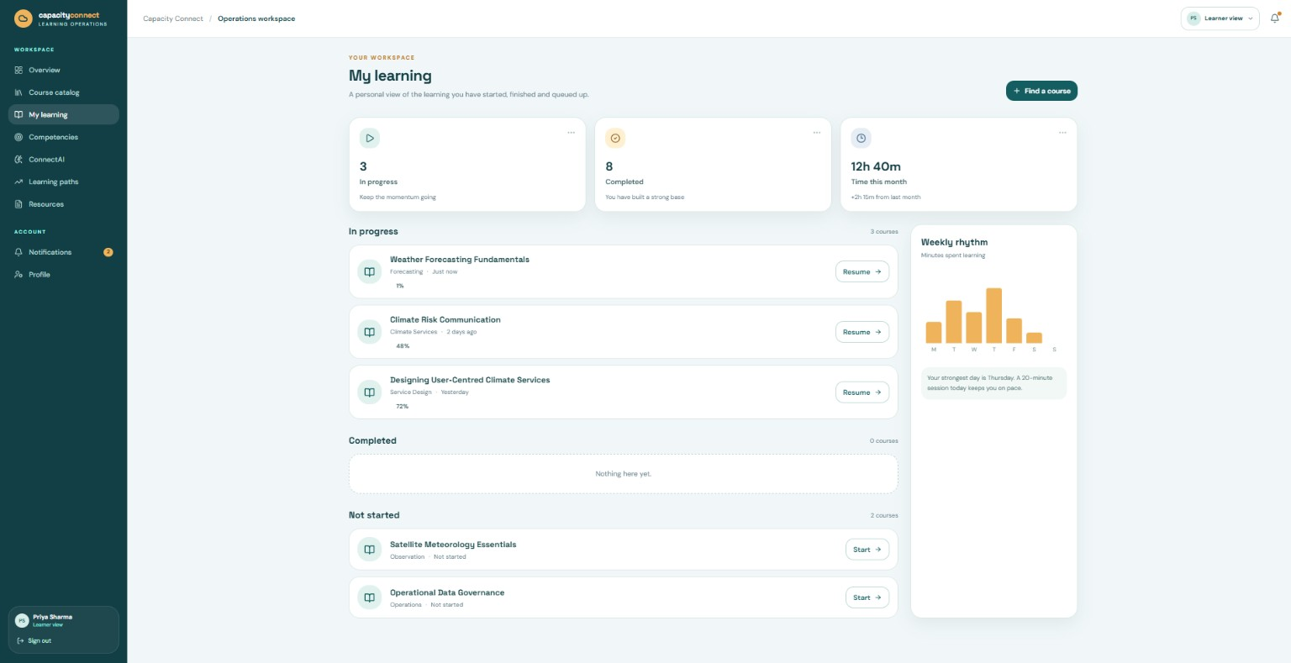
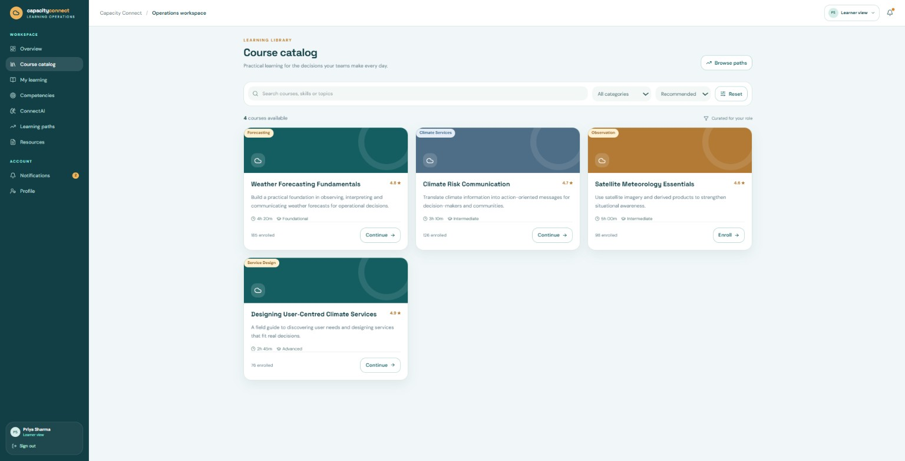
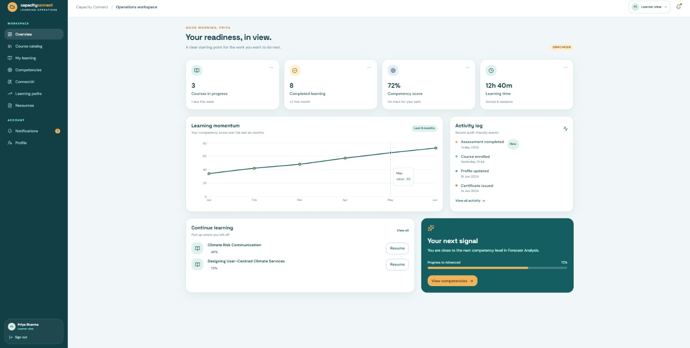
HACKSTREETGIRLS
CAPACITY CONNECT — ONE PORTAL, THREE ROLES
A centralized learning ecosystem that turns training activity into measurable competency.
PROPOSED SOLUTION
Trainee Workspace
• Profile, skills & certificates
• Course enrollment + resources
• MCQ assessments + feedback
Trainer Workspace
PROTOTYPE EVIDENCE
• Create questionnaires & deadlines
• Upload lectures / presentations / study material
• Monitor participation & performance
Learning dashboard • Course discovery • Competency view
Admin Control Tower
WHAT MAKES IT DIFFERENT
• Approve users + manage roles
• Dashboards for courses, assessments, certifications & participation
Learning paths + competency mapping + ConnectAI recommendations connect “what I learned” to “what I can do next”.
@SIH Idea submission - Template
2

Slide 3
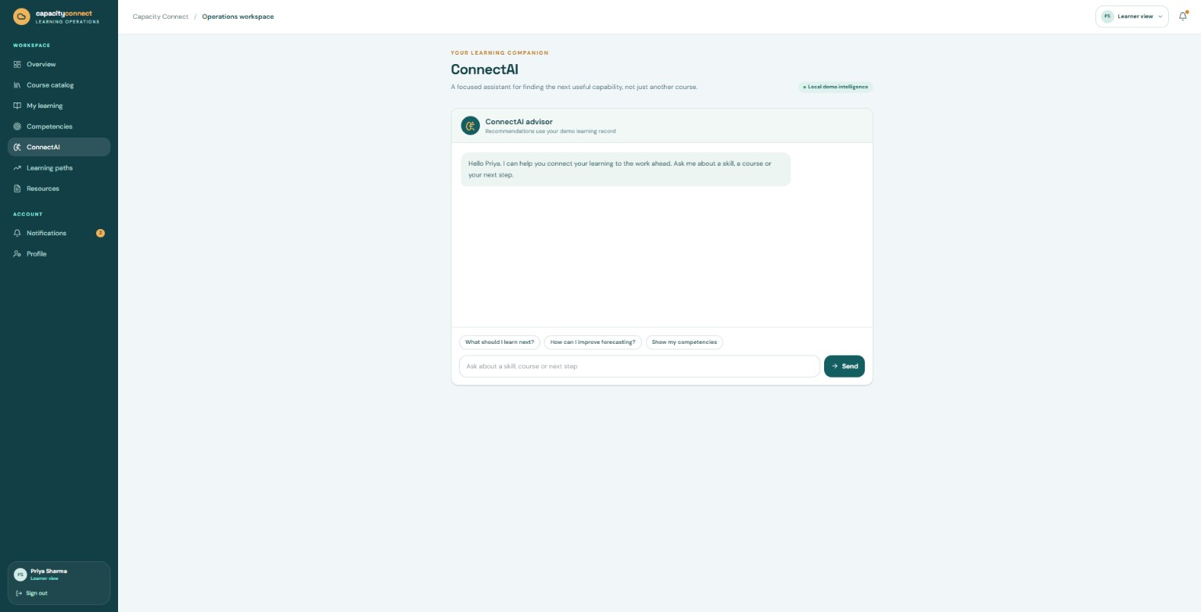
HACKSTREETGIRLS
TECHNICAL APPROACH
Modular architecture for secure role-based learning, assessment, content and competency intelligence.
PROPOSED TECHNOLOGY STACK
Web UI
API
Data
React / Next.js
Node.js / Express
PostgreSQL
Security
Storage
JWT + RBAC
Cloud object storage
IMPLEMENTATION FLOW
ConnectAI / recommendations
ROLE-BASED ACCESS
LEARNING CORE
COMPETENCY ENGINE
INSIGHT LAYER
Trainee / Trainer / Admin
Courses • Resources • Assessments
Skills • Mapping • Progress
Dashboards • Recommendations
SECURITY BY DESIGN
Encrypted authentication • role-based authorization • validated uploads • audit-friendly activity logs • responsive access across devices
@SIH Idea submission - Template
3

Slide 4
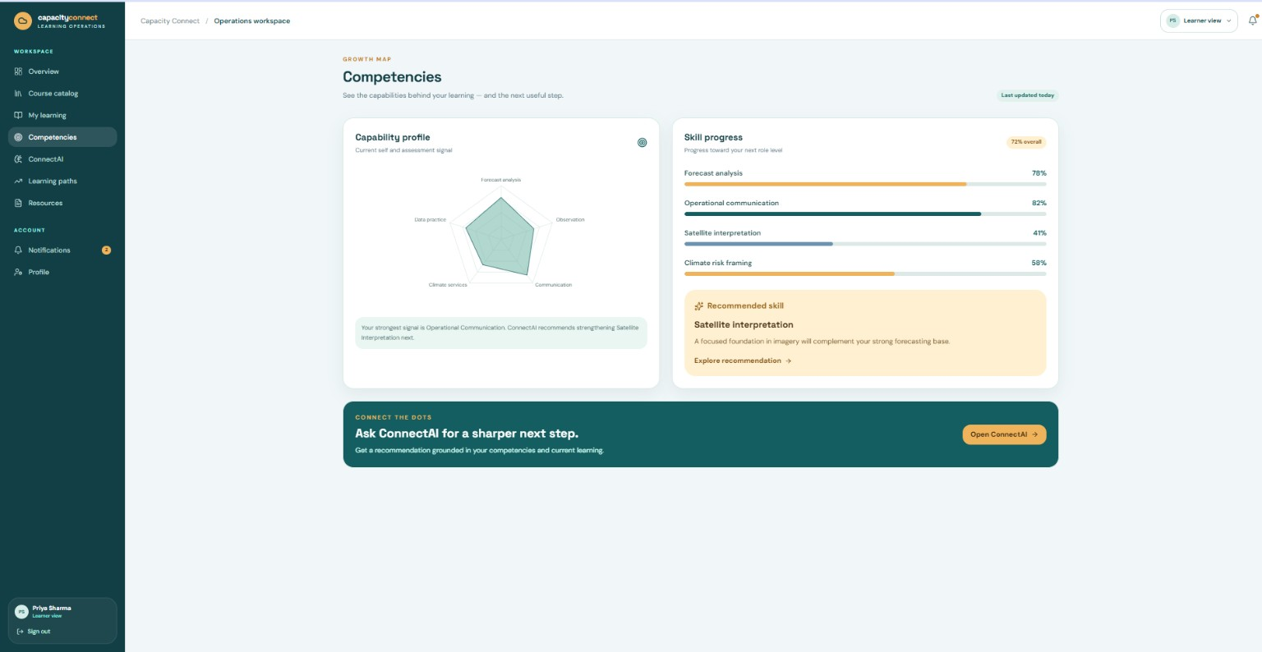
HACKSTREETGIRLS
FEASIBILITY AND VIABILITY
Start with a focused MVP, then scale modules without redesigning the core learning model.
MVP → SCALE ROADMAP
CHALLENGES & MITIGATION
01
CORE
Data privacy
RBAC, validation, secure storage & audit logs
Login • roles • profiles • courses
MEASURE
Content quality
Trainer approval + structured content workflows
02
MCQs • feedback • trainer analytics
Adoption
Simple role-based UX + guided learning paths
03
INTELLIGENCE
Competency mapping • recommendations • dashboards
Scalability
Modular services + indexed relational data
Prototype already demonstrates the learner journey: resources → learning paths → competency progress → personalized next step.
@SIH Idea submission - Template
4

Slide 5
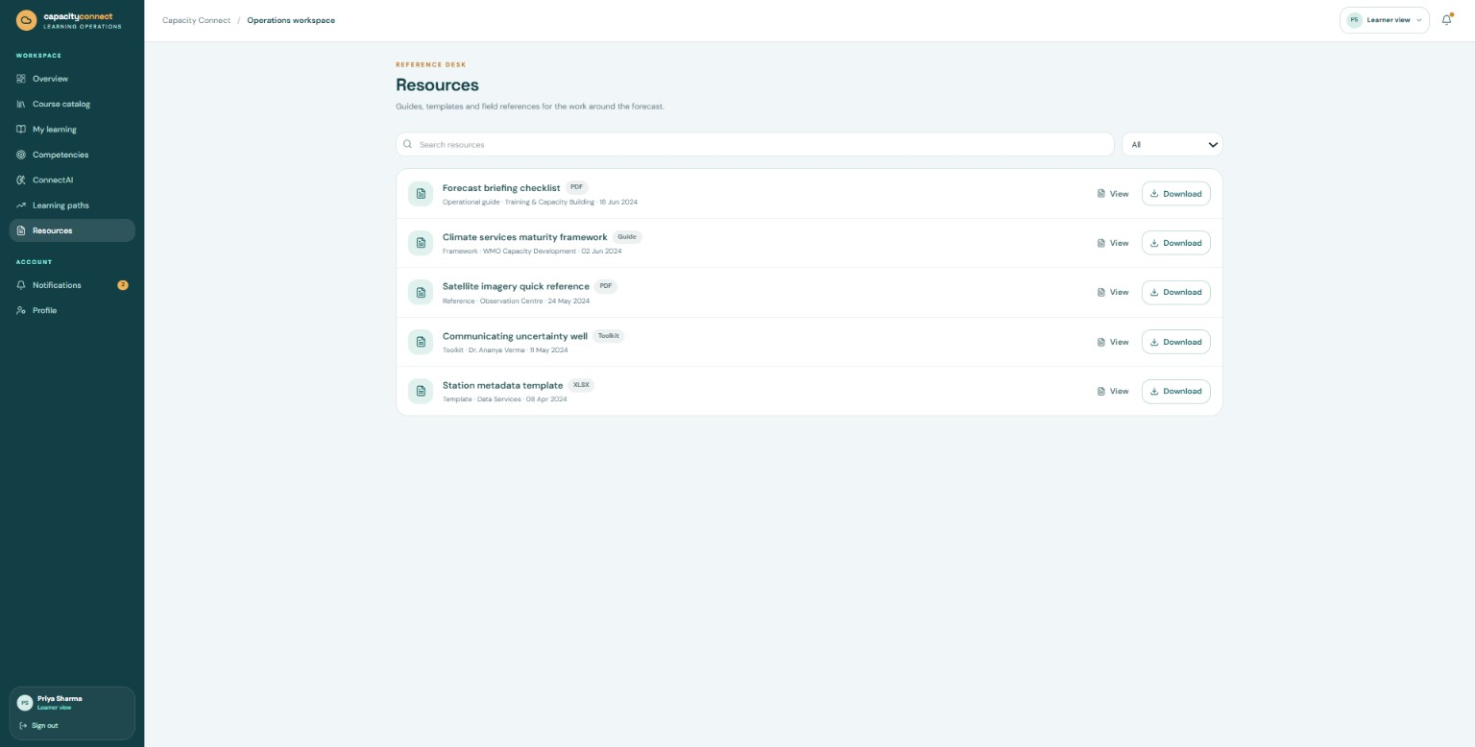
HACKSTREETGIRLS
IMPACT AND BENEFITS
A single capability-focused ecosystem for trainees, trainers and administrators.
TRAINEES
TRAINERS
ADMINS
Find the right course
Track learning progress
Build a verified skill profile
Receive next-step guidance
Publish structured content
Set assessments & deadlines
Monitor participation
Identify learning gaps
Approve & manage users
Monitor learning operations
Track certifications & assessments
Publish announcements
VALUE CHAIN
CENTRALIZE
PERSONALIZE
MEASURE
IMPROVE
Knowledge
Learning
Competency
Capability
Outcome: learning becomes visible, measurable and actionable — not just completed.
@SIH Idea submission - Template
5

Slide 6
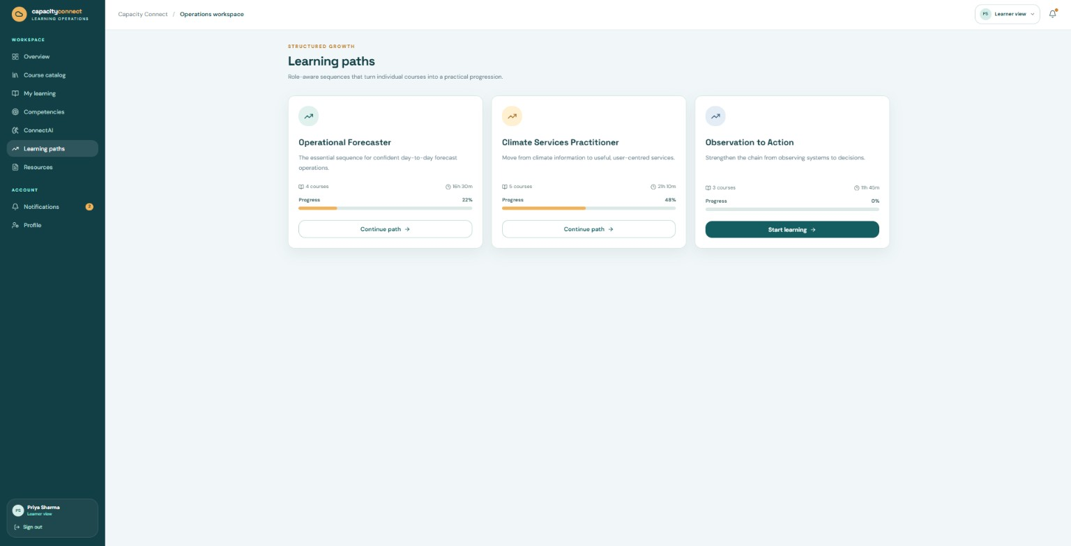
HACKSTREETGIRLS
RESEARCH AND REFERENCES
The prototype and presentation are mapped directly to the SIH26075 requirement set.
REQUIREMENT → PROTOTYPE MAPPING
PROTOTYPE SCREEN EVIDENCE
Trainee learning
Courses • resources • learning paths • progress
Competency development
Skill progress • competency profile • next-step recommendation
Knowledge sharing
Resources / content library concept
Role-aware platform
Trainee / Trainer / Admin modules in solution design
REFERENCES
TEAM 186386
HACKSTREETGIRLS
• Smart India Hackathon 2026 — Problem Statement SIH26075, Ministry of Earth Sciences (MoES), Theme: Smart Education.
• SIH 2026 Idea Presentation Format — supplied template (6-slide maximum; points/diagrams/infographics encouraged).
• Team prototype UI — Capacity Connect learner workspace screenshots supplied by HACKSTREETGIRLS.
@SIH Idea submission - Template
6

