Slide 1

Washington Metropolitan Area Transit Authority (WMATA)
White Paper solutions
Biswas Information Technology Solutions Inc., (BITS)
171 Elden St. Suite# 2C1
Herndon, VA 20170
www.b-itsinc.com
(BITS proprietary)

Slide 2
Agenda
Computer Vision
Use computer vision methodologies to accurately count the number of people on the train
Machine Learning
Create real-time predictive analytics from current data.
Create accurate models, so that we can use anomaly detection to detect accidents/delays

Slide 3
Computer Vision – How does it work
There are two major paradigms
  Static Image Detection
    Slightly simpler
    Less accurate
  Video Image Detection
    Requires more computing power
    Way more accurate

Slide 4
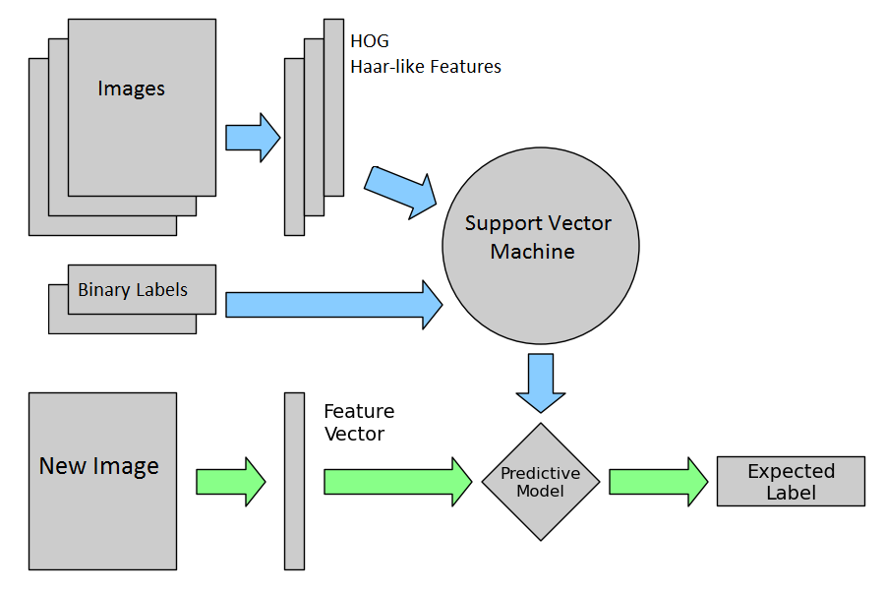
Static Image Detection
How it works:
  Split the data (of images) in Training/Test sets.
  Transform images with Histogram of Gradients (HOG) and Haar-like features
  Label the Images- 1 for person, 0 for non-person
  Use Support Vector Machines to train the binary classifier
  Sliding Window to detect people given a frame.

Slide 5
Transforming Images
All State-of-the-Art practices transform a given image. We transform images to detect “edges” or “outlines” of the object being classified.
Here are the standard approaches:
  Histogram of Gradients
  Haar-like Features

Slide 6
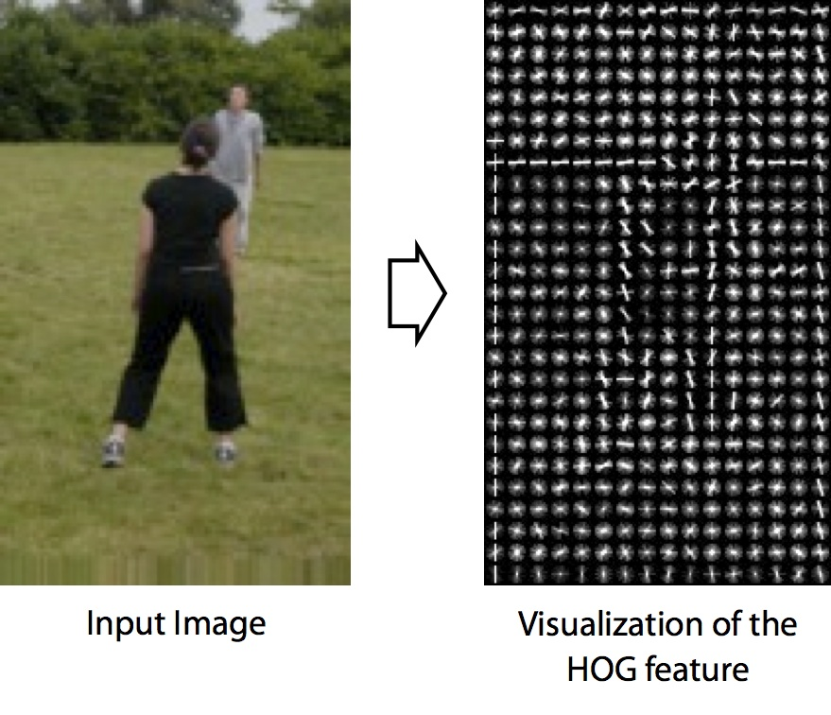
Histogram of Gradients

Slide 7
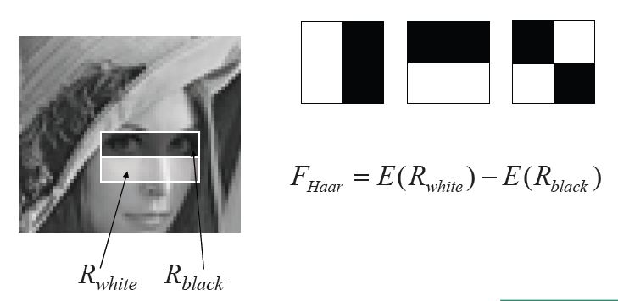
Haar-like Features

Slide 8

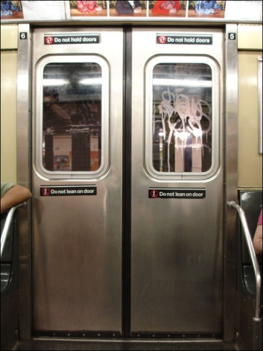
Binary Classification
1 (person)
0 (non-person)

Slide 9
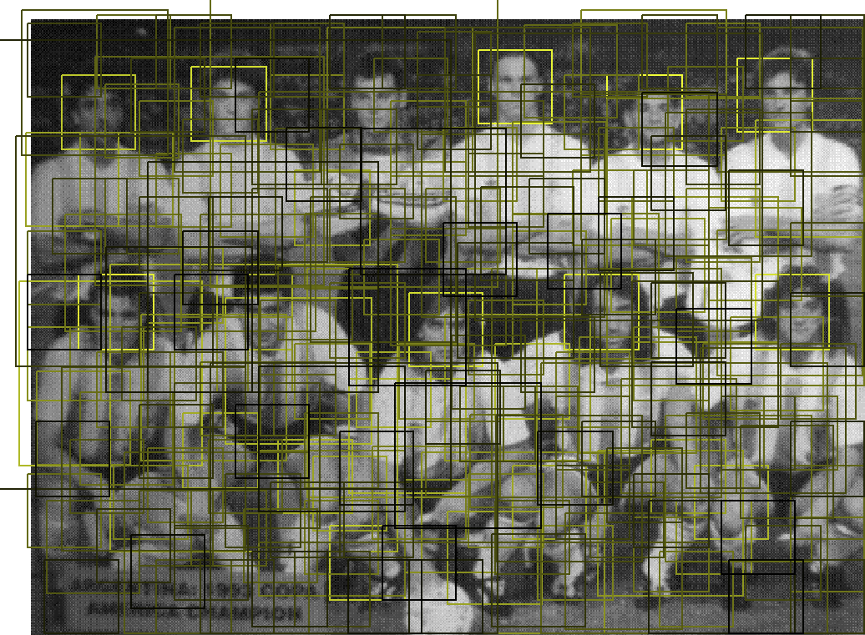
Sliding Window Detection
With our predictive model, now we take a small region in a larger image, and scan the whole image and count the total number of people

Slide 10
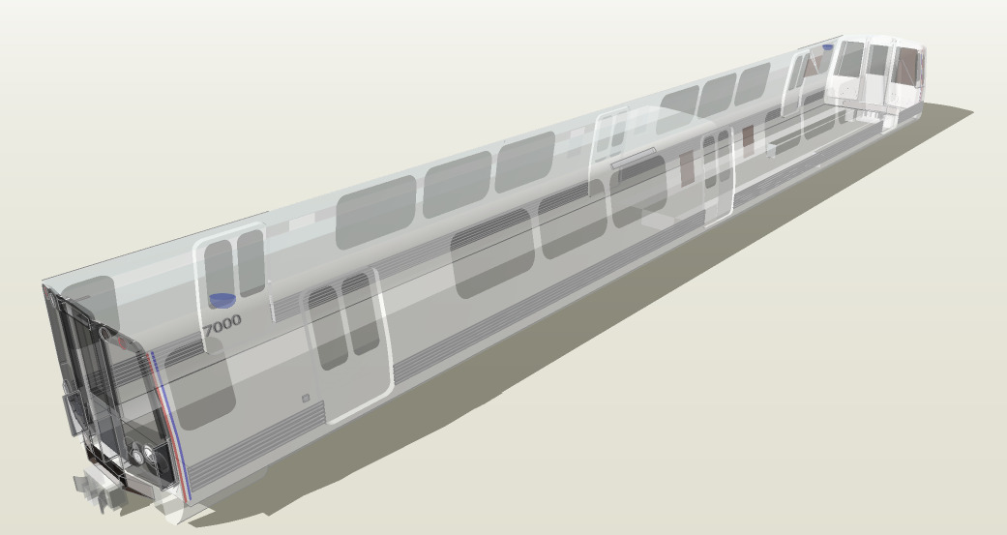
Our Solution for Static Images
Two cameras at opposite corners of the train
  1 pointed towards center
  1 pointed to a doorway
We are sampling areas that are likely to be crowded during peak hours

Slide 11
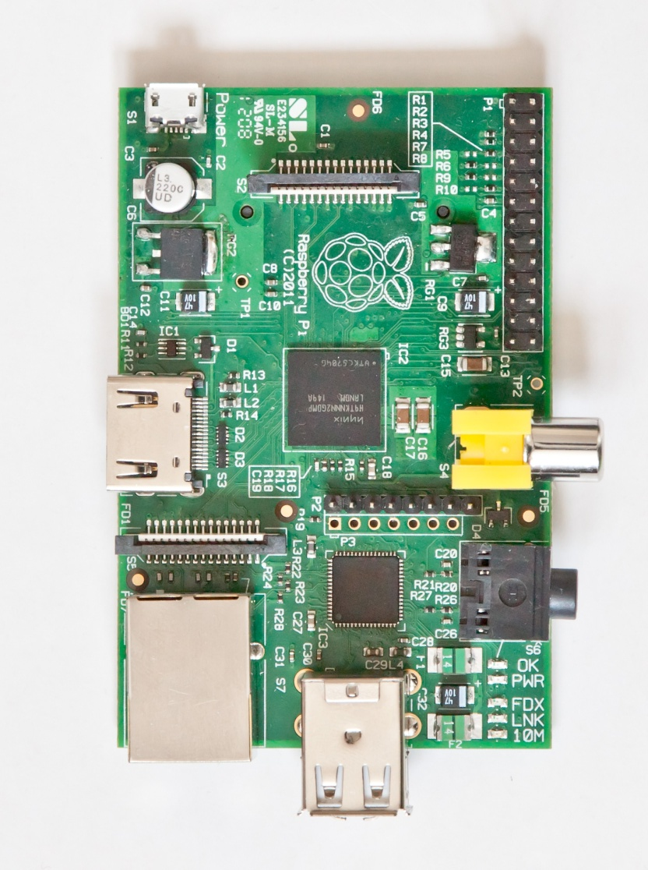
Concept Implementation
Use raspberry Pi’s or similar technology integrated into the train to
- Take the picture
- Create the features
- Predict the number of people on the train
- Wirelessly send the data to our database server

Slide 12
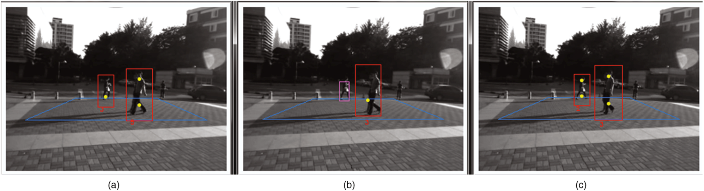
Video Image Detection
Detect differences between adjacent frames
Track objects from frame to frame
Count objects as they cross some threshold

Slide 13
Machine Learning - Predictive Analysis
Use Machine learning to create real-time predictive analytics from current data.
  Anomaly detection
  Congestion Flow Analysis
  Generalized Models for People Count

Slide 14
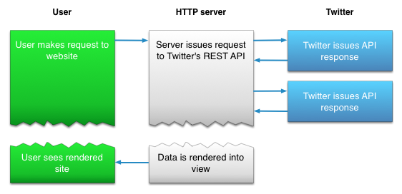
Machine Learning
Problem: Detect one-off anomalies from Social Media
Use Twitter’s Streaming API to look for one off accidents/issues needing attention.
This will vastly improve real-time monitoring services for WMATA

Slide 15
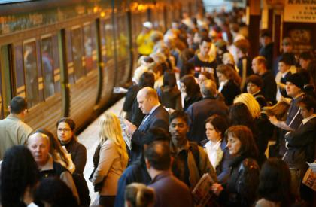
Congestion Flow Analysis
Problem: Predict the congestion in every train at every time
Given historical and real-time data from WMATA, we can create a congestion score.
These scores will be determined by subject matter experts
The scores will be labels for the classifier
Logistic Regression for future train congestion scores

Slide 16
Questions?

