Slide 1
Exploring Restaurants in Los Angeles

Slide 2
Business Direction : Two-fold
Goal : To investigate some relevant location factors by exploring the restaurants based in the various neighborhoods of LA. Could help answering the following -
Finding restaurants based on individual preferences. Could also help people looking for places to rent based on restaurant types or frequency
Corporations/individuals looking for an optimal location to set up a new restaurant

Slide 3
Plan Outline
Two ways of Clustering –
Segmenting neighborhoods based on the density of restaurants. Defining clusters with low, medium and high densities.
Segregation based on frequency of restaurants based on their type.
Combining the above two clusters and find intersections between to fine tune the location for the new restaurant.

Slide 4
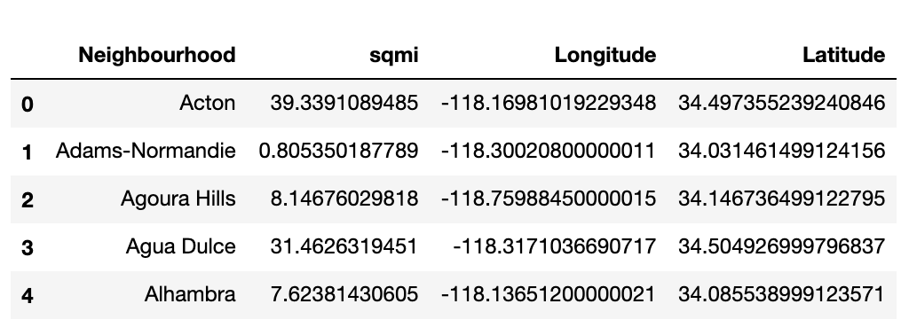
Data Source
A sample of the data
Link - https://usc.data.socrata.com/dataset/Los-Angeles-Neighborhood-Map/r8qd-yxsr.
Used the json file in the link above to gather neighborhood location data.

Slide 5
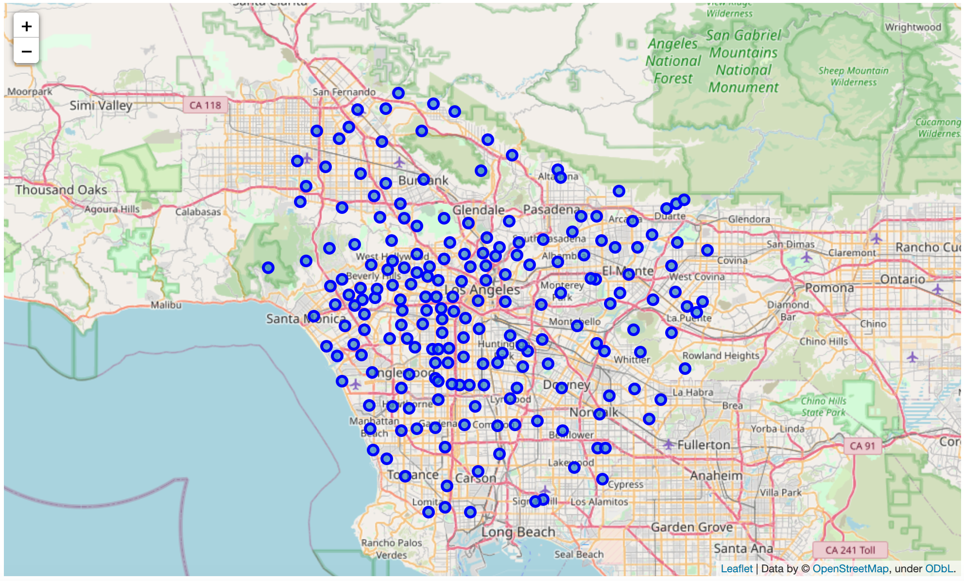
Neighborhoods in LA

Slide 6

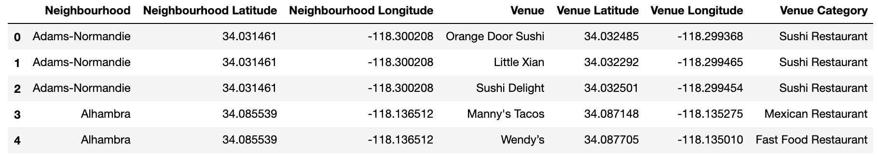
Retrieving venues
Foursquare location data was used for this purpose.
Only Restaurant venues were kept for further analysis.
A sample of the final data to analyze

Slide 7
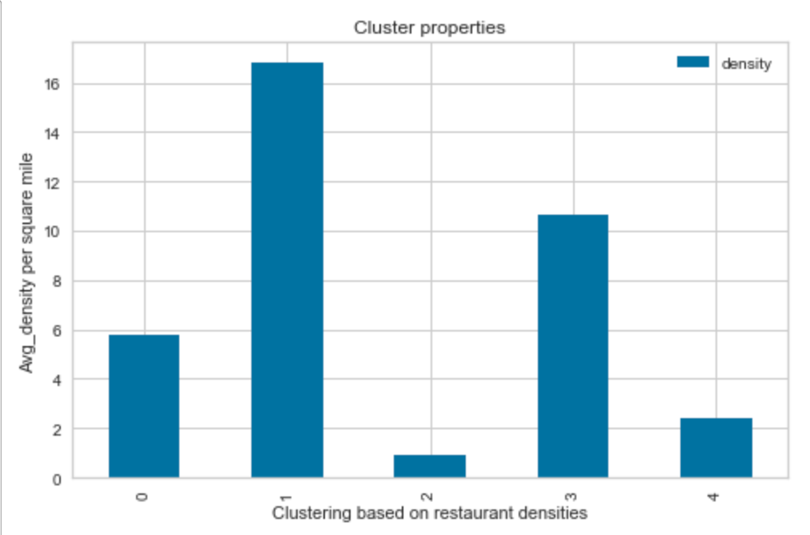
Clustering based on restaurant densities
high
high
medium
medium
low

Slide 8
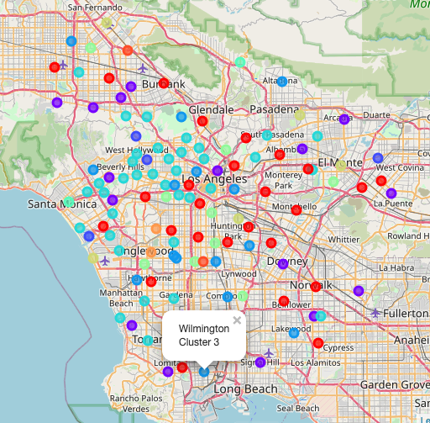
Clustering based on frequency
Neighborhoods segregated into 10 clusters

Slide 9
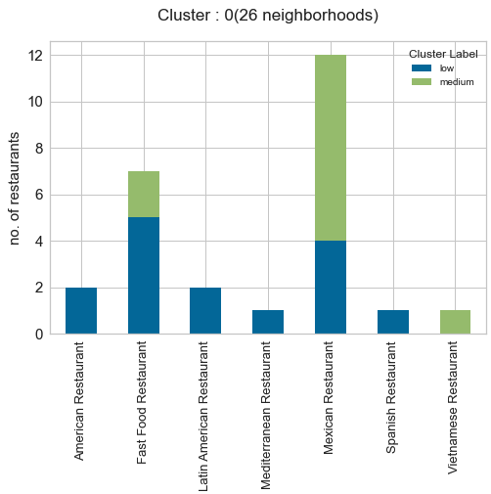
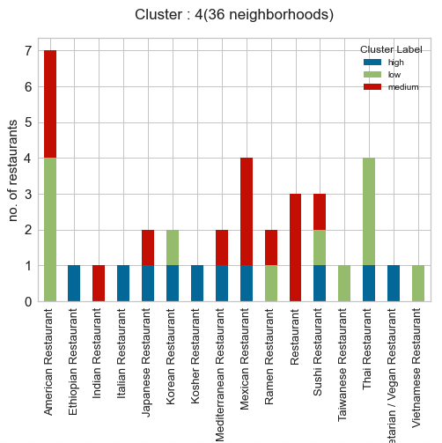
Results

Slide 10
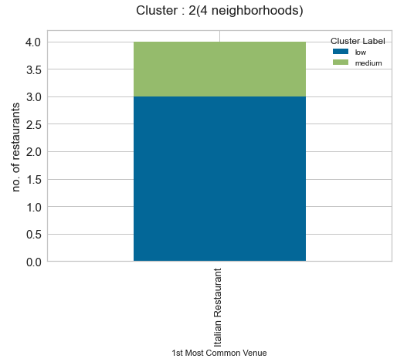
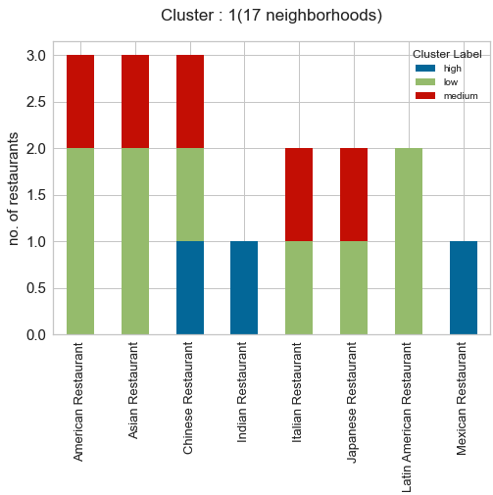
Example : Setting up an Italian restaurant
N
Could certainly avoid Cluster 2. Low density regions could mean less popular.
Cluster 1 is a good option. Diverse option of cuisines (could correspond to a diverse audience in the vicinity)
Only 2 Italian restaurants one each in medium and low-density regions - good tradeoff between competition and popularity.

Slide 11
Conclusion
Similar conclusions can be derived for other restaurants as well.
One can also look at the second most common venues to gain some additional information about the clusters.
A follow up analysis could also be looking at the distance of a particular restaurant from neighborhood center and cluster regions based on their proximity to a particular kind of restaurant.
Further, one can look at things like distance from public transport, availability of parking lots, population, etc.

