Slide 1

Machine Learning Project
Presented to: Prof. Claudio Sartori
Presented By: Jyoti Yadav
Academic Year: 2021-2022

Slide 2

What is Instacart?
Instacart is an American company that provides grocery delivery and pick-up service. The Company operates in the U.S and Canada. Instacart offers its services via a website and mobile app. Unlike another E-commerce website providing products directly from Seller to Customer. Instacart allows users to buy products from participating vendors. And this shopping is done by a Personal Shopper. The company is expanding its platform to cover 90 millions US household in 2018.
Notes:
Ordering food supplies online is a new way of restocking groceries and other essential items. Be it early morning or midnight, ordering groceries online is stress-free activity without much hassle. But what happens when you forget few items while adding items to the cart or want to get better suggestions on your items? Will you wait for a couple of hours and then order? To deal with such situations, users are provided with suggestions based on their past orders or user preferences.

Slide 3
Outline
1. Problem Overview
3. Machine learning Problem
7. Creating Training and Testing data
8. Modeling Building
9. Evaluation Metrics
10. Threshold
11. Conclusion
2. Data Source
6. Feature Engineering
4. Performance Metrics
5. Exploratory data Analysis

Slide 4
Problem Overview
The main objective of this competition was to predict which previously purchased products will be in the user’s next order. The problem is a little different from the general recommendation problem, in this case, we are not recommending new products to the user instead of that we are going to recommend the product which is previously bought by that user. This will also help Instacart to help local vendors with their retail business by reminding them to restock items which are bought frequently.

Slide 5
Data Source
The dataset is available on the Kaggle Here.
The dataset for this competition is a relational set of files describing customers' orders over time. The dataset is anonymized and contains a sample of over 3 million grocery orders from more than 200,000 Instacart users. For each user, we provide between 4 and 100 of their orders, with the sequence of products purchased in each order. We also provide the week and hour of day the order was placed, and a relative measure of time between orders.

Slide 6
File Descriptions
orders.csv - It consists of order placed by any user. The eval_set column has three categories prior, train and test.
Prior data- Order history of every user . This data contains nearly 4–100 past orders per user.
Train data- Current order data of every user . This data contains only 1 order per user.
Test data- These are the orders which will be done in future and we have to predict the products which might be reordered.
Products.csv-It consists of details of the products.
order_products__prior.csv - consists of all product details for any prior order.
order_products__train.csv - consists of all product details for a train order.
department.csv - details of department
aisles.csv - details of aisle

Slide 7
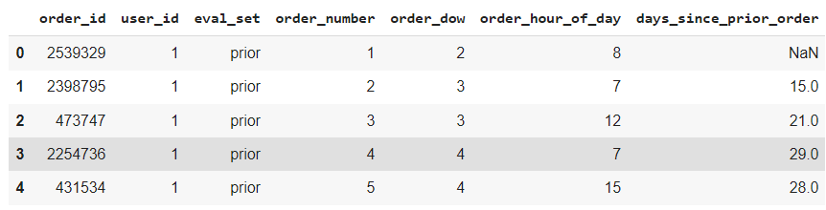
Orders.csv
Order_id : Unique for every order
User_id : Unique for every user
Eval_set : ( prior / train / test)
Order_number : ith order placed by user
Order_dow : Day of week
Order_hour_of_day : Time of day in hr
Days_since_prior_order : difference in days between 2 orders

Slide 8
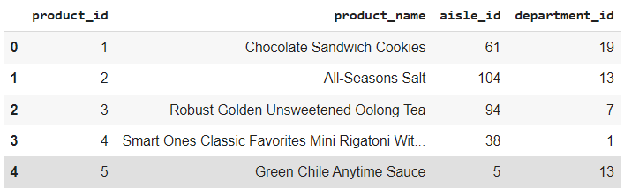
Products.csv
Here for each product, we have a unique product Id along with its name and aisle id, department id it belong to.

Slide 9
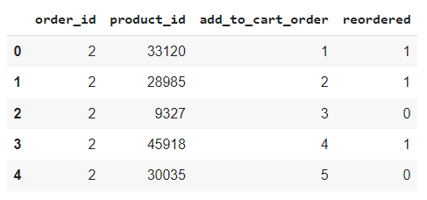
orders_products_prior.csv
Orders_products_prior contains the details of previous products.
order_id : Unique order id for every order
product_id : product ID of item
add_to_cart_order : denotes the sequence in which products were added to cart.
reordered : product is reordered Every row in this table is defining that for each order id, what is the product id (items) ordered in it and whether it is a reordered item for that user or not by reordered column. 1 stands for item is reordered and 0 for 1st time order.

Slide 10
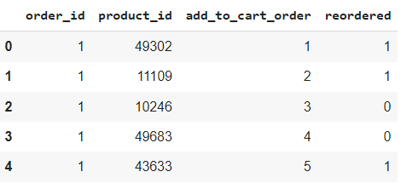
orders_products_train.csv
Same as orders_products_prior table except it is for current order to train on.

Slide 11
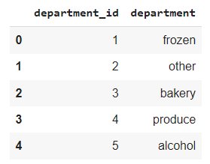
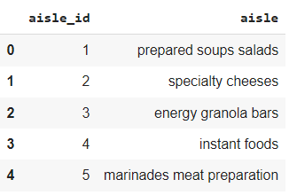
Department.csv Aisle.csv
department_id : department ID of item
department_name : name of department
aisle_id : aisle ID of item​
aisle_name : name of aisle​ ​

Slide 12
Machine learning problem
We can pose it as a classification problem where given a customer and their previous orders, we have to predict if a product will be in his/her next order or not.
It could have also be posed as a multi label classification problem but there are 49688 products, and total product recommendations could be anywhere from None to N
But as we are having huge number of products we will stick to binary classification approach. So, basically we have to predict reordered column of the data as target variable. So, for every order id we will classify each product against it as reordered or not.
Notes:
So how do we approach to this problem ?

Slide 13
Performance Metrics
The Kaggle evaluation metrics will be mean F1-Score. The F1 score can be interpreted as a harmonic mean of the precision and recall, where an F1 score reaches its best value at 1 and worst score at 0. The relative contribution of precision and recall to the F1 score are equal. The formula for the F1 score is F1 = 2 * (precision * recall) / (precision + recall)
For each orderid in the test set, we should predict a space-delimited list of productids for that order. If we wish to predict an empty order, we should submit an explicit 'None' value. You may combine 'None' with product_ids. The spelling of 'None' is case sensitive in the scoring metric. The file should have a header and look like the following:
Order_id,products 17,1,2 34,None 137,1,2,3 etc.
Notes:
Not the accuracy as the accuracy is the inappropriate measure for unbalanced dataset

Slide 14
EDA- Exploratory data analysis
EDA is an important aspect of any machine learning or data science problem. It helps get insights in data through proper examination and is very important because it exposes trends, patterns, and relationships that are not readily apparent. In this part of Instacart market basket analysis we will understand the problem statement and do EDA on the data to further explore the techniques to solve it.
Checking the missing/Null Values
In the orders.csv - only days_since_prior_order coloumn has null values in orders dataframe. Removing/modifying the null values is not helpful in our classification task. After analysis I came to conclusion that all nulls in ‘days_since_prior_order’ column are present because they are 1st orders for any user. We will later impute them with value 0.

Slide 15
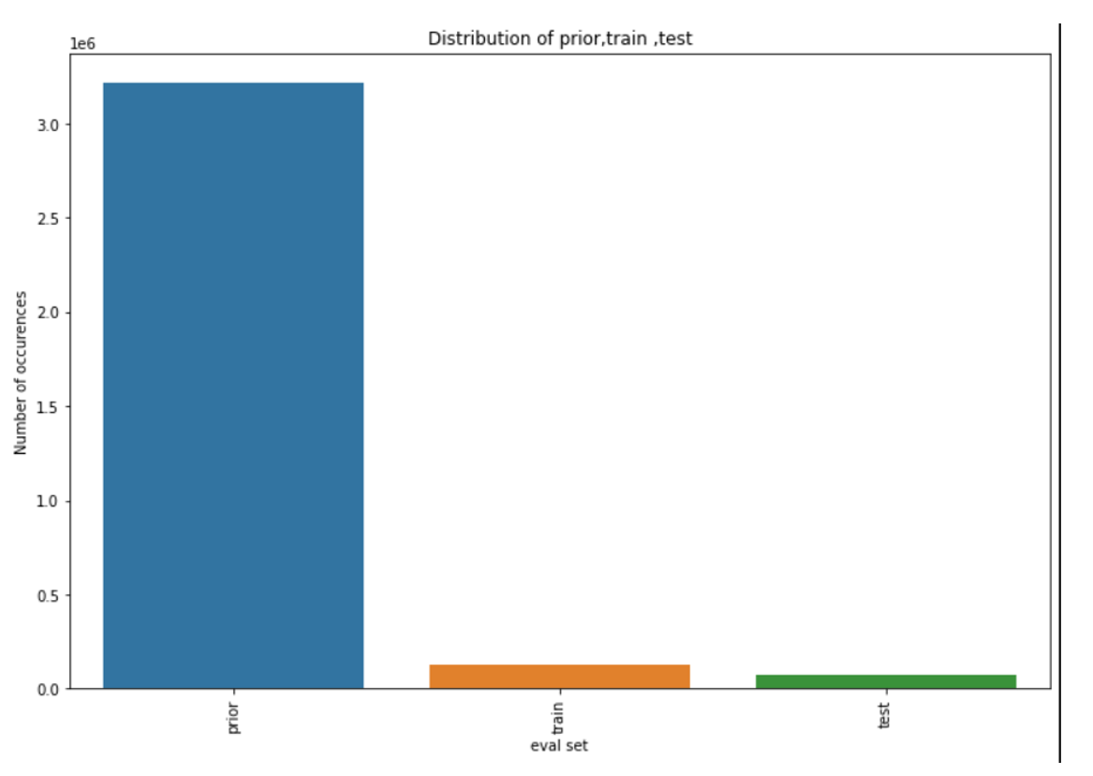
In depth EDA and problem formulation
Let's first look at the distribution of train test and prior Prior: 3214874 data points Train: 131209 data points Test: 75000 data points

Slide 16
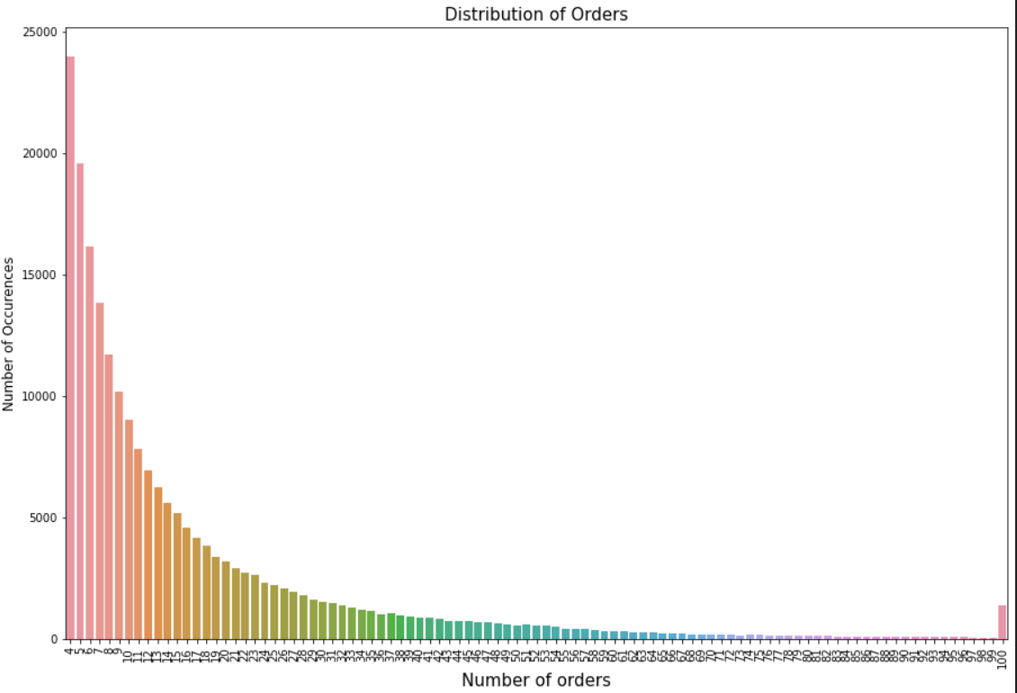
Let's check the Frequency Of Order Number Amongst The Users? Generally, how many orders a user place?
This plot explains, What’s the order count for each user? There is a high peak at 4,5,6,7&8 which tells us that users mostly orders 4 to 8 products in every order.

Slide 17
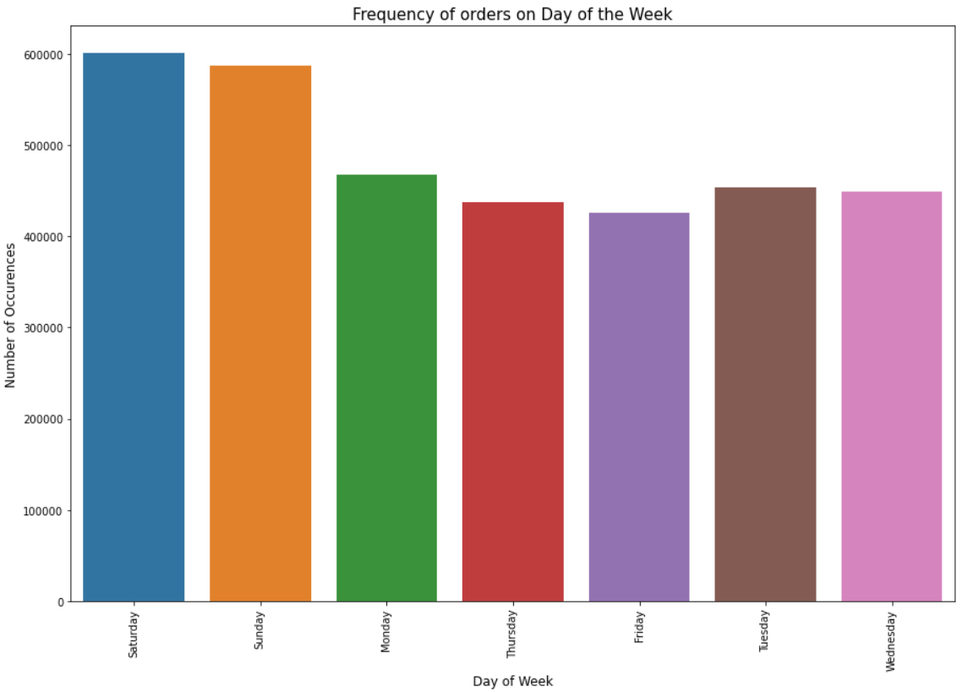
What Day Of The Week User Placed The Order?
There are 7 days in a week most of the time user placed order on that starting days of the week i.e is on Saturday and Sunday where most of the users are free on that day and have time to place the orders
Since after two days of the week frequency decreased a bit

Slide 18
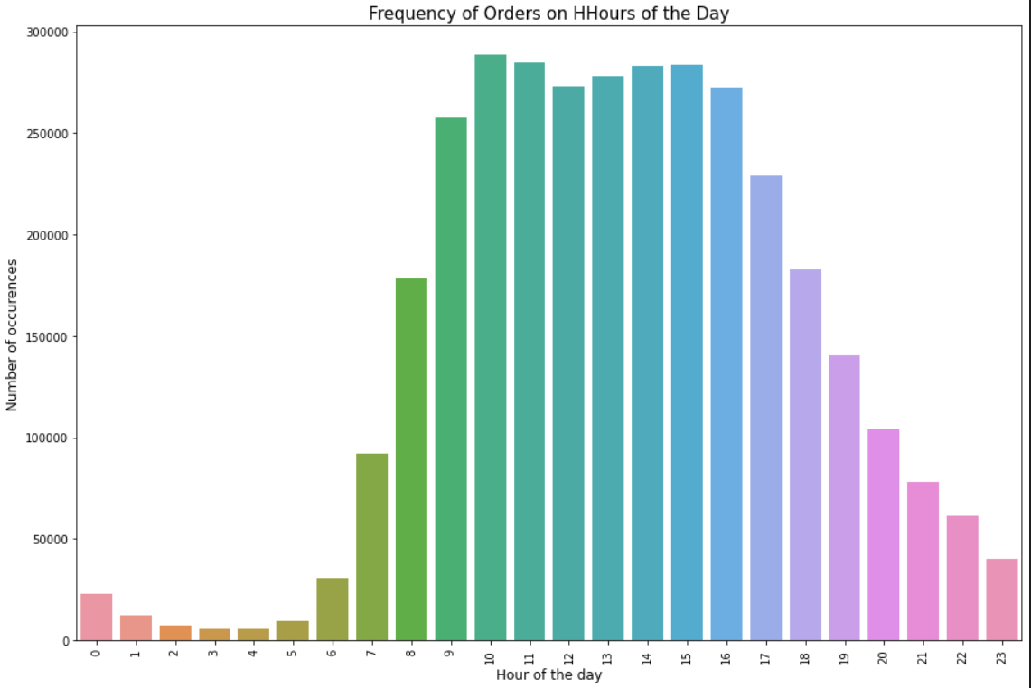
In which hour user place the order
This plot tells us what’s the user’s preferred time for placing an order?. There are high peaks in the morning hours and it slowly gets decreases. Between 10 am to 15 pm there is a high order ratio amongst users

Slide 19
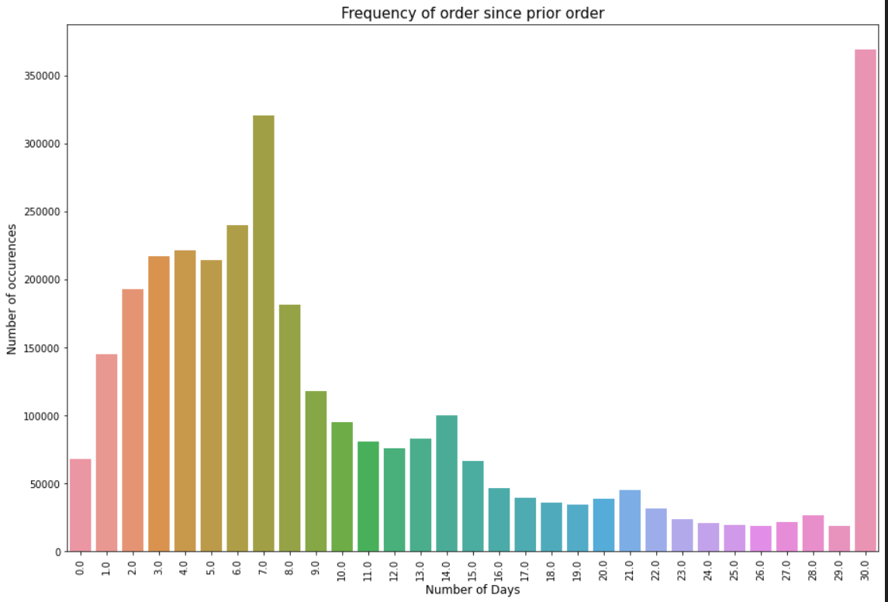
How Many Days The User Takes To Place an Order?
After placing an order, how many days a user takes to order again?.
Usually, there is a gap of 7 days after each order. If you see carefully there is a high peak on the 7th day and after that on the 14th day and then at end of the month. The user takes a week to order once again.

Slide 20
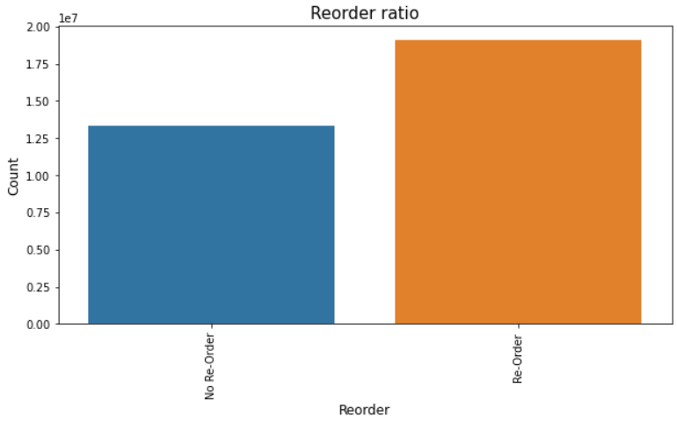
How many times user have reorder the same item?
It was observed most of the time user reorder the same item.
Notes:
Let's merge the datasets by their primaryID's in order to find out the Products,Aisle and Department and explore the behaviour of customers towards their orders

Slide 21
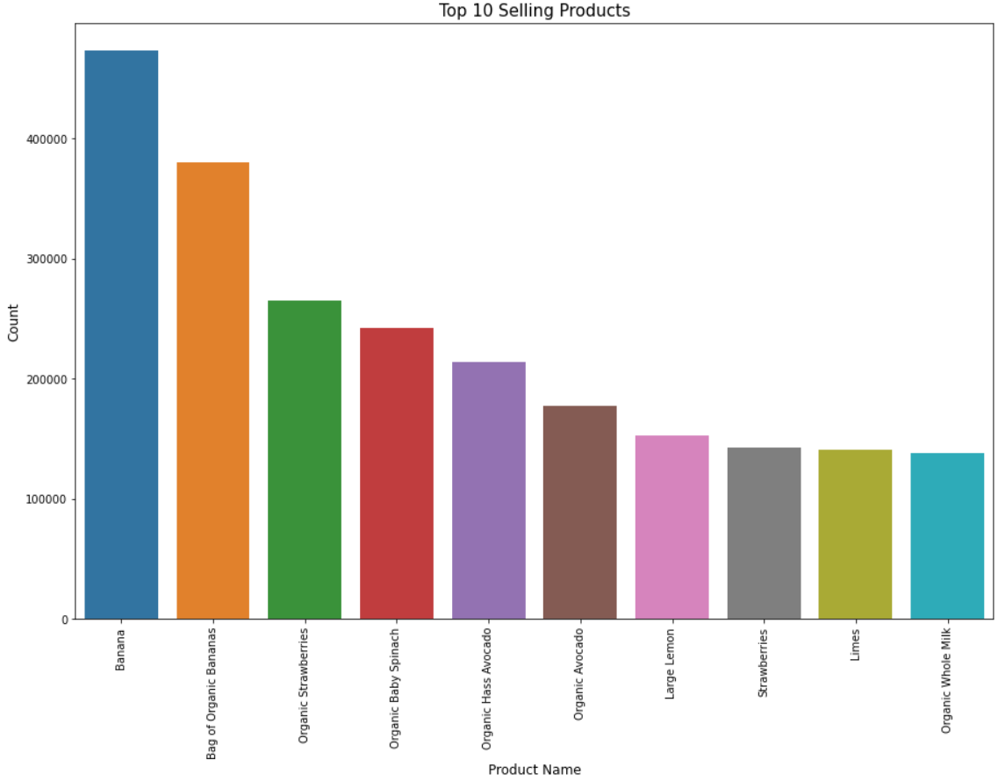
Top 10 selling and reordered items and also which item user added to the cart first
These are the top 10 selling products. We can clearly observe from the bar plot that the top most selling product is Banana and Organic Banana Chips.
Notes:
Banana ,organic banana chips , organic strawberries .

Slide 22
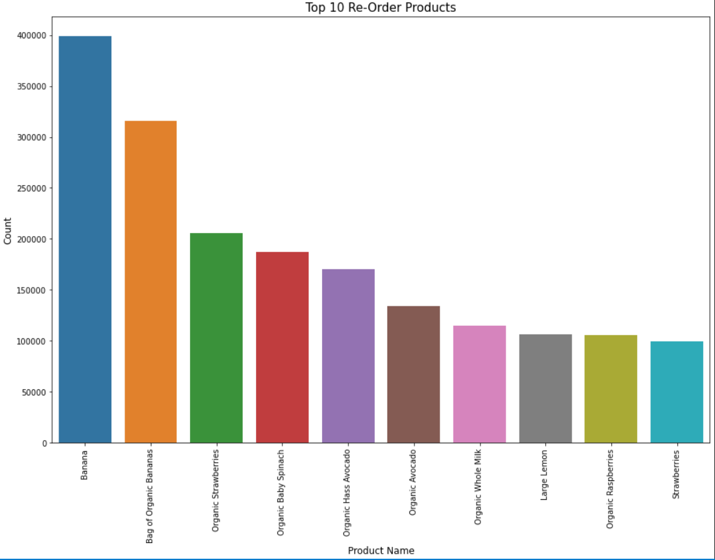
Top 10 Reordered products
There is high peak on banana and organic banana chips looks like that that is most loving product and reorder products among users.

Slide 23
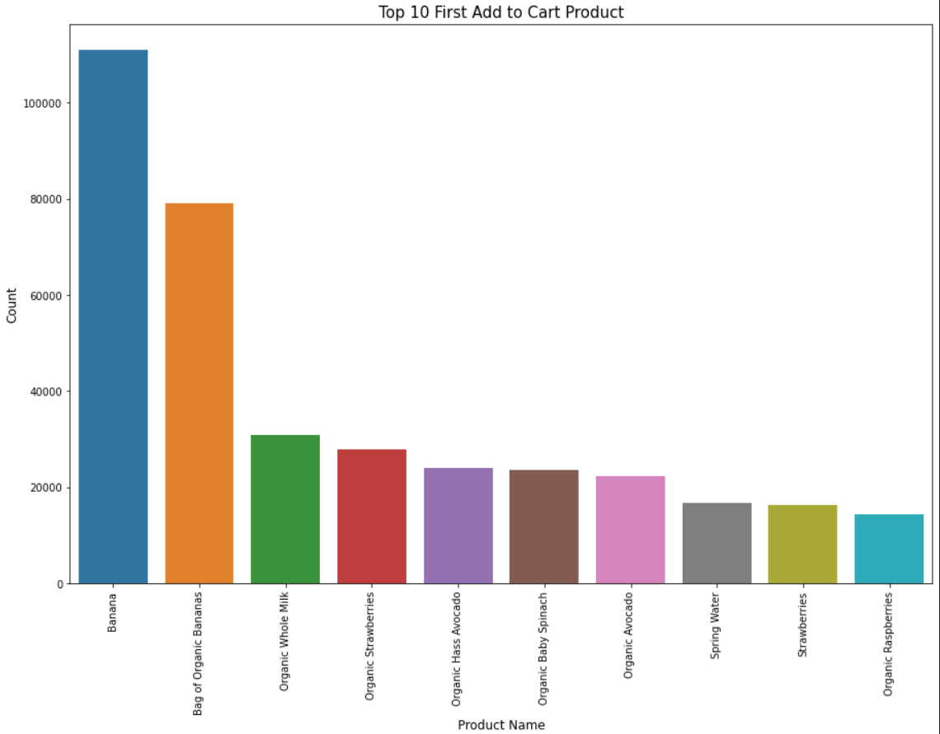
Top 10 First Add to Cart Product
Top selling, reordered and First product add to cart order product is Banana. From all this plot, the demand for produce product are high than any other Department.
Notes:
So it is clearly observed that top 10 selling products and 10 re-order product is almost same. If you see above 3 plots, all plots are almost same.

Slide 24
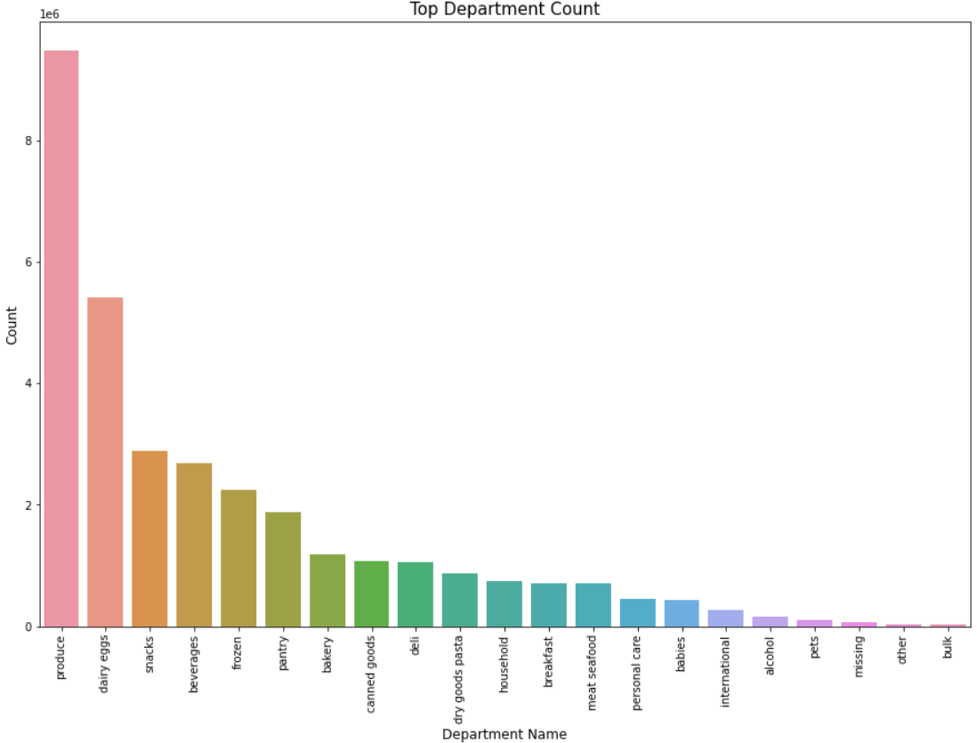
Let's look at the distribution of Top departments
As the First 2 Department are most important for any users because the Produce Department are about farm, crops and fruits and eggs are essential for the breakfast.

Slide 25
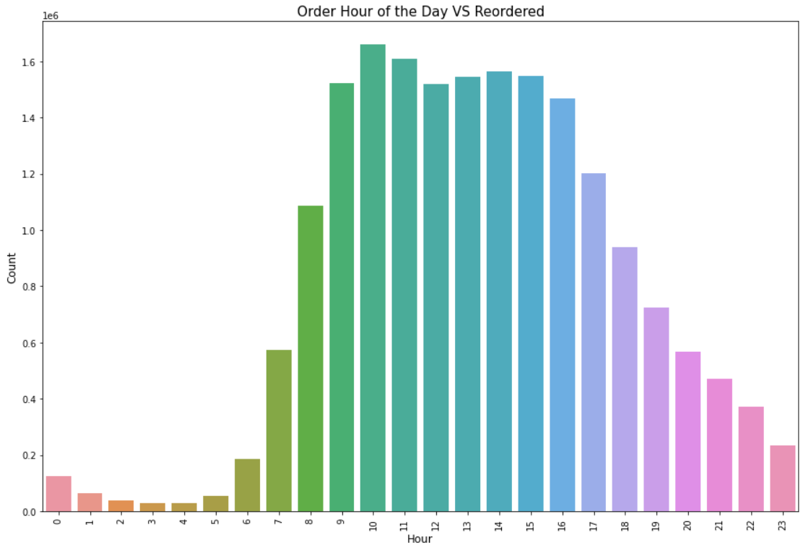
At what time user place the order again
Here I plot at what time most reordered products are placed. Most of the orders are placed between 8'0 clock in the morning and 5'0 clock in the evening.
This plot is almost same as Frequency of the order day. It shows user tends to order/reorder between this hours.

Slide 26
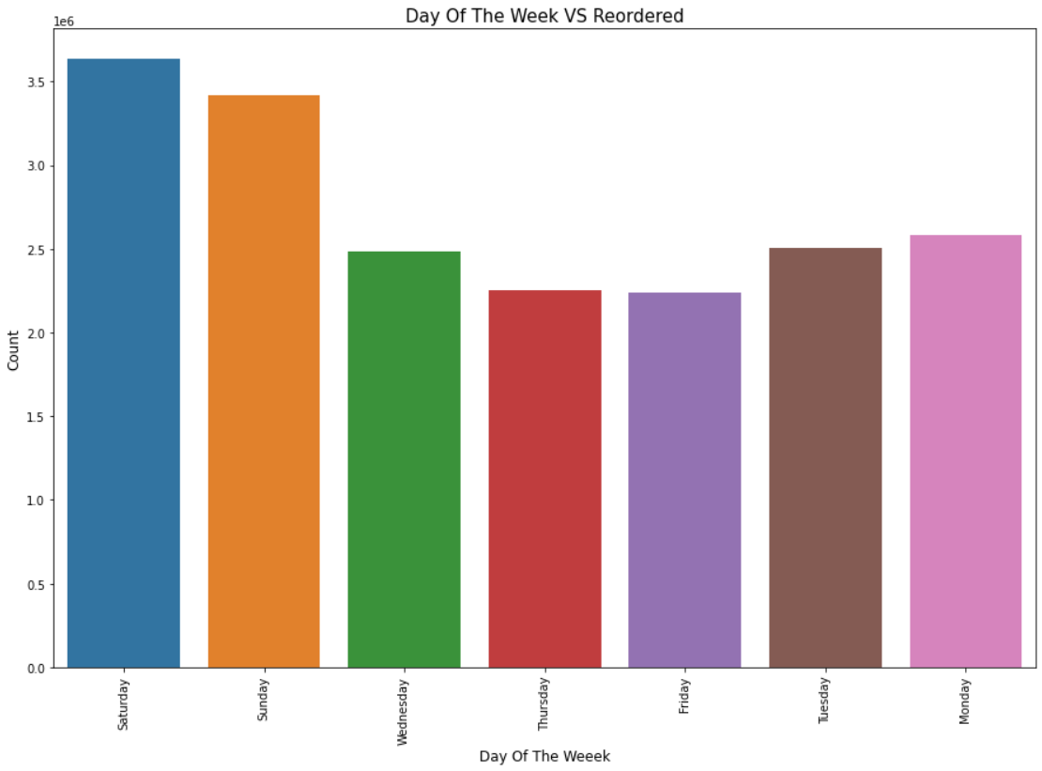
At what Day Most User place order again?
It was observed usually the people place the order again on weekends i.e on Saturday and Sunday.
The Order and Re-Order ration are almost same. The user tends to place order again on Saturday and Sunday.
Saturday and Sunday have the high ratio of Order/Re-Order getting placed.

Slide 27
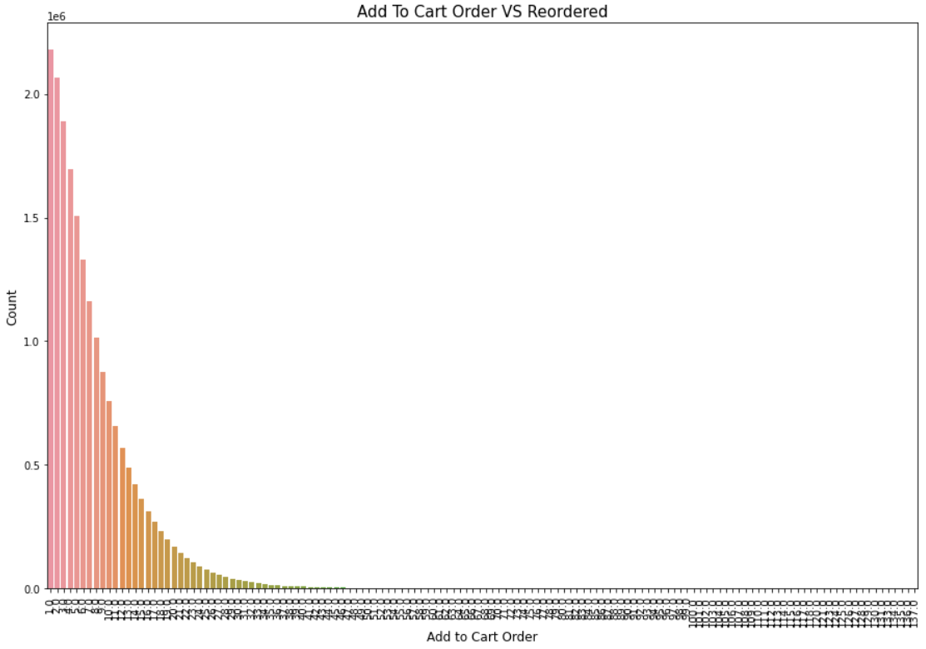
Add To Cart Order VS Reordered
The order which are added at 1th and 4th position in the cart have high chance of Re-Order by users

Slide 28
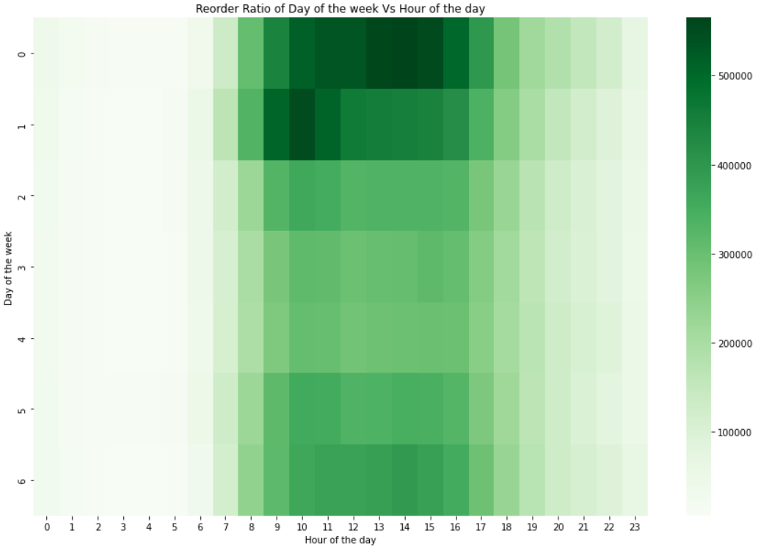
Reorder Ratio of Day of the Week Vs Hour of the Day
This Heatmap tells everything, Lot of users place order on Saturday and Sunday in between 10'clock to 15'clock.

Slide 29
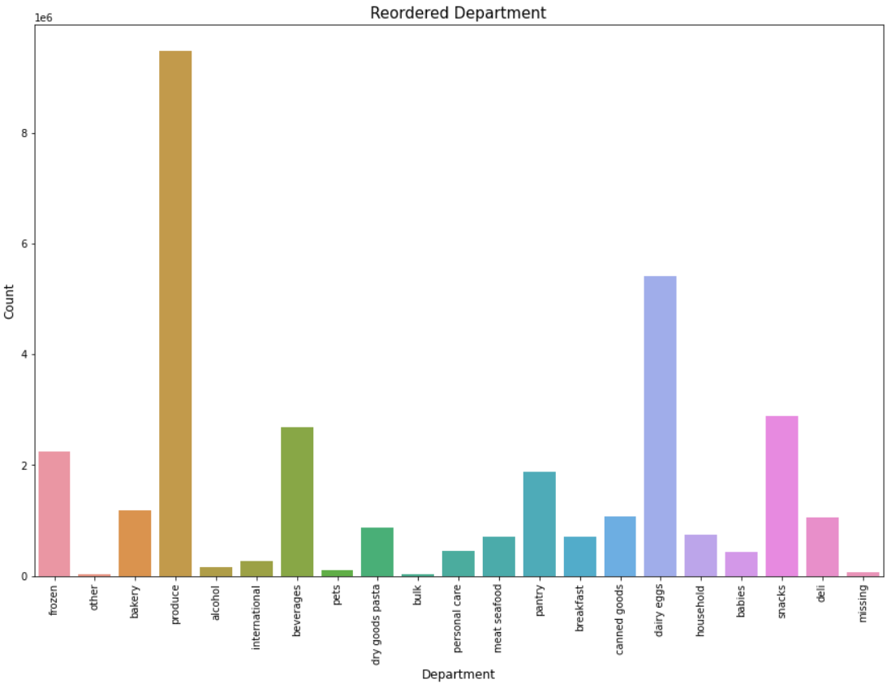
Top Reordered Department
Most Users reorder from Produce and Dairy Eggs Department as they are essential for every day that's why they have high peak than any other department.

Slide 30
Feature Engineering
1. user features
2. product features
3. user product interaction features

Slide 31
Users features
1. Taking the maximum of the order numbers placed by each user .
2. Average number of products bought in each orders.
3. Day of the week the users orders the most.
4. Hour of the day the user has placed most of the orders.
5. Reordered ratio of each user.
6. Average days since prior order.
7. Total items bought by user.
8. Merging all the created features into the users dataset.

Slide 32
Product Features
1. Number of times the product has been purchased by the users.
2. Reorder ratio of each products. .
3. Average add to cart order for each product.
4. Merging all the created features into the prd dataset.

Slide 33
User product interaction features
1. How many times a User has bought a product.
2. How many times a user bought a product after its first purchase.
3. Finding when the user has bought a product for the first time.
4. Merging all the created features into the uxp dataset.
5. How many times a customer bought a product on its last 5 orders.
6. product bought by users in the last_five orders.
7. Ratio of the products bought in the last_five orders.

Slide 34

Training and Testing
We split the data using the train_test_split into 70% Training and 30% Testing with the random state of 10.

Slide 35
Model Building
The models used for Binary classification problems are : 1. Logistic Regression
2. Decision Trees
3. Random Forest Classifier
4. XGBoost

Slide 36

Threshold
In order to choose a threshold value Let's do some analysis by checking the range of threshold values (0.18,0.19,0.21).It was observed the threshold greater than 0.21 is giving good F1 score.

Slide 37
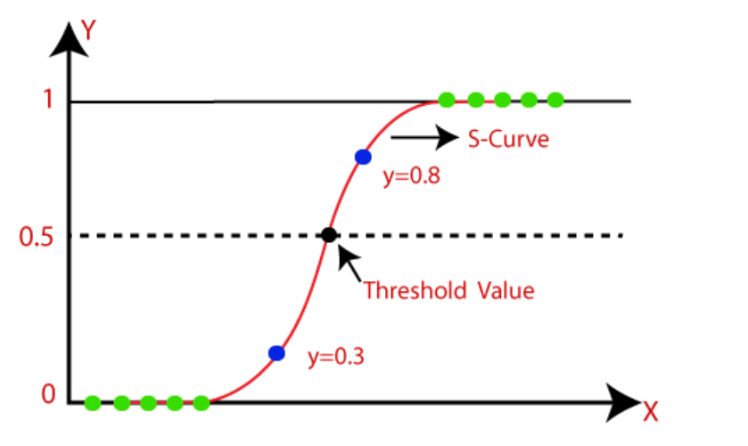
Logistic Regression
Classification algorithm
predicts the output of a categorical dependent variable(Yes/No).
It gives the probabilistic values which lie between 0 and 1.
It uses the sigmoid function

Slide 38
Results and Observations
Accuracy: 0.75
Precision for 0 class: 0.81
Precision for 1 class: 0.36
Recall for 0 class: 0.89
Recall for 1 class: 0.23
F1 score for 0 class: 0.85
F1 score for 1 class: 0.28

Slide 39
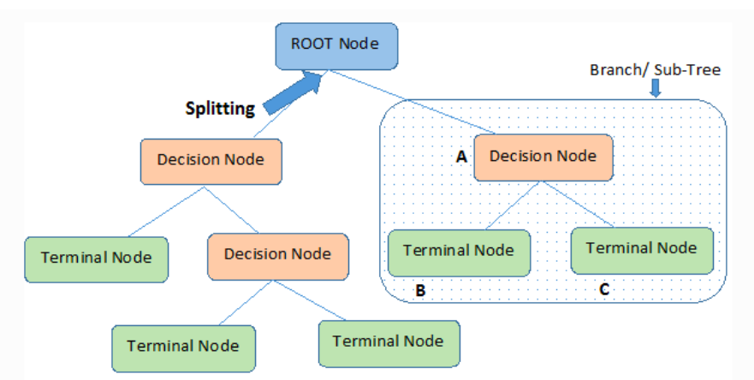
Decision Trees
Classification and Regression problems
Predicting the categorical target variable
Best parameter - RandomizedSearchCV

Slide 40
Results and Observations
Accuracy: 0.83
Precision for 0 class: 0.91
Precision for 1 class: 0.34
Recall for 0 class: 0.90
Recall for 1 class: 0.37
F1 score for 0 class: 0.91
F1 score for 1 class: 0.35

Slide 41
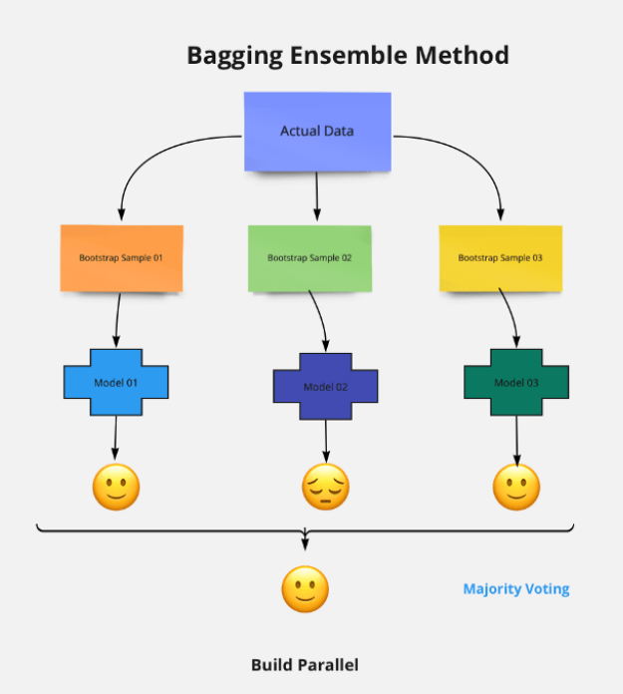
Random Forest Classifier
Classification and Regression Problems
Predicting categorical and continuous variables
Ensemble technique - Bagging
CalibratedClassifierCV

Slide 42
Results and Observations
Accuracy: 0.83
Precision for 0 class: 0.90
Precision for 1 class: 0.39
Recall for 0 class: 0.91
Recall for 1 class: 0.38
F1 score for 0 class: 0.91
F1 score for 1 class: 0.39

Slide 43
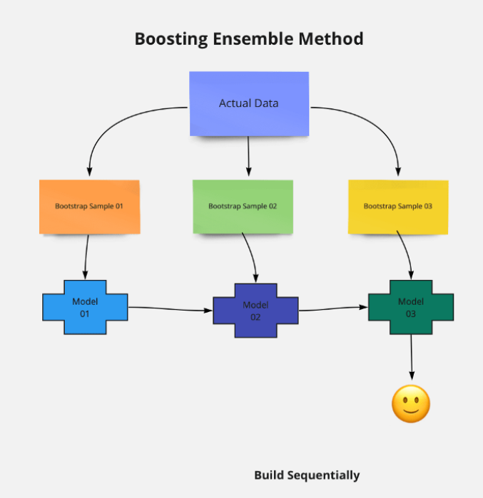
XGBoost Classifier
Classification and Regression Problems
Extreme Gradient Boosting
speed and Performance
XGBClassifier

Slide 44
Results and Observations
Accuracy: 0.80
Precision for 0 class: 0.86
Precision for 1 class: 0.46
Recall for 0 class: 0.91
Recall for 1 class: 0.34
F1 score for 0 class: 0.89
F1 score for 1 class: 0.39

Slide 45
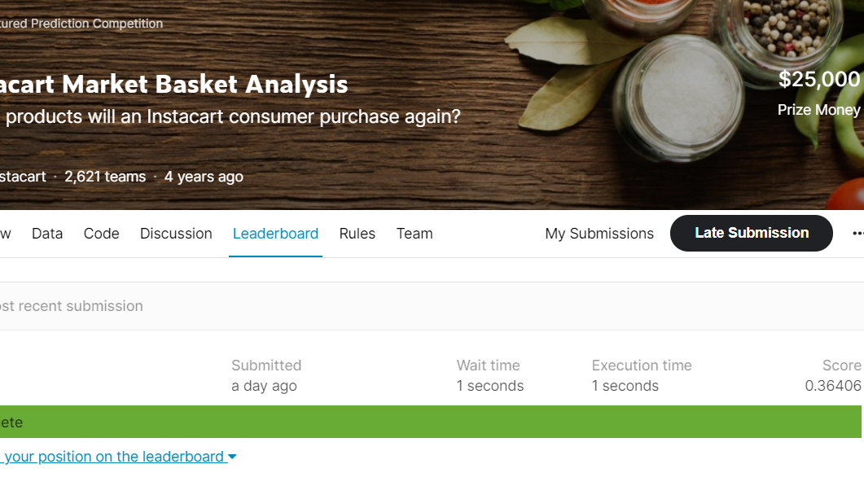
Conclusions
Best Performer - XGBoost & Random Forest
Worst Performer - Logistic Regression

