Slide 1
ICT - Semester 7
NATURAL LANGUAGE PROCESSING (20IC403T)

Slide 2
Syllabus:
UNIT-1: OVERVIEW OF NLP
Basics of Speech Processing; Place and Manner of Articulation; Word Boundary Detection; Argmax based computations; HMM and Speech Recognition, Language Structure and Analyzer - Overview of language, requirement of computational grammar. Words and their Analysis. Tokenization. Stemming. Morphological Analysis. POS tagging.
UNIT 2 CORPUS AND DATASETS
Corpus, need for corpus, corpus analysis, types of data attributes, Categorical or qualitative data attributes, Numeric or quantitative data attributes, different file formats for corpora, dataset preparation for NLP applications.
UNIT 3 SENTENCE STRUCTURE AND PROCESSING
NLP components, understanding, Morphological analysis, syntactic analysis, Semantic analysis, ambiguity handling, pragmatic analysis, Handling corpus-raw text, sentences, pre-processing.
UNIT 4 FEATURE EXTRACTION AND ADVANCED ALGORITHMS
Parsers and parsing, POS tagging and POS taggers, Name entity recognition, n-grams, bag of words, semantic tools and resources, probabilistic theory for NLP, TF-IDF, Vectorization, Encoders and decoders, normalization, Recall word embedding, Algorithms used by neural networks, Rule-Based System for NLP, Machine Learning for NLP Problems, Deep learning for NLP, case studies.
Some of the above topics would be covered through the associated laboratory course. Teaching Scheme:
L | T | P | C | Hrs./Week | Theory |  |  | Practical |  | Total Marks
 |  |  |  |  | MS | ES | IA | LW | LE/Viva
2 | 0 | 0 | 2 | 2 | 25 | 50 | 25 | -- | -- | 100

Slide 3
Pre-requisite:
  Probability and Statistics
  Machine Learning
  Deep Learning
    Some Topics are covered here at required level

Slide 4
Reference Books (Theory):
      Jurafsky, Daniel, and James H. Martin, Speech and Language Processing: An Introduction to Natural Language Processing, Speech Recognition, and Computational Linguistics, Prentice Hall. 2026 Edition.
Yoav Goldberg, Graeme Hirst. Neural Network Methods in Natural Language Processing, Morgan & Claypool Publishers.
Kamath, Uday, et al. Large Language Models: A Deep Dive.
Reference Book (Hands-on Practical):
Bird, Steven, Ewan Klein, and Edward Loper. Natural language processing with Python: analyzing text with the natural language toolkit. O'Reilly Media, Inc.
Thanaki, Jalaj. Python natural language processing. Packt Publishing Ltd.
Alammar, J., & Grootendorst, M. Hands-On Large Language Models, O'Reilly.
Online Video Course and Support Materials:
NPTEL Course: Deep Learning for Natural Language Processing, IIT Kharagpur, Prof. Pawan Goyal
  https://nptel.ac.in/courses/108105572
  https://sites.google.com/view/dl4nlp-nptel/home

Slide 5
UNIT 1
OVERVIEW OF NLP
NATURAL LANGUAGE PROCESSING
ICT - Semester 7

Slide 6
Introduction to NLP

Slide 7
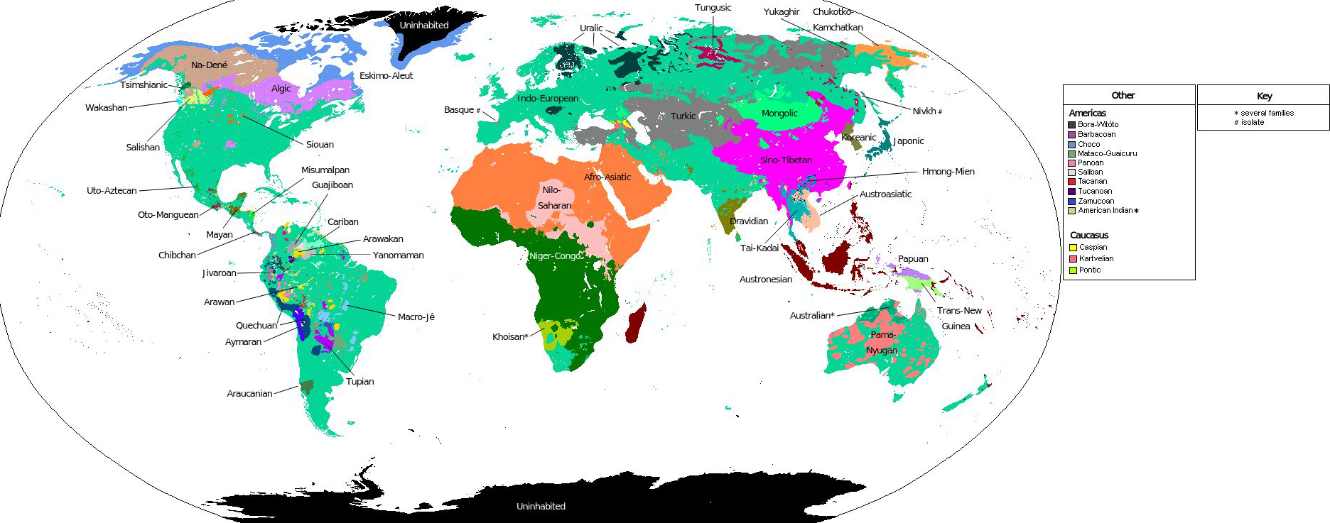
What is Natural Language?
Natural Languages: Languages that evolved naturally through human use

Slide 8
What is NLP?
NLP:
  Making computers understand what we write (or speak)
  Making computers write (and speak)
Allows computers to interpret, manipulate, and comprehend human language.
The field of NLP attempts to design, implement and test systems that process natural languages for practical applications like text translation, text summarization, speech to text conversion, chatbots etc.
Conventional NLP refers to the rule-based and statistical approaches to processing human language.
Now it is a subfield of Artificial Intelligence used to aid computers in understanding natural human language.
Most NLP techniques rely on machine learning/deep learning/reinforcement learning to derive meaning from human languages
Deep learning–based NLP refers to approaches that use neural networks—particularly deep architectures like recurrent, convolutional, and transformer models—to process and understand human language.

Slide 9
NLP Tasks
Sentiment Analysis
Machine Translation
Text Classification
Text Summarization
Question Answering
Text Entailment
Named Entity Recognition (NER)
Chatbots
Language Modeling

Slide 10
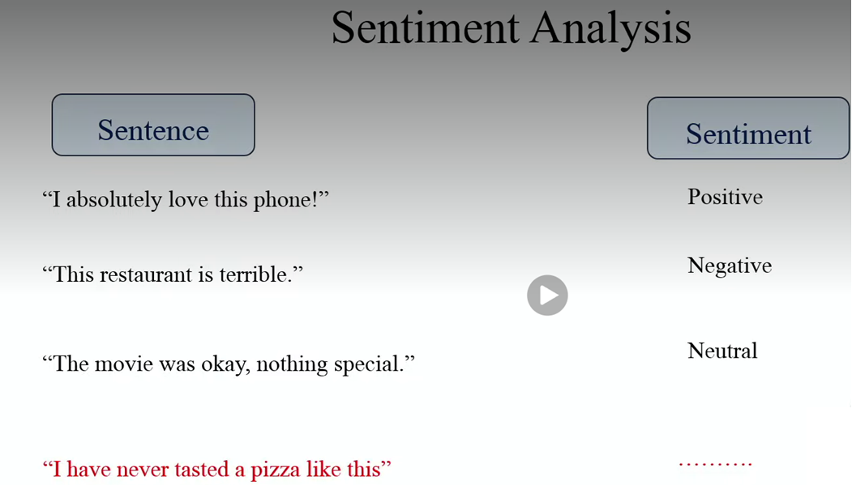
NLP Tasks

Slide 11
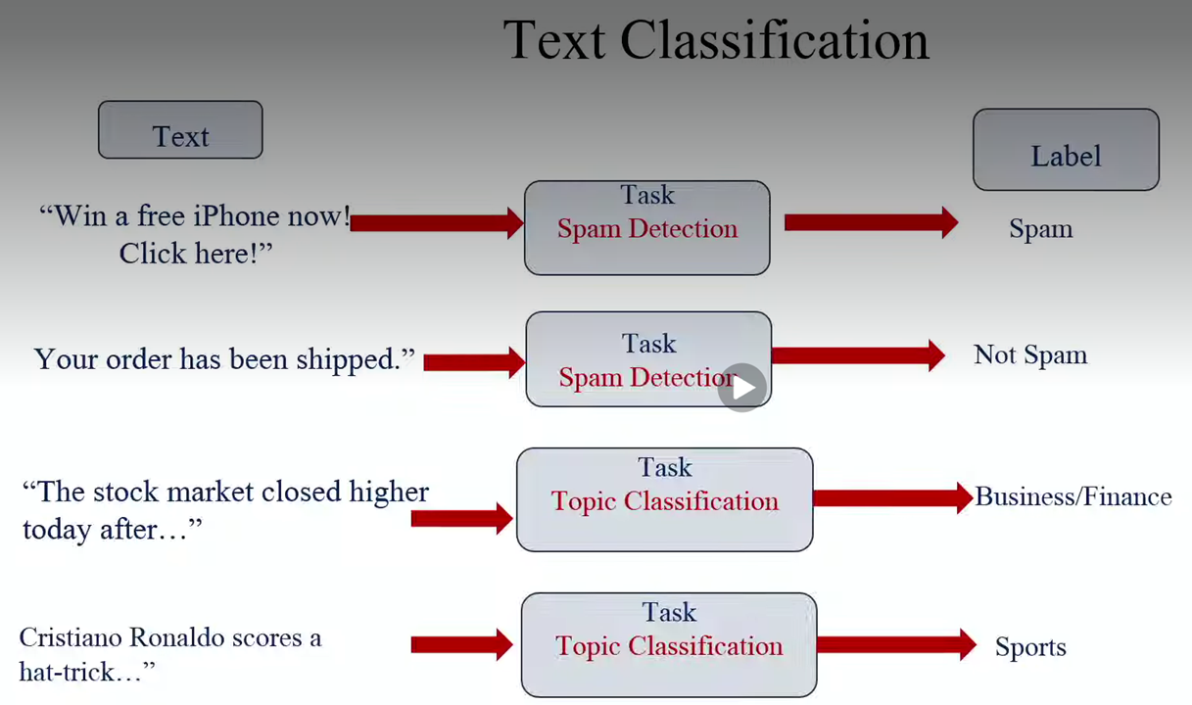
NLP Tasks

Slide 12
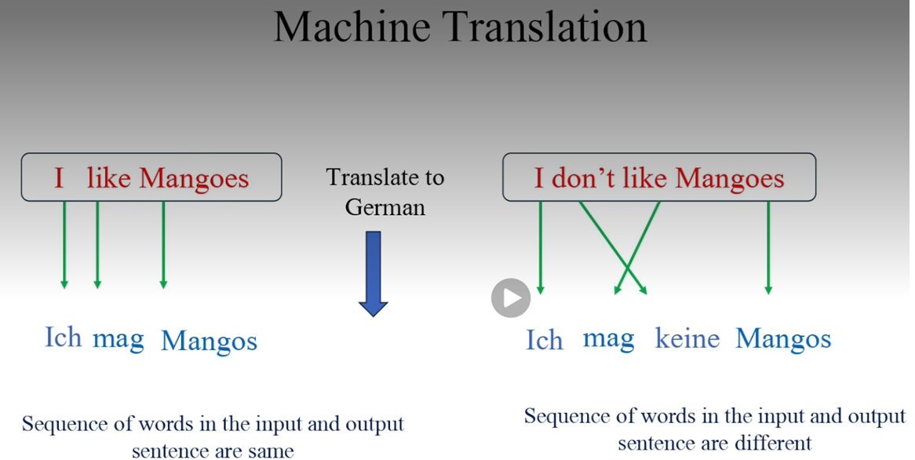
NLP Tasks

Slide 13
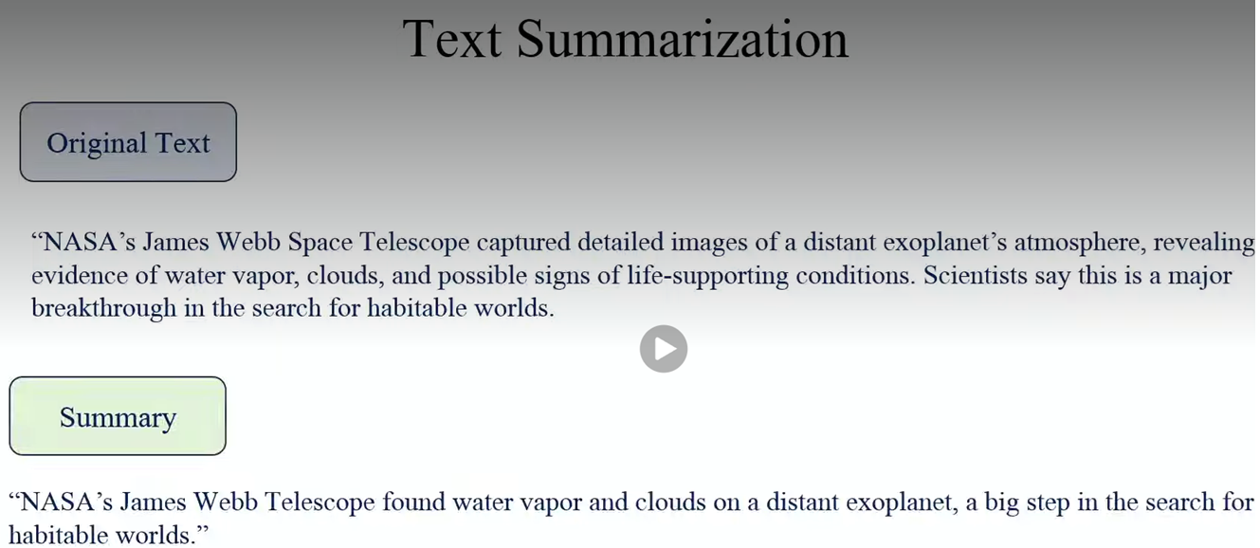
NLP Tasks

Slide 14
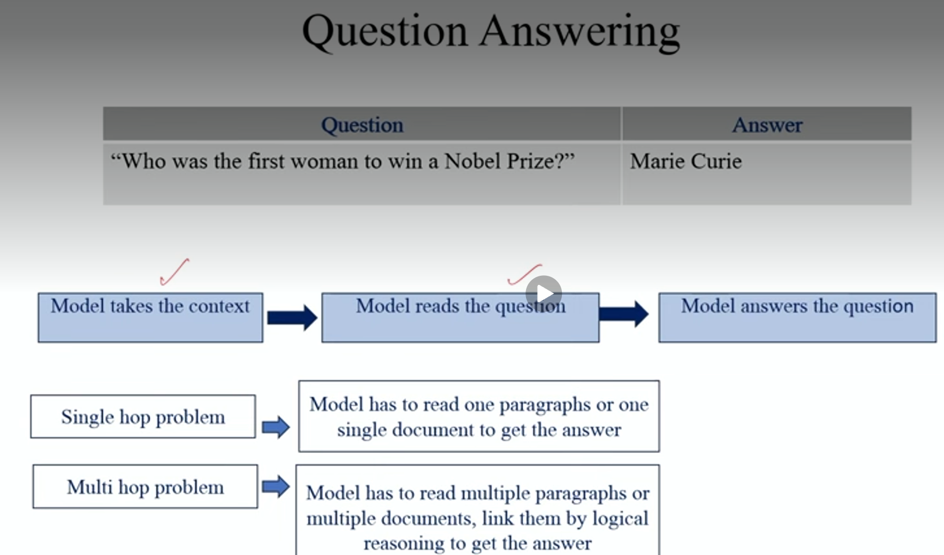
NLP Tasks

Slide 15
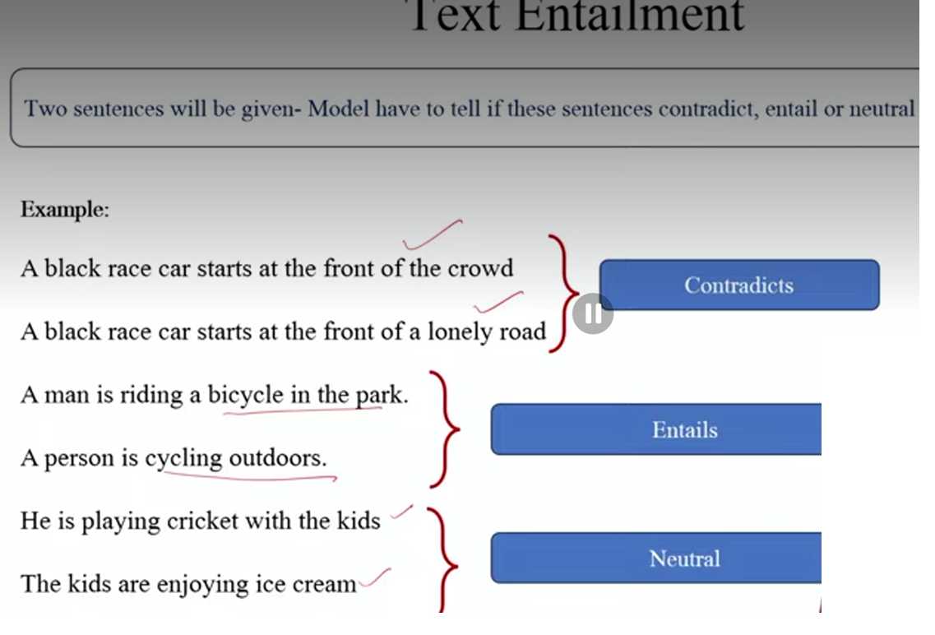
NLP Tasks

Slide 16
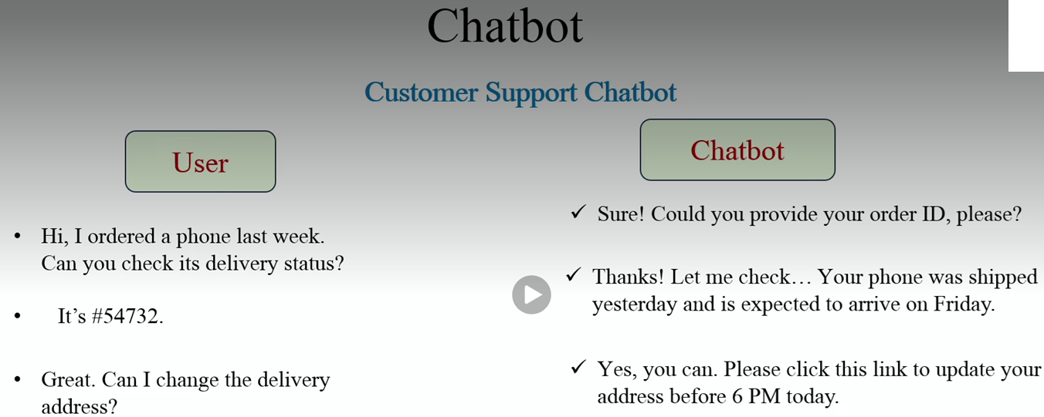
NLP Tasks

Slide 17
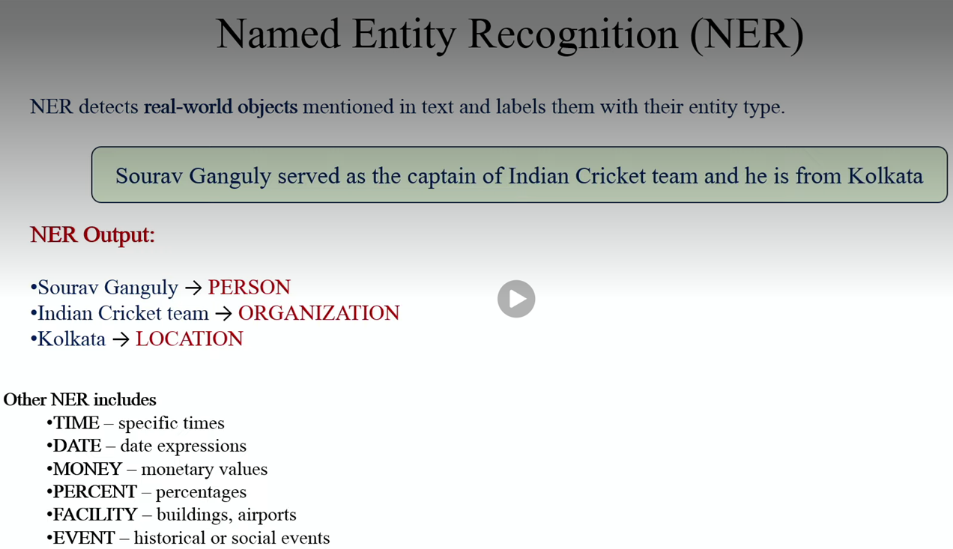
NLP Tasks

Slide 18
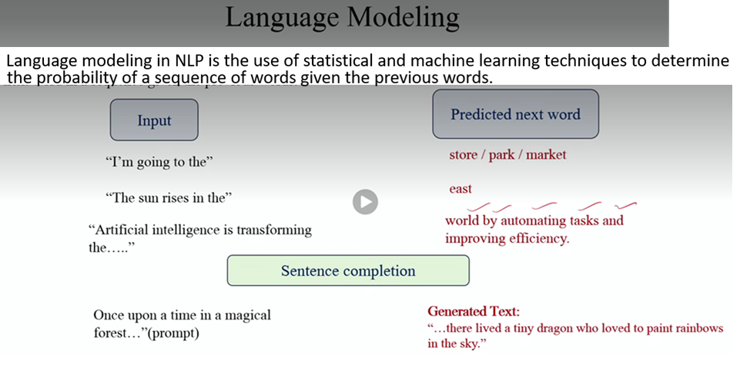
NLP Tasks
A Large Language Model (LLM) is an advanced artificial intelligence system designed to understand, process, and generate human-like text. It works by predicting the most logical next words in a sequence based on vast amounts of training data. Popular examples include OpenAI's GPT models and Google's Gemini.
LLMs are giant statistical models built on deep learning and a specific neural network architecture known as the transformer. These networks have billions of "parameters" (internal variables) that act much like a human brain's synapses.

Slide 19
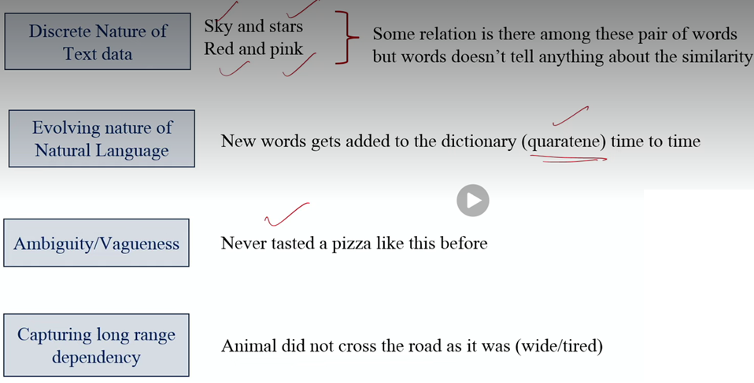
Challenges in NLP

Slide 20
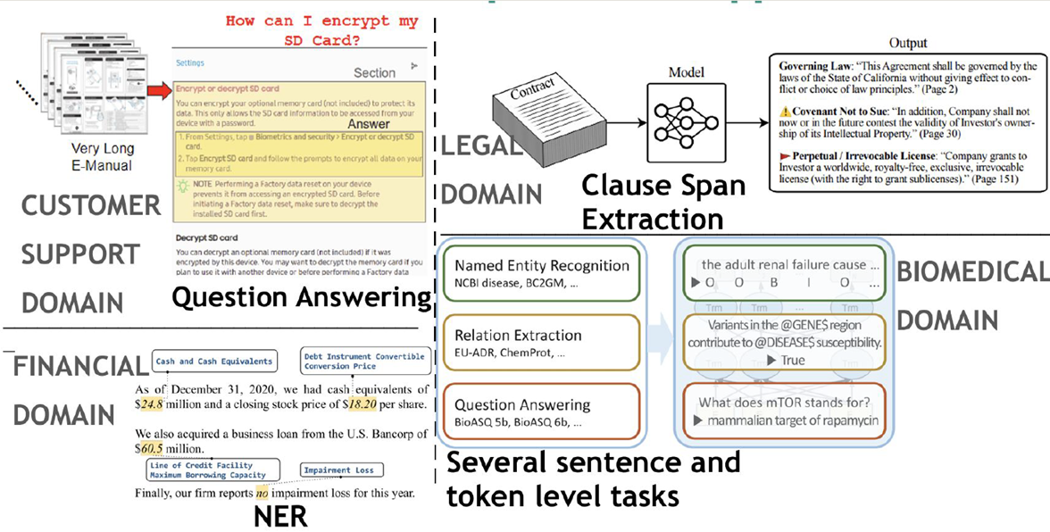
Domain Specific Applications

Slide 21
NLP Paradigms
We generally try to map problems to various ML paradigms
  Sentiment Analysis, news article groupings, etc. → Text Classification
  Named entity recognition, code-mixing, etc. → Sequence Labelling
  Machine Translation, summarization, chatbots, etc. → Text Generation

Slide 22
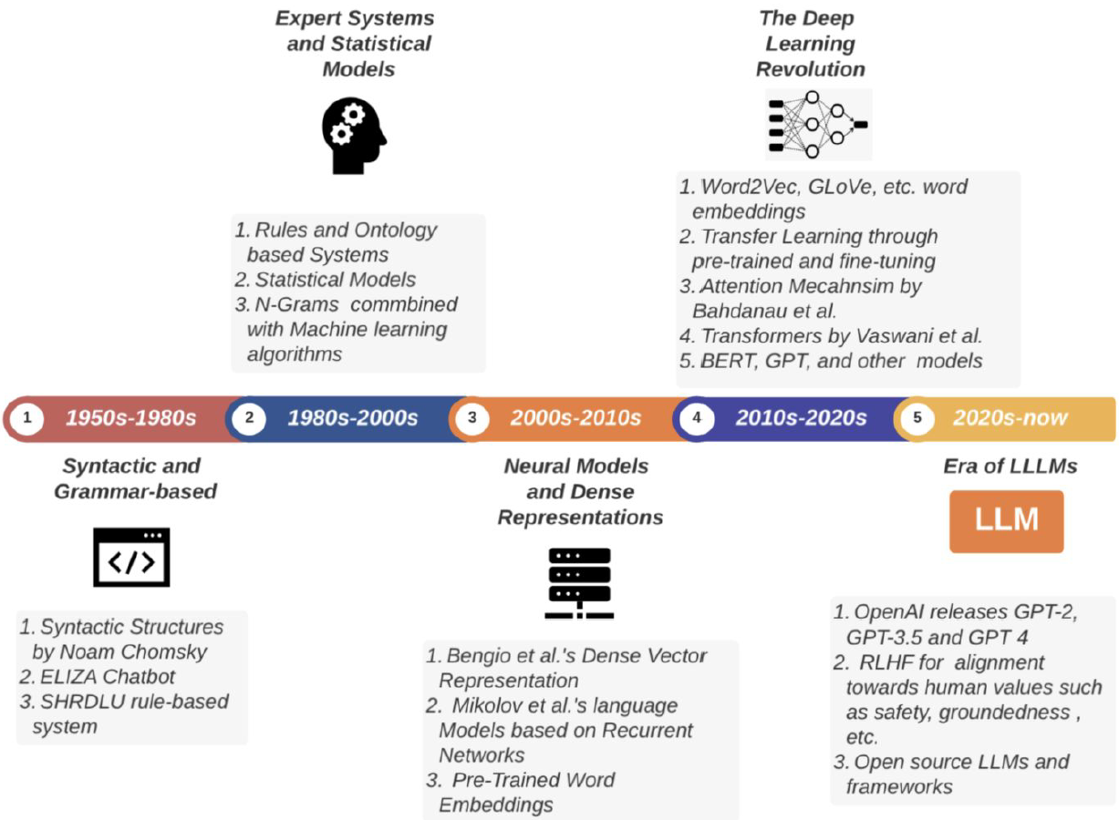
NLP Progression Timeline

Slide 23
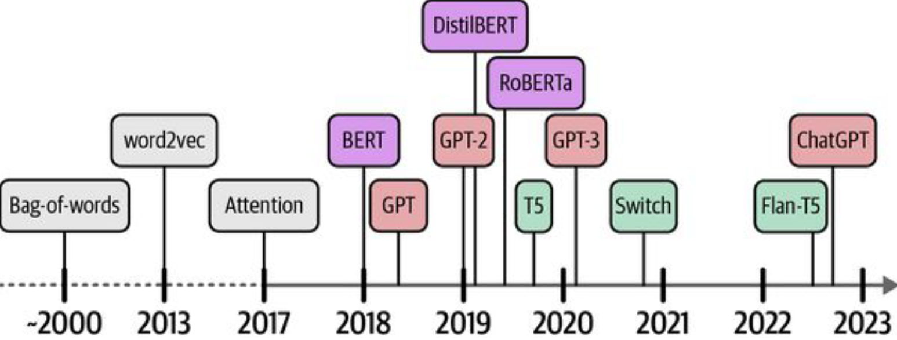
A timeline of the recent developments
BERT stands for Bidirectional Encoder Representations from Transformers
GPT stands for Generative Pre-trained Transformer

