Slide 1
NLP: Text Preprocessing

Slide 2
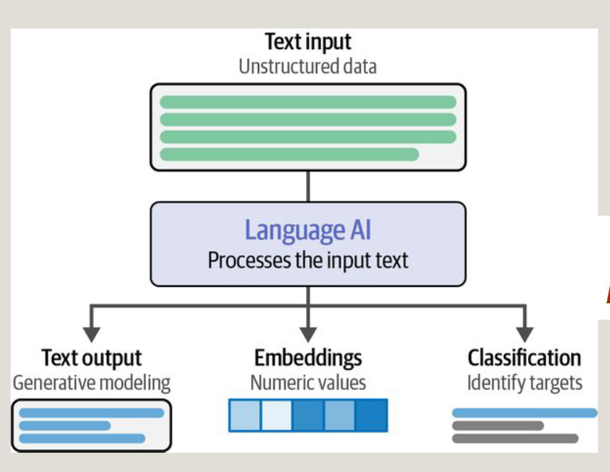
NLP: Basic Flow Diagram

Slide 3
NLP Pipeline
Text input data:
  Unstructured
  Free-form and human-generated
  Varies in length, style, grammar, and vocabulary
  Often noisy (typos, emojis, abbreviations)
Text preprocessing is an essential step in NLP that involves cleaning and transforming unstructured text data to prepare it for analysis.
  In order for the preprocessed information to be conveyed to the statistical inference algorithm, the tokens need to be translated into predictive features.
  A model is used to embed raw text into a vector space.
Infer a decision in order to be actionable
Unsupervised : Latent Semantic Analysis (LSA)
Supervised: Recurrent Neural Networks (RNN) and variants

Slide 4
NLP: Python Packages, Libraries
NLTK (Natural Language Toolkitis) - the most famous Python NLP library
NLTK Data package includes a pretrained tokenizer punkt for English, which can be downloaded as well:
  import nltk
  import nltk.data
  nltk.download('punkt’)
TextBlob is built on top of NLTK.
  simplifies complex text analysis tasks—such as sentiment analysis, part-of-speech tagging, and translation
spaCy is an NLP library designed to be fast, streamlined, and production-ready.
  present only one algorithm (the best one) for each purpose.
There are a few other libraries, such as genism (Generate Similar), that designed specifically for unsupervised topic modeling, document indexing, and semantic similarity retrieval.

Slide 5
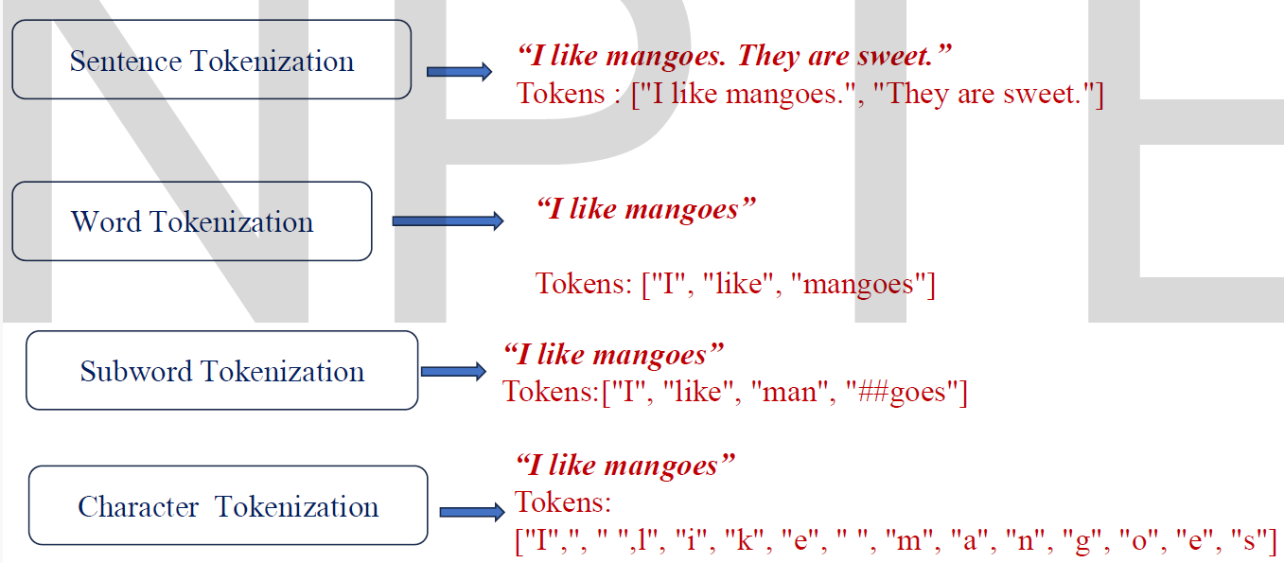
Text Pre-processing: Tokenization
Tokenization is a fundamental process in Natural Language Processing (NLP) that involves breaking down a stream of text into smaller units called tokens.
A set of predetermined rules allows us to effectively convert a sentence into a list of tokens.

Slide 6
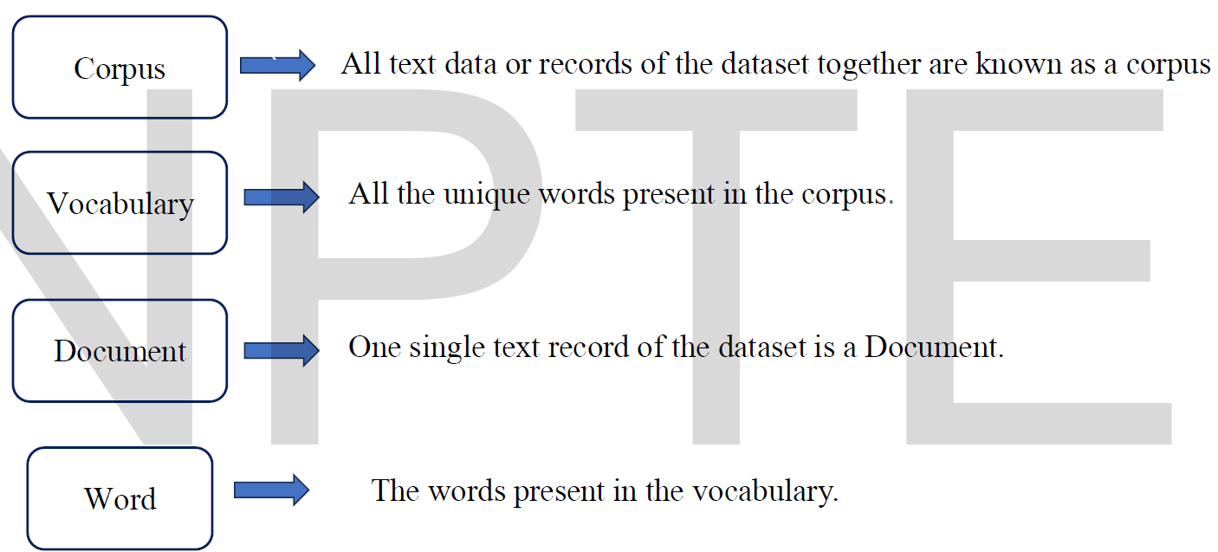
Tokenization: Key Terminology

Slide 7
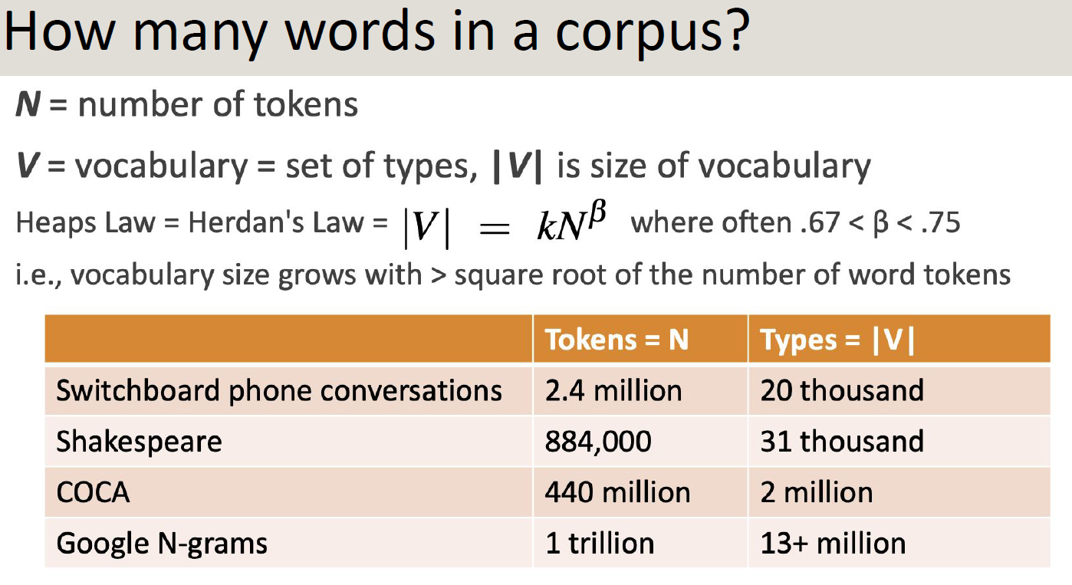
Tokenization: Key Terminology
they lay back on the San Francisco grass and looked at the stars and their
  Token: an instance of that type in running text.
  Type: an element of the vocabulary.
  How many?
    15 tokens
    13 types
Corpus

Slide 8
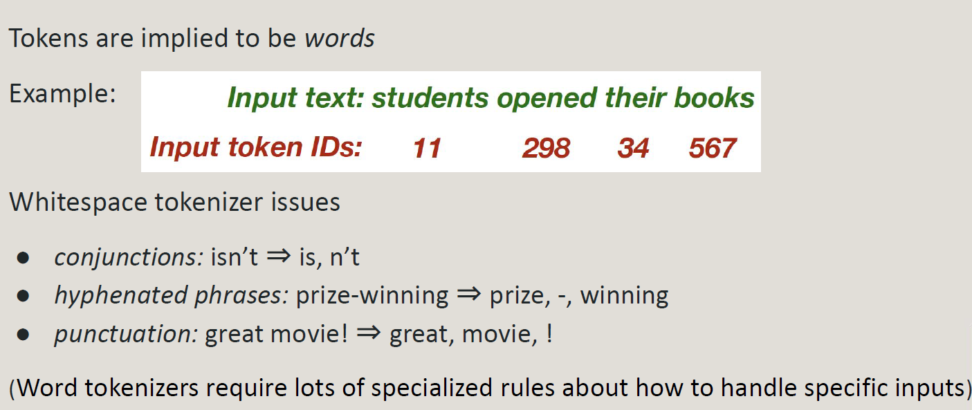
Tokenization: Whitespace tokenization
Simplest tokenization method that splits text into tokens wherever white space characters (spaces, tabs, newlines) occur.

Slide 9
Tokenization: Whitespace tokenization
from nltk.tokenize import WhitespaceTokenizer
text = "Hello, world! This is NLP."
tokenizer = WhitespaceTokenizer()
tokens = tokenizer.tokenize(text)
print(tokens)
# Output: ['Hello,', 'world!', 'This', 'is', 'NLP.']

Slide 10
Whitespace tokenization: Major Issues
1. Multi-word Expressions Split Incorrectly
Proper nouns and compound terms get fragmented:
  "New York University" → ['New', 'York', 'University'] (loses the entity meaning)
  "San Francisco", "Los Angeles", "ice cream" all split into separate tokens
2. Punctuation Attached to Words
Punctuation remains stuck to adjacent tokens:
  "Hello, world!" → ['Hello,', 'world!'] instead of ['Hello', ',', 'world', '!’]
  This complicates downstream processing like sentiment analysis or named entity recognition (NER)
3. Languages Without Spaces
Completely fails for languages like Chinese, Japanese, or Korean where words aren't separated by spaces.
4. Special Constructs Broken
Email addresses: john.doe@email.com might be split incorrectly
URLs, phone numbers (800) 234-2333, and dates Mar 11, 1983 get fragmented
Hyphenated words like "state-of-the-art" become separate tokens
5. Retrieval Problems
Searching for "York University" might incorrectly match documents containing "New York University" because both contain "York" and "University" as separate tokens

Slide 11
Whitespace tokenization: Solutions and Better Approaches
Subword Tokenization (Byte Pair Encoding - BPE, WordPiece, SentencePiece)
Modern NLP uses subword methods that:
  Break rare words into meaningful subword units
  Handle compound words better
  Manage out-of-vocabulary (OOV) words effectively
    OOV in NLP means a word that a computer model cannot recognize because it was not in the text list used to train the model.

Slide 12
Subword Tokenization
Subwords are expected to be meaningful units
Subwords can be arbitrary substrings but subwords can be meaning-bearing units like the morphemes (parts of words)
  A morpheme is the smallest meaning-bearing unit of a language
  Morphology is the study of the way words are built up from morphemes
    for example, the word fox consists of one morpheme (the morpheme fox) while the word cats consists of two: the morpheme cat and the morpheme -s that indicates plural.
    “unlikeliest” has the morphemes {un-, likely, -est}
    Here’s a sentence in English segmented into morphemes with hyphens:
    He work-ed care-ful-ly wash-ing the glass-es
  Word forms are the variations of a word that express different grammatical categories (tense, case, number, gender, etc.) and thus help convey the specific meaning and function of the word in a sentence
Unseen word can thus be represented by some sequence of known subword units. e.g. lower as {low, -er}

Slide 13
Subword Tokenization: Byte-Pair-Encoding (BPE)
Main idea: Use data to automatically tell what the tokens should be
  Token learner (Training Part)
    Raw train corpus ⇒ Vocabulary (a set of tokens)
  Token segmenter (Testing Part)
    Raw sentences ⇒ Tokens in the vocabulary

Slide 14
Subword Tokenization: Byte-Pair-Encoding (BPE)
Token learner: (Training Part)
Raw train corpus ⇒ Vocabulary (a set of tokens)
  Pre-tokenize the corpus in words & append a special end-of-word symbol _ to each word
  Initialize vocabulary with the set of all individual characters
  Choose 2 tokens that are most frequently adjacent (“A”, “B”)
    Respect word boundaries
  Add a new merged symbol (“AB”) to the vocabulary
  Change the occurrence of the 2 selected tokens with the new merged token in the corpus
  Continues doing this until k merges are done
All k new symbols and initial characters are the final vocabulary
What’s k? Open research question

Slide 15
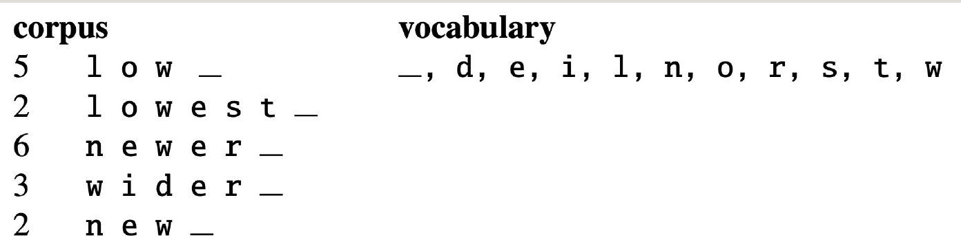
Subword Tokenization: Byte-Pair-Encoding (BPE)
Example:
Freq.

Slide 16
Subword Tokenization: Byte-Pair-Encoding (BPE)
Example:

Slide 17
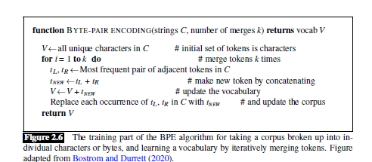
Subword Tokenization: Byte-Pair-Encoding (BPE)
Example:

Slide 18
Subword Tokenization: Byte-Pair-Encoding (BPE)
Token segmenter: (Testing Part)
  Just runs on the test data the merges we have learned from the training data, greedily, in the order we learned them
  First we segment each test sentence word into characters
  Then we apply the first merge rule
  e.g., replace every instance of “e”, ”r” in the test corpus with “er”
  Then the second merge rule
  e.g., replace every instance of “er”, “_” in the test corpus with “er_” and so on

Slide 19
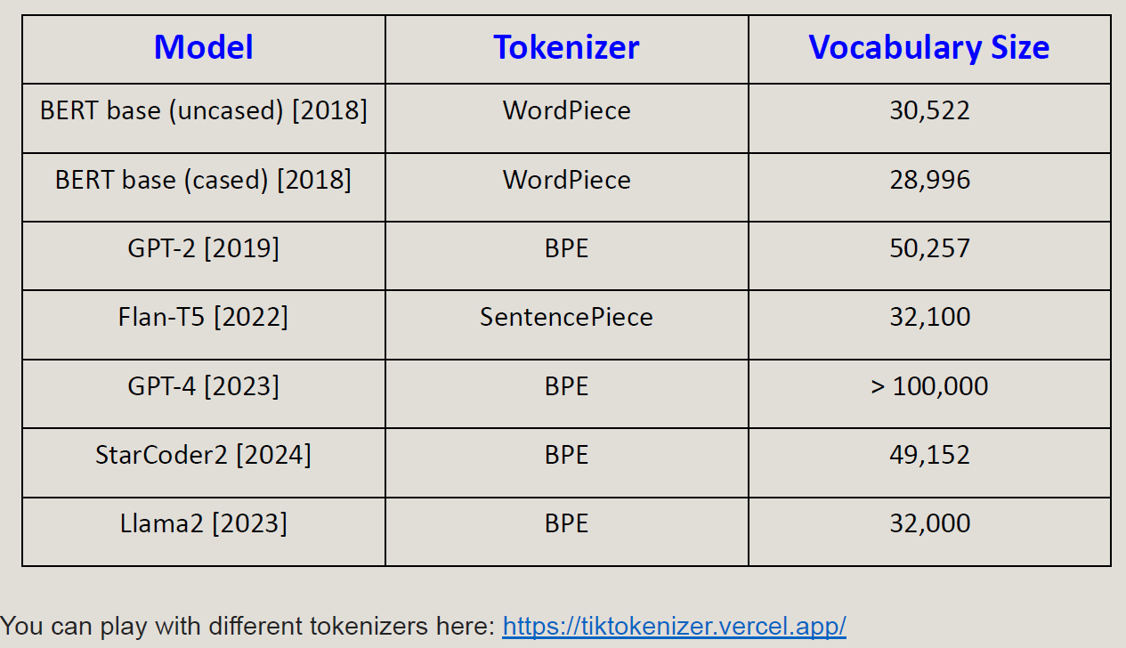
Subword Tokenizers in Models

Slide 20
Tokenization: Practical Recommendation
For production NLP systems, use established libraries like:
spaCy: Handles punctuation, contractions, and multi-word expressions intelligently
NLTK's advanced tokenizers: Beyond WhitespaceTokenizer, use word_tokenize() which uses Punkt sentence tokenizer
Hugging Face tokenizers: BPE/WordPiece implementations for transformer models

