Slide 1
Text Preprocessing: Stop Word Removal, Stemming and Lemmatization

Slide 2
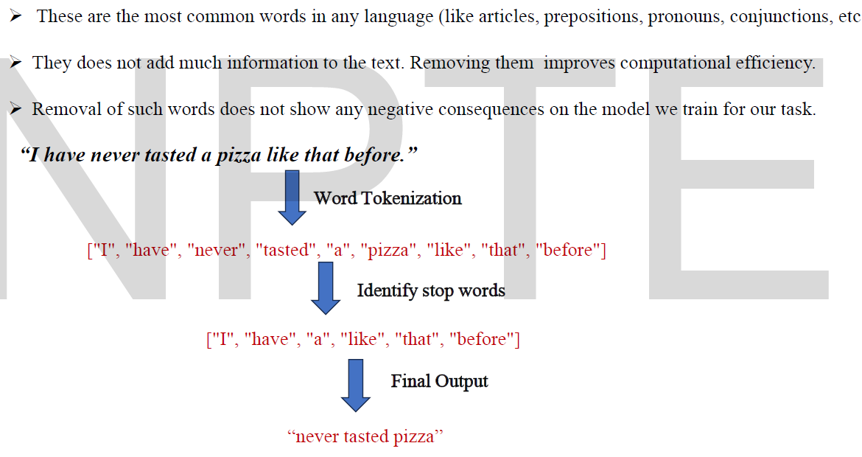
Text Pre-processing/Normalization: Stop Word Removal
Remove commonly used words in a language
  a, the, is, are etc.

Slide 3
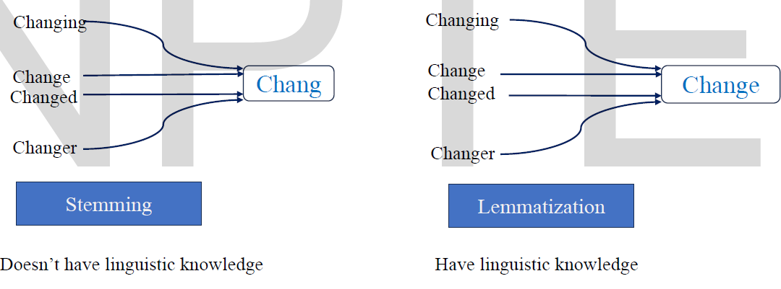
Text Pre-processing/Normalization: Stemming and Lemmatization
Stemming is a technique where words are reduced to their base or root form by removing suffixes or prefixes.
Lemmatization is a sophisticated technique that transforms words to their base forms, known as lemmas, considering the word’s meaning and context.
Lemmatization: determining that two words have the same root, despite their surface differences
  sang, sung, and sings are forms of sing

Slide 4
Text Pre-processing/Normalization: Casing
Casing: Lowercase all words or not
  With pretrained language models, besides casing, we do none of the other steps
After text normalization, most tokenizers are irreversible
We cannot recover the raw text definitively from the tokenized output

Slide 5
Python Example: Stop Word Removal
code for removing stop words using the NLTK library:
  text = "S&P and NASDAQ are the two most popular indices in US"
  from nltk.corpus import stopwords
  from nltk.tokenize import word_tokenize
  stop_words = set(stopwords.words('english'))
  text_tokens = word_tokenize(text)
  tokens_without_sw= [word for word in text_tokens if not word in stop_words]
  print(tokens_without_sw)
    Output:
    ['S', '&', 'P', 'NASDAQ', 'two', 'popular', 'indices', 'US’]
The stop words.words('english') is a set of default stop words for the English language model in NLTK.

Slide 6
Python Example: Stemming
text = "It's a Stemming testing"
parsed_text = word_tokenize(text)
# Initialize stemmer.
from nltk.stem.snowball import SnowballStemmer
stemmer = SnowballStemmer('english')
# Stem each word.
[(word, stemmer.stem(word)) for i, word in enumerate(parsed_text)
if word.lower() != stemmer.stem(parsed_text[i])]
  Output
  [('Stemming', 'stem'), ('testing', 'test')]

Slide 7
Python Example: Lemmatization
text = "This world has a lot of faces "
from textblob import Word
parsed_data= TextBlob(text).words
[(word, word.lemmatize()) for i, word in enumerate(parsed_data)
if word != parsed_data[i].lemmatize()]
  Output
  [('has', 'ha'), ('faces', 'face')]

Slide 8
Text Preprocessing: Parts of Speech (PoS) Tagging and Named Entity Recognition (NER)

Slide 9
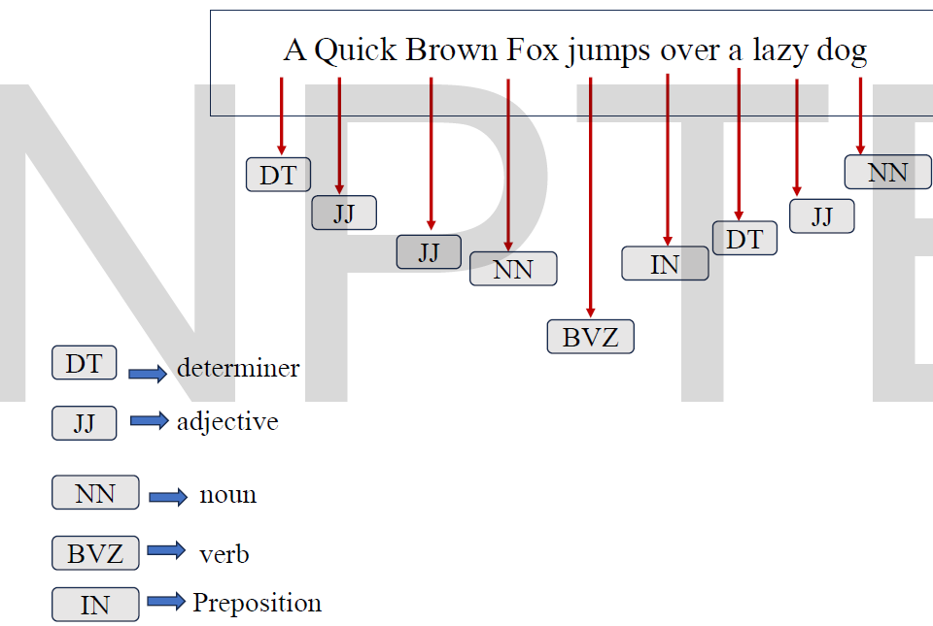
Text Pre-processing/Normalization: Part of Speech (PoS) Tagging
PoS involves assigning a grammatical category (such as noun, verb, adjective, etc.) to each word in a sentence.
Helps machines understand the syntactic structure (grammar and structure - the rules for arranging words/symbols in a sentence) of sentences, which is crucial for tasks like:
  Machine Translation
  Information extraction
  Question answering
  Text to speech conversion
Eight basic parts of speech: noun, verb, pronoun, preposition, adverb, conjunction, participle, and article. (Ref.: Dionysius Thrax of Alexandria (c. 100 B.C.))
Words often have more than one POS.
  • VERB: (Book that flight)
  • NOUN: (Hand me that book).
The goal of POS-tagging is to resolve ambiguities, choosing the proper tag for the context.

Slide 10
PoS Tagging: Popular tag-set
An English-specific tagset, the Penn Treebank tagset (Marcus et al., 1993), has been used to label many syntactically annotated corpora like the Penn Treebank corpora
It has 36 primary POS tags

Slide 11
PoS Tagging: Python Example
The code for PoS tagging using the TextBlob library:
  text = 'Google is looking at buying U.K. startup for $1 billion'
  TextBlob(text).tags
    Output
      [('Google', 'NNP'),
      ('is', 'VBZ'),
      ('looking', 'VBG'),
      ('at', 'IN'),
      ('buying', 'VBG'),
      ('U.K.', 'NNP'),
      ('startup', 'NN'),
      ('for', 'IN'),
      ('1', 'CD'),
      ('billion', 'CD')]

Slide 12
PoS Tagging: Methods and Evaluation
Methods:
  Hidden Markov Models (HMM)
  Maximum Entropy Markov Models
  Conditional Random Fields (CRF)
  RNNs, Transformers → Recent Approaches
Evaluation:
  Accuracy
  Macro-F1 (giving equal importance to each tag)

Slide 13
Text Pre-processing/Normalization: Named Entity Recognition (NER)
Named entity recognition (NER) is an optional next step in data preprocessing that seeks to locate and classify named entities in text into predefined categories.
These categories can include names of persons, organizations, locations, expressions of times, quantities, monetary values, or percentages.
While parts of speech are generally assigned to individual words or morphemes, a proper name is often an entire multiword phrase, like the name “Marie Curie”, the location “New York City”, or the organization “Stanford University”.
We’ll use the term named entity for, roughly speaking, anything that can be referred to with a proper name: a person, a location, an organization, although as we’ll see the term is commonly extended to include things that aren’t entities per se.

Slide 14
NER: Python Example
The NER performed using spaCy library:
  text = 'Google is looking at buying U.K. startup for $1 billion'
  for entity in nlp(text).ents:
  print("Entity: ", entity.text)
    Output
      Entity: Google
      Entity: U.K.
      Entity: $1 billion
Visualizing named entities in text using the displacy module, can also be incredibly helpful in speeding up development and debugging the code and training process:
  from spacy import displacy
  displacy.render(nlp(text), style="ent", jupyter = True)

Slide 15
Text Pre-processing: Other optional preprocessing steps
Dependency parsing
  Assigns a syntactic structure to sentences to make sense of how the words in the sentence relate to each other.
Coreference resolution
  The process of connecting tokens that represent the same entity.
  It is common in languages to introduce a subject with their name in one sentence and then refer to them as him/her/it in subsequent sentences.
Triplet extraction
  The process of recording subject, verb, and object triplets when available in the sentence structure.
Relation extraction
  A broader form of triplet extraction in which entities can have multiple interactions.

Slide 16
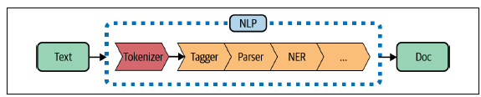
All Preprocessing in one go: Python Example
When we call nlp on a text, spaCy first tokenizes the text to produce a Doc object.
The Doc is then processed in several different steps.
This is also referred to as the processing pipeline. The pipeline used by the default models consists of a tagger, a parser, and an entity recognizer.
Each pipeline component returns the processed Doc, which is then passed on to the next component

Slide 17
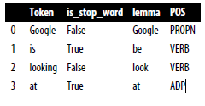
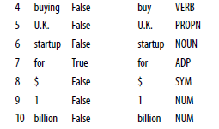
All Preprocessing in one go: Python Example
text = 'Google is looking at buying U.K. startup for $1 billion'
doc = nlp(text)
pd.DataFrame([[t.text, t.is_stop, t.lemma_, t.pos_]
      for t in doc],
      columns=['Token', 'is_stop_word', 'lemma', 'POS'])
  Output:

Slide 18
Example: Tokenization with BPE
Training Corpus
Word | Frequency
read | 3
reads | 2
reader | 2
reading | 2
unread | 1
readers | 1
Represent each word as characters followed by _
BPE Training: Perform exactly 6 merges
  At each training step, count all adjacent token pairs weighted by word frequency.
  Merge the most frequent pair.
  If there is a tie, choose the leftmost pair from the word read if possible; otherwise choose alphabetically.
(3) Fill the table after each merge.
Merge # | Most frequent pair | New token
1 | ____________________ | ____________________
2 | ____________________ | ____________________
3 | ____________________ | ____________________
4 | ____________________ | ____________________
5 | ____________________ | ____________________
6 | ____________________ | ____________________

Slide 19
Example: Tokenization with BPE
_ , a, d, e, g, i, n, r, s, u
(2)
Merge # | Most frequent pair | New token
1 | (r, e) | re
2 | (re, a) | rea
3 | (rea, d) | read
4 | (read, _) | read_
5 | (read, e) | reade
6 | (reade, r) | reader

Slide 20
Example: Tokenization with BPE
Testing on New Words
Test word | In training set?
read | Yes
reader | Yes
readers | Yes
reading | Yes
unread | Yes
readable | No
reread | No
unreader | No
(1) For each word, write the initial character form and the final BPE tokenization.
During testing, apply the learned merges in the same order.
(2) Choose any three tokenized test words, including at least one OOV word, and decode them.
During decoding, concatenate tokens and remove _.
Test word | Initial character form | Final BPE tokens
read | r e a d _ | read_
reader | r e a d e r _ | reader _
readers | r e a d e r s _ | reader s _
reading | r e a d i n g _ | read i n g _
unread | u n r e a d _ | u n read_
readable | r e a d a b l e _ | read a b l e _
reread | r e r e a d _ | re read_
unreader | u n r e a d e r _ | u n reader _
Chosen word | Token sequence | Decoded string | Matches original?
1. | read_ | read | Yes
2. | u n reader _ | unreader | Yes
3. | read a b l e _ | readable | Yes

Slide 21
In the test word – readable; the character b and l are not in vocabulory, still it is able to tokenize???
Yes — that’s exactly one of the key properties of BPE.
Tokenizing OOV words falls back to characters.
For readable:
Start from chars: r e a d a b l e _
Apply merges where possible: r e → re, re a → rea, rea d → read
⇒ read a b l e _
No merge exists for a b, b l, l e, so BPE leaves them as character tokens:
⇒ final tokens: read a b l e _
Here b and l are used as base (character) tokens. Even if they never appeared in a learned subword, they remain in the vocabulary.

Slide 22
THE END

