Slide 1
ICT - Semester 7
NATURAL LANGUAGE PROCESSING (20IC403T)

Slide 2
Reference Books (Theory):
      Jurafsky, Daniel, and James H. Martin, Speech and Language Processing: An Introduction to Natural Language Processing, Speech Recognition, and Computational Linguistics, Prentice Hall. 2026 Edition.
Yoav Goldberg, Graeme Hirst. Neural Network Methods in Natural Language Processing, Morgan & Claypool Publishers.
Kamath, Uday, et al. Large Language Models: A Deep Dive.
Reference Book (Hands-on Practical):
Bird, Steven, Ewan Klein, and Edward Loper. Natural language processing with Python: analyzing text with the natural language toolkit. O'Reilly Media, Inc.
Thanaki, Jalaj. Python natural language processing. Packt Publishing Ltd.
Alammar, J., & Grootendorst, M. Hands-On Large Language Models, O'Reilly.
Online Video Course and Support Materials:
NPTEL Course: Deep Learning for Natural Language Processing, IIT Kharagpur, Prof. Pawan Goyal
  https://nptel.ac.in/courses/108105572
  https://sites.google.com/view/dl4nlp-nptel/home

Slide 3
UNIT 2
FEATURE REPRESENTATIONS AND EXTRACTIONS IN NLP
NATURAL LANGUAGE PROCESSING
ICT - Semester 7

Slide 4
Topics to cover:
One-Hot Encoding
Bag of Words
TF-IDF Vectorization
N-gram Language Models
Word2Vec Embeddings
Glove Embeddings
FastText Embedding

Slide 5
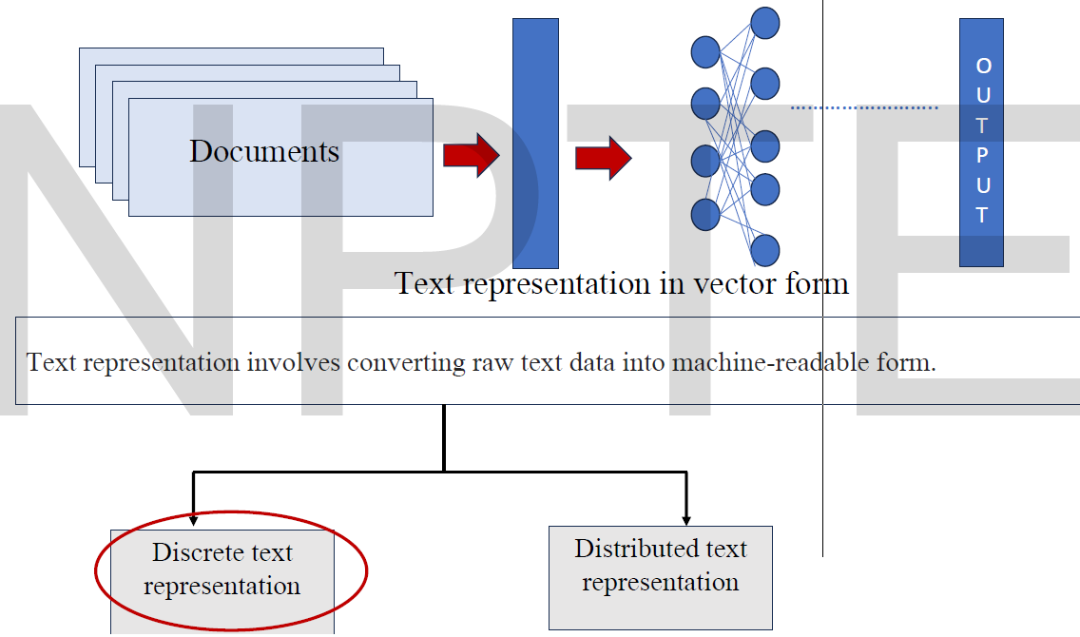
Text Representation in NLP
Text representation is a technique used in NLP to transform raw text into numerical features that capture information needed for computational processing and learning.

Slide 6
Text Representation in NLP
Discrete Text Representation:
  One Hot Encoding
  Bag of words
  TF-IDF (Term Frequency – Inverse Document Frequency)
Distributed word representation
  Word2Vec
    Skip Gram model
    Continuous Bag Of Words model
  Word Embeddings in NLP
    GloVe Embedding
    FastText Embedding

Slide 7
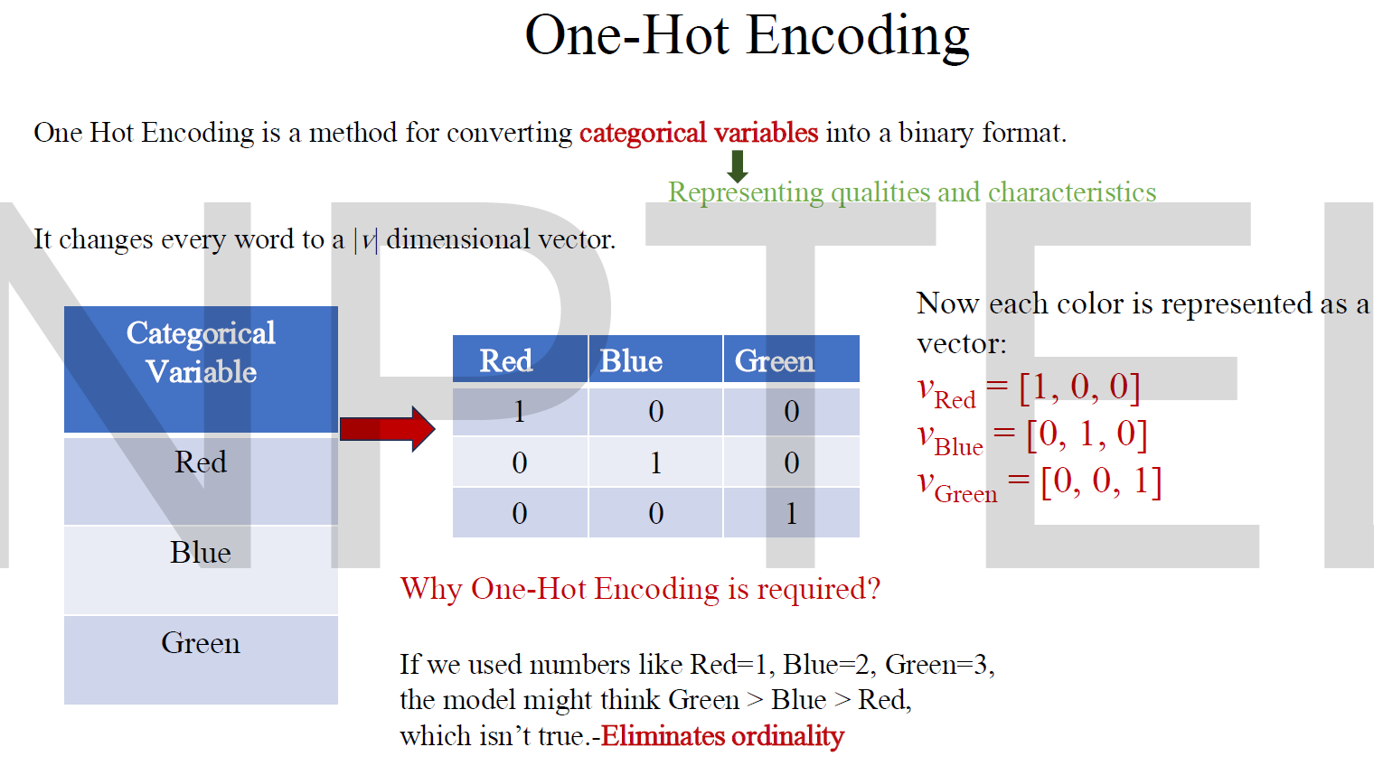

Slide 8
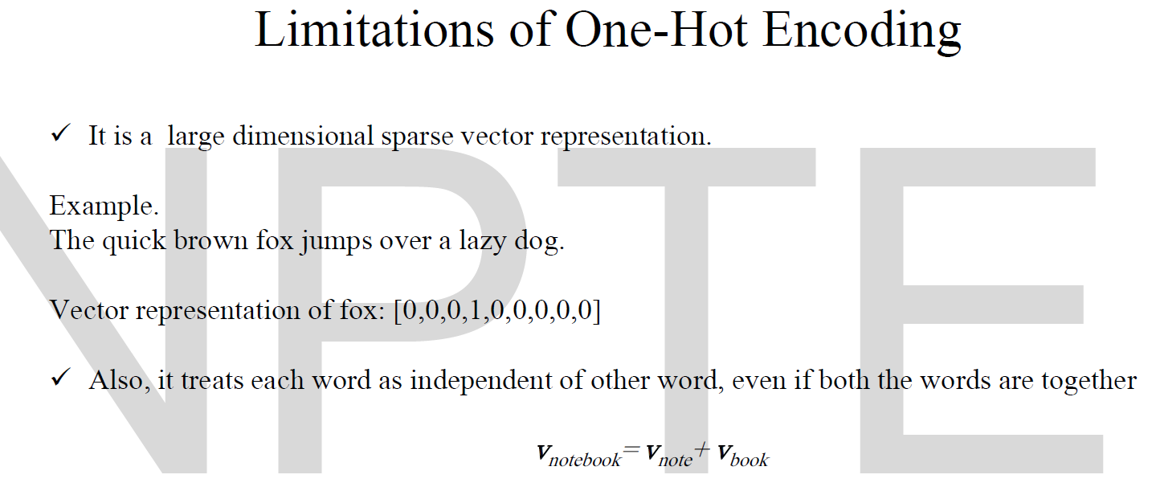
Vector dimension = number of words in vocabulary (e.g., 500,000)
The vectors are orthogonal, and there is no natural notion of similarity between one-hot vectors!

Slide 9
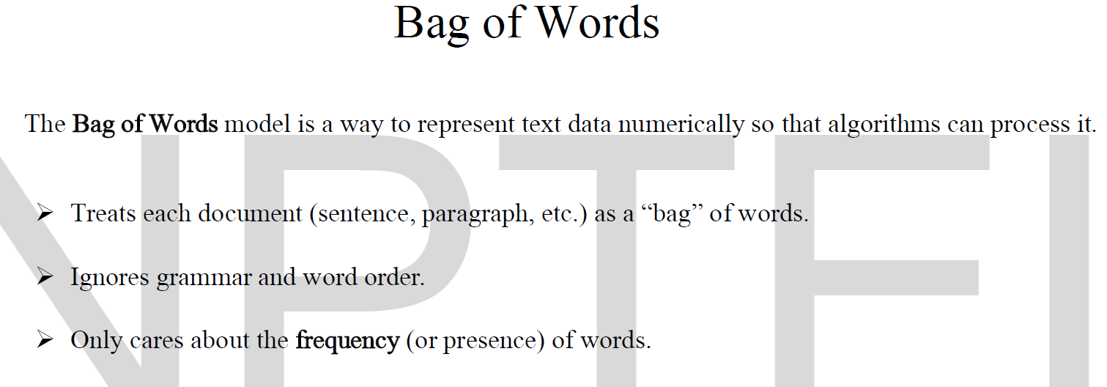

Slide 10
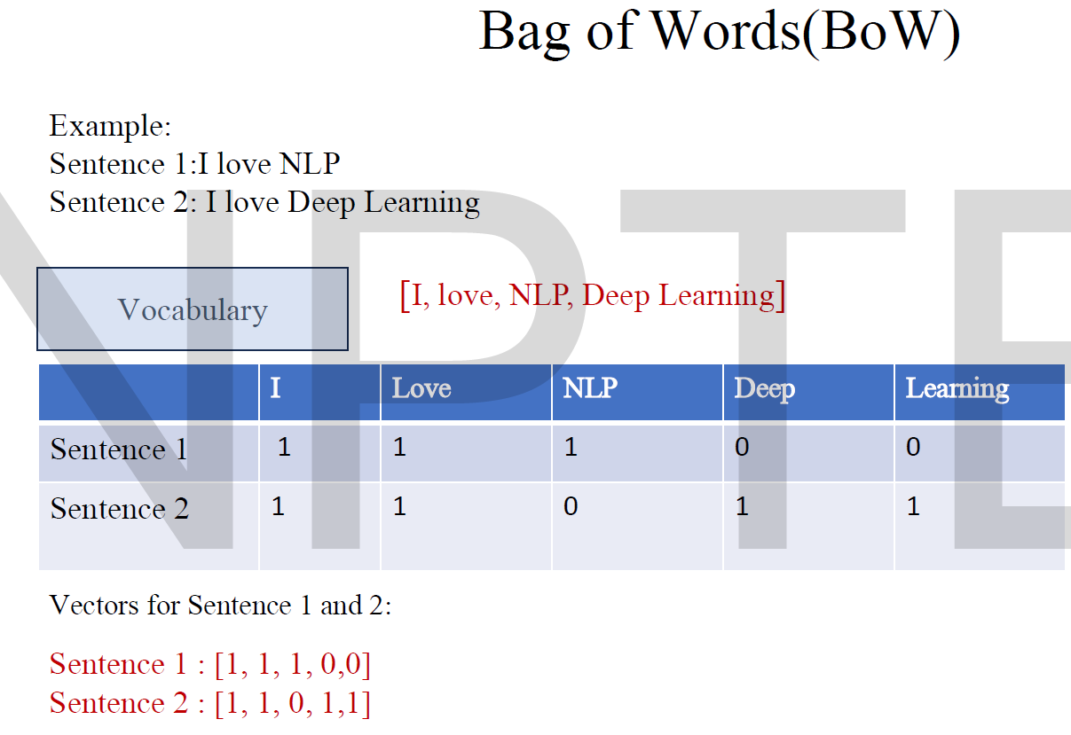

Slide 11
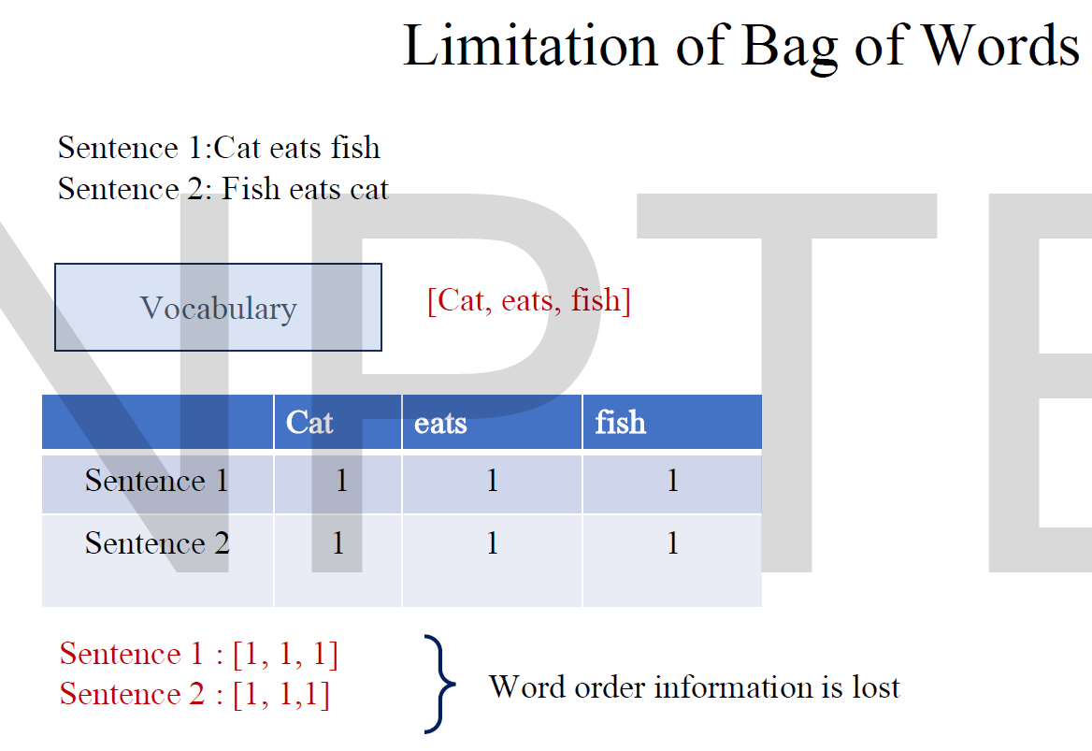

Slide 12
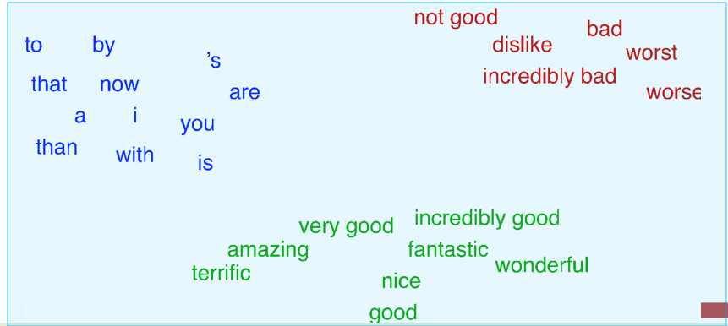
How to overcome limitations?
The meaning of a word is its use in the language.
  How can we define the word meaning that encodes this notion of similarity?
  Can we use shorter vectors?
  One way to define "usage":
  words are defined by their environments (the words around them)
    If A and B have almost identical environments we say that they are synonyms.
  Defining meaning as a point in space based on distribution
  Each word = a vector
  Similar words are "nearby in semantic space"
  We build this space automatically by seeing which words are nearby in text

