Slide 1
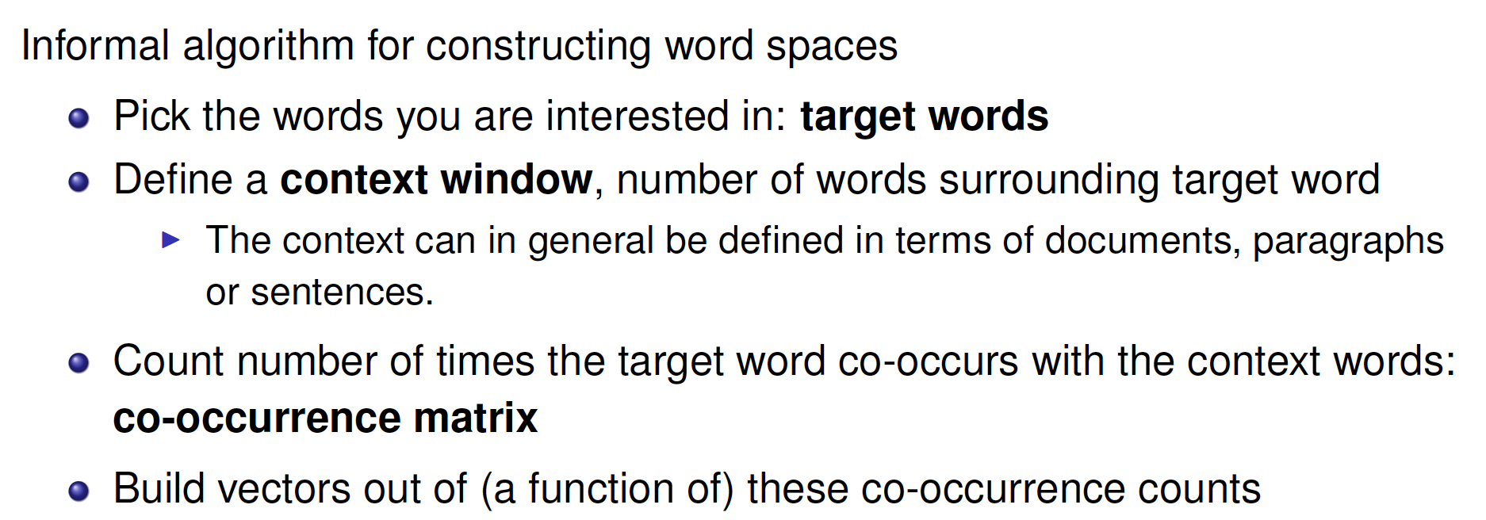
How to map words to space??

Slide 2
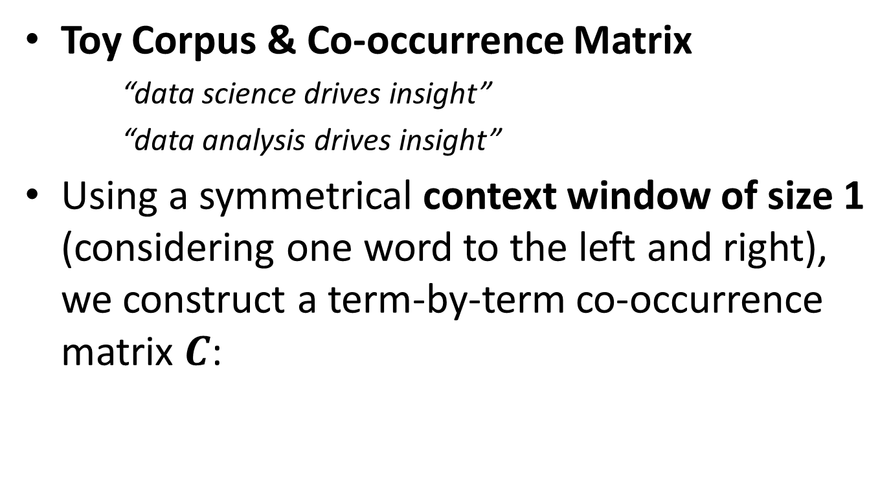
An example:
Toy Corpus & Co-occurrence Matrix
    “data science drives insight”
    “data analysis drives insight”
Using a symmetrical context window of size 1 (considering one word to the left and right), we construct a term-by-term co-occurrence matrix $C$:
Target words | data | science | analysis | drives | insight
data | 0 | 1 | 1 | 0 | 0
science | 1 | 0 | 0 | 1 | 0
analysis | 1 | 0 | 0 | 1 | 0
drives | 0 | 1 | 1 | 0 | 2
insight | 0 | 0 | 0 | 2 | 0

Slide 3
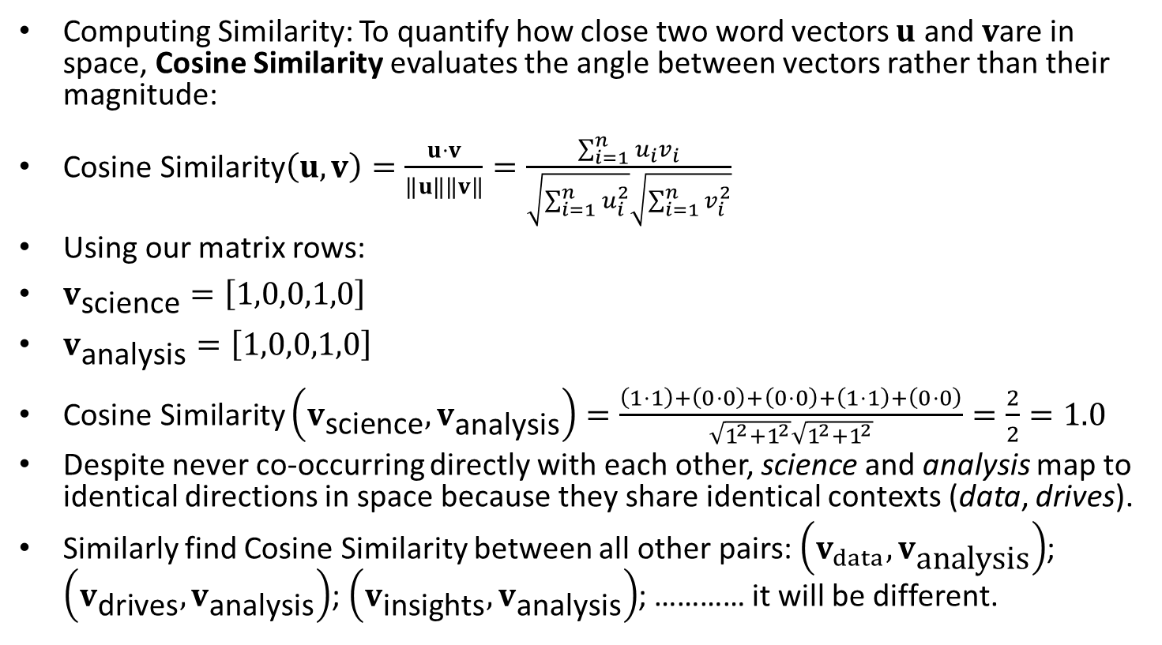
An example: Raw co-occurrence counts:
Computing Similarity: To quantify how close two word vectors $u$ and $v$are in space, Cosine Similarity evaluates the angle between vectors rather than their magnitude:
$\text{Cosine Similarity}\left(u,v\right)=\frac{u⋅v}{‖u‖‖v‖}=\frac{\sum_{i=1}^{n}{u_{i}}v_{i}}{\sqrt{\sum_{i=1}^{n}{u_{i}^{2}}}\sqrt{\sum_{i=1}^{n}{v_{i}^{2}}}}$
Using our matrix rows:
$v_{\text{science}}=\left[1,0,0,1,0\right]$
$v_{\text{analysis}}=\left[1,0,0,1,0\right]$
$\text{Cosine Similarity}\left(v_{\text{science}},v_{\text{analysis}}\right)=\frac{\left(1⋅1\right)+\left(0⋅0\right)+\left(0⋅0\right)+\left(1⋅1\right)+\left(0⋅0\right)}{\sqrt{1^{2}+1^{2}}\sqrt{1^{2}+1^{2}}}=\frac{2}{2}=1.0$
Despite never co-occurring directly with each other, science and analysis map to identical directions in space because they share identical contexts (data, drives).
Similarly find Cosine Similarity between all other pairs: $\left(v_{data},v_{\text{analysis}}\right)$; $\left(v_{\text{drives}},v_{\text{analysis}}\right)$; $\left(v_{\text{insights}},v_{\text{analysis}}\right)$; ………… it will be different.

Slide 4
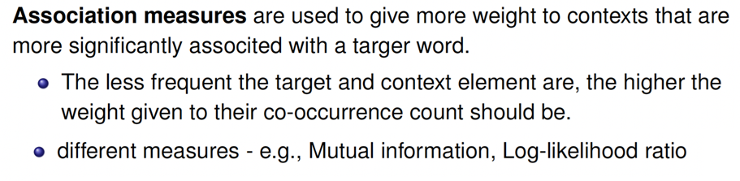
Issue with Raw co-occurrence counts:
Raw co-occurrence counts suffer from frequency bias: common words (e.g., “the”, “is”) dominate matrix entries without providing informative semantic context.
Solution: Context Weighting via association measures: Association measures adjust these weights.

Slide 5
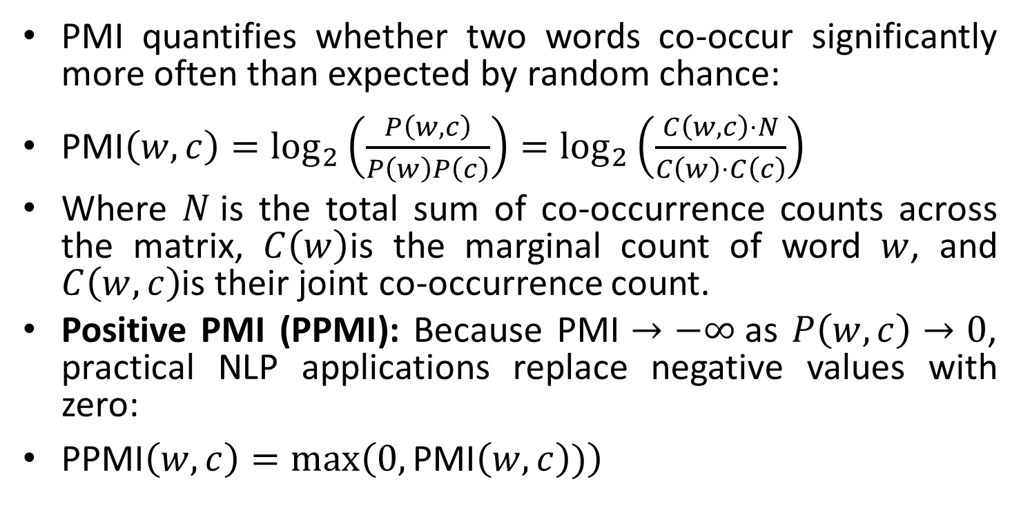
Pointwise Mutual Information (PMI)
PMI quantifies whether two words co-occur significantly more often than expected by random chance:
$\text{PMI}\left(w,c\right)=\log_{2}\left(\frac{P\left(w,c\right)}{P\left(w\right)P\left(c\right)}\right)=\log_{2}\left(\frac{C\left(w,c\right)⋅N}{C\left(w\right)⋅C\left(c\right)}\right)$
Where $N$is the total sum of co-occurrence counts across the matrix, $C\left(w\right)$is the marginal count of word $w$, and $C\left(w,c\right)$is their joint co-occurrence count.
Positive PMI (PPMI): Because $\text{PMI}→−∞$as $P\left(w,c\right)→0$, practical NLP applications replace negative values with zero:
$\text{PPMI}\left(w,c\right)=\max\left(0,\text{PMI}\left(w,c\right))\right)$
Statistically measure whether two words co-occur frequently (relative to their global frequencies)

Slide 6
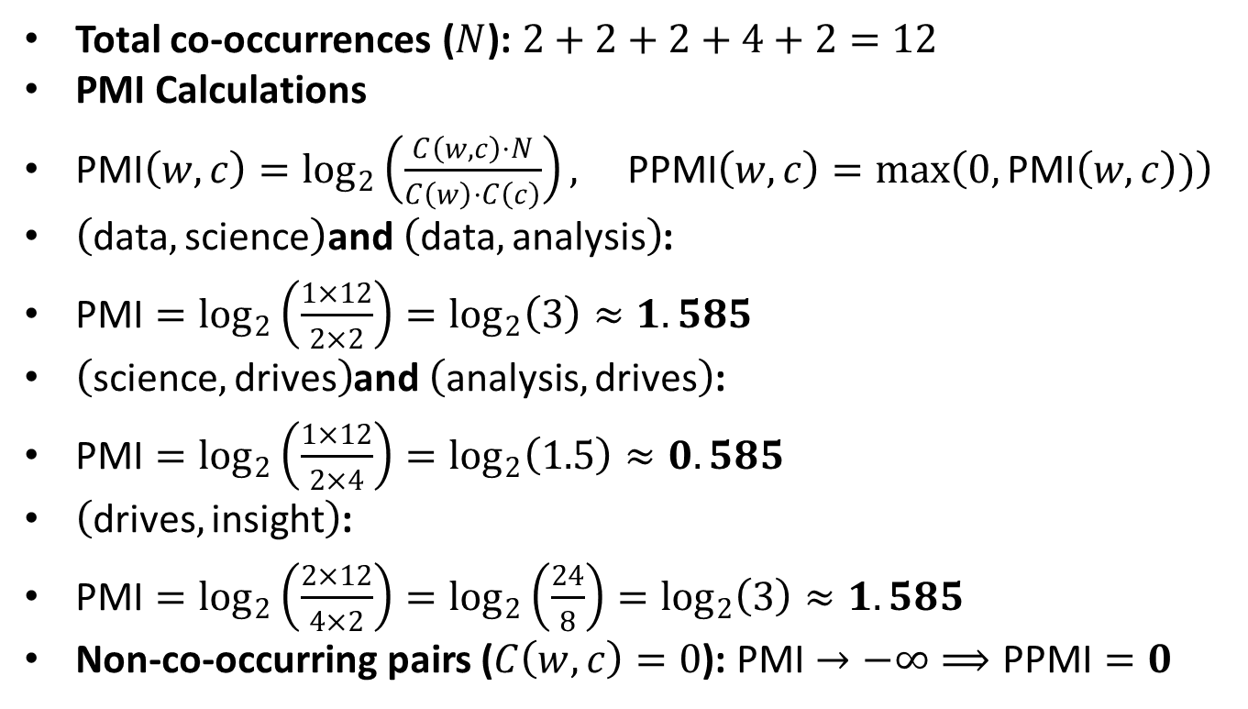
Apply PPMI to Toy Corpus
Total co-occurrences ($N$): $2+2+2+4+2=12$
PMI Calculations
$\text{PMI}\left(w,c\right)=\log_{2}\left(\frac{C\left(w,c\right)⋅N}{C\left(w\right)⋅C\left(c\right)}\right), \text{PPMI}\left(w,c\right)=\max\left(0,\text{PMI}\left(w,c\right))\right)$
$\left(\text{data},\text{science}\right)$and $\left(\text{data},\text{analysis}\right)$:
$\text{PMI}=\log_{2}\left(\frac{1×12}{2×2}\right)=\log_{2}\left(3\right)≈1.585$
$\left(\text{science},\text{drives}\right)$and $\left(\text{analysis},\text{drives}\right)$:
$\text{PMI}=\log_{2}\left(\frac{1×12}{2×4}\right)=\log_{2}\left(1.5\right)≈0.585$
$\left(\text{drives},\text{insight}\right)$:
$\text{PMI}=\log_{2}\left(\frac{2×12}{4×2}\right)=\log_{2}\left(\frac{24}{8}\right)=\log_{2}\left(3\right)≈1.585$
Non-co-occurring pairs ($C\left(w,c\right)=0$): $\text{PMI}→−∞⟹\text{PPMI}=0$

Slide 7
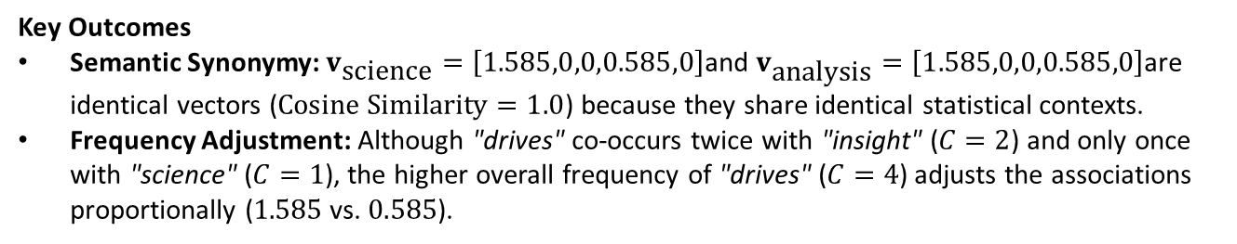
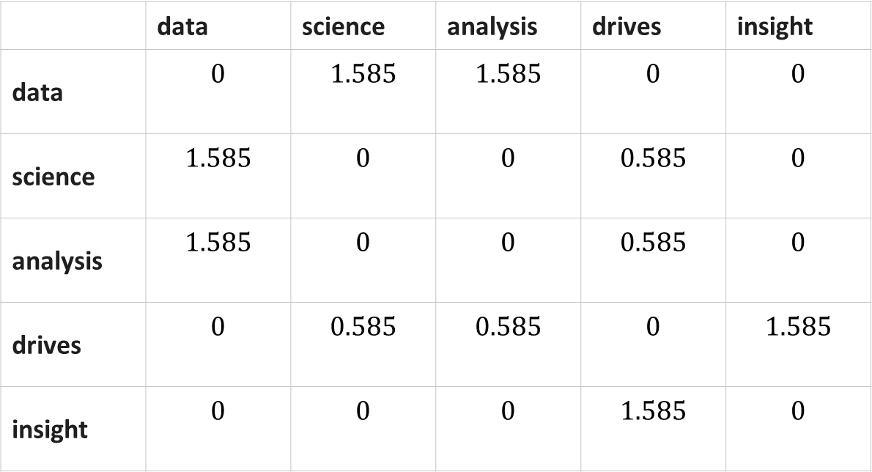
Apply PPMI to Toy Corpus
Final PPMI Matrix
 | data | science | analysis | drives | insight
data | $$0$$ | $$1.585$$ | $$1.585$$ | $$0$$ | $$0$$
science | $$1.585$$ | $$0$$ | $$0$$ | $$0.585$$ | $$0$$
analysis | $$1.585$$ | $$0$$ | $$0$$ | $$0.585$$ | $$0$$
drives | $$0$$ | $$0.585$$ | $$0.585$$ | $$0$$ | $$1.585$$
insight | $$0$$ | $$0$$ | $$0$$ | $$1.585$$ | $$0$$
Key Outcomes
Semantic Synonymy: $v_{\text{science}}=\left[1.585,0,0,0.585,0\right]$and $v_{\text{analysis}}=\left[1.585,0,0,0.585,0\right]$are identical vectors ($\text{Cosine Similarity}=1.0$) because they share identical statistical contexts.
Frequency Adjustment: Although "drives" co-occurs twice with "insight" ($C=2$) and only once with "science" ($C=1$), the higher overall frequency of "drives" ($C=4$) adjusts the associations proportionally ($1.585$ vs. $0.585$).

Slide 8
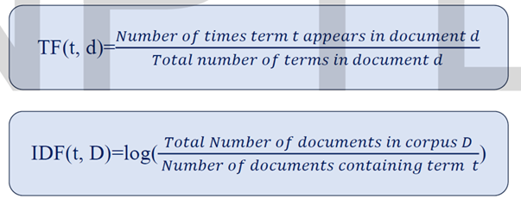
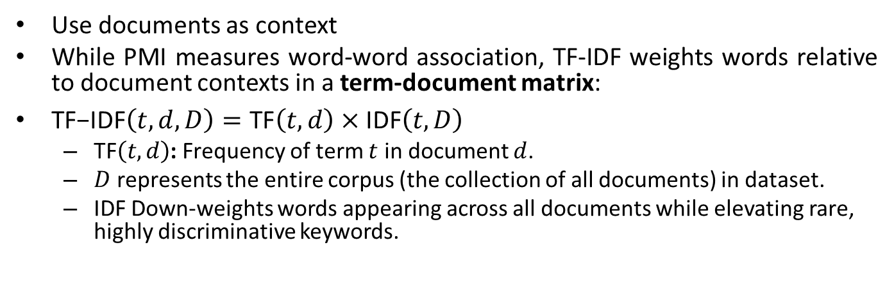
Simpler Method: TF-IDF (Term Frequency – Inverse Document Frequency)
Use documents as context
While PMI measures word-word association, TF-IDF weights words relative to document contexts in a term-document matrix:
$\text{TF−IDF}\left(t,d,D\right)=\text{TF}\left(t,d\right)×\text{IDF}\left(t,D\right)$
  $\text{TF}\left(t,d\right)$: Frequency of term $t$ in document $d$.
  $D$ represents the entire corpus (the collection of all documents) in dataset.
  IDF Down-weights words appearing across all documents while elevating rare, highly discriminative keywords.

Slide 9
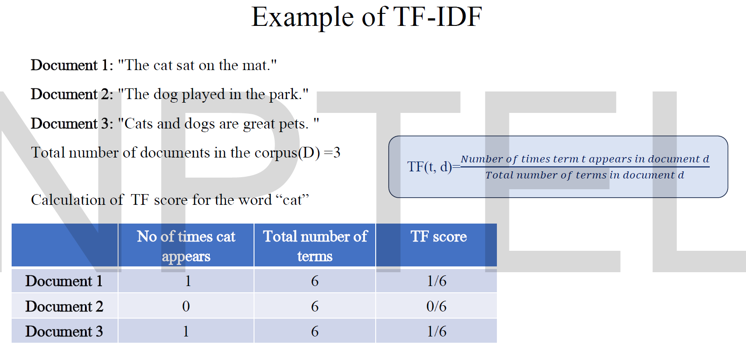
Note: Applied Lemmatization to words: Cat and Dog

Slide 10
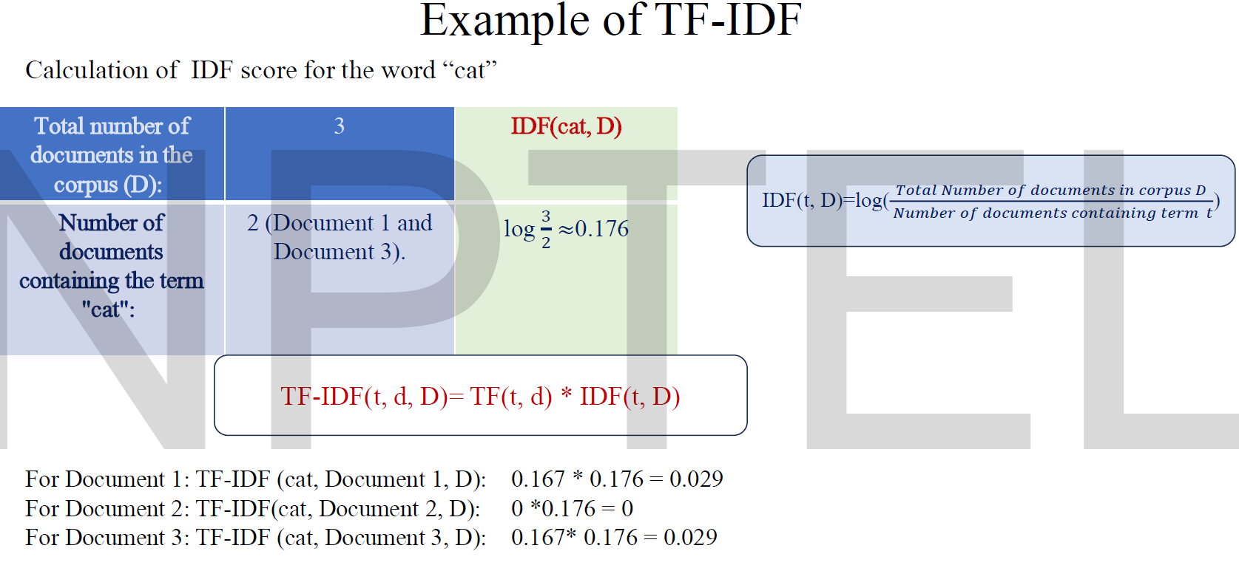
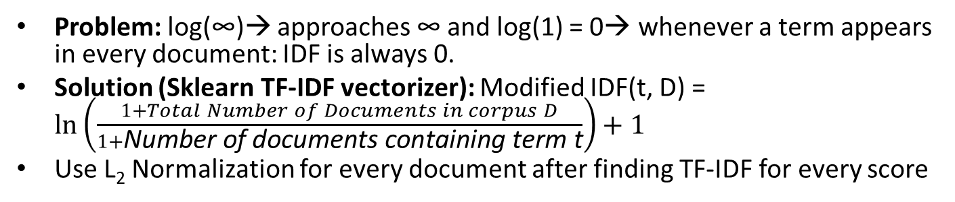
Problem: log(∞)→ approaches ∞ and log(1) = 0→ whenever a term appears in every document: IDF is always 0.
Solution (Sklearn TF-IDF vectorizer): Modified IDF(t, D) = $\ln\left(\frac{1+Total Number of Documents in corpus D}{1+\text{Number of documents containing term t}}\right)+1$
Use L₂ Normalization for every document after finding TF-IDF for every score

Slide 11
A Python Example: TF – IDF Vectorizer
sentences = [
'The stock price of google jumps on the earning data today',
'Google plunge on China Data!'
]
from sklearn.feature_extraction.text import TfidfVectorizer
vectorizer = TfidfVectorizer(stop_words='english')
TFIDF = vectorizer.fit_transform(sentences)
print(vectorizer.get_feature_names_out())
print(TFIDF.shape)
print(TFIDF.toarray())
Output
  ['china' 'data' 'earning' 'google' 'jumps' 'plunge' 'price' 'stock'
  'today']
  (2, 9)
  [[0. 0.29017021 0.4078241 0.29017021 0.4078241 0.
  0.4078241 0.4078241 0.4078241 ]
  [0.57615236 0.40993715 0. 0.40993715 0. 0.57615236
  0. 0. 0. ]]
  Note: The default tokenizer lowercases text, removes punctuation, and filters standard English stop words (the, of, on):

Slide 12
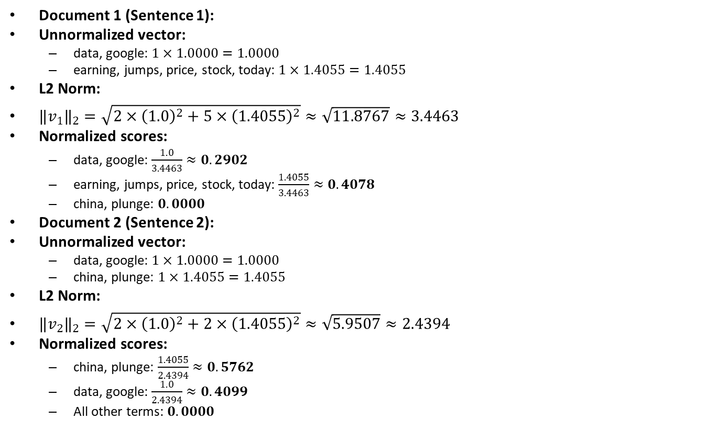
Are Python results with theoretical calculations?
Document 1 (Sentence 1):
Unnormalized vector:
  data, google: $1×1.0000=1.0000$
  earning, jumps, price, stock, today: $1×1.4055=1.4055$
L2 Norm:
$‖v_{1}‖​_{2}=\sqrt{2×{\left(1.0\right)}^{2}+5×{\left(1.4055\right)}^{2}}≈\sqrt{11.8767}≈3.4463$
Normalized scores:
  data, google: $\frac{1.0}{3.4463}≈0.2902$
  earning, jumps, price, stock, today: $\frac{1.4055}{3.4463}≈0.4078$
  china, plunge: $0.0000$
Document 2 (Sentence 2):
Unnormalized vector:
  data, google: $1×1.0000=1.0000$
  china, plunge: $1×1.4055=1.4055$
L2 Norm:
$‖v_{2}‖​_{2}=\sqrt{2×{\left(1.0\right)}^{2}+2×{\left(1.4055\right)}^{2}}≈\sqrt{5.9507}≈2.4394$
Normalized scores:
  china, plunge: $\frac{1.4055}{2.4394}≈0.5762$
  data, google: $\frac{1.0}{2.4394}≈0.4099$
  All other terms: $0.0000$

