Slide 1
Introduction to N-gram Language Models

Slide 2
Language Models (LMs)
  A language model (LM) is a machine learning model that predicts next upcoming words.
More formally:
  An LM assigns a probability to each potential next word
    gives a probability distribution over possible next words
  An LM can assign a probability to a whole sentence

Slide 3
Why word prediction?
It's a helpful part of language tasks:
  Autocomplete
  Grammar or spell checking
  Speech recognition
  Machine translation
It’s how LLMs (Large Language Models) Work:
  LLMs are trained to predict words.
    Left-to-right (autoregressive) LMs learn to predict the next word.
  LLMs generate text by predicting words
    By predicting the next word over and over again

Slide 4
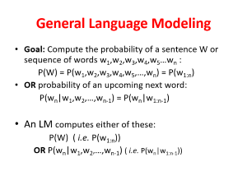

General Language Modeling
Goal: Compute the probability of a sentence W or sequence of words w₁,w₂,w₃,w₄,w₅…w_{n} :
  P(W) = P(w₁,w₂,w₃,w₄,w₅,…,w_{n}) = P(w_{1:n})
OR probability of an upcoming next word:
  P(w_{n}|w₁,w₂,…,w_{n-1}) = P(w_{n}|w_{1:n-1})
An LM computes either of these:
  P(W) ( i.e. P(w_{1:n}))
  OR P(w_{n}|w₁,w₂,…,w_{n-1}) ( i.e. P(w_{n}|w_{1:n-1}))

Slide 5
How to compute P(W) or P(w_{n}|w₁, …,w_{n-1}) ?
The joint probability P(W) = P(w₁,w₂,w₃,w₄,w₅…w_{n}) = P(w_{1:n})
Rely on the Chain Rule of Probability
Reminder: The Chain Rule
Recall the definition of conditional probabilities
  P(B|A) = P(A,B)/P(A) →Rewriting: P(A,B) = P(A) P(B|A)
More variables:
  P(A,B,C,D) = P(A) P(B|A) P(C|A,B) P(D|A,B,C)
The Chain Rule in General:
P(w₁,w₂,w₃,…,w_{n}) = P(w_{1:n})
= P(w₁)P(w₂|w₁)P(w₃|w₁,w₂)…P(w_{n}|w₁,…,w_{n-1})
= P(w₁)P(w₂|w₁)P(w₃|w_{1:2})…P(w_{n}|w_{1:n-1})

Slide 6
The Chain Rule applied to compute joint probability of words in sentence:
P(“The water of Walden Pond”) =
P(The) × P(water|The) × P(of|The water)
× P(Walden|The water of) × P(Pond|The water of Walden)
The Problem: Long conditioning histories become impossible to compute because sequences never repeat identically in finite text.

Slide 7
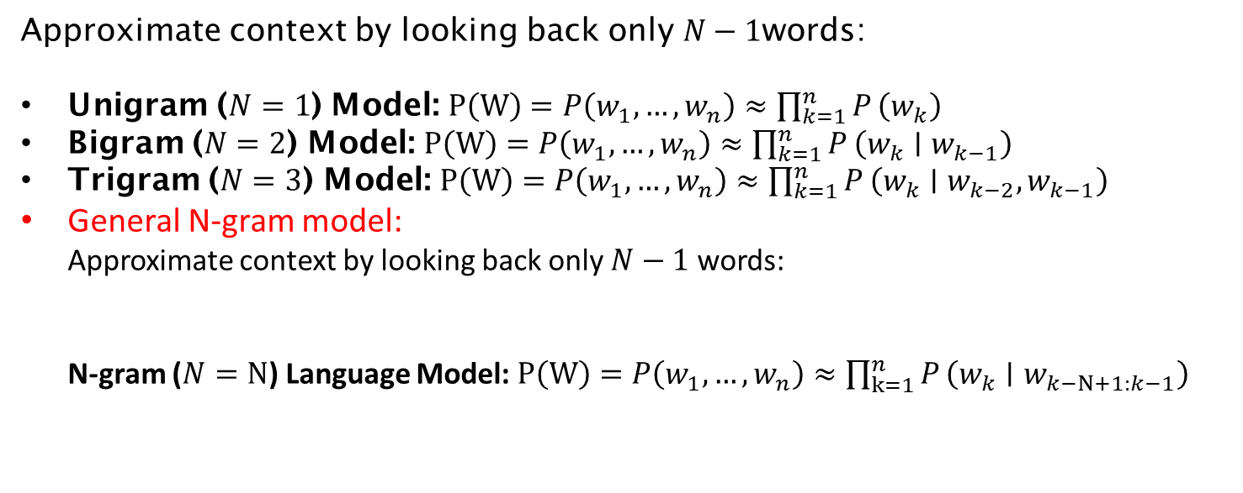
Solution: Markov Approximation
Approximate context by looking back only $N−1$words:
Unigram ($N=1$) Model: $P\left(W\right)=P\left(w_{1},…,w_{n}\right)≈\prod_{k=1}^{n}{P}\left(w_{k}\right)$
Bigram ($N=2$) Model: $P\left(W\right)=P\left(w_{1},…,w_{n}\right)≈\prod_{k=1}^{n}{P}\left(w_{k}∣w_{k−1}\right)$
Trigram ($N=3$) Model: $P\left(W\right)=P\left(w_{1},…,w_{n}\right)≈\prod_{k=1}^{n}{P}\left(w_{k}∣w_{k−2},w_{k−1}\right)$
General N-gram model:
  Approximate context by looking back only $N−1$ words:
  N-gram ($N=N$) Language Model: $P\left(W\right)=P\left(w_{1},…,w_{n}\right)≈\prod_{k=1}^{n}{P}\left(w_{k}∣w_{k−N+1:k−1}\right)$

Slide 8
Language Models: N-grams
N-gram language model predicts the probability of the next word given (N-1) previous words:
  N=1 → Unigram
  N=2 → Bigram
  N=3 → Trigram
Example:
  "I love natural language processing”
Unigrams (N=1):
  [ "I", "love", "natural", "language", "processing" ]
Bigrams (N=2):
  [ "I love", "love natural", "natural language", "language processing" ]
Trigrams (N=3):
  [ "I love natural", "love natural language", "natural language processing" ]

Slide 9
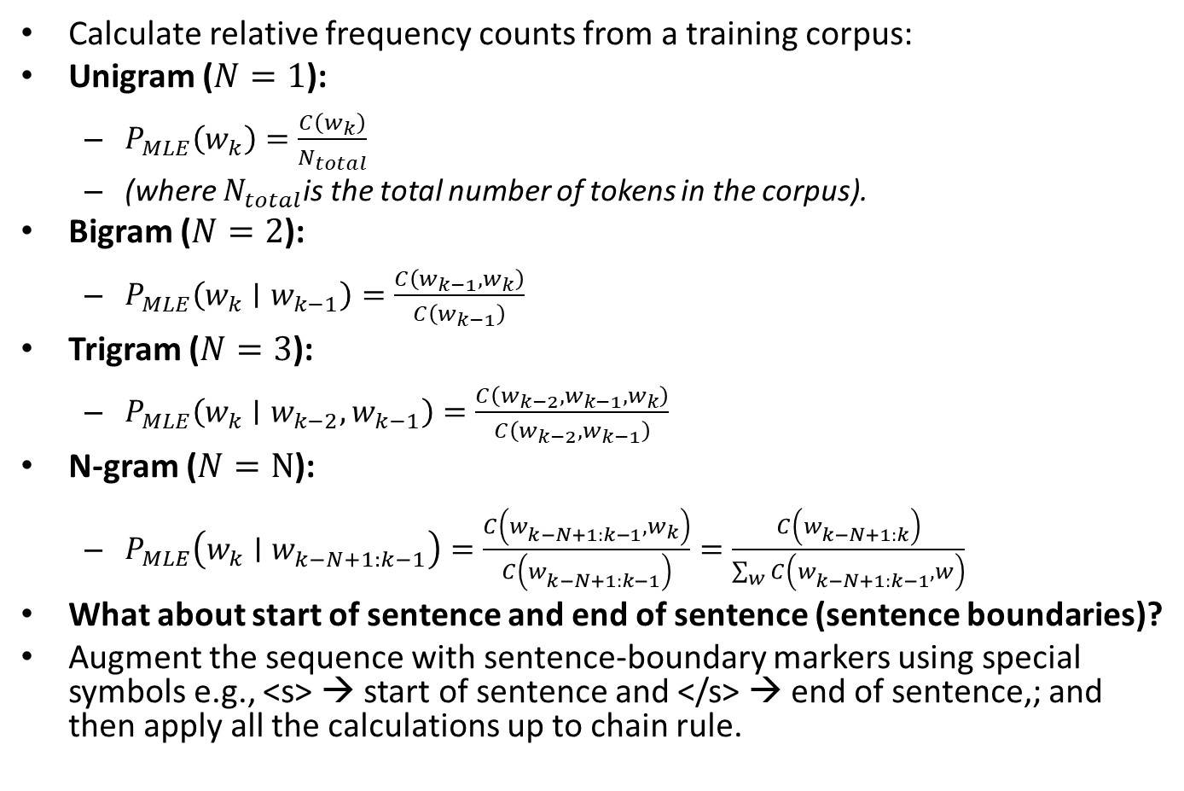
Estimating probabilities using Maximum Likelihood Estimation (MLE) :
Calculate relative frequency counts from a training corpus:
Unigram ($N=1$):
  $P_{MLE}\left(w_{k}\right)=\frac{C\left(w_{k}\right)}{N_{total}}$
  (where $N_{total}$is the total number of tokens in the corpus).
Bigram ($N=2$):
  $P_{MLE}\left(w_{k}∣w_{k−1}\right)=\frac{C\left(w_{k−1},w_{k}\right)}{C\left(w_{k−1}\right)}$
Trigram ($N=3$):
  $P_{MLE}\left(w_{k}∣w_{k−2},w_{k−1}\right)=\frac{C\left(w_{k−2},w_{k−1},w_{k}\right)}{C\left(w_{k−2},w_{k−1}\right)}$
N-gram ($N=N$):
  $P_{MLE}\left(w_{k}∣w_{k−N+1:k−1}^{}\right)=\frac{C\left(w_{k−N+1:k−1}^{},w_{k}\right)}{C\left(w_{k−N+1:k−1}^{}\right)}=\frac{C\left(w_{k−N+1:k}^{}\right)}{\sum_{w}{C}\left(w_{k−N+1:k−1}^{},w\right)}$
What about start of sentence and end of sentence (sentence boundaries)?
Augment the sequence with sentence-boundary markers using special symbols e.g., <s> → start of sentence and </s> → end of sentence,; and then apply all the calculations up to chain rule.

Slide 10
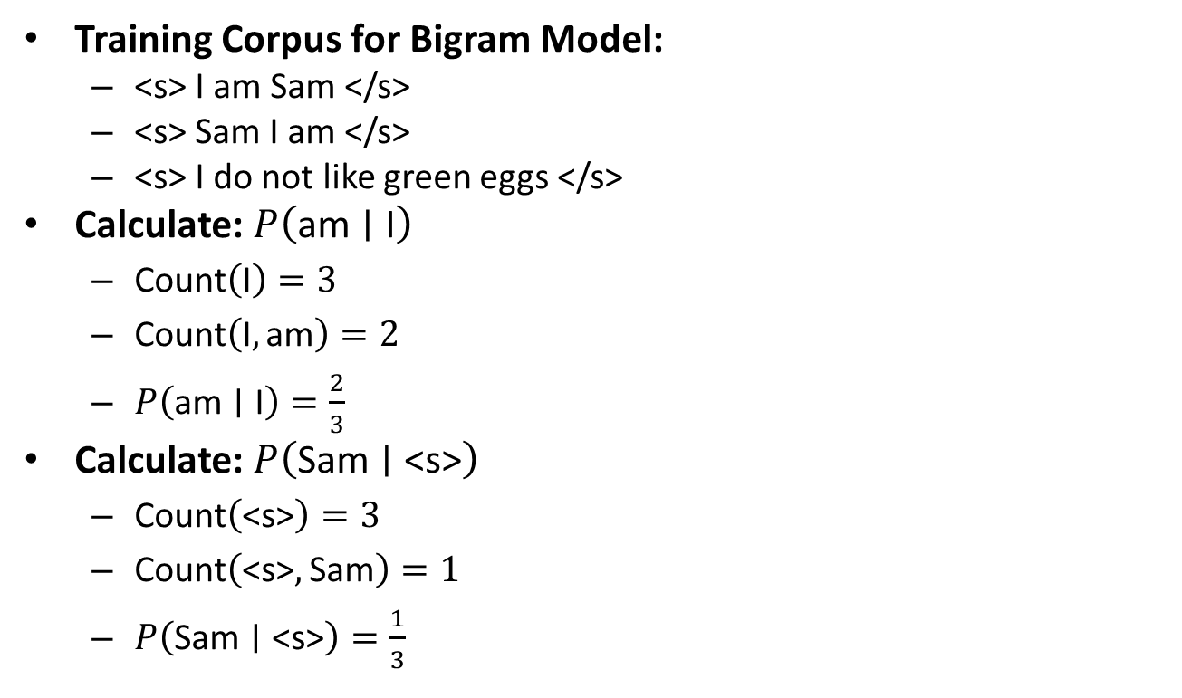
An example:
Training Corpus for Bigram Model:
  <s> I am Sam </s>
  <s> Sam I am </s>
  <s> I do not like green eggs </s>
Calculate: $P\left(\text{am}∣\text{I}\right)$
  $\text{Count}\left(\text{I}\right)=3$
  $\text{Count}\left(\text{I},\text{am}\right)=2$
  $P\left(\text{am}∣\text{I}\right)=\frac{2}{3}$
Calculate: $P\left(\text{Sam}∣\text{<s>}\right)$
  $\text{Count}\left(\text{<s>}\right)=3$
  $\text{Count}\left(\text{<s>},\text{Sam}\right)=1$
  $P\left(\text{Sam}∣\text{<s>}\right)=\frac{1}{3}$

Slide 11
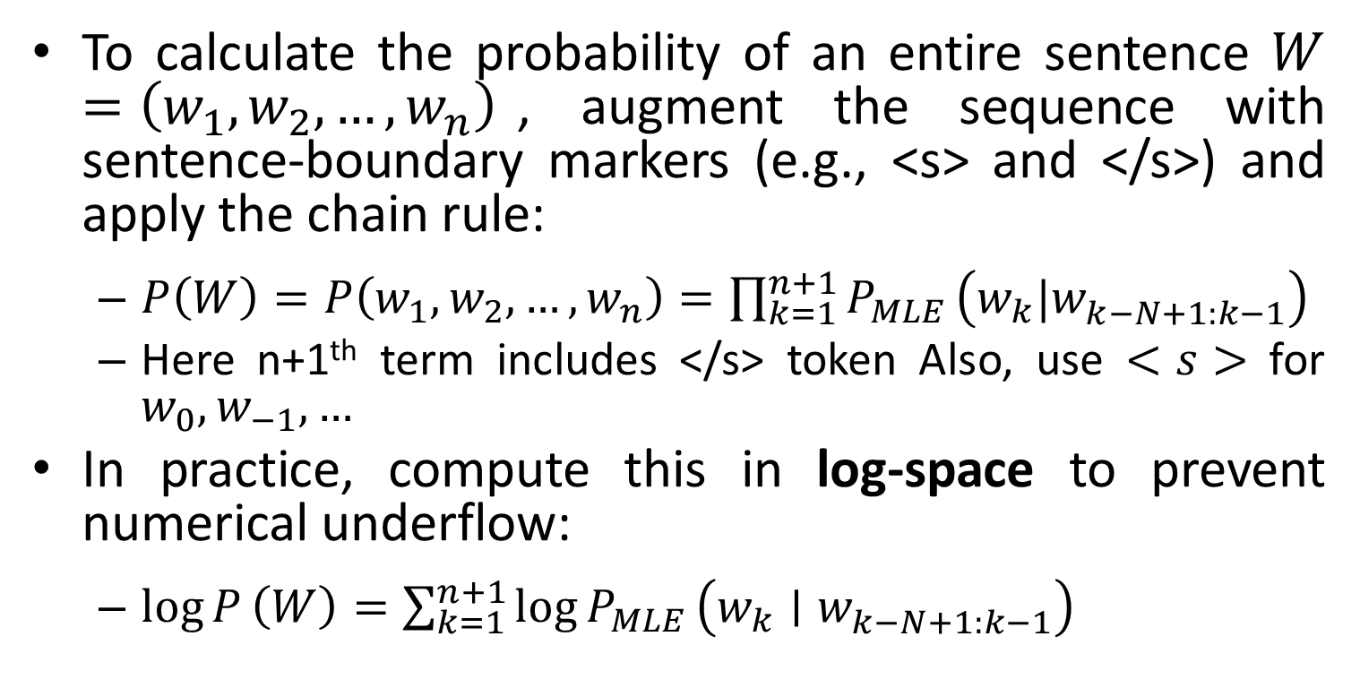
Estimating probabilities using Maximum Likelihood Estimation (MLE) :
To calculate the probability of an entire sentence $W=\left(w_{1},w_{2},…,w_{n}\right)$, augment the sequence with sentence-boundary markers (e.g., <s> and </s>) and apply the chain rule:
  $P\left(W\right)=P\left(w_{1},w_{2},…,w_{n}\right)=\prod_{k=1}^{n+1}{P_{MLE}}\left(w_{k}|w_{k−N+1:k−1}^{}\right)$
  Here n+1th term includes </s> token Also, use $<s>$ for $w_{0},w_{−1},…$
In practice, compute this in log-space to prevent numerical underflow:
  $\log{P}\left(W\right)=\sum_{k=1}^{n+1}{{\log{P}}_{MLE}}\left(w_{k}∣w_{k−N+1:k−1}^{}\right)$

Slide 12
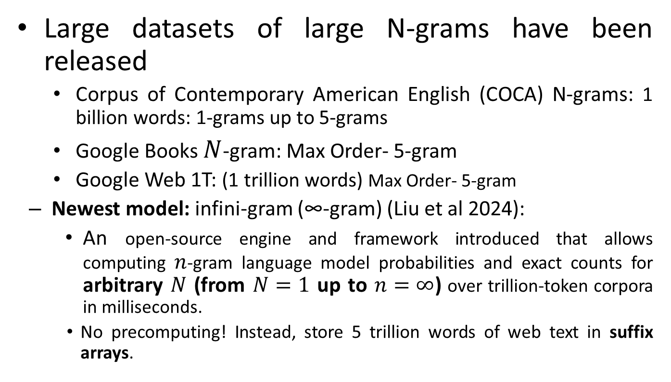
Larger N-grams: Dataset?
Large datasets of large N-grams have been released
  Corpus of Contemporary American English (COCA) N-grams: 1 billion words: 1-grams up to 5-grams
  Google Books $N$-gram: Max Order- 5-gram
  Google Web 1T: (1 trillion words) Max Order- 5-gram
  Newest model: infini-gram (∞-gram) (Liu et al 2024):
    An open-source engine and framework introduced that allows computing $n$-gram language model probabilities and exact counts for arbitrary $N$ (from $N=1$ up to $n=∞$) over trillion-token corpora in milliseconds.
    No precomputing! Instead, store 5 trillion words of web text in suffix arrays.

Slide 13
Problems with N-gram models
N-grams can't handle long-term dependencies:
  “The soups that I made from that new cookbook I bought yesterday were amazingly delicious."
N-grams don't do well at modeling new sequences (even if they have similar meanings to sequences, they've seen)
→ The solution: Large language models (LLMs)
Can handle much longer contexts because they use neural embedding spaces, can model meaning better

Slide 14
Why study N-gram models?
They are the "fruit fly of NLP“ - a simple model that introduces important topics for large language models (LLMs)
  training and testing datasets
  the perplexity performance metric
  sampling to generate sentences
  ideas like interpolation and backoff
  N-grams are efficient and fast and useful in situations where LLMs are too heavyweight

Slide 15
How to Evaluate Performance of N-gram Language Models ?

Slide 16
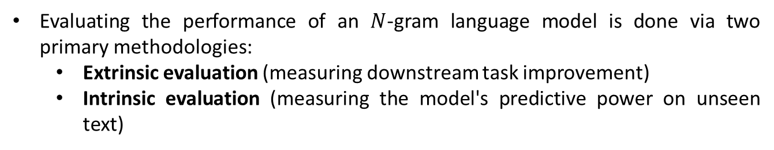
How to evaluate performance of N-gram models?
Evaluating the performance of an $N$-gram language model is done via two primary methodologies:
  Extrinsic evaluation (measuring downstream task improvement)
  Intrinsic evaluation (measuring the model's predictive power on unseen text)
"Extrinsic (in-vivo) Evaluation"
To compare models A and B
  Put each model in a real task
    Machine Translation, speech recognition, etc.
  Run the task, get accuracy score for A and for B:
    How many words translated correctly
    How many words transcribed correctly
  Compare accuracy for A and B
Extrinsic evaluation not always possible
  Expensive, time-consuming
  Doesn't always generalize to other applications

Slide 17
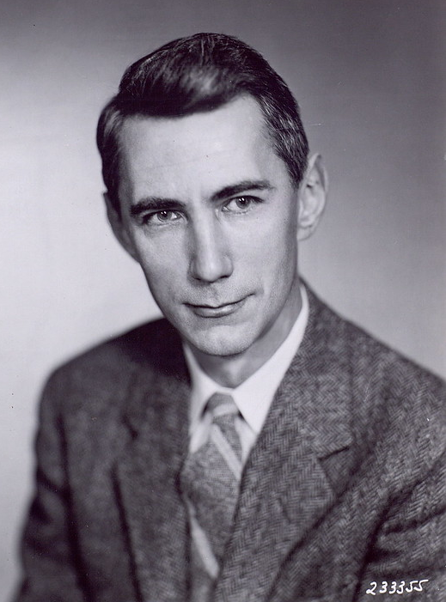
Intrinsic (in-vitro) evaluation
Perplexity:
  An evaluation metric (like perplexity) tells us how well our model does on the test set.
  Directly measures language model performance at predicting words.
  Doesn't necessarily correspond with real application performance but gives us a single general metric for language models
  Useful for large language models (LLMs) as well as N-grams
  Perplexity is directly derived from Claude Shannon’s foundational work in Information Theory (1948) and his 1951 paper, "Prediction and Entropy of Printed English.“
  Perplexity translates Shannon's abstract measure of information (bits) into an intuitive, physical scale representing word-choice uncertainty.
Claude Shannon

Slide 18
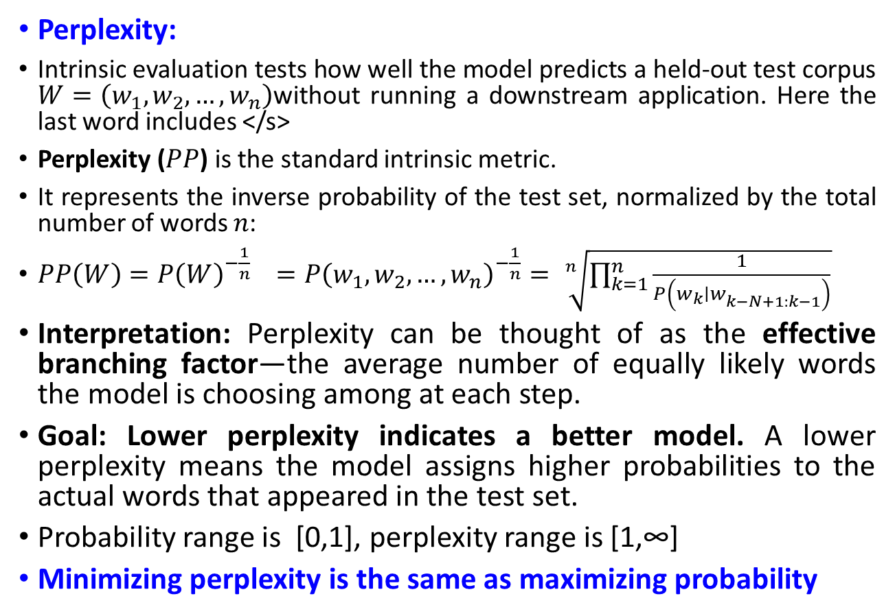
Intrinsic (in-vitro) evaluation
Perplexity:
Intrinsic evaluation tests how well the model predicts a held-out test corpus $W=\left(w_{1},w_{2},…,w_{n}\right)$without running a downstream application. Here the last word includes </s>
Perplexity ($PP$) is the standard intrinsic metric.
It represents the inverse probability of the test set, normalized by the total number of words $n$:
$PP\left(W\right)=P{\left(W\right)}^{−\frac{1}{n}} =P{\left(w_{1},w_{2},…,w_{n}\right)}^{−\frac{1}{n}}= \sqrt[n]{\prod_{k=1}^{n}{\frac{1}{P\left(w_{k}∣w_{k−N+1:k−1}^{}\right)}}}$
Interpretation: Perplexity can be thought of as the effective branching factor—the average number of equally likely words the model is choosing among at each step.
Goal: Lower perplexity indicates a better model. A lower perplexity means the model assigns higher probabilities to the actual words that appeared in the test set.
Probability range is [0,1], perplexity range is [1,∞]
Minimizing perplexity is the same as maximizing probability

Slide 19
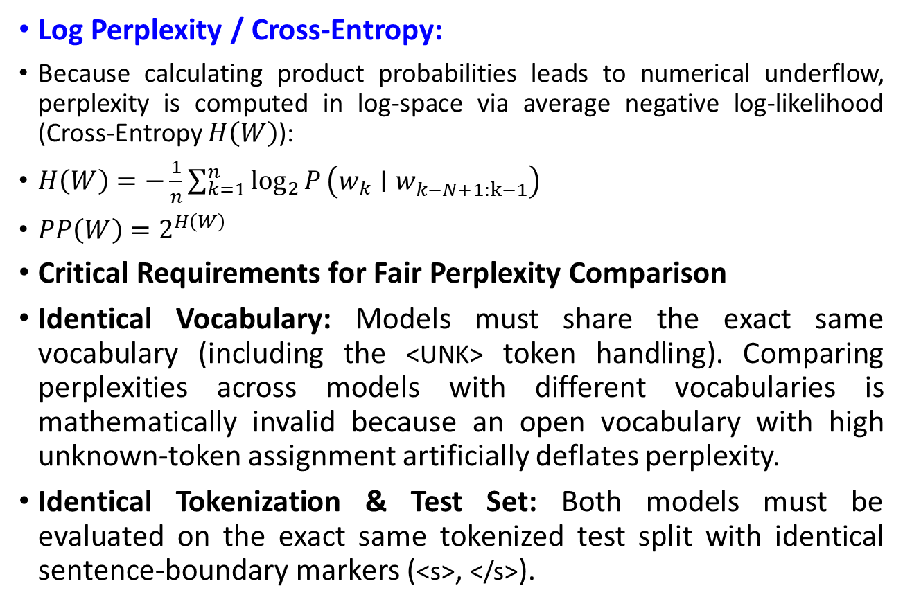
Intrinsic (in-vitro) evaluation
Log Perplexity / Cross-Entropy:
Because calculating product probabilities leads to numerical underflow, perplexity is computed in log-space via average negative log-likelihood (Cross-Entropy $H\left(W\right)$):
$H\left(W\right)=−\frac{1}{n}\sum_{k=1}^{n}{\log_{2}{P}}\left(w_{k}∣w_{k−N+1:k−1}^{}\right)$
$PP\left(W\right)=2^{H\left(W\right)}$
Critical Requirements for Fair Perplexity Comparison
Identical Vocabulary: Models must share the exact same vocabulary (including the <UNK> token handling). Comparing perplexities across models with different vocabularies is mathematically invalid because an open vocabulary with high unknown-token assignment artificially deflates perplexity.
Identical Tokenization & Test Set: Both models must be evaluated on the exact same tokenized test split with identical sentence-boundary markers (<s>, </s>).

Slide 20
Example:
Training Corpus for Bigram Model:
  <s> I am Sam </s>
  <s> Sam I am </s>
  <s> I do not like green eggs </s>
Test Sequence
  <s> I am Sam </s>
Estimate probability of Test sequence using MLE.
Find Perplexity score using direct formula and using Cross Entropy.
Repeat the task for Trigram model.
Interpret the results.

Slide 21
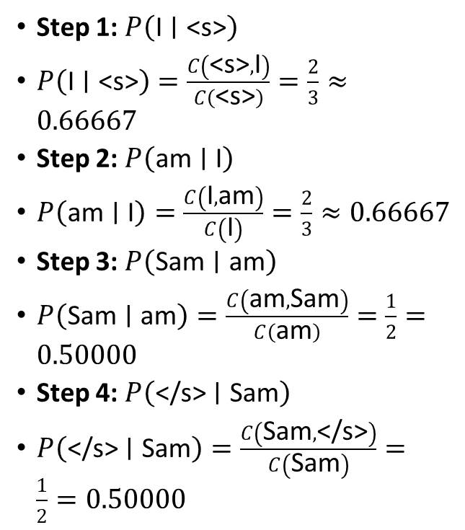
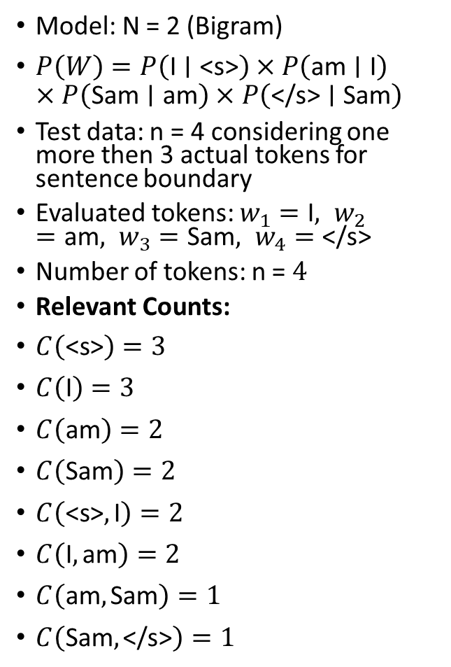
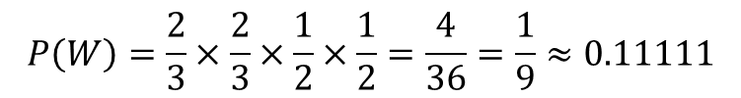
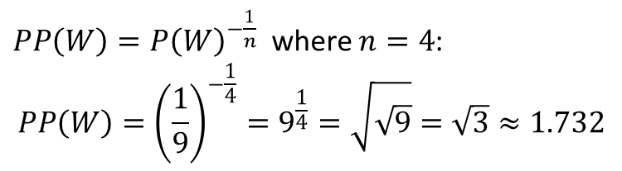
Solution:
Step 1: $P\left(\text{I}∣\text{<s>}\right)$
$P\left(\text{I}∣\text{<s>}\right)=\frac{C\left(\text{<s>},\text{I}\right)}{C\left(\text{<s>}\right)}=\frac{2}{3}≈0.66667$
Step 2: $P\left(\text{am}∣\text{I}\right)$
$P\left(\text{am}∣\text{I}\right)=\frac{C\left(\text{I},\text{am}\right)}{C\left(\text{I}\right)}=\frac{2}{3}≈0.66667$
Step 3: $P\left(\text{Sam}∣\text{am}\right)$
$P\left(\text{Sam}∣\text{am}\right)=\frac{C\left(\text{am},\text{Sam}\right)}{C\left(\text{am}\right)}=\frac{1}{2}=0.50000$
Step 4: $P\left(\text{</s>}∣\text{Sam}\right)$
$P\left(\text{</s>}∣\text{Sam}\right)=\frac{C\left(\text{Sam},\text{</s>}\right)}{C\left(\text{Sam}\right)}=\frac{1}{2}=0.50000$
Model: N = 2 (Bigram)
$P\left(W\right)=P\left(\text{I}∣\text{<s>}\right)×P\left(\text{am}∣\text{I}\right)×P\left(\text{Sam}∣\text{am}\right)×P\left(\text{</s>}∣\text{Sam}\right)$
Test data: n = 4 considering one more then 3 actual tokens for sentence boundary
Evaluated tokens: $w_{1}=\text{I}, w_{2}=\text{am}, w_{3}=\text{Sam}, w_{4}=\text{</s>}$
Number of tokens: n = $4$
Relevant Counts:
$C\left(\text{<s>}\right)=3$
$C\left(\text{I}\right)=3$
$C\left(\text{am}\right)=2$
$C\left(\text{Sam}\right)=2$
$C\left(\text{<s>},\text{I}\right)=2$
$C\left(\text{I},\text{am}\right)=2$
$C\left(\text{am},\text{Sam}\right)=1$
$C\left(\text{Sam},\text{</s>}\right)=1$
$$P\left(W\right)=\frac{2}{3}×\frac{2}{3}×\frac{1}{2}×\frac{1}{2}=\frac{4}{36}=\frac{1}{9}≈0.11111$$
$PP\left(W\right)=P{\left(W\right)}^{−\frac{1}{n}}$ where $n=4$:
$$PP\left(W\right)={\left(\frac{1}{9}\right)}^{−\frac{1}{4}}=9^{\frac{1}{4}}=\sqrt{\sqrt{9}}=\sqrt{3}≈1.732$$

Slide 22
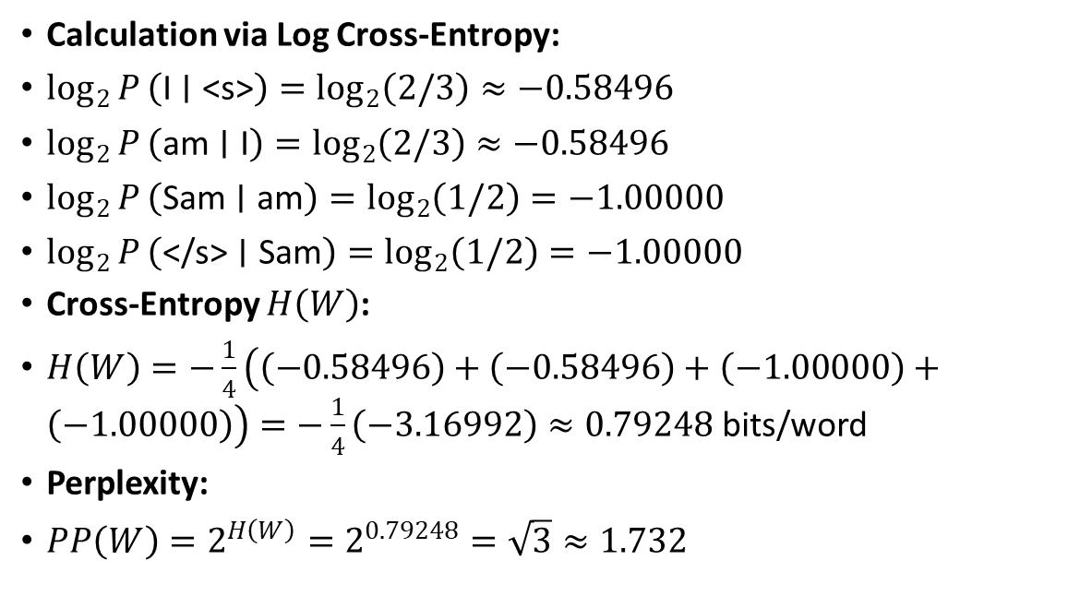
Solution:
Calculation via Log Cross-Entropy:
$\log_{2}{P}\left(\text{I}∣\text{<s>}\right)=\log_{2}\left(2/3\right)≈−0.58496$
$\log_{2}{P}\left(\text{am}∣\text{I}\right)=\log_{2}\left(2/3\right)≈−0.58496$
$\log_{2}{P}\left(\text{Sam}∣\text{am}\right)=\log_{2}\left(1/2\right)=−1.00000$
$\log_{2}{P}\left(\text{</s>}∣\text{Sam}\right)=\log_{2}\left(1/2\right)=−1.00000$
Cross-Entropy $H\left(W\right)$:
$H\left(W\right)=−\frac{1}{4}\left(\left(−0.58496\right)+\left(−0.58496\right)+\left(−1.00000\right)+\left(−1.00000\right)\right)=−\frac{1}{4}\left(−3.16992\right)≈0.79248\text{ bits/word}$
Perplexity:
$PP\left(W\right)=2^{H\left(W\right)}=2^{0.79248}=\sqrt{3}≈1.732$

Slide 23
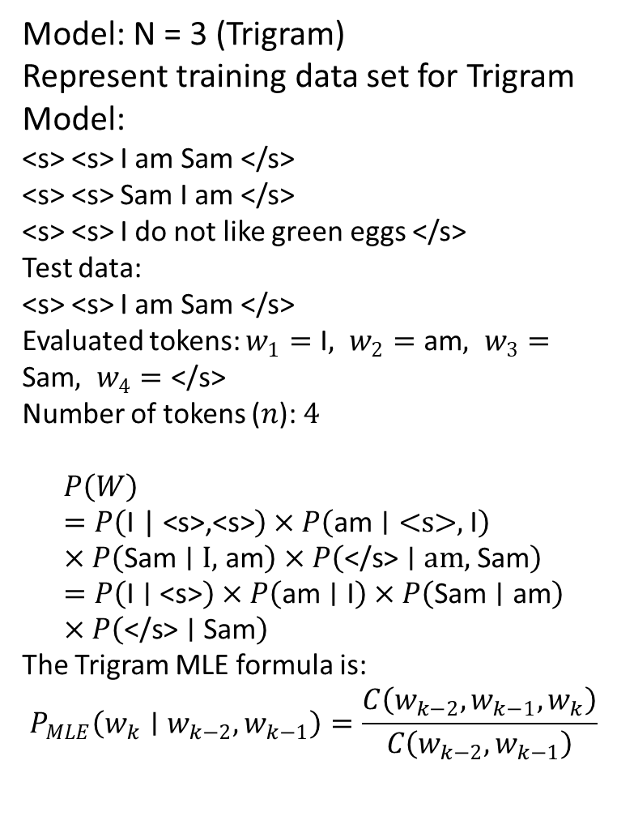
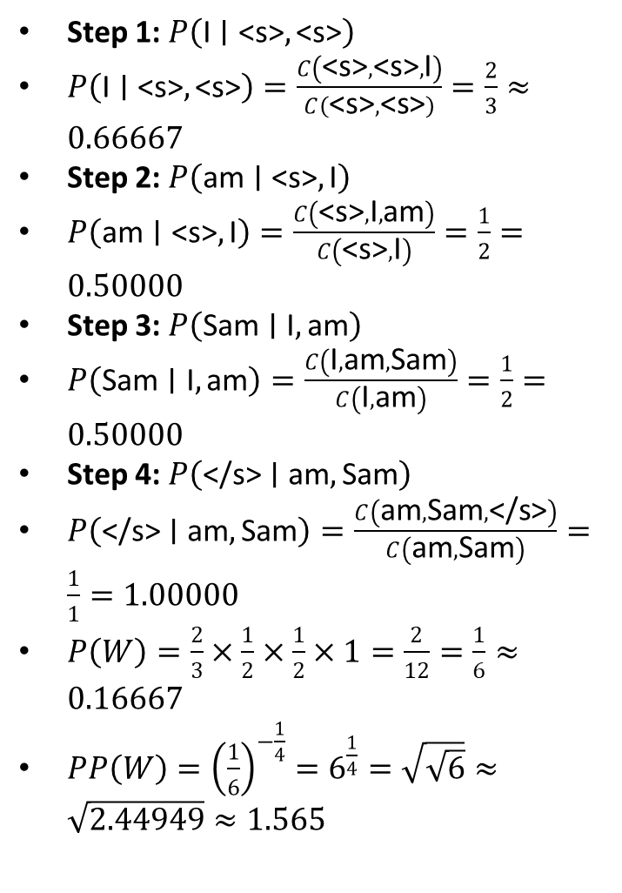
Solution:
Model: N = 3 (Trigram)
Represent training data set for Trigram Model:
<s> <s> I am Sam </s>
<s> <s> Sam I am </s>
<s> <s> I do not like green eggs </s>
Test data:
<s> <s> I am Sam </s>
Evaluated tokens: $w_{1}=\text{I}, w_{2}=\text{am}, w_{3}=\text{Sam}, w_{4}=\text{</s>}$
Number of tokens ($n$): $4$
$$P\left(W\right)=P\left(\text{I}\text{ | <s>,<s>}\right)×P\left(\text{am}∣\text{<s>, }\text{I}\right)×P\left(\text{Sam}∣\text{I, }\text{am}\right)×P\left(\text{</s>}∣\text{am, }\text{Sam}\right)=P\left(\text{I}∣\text{<s>}\right)×P\left(\text{am}∣\text{I}\right)×P\left(\text{Sam}∣\text{am}\right)×P\left(\text{</s>}∣\text{Sam}\right)$$
The Trigram MLE formula is:
$$P_{MLE}\left(w_{k}∣w_{k−2},w_{k−1}\right)=\frac{C\left(w_{k−2},w_{k−1},w_{k}\right)}{C\left(w_{k−2},w_{k−1}\right)}$$
Step 1: $P\left(\text{I}∣\text{<s>},\text{<s>}\right)$
$P\left(\text{I}∣\text{<s>},\text{<s>}\right)=\frac{C\left(\text{<s>},\text{<s>},\text{I}\right)}{C\left(\text{<s>},\text{<s>}\right)}=\frac{2}{3}≈0.66667$
Step 2: $P\left(\text{am}∣\text{<s>},\text{I}\right)$
$P\left(\text{am}∣\text{<s>},\text{I}\right)=\frac{C\left(\text{<s>},\text{I},\text{am}\right)}{C\left(\text{<s>},\text{I}\right)}=\frac{1}{2}=0.50000$
Step 3: $P\left(\text{Sam}∣\text{I},\text{am}\right)$
$P\left(\text{Sam}∣\text{I},\text{am}\right)=\frac{C\left(\text{I},\text{am},\text{Sam}\right)}{C\left(\text{I},\text{am}\right)}=\frac{1}{2}=0.50000$
Step 4: $P\left(\text{</s>}∣\text{am},\text{Sam}\right)$
$P\left(\text{</s>}∣\text{am},\text{Sam}\right)=\frac{C\left(\text{am},\text{Sam},\text{</s>}\right)}{C\left(\text{am},\text{Sam}\right)}=\frac{1}{1}=1.00000$
$P\left(W\right)=\frac{2}{3}×\frac{1}{2}×\frac{1}{2}×1=\frac{2}{12}=\frac{1}{6}≈0.16667$
$PP\left(W\right)={\left(\frac{1}{6}\right)}^{−\frac{1}{4}}=6^{\frac{1}{4}}=\sqrt{\sqrt{6}}≈\sqrt{2.44949}≈1.565$

Slide 24
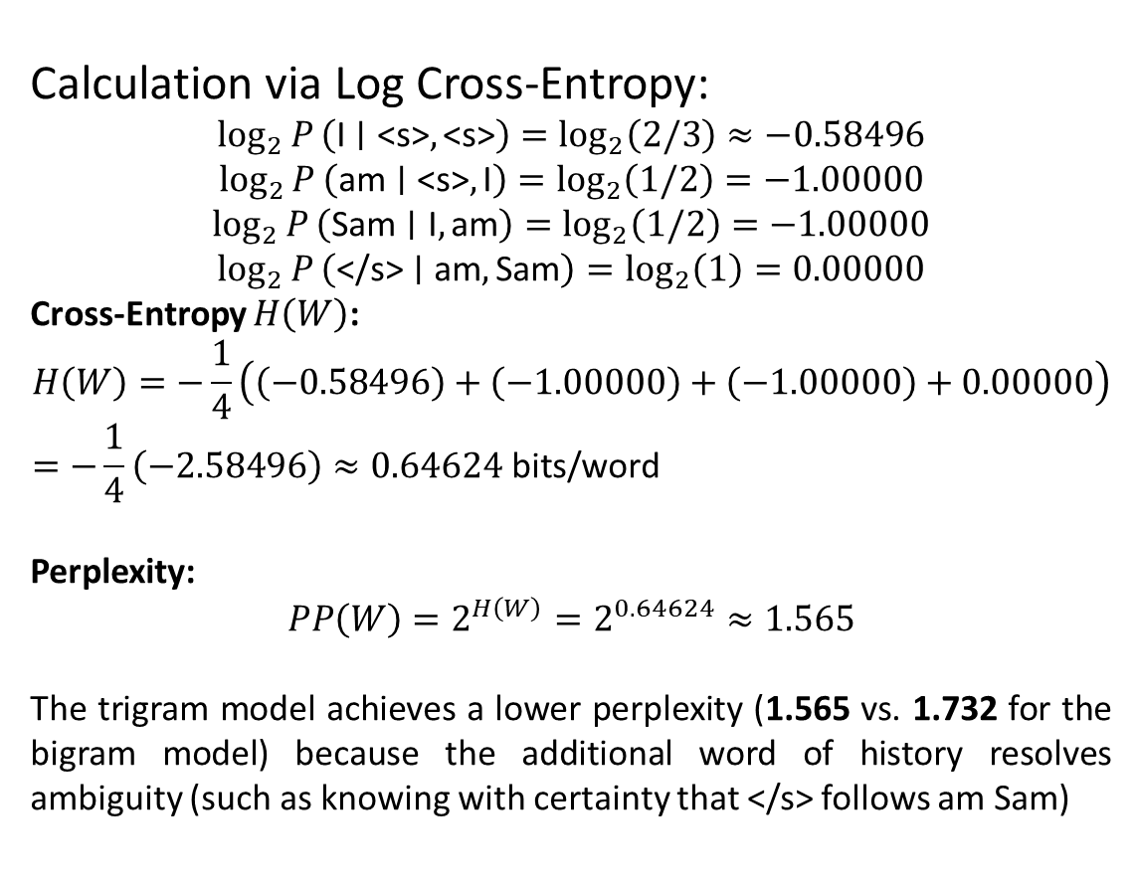
Solution:
Calculation via Log Cross-Entropy:
$$\log_{2}{P}\left(\text{I}∣\text{<s>},\text{<s>}\right)=\log_{2}\left(2/3\right)≈−0.58496$$
$$\log_{2}{P}\left(\text{am}∣\text{<s>},\text{I}\right)=\log_{2}\left(1/2\right)=−1.00000$$
$$\log_{2}{P}\left(\text{Sam}∣\text{I},\text{am}\right)=\log_{2}\left(1/2\right)=−1.00000$$
$$\log_{2}{P}\left(\text{</s>}∣\text{am},\text{Sam}\right)=\log_{2}\left(1\right)=0.00000$$
Cross-Entropy $H\left(W\right)$:
$$H\left(W\right)=−\frac{1}{4}\left(\left(−0.58496\right)+\left(−1.00000\right)+\left(−1.00000\right)+0.00000\right)=−\frac{1}{4}\left(−2.58496\right)≈0.64624\text{ bits/word}$$
Perplexity:
$$PP\left(W\right)=2^{H\left(W\right)}=2^{0.64624}≈1.565$$
The trigram model achieves a lower perplexity (1.565 vs. 1.732 for the bigram model) because the additional word of history resolves ambiguity (such as knowing with certainty that </s> follows am Sam)
Holding test set constant: Lower perplexity = better language model

