Slide 1
UNIT 2 · TECHNOLOGY FOR IoT
Programming for IoT
From code structure to digital & analog I/O on the ESP32
Code Structure
Directives
setup() / loop()
digitalRead/Write
analogRead/Write
01

Slide 2
ROADMAP
What We'll Cover Today
01
Basic structure of an ESP32 / Arduino program
05
digitalWrite() and digitalRead()
02
Preprocessor directives (#include, #define)
06
Analog signals, ADC, analogRead()
03
setup() and loop() — the two core functions
07
PWM & analogWrite()
04
GPIO pins & pinMode()
02

Slide 3
GETTING STARTED
Writing a Program for the ESP32
A program for a microcontroller is called a sketch — written in a simplified C/C++.
The Arduino IDE compiles the sketch and uploads it to the ESP32 over USB.
The board then runs that code independently, over and over, reading sensors and controlling outputs.
Every sketch follows the same predictable skeleton — once you know it, any new sketch is easy to read.
CODE → UPLOAD → RUN
1
Write sketch
in Arduino IDE
2
Upload via USB
(compiled to machine code)
3
ESP32 runs code
repeatedly
03

Slide 4
FOUNDATION
The Basic Structure of a Sketch
Every ESP32 / Arduino program has exactly three parts, always in this order.
1
Directives
// 1. DIRECTIVES
#include <Library.h>
#define LED_PIN 2
// 2. setup() -- runs ONCE
void setup() {
pinMode(LED_PIN, OUTPUT);
}
// 3. loop() -- runs FOREVER
void loop() {
digitalWrite(LED_PIN, HIGH);
}
Setup instructions for the compiler — libraries and constants.
2
setup()
Runs a single time when the board powers on or resets.
3
loop()
Runs continuously, forever, right after setup() finishes.
04

Slide 5
PART 1
Preprocessor Directives
Directives begin with # and are handled before compilation even starts.
#include brings in a library's ready-made functions, e.g. WiFi or sensor drivers.
#define creates a named constant that is swapped in everywhere it's used — easy to update once.
Directives don't end with a semicolon, unlike normal C++ statements.
#include <WiFi.h>
#define LED_PIN 2
#define BAUD_RATE 115200
Tip: Think of #define as a global find-and-replace performed before your code even compiles.
05

Slide 6
PART 2
void setup() — Runs Once
Called a single time, right after the ESP32 boots up or is reset.
Used for one-time preparation: configuring pin modes and starting communication.
Typical jobs: pinMode(), Serial.begin(), connecting to Wi-Fi.
Once setup() finishes, control passes automatically to loop().
void setup() {
pinMode(ledPin, OUTPUT);
pinMode(switchPin, INPUT);
Serial.begin(115200);
}
06

Slide 7
PART 3
void loop() — Runs Forever
Executes immediately after setup(), then repeats endlessly.
This is where the real behaviour of your device lives: reading sensors, reacting, updating outputs.
Each pass-through loop() is sometimes called one "cycle" of the program.
void loop() {
digitalWrite(ledPin, HIGH);
delay(1000);
digitalWrite(ledPin, LOW);
delay(1000);
}
setup() runs once → loop() repeats ↻ forever
07

Slide 8
BEFORE I/O
GPIO Pins & pinMode()
GPIO = General Purpose Input/Output — pins that can be configured as input or output in software.
pinMode(pin, MODE) tells the ESP32 how a pin will be used, inside setup().
MODE is either OUTPUT (to drive a device) or INPUT (to read a signal).
ESP32 GPIO CONSIDERATIONS
Logic level is 3.3 V — not 5 V tolerant
GPIO 6–11 are reserved for internal flash; never use these
GPIO 34–39 are input-only (no internal pull-ups)
pinMode(ledPin, OUTPUT);
pinMode(switchPin, INPUT);
Internal pull-up resistors can be enabled in software
08

Slide 9
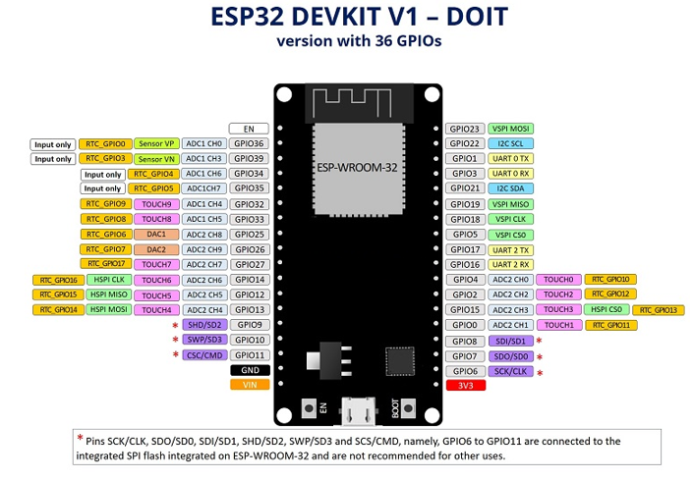
GPIO Pins
08

Slide 10
DIGITAL OUTPUT
digitalWrite() — Blinking an LED
OUTPUT
digitalWrite(pin, value)
  sets a pin HIGH (3.3 V, LED on) or LOW (0 V, LED off).
The pin must first be set OUTPUT with pinMode() in setup().
delay(ms) pauses the program for the given time in milliseconds.
const int ledPin = 2;
void setup() {
pinMode(ledPin, OUTPUT);
}
void loop() {
digitalWrite(ledPin, HIGH); // LED ON
delay(1000);
digitalWrite(ledPin, LOW); // LED OFF
delay(1000);
}
LED anode → GPIO 2 (through a 220 Ω resistor)
LED cathode → GND
09

Slide 11
DIGITAL INPUT
digitalRead() — Reading a Switch
const int switchPin = 4;
const int ledPin = 2;
void setup() {
pinMode(switchPin, INPUT_PULLUP); pinMode(ledPin, OUTPUT);
}
void loop() {
int state = digitalRead(switchPin);
if (state == LOW) {
digitalWrite(ledPin, HIGH);
} else {
digitalWrite(ledPin, LOW);
}
}
INPUT
digitalRead(pin) returns the current logic level of a pin: HIGH or LOW.
The pin must be set INPUT with pinMode() in setup().
Store the result in an int and act on it with an if / else check.
Switch terminal 1 → GPIO 4
Switch terminal 2 → GND
10

Slide 12
BEFORE ANALOGREAD
Analog Signals & the ADC
Digital signals have only two states: HIGH or LOW.
Analog signals vary continuously — e.g. a potentiometer, temperature or light sensor.
The ESP32's built-in ADC (Analog-to-Digital Converter) turns a voltage into a number.
12-bit resolution → values from 0 to 4095, over 0 V to 3.3 V.
ADC RANGE
0
4095
0 V
3.3 V
12-bit resolution: 2^12 = 4096 discrete steps
Recommended pin: potentiometer wiper → GPIO 34 (input-only ADC pin). Never exceed 3.3 V on this pin.
Voltage = (ADC Value / 4095) × 3.3
11

Slide 13
ANALOG INPUT
analogRead() — Reading a Potentiometer
ADC IN
analogRead(pin) returns a number from 0–4095 representing the pin's voltage.
Convert it to volts using the ADC formula from the previous slide.
Serial.begin() and Serial.print() let you view live readings on the Serial Monitor.
const int potPin = 34;
void setup() {
Serial.begin(115200);
}
void loop() {
int adcValue = analogRead(potPin);
float voltage = (adcValue/4095.0)*3.3;
Serial.print("Voltage: ");
Serial.println(voltage);
delay(500);
}
Potentiometer wiper → GPIO 34
Outer terminals → 3.3 V and GND
12

Slide 14
ANALOG OUTPUT
const int ledPin = 5; // PWM-capable pin
void setup() {
pinMode(ledPin, OUTPUT);
}
void loop() {
analogWrite(ledPin, 64); // ~25%
delay(1000);
analogWrite(ledPin, 128); // ~50%
delay(1000);
analogWrite(ledPin, 255); // 100%
delay(1000);
}
analogWrite() — PWM Output
PWM OUT
The ESP32 has no true analog output — analogWrite() simulates it using PWM (Pulse Width Modulation).
It rapidly switches a pin HIGH/LOW; the value 0–255 sets how much of the time it stays HIGH.
Used for LED brightness, motor speed, and buzzer tone control.
DUTY CYCLE = BRIGHTNESS
25%
50%
100%
13

Slide 15
RECAP
Your ESP32 Function Toolkit
pinMode(pin, mode)
Configure a pin as INPUT or OUTPUT
Setup
digitalWrite(pin, val)
Set a pin HIGH or LOW
Digital Out
digitalRead(pin)
Read HIGH or LOW from a pin
Digital In
analogRead(pin)
Read a 0–4095 value from an ADC pin
Analog In
analogWrite(pin, val)
Output a PWM signal, 0–255
Analog Out
14

Slide 16
EXTENDED TOPICS
Defining Your Own Function
// returnType functionName(parameters)
bool isPressed(int pin) {
return digitalRead(pin) == LOW;
}
void blinkLed(int pin, int times) {
for (int i = 0; i < times; i++) {
digitalWrite(pin, HIGH);
delay(200);
digitalWrite(pin, LOW);
delay(200);
}
}
void loop() {
if (isPressed(4)) blinkLed(2, 3);
}
A function is a named, reusable block of code — setup() and loop() are functions too.
returnType is what the function gives back — use void if it returns nothing.
Parameters (in the parentheses) are inputs the function receives.
Call the function by name wherever you need it, instead of repeating code.
19

Slide 17
EXTENDED TOPICS
Macro vs Function — What's the Difference?
MACRO (#define)
FUNCTION
#define SQUARE(x) ((x)*(x))
int square(int x) { return x * x;}
Replaced by the preprocessor before compiling — a pure text substitution.
No type checking — can cause subtle bugs.
No debugging step-through; it never really "exists" as code.
Compiled as real code — has proper type checking.
Easier to debug (breakpoints, step-through).
Preferred for anything beyond a trivial one-line swap.
20

