Slide 1
Near Field Communication (NFC)

Slide 2
What is NFC?
Near Field Communication (NFC) is a short-range wireless technology that makes life easier and more convenient for consumers around the world.
It enables communication between two electronic devices over a distance of 4 cm (about 1.5 inches) or less.
NFC is the technology behind contactless cards, mobile payments, and simple data sharing with just a tap.
Key takeaway: It's all about simple, secure, and intuitive interaction.

Slide 3

Near Field Communication (NFC)
A short-range wireless connectivity technology mainly aimed for mobile or handheld devices.
A subset of RFID technology with the exception that NFC is designed for use by devices within close proximity to each other (less than 10cm) thus providing more privacy and security.
Allows two-way communication between endpoints,
whereas RFID system was one-way only
Operates at 13.56 MHz
Low Data transfer rate: up to 424 kbits/second thus reducing power consumption.

Slide 4
The Origins of NFC
Roots in RFID: 1983
NFC is built upon Radio-Frequency Identification (RFID) technology. The first patent related to RFID was filed by Charles Walton.
The Birth of NFC: 2002
Sony and NXP Semiconductors collaborated to develop the specific technology we now know as NFC.
Standardization: 2004
The NFC Forum was established by Nokia, Philips (now NXP), and Sony to advance the technology and ensure interoperability.

Slide 5
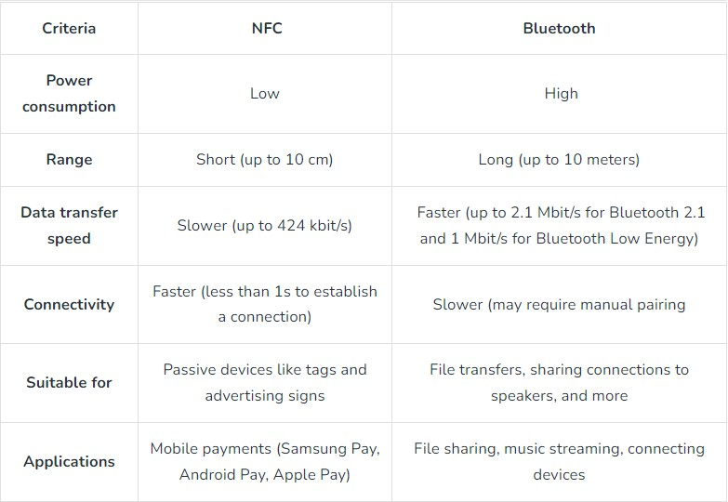
Comparison with Bluetooth

Slide 6
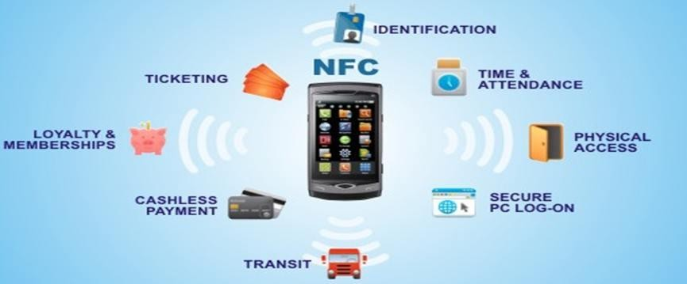
NFC Applications

Slide 7
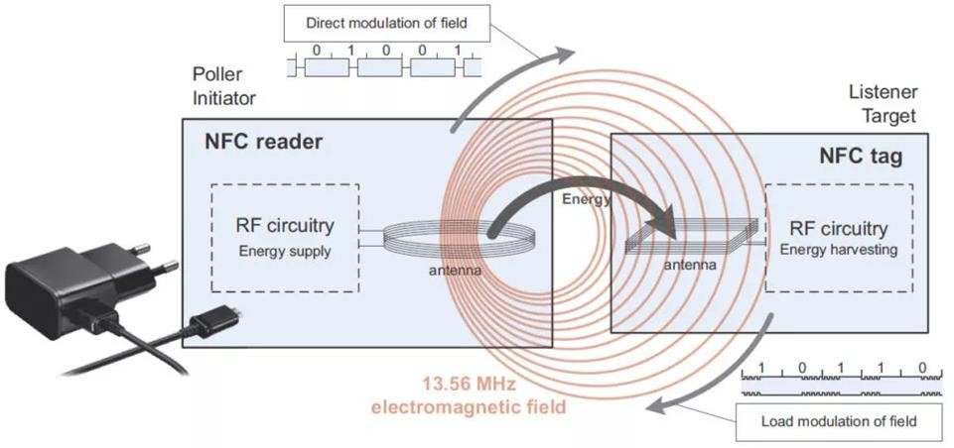
Operation of NFC
In NFC communication, one device must have an NFC reader/writer and the other an NFC tag.
NFC readers need a power source to pass an electric current through a coil of their own. This generates
an alternating magnetic field in the reader’s immediate vicinity. Bringing a tag in this magnetic field’s range finally results in inductive coupling between the two coils
The tag is essentially an integrated circuit containing data, connected to an antenna that can be read
and written by the reader.

Slide 8
Operation of NFC (Ctd…)
The device that generates the electromagnetic field is called poller (initiator), and
the second device is the listener/ tag /target.
This generated field is inductively coupled with the other device in the near field,
much like in a transformer.
Data transmission from poller to listener involves the poller modulating the amplitude of its field, which is registered by the listener.
The transmission from listener to poller takes place by means of load modulation: The listener can change the amount of drawn energy over time (by changing the impedance). Feedback changes the amplitude of the alternating electromagnetic
field, which the poller can register.

Slide 9



NFC's Modes of Operation
Reader/Writer Mode
Peer-to-Peer (P2P) Mode
Card Emulation Mode
An NFC device (like a phone) reads or writes data to an NFC tag. Example: Tapping a smart poster to open a website.
Two NFC-enabled devices exchange data with each other. Example: Sharing a photo or contact by tapping two phones together.
An NFC device acts as a contactless smart card. Example: Using your smartphone to pay at a terminal or enter a secured building.

Slide 10
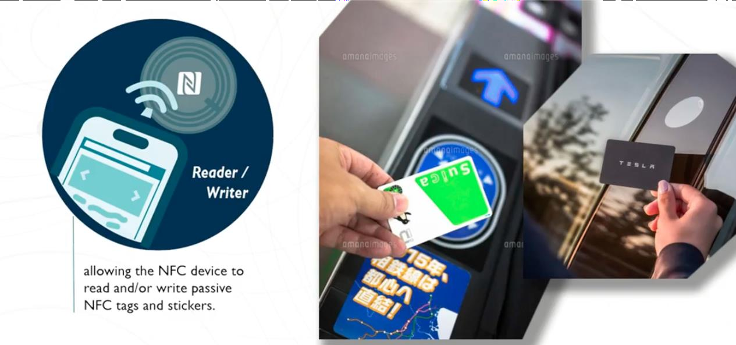
NFC Reader mode
An NFC device is in "reader mode" when it acts as an NFC reader.
The NFC reader mode allows the NFC device to read or write passive NFC tags and stickers. NFC applications such as transportation or ticketing systems use this mode. Even the key card to open a Tesla's car door operates in this mode.

Slide 11
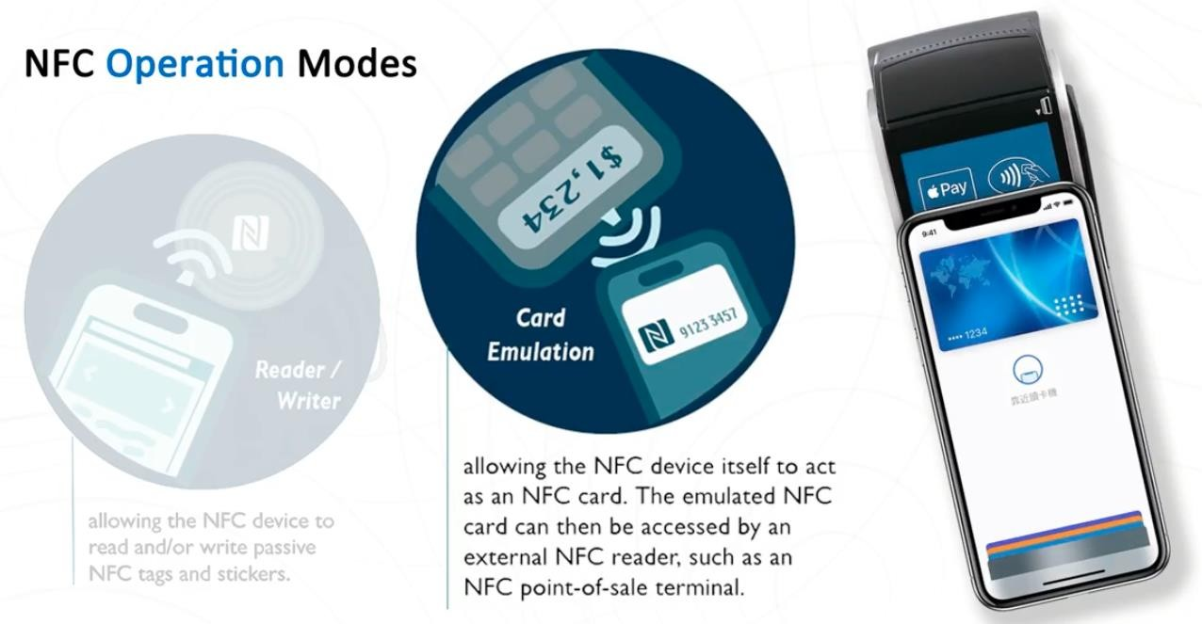
NFC Card Emulation mode
The NFC "card emulation mode" allows the NFC device itself to act as an NFC card.
The emulated NFC card can then be accessed by another NFC reader, such as a point-of- sale machine. The best example of this mode is Apple Pay. In this case, the iPhone
becomes a contactless credit card, and we can then use it to buy goods in stores

Slide 12
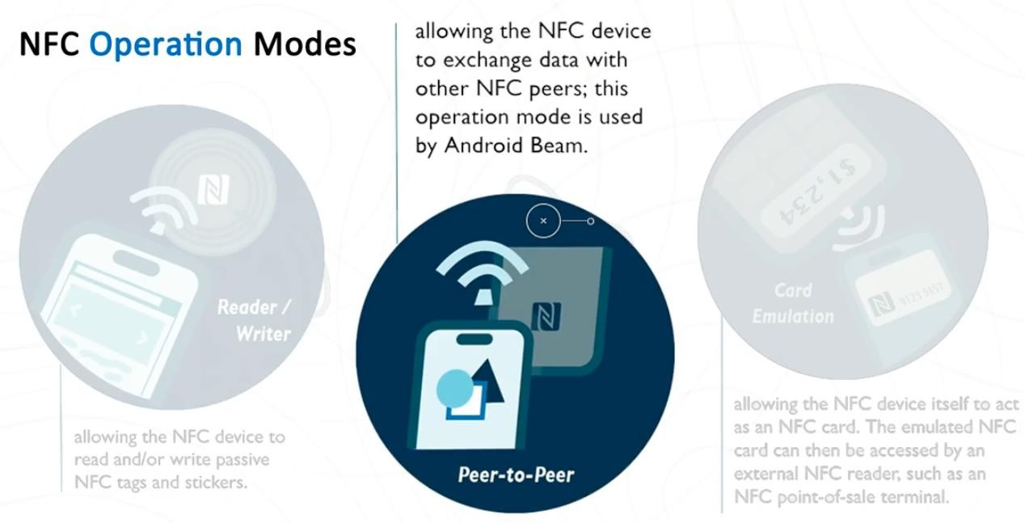
NFC Peer to Peer Communication mode
Finally is the NFC "P2P mode."
This "peer to peer" mode allows the NFC device to exchange data with another NFC peer. One example
of this mode is the Android Beam feature introduced by Google back in 2011. Besides that, this mode is
not widely used in the real world.

Slide 13



Layers of Communication
The NFC protocol stack operates in distinct layers, each handling specific aspects of communication. This layered approach ensures interoperability and modularity, similar to the OSI model but simplified for NFC's unique requirements.
RF / Physical Layer
1
This foundational layer defines the radio frequency (13.56 MHz), modulation schemes, and signal interface, based on the ISO/IEC 18092 standard.
Data Link / Logical Link Layer (LLCP)
2
Manages the connection between devices and ensures reliable data exchange. It handles error detection and flow control, guaranteeing data integrity during communication.
Application Layer
3
This is where data formats like the NFC Data Exchange Format (NDEF) reside. It processes the actual information being exchanged, such as vCards for contact sharing or URLs for launching web pages.
Each layer builds upon the one below it, allowing NFC to provide seamless and secure short-range communication for a wide array of applications.

Slide 14
Incorporation of NFC in IoT
With a straight forward tap-and-go mechanism, NFC makes it simple and intuitive to connect two different IoT devices.
Because NFC chips must be in close proximity of each other to initiate a transaction, NFC is a clear
sign that the user intends to take a certain action. The short range of NFC also protects against
unauthorized access by hackers.
NFC includes built-in features such as encryption that cut down on the potential for eavesdropping and other malicious activities.
Even objects without power or an IoT connection can passively exchange data via NFC tags. Users
with an NFC-enabled device can tap the gadget to get information such as URLs.
An NFC tag can harvest energy to power other circuits or devices.
Notes:
9712501653

