Slide 1
Real-Time Operating Systems
for IoT & Embedded Systems
RTOS Concepts · FreeRTOS Architecture · Tasks, Scheduler, Queues & Semaphores · ESP32 Demonstration
Unit 2 — Technology for IoT

Slide 2
AGENDA
What We'll Cover
1
What is an RTOS?
Definition, real-time guarantees, and why FreeRTOS is preferred over a general-purpose OS on constrained devices.
2
Where FreeRTOS fits
Comparing Arduino, ESP-IDF, MicroPython, and FreeRTOS-based bare-metal as IoT programming frameworks.
3
FreeRTOS architecture
Tasks, the scheduler, queues, and semaphores — and how they enable real-time multitasking on the ESP32.
4
Microcontroller vs SBC
Why an RTOS-based MCU (ESP32/AVR) and a Linux-based SBC (Raspberry Pi) solve different problems.

Slide 3
· CORE CONCEPT
What Is a Real-Time Operating System?
An RTOS is an operating system designed to process inputs and produce a response within a guaranteed, bounded time — a deadline.
HARD REAL-TIME
Missing a deadline = system failure.
e.g. airbag deployment, anti-lock brakes, pacemaker timing.
SOFT REAL-TIME
KEY IDEA: CORRECTNESS DEPENDS ON TIME
Missing a deadline degrades quality, but the system survives.
e.g. video streaming, an IoT sensor sending a reading a little late.
A late answer is a wrong answer — not just a slow one. This is what separates an RTOS from a general-purpose OS optimized for average throughput.
Most IoT nodes (sensing → processing → transmission) are soft real-time systems — which is exactly the class FreeRTOS targets.

Slide 4
· COMPARISON
RTOS vs. General-Purpose OS
Aspect
RTOS (e.g., FreeRTOS)
General-Purpose OS
Scheduling goal
Meet deadlines — determinism
Maximize average throughput / fairness
Scheduler
Priority-based, preemptive, predictable
Time-sliced, best-effort, variable latency
Memory footprint
A few KB – hundreds of KB RAM
Tens to hundreds of MB RAM
Boot time
Milliseconds
Seconds to tens of seconds
Typical hardware
Microcontrollers (ESP32, AVR, ARM Cortex-M)
SoCs / SBCs (Raspberry Pi, PC)
Examples
FreeRTOS, Zephyr, RIOT, VxWorks
Linux, Windows, Android

Slide 5
· MOTIVATION
Why Constrained IoT Devices Need an RTOS
1
Determinism
2
Tiny footprint
Sensor sampling, control loops, and radio timing (e.g. BLE/Zigbee slots) need predictable response — not just fast, but on-time.
Runs in a few KB of RAM/flash — fits microcontrollers that could never boot Linux.
3
Concurrency without complexity
4
Power efficiency
Lets one MCU juggle sensing, processing, and networking as independent tasks instead of one tangled loop.
Built-in idle/tickless modes sleep the CPU between events — critical for battery-powered motes.

Slide 6
LANDSCAPE
RTOS Options in the IoT World
FreeRTOS
Zephyr
RIOT OS
Mbed OS
VxWorks
Free, open-source, tiny kernel. De-facto standard on ESP32, STM32, AVR.
Linux-Foundation project. Broader hardware abstraction, built-in networking stack.
Academic/research roots. Strong 6LoWPAN & CoAP support for constrained mesh nodes.
ARM's RTOS for Cortex-M boards, with a large driver/library ecosystem.
Commercial, safety-certified. Used in aerospace, industrial, and automotive.
This course focuses on FreeRTOS — it ships built-in with ESP-IDF, the framework used for our ESP32 labs.

Slide 7
Why FreeRTOS Is Preferred for Constrained Devices
Free & open source (MIT license)
No licensing cost; source is auditable and modifiable.
Minimal footprint
Kernel can fit in ~6–12 KB of flash — leaves room for the application.
Broad MCU support
Ported to 40+ architectures: ESP32, ARM Cortex-M, AVR, PIC, RISC-V.
Industry backing
Maintained by Amazon Web Services; integrates directly with AWS IoT Core.
Mature ecosystem
Native to ESP-IDF; huge community, documentation, and reference examples.
In short: FreeRTOS gives near-bare-metal efficiency with the safety net of real-time multitasking.

Slide 8
FreeRTOS Architecture Overview
Application Tasks
Sensing · Processing · Networking · UI — written as independent C functions
FreeRTOS Kernel
Scheduler · Task control blocks · Queues · Semaphores/Mutexes · Software timers
Hardware Abstraction / Port Layer
Tick timer ISR · Context switch · Interrupt handling
MCU Hardware
e.g., ESP32 (Xtensa LX6, dual-core)

Slide 9
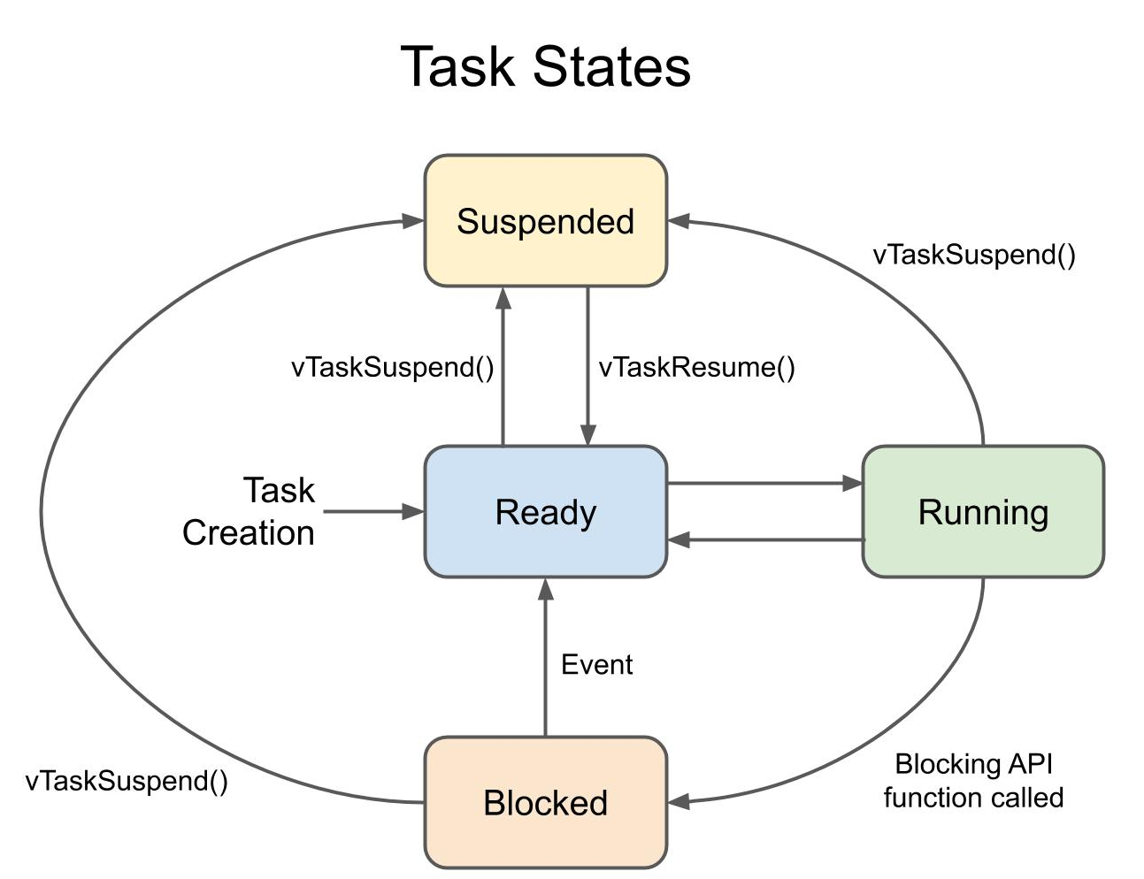
FreeRTOS Tasks & Task States
A task is an independent thread of execution with its own stack and priority — the basic unit of concurrency in FreeRTOS.
The Four States
Ready — The task is capable of running (it isn't waiting on anything) but is not currently executing because a higher- or equal-priority task is using the CPU.
Running — The task is currently executing on the CPU. On a single-core system, only one task can be in this state at any instant.
Blocked — The task is waiting for something: a time delay to expire, a queue/semaphore to receive data, or another event. It's not eligible to run until that event occurs.
Suspended — The task is explicitly taken out of scheduling. It doesn't run and isn't considered by the scheduler at all — it only leaves this state when another task calls vTaskResume() on it.

Slide 10
FreeRTOS Tasks & Task States
A task is an independent thread of execution with its own stack and priority — the basic unit of concurrency in FreeRTOS.
Suspended is different from Blocked. Blocked is temporary and event-driven — the kernel automatically wakes the task. Suspended is explicit and manual — only another task's vTaskResume() call can undo it, no matter how long it waits or what events occur.
Running is always singular (per core). Every other Ready task, no matter how many exist, waits its turn — this is what the scheduler continuously arbitrates using task priority.

Slide 11
· SCHEDULER
The FreeRTOS Scheduler: Priority-Based Preemption
Rule: the highest-priority READY task always runs. Equal-priority tasks share the CPU via round-robin time slicing.
Priority 3 (Tx Task)
Priority 2 (Process Task)
Priority 1 (Idle Task)
time →
Preemption in action: the Process task (priority 2) runs until the higher-priority Tx task becomes ready at t = 5.2 — it immediately preempts, then Process resumes (or completes) once Tx finishes. The Idle task only runs when nothing else is ready.

Slide 12
· INTER-TASK COMMUNICATION
Queues: Passing Data Safely Between Tasks
A queue is a FIFO buffer the kernel manages so tasks never touch shared memory directly — avoiding race conditions.
Sensor Task
(Producer)
Queue
[ ][ ][ ][ ]
Tx Task
(Consumer)
xQueueSend()
xQueueReceive()
Decouples producer and consumer — they can run at different speeds.
A task calling xQueueReceive() on an empty queue automatically blocks (frees the CPU) until data arrives.
This is exactly how a sensing task hands readings to a transmission task on the ESP32.

Slide 13
· SYNCHRONIZATION
Semaphores & Mutexes
Binary Semaphore
Counting Semaphore
Mutex
A single-count flag used for signaling — e.g., an ISR signals “data ready” to unblock a task.
Tracks how many of a limited resource are free — e.g., N available buffer slots.
A binary semaphore with ownership + priority inheritance — protects a shared resource (e.g., a shared UART/I²C bus) from simultaneous access.
Priority inversion — worth knowing: if a low-priority task holds a mutex a high-priority task needs, the high-priority task is blocked behind it. A plain semaphore can leave this unresolved indefinitely; FreeRTOS mutexes solve it with priority inheritance, temporarily boosting the low-priority holder so it finishes and releases the resource quickly.

Slide 14
· APPLIED EXAMPLE
Putting It Together: Three Tasks on One ESP32
A typical IoT node runs several FreeRTOS tasks concurrently, each pinned to a priority that reflects how time-critical it is.
vSensorTask
vProcessTask
vTxTask
Priority 2
Priority 1
Priority 3 (highest)
Reads a sensor every 100 ms, pushes the value onto a queue, then blocks (vTaskDelay).
Blocks on xQueueReceive(); filters/averages readings when data arrives.
Woken by a binary semaphore every transmit interval; sends data over Wi-Fi/BLE — time-critical, so it preempts the others.
Without an RTOS, this would be one superloop juggling timers by hand. With FreeRTOS, each concern is an independent task — the scheduler guarantees the transmit deadline is met even while sensing and processing keep running.

Slide 15
· PLATFORM CHOICE
Microcontroller + RTOS vs. SBC + Linux
Aspect
Microcontroller + RTOS
SBC + Linux
Example board
ESP32 / AVR (with FreeRTOS)
Raspberry Pi (with Linux)
CPU class
Single/dual-core MCU, tens–hundreds of MHz
Multi-core application processor, 1+ GHz
RAM
KBs – low MBs
512 MB – 8+ GB
Timing behavior
Deterministic — bounded worst-case latency
Best-effort — not guaranteed
Power draw
mW – low W; sleeps deeply between events
Watts; harder to deep-sleep
Best fit
Direct sensor/actuator control, battery nodes
Edge gateways, local AI inference, local dashboards

Slide 16
Q21 · RECAP
Where FreeRTOS Fits Among IoT Frameworks
Framework
Abstraction Level
Real-Time Capability
Footprint
Learning Curve
Arduino (IDE)
Very high (setup/loop)
None (superloop)
Small–Moderate
Gentle
MicroPython
High (Python)
Cooperative (asyncio)
Moderate–Large
Gentle
ESP-IDF + FreeRTOS
Low–Moderate (C, RTOS API)
Preemptive, real-time
Small
Steep
Bare-metal (no OS)
Lowest (direct registers)
Manual / none
Smallest
Steepest
Highlighted row: FreeRTOS trades ease-of-use for real-time guarantees — the right trade for production IoT nodes with timing constraints.

Slide 17
Key Takeaways
An RTOS guarantees a bounded response time — not just fast execution, but on-time execution.
FreeRTOS is preferred on constrained IoT devices for its tiny footprint, broad MCU support, and AWS-backed ecosystem.
Tasks, the priority-based preemptive scheduler, queues, and semaphores/mutexes are the four building blocks that let one MCU safely multitask.
Choose the platform to the job: RTOS + microcontroller for deterministic, low-power control; Linux + SBC for compute-heavy edge processing.
Maps to Question Bank: Q19, Q21, Q22, Q23 (Unit 2)

