Slide 1
Maintenance
Maintenance of any software:
–Requires much more effort than the effort to develop the product itself.
–Development effort to maintenance effort is typically 40:60.

Slide 2
Types of Maintenance?
Corrective maintenance:
  Correct errors which were not discovered during the product
development phases.
Perfective maintenance:
  Improve implementation of the system
  enhance functionalities of the system.
Adaptive maintenance:
  Port software to a new environment,
    e.g. to a new computer or to a new operating system.

Slide 3
Iterative Waterfall Model
Classical waterfall model is idealistic:
–Assumes that no defect is introduced during any development activity.
–In practice:
  Defects do get introduced in almost every phase of the life cycle.

Slide 4
Iterative Waterfall Model (CONT.)
Defects usually get detected much later in the life cycle:
–For example, a design defect might go unnoticed till the coding or testing phase.
–The later the phase in which the defect gets detected, the more expensive is its removal --- why?

Slide 5
Iterative Waterfall Model (CONT.)
Once a defect is detected:
–The phase in which it occurred needs to be reworked.
– Redo some of the work done during that and all subsequent phases.
Therefore need feedback paths in the classical waterfall model.

Slide 6
Iterative Waterfall Model (CONT.)
Feasibility Study
Req. Analysis
Design
Coding
Testing
Maintenance
56

Slide 7
Phase Containment of Errors (Cont...)
Errors should be detected:
  In the same phase in which they are introduced.
For example:
  If a design problem is detected in the design phase itself,
    The problem can be taken care of much more easily
    Than say if it is identified at the end of the integration and system testing phase.

Slide 8
Phase Containment of Errors
Reason: rework must be carried out not only to the design but also to code and test phases.
The principle of detecting errors as close to its point of introduction as possible:
  is known as phase containment of errors.
Iterative waterfall model is by far the most widely used model.
  Almost every other model is derived from the waterfall model.

Slide 9
Iterative Waterfall Model (CONT.)
Feasibility Study
Req. Analysis
Design
Coding
Testing
Maintenance
59

Slide 10
Waterfall Strengths
Easy to understand, easy to use, especially by inexperienced staff
Milestones are well understood by the team
Provides requirements stability during development
Facilitates strong management control (plan, staff, track)

Slide 11
Waterfall Deficiencies
All requirements must be known upfront – in most projects requirement change occurs after project start
Can give a false impression of progress
Integration is one big bang at the end
Little opportunity for customer to pre-view the system.

Slide 12
When to use the Waterfall Model?
Requirements are well known and stable
Technology is understood
Development team have experience with similar projects
62

Slide 13
Classical Waterfall Model (CONT.)
Irrespective of the life cycle model actually followed:
–The documents should reflect a classical waterfall model of development.
–Facilitates comprehension of the documents.

Slide 14
Classical Waterfall Model (CONT.)
Metaphor of mathematical theorem proving:
–A mathematician presents a proof as a single chain of deductions,
  Even though the proof might have come from a convoluted set of partial attempts, blind alleys and backtracks.

Slide 15
V Model
7/18/2020

Slide 16
V Model
It is a variant of the Waterfall
  emphasizes verification and validation
  V&V activities are spread over the entire life cycle.
In every phase of development:
  Testing activities are planned in parallel with development.

Slide 17
Project Planning
Production,
Operation &
Maintenance
Requirements Specification
System Testing
High Level Design
Integration Testing
Detailed Design
Unit testing
Coding

Slide 18
V Model Steps
Planning
Requirements Analysis and Specification
High-level Design
Detailed Design
System test design
Integration Test dsign
Unit test design

Slide 19
V Model: Strengths
Starting from early stages of software development:
– Emphasizes planning for verification and validation of the software
Each deliverable is made testable
Easy to use

Slide 20
V Model Weaknesses
Does not support overlapping of phases
Project Planning
Production, Operation & Maintenance
Does not handle iterations or phases
Requirements
Specification
System Testing
Does not easily accommodate later changes to requirements
High Level Design
Integration Testing
Detailed Design
Unit testing
Coding
Does not provide support for effective risk handling

Slide 21
When to use V Model
Natural choice for systems requiring high reliability:
– Embedded control applications, safety-critical software
All requirements are known up-front
Solution and technology are known

Slide 22
Prototyping Model
7/18/2020

Slide 23
Prototyping Model
A derivative of waterfall model.
Prototype Construction
Design
Before starting actual development,
Coding
– A working prototype of the system should first be built.
Testing
A prototype is a toy implementation of a system:
–Limited functional capabilities,
–Low reliability,
–Inefficient performance.
Maintenance

Slide 24
Reasons for prototyping
Learning by doing: useful where requirements are
only partially known
Improved communication
Prototype Construction
Design
Improved user involvement
Reduced need for documentation
Reduced maintenance costs
Coding
Testing
Maintenance

Slide 25
Reasons for Developing a Prototype
Illustrate to the customer:
–input data formats, messages, reports, or interactive dialogs.
Examine technical issues associated with product development:
–Often major design decisions depend on issues like:
  Response time of a hardware controller,
  Efficiency of a sorting algorithm, etc.

Slide 26
Prototyping Model (CONT.)
Another reason for developing a prototype:
–It is impossible to “get it right” the first time,
–We must plan to throw away the first version:
  If we want to develop a good software.

Slide 27
Prototyping Model
Prototype Construction
Start with approximate requirements.
Carry out a quick design.
Design
Coding
Prototype is built using several short-cuts:
–Short-cuts might involve:
Testing
Maintenance
Using inefficient, inaccurate, or dummy functions.
A table look-up rather than performing the actual computations.

Slide 28
Prototyping Model (CONT.)
Build Prototype
Customer Evaluation of Prototype
Customer
satisfied
Requirements
Gathering
Design
Quick Design
Refine Requirements
Implement
Test
Maintain

Slide 29


Prototyping Model (CONT.)
The developed prototype is submitted to the customer for
Build Prototype
his evaluation:
Requirements Gathering
Customer Evaluation of Prototype
Customer
satisfied
Design
Quick Design
Refine
–Based on the user feedback, the prototype is refined.
Implement
Requirements
Test
–This cycle continues until the user approves the prototype.
The actual system is developed using the waterfall model.
Maintain

Slide 30
Prototyping Model
Prototype Construction
(CONT.)
Requirements analysis and specification phase becomes redundant:
Design
Coding
Testing
–Final working prototype (incorporating all user
feedbacks) serves as an animated requirements specification.
Design and code for the prototype is usually thrown away:
–However, experience gathered from developing the prototype helps
a great deal while developing the actual software.
Maintenance

Slide 31
Prototyping Model (CONT.)
Even though construction of a working prototype model involves additional cost --- overall development cost usually lower for:
  Systems with unclear user requirements,
  Systems with unresolved technical issues.
Many user requirements get properly defined and technical issues get resolved:
  These would have appeared later as change requests and resulted in incurring massive redesign costs.

Slide 32
Prototyping: advantages
The resulting software is usually more usable
User needs are better accommodated
The design is of higher quality
The resulting software is easier to maintain
Overall, the development incurs less cost

Slide 33
Prototyping: disadvantages
For some projects, it is expensive
Susceptible to over-engineering:
– Designers start to incorporate sophistications that they could not incorporate in the prototype.

Slide 34
1. Difficulty in accommodating change requests during development.
Major difficulties of Waterfall-Based Models
40% of the requirements change during development
High cost incurred in developing custom applications.
“Heavy weight processes.”

Slide 35
Major difficulties of Waterfall-Based Life Cycle Models
Requirements for the system are determined at the start:
  Are assumed to be fixed from that point on.
  Long term planning is made based on this.

Slide 36
“… the assumption that one can specify a satisfactory system in advance, get bids for its construction, have it built, and install it. …this assumption is fundamentally wrong and many software acquisition problems spring from this…” Frederick Brooks
86

Slide 37
Incremental Model
7/18/2020
87

Slide 38
“The basic idea… take advantage of what was being learned during the development of earlier, incremental, deliverable versions of the system. Learning comes from both the development and use of the system… Start with a simple implementation of a subset of the software requirements and iteratively enhance the evolving sequence of versions. At each version design modifications are made along with adding new functional capabilities. “ Victor Basili
88

Slide 39
Key characteristics
–Builds system incrementally
Incremental and Iterative
Development (IID)
–Consists of a planned number of iterations
–Each iteration produces a working program
Benefits
–Facilitates and manages changes
Foundation of agile techniques and the basis for
–Rational Unified Process (RUP)
–Extreme Programming (XP)

Slide 40
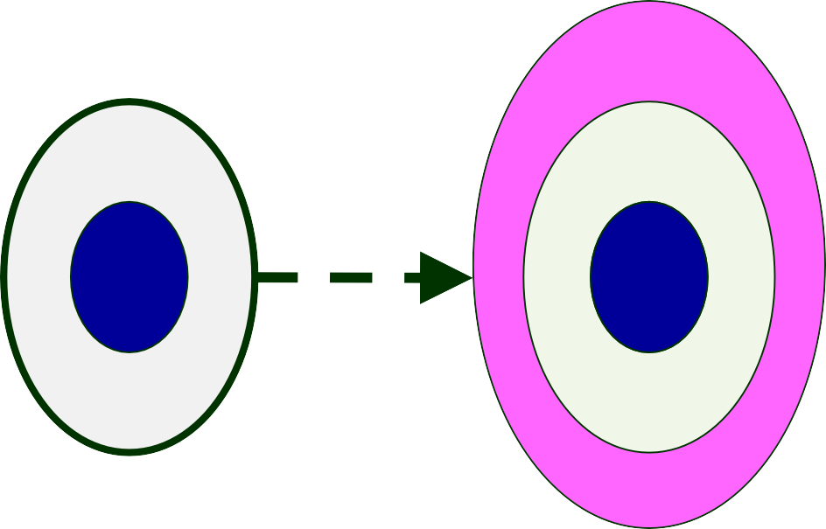
Customer’s Perspective
C
A
B
A
A _{B}
B

Slide 41
Incremental Model
Requirements
Split into
Outline
Design
Features
Develop
Validate
Integrate
Validate
Increment
Increment
Increment
System
Final
System

Slide 42
Incremental Model: Requirements
Split into
Features
Requirements: High Level Analysis
Slice
Slice
Slice Slice Slice Slice Slice Slice Slice Slice Slice
Slice

Slide 43
Incremental Model
Waterfall: single release
Iterative: many releases (increments)
–First increment: core functionality
–Successive increments: add/fix functionality
–Final increment: the complete product
Each iteration: a short mini-project with a separate lifecycle
–e.g., waterfall

Slide 44
Incremental delivery
increment
1
Customer Feedback
 | design
design
build
install
increment
2
build
install
Customer Feedback
increment
3
design
build
install
Customer Feedback

Slide 45
The incremental process
Planned
Identify System Objectives
incremental
delivery
Plan increments
Incremental delivery plan
Design increment
Build the increment
Feedback
Repeat for each
increment
Implement the increment
Evaluate the results

Slide 46
Which step first?
Some steps will be pre-requisite because of physical dependencies
Others may be in any order
Value to cost ratios may be used
  V/C where
  V is a score 1-10 representing value to customer
  C is a score 0-10 representing cost to developers

Slide 47
V/C ratios: an example
step |  | value | cost | ratio
profit reports |  | 9 | 2 | 4.5 | 2nd
online database |  | 1 | 9 | 0.11 | 5th
ad hoc enquiry |  | 5 | 5 | 1 | 4th
purchasing plans |  | 9 | 4 | 2.25 | 3rd
profit-based pay managers | for | 9 | 1 | 9 | 1st

Slide 48
Evolutionary Model with Iterations

Slide 49
An Evolutionary and Iterative Development Process...
Recognizes the reality of changing requirements
–Capers Jones’s research on 8000 projects: 40% of final requirements arrived after development had already begun
Promotes early risk mitigation:
  Breaks down the system into mini-projects and focuses on the riskier issues first.
  “plan a little, design a little, and code a little”
Encourages all development participants to be involved earlier on,:
  End users, Testers, integrators, and technical writers

Slide 50
Evolutionary Model with Iteration
“A complex system will be most successful if implemented in small steps… “retreat” to a previous successful step on failure… opportunity to receive some feedback from the real world before throwing in all resources… and you can correct possible errors…” Tom Glib in Software Metrics
100

