Slide 1

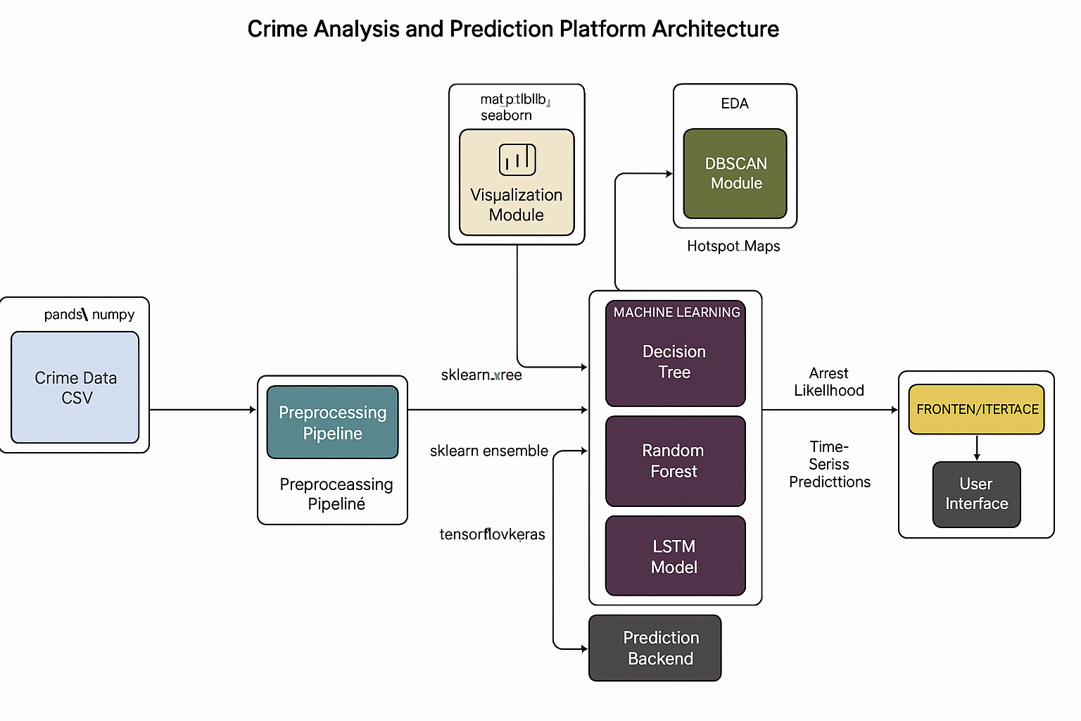
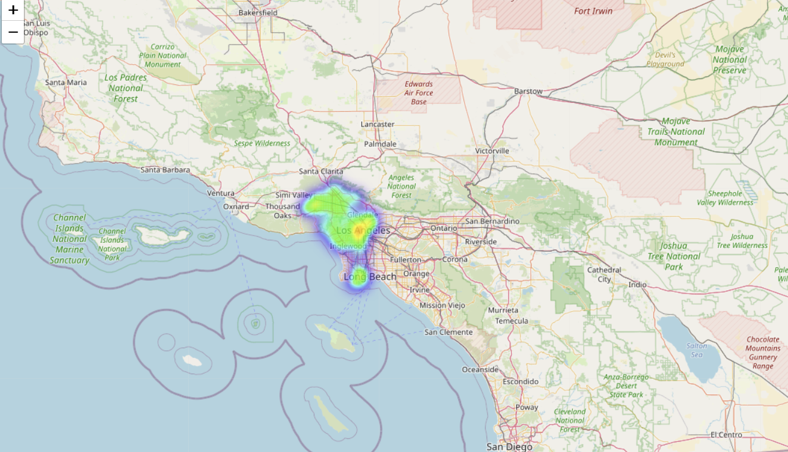
Mapping and Predicting Crime Hotspots Using Machine Learning
Student : N. Jyotshna ,Instructor : Dr. Yong Zhuang
Abstract
Approach / Model Training
Hotspot
Urban crime poses significant challenges for public safety and resource allocation. In particular, identifying crime hotspots and predicting arrest outcomes are crucial for informed decision-making by law enforcement agencies. However, challenges such as spatial variability, class imbalance in arrest data, and complex temporal patterns make accurate prediction difficult. This project addresses these challenges by analyzing Los Angeles crime data from 2020. We extracted temporal features, addressed missing values, and applied DBSCAN clustering to detect high-density crime areas. To manage the class imbalance in arrest outcomes, we used SMOTE and applied PCA for visualization. Our modeling pipeline included a baseline Decision Tree, an enhanced Random Forest that incorporated hotspot features, and a Long Short-Term Memory (LSTM) model to capture spatio-temporal patterns. Results showed that the Random Forest model significantly outperformed the baseline, highlighting the value of spatial hotspot features. The LSTM model demonstrated the ability to learn deeper temporal trends for location-wise arrest prediction. The project concludes with visualizations of identified hotspots and model performance, offering practical insights for predictive policing and public safety strategies.
Future Work
To enhance the system, we can use hyperparameter tuning can improve DBSCAN, Random Forest, and LSTM performance. Feature engineering can add external data like weather or holidays. Advanced models like K-Means, HDBSCAN, XGBoost, or GNNs may improve accuracy. Time series techniques like ARIMA or Prophet can support crime the forecasting. Finally, a dashboard using Dash or Streamlit can enable interactive, real-time visualization.
Results
Technical Details
Model |  | Precision | Recall | F1
Decision Tree |  | 0.65 | 0.69 | 0.67
LSTM |  | 0.71 | 0.73 | 0.72
RandomForest |  | 0.91 | 0.94 | 0.93
The Random Forest model achieved the highest performance with an F1-score of 0.93, significantly outperforming the baseline Decision Tree (0.30) and LSTM (0.58). Adding hotspot features and using SMOTE improved model accuracy. These results highlight the value of spatial clustering and temporal modeling in predicting arrest outcomes.
Python 3.x with libraries like Pandas and NumPy for data handling, Scikit-learn for modeling (DBSCAN, PCA, Decision Trees, Random Forest), and SMOTE to handle class imbalance.
Data is split 80/20 using random_state=4.Visualizations are done with Matplotlib, Seaborn, and Folium (for heatmaps). An LSTM model is built using TensorFlow/Keras with a 7-day sequence, Adam optimizer, and Binary Crossentropy loss. All models use default settings unless specified, ensuring reproducibility.
Bibilography
Pedregosa, F. et al. (2011). Scikit-learn: Machine Learning in Python. Journal of Machine Learning Research, 12, 2825-2830.
Lemaître, G., Nogueira, F., & Aridas, C. K. (2017). Imbalanced-learn: A Python Toolbox to Tackle the Curse of Imbalanced Datasets in Machine Learning. Journal of Machine Learning Research, 18(17), 1-5.
Harris, C. R. et al. (2020). Array programming with NumPy. Nature, 585(7825), 357-362.
McKinney, W. (2010). Data Structures for Statistical Computing in Python. Proceedings of the 9th Python in Science Conference.
Hunter, J. D. (2007). Matplotlib: A 2D Graphics Environment. Computing in Science & Engineering, 9(3), 90-95.

