Slide 1
DASK
Parallel Computing Library for Python

Slide 2
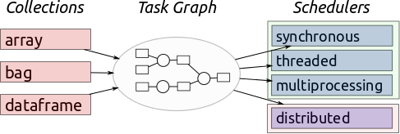
Introduction
Python Library
Multi-core (single machine) and distributed parallel execution (multi-machines).
High Level collections: similar to Spark, Databases…
It mimics functionalities of numpy, lists & pandas.
Low Level collections: similar to IPython Parallel, Airflow, Celery.

Slide 3
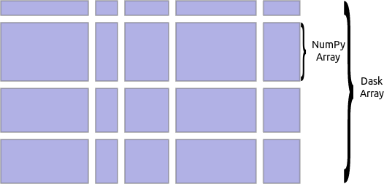
dask.array
Similar interface as Numpy.
Compliments large on-disk array stored like HDF5, NetCDF, BColz.
Dask.array coordinates many numpy arrays arranged into grid.
Commonly used to speedup in-memory computations using multiple cores.
http://dask.pydata.org/en/latest/array.html

Slide 4
dask.bag
dask.Bag often used to parallelize simple computations on unstructured or semi-structured data like text data, log files, JSON records, or user defined Python object.
Disadvantages:
It utilizes dask.multiprocessing as default Scheduler. Hence it does not perform very well for tasks that include computations with many inter-worker communications.
Slower than array/dataframe computations.
http://dask.pydata.org/en/latest/bag.html

Slide 5
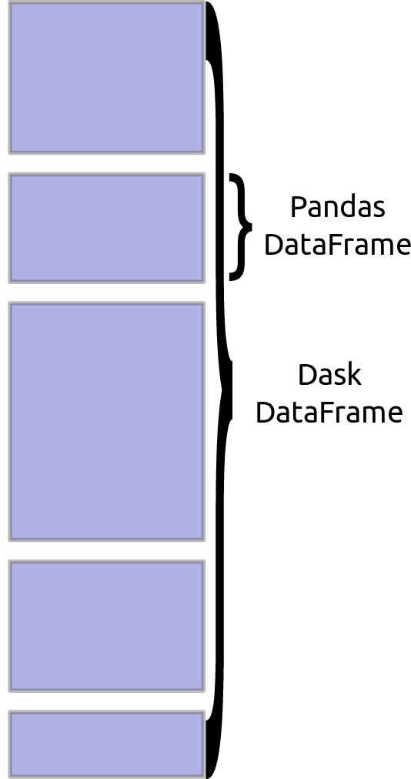
dask.dataframe
Dataframes from various data storage formats like CSV, HDF, Apache Parquet, and others can be created.
For most formats this data can live on various storage systems including local disk, network file systems (NFS), the Hadoop File System (HDFS), and Amazon’s S3.
Dask dataframes coordinate many Pandas DataFrames/Series arranged along the index.
Dask.dataframe is partitioned row-wise, grouping rows by index value for efficiency.
Disadvantage: Setting a new Index from unsorted column is expensive; also for groupby-apply and join on unsorted columns.
Index
http://dask.pydata.org/en/latest/dataframe-api.html

Slide 6
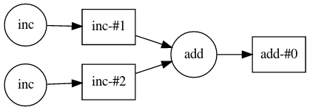

dask.delayed
To parallelize custom algorithms.
Implemented by delaying the computations and turning them into a dask-graph.
Example:
Operations not supported by dask.delayed:
Mutating operators (a += 1).
Iteration (for, while loops).
Use as a predicate (if/else … ).

Slide 7
dask.distributed
Dask can run on a cluster of hundreds of machines and thousands of cores.
The central dask-scheduler process coordinates the actions of several dask-worker processes spread across multiple machines and the concurrent requests of several clients.
dask-worker 1
dask-worker 2
dask-scheduler
dask-worker 3
.
.
.
.
Client
dask-worker n
Users interact by connecting a local Python session to the scheduler and submitting work, by individual calls to the simple interface:
client.submit(function, *args, **kwargs).
https://distributed.readthedocs.io/en/latest/

Slide 8
dask.distributed Network setup
dask.scheduler and dask.worker network can be initiated/connected in following ways:
Command line
SSH
Shared Network FIle System (NFS)
Python interface
LocalCluster
Amazon EC2
https://distributed.readthedocs.io/en/latest/setup.html

Slide 9
Choosing the Scheduler
dask.threaded.get
dask.multiprocessing.get
dask.get
distributed.Client.get
Computation on Single machine, multiple cores
Computation on multiple machines

Slide 10
dask.distributed.Client
The Client is the primary entry point for users of dask.distributed.
When we create a Client object it registers itself as the default Dask scheduler.
https://distributed.readthedocs.io/en/latest/client.html

Slide 11
Dask for Machine Learning
Model Selection and hyperparameter search: dask-searchcv: GridSearchCV, RandomSearchCV, Pipeline (Similar to functions in sklearn.model_selection).
With Joblib: with joblib.parallel_backend('dask.distributed', scheduler_host='localhost:8786').
Convex Optimization: dask-glm.
dask-xgboost: dask based parallel implementation of XGboost.
dask-tensorflow: starts Tensorflow clusters from Dask.
https://github.com/dask/dask-searchcv
https://matthewrocklin.com/blog//work/2017/03/28/dask-xgboost
http://matthewrocklin.com/blog/work/2017/03/22/dask-glm-1
http://matthewrocklin.com/blog/work/2017/02/11/dask-tensorflow

Slide 12
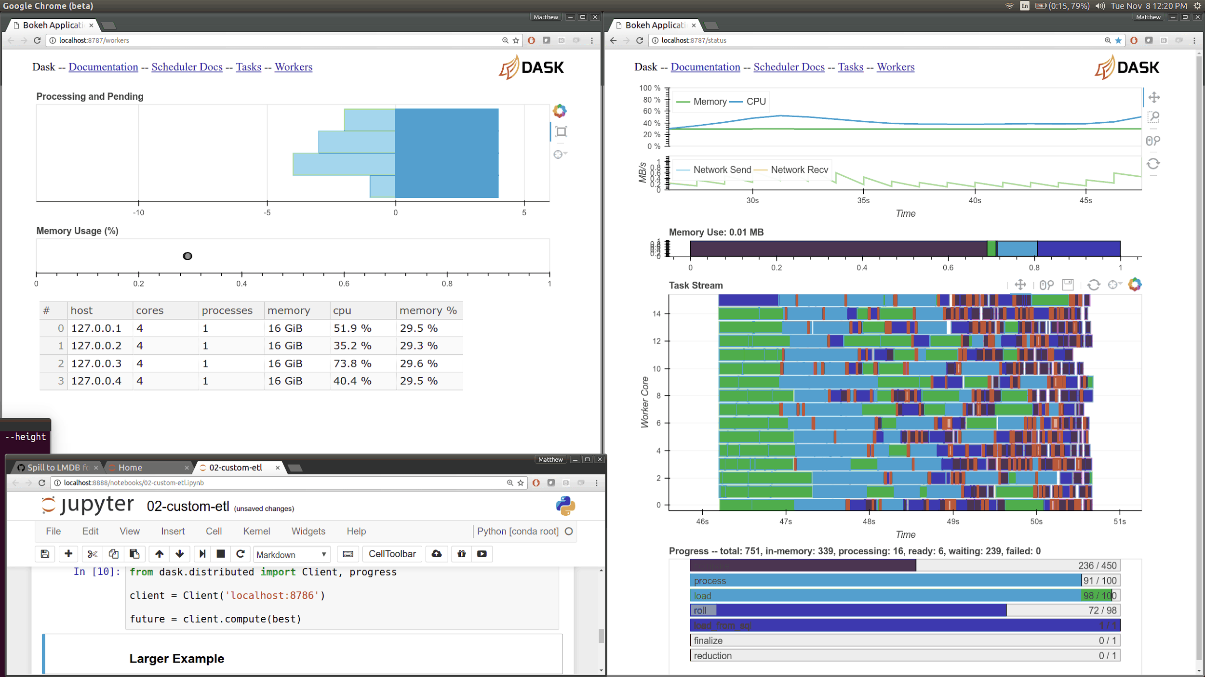
Web Interface
Built over Bokeh server
Displays:
Worker Status, load
Tasks Distribution
Progress bar

