Slide 1
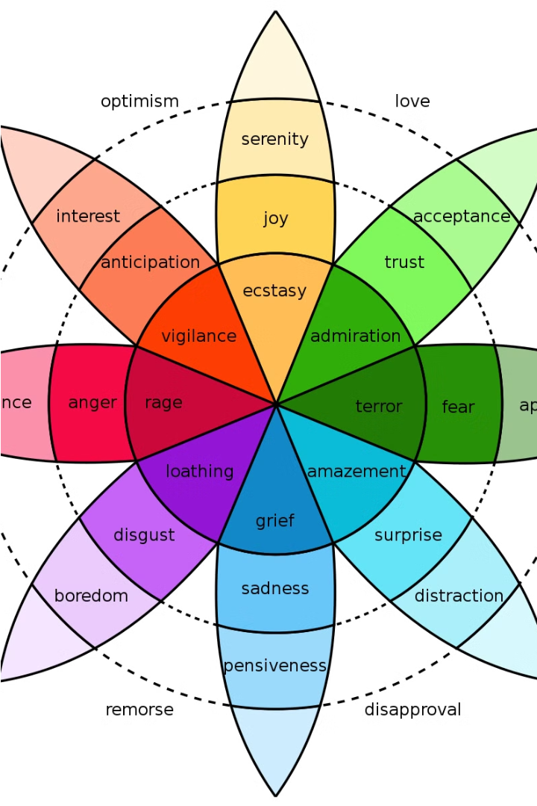
Emotional Health Analyzer
Gain insights into your emotional well-being with our comprehensive Emotional Health Analyzer. Uncover patterns and trends to better understand and manage your emotions.

Slide 2

What is Emotional Health?
Emotional health refers to an individual's ability to manage their thoughts, feelings, and behaviors in a healthy and productive manner. It encompasses our overall well-being, including our capacity to cope with life's challenges, maintain positive relationships, and find fulfillment.

Slide 3



Importance of Emotional Health
Improved Well-Being
Better Relationships
Physical Health Benefits
Strong emotional health promotes a positive outlook, higher life satisfaction, and enhanced overall well-being.
Emotionally healthy individuals tend to have stronger, more fulfilling interpersonal relationships and connections.
Emotional wellness can contribute to better physical health outcomes, including reduced risk of chronic diseases.

Slide 4
Factors Affecting Emotional Health
Stress and Anxiety
Relationships and Social Support
High levels of stress and anxiety can take a toll on our emotional well-being, leading to feelings of overwhelm, irritability, and difficulty focusing.
Strong, supportive relationships and a sense of community can nurture our emotional health, while toxic or isolated environments can be detrimental.
Lifestyle Factors
Traumatic Experiences
Things like diet, exercise, sleep, and work-life balance can significantly impact our emotional well-being, either positively or negatively.
Unresolved trauma, whether from childhood or adulthood, can contribute to emotional health challenges, such as depression, anxiety, and PTSD.

Slide 5



Identifying Emotional Health Issues
Emotional Indicators
Stress and Anxiety
Relationship Challenges
Pay attention to persistent changes in mood, energy levels, sleep patterns, appetite, and ability to focus. These can be signs of underlying emotional health concerns.
High levels of stress or anxiety that interfere with daily life may indicate the need for emotional support. Look for physical symptoms like tension, headaches, or rapid heartbeat.
Difficulties in personal or professional relationships, increased conflict, or withdrawal from loved ones can signal emotional health struggles. Be aware of changes in your social interactions.

Slide 6



Assessing Emotional Health
Self-Reflection
Questionnaires
Professional Evaluation
Start by taking an honest look at your thoughts, feelings, and behaviors. Consider how they impact your daily life and relationships.
Use validated emotional health assessments to gain deeper insights into your overall well-being and identify potential areas of concern.
Consulting a mental health professional can provide a comprehensive evaluation and personalized recommendations for improving your emotional health.

Slide 7

Strategies for Improving Emotional Health
Mindfulness Practices
Social Connection
Self-Care Routines
Cognitive Reframing
Prioritize spending quality time with supportive friends and family, engage in social activities, and build meaningful relationships.
Engage in mindfulness meditation, yoga, or deep breathing exercises to cultivate present-moment awareness and reduce stress and anxiety.
Establish healthy habits like regular exercise, adequate sleep, a balanced diet, and making time for hobbies and relaxation.
Challenge negative thought patterns and cultivate a more positive, optimistic mindset through techniques like cognitive-behavioral therapy.

Slide 8
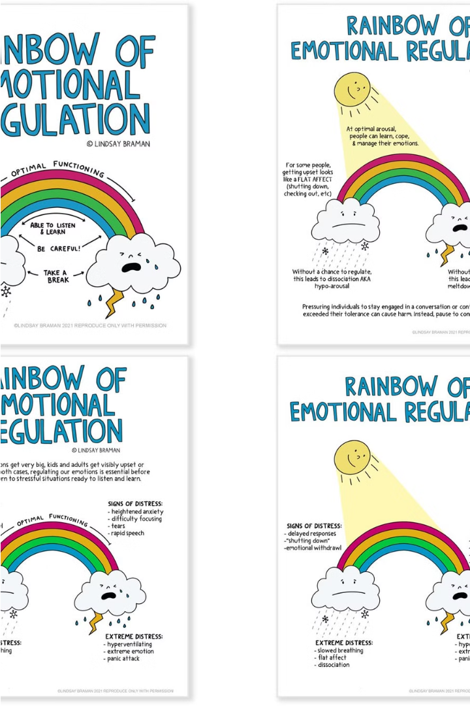
Mindfulness and Emotional Regulation
Mindfulness practices can be a powerful tool for improving emotional health. By cultivating present-moment awareness and acceptance, individuals can develop the ability to regulate their emotions more effectively. This can lead to greater emotional resilience, reduced stress and anxiety, and enhanced overall well-being.

Slide 9

Seeking Professional Support
Understand the Need
Finding the Right Provider
Recognizing when professional support is needed can be a crucial step in improving emotional health. This could involve consulting a therapist, counselor, or mental health specialist.
Researching qualified mental health professionals in your area and assessing their expertise, approach, and fit with your needs can help you find the right support.
Prepare for the Sessions
Being open and honest with the professional, setting goals, and actively participating in the process can maximize the benefits of seeking support.

Slide 10



Maintaining Emotional Wellness and conclusion
Mindfulness Practices
Regular Exercise
Journaling
Incorporating daily mindfulness exercises like meditation, deep breathing, and yoga can help cultivate self-awareness and promote emotional balance.
Physical activity releases endorphins, reduces stress, and boosts mood, making it a powerful tool for maintaining emotional wellness.
Expressing thoughts and feelings through journaling can provide an outlet for processing emotions and promote self-reflection.

Slide 11
Conclusion
Prioritizing emotional health is crucial for overall well-being. By incorporating mindfulness practices, regular exercise, and journaling into our daily routines, we can cultivate the self-awareness and coping strategies needed to maintain emotional wellness over the long term. Remember, taking care of our emotional needs is just as important as caring for our physical health.

