Slide 1

SmartStock Inventory Optimization
A Complete Solution for Retail Stores
Eliminate Costly Overstock, Prevent Revenue-Draining Stockouts, and Achieve Precision Demand Forecasting.

Slide 2
Team Members & Contributions
Jyotsna Sai – Designed and implemented the user interface
Pamisetty Varsha – Developed backend services and APIs
Rudrakshi Jaiswal– Managed database operations and supported machine learning tasks
Kadiga Vijay– Handled database management and contributed to machine learning implementation

Slide 3


The Retail Inventory Challenges
Overstock Crisis
Stockout Frustration
Excess inventory drains capital, inflates storage costs, and risks spoilage, directly eroding profit margins.
Empty shelves lead to immediate lost sales, customer frustration, and lasting damage to brand loyalty and reputation.

Slide 4




SmartStock's Core Mission
Our solution is designed to tackle the dual challenges of overstock and stockout head-on, ensuring optimal inventory levels.
Accurate Demand Prediction
Optimal Stock Recommendations
Perfect Inventory Balance
Leveraging advanced analytics to forecast future demand for every product with high precision.
Providing intelligent recommendations for ideal stock levels to meet anticipated demand without excess.
Achieving a dynamic equilibrium that minimizes costs and maximizes sales efficiency.

Slide 5

SmartStock: Built for Advanced Inventory Optimization
Machine Learning
Frontend (React.js)
HuggingFace demand models
User interface and interactions
SmartStock's Core System
Database (MySQL)
Backend (Python)
Persistent inventory data
API logic (Flask/Django)
Our sophisticated architecture harnesses cutting-edge technologies, empowering businesses with precise control to eliminate costly overstock, prevent disruptive stockouts, and drive superior sales performance.

Slide 6
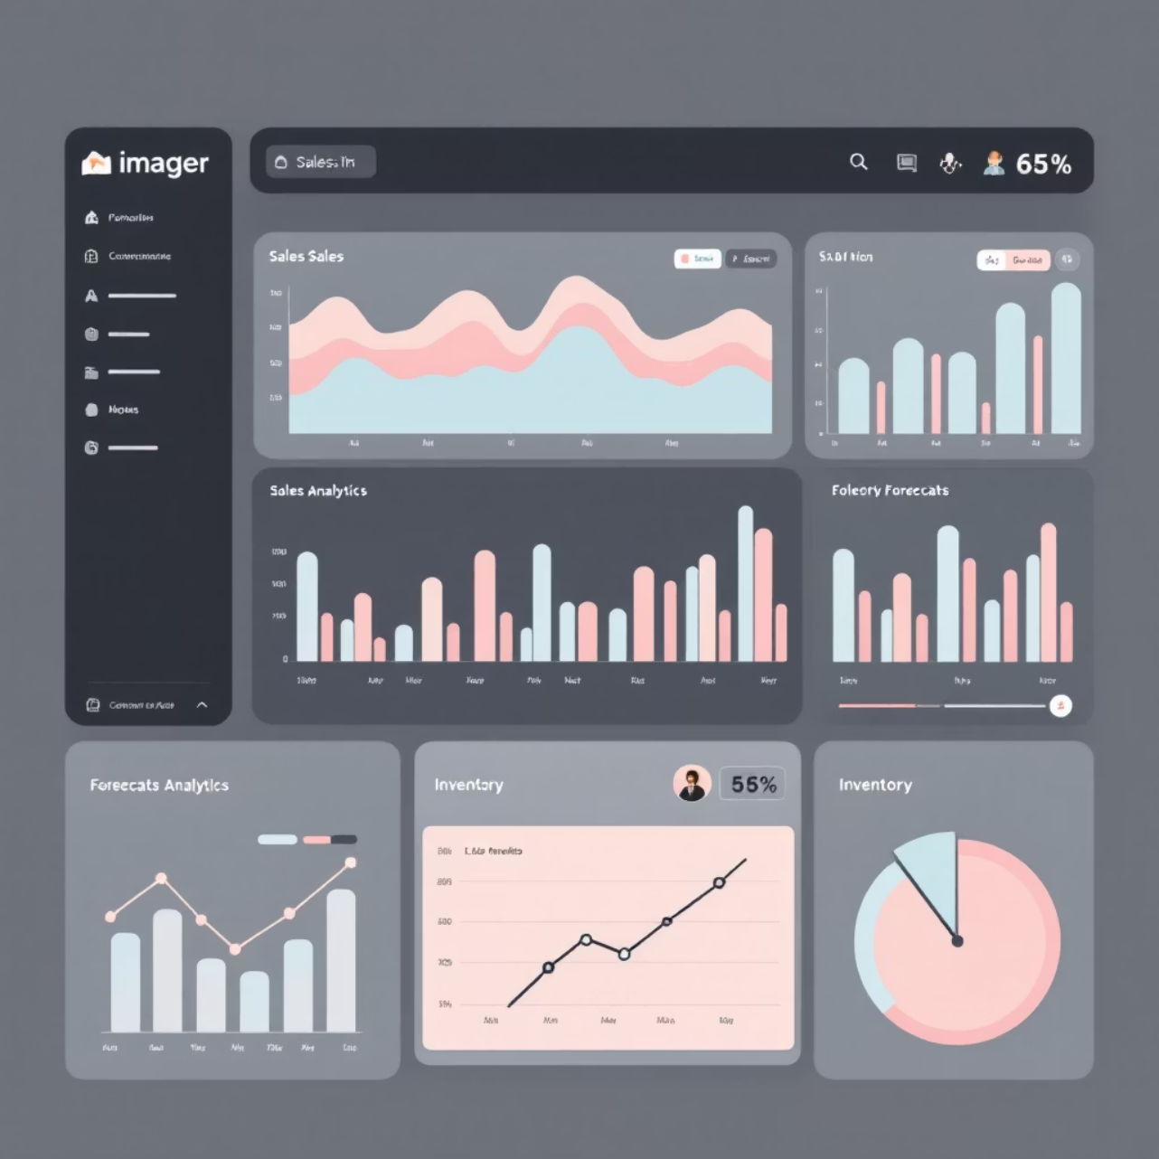
Frontend: Interactive User Experience Layer
Responsive User Interface
Powered by React.js, the SmartStock interface delivers a seamless and intuitive user experience designed for real-time decision-making. The UI presents critical insights, forecast visualizations, and actionable inventory recommendations—all in a clean, responsive layout.
Gain immediate clarity with visual predictions and precise inventory recommendations.
Seamlessly interact with the backend to retrieve and analyze data, ensuring smooth operations.
Stay ahead with proactive low-stock alerts and integrated critical business insights.

Slide 7

Backend: The Intelligence Core
Developed with Python using Django, our backend orchestrates data flow and processing.
Efficiently handles all incoming API requests from the frontend.
Acts as the bridge connecting the ML model with our robust database.
Manages all critical business logic and ensures data validation.
Generates precise demand predictions based on processed data.

Slide 8

Database Layer: Reliable Data Repository
Our MySQL database is the secure and scalable foundation for all operational and analytical data.
Product Information
Detailed attributes for every item.
Inventory Levels
Real-time stock counts and locations.
Sales History
Comprehensive transaction records for analysis.
Forecasts & Recommendations
Stores all generated predictions and actionable insights.

Slide 9




Machine Learning: Powering Predictions with Hugging Face
We leverage advanced machine learning capabilities for superior demand forecasting.
Dataset Import
Time-Series Analysis
Data Preparation
Seamlessly import relevant retail and inventory datasets from Hugging Face.
Utilize historical time-series sales data to identify patterns and trends.
Transform raw data into an optimized format for our cutting-edge ML forecasting models.

Slide 10
Seamless Operational Workflow
Our integrated system ensures a smooth flow from data request to actionable insight.
01
02
03
Frontend Request
Data Retrieval
ML Forecasting
User initiates a request (e.g., "Predict demand for Product A").
Backend efficiently fetches necessary historical data from MySQL.
The dedicated ML model executes precise demand forecasting algorithms.
04
05
Prediction & Recommendation
Dashboard Display
Backend returns the generated prediction and optimal stock recommendation.
Frontend visualizes insights for immediate understanding and action.

Slide 11




SmartStock: The Future of Retail Inventory
SmartStock offers precise inventory management, turning challenges into opportunities. We eliminate overstock and prevent stockouts, helping retailers optimize capital, improve customer satisfaction, and increase profits.
Empowering Tomorrow's Retail
Real-time Inventory Sync
Multi-location Optimization
Get instant, accurate stock updates across all sales channels and locations.
Advanced algorithms optimize inventory across all stores and warehouses.
Predictive Pricing
AI-Powered Anomaly Detection
AI suggests dynamic pricing based on demand, stock, and market trends.
Proactively identifies unusual sales patterns or stock issues to prevent problems.

Slide 12

Thank You
We appreciate you taking the time to learn about SmartStock.

