Slide 1
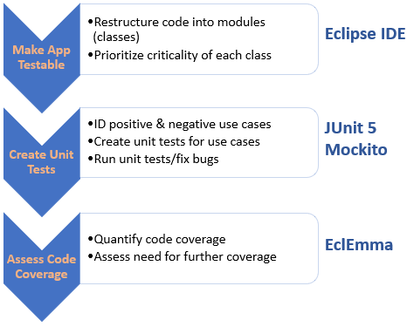
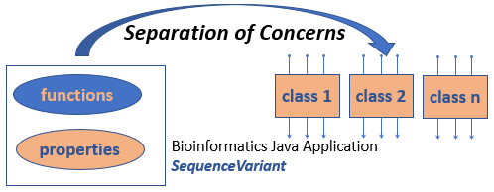
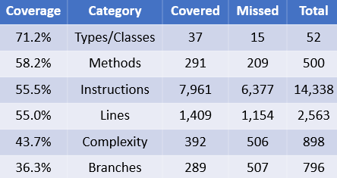
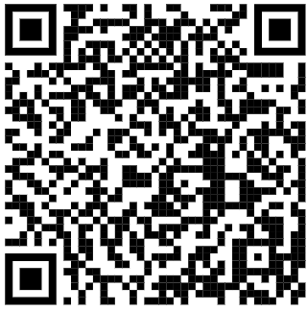
The reliability of bioinformatics software can be significantly improved with the integration of unit tests.
Improving the reliability of bioinformatics software with unit tests
Non-Cognitive Predictors of Student Success: A Predictive Validity Comparison Between Domestic and International Students
Jacqueline Young¹, M.C.S., M.S. Bioinformatics Student
Farnaz Fouladi¹, Ph.D., Postdoctoral Research Fellow
Anthony Fodor¹, Ph.D., Professor
¹Department of Bioinformatics & Genomics
University of North Carolina at Charlotte
BACKGROUND
There is a lack of software engineering practices being applied in bioinformatics when compared to commercial development (Lawlor et al. 2015)
Findings based upon insufficiently tested software should be considered unvalidated (Lawlor et al. 2015)
In order to create high quality tests, the code needs to be testable (Ghafar et al. 2019)
The number of methods executed by a JUnit test is strongly related to that test uncovering a defect (Petric 2018)
METHODS
Refactored code of a bioinformatics Java app (SequenceVariant) using Eclipse 4.12.0 via separation of concerns design pattern
Utilized JUnit 5.4.0 & Mockito 3.3.3 frameworks to create 54 new unit tests
Utilized EclEmma 3.1.3 to quantify code coverage of SequenceVariant by unit tests
RESULTS The following code coverage results were obtained across the SequenceVariant app
SEPARATION OF CONCERNS (Natesan 2019)
A software architecture design pattern for separating an app into distinct sections , where each section addresses a separate concern
Increases code reusability, maintainability and extensibility
There are various types of separation of concerns
vertical
horizontal
data
aspect
Software Reliability
Mod 1
Mod 2
Mod 3
Unit Test Coverage
CITATIONS
Lawlor, Brendan et al. (2015). “Engineering bioinformatics: building reliability, performance and productivity into bioinformatics software.” Bioengineered, 6:4
Ghafari, M. et al. (2019). “Testability First!” ACM/IEEE International Symposium on Empirical Software Engineering and Measurement (ESEM)
Petric, Jean et al. (2018). “How effectively is defective code actually tested? An analysis of JUnit tests in seven open source systems.” In Proceedings of the 14th International Conference on Predictive Models and Data Analytics in Software Engineering, PROMISE’18
Natesan, N (2019). "How to implement Design Pattern - Separation of concerns." Software Intelligence Pulse, https://www.castsoftware.com/blog/how-to-implement-design-pattern-separation-of-concerns
DISCUSSION
Unit tests highly improved the reliability of core functions of SequenceVariant
This work provided viable workflow steps and tools for use by other bioinformaticians
Notes:
Notes:
In Powerpoint, click View > Guides
Keep text within gutter guides.
Author list: Don’t split names onto two lines (e.g., “Jimmy [break] Smith”). If that happens, use a new line, unless you need the space. Bold the first names of anybody who’s presenting in person.
Intro/methods/result: Do not drop below font size 28, but if you have extra space, jack up the font size until the space is full.
Do not use color in the sidebars except in graphs/figures. It’ll pull attention from the center and slow interpretation for passersby.

