Slide 1
Scene
Scene
Overworld Map
Local Map
Mouse/ Keyboard
Game Pad
Sound Manager
Tile Map
Objects
NPCs
Player Actor
Interrogations
Input Mapping
Interactions
Progression
Global Events
Cutscene
Dialog
Story Points
Save/Load
Journal
Day/Night
Case Manager
Quest
Inventory
Character
Settings
Mystery
Investigation

Slide 2
Town MVP
PI office
Grocery Store
Theatre
City Hall
Bar
Park
Docks
Warehouse
Residence
Apartments

Slide 3
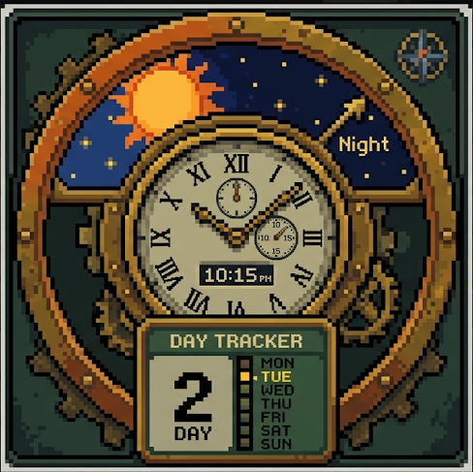
Day/night wheel
Cosmetic Cover
Digital Readout
Hour Hand
Minute Hand
Day Tracker

