Slide 1
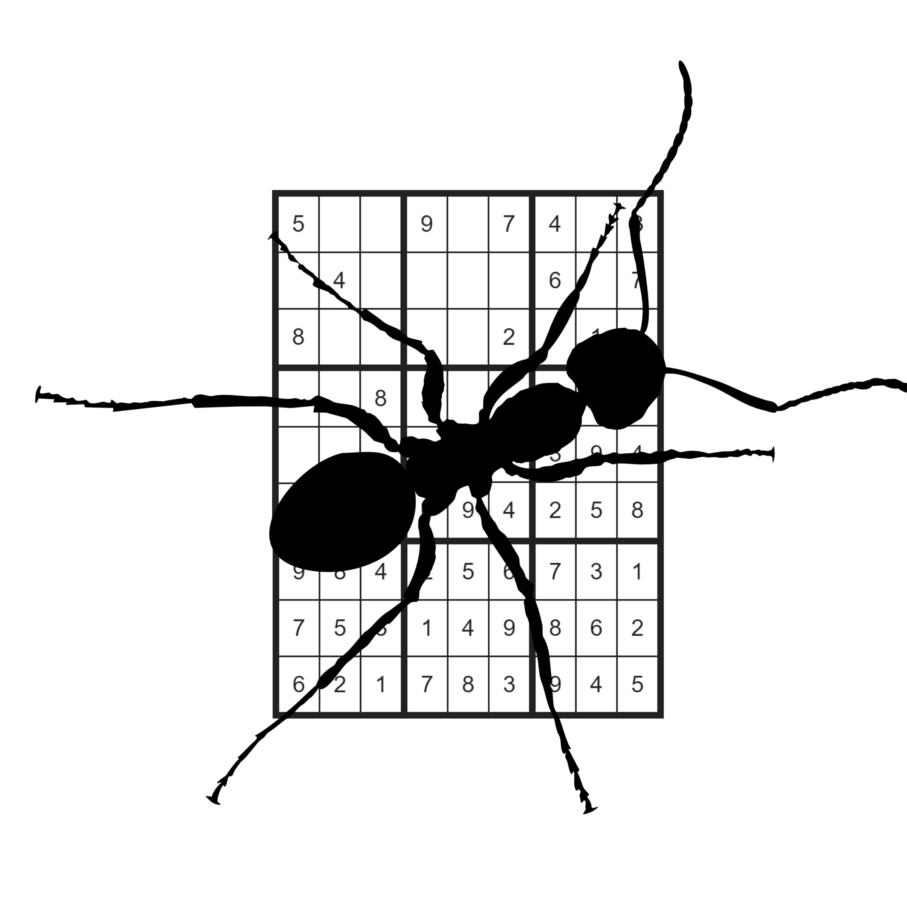
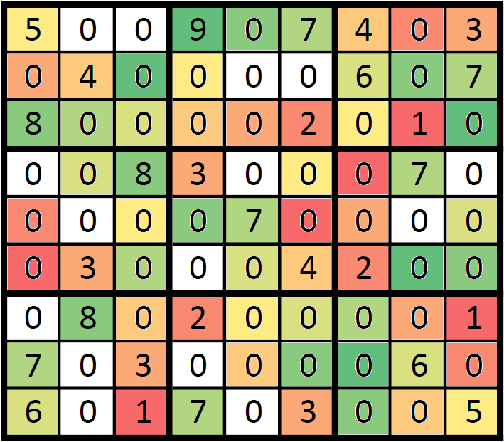
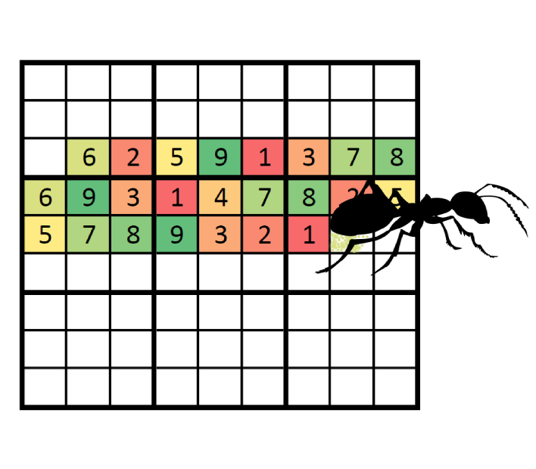
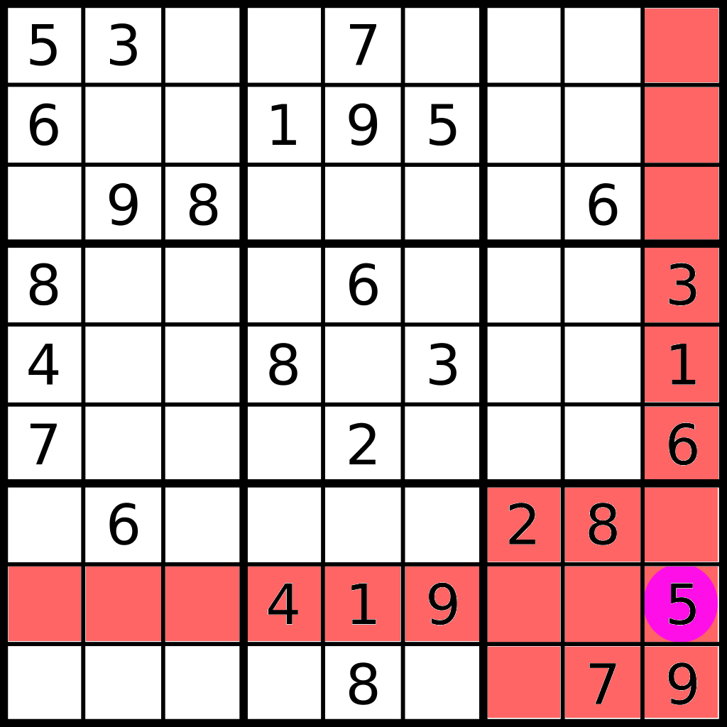
Solving Sudokus
With Ant Colony Optimisation
Jüri Gramann, Raid Vellerind
University of Tartu
Algorithmics Course
Fall 2018/19
Solving a sudoku is a NP-complete problem. There are multiple possible ways to solving a sudoku and one of them is ant colony optimization. For solving Sudokus with ant colonies, we give each ant a copy of the Sudoku and let them randomly guess which value should be in which cell. Most ants will be drawn towards the best solution by global pheromone trail.
Global pheromone table is initialised with default probability for each possible value in given cells value set. After every generation, the global pheromone table is updated based on the findings of “best ant” and all of the pheromone values are increased. The „best ant“ is an ant who got the most cells fixed in a generation but did not find a correct solution. Over gene-rations, pheromones for wrong values get decreased.
Each ant starts its
journey from a random
cell. If the cell’s
value is not fixed,
the ant will make a
weighed random decision based
on the pheromone table. After that, constraint propagation is applied to the Sudoku to determine what effect the ant’s decision had on the whole Sudoku. Then the ant lowers the pheromone level for next generation. That way, if the ant does not find a solution, other ants will choose it at a lower probability.
Constraint propagation is a method that
fills in all the “obvious” cells. For this
the peers of a cell are checked. Any cell has exactly three units and 20 peers. The three units are row, column and box. The set of
peers is made up of the cells containing in units. For easier Sudokus, constraint propagation is enough to solve the whole
Sudoku.
constraint_propagation:
while changes in sudoku:
Eliminate from a cell’s value
set all values that are fixed
in any of the cell’s peers.
If any values in a cell’s value
set are in the only possible
place in any of the cell’s units,
then fix that value.
return changed sudoku
The final solution of the
Sudoku emerges when the
described bits and pieces
come together. To solve a
Sudoku, the first step is
to propagate constraints.
Then the global pheromone
table is initialized and
ants are generated. Each
ant receives a copy of the Sudoku and starts to travel through it. Based on “best ant’s” result, the global pheromone map is updated. New ants from next generation use this as their guide, until the Sudoku is solved.
solve_sudoku():
initialise_sudoku
constraint_propagation
initialise_global_pheromones
while sudoku not solved:
generate ants
each ant tries to solve sudoku
find best ant
update global pheromones
if best ant has solution
break
return solved sudoku
The project is based on the article: Lloyd H, Amos M. Solving Sudoku with
Ant Colony Optimisation. arXiv preprint arXiv:1805.03545. 2018 May 9.
Project available at: https://github.com/jyrigr/MTAT.03.238-Project

