Slide 1
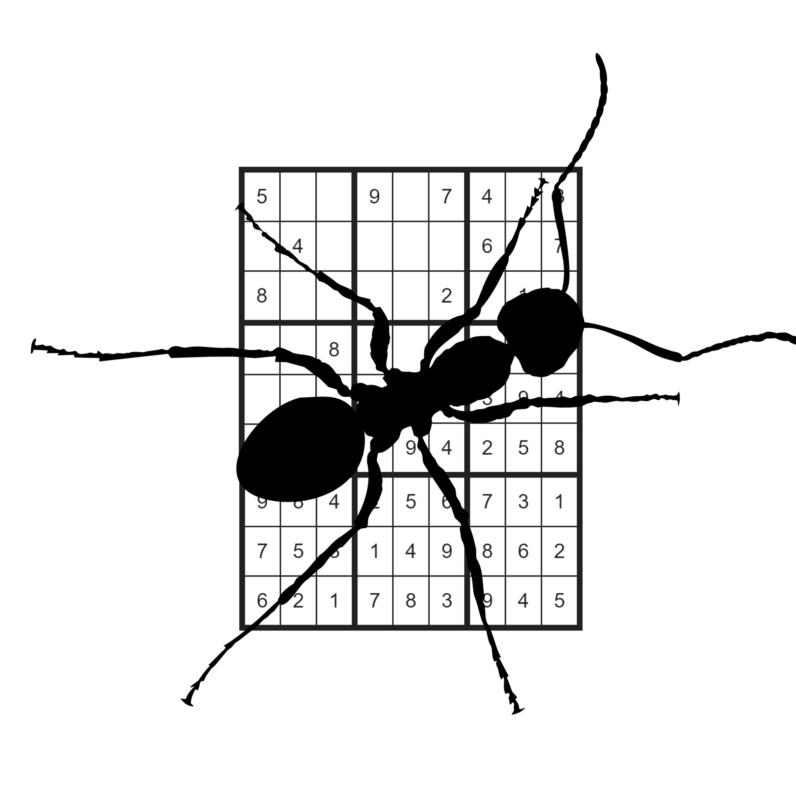
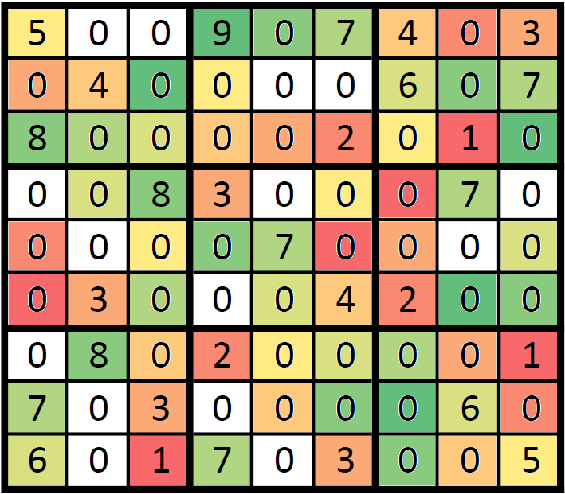
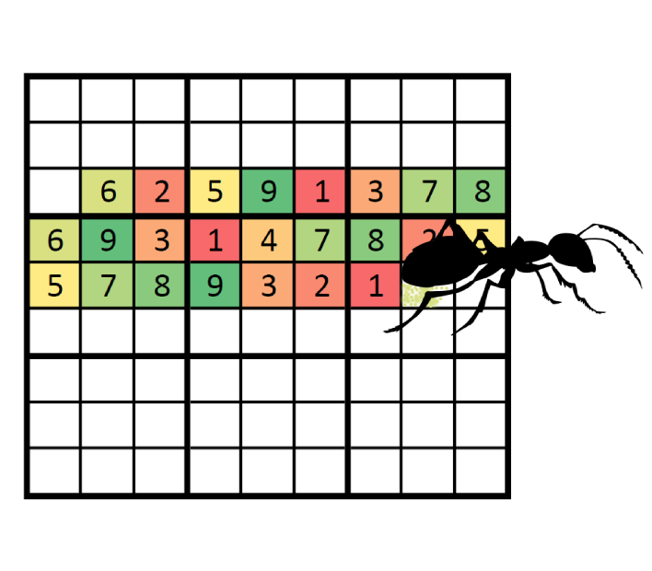
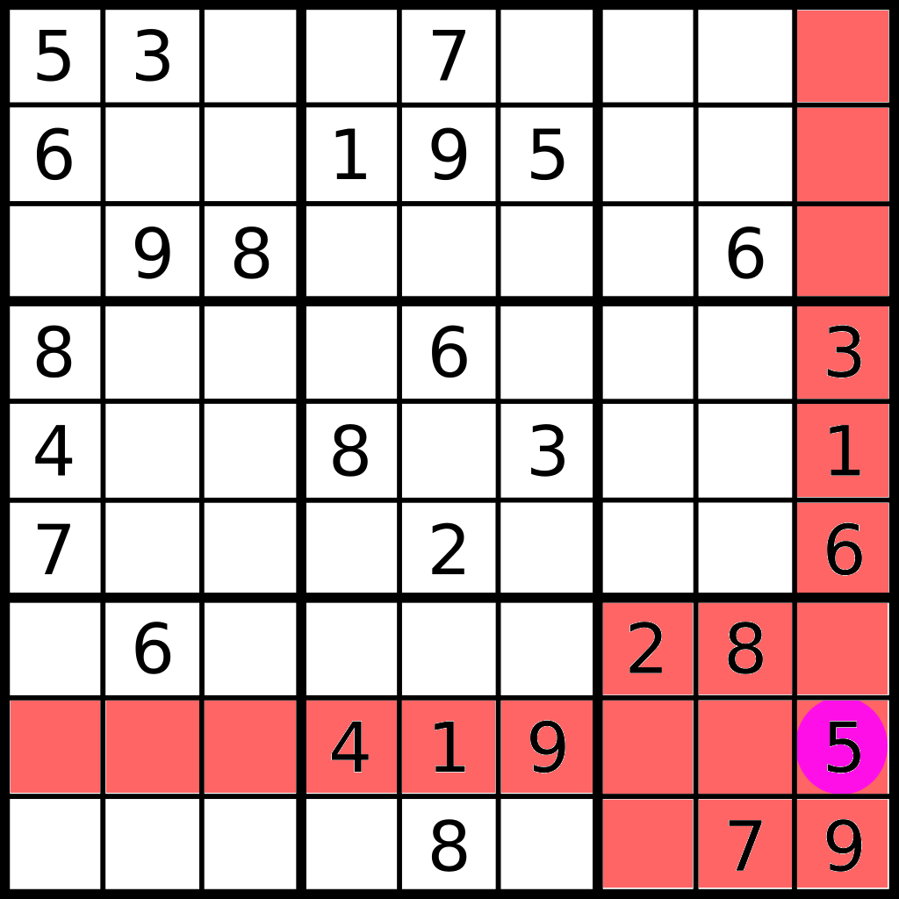
Solving Sudokus
With Ant Colony Optimisation
Jüri Gramann, Raid Vellerind
University of Tartu
Algorithmics Course
Fall 2018/19
For solving Sudokus with ant colony optimisation, we give each ant a copy of the Sudoku and let them randomly guess witch value should be in which cell. Most ants will be drawn towards the best solution by global pheromone trail.
Global pheromone map is
initialised with default
probability for each
value in given cell’s
value set. With every
generation the global
pheromone value is updated based on the findings of “best ant.” The cell value will most probably be the one with the highest pheromone level. If for any cell the pheromone level has not changed from default, the choice for a suitable value is made randomly.
Each ant starts
its journey from a
random cell. If the
cell’s value is not
fixed, the ant will
make a weighed decision
based on the pheromone levels of given cell. After each operation, constraint propagation is applied to the Sudoku to determine which effect the ant’s decision had on the whole Sudoku. For an empty Sudoku, an ant would start randomly assigning values and excrete pheromone.
Constraint propagation is a method that
fills in all the “obvious” cells. For
this the peers of a cell are checked. Any cell has exactly three units and 20 peers. The three units are row, column and box.
The set of peers is made up of the cells containing in units. For easier Sudokus, constraint propagation is enough to
solve the whole Sudoku.
The final solution of the
Sudoku emerges when the
described bits and pieces
come together. To solve a
Sudoku, the first step is
to propagate constraints.
Then the global pheromone
map is initialized and
ants are generated. Each
ant receives a copy of the Sudoku and starts to travel through it. Based on “best ant’s” result, the global pheromone map is updated. New ants from next generation use this as their guide, until the Sudoku is solved
constraint_propagation:
while changes in sudoku:
Eliminate from a cell’s value
set all values that are fixed
in any of the cell’s peers.
If any values in a cell’s value
set are in the only possible
place in any of the cell’s units,
then fix that value.
return changed sudoku
solve_sudoku():
initialise_sudoku
constraint_propagation
initialise_global_pheromones
while sudoku not solved:
generate ants
each ant tries to solve sudoku
find best ant
update global pheromones
if best ant has solution
break
return solved sudoku
The project is based on the article: Lloyd H, Amos M. Solving Sudoku with
Ant Colony Optimisation. arXiv preprint arXiv:1805.03545. 2018 May 9.

