Slide 1
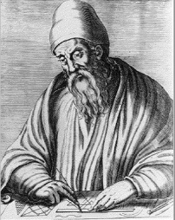
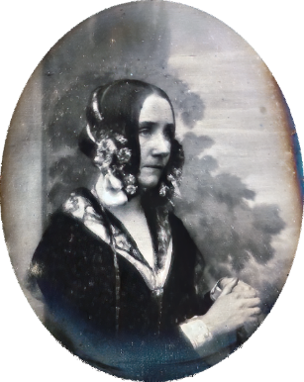
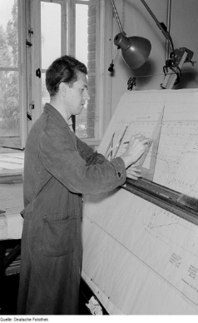
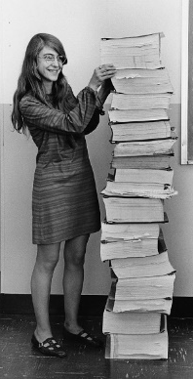
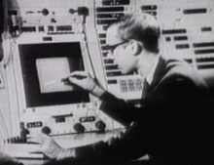

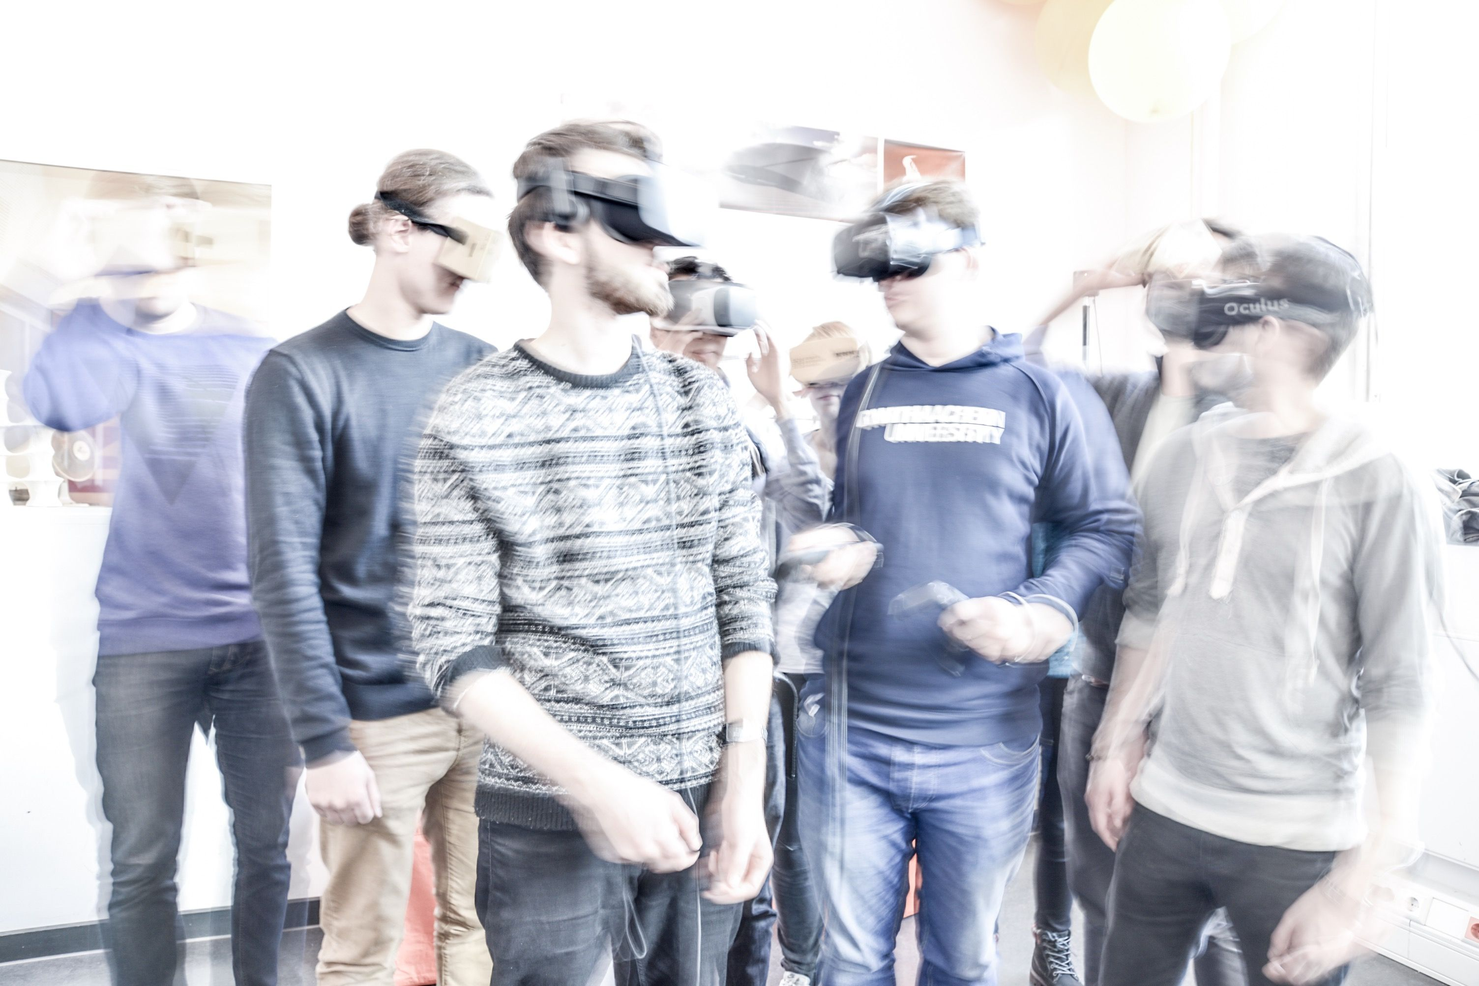
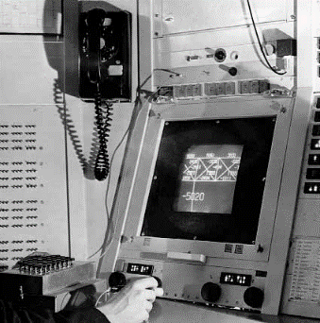
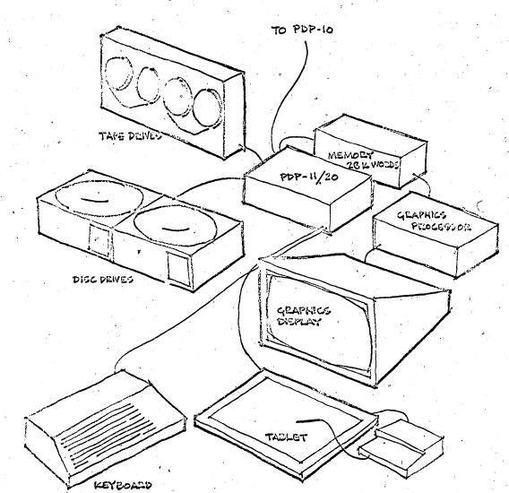
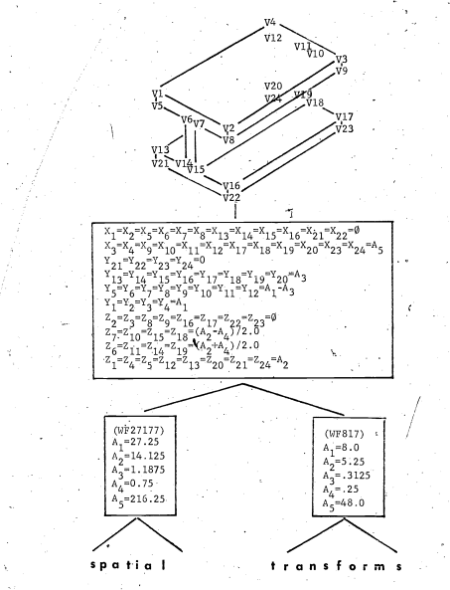
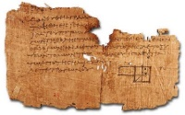
Research Data Management
TabularRDM
Dr.-Ing. Jyrki Oraskari

Slide 2

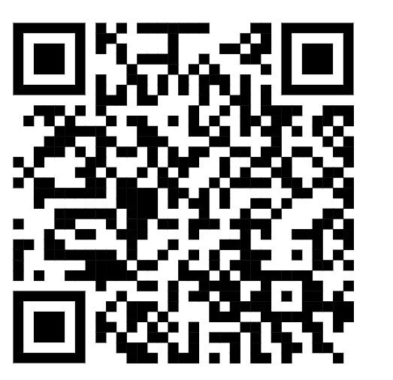
TabularRDM: Installation Prerequisites
Node.js & Package Engine
v18+
TabularRDM runs on top of Vite and Node.js. Before getting started, verify that Node.js is installed on your workstation.
You can download the official installer directly from https://nodejs.org/en/download prior to extracting the source package.
Required Node.js Environment

Slide 3
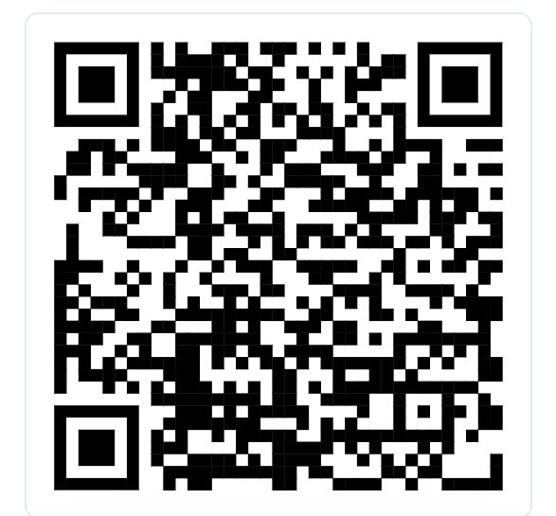
TabularRDM: Step-by-Step Installation
Download & Extract: Scan the source QR code, select Select Code / Download ZIP, and unzip the project directory on your local device.
Open Terminal: Navigate into the unzipped folder. Windows Users: Open a terminal window in the directory and type: cmd
Install Dependencies: Execute npm install in your terminal to fetch required Node components and dependencies.
Launch Local Server: Run npm run dev and navigate to http://localhost:5173/ in your browser to start working.

Slide 4
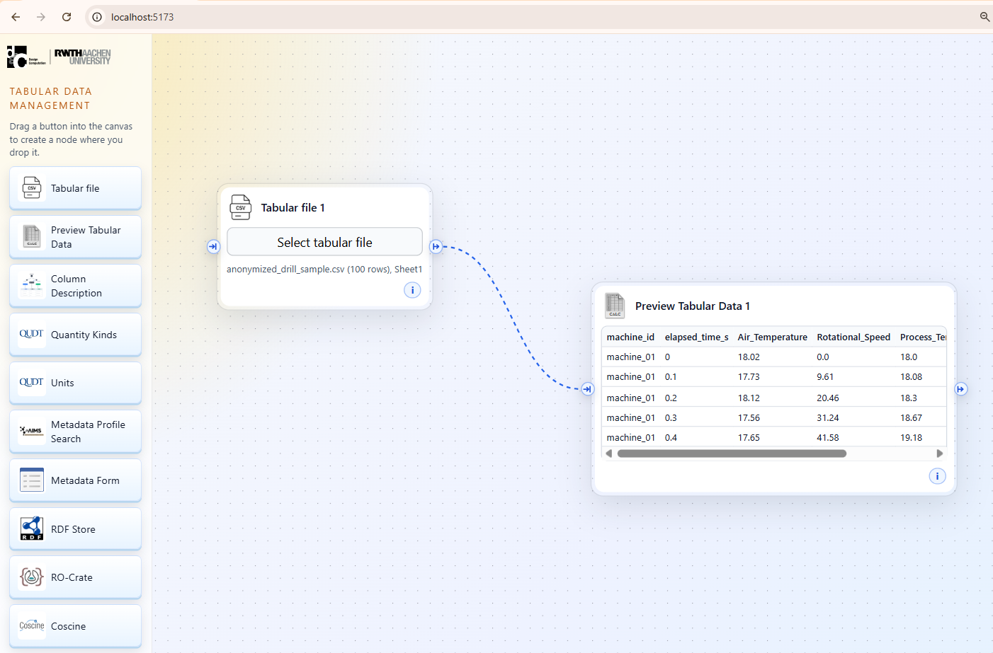
TabularRDM
Select a CSV or an Excel file
Can you see the right columns?
Use the provided sample.csv in the tutorial

Slide 5
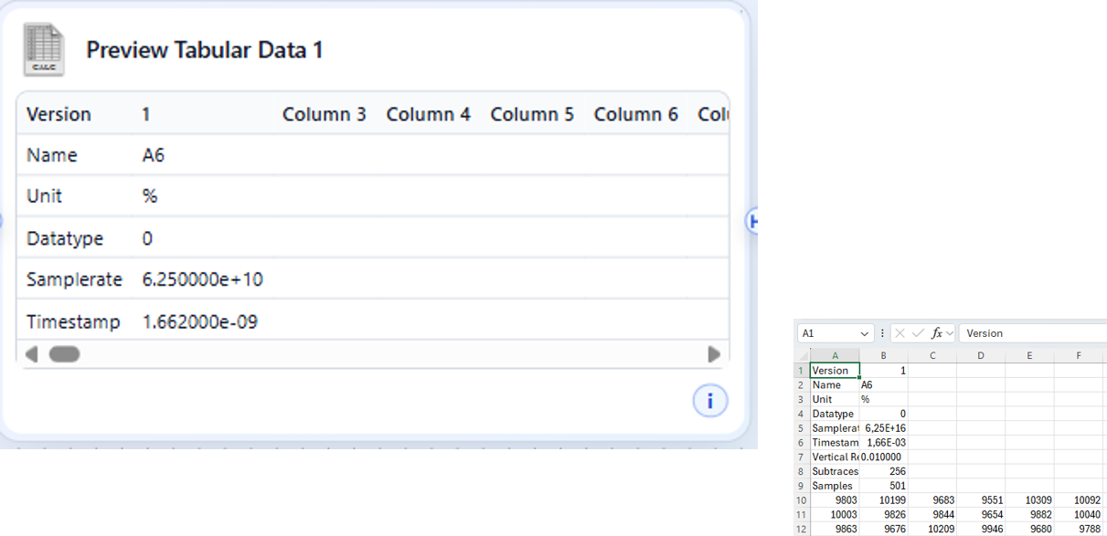
TabularRDM
If the previewed tabular data looks like this. Open the file in Excel.
Task: Describe the meaning of the columns.

Slide 6
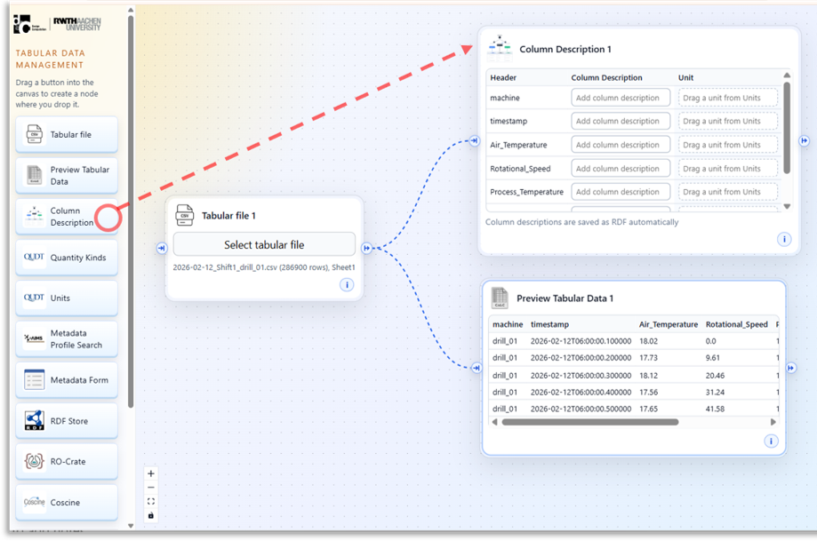
TabularRDM
Drag the Column Description icon to the view
Connect that to the Tabular file on the view.

Slide 7
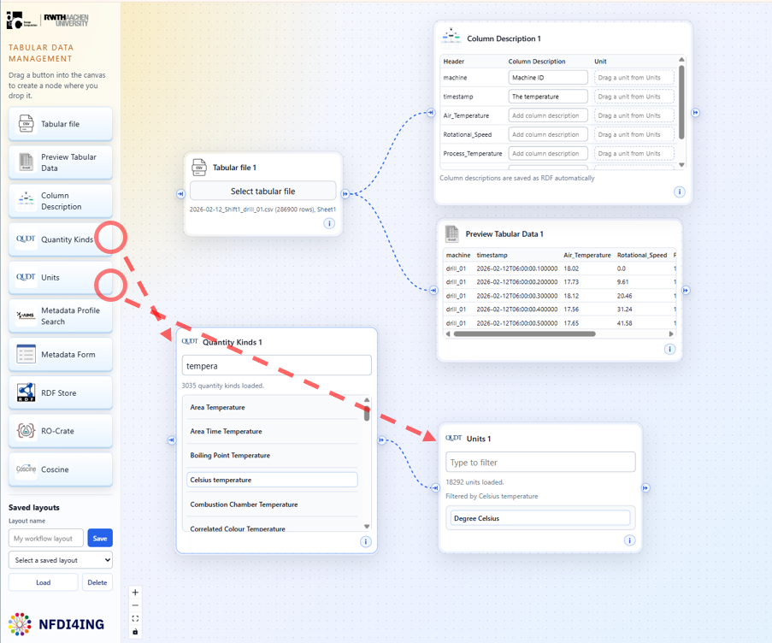
TabularRDM
Drag the Quantity Kinds and Units to the view
Connect them as shown here.
In the Quantity Kinds search box, search for temperature
Select “Celsius temperature” and see how Units are updated

Slide 8
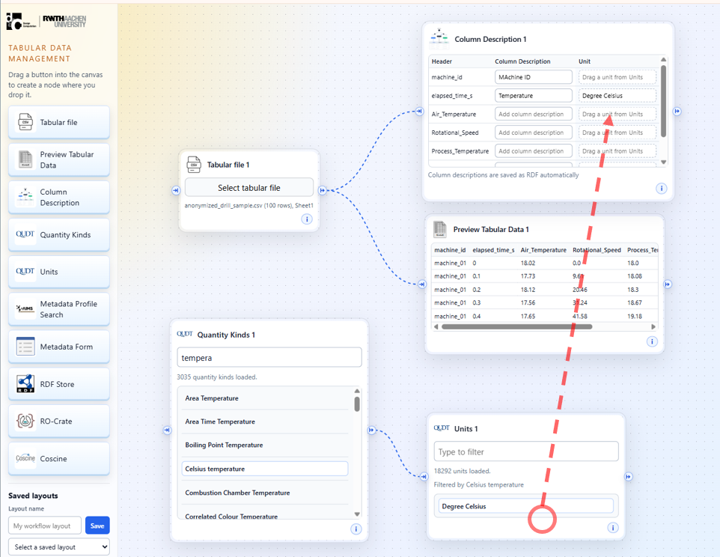
TabularRDM
Drag and drop the Degree Celsius to the column description field of Units

Slide 9
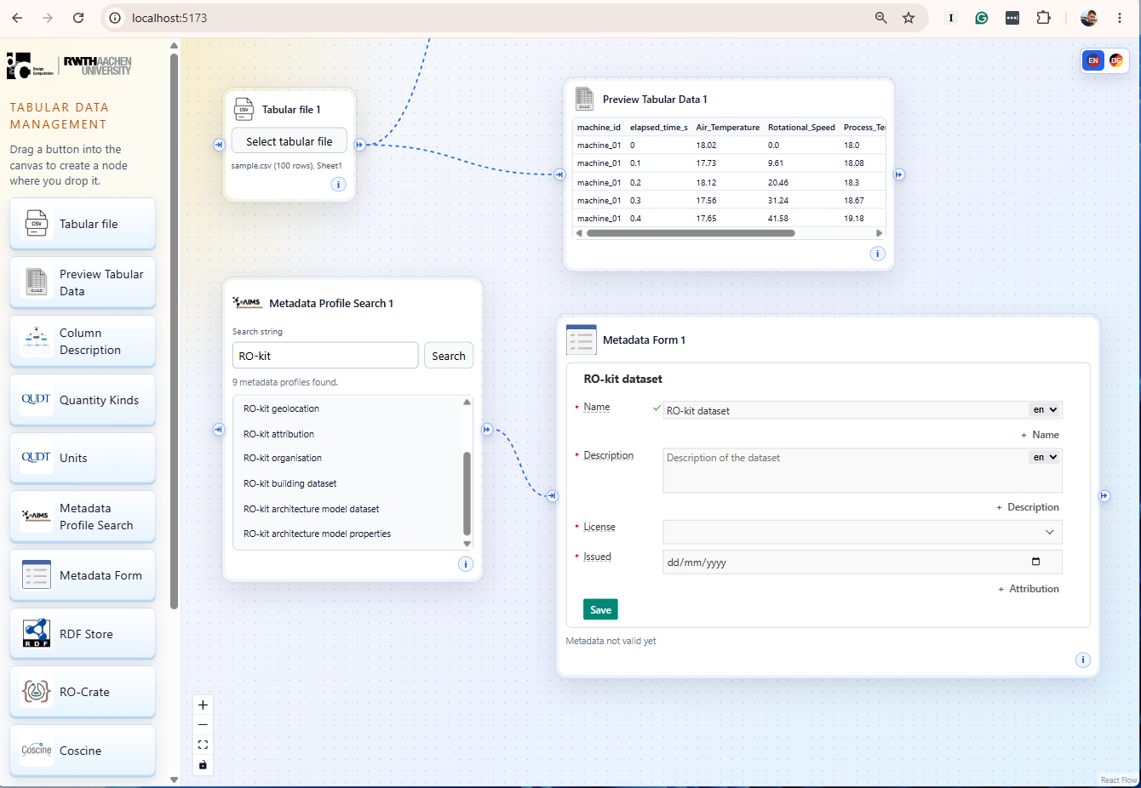
TabularRDM
Drag the Metadata Profile Search and Metadata Form icons to the view
Connect them on the view and fill the form.

Slide 10
TabularRDM
Drag the Metadata Profile Search and Metadata Form icons to the view
Connect them on the view and fill the form.

Slide 11
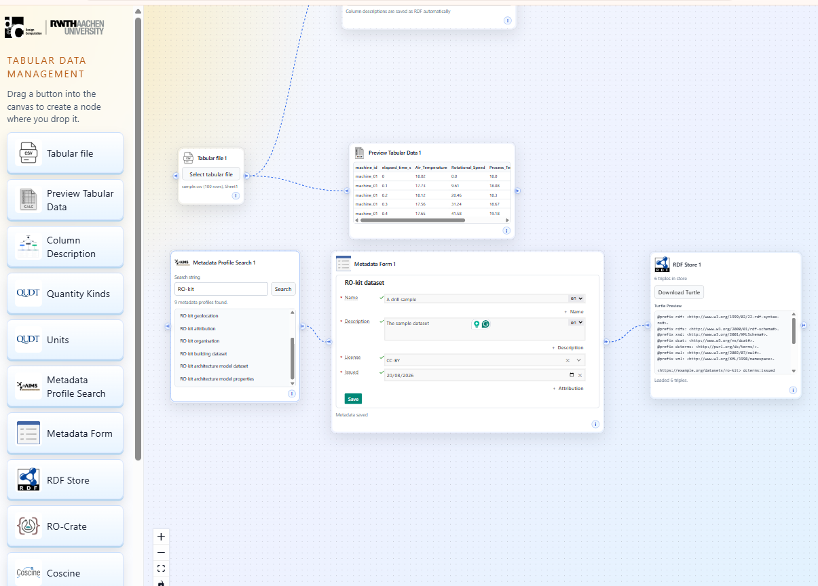
TabularRDM
Drag the RDF Storage icon to the view
Connect that with the Metadata form. Save the forma and the ste Download button.

Slide 12
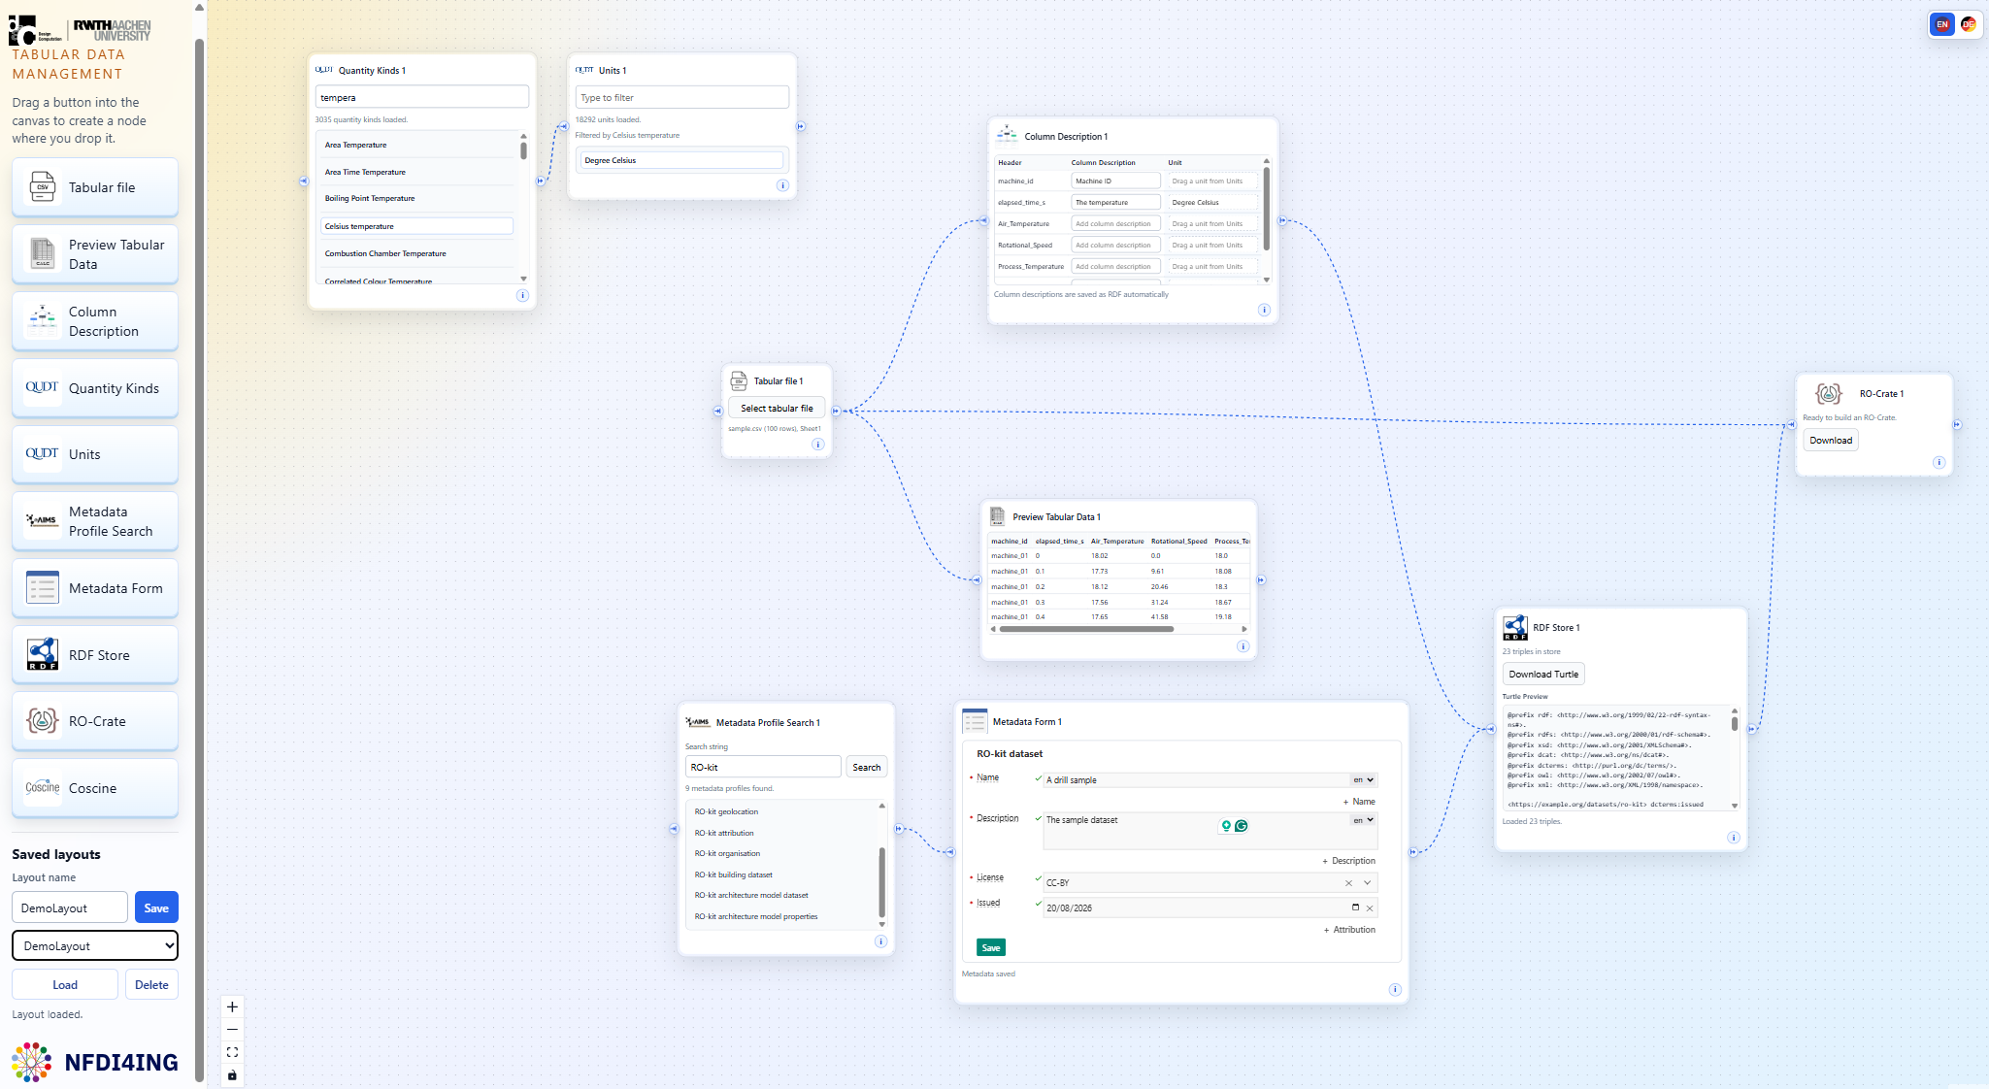
TabularRDM
Drag the RO Crate icon to the view
Connect that to the RDF Storage and Tabular file. Test the Download button.
There is also the Coscine upload functionality.

