Slide 1
A multi-view
Auto Lip Reading (ALR)
Team 12. The Kip-reader’s
l
2016.10.10
Jesper Loenbaek
Youngsoo Jang
HyoJung Han
Notes:
<number>

Slide 2
Table of Content
About Lip-reading
Speech Recognition
Previous Work
Our Approach
Dataset – OULUVS2
Q&A
Notes:
<number>

Slide 3
About Lip-reading
What is Lip-reading?
Understanding speech by visually interpreting movement of lips, face and tongue
Who use it?
Deaf or hear-of-hearing people
People with normal hearing process (McGurk Effect)
https://www.youtube.com/watch?v=G-lN8vWm3m0&t=1m17s
Notes:
State : continuous -> discrete (0~499)
<number>

Slide 4
Application
Enhancing Speech recognition
Audio-visual data fusion
Visual Password
Silent speech interface
Forensic video analysis
Visual Speech Recognition (VSR)
Speech recognition by only using video
When no sound or only pure quality is available
Audio Visual Speech Recognition (AVSR)
Combining audio and visual input to enhance speech recognition
Notes:
State : continuous -> discrete (0~499)
<number>

Slide 6
Visual Speech Recognition Task and Method
VSR task
Input: Sequence of lip images
Output: Text
Goal: get state-of-the-art accuracy
Method in VSR
Data pre-processing: Lip tracking and ROI(Region of Interest) extraction
Extracting visual features for various people
Classification
Notes:
State : continuous -> discrete (0~499)
<number>

Slide 7
Previous Work
Focused on feature extraction (ex. component analysis)
T.F. Cootes, G.J. Edwards and C.J. Taylor, “Active Appearance Models”, IEEE Trans. on Pattern Anal. And Machine Intel.
G. Zhao, M. Barnard, and M. Pietik ainen, “Lipreading With Local Spatiotemporal Descriptors”, IEEE Trans. on Multimedia
Deep autoencoder
Feature extraction by using deep autoencoder
LSTM (Long Short Term Memory)
End-to-end learning with Neural Network, LSTM
WAND, Michael, et al. “Lipreading with long short-term memory”, IEEE International Conference on Acoustics, Speech and Signal Processing
CNN (Convolutional Neural Network)
Feature extraction by CNN
K. Noda, Y. Yamaguchi, K. Nakadai, H. G. Ok“Lipreading using Convolutional Neural Network”, in Proc. Interspeech
Notes:
State : continuous -> discrete (0~499)
<number>

Slide 8
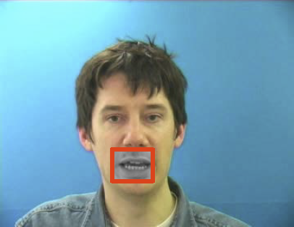
Our Approach
Neural Network approach
CNN: for feature extraction
DNN (Deep Neural Network): learning with basic neural network
RNN or LSTM: learning for the sequential data
End-to-End architecture
Improve the performance with our new architecture
Make a demo with end-to-end model
Input: face or mouth video, Output: the sentence
Our Algorithm
Answer sentence
Video Input
Notes:
State : continuous -> discrete (0~499)
<number>

Slide 9
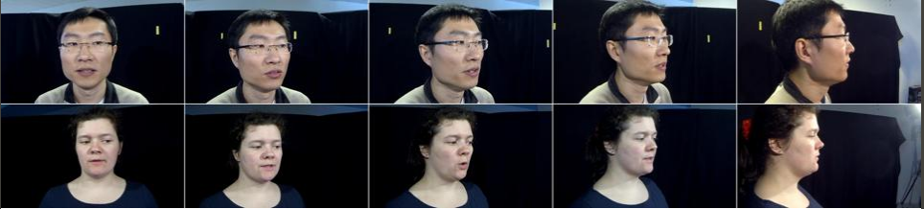

Dataset – OULUVS2
OULUVS2: A Multi-View AudioVisual DataBase
http://ouluvs2.cse.oulu.fi/index.html
ACCV2016 WORKSHOP: Multi-View Lip-Reading/Audio-Visual Challenges
Notes:
State : continuous -> discrete (0~499)
<number>

Slide 10
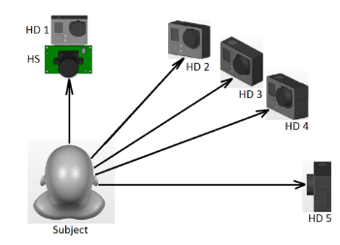
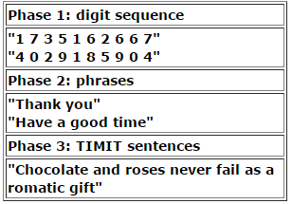
Dataset – OULUVS2
Recordings
video recordings from 52 subjects
from five different views simultaneously
Contents
digits : randomly generated ten fixed digit sequences.
phrases: ten daily-use short English phrases
TIMIT sentence: five randomly selected TIMIT sentences
Notes:
State : continuous -> discrete (0~499)
<number>

Slide 11
Dataset – OULUVS2
Q) What lip says?
See you
2. Thank you
3. Excuse me
4. Goodbye
5. Hello
Notes:
State : continuous -> discrete (0~499)
<number>

Slide 12
Q&A

Slide 13
End of Presentation

Slide 14
Dataset – OULUVS2
Basketball can be
an entertaining sport.
Chocolate and roses never
fail as a romantic gift.
See you
2. Thank you
3. Excuse me
4. Goodbye
5. Hello
Q) What lip says?
Notes:
State : continuous -> discrete (0~499)
<number>

