Slide 1
Websocket chat application
Presenter: JayaShankar Mangina
DATE: December ,2021.

Slide 2

HTTP REQUEST– RESPONSE CYCLE
Request 1
Response 1
CLIENT
SERVER
Request 2
Response 2

Slide 3
WEBSOCKET CONNECTION CYCLE
HANDSHAKE (HTTP UPGRADE)
CLIENT
BI-DIRECTIONAL MESSAGES
SERVER
(OPEN AND PERSISTENT CONNECTION)
ONE SIDE CLOSES CHANNEL
(CONNECTION CLOSED)

Slide 4
registerStompEndpoints
WebSocketMessageBrokerConfigurer
CONFIGURATION
@Configuration
configureMessageBroker
SessionDisconnectEvent
@EnableWebSocketMessageBroker
SessionConnectedEvent
@Controller
@Payload
StompHeaderAccessor
CHAT CONTROLLER
@SendTo
SimpMessageSendingOperations
@MessageMapping
Logger
@EventListener
LoggerFactory
WEBSOCKET EVENT LISTENER
@Autowired

Slide 5
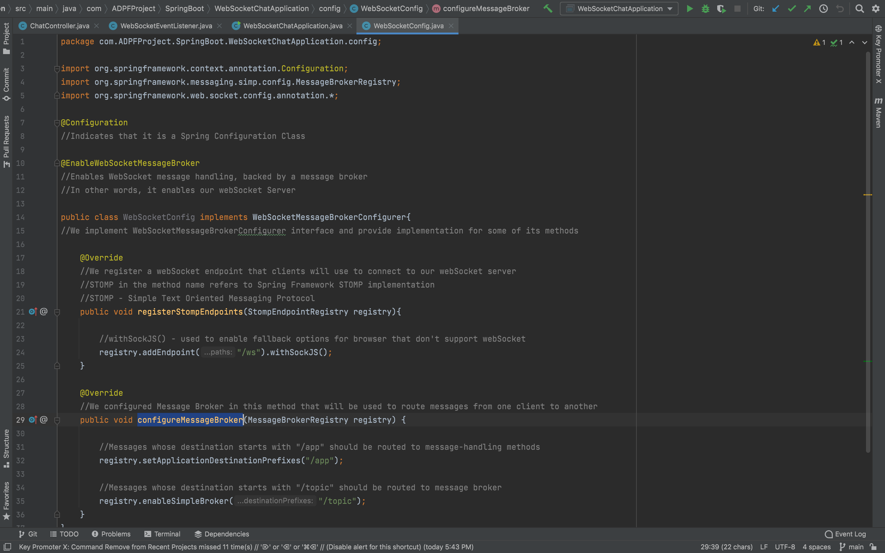
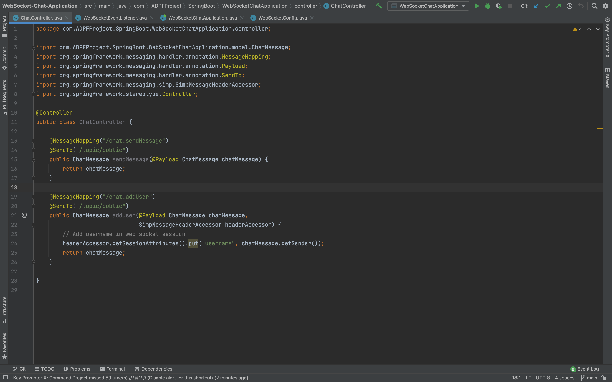
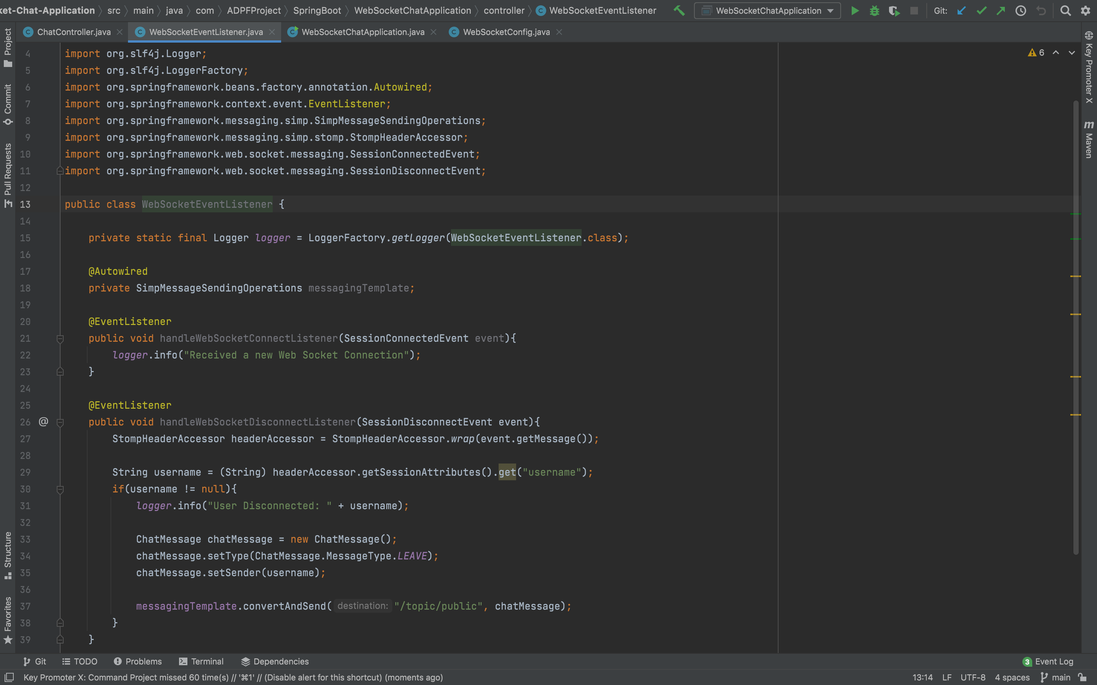
SAMPLE SCREENSHOTS

Slide 6
THE END

