Slide 1
PIM-TMR convergence
2023/03/15

Slide 2
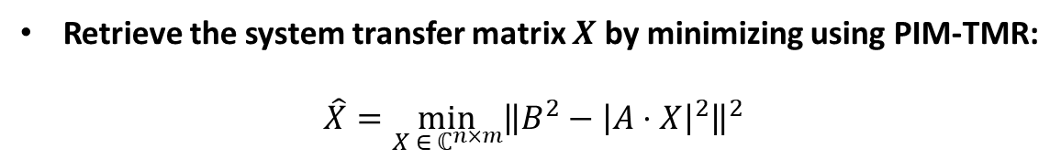
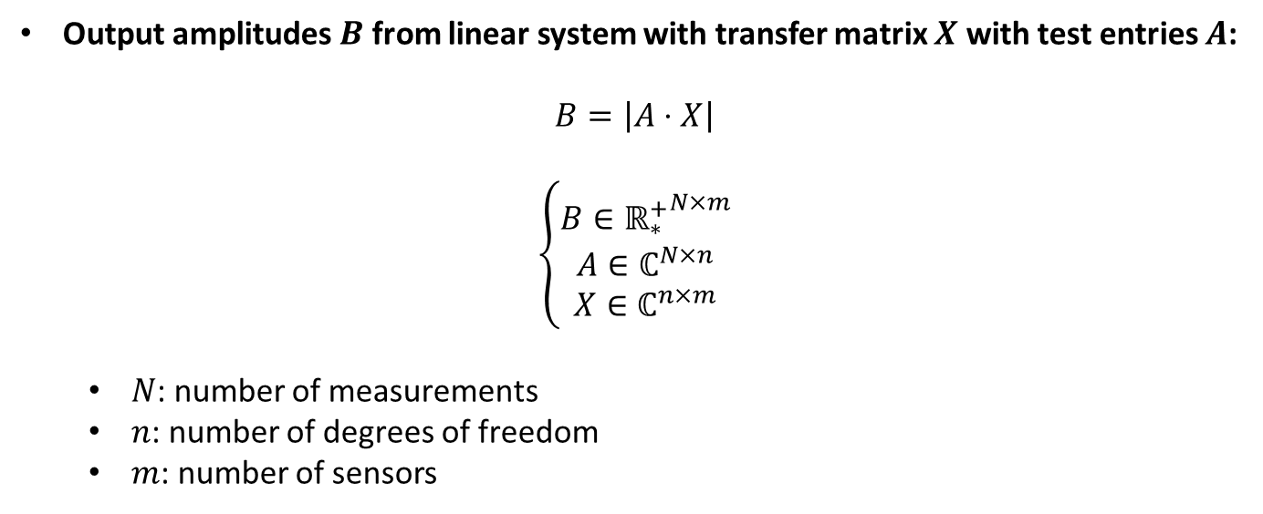
Model & objective
Output amplitudes $B$ from linear system with transfer matrix $X$ with test entries $A$:
$$B=\left|A⋅X\right|$$
$$\left\{\begin{aligned}B∈{{\text{ℝ}}_{∗}^{+}}^{N×m} \\ A∈ℂ^{N×n} \\ X∈ℂ^{n×m}\end{aligned}\right.$$
$N$: number of measurements
$n$: number of degrees of freedom
$m$: number of sensors
Retrieve the system transfer matrix $X$ by minimizing using PIM-TMR:
$$\hat{X}=\min_{X ∈ ℂ^{n×m}}{{\left\|B^{2}−{\left|A⋅X\right|}^{2}\right\|}^{2}}$$

Slide 3
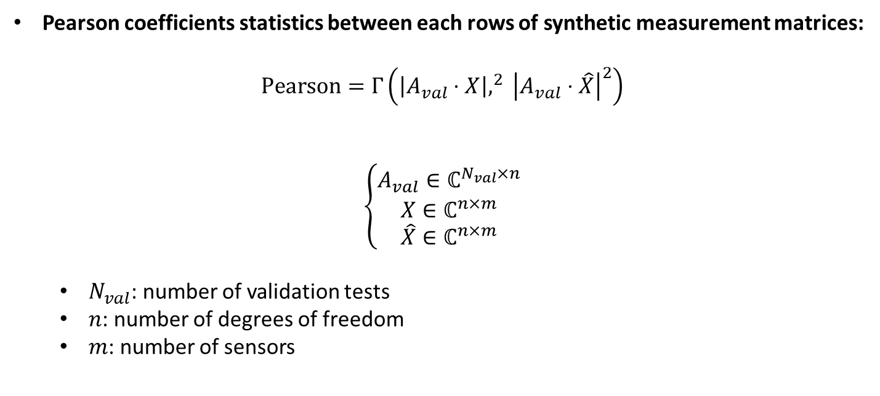
Validation metric
Pearson coefficients statistics between each rows of synthetic measurement matrices:
$$Pearson=Γ\left(\left|A_{val}⋅X\right|,^{2} {\left|A_{val}⋅\hat{X}\right|}^{2}\right)$$
$$\left\{\begin{aligned}A_{val}∈ℂ^{N_{val}×n} \\ X∈ℂ^{n×m} \\ \hat{X}∈ℂ^{n×m}\end{aligned}\right.$$
$N_{val}$: number of validation tests
$n$: number of degrees of freedom
$m$: number of sensors

Slide 4
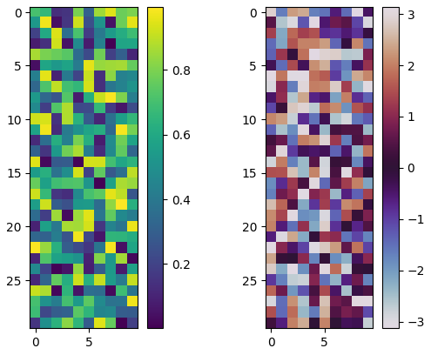
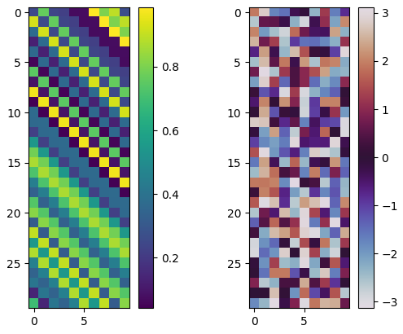
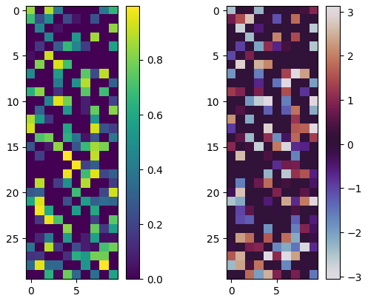
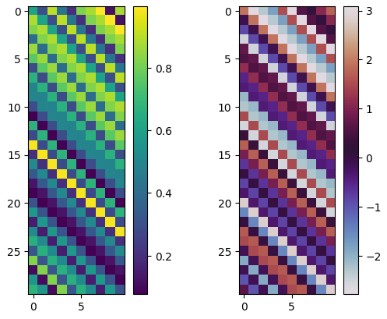
Tested system transfer matrices types and examples
Complex random (sparsity = 0)
Toeplitz random (sparsity = 0)
Random(complex or not, sparsity)
Random_toeplitz(complex or not, sparsity, toeplitz_phase)
Diagonal_random(complex or not)
Complex random (sparsity = 0.5)
Full Toeplitz complex random (sparsity = 0)

Slide 5


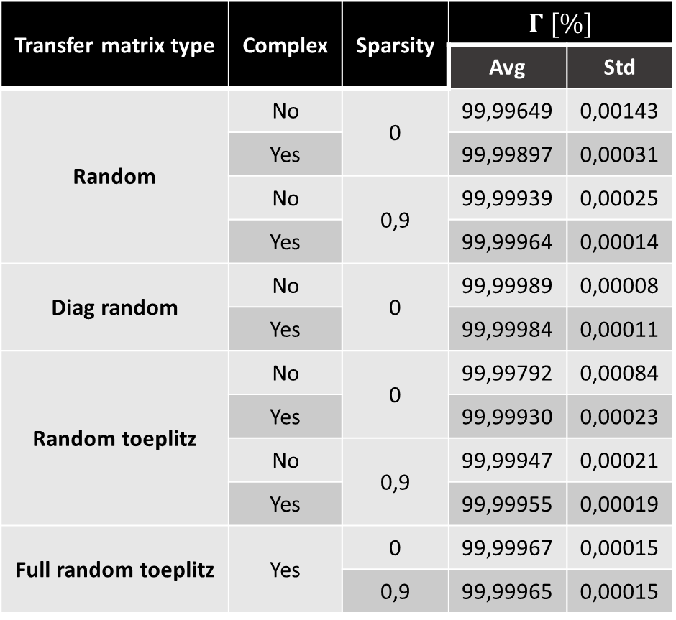
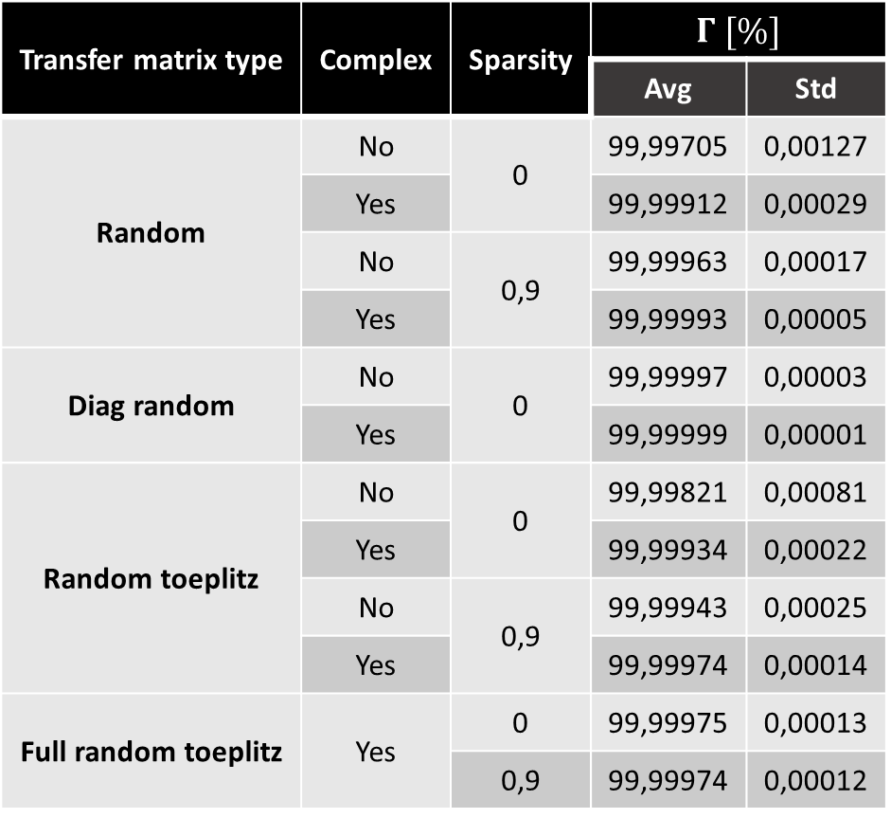


Results without noise
System hyperparameters:
$$N=1000$$
$$n=30$$
$$m=4n$$
Validation hyperparameters:
$A_{val}$: Complex random
$$N_{val}={10}^{4}$$
Sparsity of $A_{val}=0$
Sparsity of $A_{val}=0,5$
Transfer matrix type | Complex | Sparsity | $$Γ [\%]$$
 |  |  | Avg | Std
Random | No | 0 | 99,99649 | 0,00143
 | Yes |  | 99,99897 | 0,00031
 | No | 0,9 | 99,99939 | 0,00025
 | Yes |  | 99,99964 | 0,00014
Diag random | No | 0 | 99,99989 | 0,00008
 | Yes |  | 99,99984 | 0,00011
Random toeplitz | No | 0 | 99,99792 | 0,00084
 | Yes |  | 99,99930 | 0,00023
 | No | 0,9 | 99,99947 | 0,00021
 | Yes |  | 99,99955 | 0,00019
Full random toeplitz | Yes | 0 | 99,99967 | 0,00015
 |  | 0,9 | 99,99965 | 0,00015
Transfer matrix type | Complex | Sparsity | $$Γ [\%]$$
 |  |  | Avg | Std
Random | No | 0 | 99,99705 | 0,00127
 | Yes |  | 99,99912 | 0,00029
 | No | 0,9 | 99,99963 | 0,00017
 | Yes |  | 99,99993 | 0,00005
Diag random | No | 0 | 99,99997 | 0,00003
 | Yes |  | 99,99999 | 0,00001
Random toeplitz | No | 0 | 99,99821 | 0,00081
 | Yes |  | 99,99934 | 0,00022
 | No | 0,9 | 99,99943 | 0,00025
 | Yes |  | 99,99974 | 0,00014
Full random toeplitz | Yes | 0 | 99,99975 | 0,00013
 |  | 0,9 | 99,99974 | 0,00012

Slide 6
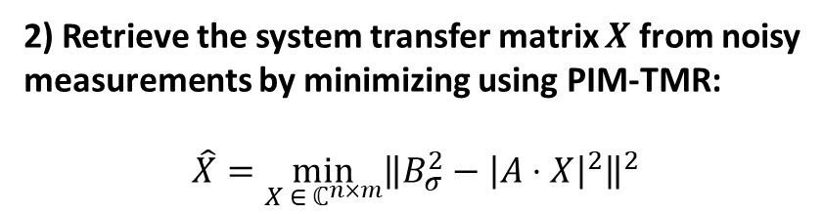
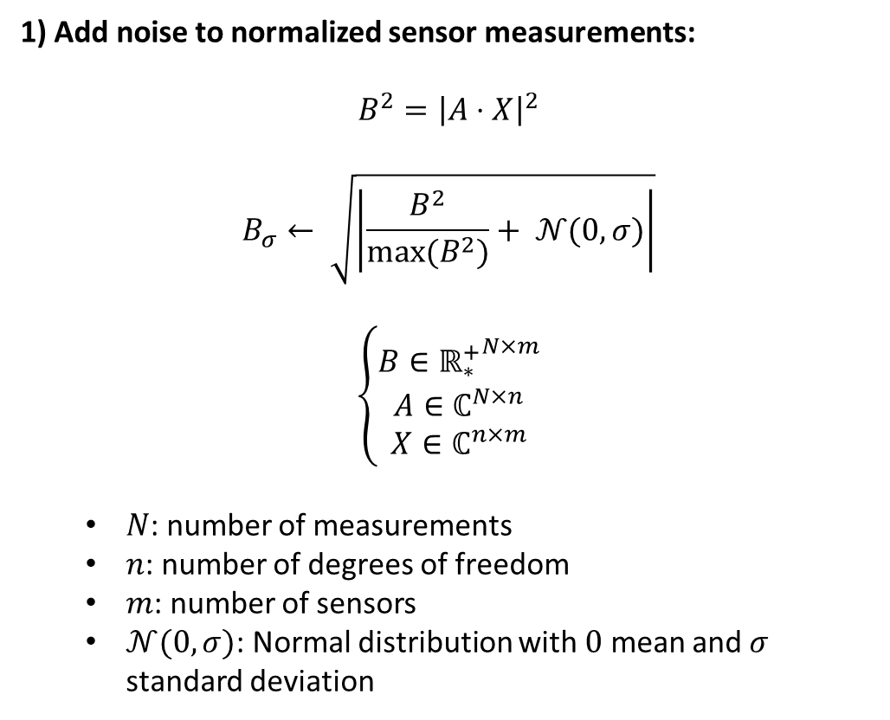
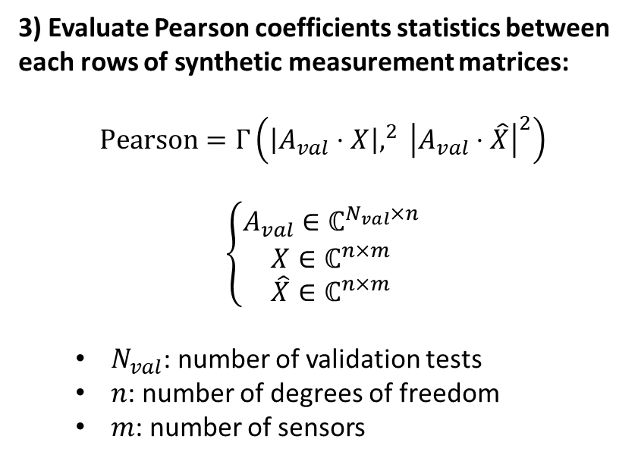
Adding noise to the sensor measurements
1) Add noise to normalized sensor measurements:
$$B^{2}={\left|A⋅X\right|}^{2}$$
$$B_{σ}← \sqrt{\left|\frac{B^{2}}{max⁡(B^{2})}+ 𝒩(0,σ)\right|}$$
$$\left\{\begin{aligned}B∈{{\text{ℝ}}_{∗}^{+}}^{N×m} \\ A∈ℂ^{N×n} \\ X∈ℂ^{n×m}\end{aligned}\right.$$
$N$: number of measurements
$n$: number of degrees of freedom
$m$: number of sensors
$𝒩(0,σ)$: Normal distribution with $0$ mean and $σ$ standard deviation
2) Retrieve the system transfer matrix $X$ from noisy measurements by minimizing using PIM-TMR:
$$\hat{X}=\min_{X ∈ ℂ^{n×m}}{{\left\|B_{σ}^{2}−{\left|A⋅X\right|}^{2}\right\|}^{2}}$$
3) Evaluate Pearson coefficients statistics between each rows of synthetic measurement matrices:
$$Pearson=Γ\left(\left|A_{val}⋅X\right|,^{2} {\left|A_{val}⋅\hat{X}\right|}^{2}\right)$$
$$\left\{\begin{aligned}A_{val}∈ℂ^{N_{val}×n} \\ X∈ℂ^{n×m} \\ \hat{X}∈ℂ^{n×m}\end{aligned}\right.$$
$N_{val}$: number of validation tests
$n$: number of degrees of freedom
$m$: number of sensors

Slide 7

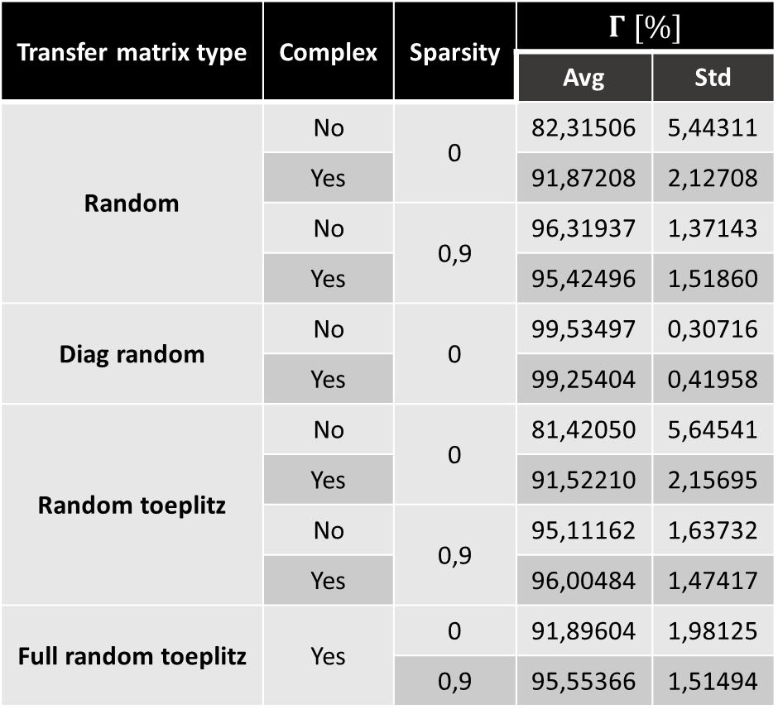
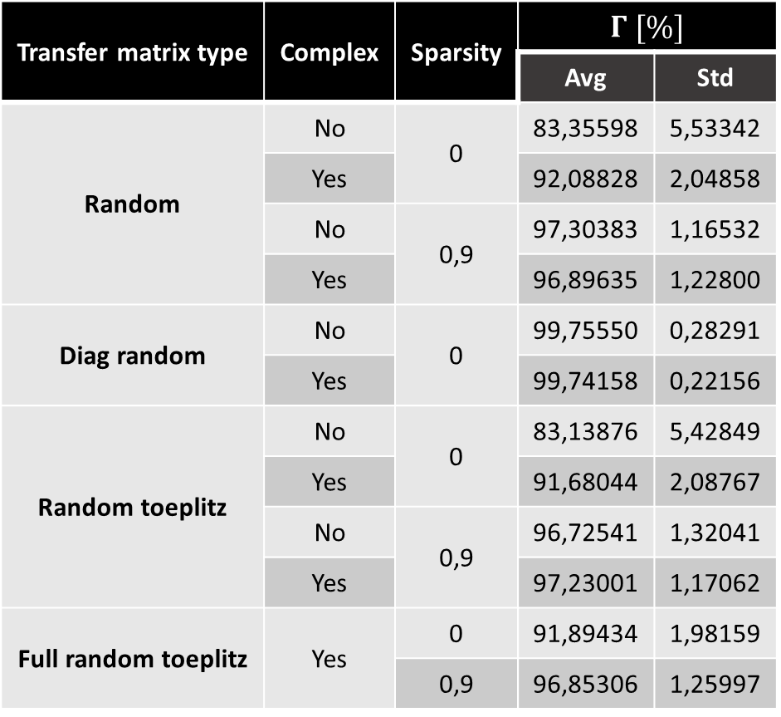



Results with noise ($σ=1\%)$
System hyperparameters:
$$N=1000$$
$$n=30$$
$$m=4n$$
Validation hyperparameters:
$A_{val}$: Complex random
$$N_{val}={10}^{4}$$
Sparsity of $A_{val}=0$
Sparsity of $A_{val}=0,5$
Transfer matrix type | Complex | Sparsity | $$Γ [\%]$$
 |  |  | Avg | Std
Random | No | 0 | 82,31506 | 5,44311
 | Yes |  | 91,87208 | 2,12708
 | No | 0,9 | 96,31937 | 1,37143
 | Yes |  | 95,42496 | 1,51860
Diag random | No | 0 | 99,53497 | 0,30716
 | Yes |  | 99,25404 | 0,41958
Random toeplitz | No | 0 | 81,42050 | 5,64541
 | Yes |  | 91,52210 | 2,15695
 | No | 0,9 | 95,11162 | 1,63732
 | Yes |  | 96,00484 | 1,47417
Full random toeplitz | Yes | 0 | 91,89604 | 1,98125
 |  | 0,9 | 95,55366 | 1,51494
Transfer matrix type | Complex | Sparsity | $$Γ [\%]$$
 |  |  | Avg | Std
Random | No | 0 | 83,35598 | 5,53342
 | Yes |  | 92,08828 | 2,04858
 | No | 0,9 | 97,30383 | 1,16532
 | Yes |  | 96,89635 | 1,22800
Diag random | No | 0 | 99,75550 | 0,28291
 | Yes |  | 99,74158 | 0,22156
Random toeplitz | No | 0 | 83,13876 | 5,42849
 | Yes |  | 91,68044 | 2,08767
 | No | 0,9 | 96,72541 | 1,32041
 | Yes |  | 97,23001 | 1,17062
Full random toeplitz | Yes | 0 | 91,89434 | 1,98159
 |  | 0,9 | 96,85306 | 1,25997

Slide 8
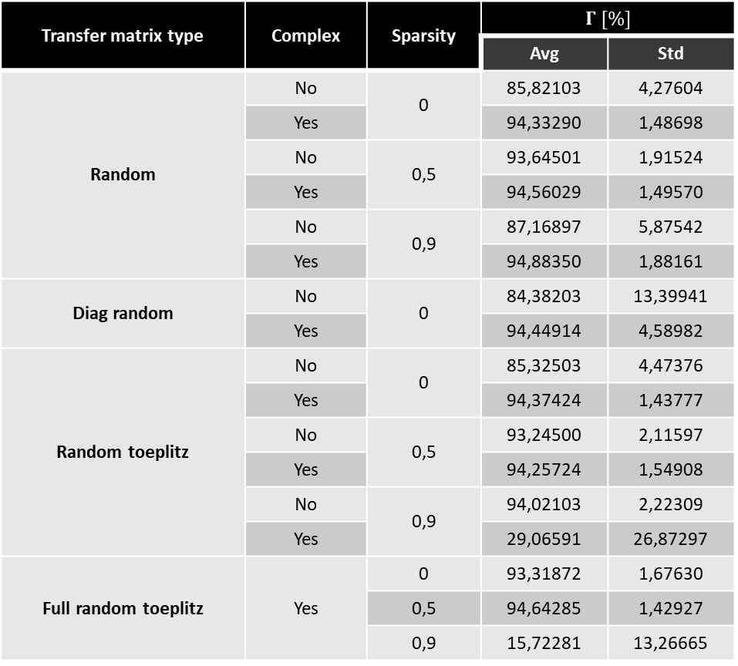
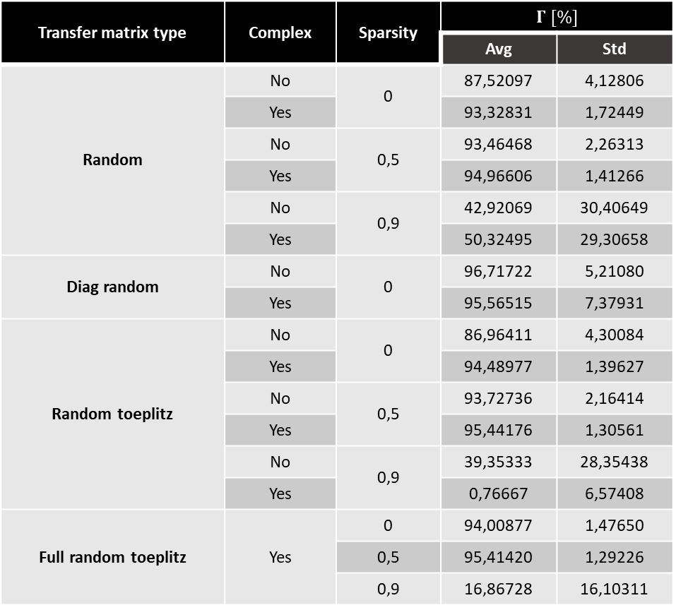
Results with noise ($σ=5\%)$
System hyperparameters:
$$N=1000$$
$$n=30$$
$$m=4n$$
Validation hyperparameters:
$A_{val}$: Complex random
$$N_{val}={10}^{4}$$
Sparsity of $A_{val}=0$
Sparsity of $A_{val}=0,5$
Transfer matrix type | Complex | Sparsity | $$Γ [\%]$$
 |  |  | Avg | Std
Random | No | 0 | 85,82103 | 4,27604
 | Yes |  | 94,33290 | 1,48698
 | No | 0,5 | 93,64501 | 1,91524
 | Yes |  | 94,56029 | 1,49570
 | No | 0,9 | 87,16897 | 5,87542
 | Yes |  | 94,88350 | 1,88161
Diag random | No | 0 | 84,38203 | 13,39941
 | Yes |  | 94,44914 | 4,58982
Random toeplitz | No | 0 | 85,32503 | 4,47376
 | Yes |  | 94,37424 | 1,43777
 | No | 0,5 | 93,24500 | 2,11597
 | Yes |  | 94,25724 | 1,54908
 | No | 0,9 | 94,02103 | 2,22309
 | Yes |  | 29,06591 | 26,87297
Full random toeplitz | Yes | 0 | 93,31872 | 1,67630
 |  | 0,5 | 94,64285 | 1,42927
 |  | 0,9 | 15,72281 | 13,26665
Transfer matrix type | Complex | Sparsity | $$Γ [\%]$$
 |  |  | Avg | Std
Random | No | 0 | 87,52097 | 4,12806
 | Yes |  | 93,32831 | 1,72449
 | No | 0,5 | 93,46468 | 2,26313
 | Yes |  | 94,96606 | 1,41266
 | No | 0,9 | 42,92069 | 30,40649
 | Yes |  | 50,32495 | 29,30658
Diag random | No | 0 | 96,71722 | 5,21080
 | Yes |  | 95,56515 | 7,37931
Random toeplitz | No | 0 | 86,96411 | 4,30084
 | Yes |  | 94,48977 | 1,39627
 | No | 0,5 | 93,72736 | 2,16414
 | Yes |  | 95,44176 | 1,30561
 | No | 0,9 | 39,35333 | 28,35438
 | Yes |  | 0,76667 | 6,57408
Full random toeplitz | Yes | 0 | 94,00877 | 1,47650
 |  | 0,5 | 95,41420 | 1,29226
 |  | 0,9 | 16,86728 | 16,10311

Slide 9
Conclusion and notes
PIM-TMR does not care of system matrix type in the noiseless case !
Sparsity of the validation input matrix does not significantly change results, even in the noisy case
Complex system transfer matrices seem more robust to noise
Extreme sparsity (90%) of the system transfer matrices tends to reduce the metric result
Statistics should be obtained from several draws of transfer matrices within the same matrix type
Hyperparameters should be varied

