Slide 1


工作汇报
汇报人：冀永胜
日期：2022/9/28

Slide 2
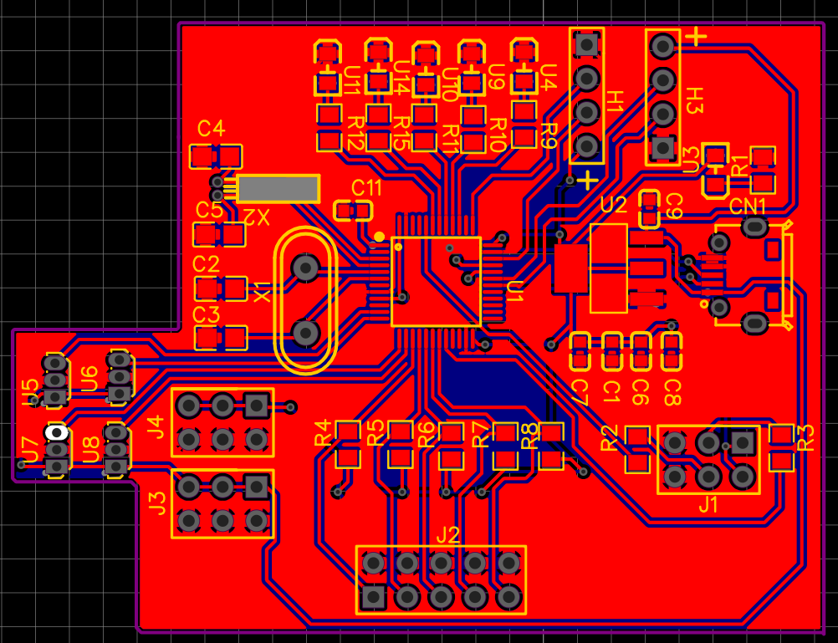
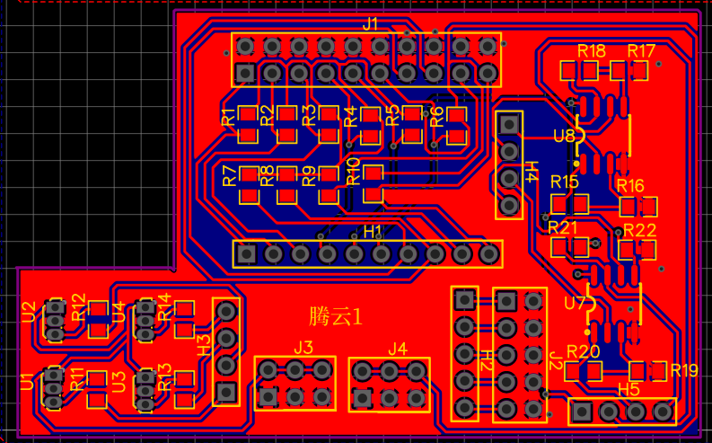
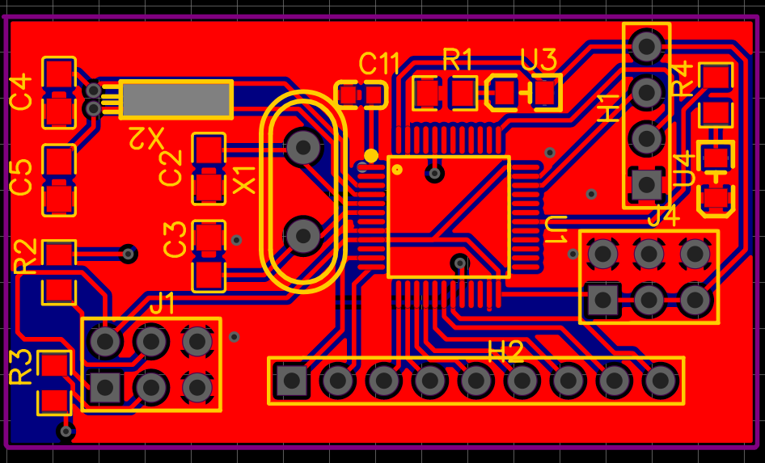
hardware circuit
Purpose: the system can run
Future: Flexible Hybrid Electronics
Notes:
粘附性
模块化，可扩展性

Slide 3

human-computer interaction
Pressure sensor
MCU
MCU
Data
BLE 2.0 Module(HC05)
BLE 2.0 Module(HC05)
Other sensor(soft or solid)
Control
现在已经实现的模块：
1、定时器定时
2、DMA模数转化（16路）
3、PWM调制
4、用手机控制蓝牙点灯
Voltage regulator(3.3V)
Notes:
粘附性
模块化，可扩展性

