Slide 1
Survey

Slide 2
Paper LIST
DeepOption: A novel option pricing framework based on deep learning with fused distilled data from multiple parametric methods (https://doi.org/10.1016/j.inffus.2020.12.010)

Slide 3
DeepOption

Slide 4
Motivation
Option data rare imbalanced because of the liquidity of options.
Imbalanced data: predominantly learns the patterns of classes that constitute the majority, whereas the patterns in small classes are insufficiently learned.
imbalanced with respect to moneyness
Practicability model: moneyness divided the data into sections to apply to different models.
DNN is a data-driven approach, imbalanced data cause it hard to learn high-level patterns or robust features.

Slide 5
methodology
Using various parametric methods to generate additional balanced training data.
1. improve the performance using parametric methods.
2. using single model on insufficient or imbalanced data
3. distilled data will allow the DNN model to mimic the knowledge acquired by various parametric option pricing methods (supervised learning)

Slide 6
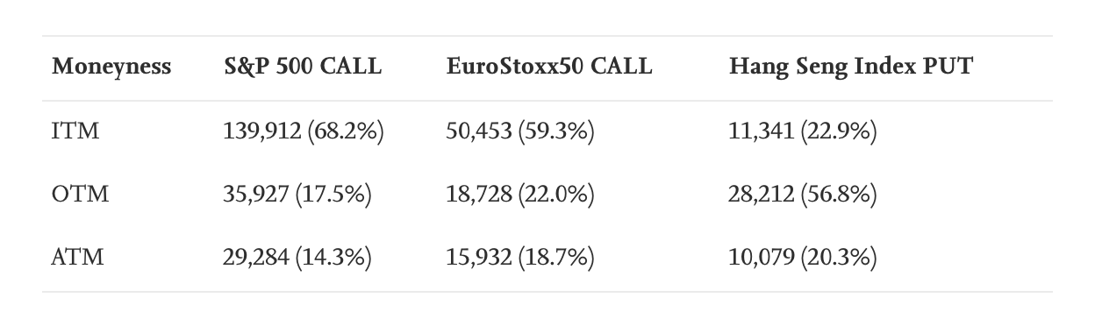

Methodology-data
S&P 500 call options, EuroStoxx50 call options, and Hang Seng Index
closed price
Call heavily biased for the ITM option
Put heavily biased for the OTM option
Bloomberg and Wind Database
Prevent larger input variables: min-max normalization

Slide 7
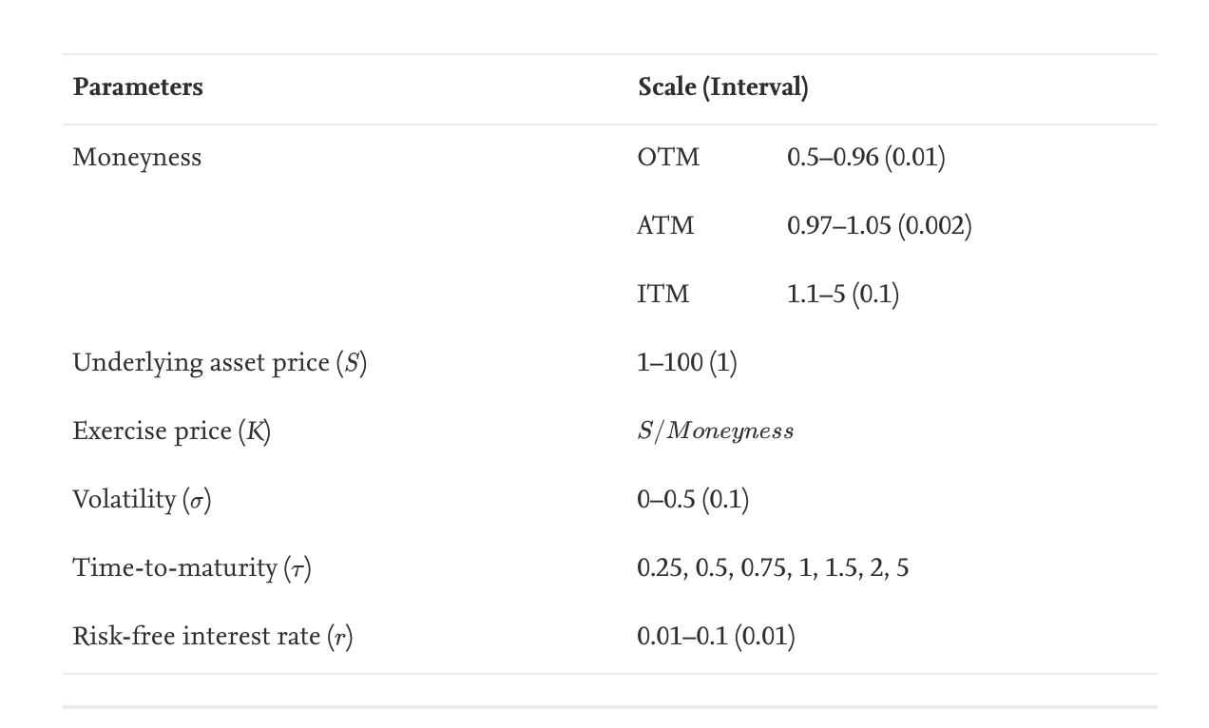
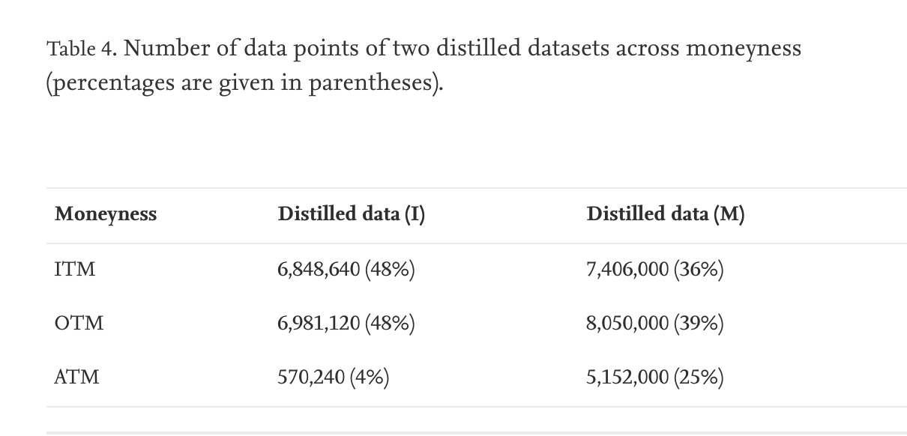
Methodology-Framework
Generation and Fusion of distilled Data
Four parametric methods- BI, BS, MC, FDM
Why? Enable the proposed model to gain knowledge from each parametric method as well as the option price.
Generated two distilled dataset
Generated considering regular intervals
Generated considering moneyness

Slide 8
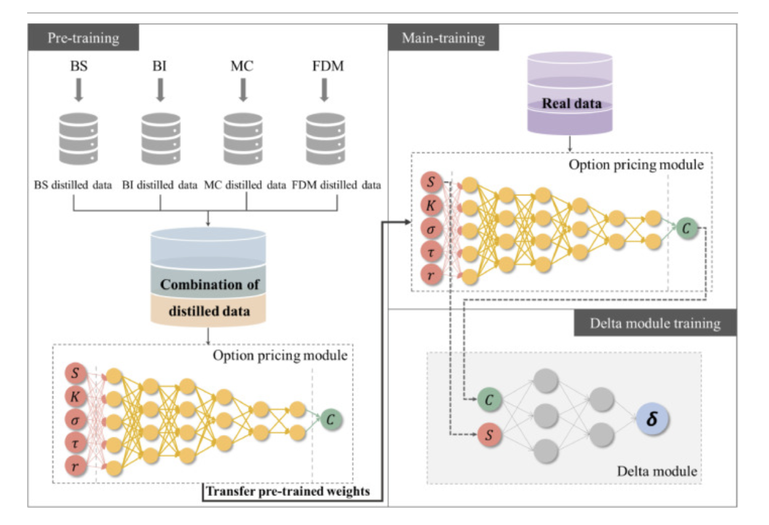
Methodology-Framework
Architecture and training

Slide 9
Methodology-Framework
Generating data and Pre-training
Input
Simulate data
BS, BI, MC, FDM
Output
Option price
Flow
Generate data
Combine data
Normalize data
DFNN pre-trains

Slide 10
Methodology-Framework
Main training
Input
Real option data
Pre-train weight
Output
Option price
DFNN
Transfer the pre-train weight and fine-tune

Slide 11
All in all
New: generate balanced dataset
Data: S&P 500, EuroStoxx50, Hang Seng Index (Bloomberg and Wind Database)
Input: Underlying asset price, exercise price, volatility, time-to-maturity, risk-free interest rate
Output: option price
Code: pseudocode

Slide 12
Paper LIST
DeepOption: A novel option pricing framework based on deep learning with fused distilled data from multiple parametric methods (https://doi.org/10.1016/j.inffus.2020.12.010)
Generative Bayesian neural network model for risk-neutral pricing of American index options (https://doi.org/10.1080/14697688.2018.1490807)

Slide 13
Generative Bayesian neural network model

Slide 14
Motivation
Most successful American option pricing models did not exact quite closely approximate pricing American options.
Capability to incorporate current or previous market information?
Predict future price well?
Model generate fair prices in the deep ITM or deep OTM?
Deep ITM/OTM: rarely traded options where volume is 1.18%-1.5%; moneyness is 1.3 or more and 0.86 or less
ML models effective in estimating the cross-sectional option prices, fail to represent option prices outside that area.

Slide 15
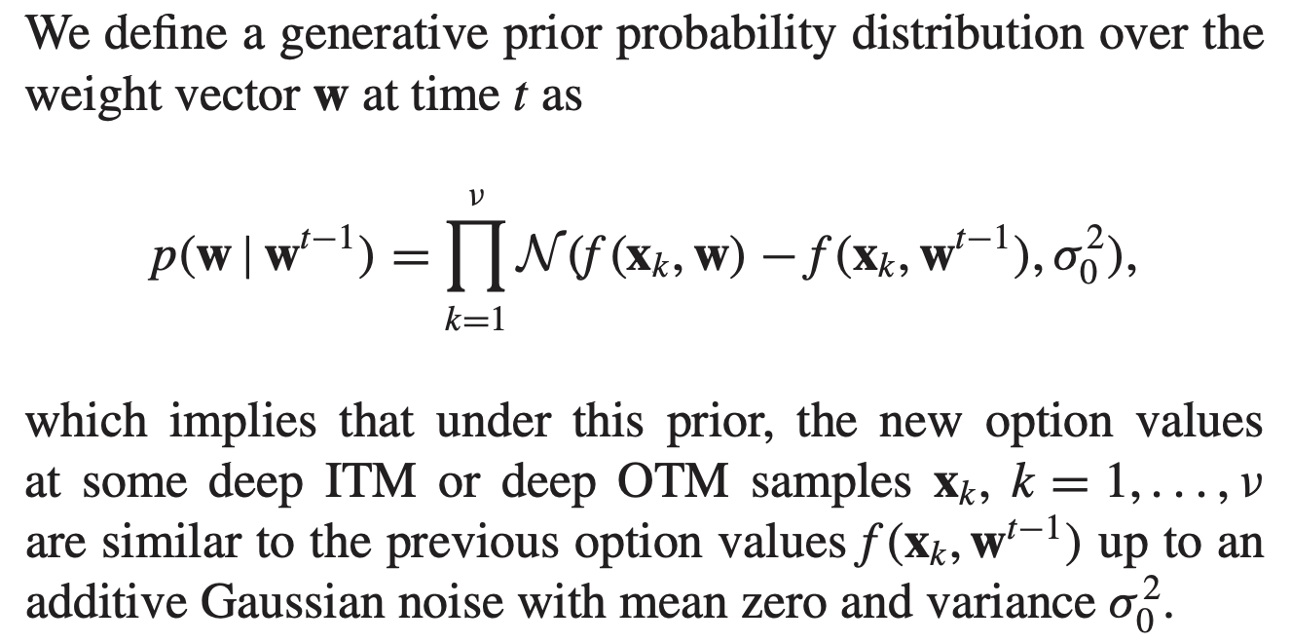
Generative Bayesian NN
Generative Bayesian learning model with a prior incorporating a financial structure.

Slide 16
Generative Bayesian NN
Training the model using an artificial sample generated from a risk-neutral financial option model- CGMY.
Bayesian neural network is superior to the CGMY model.

Slide 17
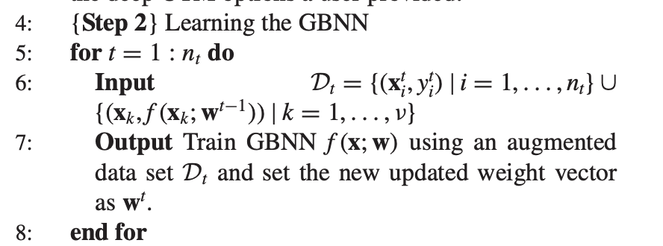
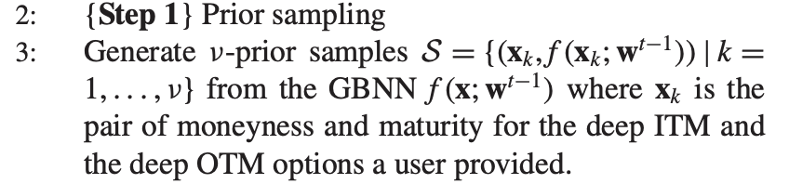
Generative Bayesian NN
Prior sampling
Learning the GBNN

Slide 18
All in all
New: GBNN model; use a prior information incorporating some financial market structures
Data: S&P 100 (2003-2012)
Code: little pseudocode

Slide 19
Paper LIST
DeepOption: A novel option pricing framework based on deep learning with fused distilled data from multiple parametric methods (https://doi.org/10.1016/j.inffus.2020.12.010)
Generative Bayesian neural network model for risk-neutral pricing of American index options (https://doi.org/10.1080/14697688.2018.1490807)
Option pricing using Machine Learning (https://doi.org/10.1016/j.eswa.2020.113799)

Slide 20
Option pricing using Machine Learning

Slide 21
Motivation
Most of the previous researchers focus especially on the neural networks method (NN), the other algorithms being unexplored.
Propose three three different decision tress algorithms: random forest, XGBoost, LightGBM
Using different data: call options on crude oil futures
highest liquidity

Slide 22
Random forest XGBoost Lightgbm
Model

Slide 23
Data and Methodology
Data
all European call options that had as support the WTI oil futures contracts (Reuters Index Code: CL) traded on the Chicago Mercantile Exchange between 03.01.2017 and 14.11.2018
analyzing 1465 options, representing 121,488 daily prices.
provided by Thomson Reuters Tick History DataStream
a maturity of less than 1 year, a moneyness (S / K) less than 1.7 and a premium greater than 1

Slide 24
Data and Methodology -three new model
Random forest
100 decision trees with max depth of 20
XGBoost and LightGBM
Learning right 0.3

Slide 25
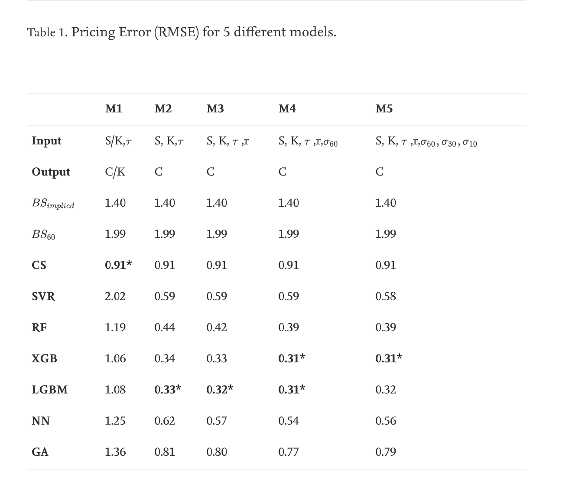
Data and Methodology -Input & output

Slide 26
All in all
New: three new model
Data: all European call options that had as support the WTI oil futures contracts (Thomson Reuters Tick History DataStream)
Input & Output: 5 different combination
Code: NA

Slide 27
Paper LIST
DeepOption: A novel option pricing framework based on deep learning with fused distilled data from multiple parametric methods (https://doi.org/10.1016/j.inffus.2020.12.010)
Generative Bayesian neural network model for risk-neutral pricing of American index options (https://doi.org/10.1080/14697688.2018.1490807)
Option pricing using Machine Learning (https://doi.org/10.1016/j.eswa.2020.113799)
Deep Learning Based Hybrid Computational Intelligence Models for Options Pricing (https://link.springer.com/article/10.1007/s10614-020-10063-9)

Slide 28
Deep Learning Based Hybrid Computational Intelligence Models

Slide 29
Motivation
BS for deep OTM can be dangerous because low volume.
Lack of DL studies on options
Develop hybrid DL models:
option price models w/o depending on external implied volatility estimations
novel DNN classifiers which had multi-stage topologies for various option scenarios

Slide 30
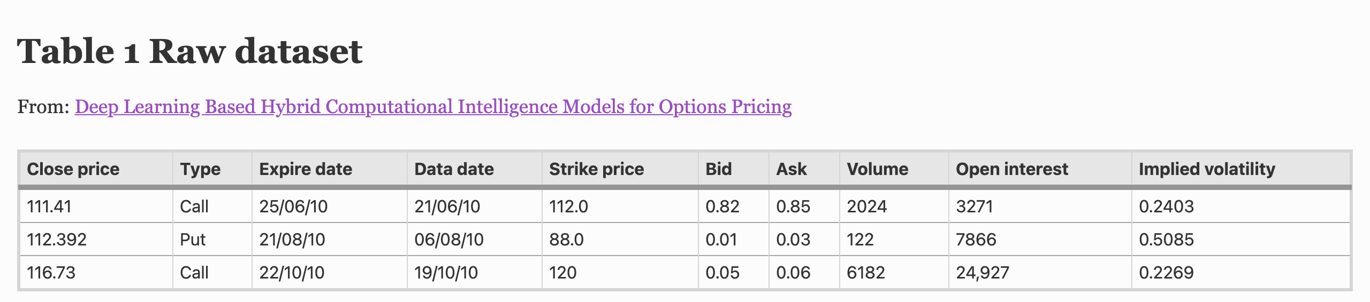
Methodology- Data
options data between Feb. 2010 and Nov. 2010 for S&P 500 ETF
Extracted data through Yahoo finance
70% of data is erased due to low volume

Slide 31
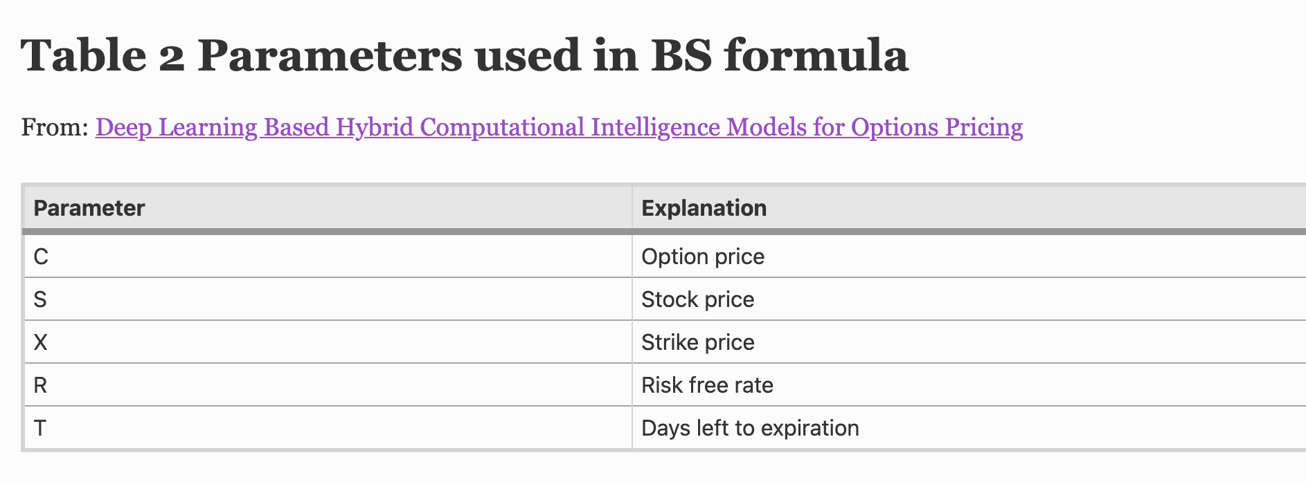
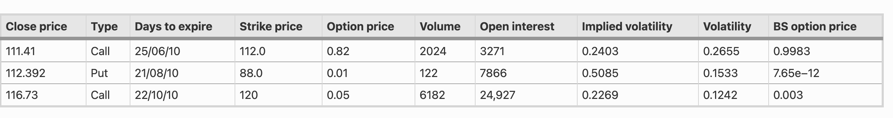
Methodology- BS

Slide 32
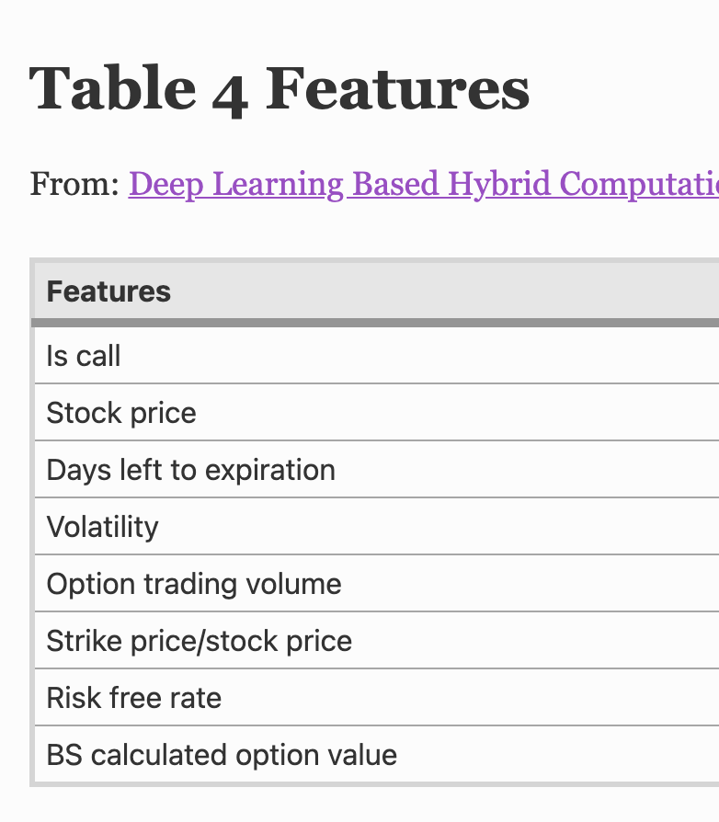
Methodology- DNN
same parameters with BS, but
depending on pre-volatility and underlying price prediction stages that use time series dependent models
(strike price)/(stock price) ratio

Slide 33
Methodology- DNN
Single Stage DNN
Multi Stage DNN Approach
deep multilayer perceptron (DMLP)
8-50-50-1 topology
4 different multistage
DMLP based models are proposed namely, VS-BS/DMLP, VS-2DMLP, C-BS/DMLP, C-2DMLP

Slide 34
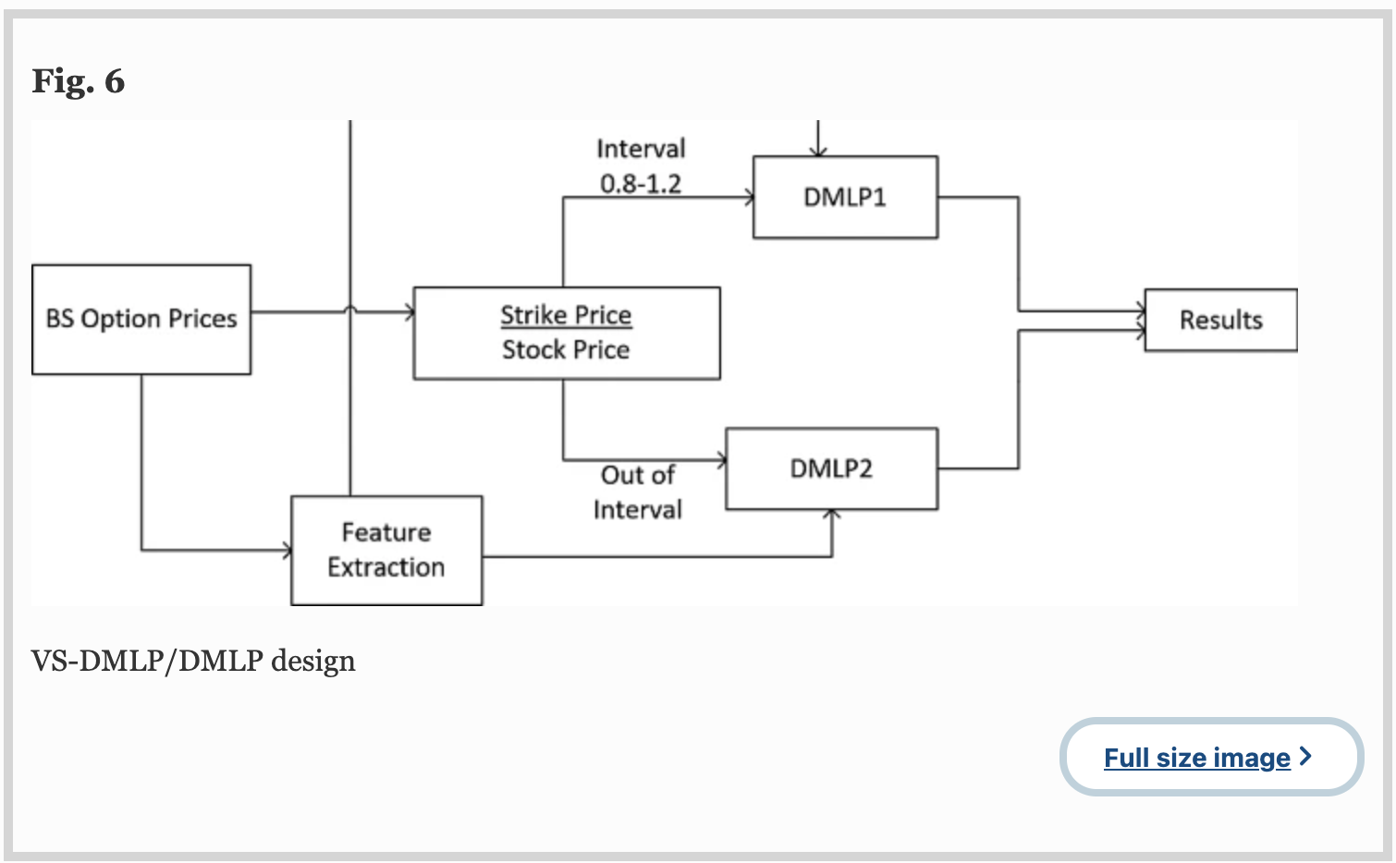
Methodology- DNN VS-DMLP/DMLP

Slide 35
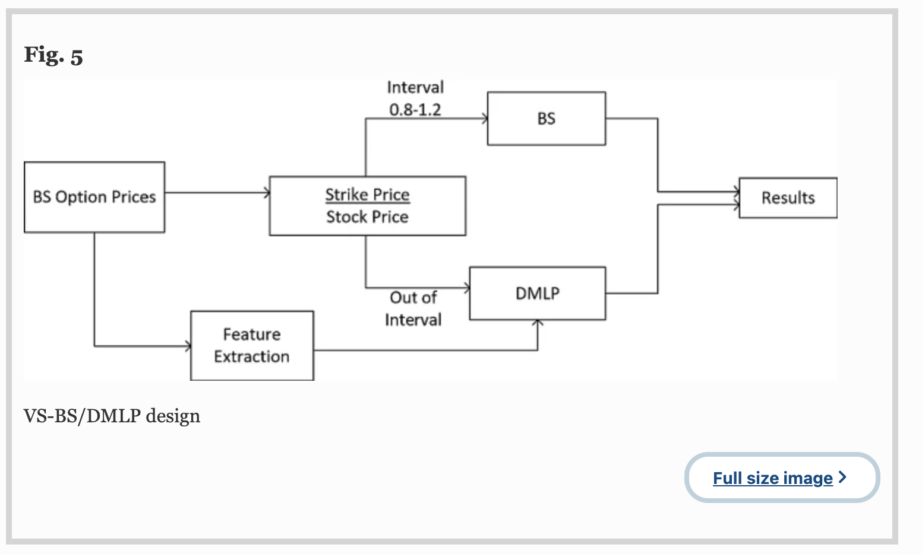
Methodology- DNN VS-BS/DMLP

Slide 36
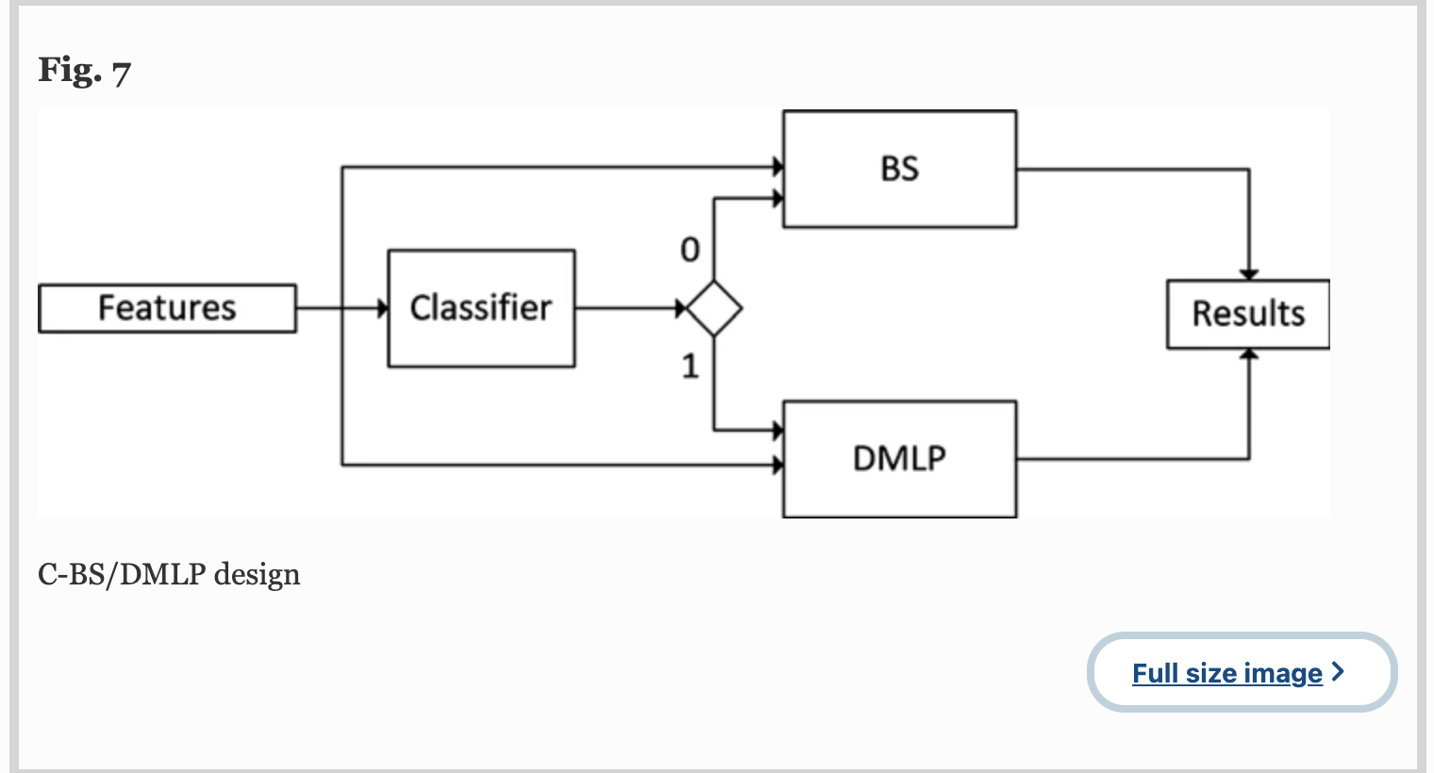
Methodology- DNN C-BS/DMLP

Slide 37
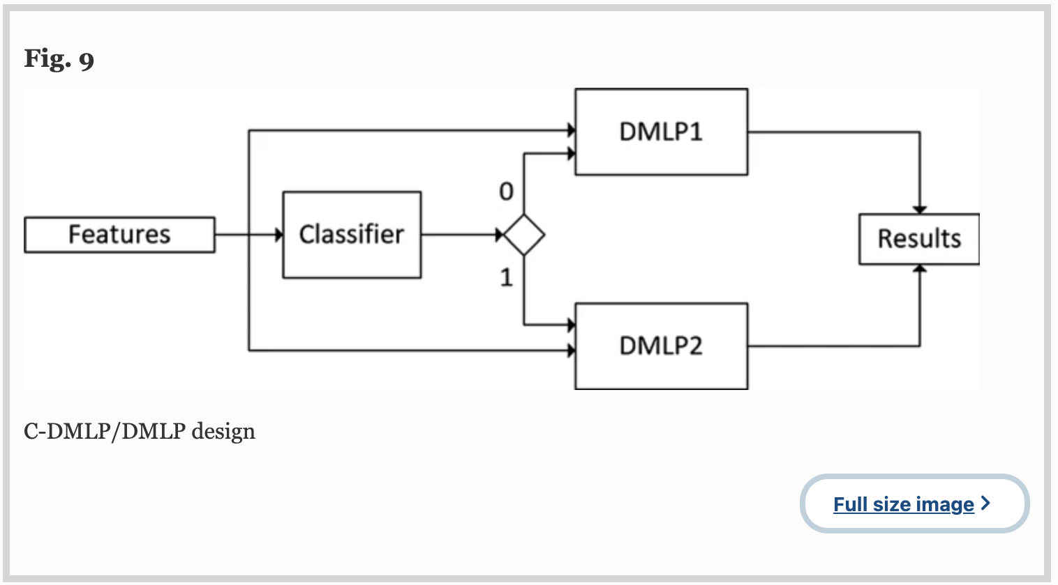
Methodology- DNN C-DMLP/DMLP

Slide 38
All in all
New: three new model
Data: S&P 500 ETF (Yahoo finance)
Input: Is call; stock price; days left to expiration; volatility; option trading volume; strike price /stock price; risk free rate; BS option value
Code: NA
Output: Option price

Slide 39
Paper LIST
DeepOption: A novel option pricing framework based on deep learning with fused distilled data from multiple parametric methods (https://doi.org/10.1016/j.inffus.2020.12.010)
Generative Bayesian neural network model for risk-neutral pricing of American index options (https://doi.org/10.1080/14697688.2018.1490807)
Option pricing using Machine Learning (https://doi.org/10.1016/j.eswa.2020.113799)
Deep Learning Based Hybrid Computational Intelligence Models for Options Pricing (https://link.springer.com/article/10.1007/s10614-020-10063-9)
Deep Learning in Model Risk Neutral Distribution for Option Pricing
(https://ieeexplore.ieee.org/document/8929176)

Slide 40
Deep Learning in Model Risk Neutral Distribution

Slide 41
Motivation
Issue in option pricing is the estimation of the risk neutral distribution of an underlying asset.
DL method with a mixture distribution model to handle European option pricing

Slide 42
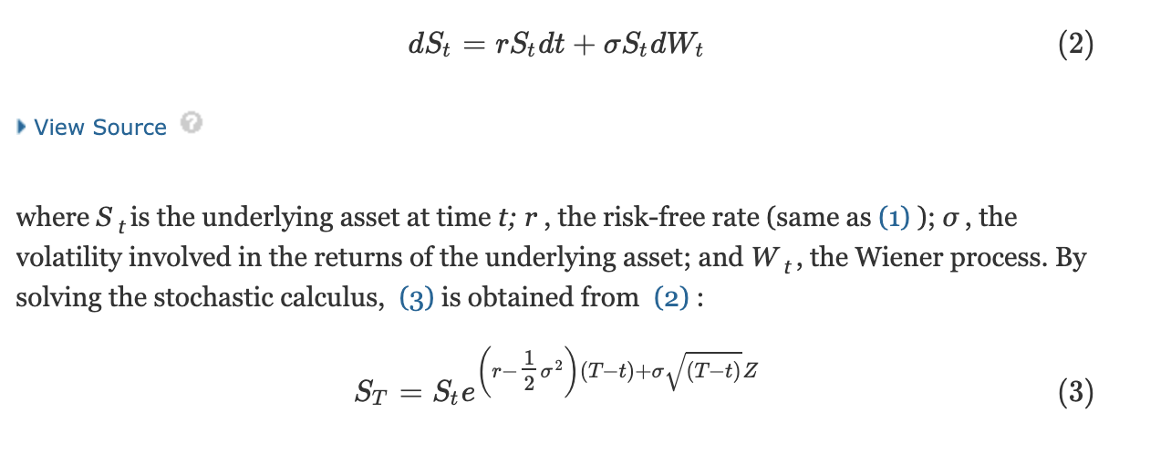
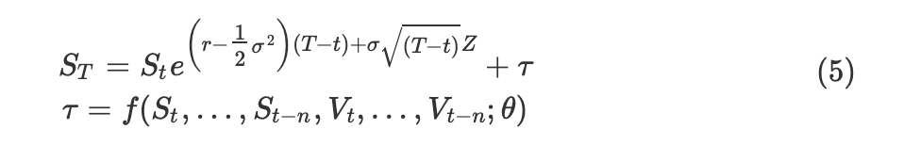
Method-BS
BS
To solve the problem of the constrains in the stochastic process model

Slide 43
Method-BS
usually estimate the risk neutral distribution term by constructing a stochastic process model on the underlying asset using some parameters
BS

Slide 44
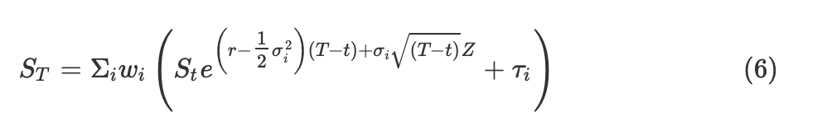
Method- model
To solve the problem of the constrains in the stochastic process model
To estimate σ and τ, the most important factor that can generate a more complex risk neutral distribution is the adoption of the concept of a Gaussian mixture model
The new formula with the combination of I distribution

Slide 45
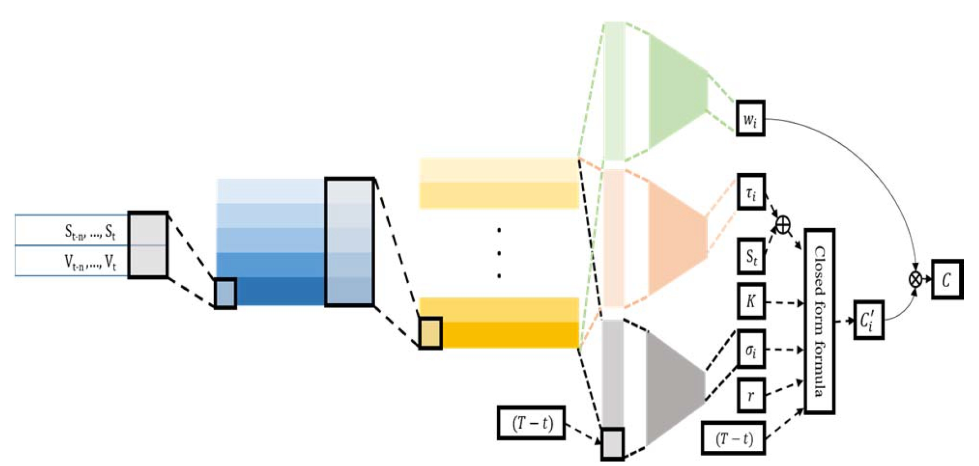
Method
i sets of parameters are estimated using the proposed structure in (5)
Each set is given a weight wi obtained from the NN using the series data of historical price and trading volume.

Slide 46
All in all
New: DNN structured with a Gaussian mixture model
Data: TAIEX (Taiwan Futures Exchange); data frequency is per minute data; Only near month contracts
are used and weekly options are excluded.
Input: new formula of the underlying asset at time t & V (training wi)
S, K, σ, r, t
Code: NA
Output: Option price

Slide 47
Paper LIST
DeepOption: A novel option pricing framework based on deep learning with fused distilled data from multiple parametric methods (https://doi.org/10.1016/j.inffus.2020.12.010)
Generative Bayesian neural network model for risk-neutral pricing of American index options (https://doi.org/10.1080/14697688.2018.1490807)
Option pricing using Machine Learning (https://doi.org/10.1016/j.eswa.2020.113799)
Deep Learning Based Hybrid Computational Intelligence Models for Options Pricing (https://link.springer.com/article/10.1007/s10614-020-10063-9)
Deep Learning in Model Risk Neutral Distribution for Option Pricing (https://ieeexplore.ieee.org/document/8929176)
A Market Making Quotation Strategy Based on Dual Deep Learning Agents for Option Pricing and Bid-Ask Spread Estimation

Slide 48
Dual Deep Learning Agents

Slide 49
Motivation
proposed a fully-connected deep feed-forward NN to improve the performance of BS model.
BS relay on so many constrains
Data driven can fix the bias; make the model more close to the real-world.
Proposed a deep learning agent on bid-ask spread estimation.
Data driven model could fit the real situation better
Combining the above dual agents, proposed a better quotation strategy

Slide 50
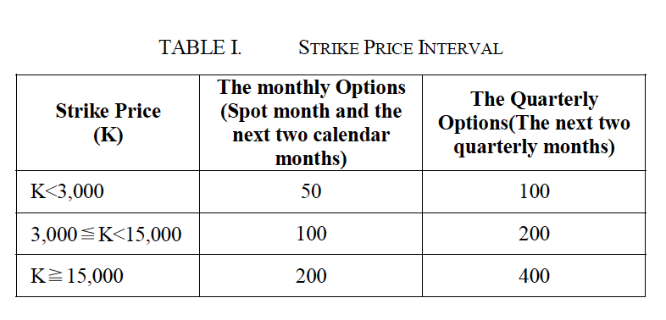
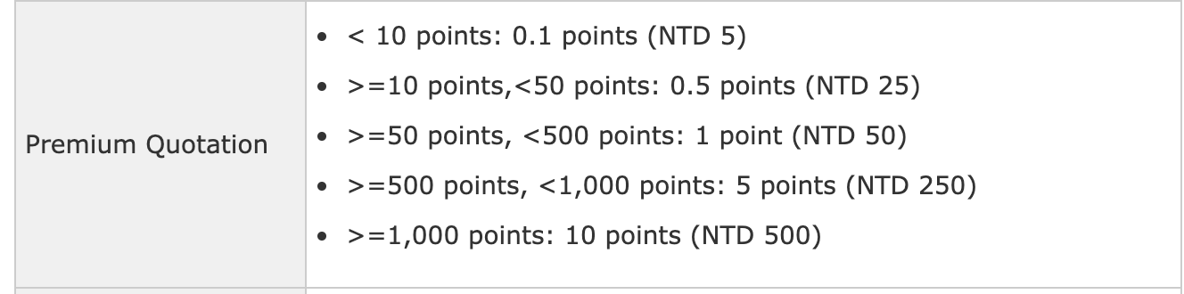
Quotation Strategy Background
Taiwan Stock Exchange Capitalization Weighted Stock Index Options
European
It takes NTD 50 per index point

Slide 51
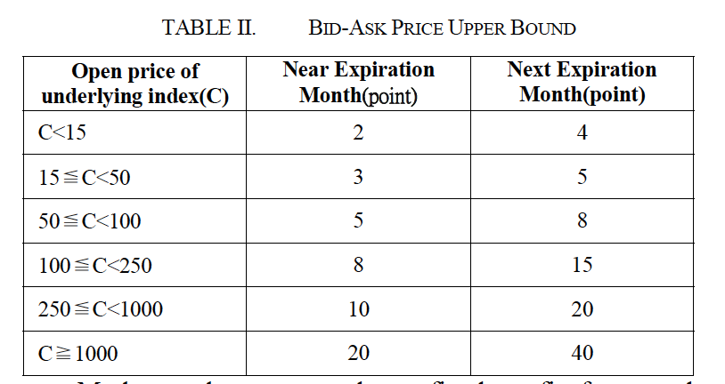
Quotation Strategy Background
How market makers earn profits
Theoretically: they make a fixed profit from each successful two-sided transaction
Practically: they need to offer their bid-ask spread as narrow as they can so as to get their quotes executed.

Slide 52
Quotation Strategy Background
Dataset
TAIEX
12 months (1/3/2017- 12/29/2017)
Transactions list: transaction date and time; option type; maturity; strike price; executed price; volume
Order list: order date and time; product type; order quantity; order price

Slide 53
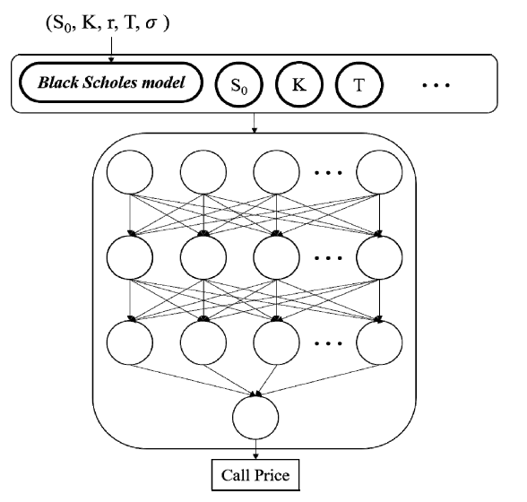
DNN Based Quoting method- Option Price
Input: original inputs in Black Scholes; BS output; short term volatility in previous 1-minute and previous 5-minutes
Output: call price
Model: 5 fully connected feedforward networks layers; all hidden layer have 8 nodes and tangent activation
Experiment: two part (BS + previous volatility)

Slide 54
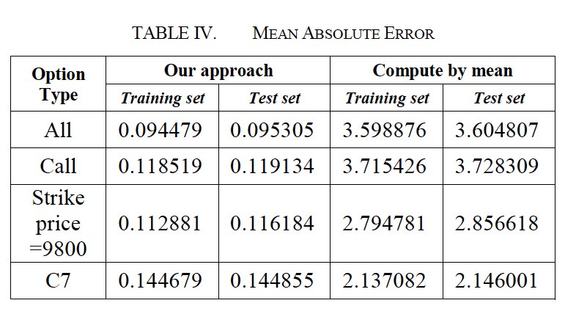
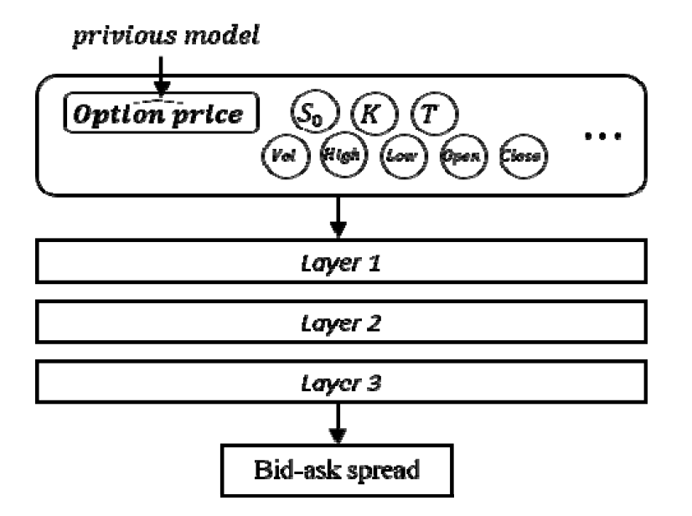
DNN Based Quoting method- Bid-Ask
Input: the strike price and trading volume during previous second for our target option and it’s underlying futures
Output: bid-ask spread;
Model: 3 fully connected feedforward networks layers; hidden layer with 15, 10, 5 nodes and ReLU activation;
Experiment: S*= min(A – B) (target is the narrowest spread made by one of the market maker during that minute);

Slide 55
All in all
New: agent for predicting option price; agent for bid-ask spread model
Data: TAIEX; option per second in 2017
Input:
Code: NA
Output: Option price & bid-ask spread

