Slide 1
第一、二章作业讲解
陈岭
lingchen@cs.zju.edu.cn

Slide 2
Chap. 1
7th Edition 1.3, 1.7, 1.8, 1.12

Slide 3
1.3 List six major steps that you would take in setting up a database for a particular
enterprise.

Slide 4
Steps of Database Design
Requirement analysis
  What data, applications, and operations needed
Conceptual database design
  A high-level description of data, constraints using E - R model or a similar high level data model
Logical database design:
  Convert the conceptual design into a DB schema
Schema refinement
  Normalization of relations: Check relational schema for redundancies and related anomalies.
Physical database design :
  Indexing, clustering and database tuning
Create and initialize the database & Security design
  Load initial data, testing
  Identify different user groups and their roles

Slide 5
1.7 List four significant differences between a file-processing system and a DBMS.

Slide 6
Database systems VS File Processing Systems
File processing system supported by a conventional OS:
  New application programs must be written when needed, and new data files are created as required.
  But over a long period of time, data files may be in different formats. Data files are independent of each other.
Drawbacks of using file systems to store data:
  Data redundancy and inconsistency
    Multiple file formats, duplication of information in different files.

Slide 7
Drawbacks of using file systems (cont.)
  Difficulty in accessing data
    Need to write a new program to carry out each new task.
  Data isolation - multiple files and multiple formats. (Difficult to retrieve, difficult to share)
  Integrity problems
    Integrity constraints (e.g. account balance > 0) become part of program code
    Hard to add new constraints or change existing ones

Slide 8
Drawbacks of using file systems (cont.)
  No atomicity of updates (consistent)
    Failures may leave database in an inconsistent state with partial updates carried out.
    E.g. transfer of funds from one account to another should either complete or not happen at all – atomicity.
  Difficult to concurrent access by multiple users
    Concurrent accessed needed for performance
    Uncontrolled concurrent accesses can lead to inconsistencies
      E.g. two people reading a balance and updating it at the same time
  Security problems (Right person use right data)
Database systems offer solutions to all the above problems!

Slide 9
1.8 Explain the concept of physical data independence, and its importance in database systems.

Slide 10
Physical data independence is the ability to modify the physical scheme without making it necessary to rewrite application programs.
Such modifications include changing from unblocked to blocked record storage, or from sequential to random access files. Such a modification might be adding a field to a record; an application program’s view hides this change from the program.

Slide 11
1.12 Explain the difference between two-tier and three-tier application architectures.
Which is better suited for web applications? Why??

Slide 12
  In a two-tier application architecture, the application runs on the client machine, and directly communicates with the database system running on server.
  In contrast, in a three-tier architecture, application code running on the client’s machine communicates with an application server at the server, and never directly communicates with the database.
  The three-tier archicture is better suited for Web applications.

Slide 13
Chap. 2
7th Edition: 2.6; 2.7; 2.14; 2.15;

Slide 14

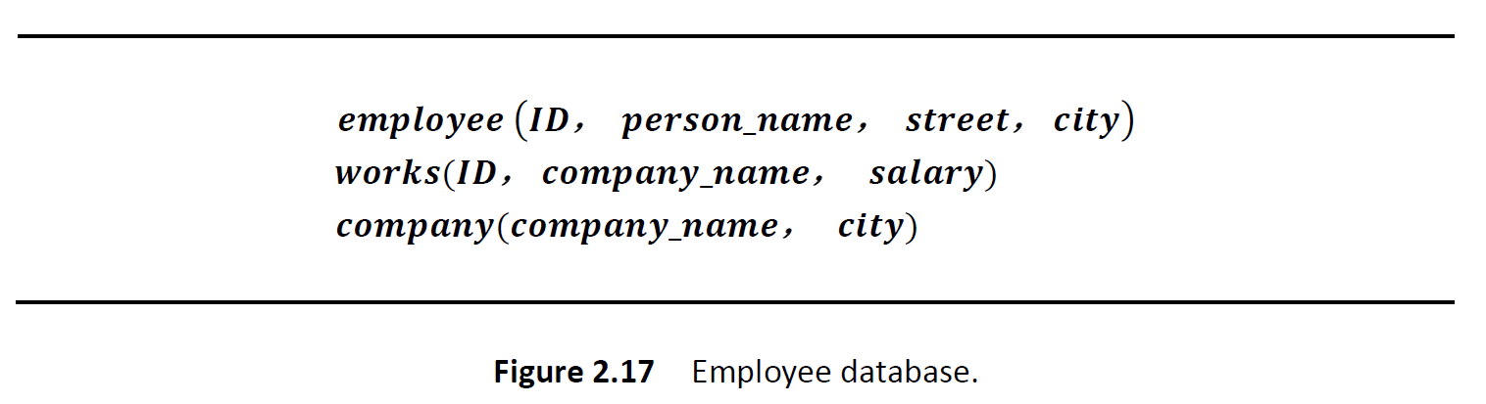
2.6 Consider the relational database of Figure 2-14. Give an expression in the relational algebra to express each of the following queries:
a. Find the names of all employees who live in city “Miami”.
b. Find the names of all employees whose salary is greater than $100,000.
c. Find the names of all employees who live in “Miami” and whose salary is greater than $100,000.
Original:
Updated:

Slide 15
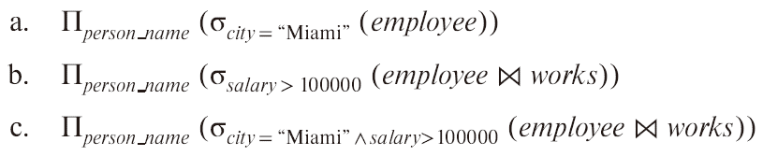
a. ∏_{person_name} (σ_{city} _{= “Miami”} (employee))
Original:
b. ∏_{person_name} (σ_{salary} _{> 100 000} (works))
c. ∏ _{person_name} ((σ_{city} _{= “Miami”} (employee))
(σ_{salary} _{> 100 000} (works)))
Updated:

Slide 16
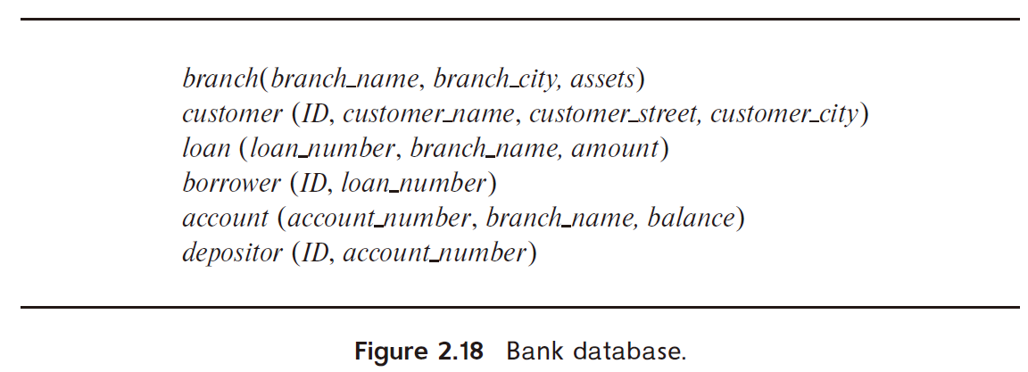
2.7 Consider the bank database of Figure 2.18. Give an expression in the relational algebra for each of the following queries:
a. Find the name of each branch located in “Chicago”.
b. Find the ID of each borrower who has a loan in branch “Downtown”.

Slide 17
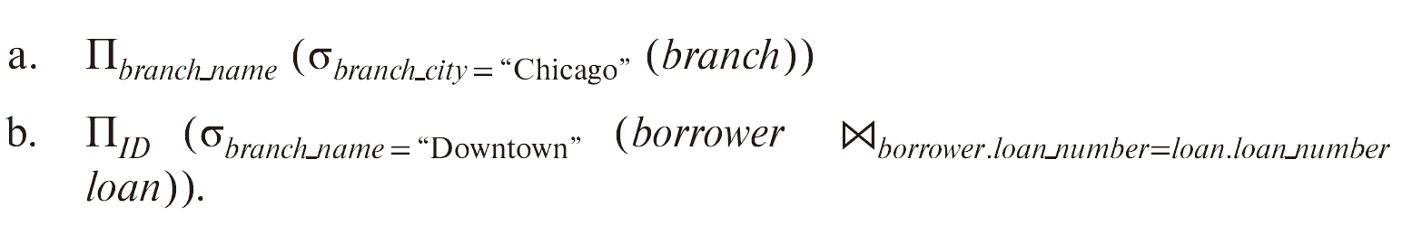

Slide 18
2.14 Consider the employee database of Figure 2.17. Give an expression in the relational algebra to express each of the following queries:
a. Find the ID and name of each employee who works for “BigBank”.
b. Find the ID, name, and city of residence of each employee who works for “BigBank”.
c. Find the ID, name, street address, and city of residence of each employee who works for “BigBank” and earns more than $10000.
d. Find the ID and name of each employee in this database who lives in the same city as the company for which she or he works.

Slide 19
a. Find the ID and name of each employee who work for “BigBank”.

Slide 20

b. Find the ID, name and city of residence of each employee who works for “BigBank”.

Slide 21
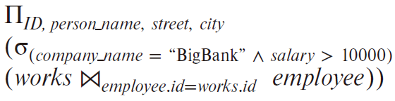
c. Find the ID, name, street address, and city of residence of each employee who works for “BigBank” and earn more than $10,000.

Slide 22
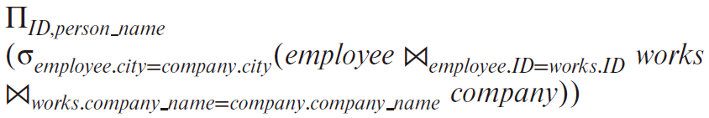
d. Find the ID and name of each employee in this database who lives in the same city as the company for which she or he works.

Slide 23
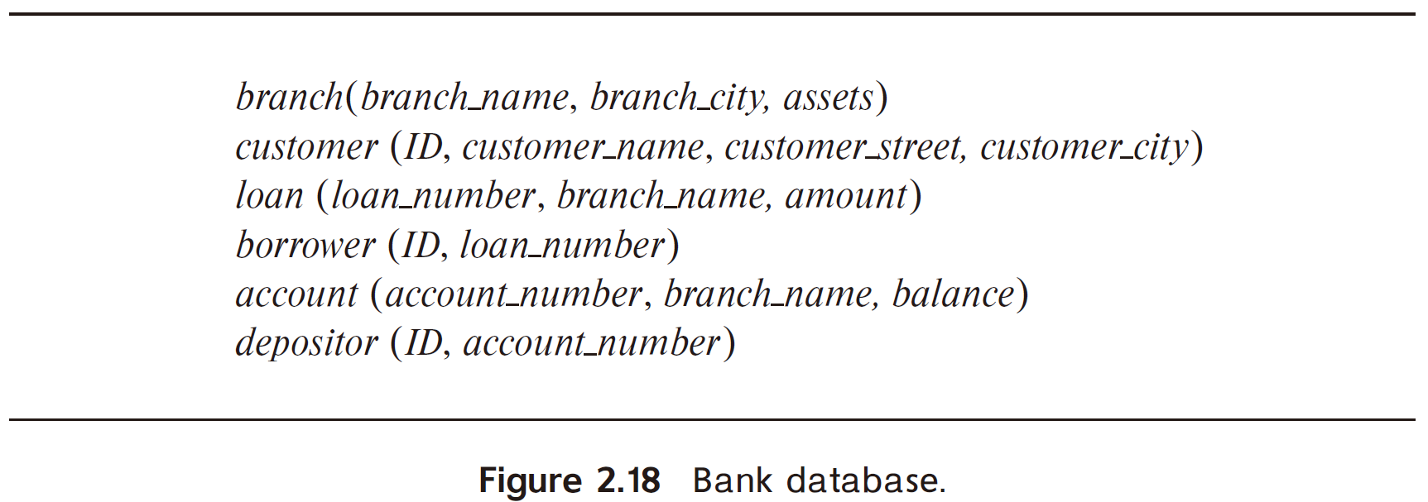
2.15 Consider the bank database of Figure 2.18. Give an expression in the relational algebra for each of the following queries:
a. Find all loan numbers with a loan value greater than $10,000.
b. Find the ID of each depositor who has an account with a balance greater than $6,000.
c. Find the ID of each depositor who has an account with a balance greater than $6,000 at the “Uptown” branch.

Slide 24

a. Find all loan numbers with a loan value greater than $10,000.

Slide 25
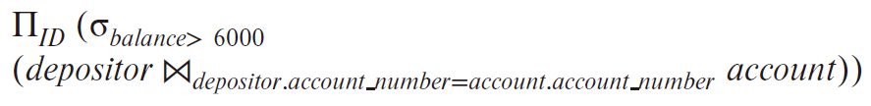
b. Find the names of all depositors who have an account with a value greater than $6,000.

Slide 26
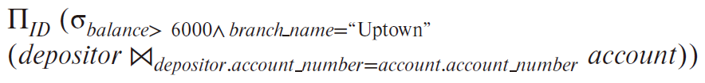
c. Find the names of all depositors who have an account with a value greater than $6,000 at the “Uptown” branch.

