Slide 1
第13章作业讲解
陈岭
lingchen@cs.zju.edu.cn

Slide 2
Chap. 13
7th Edition: 13.1, 13.7, 13.11

Slide 3
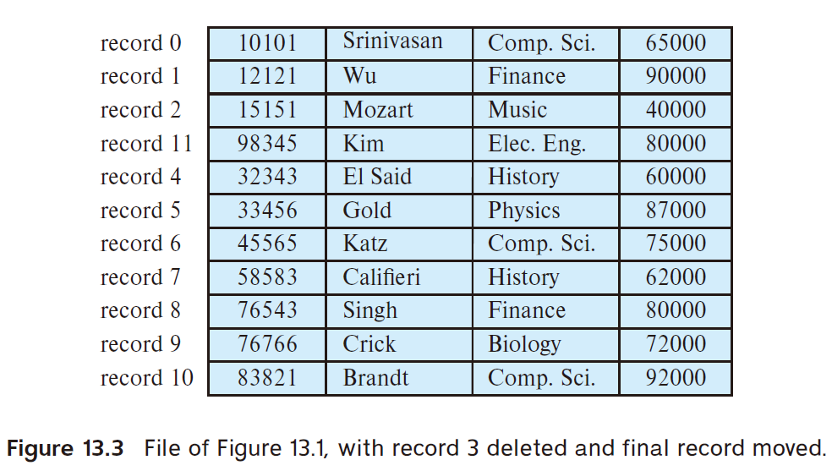
13.1 Consider the deletion of record 5 from the file of Figure 13.3. Compare the relative merits of the following techniques for implementing the deletion:
a. Move record 6 to the space occupied by record 5, and move record 7 to the space occupied by record 6.
b. Move record 7 to the space occupied by record 5.
c. Mark record 5 as deleted, and move no records.

Slide 4
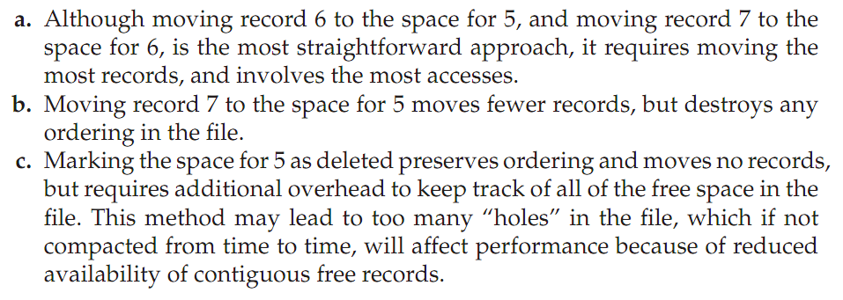

Slide 5
13.7 Give an example of a relational-algebra expression and a query-processing strategy in each of the following situations:
a. MRU is preferable to LRU.
b. LRU is preferable to MRU.

Slide 6
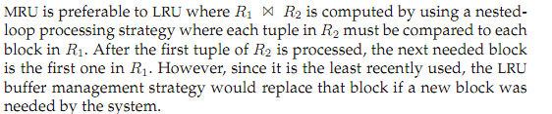
(a)

Slide 7
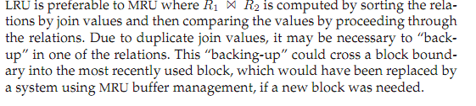
(b)

Slide 8
13.11 List two advantages and two disadvantages of each of the following strategies for storing a relational database:
a. Store each relation in one ﬁle.
b. Store multiple relations (perhaps even the entire database) in one ﬁle.

Slide 9
