Slide 1
第三、四、五章作业讲解
陈岭
lingchen@cs.zju.edu.cn

Slide 2
Chap. 3
7th Edition: Ex. 3.8, 3.9, 3.10, 3.15

Slide 3
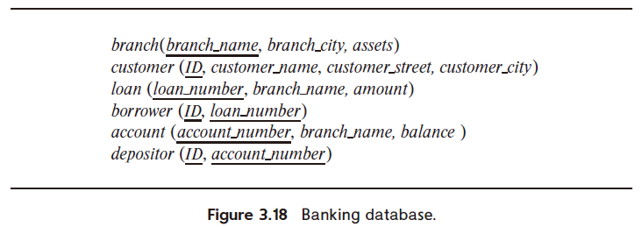
3.8 Consider the bank database of Figure 3.18, where the primary keys are underlined. Construct the following SQL queries for this relational database.
  a. Find the ID of each customer of the bank who has an account but not a loan.
  b. Find the ID of each customer who lives on the same street and in the same city as customer '12345'.
  c. Find the name of each branch that has at least one customer who has an account in the bank and who lives in “Harrison”.

Slide 4
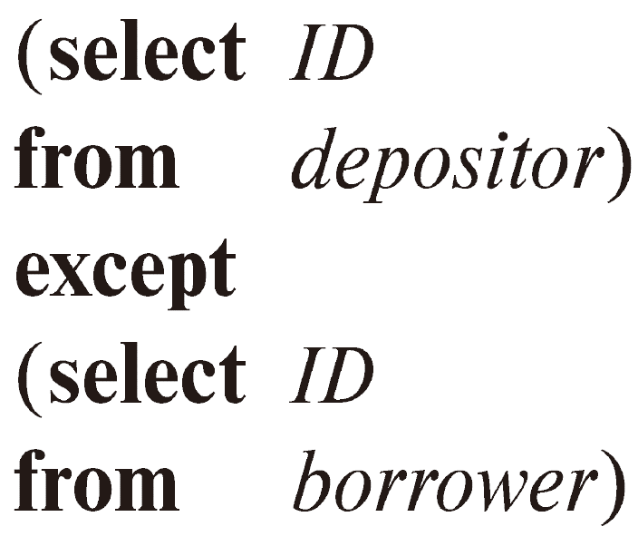
  a. Find the ID of each customer of the bank who has an account but not a loan.

Slide 5
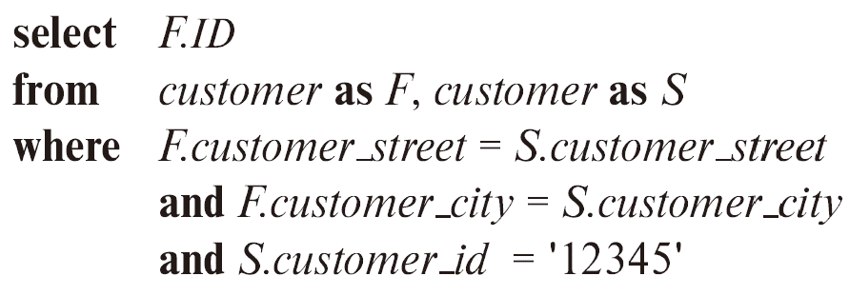
  b. Find the ID of each customer who lives on the same street and in the same city as customer '12345'.

Slide 6
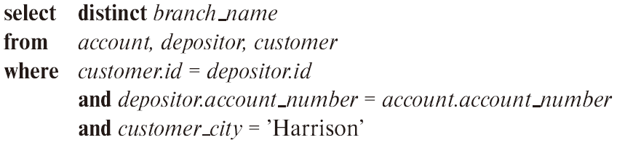
  c. Find the name of each branch that has at least one customer who has an account in the bank and who lives in “Harrison”.

Slide 7
3.9 Consider the relational database of Figure 3.19, where the primary keys are underlined. Give an expression in SQL for each of the following queries.
  a. Find the ID, names and citiy of residence of each employee who works for “First Bank Corporation”.
  b. Find the ID, name, and city of residence of each employee who works for "First Bank Corporation" and earns more than $10000.
  c. Find the ID of each employee who does not work for "First Bank Corporation".
  d. Find the ID of each employee who earns more than every employee of "Small Bank Corporation".
  e. Assume that companies may be located in several cities. Find the name of each company that is located in every city in which "Small Bank Corporation" is located.
  f. Find the name of the company that has the most employees (or companies, in the case where there is a tie for the most).
  g. Find the name of each company whose employees earn a higher salary, on average, than the average salary at "First Bank Corporation".

Slide 8
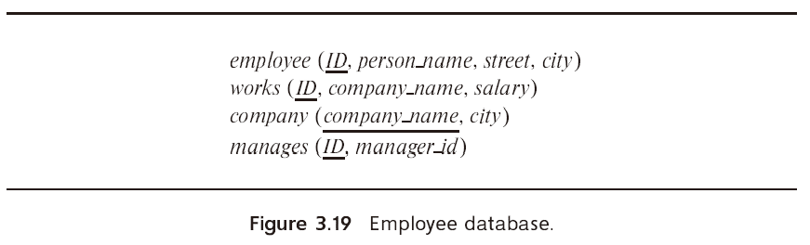

Slide 9
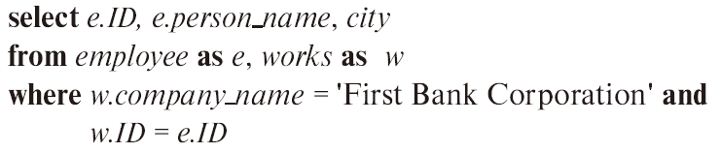
  a. Find the ID, names and citiy of residence of each employee who works for “First Bank Corporation”.

Slide 10
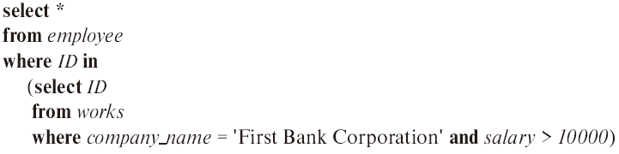
  b. Find the ID, name, and city of residence of each employee who works for "First Bank Corporation" and earns more than $10000.

Slide 11

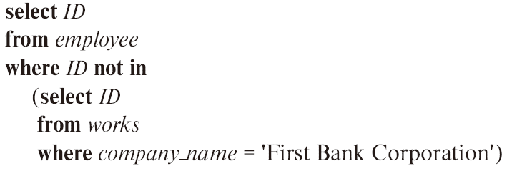
  c. Find the ID of each employee who does not work for "First Bank Corporation".
If one allows people to appear in employee without appearing also in works, the solution is slightly more complicated. An outer join as discussed in Chapter 4 could be used as well.

Slide 12
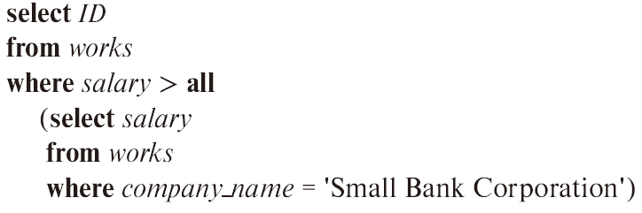
  d. Find the ID of each employee who earns more than every employee of "Small Bank Corporation"..

Slide 13
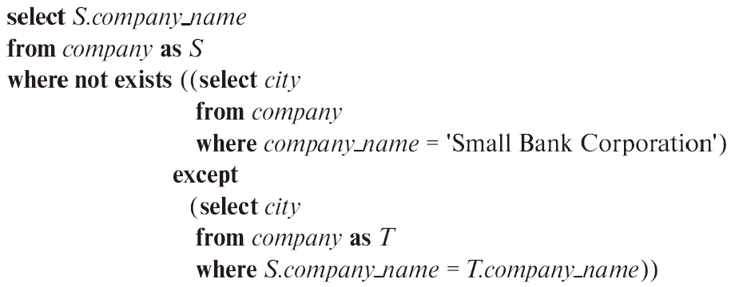
  e. Assume that companies may be located in several cities. Find the name of each company that is located in every city in which "Small Bank Corporation" is located.

Slide 14
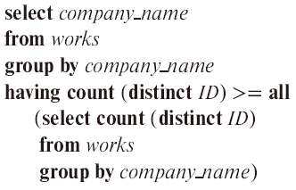
  f. Find the name of the company that has the most employees (or companies, in the case where there is a tie for the most).

Slide 15
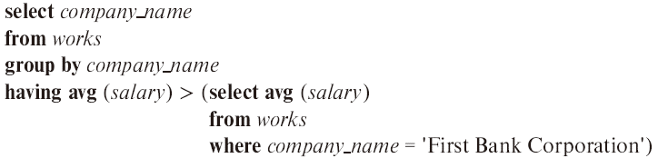
  g. Find the name of each company whose employees earn a higher salary, on average, than the average salary at "First Bank Corporation".

Slide 16
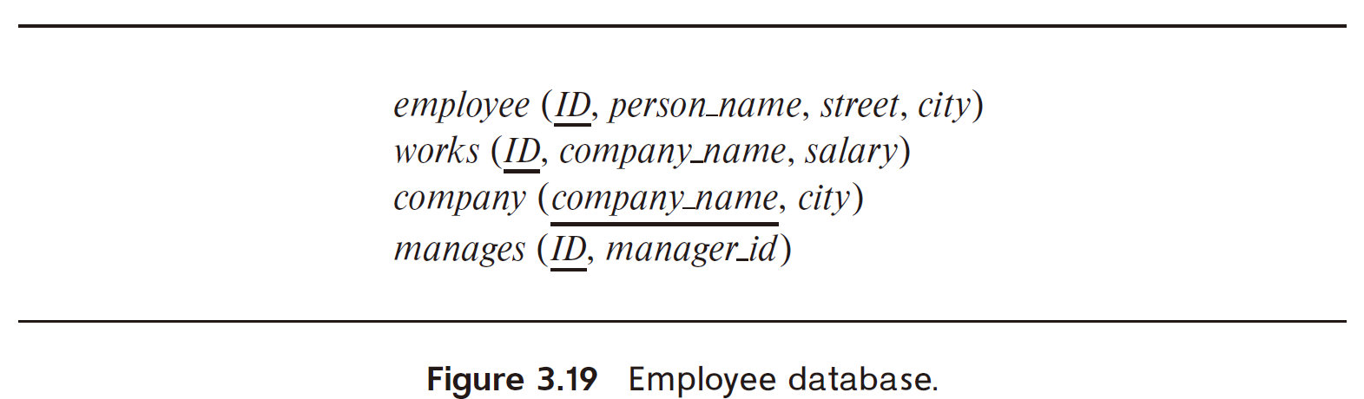
3.10 Consider the relational database of Figure 3.19. Give an expression in SQL for each of the following:
  a. Modify the database so that the employee whose ID is '12345' now lives in “Newtown”.
  b. Give each manager of “First Bank Corporation” a 10 percent raise unless the salary becomes greater than $100000; in such cases, give only a 3 percent raise.

Slide 17
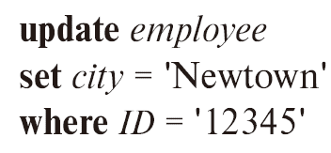
  a. Modify the database so that the employee whose ID is 12345 now lives in “Newtown”..

Slide 18
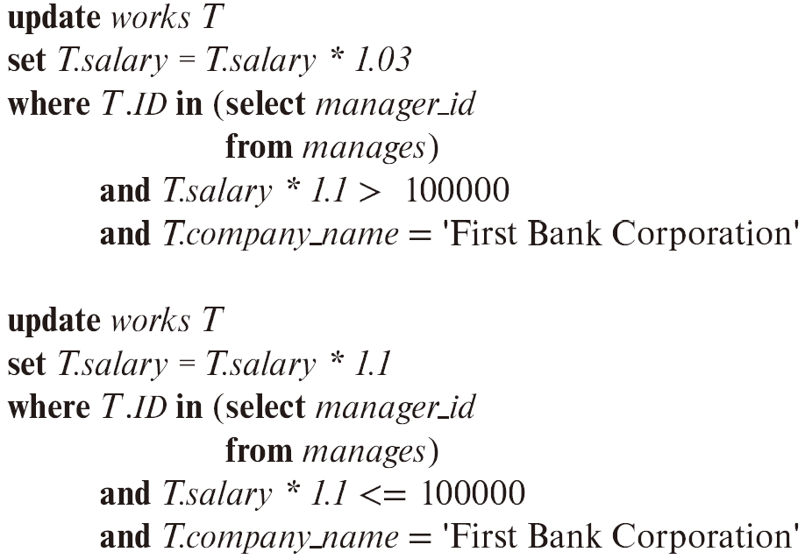
  b. Give each manager of “ "First Bank Corporation”" a 10 percent raise unless the salary becomes greater than $100000; in such cases, give only a 3 percent raise.

Slide 19
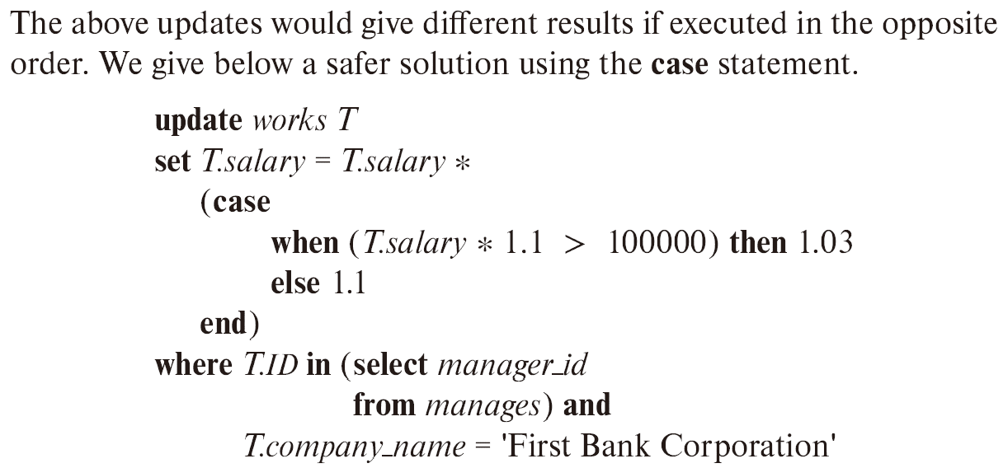
  b. Give each manager of “First Bank Corporation” a 10 percent raise unless the salary becomes greater than $100000; in such cases, give only a 3 percent raise.

Slide 20
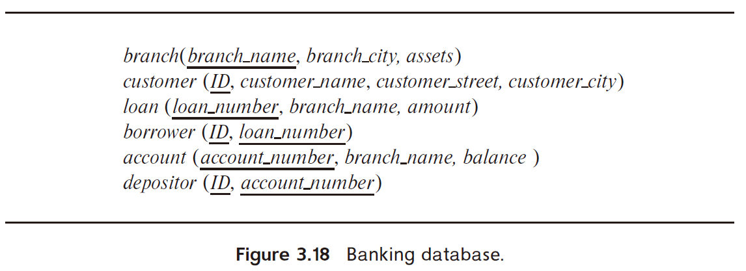
3.15 Consider the bank database of Figure 3.18, where the primary keys are underlined. Construct the following SQL queries for this relational database.
  a. Find each customer who has an account at every branch located in “Brooklyn”.
  b. Find the total sum of all loan amounts in the bank.
  c. Find the names of all branches that have assets greater than those of at least one branch located in “Brooklyn”.

Slide 21
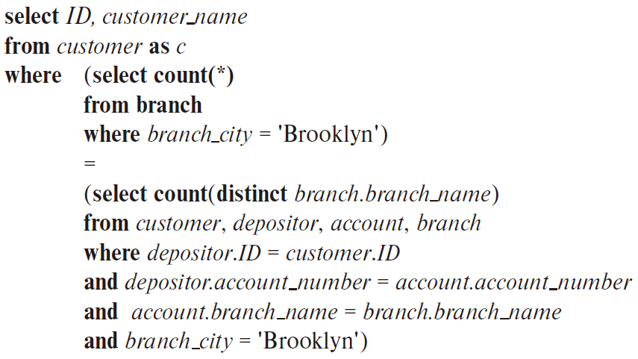
  a. Find each customer who has an account at every branch located in “Brooklyn”.

Slide 22
  b. Find the total sum of all loan amounts in the bank.
Answer:
select sum(amount)
from loan

Slide 23
  c. Find the names of all branches that have assets greater than those of at least one branch located in “Brooklyn”.
Answer:
select branch_name
from branch
where assets > some (select assets
from branch
where branch_city = ’Brooklyn’)

Slide 24
Chap. 4
7th Edition: Ex. 4.7, 4.18, 4.20

Slide 25
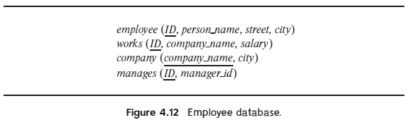
4.7 Consider the employee database of Figure 4.12. Give an SQL DDL definition of this database. Identify referential-integrity constraints that should hold, and include them in the DDL definition.

Slide 26
Answer:
create table employee
  (ID char(10),
  person_name char(20),
  street char(30),
  city char(30),
  primary key (ID) )
create table works
  (ID char(10),
  company_name char(15),
  salary integer,
  primary key (ID),
  foreign key (ID) references employee,
  foreign key (company_name) references company)

Slide 27
Answer:
create table company
  (company_name char(15),
  city char(30),
  primary key (company_name))
create table manages
  (ID char(10),
  manager_id char(10),
  primary key (ID),
  foreign key (ID) references employee,
  foreign key (manager_id) references employee)

Slide 28
4.18 For the database of Figure 4.12, write a query to find the ID of each employee with no manager. Note that an employee may simply have no manager listed or may have a null manager. Write your query using an outer join and then write it again using no outer join at all.

Slide 29
Answer:
select ID
from employee natural left outer join manages
where manager_id is null
select ID
from employee e
where not exists
  (select ID
  from manages m
  where e.ID = m.ID
  and m.manager_id is not null)

Slide 30
4.20 Show how to define a view tot_credits (year, num_credits), giving the total number of credits taken by students in each year.
Answer:
create view tot_credits(year, num_credits) as
  (select year, sum(credits)
  from takes natural join course
  group by year)

Slide 31
Chap. 5
7th Edition: Ex. 5.1, 5.7

Slide 32
5.1 Consider the following relations for a company database:
  emp (ename, dname, salary)
  mgr (ename, mname)
and the Java code in Figure 5.20, which uses the JDBC API. Assume that the userid, password, machine name, etc. are all okay. Describe in concise English what the Java program does. (That is, produce an English sentence like “It finds the manager of the toy department,” not a line-by-line description of what each Java statement does.)

Slide 33
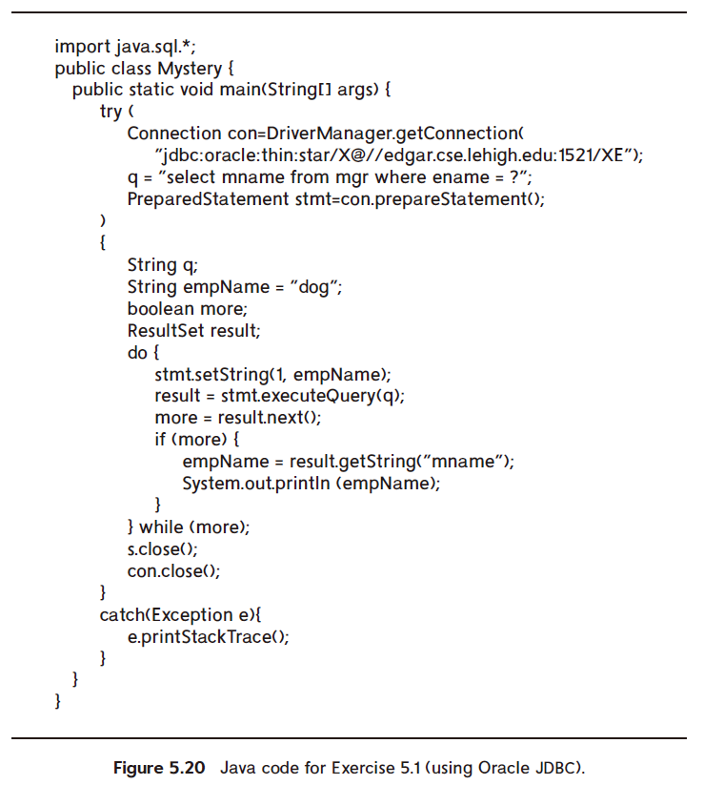

Slide 34
Answer: It prints out the manager of “dog” that manager’s manager, etc. until we reach a manager who has no manager (presumably, the CEO, who most certainly is a cat.)
NOTE: if you try to run this, use your OWN Oracle
ID and password.

Slide 35
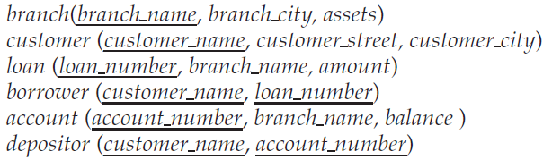
5.7 Consider the bank database of Figure 5.25. Write an SQL trigger to carry out the following action: On delete of an account, for each owner of the account, check if the owner has any remaining accounts, and if she does not, delete her from the depositor relation.

Slide 36
Answer:
create trigger check-delete-trigger after delete on account
referencing old row as orow
for each row
delete from depositor
where depositor.customer_name not in
    ( select customer_name from depositor
    where account_number <> orow.account number )
end

