Slide 1
第六、七章作业讲解
陈岭
lingchen@cs.zju.edu.cn

Slide 2
Chap. 6
7th Edition: Ex. 6.1, 6.2, 6.21, 6.24

Slide 3
6.1 Construct an E-R diagram for a car insurance company whose customers own one or more cars each. Each car has associated with it zero to any number of recorded accidents. Each insurance policy covers one or more cars and has one or more premium payments associated with it. Each payment is for a particular period of time, and has an associated due date, and the date when the payment was received.

Slide 4
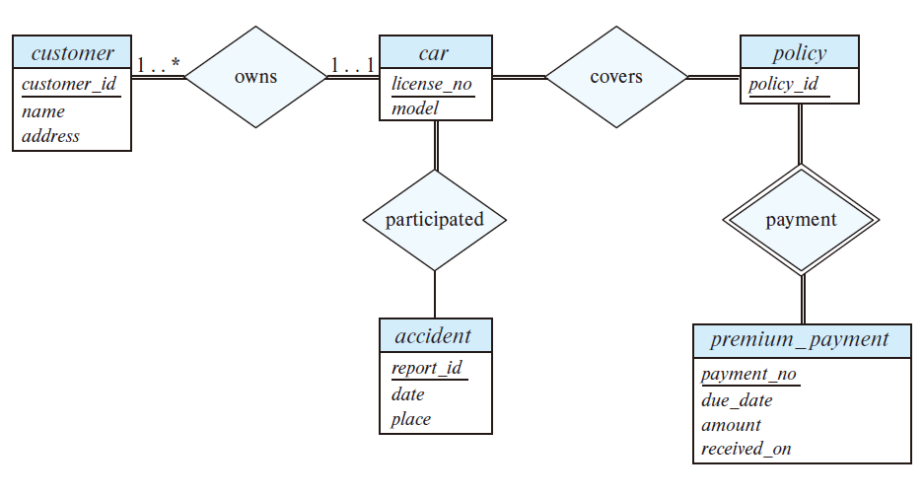
Answers：

Slide 5
6.2 Consider a database that includes the entity sets student, course, and section from the university schema and that additionally records the marks that students receive in different exams of different sections.
a. Construct an E-R diagram that models exams as entities, and uses a ternary relationship as part of the design.
b. Construct an alternative E-R diagram that uses only a binary relationship between student and section. Make sure that only one relationship exists between a particular student and section pair, yet you can represent the marks that a student gets in different exams.

Slide 6
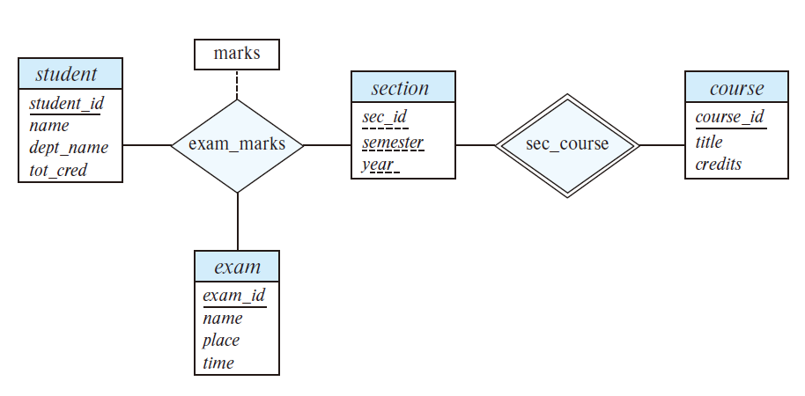
  Construct an E-R diagram that models exams as entities, and uses a ternary relationshipas part of the design.
  Answers:

Slide 7
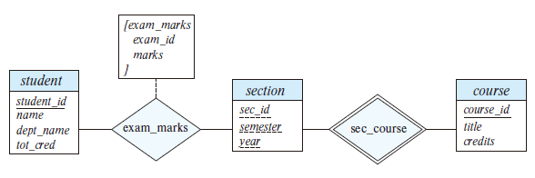
  b. Construct an alternative E-R diagram that uses only a binary relationship between student and section. Make sure that only one relationship exists between a particular student and section pair, yet you can represent the marks that a student gets in different exams.
  Answers:

Slide 8
6.21 Consider the E-R diagram in Figure 6.30, which models an online bookstore.
  a. Suppose the bookstore adds Blu-ray discs and downloadable video to its collection. The same item may be present in one or both formats, with differing prices. Draw the part of the E-R diagram that models this addition, showing just the parts related to video.
  b. Now extend the full E-R diagram to model the case where a shopping basketmay contain any combination of books, Blu-ray discs, or downloadable video.

Slide 9
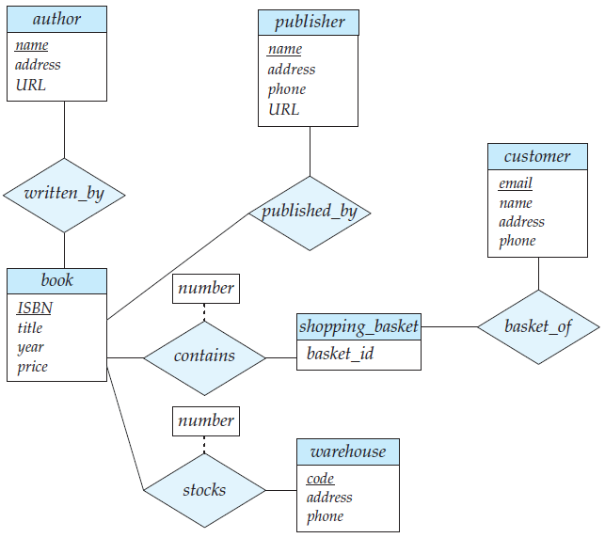

Slide 10
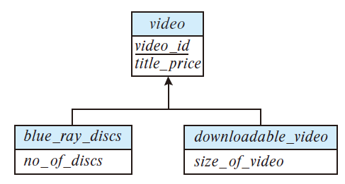
  a. Suppose the bookstore adds Blu-ray discs and downloadable video to its collection. The same item may be present in one or both formats, with differing prices. Extend the E-R diagram to model this addition, ignoring the effect on shopping baskets.
  Answers:

Slide 11
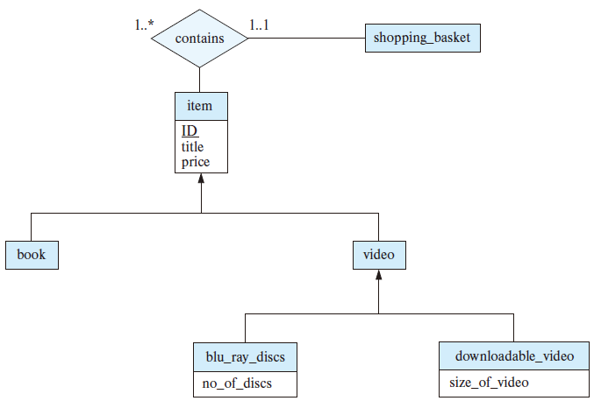
  b. Answers:

Slide 12
6.24 Design a database for an airline. The database must keep track of customers and their reservations, flights and their status, seat assignments on individual flights, and the schedule and routing of future flights. Your design should include an E-R diagram, a set of relational schemas, and a list of constraints, including primary-key and foreign-key constraints.

Slide 13
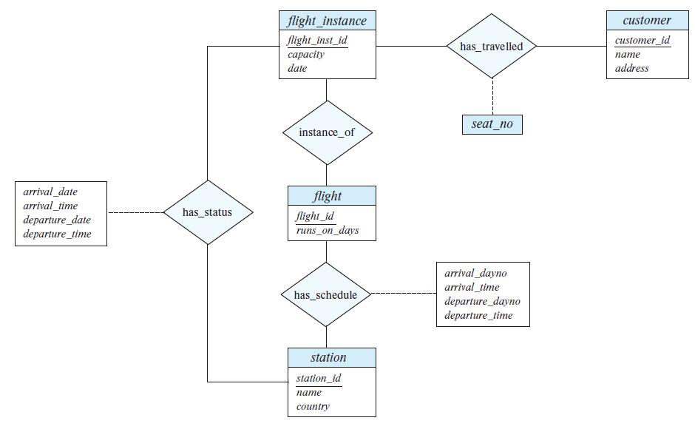

Slide 14
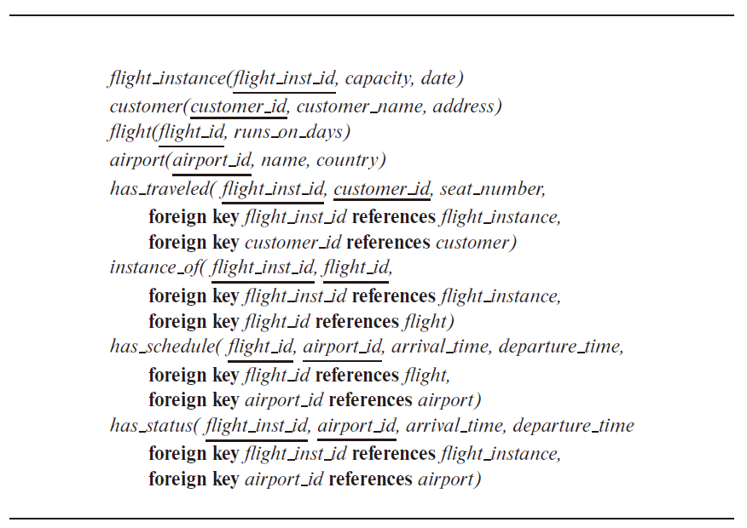

Slide 15
Chap. 7
7th Edition: Ex. 7.1, 7.13, 7.22, 7.42,

Slide 16
7.1 Suppose that we decompose the schema r (A, B, C, D, E) into
        r1(A, B, C)
        r2(A, D, E)
Show that this decomposition is a lossless decomposition if the following set F of functional dependencies holds:
        A → BC
        CD → E
        B → D
        E → A

Slide 17
Answers:
A decomposition {R1, R2} is a lossless-join decomposition if
R1 ∩ R2 → R1 or R1 ∩ R2 → R2.
Let R1 = (A, B, C), R2 = (A, D, E), and R1 ∩ R2 = A. Since A is a candidate key,
Therefore R1 ∩ R2 → R1.

Slide 18
7.13 Show that the decomposition in Exercise 7.1 is not a dependency-preserving decomposition.

Slide 19
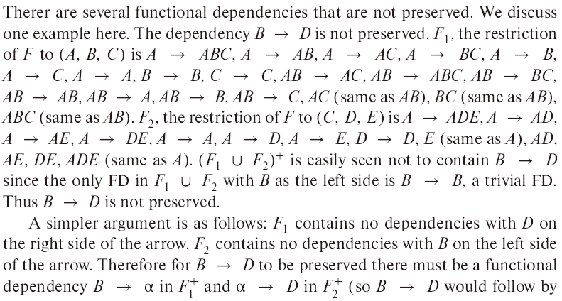
Answer:

Slide 20
7.22 Give a lossless, dependency-preserving decomposition into 3NF of schema R of Exercise 7.1.
Answer:
R′ = {(A, B,C), (C, D, E), (B, D), (E, A)}.
Schema (A, B, C) contains a candidate key. Therefore R′ is a third normal form dependency-preserving lossless-join decomposition.

Slide 21
7.42 Normalize the following schema, with given constraints, to 4NF.
    books(accessionno, isbn, title, author, publisher)
    users(userid, name, deptid, deptname)
    accessionno→isbn
    isbn→title
    isbn→publisher
    isbn→→author
    userid→name
    userid→deptid
    deptid→deptname

Slide 22
Answer:
books_accnno(accessionno, isbn)
books_details1(isbn, title, publisher)
books_authors(isbn, author)
users(userid, name, deptid)
departments(deptid, deptname)

