Slide 1
Steps of Database Design
Requirement analysis
  What data, applications, and operations needed
Conceptual database design:
  A high-level description of data, constraints using
  E - R model or a similar high level data model
Logical database design:
  Convert the conceptual design into a DB schema
  Relation Schema
Schema refinement
  Normalization of relations: Check relational schema for redundancies and related anomalies.
Physical database design:
  Indexing, clustering and database tuning
Create/initialize the database & Security design
  Load initial data, testing
  Identify different user groups and their roles

Slide 2
Chapter 6: Entity-Relationship Model
Entity Sets
Relationship Sets
Keys
E-R Diagram
Weak Entity Sets
Extended E-R Features
Design of an E-R Database Schema
Reduction of an E-R Schema to Tables

Slide 3
6.1 Entity Sets (实体集)
The real world can be modeled as:
  a collection of entities (实体),
  relationships (联系) among entities.
An entity is an object that exists and is distinguishable from other objects.
(An entity may be concrete, or abstract)
Example: specific student, company, event, plant
Entities have attributes (属性)
  Example: student has id, name, age, sex and address
An entity set is a set of entities of the same type that share the same properties.
  Example: set of all students, companies, trees, holidays, customers, accounts, loans
  一个实体集包含多个同类实体

Slide 4

Example: Entity Sets customer and loan
Attribute names
Attribute value
An entity
instructor

Slide 5
Attributes
An entity is represented by a set of attributes, that is descriptive properties possessed by all members of an entity set.
Domain (域, value set)– the set of permitted values for each attribute
Attribute types:
  Simple and composite attributes (简单和复合属性，如sex, name).
  Single-valued and multi-valued attributes(单值和多值属性)
    E.g. multivalued attribute: phone-numbers (多个电话号码)
  Derived attributes (派生属性)
    Can be computed from other attributes
    E.g. age, given date of birth
    versus base attributes or stored attributes (基属性，存储属性)

Slide 6

Composite Attributes
复合属性
分量属性

Slide 7
6.2 Relationship Sets (联系集)
A relationship is an association among several entities (是二个或多个不同类实体之间的关联)
student entity
instructor entity
relationship
advisor1
( 98988 , 76766 )
advisor2
( 12345 , 45565 )
A relationship set is a set of relationship of the same type.
example: advisor( s_ID, i_ID)
一个联系集包含多个同类联系（或联系实例, relationship instance）
一个联系集表示二个或多个实体集之间的关联。

Slide 8
Formally, a relationship set is a mathematical relation among n ≥ 2 entities, each taken from entity sets
{(e₁, e₂, … e_{n}) | e₁∈E₁, e₂∈E₂, …, e_{n}∈E_{n}}
where (e₁, e₂, …, e_{n}) is a relationship，E_{i} is entity set.
  Example: (98988, 76766) ∈ advisor,
  where 98988 ∈ student, 76766∈ instructor

Slide 9

Example1: Relationship Set advisor
advisor ( s_ID, i_ID)

Slide 10

Example2: Relationship Set (cont.)
An attribute can also be property of a relationship set.
For instance, the advisor relationship set between entity sets student and instructor may have the attribute date
advisor ( s_ID, i_ID,date)

Slide 11
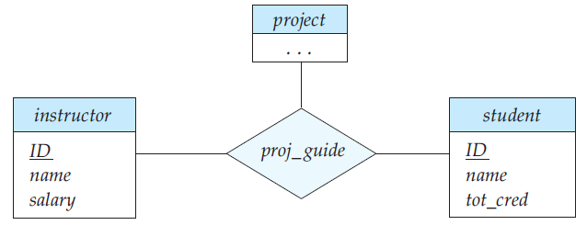
(1) Degree of a Relationship Set
Refers to the number of entity sets that participate in a relationship set.
Relationship sets that involve two entity sets are binary (or degree two). （二元联系，二度联系）
Relationship sets may involve more than two entity sets.
  E.g Suppose a student can have at most one instructor as
  a guide on a project.
  Then there is a ternary relationship set between entity sets( instructor, project , student ) (三元联系集)

Slide 12
(1) Degree of a Relationship Set
Relationships between more than two entity sets are rare. Most relationships are binary. (More on this later.)

Slide 13
(2) Mapping Cardinalities (映射基数)
Express the number of entities to which another entity can be associated via a relationship set.
(一个联系集中，一个实体可以与另一类实体相联系的实体数目。其中数目是指最多一个还是多个)
Most useful in describing binary relationship sets.
For a binary relationship set the mapping cardinality must be one of the following types:
  One to one (1 : 1) ， 如：就任总统（总统，国家）
  One to many (1 : n)， 如：分班情况（班级，学生）
  Many to one (n : 1)， 如：就医（病人，医生）
  Many to many (n : m)， 如：选课（学生，课程）

Slide 14
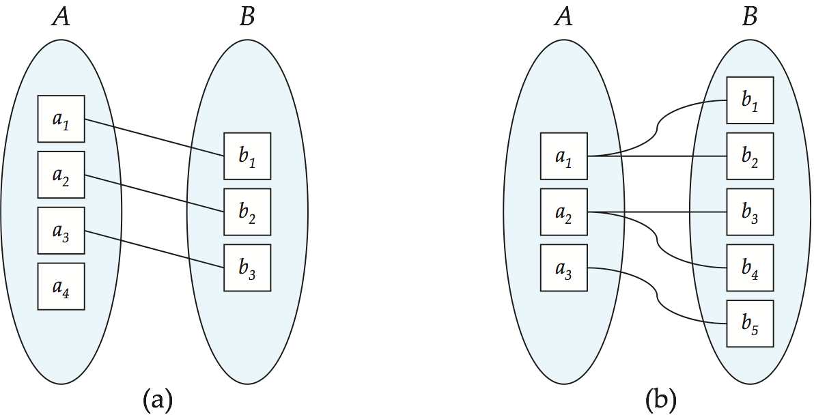
Mapping Cardinalities
One to one
One to many
Note: Some elements in entity set A and B may not be mapped to any
elements in the other set

Slide 15
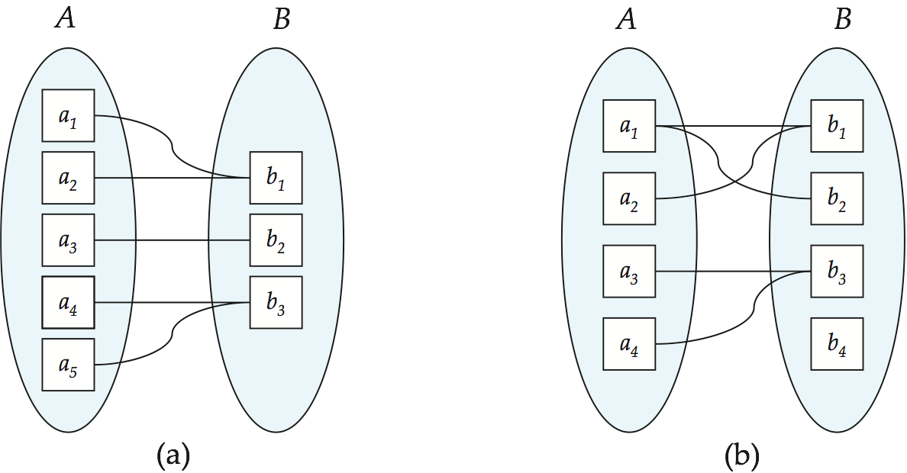
Mapping Cardinalities
Many to one
Many to many
Note: Some elements in A and B may not be mapped to any
elements in the other set

Slide 16
6.3 Keys (码，键) keys for entity sets
A super key（超码）of an entity set is a set of one or more attributes whose values uniquely determine each entity.
A candidate key（候选码）of an entity set is a minimal super key.
  instructor –ID is candidate key of instructor
Although several candidate keys may exist, one of the candidate keys is selected to be the primary key（主码或主键）
Example: instructor (ID,name, dept_name,salary),
  candidate key: ID
  super key: {ID}, {ID, name}, {ID,…}

Slide 17
▲ Keys for Relationship Sets
The combination of primary keys of the participating entity sets forms a super key of a relationship set.
（参与一个联系集的各实体集的码的组合，构成该联系集的超码）
  (s_ID, i_ID) is the super key of advisor
  NOTE: this means a pair of entity can have at most one relationship in a particular relationship set.
Must consider the mapping cardinality of the relationship set when deciding what are the candidate keys. (1:1, 1:n, m:n)
Need to consider semantics of relationship set in selecting the primary key in case of more than one candidate key.
(e.g. 作为码的属性不能为空，值不应常变）

Slide 18

6.4 E-R Diagrams
Rectangles divided into two parts represent entity sets. The first part, which in this textbook is shaded blue, contains the name of the entity set. The second part contains the names of all the attributes of the entity set.
Diamonds represent relationship sets.
Undivided rectangles represent the attributes of a relationship set.Attributes that are part of the primary key are underlined.

Slide 19
E-R Diagrams
Lines link entity sets to relationship sets.
Dashed lines link attributes of a relationship set to the relationship set.
Double lines indicate total participation of an entity in a relationship set.
Double diamonds represent identifying relationship sets linked to weak entity sets

Slide 20

(1) E-R Diagram With Composite, Multivalued, and Derived Attributes
Composite attr.
Multivalued attr.
Derived attr.

Slide 21

(2) Relationship Sets with Attributes
Descriptive attribute of the relationship

Slide 22

(3) Roles
Entity sets of a relationship need NOT be distinct。 E.g Recursive relationship set (自环联系集)
Role: the function that an entity plays in a relationship.
Eg.The following figure shows the role indicators course_id and prereq_id between the course entity set and the prereq relationship set.
Role labels are optional, and are used to clarify semantics of the relationship
role indicators

Slide 23

(4) Express the Cardinality Constraints (基数约束)
We express cardinality constraints by drawing either a directed line (→), signifying “one,” or an undirected line (—), signifying “many,” between the relationship set and the entity set.
(a) One-to-one relationship:
  one-to-one relationship between an instructor and a student: this indicates that an instructor may advise at most one student, and a student may have at most one advisor.
  注：一个联系集的类型取决于被表达对象的语义约束及设计者的意图

Slide 24
(b) One-To-Many Relationship
one-to-many relationship between an instructor and a student : this indicates that an instructor may advise many students, but a student may have at most one advisor.
one
many

Slide 25
(c) Many-To-One Relationships
In a many-to-one relationship between an instructor and a student : this indicates that an instructor may advise at most one student, but a student may have many advisors.

Slide 26
(d) Many-To-Many Relationship
An instructor is associated with several (possibly 0) students via advisor
A student is associated with several (possibly 0) instructors via advisor

Slide 27

(5) Participation of an Entity Set in a Relationship Set（参与约束）
Total participation (全参与) (indicated by double line): every entity in the entity set participates in at least one relationship in the relationship set
  E.g. participation of loan in borrower is total
  every loan must have a customer associated to it via borrower
Partial participation (部分参与): some entities may not participate in any relationship in the relationship set
  E.g. participation of customer in borrower is partial
映射基数约束(Mapping cardinality constraints)，限定了一个实体与发生关联的另一端实体可能关联的数目上限。
全参与和部分参与约束，则反映了一个实体参与关联的数目下限：0次，还是至少1次。
partial participation
Total participation

Slide 28

(6) Alternative Notation for relationship Constraints
Alternative notation for cardinality constraints and participation constraints ( 例如：每个学生有且仅有一个导师，教师可以有零个或多个学生。)
1：1至少至多一个

Slide 29

(7) E-R Diagram with a Ternary Relationship
一个教师可以指导多个学生，并可以参与到多个项目。

Slide 30
(8) Binary vs. Non-Binary Relationships
(a) Some relationships that appear to be non-binary may be better represented using binary relationships
  E.g. A ternary relationship parents, relating a child to his/her father and mother, is best replaced by two binary relationships, father and mother。
  parents (he, she, child). => father (he, child), mother (she, child)
    Using two binary relationships allows partial information (e.g. only mother being know) .
  But there are some relationships that are naturally non-binary
    E.g. proj_guide (instructor, project, student)

Slide 31

(b) Converting Non-Binary Relationships to Binary Form
In general, any non-binary relationship can be represented using binary relationships by creating an artificial entity set.
  Replace non-binary relationship R between entity sets A, B and C by an entity set E, and three new relationship sets:
  Create a special identifying attribute for E
  Add any attributes of R to E
  For each relationship (a_{i} , b_{i} , c_{i} ) in R, create R_{A}, R_{B} , R_{C}
E.g:
teacher
teaching
teacher
student
schooling
course
student
enroll
course
place
c-room
c-room

Slide 32
6.5 Weak Entity Sets (弱实体集)
An entity set that does not have a primary key is referred to as a weak entity set.
Vs strong entity set (强实体集)
Consider a section entity, which is uniquely identified by a course identifier, semester, year, and section identifier. Clearly, section entities are related to course entities. Suppose we create a relationship set sec_course between entity sets section and course.
section(sec_id,semester,year)

Slide 33

Weak Entity Sets (cont.)
The existence of a weak entity set depends on the existence of a identifying entity set or owner entity set（标识实体集或属主实体集）.
  E.g. course(course_id,title,credits) is an identifying entity set.
  It must relate to the identifying entity set via a total, one-to-many relationship set from the identifying to the weak entity set.
The related relationship is called identifying relationship（标识性联系）
  e.g. course-section

Slide 34
Weak Entity Sets (cont.)
The discriminator or partial key (分辨符或部分码) of a weak entity set is the set of attributes that distinguishes among all those entities in a weak entity set that depend on one particular strong entity. (e.g sec_id,semester,year)
The primary key of a weak entity set is formed by the primary key of the strong entity set on which the weak entity set is existence dependent, plus the weak entity set’s discriminator.

Slide 35
Weak Entity Sets (cont.)
Primary key for section:
{course_id, sec_id,semester,year }
{sec_id,semester,year} is discriminator of the section entity set
Owner entity set
Identifying relationship
Weak entity set

Slide 36
Weak Entity Sets (cont.)
Note: the primary key of the strong entity set is NOT explicitly stored with the weak entity set, since it is implicit in the identifying relationship.
If course_id were explicitly stored, section could be made a strong entity, but then the relationship between section and course would be duplicated by an implicit relationship defined by the attribute course_id common to course and section

Slide 37
6.6 Extended E-R features
(1) Stratum (层) of the entity set
  Specialization(特殊化、具体化)
    Top-down design process; we designate subgroupings within an entity set that are distinctive from other entities in the set.
    These subgroupings become lower-level entity sets that have attributes or participate in relationships that do NOT apply to the higher-level entity set.
    Attribute inheritance – a lower-level entity set inherits all the attributes and relationship participation of the higher-level entity set to which it is linked.

Slide 38

Specialization Example

Slide 39

（皆指实体集间的上下级变换）
  Generalization （泛化、普遍化）
    A bottom-up design process – combine a number of entity sets that share the same features into a higher-level entity set.
    Specialization and generalization are simple inversions of each other; they are represented in an E-R diagram in the same way.
    The terms specialization and generalization are used interchangeably.

Slide 40

Design Constraints on a Specialization/Generalization
Constraint on which entities can be members of a given lower-level entity set.
  condition-defined （条件定义的）
    All student entities are evaluated on the defining student_type attribute. Only those entities that satisfy the condition student_type = “graduate” are allowed to belong to the lower-level entity set graduate_student
  user-defined （用户定义的）
    e.g. employee to different teams
Constraint on whether or not entities may belong to more than one lower-level entity set within a single generalization.
  Disjoint （不相交）
    an entity can belong to only one lower-level entity set
    Noted in E-R diagram by writing disjoint next to the ISA triangle
  Overlapping （可重叠）
    an entity can belong to more than one lower-level entity set.
student
ISA
graduate_student
Disj
undergraduate_student
person
ISA
student
employee

Slide 41

Design Constraints on a Specialization/Generalization (cont.)
Completeness constraint（完全性约束）- specifies whether or not an entity in the higher-level entity set must belong to at least one of the lower-level entity sets within a generalization.
  total : an entity must belong to one of the lower-level entity sets
  partial: an entity need not belong to one of the lower-level entity sets
（完全泛化）
（部分泛化）

Slide 42

(2) Aggregation (聚集，合并)
Consider the ternary relationship proj_guide, which we saw earlier
Suppose we want to record evaluations of a student by a guide on a project

Slide 43
Aggregation (cont.)
Relationship sets eval_for and proj_guide represent overlapping information
  Every eval_for relationship corresponds to a proj_guide relationship
  However, some proj_guide relationships may not correspond to any eval_for relationships
    So we can’t discard the proj_guide relationship
Eliminate this redundancy via aggregation
  Treat relationship as an abstract entity
  Allows relationships between relationships
  Abstraction of relationship into new entity
Without introducing redundancy, the following diagram represents:
  A student is guided by a particular instructor on a particular project
  A student, instructor, project combination may have an associated evaluation

Slide 44

E-R Diagram With Aggregation
复合实体集

Slide 45

Summary of Symbols Used in E-R Notation

Slide 46
Summary of Symbols (cont.)

Slide 47

Alternative E-R Notations

Slide 48
Alternative E-R Notations (cont.)

Slide 49
6.7 Design of an E-R database schema
(1) the steps of database design
a) Requirment analysis
  What data, applications, and operations needed
b) Conceptual database design: ★
  A high-level description of data, constraints using E - R model or a similar high level data model
c) Logical database design:
  Convert the conceptual design into DB schema --- tables
  Schema refinement: Normalization of relations: Check relational schema for redundancies and related anomalies.
d) Physical database design:
  Indexing, clustering and database tuning

Slide 50

补充：
数据库的设计步骤
（数据模型）逻辑模型
物理模型
概念模型
现实世界
信息世界
E-R 图
机器世界
关系模式（表结构）
物理存储结构

Slide 51
补充：
目标组织
需求分析
结构设计
行为设计
数据分析
行为分析
(用户业务活动分析)
概念结构设计
设计局部视图
概念模型设计
功能模型, 功能说明
设计集成视图
逻辑模型设计
事务处理设计
(概要设计)
逻辑结构设计
设计逻辑结构
子模式设计
应用程序设计
(详细设计)
优化逻辑模型
物理模型设计
应用程序编码
物理结构设计
设计物理结构
加载试验数据
程序调试和试运行
评价物理结构
功能、性能考核
N
数据库实施
满意？
物理实现
加载数据库
试运行(加载试验数据)
运行、维护
数据库运行维护
数据库系统开发步骤

Slide 52
(2) Some E-R Design consideration
1) Use an attribute or entity set to represent an object?
e.g : (a) instructor(ID,name, …, phone)
优点：简单。但多个电话怎么处理？电话的其他属性？
or, (b) instructor (ID, name, …);
phone(phone-num, location, type, color);
ins-phone(i_ID, phone-num)
若一个对象只对其名字及单值感兴趣，则可作为属性，如性别；若一个对象除名字外，本身还有其他属性需描述，则该对象应定义为实体集。如电话, 住址，部门
一个对象不能同时作为实体和属性。
一个实体集不能与另一实体集的属性相关联，只能实体与实体相联系。

Slide 53
E-R Design Decisions (cont.)
2) Use it as an entity set or a relationship set?
  e.g. customer, borrower, depositor
  Relationship set - to describe an action that occurs between entities.
  ( 二个对象之间发生的动作-用“relationship set”表示 )
  The mapping cardinality will affect the matter.
  Considering the branch, loan, customer, …
  Whether a customer can have multiple loans in a branch would affect the design
customer
loan
branch
Loan-num
amount
customer
borrow
loan
Loan-bra
branch
Loan-num
amount

Slide 54
E-R Design Decisions (cont.)
3) Use it as an attribute of an entity or a relationship? e.g. student(sid,name,sex,age,…,supervisor-id, supervisor-name, supervisor-position,…, class, monitor )
  要从对象的语义独立性和减少数据冗余考虑 student(sid,name,sex,age,…);
  supervisor(sup-id, name, position, …);
  stu-sup(sid, sup-id, from, to ); class(classno,specialty,monitor,stu-num);
  stu-class(sid,classno);

Slide 55
E-R Design Decisions (cont.)
4) The use of a ternary or n-ary relationship versus a pair of binary relationships.
*5) The use of a strong or weak entity set.
*6) The use of specialization/generalization – contributes to modularity in the design. (有助于模块化)
*7) The use of aggregation – can group a part of E-R diagram into a single entity set, and treat it as a single unit without concern for the details of its internal structure.

Slide 56
(3) Example1: Design of University Database
Get system requirements
  classroom,department,course,instructor,section,student,time_slot
Entity sets design
  classroom (building, room_number, capacity).
  department (dept_name, building, budget).
  course (course_id, title, credits).
  instructor (ID, name, salary).
  section (course_id, sec_id, semester, year).
  student (ID, name, tot cred).
  time_slot (time_slot_id, {(day, start_time, end_time) }).

Slide 57
Example: Design of University Database (cont.)
Relationship sets design
  inst_dept: relating instructors with departments.
  stud_dept: relating students with departments.
  teaches: relating instructors with sections.
  takes: relating students with sections, with a descriptive attribute grade.
  course_dept: relating courses with departments.
  sec_course: relating sections with courses.
  sec_class: relating sections with classrooms.
  sec_time_slot: relating sections with time slots.
  advisor: relating students with instructors.
  prereq: relating courses with prerequisite courses.
E-R diagram

Slide 58

E-R Diagram for a University Enterprise

Slide 59
6.8 Reduction of an E-R Schema to Tables (逻辑设计 - 将E-R模式转化为数据库表)
Converting an E-R diagram to a table format is the basis for deriving a relational database design from an E-R diagram.
A database which conforms to an E-R diagram can be represented by a collection of tables.
For each entity set and relationship set there is a unique table which is assigned the name of the corresponding entity set or relationship set.

Slide 60

(1) Representing Entity Sets as Tables
A strong entity set => to a table with the same attributes.
  department (dept_name, building, budget).
  还有：classroom (building, room_number, capacity).
  course (course_id, title, credits).
  instructor (ID, name, salary).
  student (ID, name, tot cred).

Slide 61
(1.a) Entity set with composite Attributes
Composite attributes are flattened out by creating a separate attribute for each component attribute
  E.g. given entity set instructor with composite attribute name with component attributes first-name and last-name the table corresponding to the entity set has two attributes
  name.first-name and name.last-name
  or first-name and last-name

Slide 62
(1.b) Entity set with multivalued Attributes
A multivalued attribute M of an entity E is represented by a separate table EM :
  E.g. Multivalued attribute phone_number of instructor is represented by a table
  instructor(ID, name, salary, phone_number)
  instructor(ID, name, salary)
  instructor_phone ( ID, phone_number)
  Each value of the multivalued attribute maps to a separate row of the table EM
    E.g., an instructor entity with primary key 22222 and
    phone_numbers 555-1234 and 555-4321 maps to two rows:
    (22222 , 555-1234 ) and (22222 , 555-4321 ) in relation instructor_phone

Slide 63

(2) Representing Weak Entity Sets
A weak entity set becomes a table that includes a column for the primary key of the identifying strong entity set
section(course_id,sec_id,semester,year,building,room_number ,time_slot_id)

Slide 64
(3) Representing Relationship Sets as Tables
A relationship set is represented as a table with columns for the primary keys of the two participating entity sets, (which are foreign keys here) and any descriptive attributes of the relationship set itself.
(a) tables for many to many relationship sets:
takes(ID,course_id,sec_id,semester,year,grade)
teaches(ID,course_id,sec_id,semester,year)
prereq(course_id,prereq_id)

Slide 65
(3) Representing Relationship Sets as Tables (cont.)
(b) tables for many to one relationship sets:
(c) tables for one to one relationship sets: like (b)
advisor(s_ID,i_ID)

Slide 66
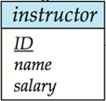
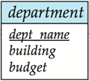
(4) Redundancy of Tables (表的冗余) → 表的合并
(a) Many-to-one and one-to-many relationship sets that are total on the many-side can be represented by adding an extra attribute to the many side, containing the primary key of the one side. (对1: n联系，可将“联系”所对应的表，合并到对应“多”端实体的表中)
inst_dept
instructor(ID,name,salary); department(dept_name,building,budget)
Inst_dept (ID, dept_name).
instructor( ID, name,dept_name, salary);

Slide 67
(4.a) Redundancy of Tables (cont.)
If participation is partial on the many side, replacing a table by an extra attribute in the relation corresponding to the “many” side could result in null values。
  In the above example, if inst_dept were partial, then we would store null values for the dept_name attribute for those instructors who have no associated department.
For one-to-one relationship sets, either side can be chosen to act as the “many” side
  That is, extra attribute can be added to either of the tables corresponding to the two entity sets

Slide 68
inst_dept(ID, dept_name);
instructor(ID, name,salary);
instructor(ID, name,dept_name, salary);
stu_dept(ID, dept_name);
student(ID,name, tot_cred);
student(ID,name,dept_name,tot_cred)
course_dept (course_id, dept_name) ;
course(course_id,title,credits);
course(course_id,title,dept_name,credits)
sec_class (course_id, sec_id, semester, year, building, room _number) ;
section(course_id,sec_id,semester,year);
section(course_id,sec_id,semester,year,building,room_number)

Slide 69
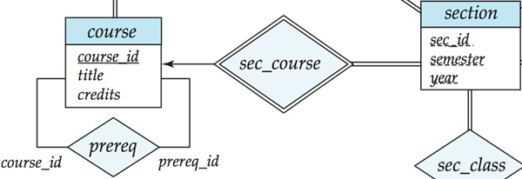
(4.b) Redundancy of Tables (cont.)
(b) The table corresponding to a relationship set linking a weak entity set to its identifying strong entity set is redundant. (联系弱实体集及其标识性实体集的联系集对应的表是冗余的，即对应identifying relationship的表是多余的。)
  E.g. The section table already contains the information that would appear in the sec_course table (i.e., the columns course_id ,sec_id,semester,year).
Owner entity set
identifying relationship
Weak entity set

Slide 70
section(course_id,sec_id,semester,year,building,room_number,time_slot_id)
sec_course (course_id,sec_id,semester,year)

Slide 71
(5) Representing Specialization as Tables
Method 1:
  Form a schema for the higher-level entity
  Form a schema for each lower-level entity set, include primary key of higher-level entity set and local attributes
  schema attributes
  person ID, name, street, city
  student ID, tot_cred
  employee ID, salary
  Drawback: getting information about, an employee requires accessing two relations, the one corresponding to the low-level schema and the one corresponding to the high-level schema

Slide 72
Representing Specialization as Tables (cont.)
Method 2:
  Form a schema for each entity set with all local and inherited attributes
  schema attributes
  person ID, name, street, city
  student ID, name, street, city, tot_cred
  employee ID, name, street, city, salary
  If specialization is total, the schema for the generalized entity set (person) not required to store information
    Can be defined as a “view” relation containing union of specialization relations
    But explicit schema may still be needed for foreign key constraints
  Drawback: name, street and city may be stored redundantly for people who are both students and employees

Slide 73
University database
classroom(building,room_number,capacity)
department(dept_name,building,budget)
course(course_id,title,dept_name,credits)
instructor(ID,name,dept_name,salary)
section(course_id,sec_id,semester,year,building,room_number,time_slot_id)
teaches(ID,course_id,sec_id,semester,year)
student(ID,name,dept_name,tot_cred)
takes(ID,course_id,sec_id,semester,year,grade)
advisor(s_ID,i_ID)
time_slot(time_slot_id,day,start_time,end_time)
prereq(course_id,prereq_id)

Slide 74
Example2:
A company database needs to store information about employees (identified by empid, with name, salary and phone as attributes); departments (identified by dno, with dname and budget as attributes) and children of the empoyee (with name and age as attributes). Employees work in departments; each department is managed by an employee; a child must be identified uniquely by name when parent (who is an employee; assume that only one parent works for the company) is known. We are not interested in information about a child once the parent leaves the company. Draw an E-R diagram that captures this information, and then transform it into relational schema.

Slide 75
empid
name
salary
phone
dno
Work-at
dname
employees
departments
budget
managed
Has-child
Employees(empid, ename, salary, phone)
Departments(dno, dname, budget)
Children(empid, name, age)
Has-child(empid, name)
Work-at(empid, dno)
Managed(manager-id, dno)
chidren
name
age
Departments(dno, dname, budget, manager-id)

Slide 76
example3
Students take courses. Each student has a student ID number, name, age, and gender. Each course has a course ID number, name, credits and room number. Each student is either an undergraduate or graduate student. For each undergraduate student, we want to record also his/her year, GPA, and (possibly multiple) email addresses. For each graduate student, we want to record his/her advisor name, and also his/her multiple email addresses. In addition, each course is assigned to exactly one graduate student, who acts as the TA (助教) of the course. For this TA role we want to record the start and end times (e.g., start at 07/02/01 and ends at 07/06/30).

Slide 77
name
gender
name
room
S-ID
age
C-ID
credits
student
course
take
Start_t
score
ISA
TA
disjoint
End_t
undergraduate
Graduate
year
GPA
email
advisor
email

Slide 78
End of Chapter
Exercises:
7th Edition: 6.1, 6.2, 6.21, 6.24

