Slide 1
Chapter 12: Physical Storage Systems
Chapter 13: Data Storage Structures
Overview of Physical Storage Media
Magnetic Disks
* RAID
File Organization
Organization of Records in Files
Data-Dictionary Storage
Data Buffer
Column-Oriented Storage

Slide 2
Introduction
The structure of database management system can be divided into two big parts:
1) Query processor
  Parsing and translation
  Optimization
  Evaluation (Execution)
2) Storage manager
  File manager
  Buffer manager
  Transaction manager
  Authorization and integrity manager

Slide 3

Introduction (cont.)

Slide 4
Introduction (cont.)
Storage manager
  Provides interface between the low-level data stored in the database (file system) and the application programs and queries submitted to the system.
  Responsible for efficient storing, retrieving, updating data in the database.
  Includes:
    Transaction manager
    Authorization and integrity manger
    File manager (interaction with the file system to process data files, data dictionary, index files)
    Buffer manager

Slide 5

Overall System Structure
Query processor
Storage manager

Slide 6
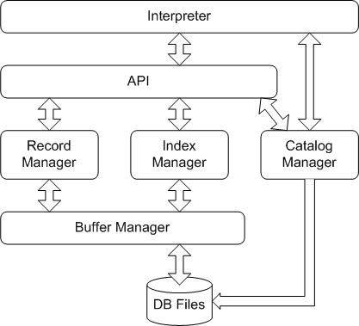
The architecture of MiniSQL
Query processor
Storage manager

Slide 7

1 Overview of Physical Storage Media
Classification of Physical Storage Media
The physical level of database: file storage (.mdf, .ldf, .ora, .dbf)
Storage media can be classified by
  Speed with which data can be accessed
  Cost per unit of data
  Reliability
    data loss on power failure or system crash
    physical failure of the storage device. (RAID)

Slide 8
1 Overview of Physical Storage Media
Storages classified by reliability:
  volatile storage: loses contents when power is switched off. E.g.: SDR, DDR2, DDR3, DDR4
  (SDR: Synchronous Dynamic RAM; DDR: Dual Date Rate SDRAM; DDR2 1.8v, DDR3 1.5v, DDR4 1.2v)
  non-volatile storage (非易失性存储器):
    Contents persist even when power is switched off.
    Includes secondary and tertiary storage, as well as batter-backed up main-memory.

Slide 9
1 Overview of Physical Storage Media
Storages classified by speed:
(a) Cache (高速缓冲存储器) - fastest and most costly form of storage; volatile; managed by the computer system hardware. ( ≤ 0.5 ns) size: ~ KB ~MB
(b) Main memory:
  fast access (1 to 50 of nanoseconds - ns;
  1 nanosecond = 10^{–9} seconds)
  generally too small (or too expensive) to store the entire database

Slide 10
1 Overview of Physical Storage Media
    capacities of up to a few Gigabytes
    (1GB=10⁹B) , widely used currently.
    Capacities have gone up and per-byte costs have decreased steadily and rapidly (roughly factor of 2 every 2 to 3 years)
    8GB (RMB 200 JD 20/04/2016)
  Volatile - contents of main memory are usually lost if a power failure or system crash occurs.

Slide 11
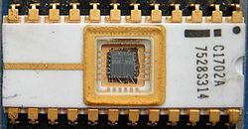
1 Overview of Physical Storage Media
(c) Flash memory (闪存)
  EPROM (Erasable Programmable Read-Only Memory)
  EEPROM (Electrically Erasable Programmable Read-Only Memory 电可擦可编程只读存储器)
  NOR Flash
  NAND Flash
  Data survives when power failure
  Data can be written at a location only once, but location can be erased and written to again
    Can support only a limited number of write/erase cycles (10⁴ - 10⁶).
    Erasing of memory has to be done to an entire bank of memory
    (固态硬盘并不能直接覆盖原来的数据，固态硬盘必须要把旧的数据先擦出然后才可以把新的数据写入。对于固态硬盘来说，垃圾回收是指把现存数据重新转移到其他闪存位置，并且把一些无用的数据彻底删除的过程。一块固态硬盘中的闪存可以被分为许多Block(块)，每个块又可以分成页面(pages)。数据可以直接以页面为单位写入，但是要想删除数据却需要以块为单位。因此要删除无用的数据，固态硬盘首先需 要把一个块内包含有用的数据先复制粘贴到全新的块中的页面内，这样原来块中包含的无用数据才能够以块为单位删除。删除后，才能够写入新的数据。)

Slide 12
1 Overview of Physical Storage Media
  Reads are roughly as fast as main memory (< 100ns)
  But writes are slow ( ~ 10µs), erase is slower.
  Cost per unit of storage roughly similar to main memory. (becoming more cheaper than main memory)
  Widely used in embedded devices such as digital cameras and smart phones.
  E.g. (64GB MicroSD RMB 80 JD 20/04/2016)
  MLC (multi-level cell) VS SLC (single-level cell) VS TLC (Triple-Level Cell)
  ONFI (Open NAND Flash Interface) VS Toggle DDR Nand Flash接口标准
  SSD (solid-state drive)
  Trim指令 (通过disable delete notify来关闭)

Slide 13
1 Overview of Physical Storage Media
(d) Magnetic-disk
  Data is stored on spinning disk, and read/written magnetically.
  Primary medium for the long-term storage of data; typically stores entire database.
  Data must be moved from disk to main memory for access, and written back for storage.
    Much slower access than main memory (more on this later)
  Direct-access - possible to read data on disk in any order, unlike magnetic tape.

Slide 14
1 Overview of Physical Storage Media
  Capacities range up to roughly 8T GB (2T per platter) currently (采用SMR技术，性能不如PMR)
    Much larger capacity and lower cost/byte than main memory/flash memory
    Growing constantly and rapidly with technology improvements (factor of 2 to 3 every 2 years) (如垂直记录技术大幅度提高了记录密度)
  Survives power failures and system crashes.
    Disk failure can destroy data, but is very rare
  E.g. (3TB RMB 570 JD 20/04/2016)

Slide 15
1 Overview of Physical Storage Media
(e) Optical storage
  non-volatile, data is read optically from a spinning disk using a laser
  CD-ROM (640 MB), DVD (4.7 to 17 GB) and Blu-ray (25 GB per layer, with dual layer discs (50 GB) being the industry standard for feature-length video discs. Triple layer discs (100 GB) and quadruple layers (128 GB) are available for BD-XL re-writer drives) are most popular forms
  Write-one, read-many (WORM) optical disks used for archival storage (CD-R, DVD-R, BD-R)
  Multiple write versions also available (CD-RW, DVD-RW, DVD-RAM, BD-RW)
  Reads and writes are slower than with magnetic disk.
  Juke-box (自动光盘机) systems, with large numbers of removable disks, a few drives, and a mechanism for automatic loading/unloading of disks available for storing large volumes of data

Slide 16
1 Overview of Physical Storage Media
(f) Tape storage
  non-volatile, used primarily for backup (to recover from disk failure), and for archival data
  sequential-access – much slower than disk
  very high capacity (40 TB level tapes available)
  tape can be removed from drive – storage costs much cheaper than disk, but drives are expensive
  Tape jukeboxes available for storing massive amounts of data
    hundreds of terabytes (TB, 1 terabyte = 10¹² bytes) to even a petabyte (PB, 1 petabyte = 10¹⁵ bytes)

Slide 17
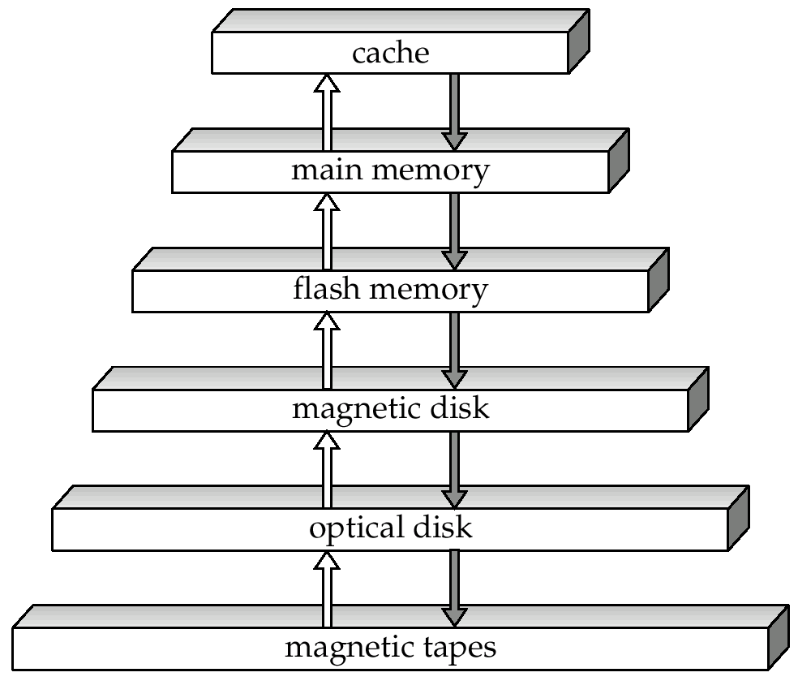
Storage Hierarchy
primary storage
(Fastest, Volatile)
secondary storage
高
小
↑
↑
(On-line )
Speed cost
Capacity
↓
↓
大
Non-volatile
低
tertiary storage
(Off-line )
The efficiency and resilience of a DBMS heavily depend on proper use of this hierarchy.
( Slowest )

Slide 18
Storage Hierarchy (Cont.)
primary storage: Fastest media but volatile (cache, main memory).
secondary storage (辅助存储器，联机存储器): next level in hierarchy, non-volatile, moderately fast access time
  also called on-line storage
  E.g. flash memory, magnetic disks
tertiary storage (三级存储器，脱机存储器): lowest level in hierarchy, non-volatile, slow access time
  also called off-line storage
  E.g. magnetic tape, optical storage

Slide 19
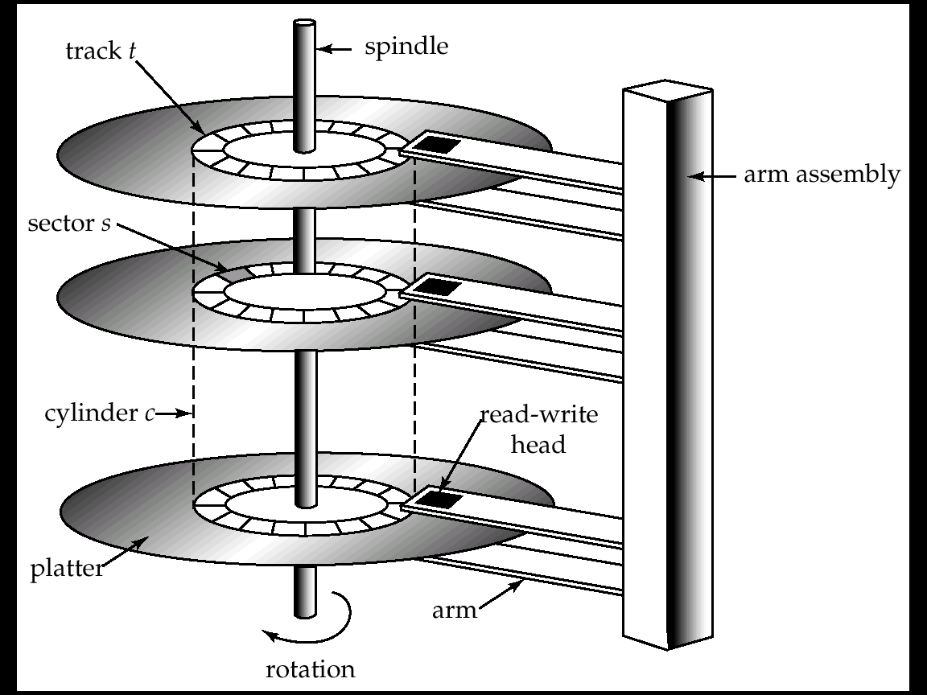
2 Magnetic Hard Disk Mechanism
NOTE: The diagram is schematic, and simplifies the structure of actual disk drives.

Slide 20
几万～几十万 tracks/ platter
几百～几万 sectors/track
The size of a sector is 512 Bytes (4KB in some new HDs)

Slide 21
(1) Magnetic Disks
Read-write head
  Positioned very close to the platter surface (almost touching it)
  Reads or writes magnetically encoded information.
Surface of platter divided into circular tracks
  Over 16,000 tracks per platter on typical hard disks
Each track is divided into sectors.
  A sector is the smallest unit of data that can be read or written.
  Sector size typically 512 bytes
  Typical sectors per track: 1000 (on inner tracks) to 20000 (on outer tracks)
  ≥ 500KB per track, ≥ 500GB per platter

Slide 22
(1) Magnetic Disks (cont.)
To read/write a sector
  disk arm swings to position head on right track
  platter spins continually; data is read/written as sector passes under head
Head-disk assemblies
  multiple disk platters on a single spindle (typically 1 to 4 platters)
  Two heads per platter, mounted on a common arm.
Cylinder i consists of i ^{th} track of all the platters

Slide 23
(1) Magnetic Disks (cont.)
Disk controller – interfaces between the computer system and the disk drive hardware.
  Accepts high-level commands to read or write a sector
  Initiates actions such as moving the disk arm to the right track and actually reading or writing the data
  Computes and attaches checksums (校验和) to each sector to verify that data is read back correctly
    If data is corrupted, with very high probability stored checksum won’t match recomputed checksum
  Ensures successful writing by reading back sector after writing it
  Performs remapping of bad sectors (坏扇区的重映射：将该扇区映射到预留的物理扇区，并且重映射被记录在磁盘或其他非易失性存储器中)

Slide 24
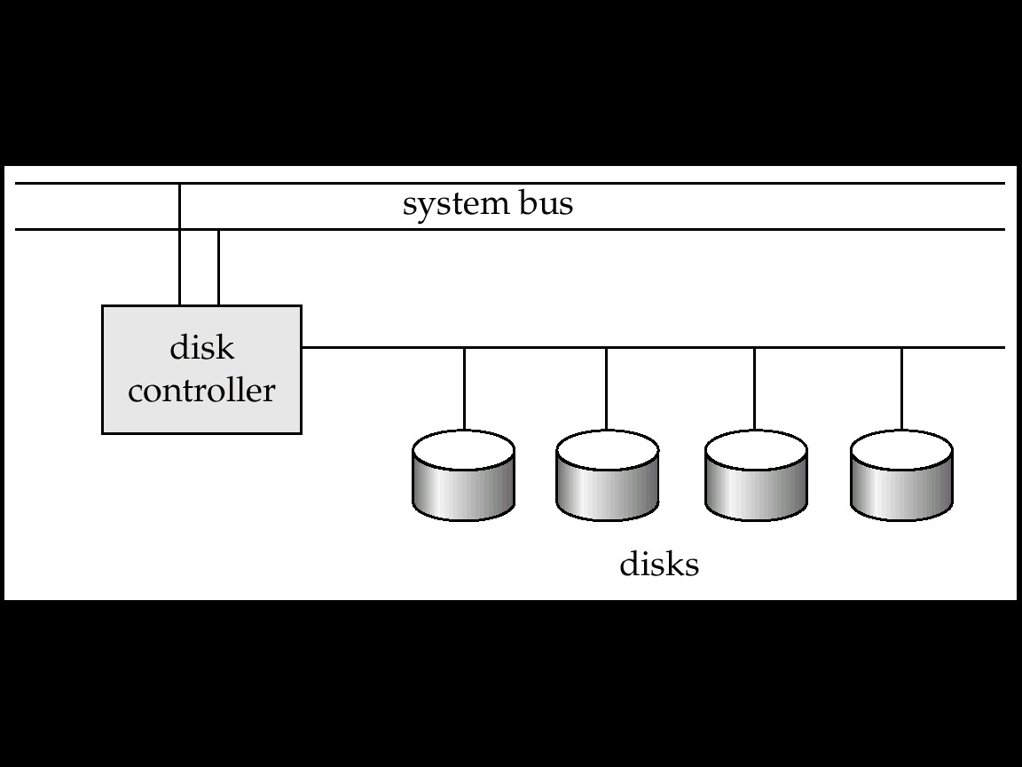
(2) Disk Subsystem

Slide 25
(2) Disk Subsystem
Disk interface standards families
  ATA (AT adaptor) range of standards, faster version of IDE (Integrated drive electronics), SATA
  SCSI (Small Computer System Interconnect) range of standards, SAS
  Several variants of each standard (different speeds and capabilities)
    RAID: Redundant Arrays of Independent Disks
    SAN: Storage Area Network
      FC: Fibre Channel interface
      iSCSI: Internet Small Computer System Interface

Slide 26
(3) Performance Measures of Disks
Access time – the time it takes from when a read or write request is issued to when data transfer begins = Seek time (寻道时间) + Rotational latency (旋转等待时间)
  Seek time – time it takes to reposition the arm over the correct track.
    4 to 10 milliseconds on typical disks
Seek time
Read-write head
Rotational latency time

Slide 27
(3) Performance Measures of Disks
  Rotational latency time – (旋转等待(潜伏)时间) it takes for the sector to be accessed to appear under the head.
    Average latency is 1/2 of the worst case latency.
    4 to 11 milliseconds on typical disks (5400 to 15000 r.p.m.)
Data-transfer rate – the rate at which data can be retrieved from or stored to the disk.
  Depends on rotational rate and disk interface,……
  100MB per second is typical.
  Multiple disks may share a controller, so the rate that controller can handle is also important
    E.g. SATA 1: 1.5Gbit/s; SATA 2: 3Gbit/s; SATA 3: 6Gbit/s

Slide 28
Example
IBM Deskstar 14GPX (10.1 GB capacity)
  3.5 INCH， 7200R/minute
  容量14.4GB，含5张双面盘片， 每张约3.35GB
  平均寻道时间 9.1 ms
    相邻磁道寻道时间 2.2 ms
    最大寻道时间15.5 ms
  平均旋转等待时间 4.17 ms
  数据传输速率 13MB/s (≈610ns/B)。故磁盘读写主要是寻道时间和旋转等待时间，相比之下数据传输 (真正的读写)时间可略(0.3ms/sector)
  故磁盘存取时间 >10 ms，
  而内存的存取时间 ≈ 10 ns
Many problems are derived from this fact!
相差≈ 100万倍

Slide 29


Example: Megatron 747 (vintage 2008)
3.5吋（直径），含有8个盘片，16个盘面；每个盘面有65536个磁道；
每个磁道平均256扇区；每个扇区4096字节。
最大容量=16*65536*256*4096=1000GB=1TB
转速7200转/分，即旋转一圈8.33ms；故旋转等待时间最小=0ms，最大8.33ms, 平均4.17ms
磁头相邻磁道启、停需1ms；每移动4000磁道另加1ms。故最小寻道时间=0，最大寻道时间=1+65536/4000=17.38ms，平均寻道6.46ms
传输时间：每扇区=8.33ms/256 =0.03ms
磁盘存取1扇区时间，最长=17.38+8.33+0.03=25.74ms，最短=0+0+0.03ms=0.03ms，平均≦ 6.45+4.17+0.03=10.66ms
Megatron VS Magneto

Slide 30
希捷ST318203LC的规格：
3.5英寸，18.2GB, 80-pin Ultra-2 SCSI，Spindle speed:10016 RPM
盘片数：6，磁头数：12，总柱面数：9801，总磁道数：117612
每扇区字节数：512，磁道密度：12580/英寸，记录密度：258048位/英寸
平均寻道时间：5.7毫秒（读），6.5毫秒（写）
道间寻道时间：0.7毫秒（典型情况）
全盘寻道时间：12毫秒（典型情况）
内部传输速度：193Mbits/sec ~ 308Mbits/sec
格式化整数传输速度：18Mbits/sec ~ 80Mbits/sec
外部( I/O )传输速度：80Mbits/sec
错误率：1 per 10¹⁵ bits read

Slide 31
日立 2TB SATA2 32M(HDS722020ALA330)
容量：2000GB
接口标准：S-ATA II
盘体尺寸：3.5寸
转速：7200rpm
缓存容量：32M
平均寻道时间：8.2ms
单碟容量：400G
最大内部数据传输率:1700Mbps

Slide 32
Performance Measures (cont.)
Mean time to failure (MTTF, 平均故障时间) – the average time the disk is expected to run continuously without any failure.
  Typically 3 to 5 years
  Probability of failure of new disks is quite low, corresponding to a “theoretical MTTF” of 30,000 to 1,200,000 hours for a new disk

Slide 33
(4) Optimization of Disk-Block Access
(a) Block – a contiguous sequence of sectors from a single track
  data is transferred between disk and main memory in blocks.
  sizes range from 512 bytes to several kilobytes
    Smaller blocks: more transfers from disk
    Larger blocks: more space wasted due to partially filled blocks
  Typical block sizes today range from 4 to 16 kilobytes/Block

Slide 34
(4) Optimization of Disk-Block Access
(b) Disk-arm-scheduling algorithms (磁盘臂调度算法) order pending accesses to tracks so that disk arm movement is minimized. Eg.: ( 1, 6, 3, 5, 2, 4) → ( 1, 2, 3, 4, 5, 6 )
  elevator algorithm (电梯算法): move disk arm in one direction (from outer to inner tracks or vice versa), processing next request in that direction, till no more requests in that direction, then reverse direction and repeat.

Slide 35
Optimization of Disk Block Access (cont.)
(c) File organization – optimize block access time by organizing the blocks to correspond to how data will be accessed. E.g:
  1) Store related information on the same or nearby cylinders.
  2) Files may get fragmented over time：
    E.g. if data is inserted to/deleted from the file
    Or free blocks on disk are scattered, and newly created file has its blocks scattered over the disk
    Sequential access to a fragmented file results in increased disk arm movement
  ∴ Some systems have utilities to defragment the file system, in order to speed up file access
    But the system is generally unusable when these utilities are running.

Slide 36
Optimization of Disk Block Access (cont.)
(d) Nonvolatile write buffers (非易失性写缓冲区): speed up disk writes by writing blocks to a non-volatile RAM buffer immediately
  Non-volatile RAM: battery backed up RAM or flash memory
    Even if power fails, the data is safe and will be written to disk when power returns
  Controller then writes to disk whenever the disk has no other requests or request has been pending for some time
  Then writes can be reordered to minimize disk arm movement

Slide 37
Optimization of Disk Block Access (cont.)
(e) Log disk (日志盘) – a disk devoted to writing a sequential log of block updates
  Used exactly like nonvolatile RAM
    Write to log disk is very fast since no seeks are required
    No need for special hardware (unlike NV-RAM)
  File systems typically reorder writes to disk to improve performance
  Journaling file systems write data in safe order to NV-RAM or log disk

Slide 38
3 *RAID
RAID: Redundant Arrays of Independent Disks (独立磁盘冗余阵列)
  disk organization techniques that manage a large numbers of disks, providing a view of a single disk of
    high capacity and high speed by using multiple disks in parallel, and
    high reliability by storing data redundantly, so that data can be recovered even if a disk fails
The chance that some disk out of a set of N disks will fail is much higher than the chance that a specific single disk will fail.
  E.g., a system with 100 disks, each with MTTF of 100,000 hours (approx. 11 years), will have a system MTTF of 1000 hours (approx. 41 days)
  Techniques for using redundancy to avoid data loss are critical with large numbers of disks
Originally a cost-effective alternative to large, expensive disks
  I in RAID originally stood for ``inexpensive’’
  Today RAIDs are used for their higher reliability and bandwidth.
    The “I” is interpreted as independent
RAID技术从二个方面改善系统性能：冗余---可靠性、并行性---速度

Slide 39
(1) Improvement of Reliability via Redundancy
Redundancy – store extra information that can be used to rebuild information lost in a disk failure
E.g., Mirroring (or shadowing)
  Duplicate every disk. Logical disk consists of two physical disks.
  Every write is carried out on both disks
    Reads can take place from either disk
  If one disk in a pair fails, data still available in the other
    Data loss would occur only if a disk fails, and its mirror disk also fails before the system is repaired
      Probability of combined event is very small
        Except for dependent failure modes such as fire or building collapse or electrical power surges
Mean time to data loss depends on mean time to failure,
and mean time to repair
  E.g. MTTF of 100,000 hours, mean time to repair of 10 hours gives mean time to data loss of 500x10⁶ hours (=100000²/(2x10)= 57,000 years) for a mirrored pair of disks (ignoring dependent failure modes)

Slide 40
(2) Improvement in Performance via Parallelism
Two main goals of parallelism in a disk system:
  1. Load balance multiple small accesses to increase throughput
  2. Parallelize large accesses to reduce response time.
Improve transfer rate by striping data across multiple disks.
Bit-level striping (比特级拆分)– split the bits of each byte across multiple disks
  In an array of eight disks, write bit i of each byte to disk i.
  Each access can read data at eight times the rate of a single disk.
  But seek/access time worse than for a single disk
    Bit level striping is not used much any more
Block-level striping (块级拆分) – with n disks, block i of a file goes to disk (i mod n) + 1
  Requests for different blocks can run in parallel if the blocks reside on different disks
  A request for a long sequence of blocks can utilize all disks in parallel

Slide 41

(3) RAID Levels
Schemes to provide redundancy at lower cost by using disk striping combined with parity bits
  Different RAID organizations, or RAID levels, have differing cost, performance and reliability characteristics
RAID Level 0: Block striping; non-redundant.
  Used in high-performance applications where data lost is not critical.
RAID Level 1: Mirrored disks with block striping
  Offers best write performance.
  Popular for applications such as storing log files in a database system.
Block striping

Slide 42
RAID Levels (cont.)
RAID Level 2: Memory-Style Error-Correcting-Codes (ECC) with bit striping.
RAID Level 3: Bit-Interleaved Parity
  a single parity bit is enough for error correction, not just detection, since we know which disk has failed
    When writing data, corresponding parity bits must also be computed and written to a parity bit disk
    To recover data in a damaged disk, compute XOR of bits from other disks (including parity bit disk)
内存风格纠错码
bit striping
位交叉奇偶校验

Slide 43
RAID Levels (cont.)
RAID Level 3 (Cont.)
  Faster data transfer than with a single disk, but fewer I/Os per second since every disk has to participate in every I/O.
  Subsumes Level 2 (provides all its benefits, at lower cost).
RAID Level 4: Block-Interleaved Parity; uses block-level striping, and keeps a parity block on a separate disk for corresponding blocks from N other disks.
  When writing data block, corresponding block of parity bits must also be computed and written to parity disk
  To find value of a damaged block, compute XOR of bits from corresponding blocks (including parity block) from other disks.
块交叉奇偶校验

Slide 44
RAID Levels (cont.)
RAID Level 4 (Cont.)
  Provides higher I/O rates for independent block reads than Level 3
    block read goes to a single disk, so blocks stored on different disks can be read in parallel
  Provides high transfer rates for reads of multiple blocks than no-striping
  Before writing a block, parity data must be computed
    Can be done by using old parity block, old value of current block and new value of current block (2 block reads + 2 block writes)
    Or by recomputing the parity value using the new values of blocks corresponding to the parity block
      More efficient for writing large amounts of data sequentially
  Parity block becomes a bottleneck for independent block writes since every block write also writes to parity disk

Slide 45
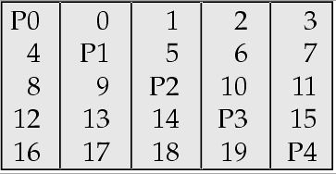
RAID Levels (cont.)
RAID Level 5: Block-Interleaved Distributed Parity; partitions data and parity among all N + 1 disks, rather than storing data in N disks and parity in 1 disk.
  E.g., with 5 disks, parity block for nth set of blocks is stored on disk (n mod 5) + 1, with the data blocks stored on the other 4 disks.
块交叉分布奇偶校验

Slide 46
RAID Levels (cont.)
RAID Level 5 (Cont.)
  Higher I/O rates than Level 4.
    Block writes occur in parallel if the blocks and their parity blocks are on different disks.
  Subsumes Level 4: provides same benefits, but avoids bottleneck of parity disk.
RAID Level 6: P+Q Redundancy scheme; similar to Level 5, but stores extra redundant information to guard against multiple disk failures.
  Better reliability than Level 5 at a higher cost; not used as widely.

Slide 47
(3) Choice of RAID Level
Factors in choosing RAID level
  Monetary cost
  Performance: Number of I/O operations per second, and bandwidth during normal operation
  Performance during failure
  Performance during rebuild of failed disk
    Including time taken to rebuild failed disk
RAID 0 is used only when data safety is not important
  E.g. data can be recovered quickly from other sources
Level 2 and 4 never used since they are subsumed by 3 and 5
Level 3 is not used anymore since bit-striping forces single block reads to access all disks, wasting disk arm movement, which block striping (level 5) avoids
Level 6 is rarely used since levels 1 and 5 offer adequate safety for almost all applications
So competition is between 1 and 5 only

Slide 48
Choice of RAID Level (cont.)
Level 1 provides much better write performance than level 5
  Level 5 requires at least 2 block reads and 2 block writes to write a single block, whereas Level 1 only requires 2 block writes
  Level 1 preferred for high update environments such as log disks
Level 1 had higher storage cost than level 5
  disk drive capacities increasing rapidly (50%/year) whereas disk access times have decreased much less (x 3 in 10 years)

Slide 49
Choice of RAID Level (cont.)
  I/O requirements have increased greatly, e.g. for Web servers
  When enough disks have been bought to satisfy required rate of I/O, they often have spare storage capacity
    so there is often no extra monetary cost for Level 1!
Level 5 is preferred for applications with low update rate, and large amounts of data.
Level 1 is preferred for all other applications.

Slide 50
(4) Hardware Issues
Software RAID: RAID implementations done entirely in software, with no special hardware support
Hardware RAID: RAID implementations with special hardware
  Use non-volatile RAM to record writes that are being executed
  Beware: power failure during write can result in corrupted disk
    E.g. failure after writing one block but before writing the second in a mirrored system
    Such corrupted data must be detected when power is restored
      Recovery from corruption is similar to recovery from failed disk
      NV-RAM helps to efficiently detected potentially corrupted blocks
        Otherwise all blocks of disk must be read and compared with mirror/parity block

Slide 51
Hardware Issues (cont.)
Hot swapping (热插拔) replacement of disk while system is running, without power down
  Supported by some hardware RAID systems,
  reduces time to recovery, and improves availability greatly
Many systems maintain spare disks (备盘) which are kept online, and used as replacements for failed disks immediately on detection of failure
  Reduces time to recovery greatly
Many hardware RAID systems ensure that a single point of failure will not stop the functioning of the system by using
  Redundant power supplies with battery backup
  Multiple controllers and multiple interconnections to guard against controller/interconnection failures

Slide 52
4 File Organization (文件组织)
--- 定长记录和不定长记录的组织
The database is stored as a collection of files.
Each file is a sequence of records.
A record is a sequence of fields.
Two kinds of record:
  Fixed-length records.
  Variable-length records.

Slide 53
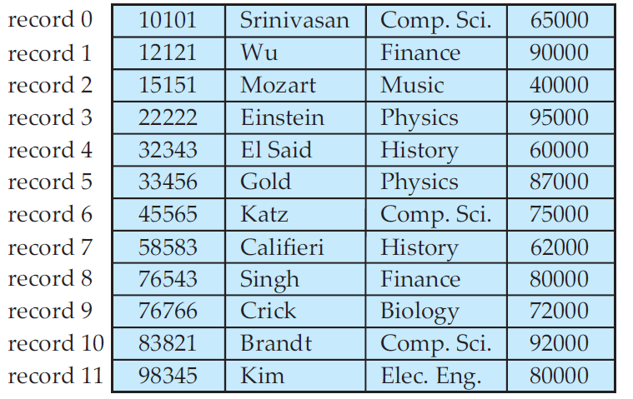
(1) Fixed-Length Records
advantages---Simple approach:
  Stores record i starting from byte n ∗ (i – 1), where n is the size of each record.
  Record access is simple but records may cross blocks
    Modification: do not allow records to cross block boundaries
Deletion of record i :
alternatives:
  方法1：move records i + 1, . . ., n
  to i, . . . , n – 1
  方法2：move record n to i
  方法3：do not move records, but
  link all free records on a
  free list. (See next page)

Slide 54

Free Lists
Store the address of the first deleted record in the file header (还有其他信息).
Use this first record to store the address of the second deleted record, and so on
Can think of these stored addresses as pointers since they “point” to the location of a record.
Advantage: more space efficient representation: reuse space for normal attributes of free records to store pointers. (No pointers stored in in-use records.)
Insertion
we use the record pointed to by the header. We change the header pointer to point to the next available record. If no space is available, we add the new record to the end of the file.
Link for free list

Slide 55

(2) Variable-Length Records
Variable-length records arise in database systems in several ways:
  Record types that allow variable lengths for one or more fields (e.g. varchar).
  Storage of multiple record types in a file.
  Record types that allow repeating fields (used in some older data models).
Attributes are stored in order
Variable length attributes represented by fixed size (offset, length), with actual data stored after all fixed length attributes
Null values represented by null-value bitmap

Slide 56
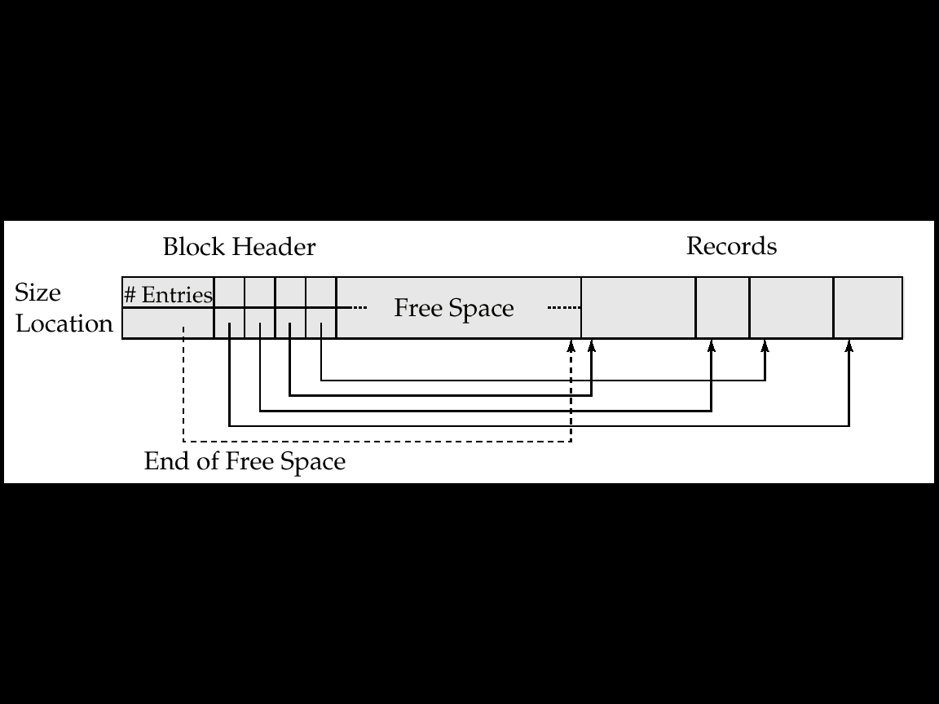
(2.a) Variable-Length Records
---by Slotted Page Structure (分槽的页结构)
page
1 2 3 4
#3
#2
#4
#1
4
Slotted page header contains:
  number of record entries
  end of free space in the block
  location and size of each record
Records can be moved around within a page to keep them contiguous with no empty space between them; entry in the header must be updated. (页内无碎块---删除时页内移动记录)
Pointers (Index) should not point directly to record — instead they should point to the entry for the record in header---indirect pointer (间接指针)
记录长度
记录指针
a record entry
rid= < slot# pid >

Slide 57
(2.a) Variable-Length Records---by Slotted Page Structure
To delete record #2
1 2 3 4
#3
#2
#4
#1
4
-1
1 2 3 4
#3
#4
#1
3
-1

Slide 58
860
1023
#1
#2
960
1023
2 | 859 | 64 | 960 | 100 | 860 | …
Record#2
Record#1
Assume the page size is 1024B. Two records are put into the page, record#1 is 64B, record#2 is 100B. Do the following:
Insert a new record with size 64B.
Delete the record#1 from the page.
Insert a new record with size 72B.

Slide 59
5 Organization of Records in Files
(文件中记录的组织---关于存放次序)
So far, we have studied how records are represented in a file structure. A relation is a set of records. Given a set of records, the next question is how to organize them in a file.
Heap file (堆文件, 流水文件) – a record can be placed anywhere in the file where there is space
Sequential file (顺序文件) – store records in sequential order, based on the value of a search key of each record
Hashing file (散列文件) – a hash function computed on some attribute of each record; the result specifies in which block of the file the record should be placed
clustering file organization (聚集文件组织) – records of several different relations can be stored in the same file
  Motivation: store related records in different relations on the same block to minimize I/O

Slide 60
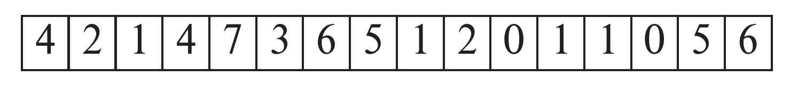
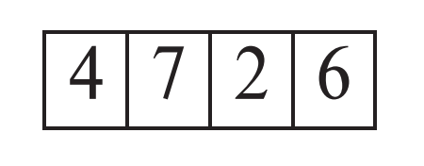
(1) Heap File Organization
Records can be placed anywhere in the file where there is free space
Records usually do not move once allocated
Important to be able to efficiently find free space within file
Free-space map
  Array with 1 entry per block. Each entry is a few bits to a byte, and records fraction of block that is free
  In example below, 3 bits per block, value divided by 8 indicates fraction of block that is free
  Can have second-level free-space map
  In example below, each entry stores maximum from 4 entries of first-level free-space map
Free space map written to disk periodically, OK to have wrong (old) values for some entries (will be detected and fixed)

Slide 61

(2) Sequential File Organization
Suitable for applications that require sequential processing of the entire file
The records in the file are ordered by a search-key
ID name dept_name salary
Search key： ID

Slide 62

Sequential File Organization (cont.)
Deletion – use pointer chains
Insertion – locate the position where the record is to be inserted
  if there is free space insert there
  if no free space, insert the record in an overflow block
  In either case, pointer chain must be updated
Need to reorganize the file
from time to time to restore
sequential order.
(需要定期对文件重新排序)

Slide 63

(3) Clustering File Organization
Simple file structure: stores each relation in a separate file
Can instead store several relations in one file using a clustering file organization
E.g., clustering organization of department and instructor:
Department
Instructor
Department
Instructor
  Good for queries involving department instructor, and for queries involving one single customer and his accounts.
  Bad for queries involving only customer
  Results in variable size records

Slide 64
6 Data Dictionary Storage
Data dictionary (also called system catalog) stores metadata: that is, data about data, such as:
1) Information about relations
  names of relations
  names and types of attributes of each relation
  names and definitions of views
  integrity constraints
2) User and accounting information, including passwords
3) Statistical and descriptive data
  number of tuples in each relation
4) Physical file organization information
  How relation is stored (sequential/hash/…)
  Physical location of relation
    operating system file name or
    disk addresses of blocks containing records of the relation
5) Information about indices (Chapter 12)

Slide 65
Data Dictionary Storage (Cont.)
Catalog structure: can use either
  1) specialized data structures designed for efficient access
  2) a set of relations, with existing system features used to ensure efficient access
  The latter alternative is usually preferred
A possible catalog representation:
Relation-metadata = (relation-name, number-of-attributes,
storage-organization, location)
Attribute-metadata = (attribute-name, relation-name, domain-type,
position, length)
User-metadata = (user-name, encrypted-password, group)
Index-metadata = (index-name, relation-name, index-type,
index-attributes)
View-metadata = (view-name, definition)

Slide 66
7 Data Buffer (数据缓冲)
Magnetic DISK
CPU Cache
RAM Buffer
blocks
≈ 0. 2 ns
≈ 10 ns
Buffer manager
≈ 10 ms
A database file is logically partitioned into fixed-length storage units called blocks. Blocks are units of both storage allocation and data transfer in database system.
Buffer – portion of main memory available to store copies of disk blocks.
Database system seeks to minimize the number of block transfers between the disk and memory.
  To reduce the number of disk accesses: keeping as many blocks as possible in main memory.
  But buffer is limited in size. How to do with?
Buffer manager – subsystem responsible for allocating buffer space in main memory.

Slide 67
Page Requests from Higher Levels
BUFFER POOL
data page
free frame
MAIN MEMORY
choice of frame dictated
by replacement policy
DISK
DB
Data must be in RAM for DBMS to operate on it!
Table of <frame#, pageid> pairs is maintained.
Page: a unit of data; Block: a unit of disk space; Frame: a unit of buffer pool; in practice block ≈ page

Slide 68
Page Requests from Higher Levels
Dirty block
Dirty bit=1
BUFFER POOL
data page
pinned block
pin count ≠0
MAIN MEMORY
choice of frame dictated
by replacement policy
DISK
DB

Slide 69
(1) Buffer Manager
Application programs call on the buffer manager when they need a block from disk.
  If the block is already in the buffer, the requesting program is given the address of the block in main memory
  If the block is not in the buffer,
    1) The buffer manager allocates free space in the buffer for the block, replacing (throwing out) some old pages, if no free spaces, to make space for the new block. (在buffer中为新页分配空间)
    2) The block that is thrown out is written back to disk only if it was modified since the most recent time that it was written to/fetched from the disk. (将被覆盖的旧块若已被修改过，则写回磁盘)
    3) Once space is allocated in the buffer, the buffer manager reads the block from the disk to the buffer, and passes the address of the block in main memory to requester. (从磁盘读入新块放buffer)

Slide 70
(1) Buffer Manager (cont.)
Pinned block (被钉住的块)– memory block that is not allowed to be written back to disk. (如当前块正在被使用时)
  Page in pool may be requested many times (被多个事务使用),
    a pin count is used. A page is a candidate for replacement iff pin count = 0.
Toss-immediate strategy – frees the space occupied by a block as soon as the final tuple of that block has been processed. (用后立即丢弃)
Forced output of blocks.
  Requestor of block must unpin it, and indicate whether page has been modified:
    dirty bit is used for this.
Buffer-Replacement Policies: LRU (最近最少使用), MRU (最近最常使用)

Slide 71
(2) Buffer-Replacement Policies
当Buffer的空闲区不够，不能容下新读入的Block时，需要将Buffer中原有Block覆盖（替换）。主要策略：
LRU strategy (Least Recently Used, 最近最少使用): Replace the block which was least recently used.
  Idea behind LRU – use past pattern of block references as a predictor for future references.
  Queries have well-defined access patterns, and a database system can use the information in a user’s query to predict future references

Slide 72
(2) Buffer-Replacement Policies (cont.)
  But LRU can be a bad strategy for certain access patterns involving repeated scans of data.
  E.g.
  设 M=5 (buffer has 5 blocks), 1 for borr. , 3 for cust. ,1 for out
  对customer，LRU的块可能是下面快要用的块(循环)，而最近刚用过的块暂时不用，当空间不够时倒是可以将其覆盖的, 故LRU策略不佳。
department
instructor
department instructor

Slide 73
Buffer-Replacement Policies (cont.)
MRU strategy (Most recently used，最近最常使用) – system must pin the block currently being processed. After the final tuple of that block has been processed, the block is unpinned, and it becomes the most recently used block.

Slide 74
Buffer-Replacement Policies (cont.)
Buffer manager can use statistical information regarding the probability that a request will reference a particular relation
  E.g., the data dictionary is frequently accessed. Heuristic: keep data-dictionary blocks in main memory buffer.
Buffer manager also support forced output of blocks for the purpose of recovery (more in Chapter 17)
Mixed strategy with hints on replacement strategy provided by the query optimizer and concurrency-control subsystem is preferable.

Slide 75
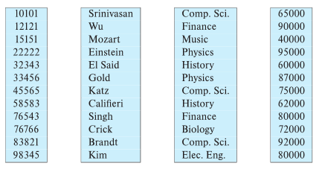
8 Column-Oriented Storage
Also known as columnar representation
Store each attribute of a relation separately
Example

Slide 76
8 Column-Oriented Storage (cont.)
Benefits:
  Reduced IO if only some attributes are accessed
  Improved CPU cache performance
  Improved compression
  Vector processing on modern CPU architectures
Drawbacks:
  Cost of tuple reconstruction from columnar representation
  Cost of tuple deletion and update
  Cost of decompression
Columnar representation found to be more efficient for decision support than row-oriented representation
Traditional row-oriented representation preferable for transaction processing
Some databases support both representations
  Called hybrid row/column stores

Slide 77
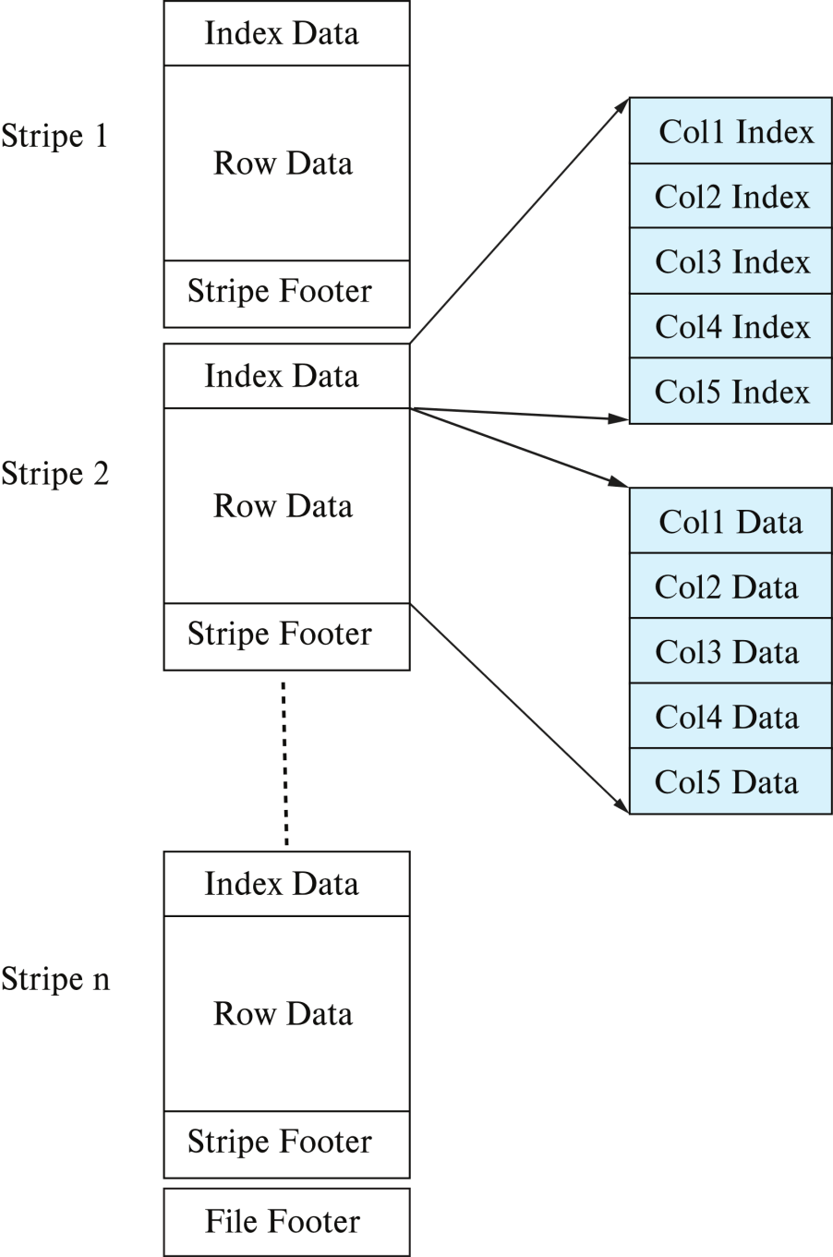
8 Column-Oriented Storage (cont.)
ORC and Parquet: file formats with columnar storage inside file
Very popular for big-data applications
ORC file format shown on right:
A sequence of tuples occupying several hundred megabytes is broken up into a columnar representation called a stripe. An ORC file contains several such stripes, with each stripe occupying around 250 megabytes
The index data region of a stripe stores for each attribute the starting point within the stripe for each group of (say) 10,000 values of that attribute

Slide 78
References:
Microsoft SQL Server 2008 Internals
By Kalen Delaney
The Storage Engine (In Chapter 1)

Slide 79
End of Chapter
Exercise：7th Edition 13.1, 13.7, 13.11

