Slide 1

Chapter 15: Query Processing
Overview
Measures of Query Cost
Selection Operation
Sorting
Join Operation
*Other Operations
Evaluation of Expressions

Slide 2

1 Basic Steps in Query Processing
1. Parsing and translation
2. Optimization
3. Evaluation

Slide 3

Basic Steps in Query Processing (cont.)
Parsing and translation (语法分析与翻译) vs. compiler
  Parser checks syntax, verifies relations
  translate the query into its internal form--- extended relational algebra (ERA).
Evaluation
  The query-execution engine takes a query-evaluation plan, executes that plan, and returns the answers to the query.
parser
SQL programs
Parser-tree
Internal form--ERA

Slide 4
Basic Steps in Query Processing (cont.)
Optimization ------- why ?
  (1) For a given SQL query, may have many equivalent relational algebra expressions .
    E.g., σ_{salary<75000}(∏_{salary}(instructor)) is equivalent to
    ∏_{salary}(σ_{salary<75000}(instructor))
  (2) Each relational algebra operation can be evaluated using one of several different algorithms.
    E.g., For above (b), how to do the σ operation, use linear scan, or index?
  Correspondingly, a relational-algebra expression can be evaluated in many ways.

Slide 5
Basic Steps in Query Processing: Optimization (cont.)
Optimization ------- how ?
  (1) Find out various equivalent relational algebra expressions. (Chap. 16)
  (2) A sequence of primitive operations which specify detailed evaluation strategy is called a query-execution plan or query-evaluation plan .
E.g. 1:
(1) use an index on salary to find instructors with salary < 75000,
∏_{salary}
︱
σ_{salary>75000,} using index 1
︱
instructors
Query-execution plan

Slide 6

E.g. 2:
∏_{name,title} ( σ_{dept_name=‘Music} (instructor course teacher )
Some equivalent relational algebra expressions
(Partial query-execution plan)

Slide 7
Basic Steps: Optimization (cont.)
  (3) Query Optimization: Among all equivalent evaluation plans choose the one with lowest cost. Two factors are considered for cost:
    Cost is dependent on the algorithms of the executions.
    Cost is also estimated using statistical information from the database catalog.
      e.g. number of tuples in each relation, size of tuples, etc.

Slide 8
Basic Steps: Optimization (cont.)
In this chapter we study
  How to measure query costs:
    Algorithms for evaluating relational algebra operations: select, sort, join
    How to combine algorithms for individual operations in order to evaluate a complete expression
In the chapter of Query Optimization
  We study how to optimize queries, that is, how to find an evaluation plan with lowest estimated cost

Slide 9

2 Measures of Query Cost
Cost is generally measured as total elapsed time for answering query.
  Many factors contribute to time cost
    disk accesses ＋ CPU ＋ network communication
Typically disk access is the predominant cost, and is relatively easy to estimate. Measured by taking into account:
  Number of seek operations performed
  Number of blocks read × average-block-read-cost
  Number of blocks written × average-block-write-cost
    Cost to write a block is greater than cost to read a block (data is read back after being written to ensure that the write was successful)

Slide 10

Measures of Query Cost (cont.)
For simplicity, we just use the number of block transfers from disk and the number of seeks as the cost measures:
  t_{T} – time to transfer one block. (≈ 0.1ms)
  t_{S} – time for one seek. (≈ 4ms)
  Cost for b block transfers plus S seeks
  b * t_{T} + S * t_{S}
We ignore CPU costs for simplicity.
  But real systems do take CPU cost into account
We do not include cost to writing the final result back to disk in our cost formulae.

Slide 11
Measures of Query Cost (cont.)
Costs depends on the size of the buffer in main memory
  Having more memory, reduces need for disk access
  Amount of real memory available to buffer depends on other concurrent OS processes, and hard to determine ahead of actual execution
  So we often use the worst case estimates, assuming only the minimum amount of memory needed for the operation is available, and the best case estimates.
  Required data may be buffer resident already, avoiding disk I/O. But hard to take into account for cost estimation

Slide 12
3 Selection Operation
(1) basic algorithms
File scan – search algorithms that locate and retrieve records that fulfill a selection condition, do not use index. + 1 seek
  Algorithm A1 (linear search线性搜索). Scan each file block and test all records (tuples) to see whether they satisfy the selection condition.
    Cost estimate = 1 seek + b_{r} block transfers
      b_{r} denotes number of blocks in the file for relation r
    If selection is on a key attribute,
    cost = 1 seek + (b_{r} /2)block transfers
    Linear search can be applied regardless of
      selection condition or
      ordering of records in the file, or
      availability of indices
Note: binary search generally does not make sense since data is not stored consecutively
  except when there is an index available,
  and binary search requires more seeks than index search
Notes:
∵ key attribute no duplicate

Slide 13
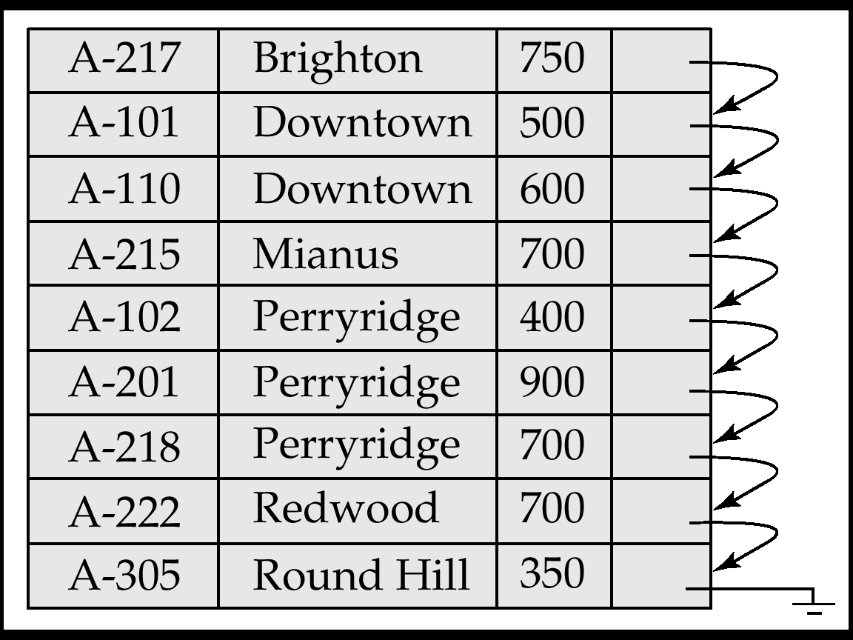
account(account_number, branch_name, balance)
Assume: account is sequentially ordered on search-key branch_name.
Select * from account where branch_name = ‘Downtown’; May return 100 tuples.

Slide 14
(2) Selections Using Indices and Equality
Index scan – search algorithms that use a B⁺ index. Selection condition must be on search-key of index.
  A2 (primary index on candidate key, equality, 利用主索引，码属性的等值比较). Retrieve a single record that satisfies the corresponding equality condition
    Cost = (H_{i} + 1)* (t_{S} + t_{T}), 其中H_{i} 为索引树高
  A3 (primary index on non-candidate key, equality, 主索引,非码属性的等值比较). Retrieve multiple records. --- duplicate
    Records will be on consecutive blocks
    Cost = H_{i} * (t_{T} + t_{S}) + t_{S} + t_{T} * b ,
    b containing retrieved records
= ⎡sc(A, r) / f_{r}⎤

Slide 15
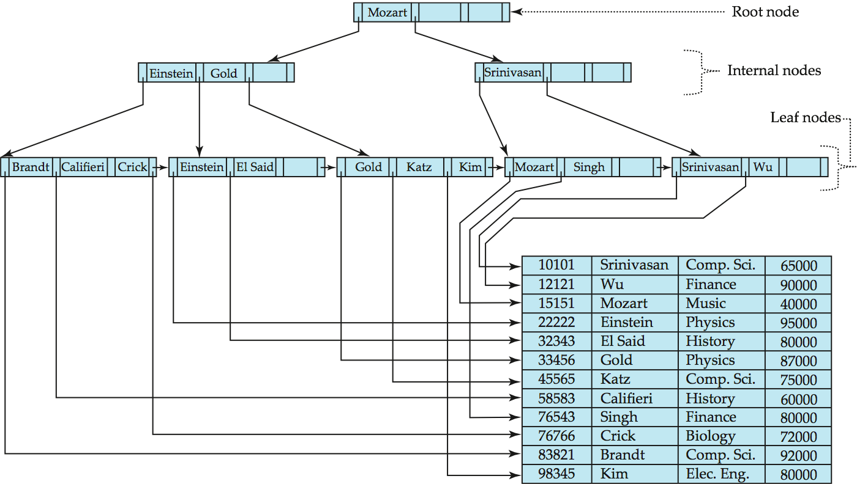

Slide 16
(2) Selections Using Indices and Equality (cont.)
  A4 (equality on search-key of secondary index,利用辅助索引的等值比较 )
    (1) Retrieve a single record if the search-key is a candidate key:
    Cost = (h_{i} + 1) * (t_{T} + t_{S})
    (2) Retrieve multiple records if search-key is not a candidate key:
      each of n matching records may be on a different block
        Cost = h_{i} * (t_{T} +t_{S})+ n* (t_{T} + t_{S})= (h_{i} + n) * (t_{T} + t_{S})
        Can be very expensive!
        May be more worse than linear scan.

Slide 17
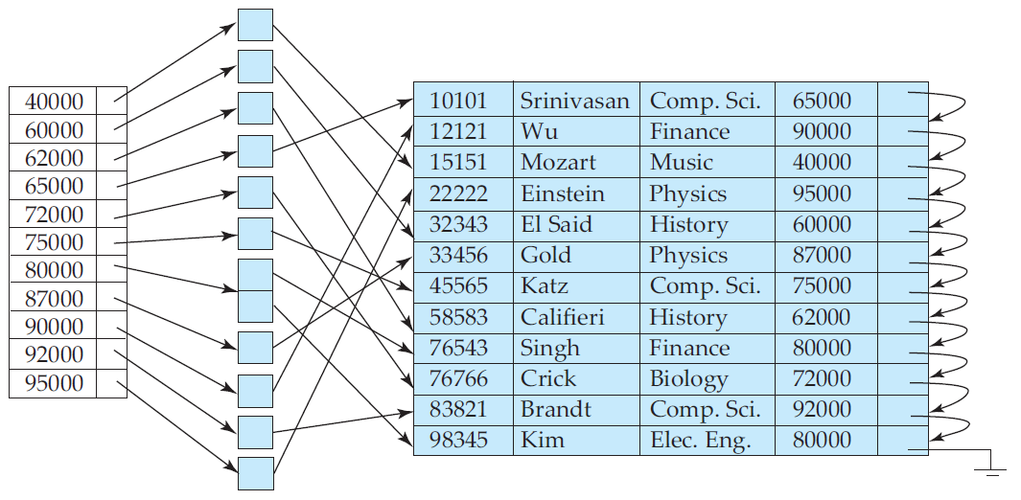
Index entries
ID name dept_name salary

Slide 18
(3) Selections Involving Comparisons
比较符：>, >=, <, <=, <> , 与等值比较的不同之处在于选择范围大
Can implement selections of the form σ_{A≤V} (r) or σ_{A ≥ V} (r), by using:
  a) linear scan, as A1;
  b) by using indices in the following ways:
  A5 (primary index, comparison, 基于主索引的比较). (Assume the relation is sorted on attribute A)
    For σ_{A ≥ V}(r) use index to find first tuple A ≥ v and scan relation sequentially from there.
    For σ_{A≤V} (r) just scan relation sequentially till find first tuple A>v; do not use index

Slide 19
(3) Selections Involving Comparisons (cont.)
  A6 (secondary index, comparison, 基于辅助索引的比较).
    For σ_{A ≥ V}(r) use index to find first index entry A ≥ v and scan index leaf nodes sequentially from there to the end, to find pointers to records.
    For σ_{A≤V} (r) just scan leaf pages of index finding pointers to records, till first entry A>v is meet.
    In either case, retrieve records that are pointed to
      requires an I/O for each record
      Linear file scan may be cheaper if many records are
      to be fetched!

Slide 20
(4) Implementation of Complex Selections
Have logical operators
  Conjunction: σ_{θ1}∧ _{θ2}∧. . . _{θn}(r)
E.g. Select …from…
where dept_name=‘Music’ and salar=75000
  A7 (conjunctive selection using one index).
  Step1: Select a combination of θ_{i} and algorithms A1 through A7 that results in the least cost for σ_{θi} (r). (第一步从n个条件θ₁ …θ_{n}中选择代价最小的θ_{i}先执行，返回元组放内存，然后第二步对这些元组施行其他θ_{i})
  Step2: Test other conditions θ_{j} on tuples in memory buffer fetched by step1.

Slide 21
(4) Implementation of Complex Selections (cont.)
A8 (conjunctive selection using composite index).
  Use appropriate composite (multiple-key) index if available:
  如 create index a-bb on account (branch-name, balance),
  则使用该组合索引– composite index, 于是可用 A3~A5算法.
E.g.: Select * from instructor where
dept_name=‘Music’ and salary= 75000;

Slide 22
(4) Implementation of Complex Selections (cont.)
A9 (conjunctive selection by intersection of identifiers, 通过识别符—指针的交集实现合取选择---先根据各合取条件分别通过索引取得对应的元组的指针，而非元组数据本身，然后对这些指针合取运算，再根据指针取出元组数据，节省了许多取数据的时间).
  (1) Use corresponding index for each condition, and take intersection of all the obtained sets of record pointers.
  (2) Sort the list of pointers obtained by step(1)
  (3) Fetch records from file according to the result pointers of step(2).
  If some conditions do not have appropriate indices, apply test in memory.
E.g: create index idx_bn on account(dept-name);
create index idx_bal on account(salary);
Select * from instructor where
dept_name=‘Music’ and salary= 75000;

Slide 23
Algorithms for Complex Selections
Disjunction:σ_{θ1}∨ _{θ2} ∨. . . _{θn} (r).
A10 (disjunctive selection by union of identifiers， 通过识别符的并集实现析取选择).
  Applicable if all conditions have available indices.
    Otherwise use linear scan.
  Use corresponding index for each condition, and take union of all the obtained sets of record pointers.
  Then fetch records from file
Negation: σ_{¬θ}(r)
  Use linear scan on file
  change the form of ¬θ, and use index.
  E.g. σ_{¬( A<50)}(r) => σ_{A>=50} (r)

Slide 24
4 Sorting
Why: two cases for sorting of data:
  output request
  join operations can be implemented quickly.
We may build an index on the relation, and then use the index to read the relation in sorted order. But this is only logically, not physically ordered the relation, and may lead to one disk block access for each tuple.
How:
  For relations that fit in memory, techniques like quicksort can be used for sorting.
  For relations that don’t fit in memory,
  external sort-merge (外部排序归并) is a good choice.

Slide 25
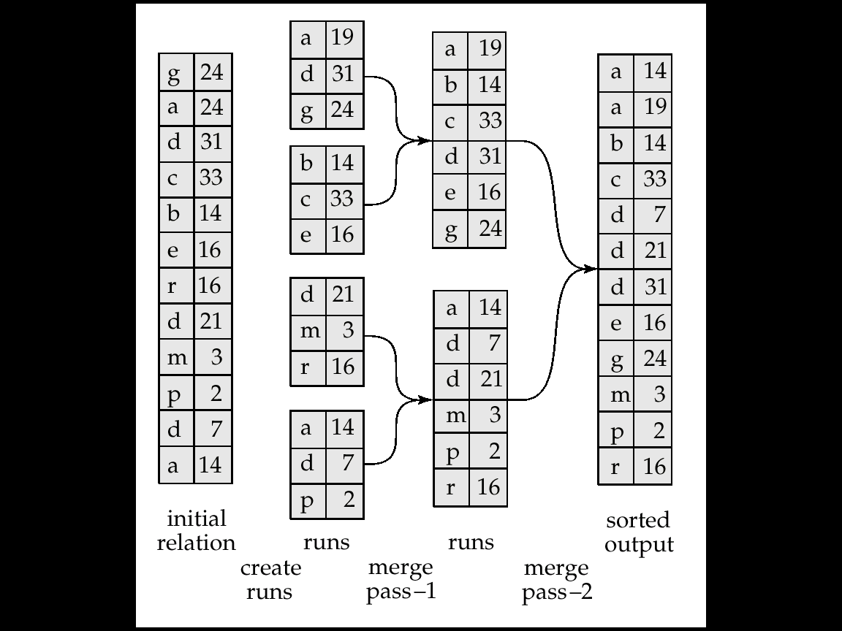
Example: External Sorting Using Sort-Merge
Pass 1
Pass 0
Pass 1
Pass 2
Assume: M = 3
one block for 1 tuple
R1
R21
R21
19
R2
R31
算法思路类似于体育比赛：
小组赛→大组赛→决赛
R3
R22
R22
R4
Sort key
Run files(归并段)
N₀=b/M
N₂=N₁/(M-1)
= 1
N₁= N₀/(M-1)

Slide 26
External Sort-Merge
Let M denote memory size, b is the total blocks of the relation.
Step1: Create sorted runs. Let i be 0 initially.
Repeatedly do the following till the end of the relation:
(a) Read M blocks of relation into memory
(b) Sort the in-memory blocks
(c) Write sorted data to run R_{i} ; increment i.
Let the final value of i be N₀= ⎡b / M⎤
Note: When sorting a file, several subfiles are generated in the intermediate steps. We refer to each subfile as a run.

Slide 27
External Sort-Merge (cont.)
Step2. Merge the runs (N-way merge). Assume that N = M-1.
  Use N blocks of memory to buffer input runs, and 1 block to buffer output. Read the first block of each run into its buffer page
  repeat
    Select the first record (in sort order) among all N buffer pages
    Write the record to the output buffer. If the output buffer is full write it to disk.
    Delete the record from its input buffer page.
    If the buffer page becomes empty then
    read the next block (if any) of the run into the buffer.
  until all input buffer pages are empty:

Slide 28
External Sort-Merge (cont.)
If i ≥ M, several merge passes are required.
  In each pass, contiguous groups of M - 1 runs are merged into one (as a new run).
  A pass reduces the number of runs by a factor of M -1, and creates runs longer by the same factor.
E.g. If b_{r}=1000blocks, M=11, and there are 91 runs, one pass reduces the number of runs to 10, each 10 times the size of the initial runs:
Pass 0: N₀=⎡1000/11⎤ =91 runs;
pass 1: N₁= ⎡91/10⎤ =10runs;
pass 2: N₂= ⎡10/10⎤ =1 runs .

Slide 29
External Merge Sort (cont.)
Cost analysis:
  Total number of merge passes = ⎡log_{M–1}(N₀)⎤ --not include pass 0
  That is merge passes = ⎡log_{M–1}(b_{r} /M)⎤
  Block transfer for initial run creation and in each pass is 2b_{r .}
    for final pass, we do not count write cost
      we ignore final write cost for all operations since the output of an operation may be sent to the parent operation without being written to disk.
Total number of block transfer for external sorting:
  BTCost = 2 b_{r} (⎡log_{M–1}(b_{r} / M)⎤ + 1) – b_{r}
  = 2 b_{r} ⎡log_{M–1}(b_{r} / M)⎤ + b_{r} = b_{r} (2 ⎡log_{M–1}(b_{r} / M)⎤+1)
归并次数(pass次数)
Pass 0产生的run文件数
final write

Slide 30
Cost of seeks
  During run generation (step1): one seek to read each run and one seek to write each run
    2 ⎡b_{r} / M⎤
  During the merge phase (step2):
    Buffer size: b_{b} (read/write b_{b} blocks at a time for a run)
    Need 2 ⎡b_{r} / b_{b}⎤ seeks for each merge pass
      except the final one which does not require a write
    Total number of seeks:
    2 ⎡b_{r} / M⎤ + 2 ⎡b_{r} / b_{b}⎤ (⎡log_{M–1}(b_{r} / M)⎤ ) - b_{r} / b_{b}
    ＝ 2 ⎡b_{r} / M⎤ + ⎡b_{r} / b_{b}⎤ (2 ⎡log_{M–1}(b_{r} / M)⎤ -1)
b_{b}是每个Run文件每次读写的大小(块数), 通常为1

Slide 31
5 Join Operation
depositor
customer
Several different algorithms to implement joins
  Nested-loop join
  Block nested-loop join
  Indexed nested-loop join
  Merge-join
  Hash-join
Examples use the following information
  Num of records of customer: n = 10,000, depositor: n=5000
  Num of blocks of customer: b = 400, depositor: b=100

Slide 32
(1) Nested-Loop Join (嵌套循环连接)
(Inner relation)
(output)
r s
s
(Outer relation)
… A ..1
.. A …a … ..1
r
… K ..2
.. A …a … ..7
Outer relation
… H ..3
.. A …a
.. B …c … ..8
.. E …b
… D ..4
.. D …d … ..4
b_{r}=2, b_{s}=3
n_{r}=6, n_{s}=9
.. B …c
… P ..5
.. H …f … ..3
… P ..6
.. B …f … ..9
.. D …d
.. F …e
… A ..7
.. H …f
… B ..8
… H ..9
Nested-Loop Join
The cost in block transfer in the worst case: (only one block of each relation can be held in memory ) = 6 * 3 + 2 = 20
Seeks = 6+2 = 8
M=3

Slide 33
(1) Nested-Loop Join (嵌套循环连接)
To compute the theta join: r _{θ} s
for each tuple t_{r} in r do begin
for each tuple t_{s} in s do begin
test pair (t_{r},t_{s}) to see if they satisfy the join condition θ
if they do, add t_{r} • t_{s} to the result.
end
end
  r is called the outer relation and s the inner relation of the join.
Requires no indices and can be used with any kind of join condition.
Expensive since it examines every pair of tuples in the two relations.

Slide 34
Nested-Loop Join (cont.)
In the worst case, if there is enough memory only to hold one block of each relation, the estimated cost is
n_{r} ∗ b_{s} + b_{r} block transfers, plus
n_{r} + b_{r} disk seeks
If the smaller relation fits entirely in memory, use that as the inner relation:
  In the best case:
  cost = b_{r} + b_{s} block transfers plus 2 seeks.

Slide 35
Nested-Loop Join (cont.)
Assuming worst case memory availability, cost estimate is
  5000 ∗ 400 + 100 = 2,000,100 block transfers and 5000 + 100 = 5100 seeks with depositor as outer relation, and
  10000 ∗ 100 + 400 = 1,000,400 block transfers and 10000 + 400 = 10,400 seeks with customer as the outer relation.
If smaller relation (depositor) fits entirely in memory, the cost estimate will be 500 block transfers plus 2 seeks.
Block nested-loops algorithm (next slide) is preferable.

Slide 36
(2) Block Nested-Loop Join
outer relation
Inner relation
r
s
r
s
M=3
Nested-Loop Join
BT Cost = 6 * 3 + 2 = 20
Seeks=6+2=8
Block Nested-Loop Join
Block transfer cost = 2 * 3 + 2 = 8
Seeks =4
  Each block in the inner relation s is read once for each block in the outer relation (instead of once for each tuple in the outer relation)

Slide 37
(2) Block Nested-Loop Join
Variant of nested-loop join in which every block of inner relation is paired with every block of outer relation.
for each block B_{r} of r do begin
for each block B_{s} of s do begin
for each tuple t_{r} in B_{r} do begin
for each tuple t_{s} in B_{s} do begin
Check if (t_{r},t_{s}) satisfy the join condition
if they do, add t_{r} • t_{s} to the result.
end
end
end
end
在内存中处理

Slide 38
Block Nested-Loop Join (cont.)
Worst case : Block transfer cost= b_{r} ∗ b_{s} + b_{r} .(设内存中只有3个block) plus 2*b_{r} seeks
  E.g. 100 * 400 +100 = 40100 block transfers, plus 200 seeks;
  or 400 * 100 + 400 = 40400 block transfer, 800seeks
  Let the relation with smaller number of blocks be outer relation
Best case: b_{r} + b_{s} block accesses (s全部且始终在内存). Plus 2 seeks.
  Let the relation with smaller number of blocks be inner relation

Slide 39
Block Nested-Loop Join (cont.)
Improvements :
  1) when M > 3, but M < b_{s} and M < b_{r}
  use M - 2 disk blocks as blocking unit for outer relations, where M = memory size in blocks; use remaining two blocks to buffer inner relation and output. --充分利用内存buffer, 增大buffer中外层关系的block数（从而减少内层关系读入批数)，有利于减少代价（减少约M-2倍）。
  Data Transfer cost = ⎡b_{r} / (M-2)⎤ ∗ b_{s} + b_{r}
  Seeks times= 2 ⎡b_{r} / (M-2)⎤
E.g. M=10, DT cost= ⎡400 / (10-2)⎤ * 100 + 400 = 5400, seeks= 2 * 50
How about M-2 blocks for inner relation?

Slide 40
M = 4
M-2=2
r
s
r
s
BT Cost= 2 x 4 + 4 = 12
Seeks= 2 x 2 = 4
BT Cost= 4 x 4 + 4 = 20
Seeks=2 x 4 =8

Slide 41
Block Nested-Loop Join (cont.)
Improvements :
  2) If equi-join (等值连接) attribute forms a key on inner relation, stop inner loop on first match
  3) Scan inner loop forward and backward alternately, to make use of the blocks remaining in buffer (when LRU replacement strategy is used )
  4) Use index on inner relation if available (next slide)

Slide 42
(3) Indexed Nested-Loop Join
Index lookups can replace file scans if (使用indexed nested-loop join的2个条件)
  join is an equi-join or natural join
  an index is available on the inner relation’s join attribute
    If not, construct an index just for the join.

Slide 43
(3) Indexed Nested-Loop Join (cont.)
For each tuple t_{r} in the outer relation r, use the index to look up tuples in s that satisfy the join condition with tuple t_{r}.
r
s

Slide 44
(3) Indexed Nested-Loop Join (cont.)
Worst case: buffer has space for only one page of r , one page of index and one page for output. For each tuple in r, we perform an index lookup on s.
  Disk access cost ＝ n_{r} ∗ c + b_{r}
    Where c is the cost of traversing index and fetching all matching s for one tuple of r. n_{r} is the number of tuples of relation r.

Slide 45
(3) Indexed Nested-Loop Join (cont.)
Worst case:
  Cost ＝ n_{r} ∗ c + b_{r}
    c can be estimated as cost of a single selection on s using the index (referred to algorithms A3~A5, page12.11).
    For the B⁺tree index, c= Ht_{i} +1
    i.e. Cost= [ n_{r} ∗ (Ht_{i} +1 ) + b_{r} ] ∗ (t_{T} + t_{S})
  If indices are available on join attributes of both r and s, how do we choose?
Use the relation with fewer tuples as the outer relation.
Best case?

Slide 46
Example of Nested-Loop Join Costs
( n =5000, n =10000)
Example: Compute depositor customer, with depositor as the outer relation.
  Let customer have a primary index (B⁺-tree ) on the join attribute customer-name, which contains 50 entries in each index node (n=50), and customer-name is key attribute.
  Since customer has 10,000 tuples, the height of the B⁺ tree is 3
  (log_{⎡n/2⎤}(K)= log₂₅(10000)=3, ∴c= 3 + 1 = 4)
  Cost of indexed nested loops join =
  5000 * 4 + 100= 20,100 disk accesses
  i.e. Cost=20100*(t_{T} + t_{S}).

Slide 47
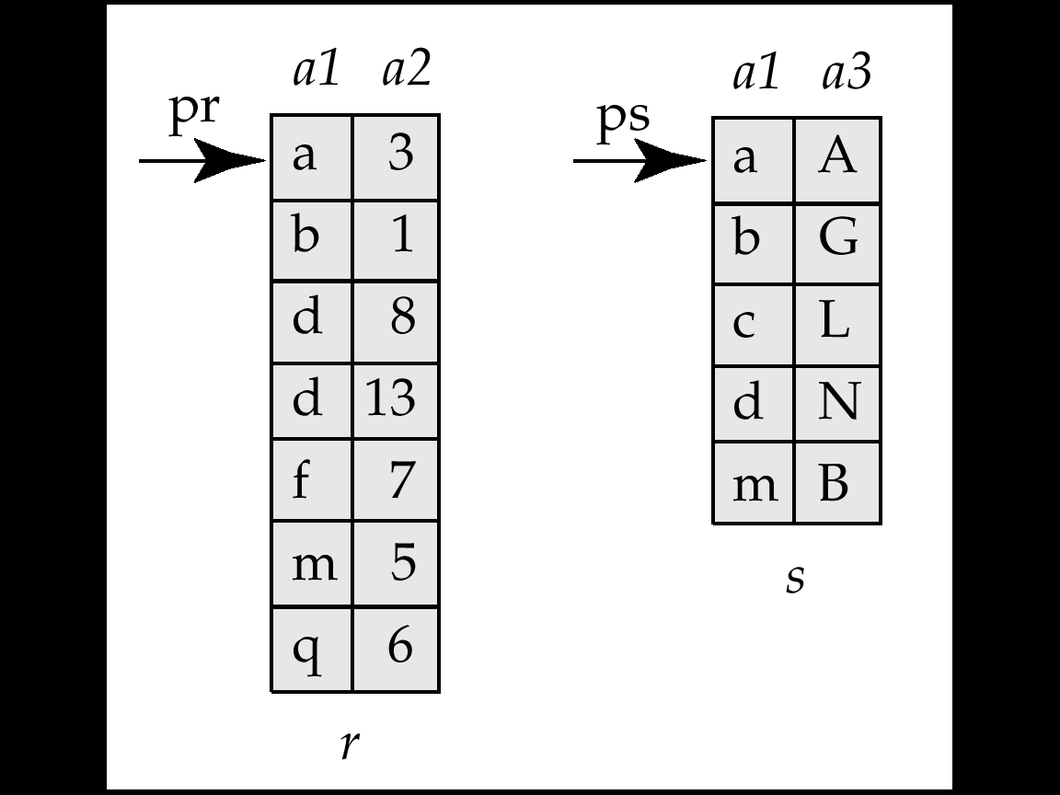
(4) Merge-Join (sort-merge join, 排序归并连接)
Only for equi-join or natural join.
Sort both relations on their join attribute (if not already sorted on the join attributes).
Merge the sorted relations to join them
  Every pair with same value on join attribute must be matched
  Detailed algorithm in book
a1 a2 a3
a | 3 | A
b | 1 | G
d | 8 | N
d | 13 | N
m | 5 | B
For natural join

Slide 48
Merge-Join (cont.)
Can be used only for equi-joins and natural joins
Each block needs to be read only once (assuming all tuples for any given value of the join attributes fit in memory).
Thus number of block accesses for merge-join :
BTcost = b_{r} + b_{s}
Seek Times = ⎡b_{r} / b_{b} ⎤ + ⎡b_{s} / b_{b} ⎤, where b_{b} depends on buffer size
If the relations are unsorted, then plus the cost of sorting.
  BT= b_{r} (2 ⎡log_{M–1}(b_{r} / M)⎤+2) + b_{s} (2 ⎡log_{M–1}(b_{s} / M)⎤+2) + b_{r} + b_{s}
  cost for sorting b_{r} (including final write) cost for sorting b_{s} cost for join
  ST= 2 ⎡b_{r} / M⎤ + 2 ⎡b_{r} / b_{b}⎤ ⎡log_{M–1}(b_{r} / M)⎤ +
  2 ⎡b_{s} / M⎤ + 2 ⎡b_{s} / b_{b}⎤ ⎡log_{M–1}(b_{s}/ M)⎤+
  ⎡b_{r} / b_{b}⎤+⎡b_{s} / b_{b} ⎤

Slide 49
Merge-Join (Cont.) -- hybrid merge-join (混合归并连接)
hybrid merge-join: If one relation is sorted, and the other has a secondary B⁺-tree index on the join attribute. (Assume r is sorted, s is indexed )
  1) Merge and join the sorted relation with the leaf entries of the B⁺-tree (树叶中k值有序排列) .
  2) Sort the result file on the addresses (P_{s} ) of the unsorted relation’s tuples
  3) Scan the unsorted relation in physical address order( by P_{s} ) and merge with previous result t_{r} , to replace addresses P_{s} by the actual tuples
    ∵Sequential scan more efficient than random lookup
( t_{r} P_{s} )
( t_{r} P_{s} )
( t_{r} t_{s} )

Slide 50
(5) Hash-Join (哈希连接)
(a) partition (分区)
Original
Relation
OUTPUT
Partitions
1
K
H₁
INPUT
2
K
hash
function
H
H₂
. . .
K
i
n-1
K
H_{n-1}
Disk
Main memory buffers
Disk
The hash function is based on join attributes K, which maps K to i
BT Cost of partition: 2*b_{r}
Seeks = 2(b_{r} / b_{b})

Slide 51
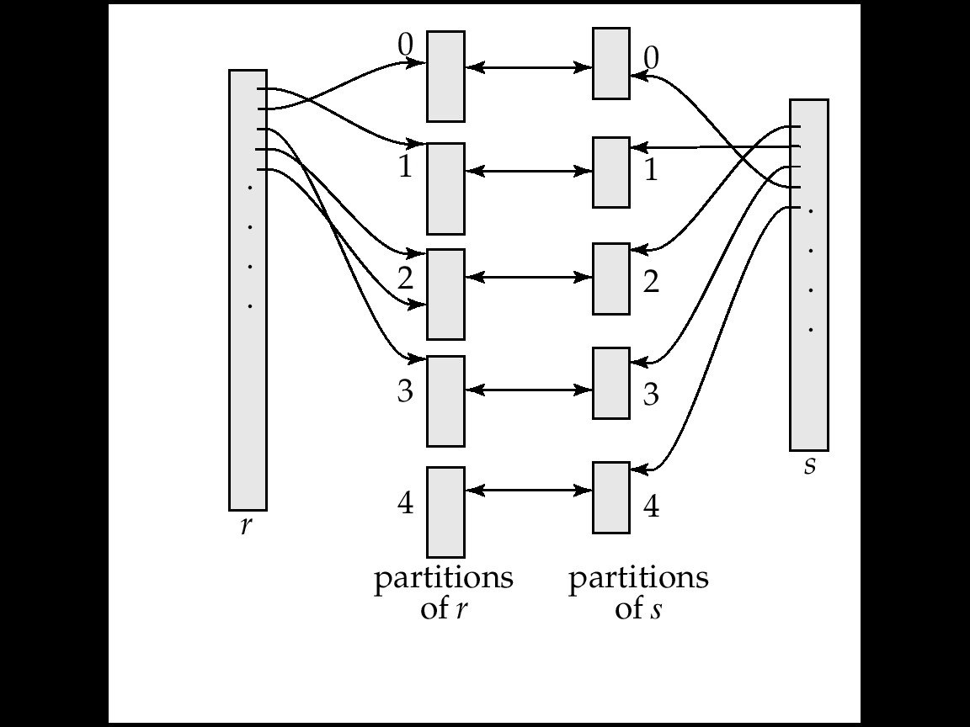
Hash-Join -- (b) join
Hr_{i}
Hs_{i}
具有相同连接属性值的元组t_{r}和t_{s}一定分别放在相同编号的分区Hr_{i}和Hs_{i}中,故连接只在(Hr_{i} Hs_{i}) 中发生。
Join BTcost= b_{r} + b_{s}
Seeks=2*n_{h,} (= 2*5=10)

Slide 52
(5) Hash-Join (cont.)
Build in-memory hash index h2 for Hs_{i}
Partitions
of r & s
Join Result
1partition of Hs_{i}
(build input)
Hs
h2
Hr
Output
buffer
1bolck from Hr_{i}
(probe input)
Disk
Main memory buffers
Disk
进行连接时，要考虑到通常buffer较小，分区不均匀，且有些分区可能较大。
Build input: 构造用输入
Probe input: 探查用输入

Slide 53
(5) Hash-Join (cont.)
Applicable for equi-joins and natural joins.
A hash function h is used to partition tuples of both relations
h maps JoinAttrs values to {0, 1, ..., n}, where JoinAttrs denotes the common attributes of r and s used in the natural join.
  Hr₀ , Hr₁ , . . ., Hr_{n} denote partitions of r tuples
    Each tuple t_{r} ∈ r is put in partition Hr_{i} where i = h(t_{r} [JoinAttrs]).
  Hs₀ , Hs₁. . ., Hs_{n} denotes partitions of s tuples
    Each tuple t_{s} ∈s is put in partition Hs_{i}, where i= h(t_{s} [JoinAttrs]).

Slide 54
(5.a) Hash-Join Algorithm
The hash-join of r and s is computed as follows. (algorithm is as Fig. 12.9)
对r和s分别做分区
Partition the relation s using hashing function h. Partition r similarly.
2. For each i:
  (a) Load Hs_{i} into memory and build an in-memory hash index on it using the join attribute. This hash index uses a different hash function than the earlier one h. (将Hs_{i} 读入内存，并建索引)
  (b) Read the tuples in Hr_{i} from the disk one by one. For each tuple t_{r} locate each matching tuple t_{s} in Hs_{i} using the in-memory hash index. Output the concatenation of their attributes.
对每对Hsi Hri分区进行连接

Slide 55
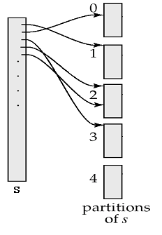


About partitioning
♦ 每次分区个数n_{h}≤M-1(每个partition需对应一块内存)；每一个Hs_{i}分区的大小必须≤M-2块(Build Input要加载到内存)
H_{s0}
Case1:
M = 6 blocks
b_{s} = 20 blocks
n_{h} = M-1 = 5
(n_{h}为分区的总数)
H_{si}=b_{s}/n_{h}=20/5=4
(满足H_{si} ≤M-2)
Case2: M = 6, b_{s} =80
n_{h} = M-1 = 5
H_{si} = 80/5 =16 > M-2=4
In this case recursive partition is needed:
Pass1: H_{s0}, H_{s1},H_{s2},H_{s3} , H_{s4} (size=16)
Pass2: H_{s0}→ H_{s00}, H_{s01}, H_{s02},H_{s03} , H_{s04}
(size=3) H_{s1}→H_{s10}, H_{s11}, H_{s12}, H_{s13} ,H_{s14}
H_{s2}→H_{s20}, H_{s21}, H_{s22}, H_{s23} , H_{s24}
H_{s3}→H_{s30}, H_{s31}, H_{s32}, H_{s33} , H_{s34}
When b_{s}/(M-1) > M-2, b_{s} > (M²-3M+2)≈(M-1)² , then recursive partition is needed. (That is, if M≤ ⎡ ⎤ +1, recursive partition is required; if M > ⎡ ⎤ +1 , need not recursive partition.)
In memory
Out of memory

Slide 56
Hash-Join Algorithm (cont.)
Recursive partitioning (递归分区) required if the size of partitions is greater than the number of pages M of memory.
  Use M – 1 partitions for s；
  Further partition the M – 1 partitions using a different hash function；
  Use same partitioning method on r .
  Rarely required: e.g., recursive partitioning not needed for relations of 1GB or less with memory size of 2MB, with block size of 4KB.
    E.g. : b_{s}=1GB/4KB=256K, M > ⎡ ⎤ +1= 512 blocks.
    M > 512*4KB=2MB

Slide 57
*Handling of Overflows
Hash-table overflow occurs in partition Hs_{i} , if Hs_{i} does not fit in memory. Reasons could be
  Many tuples in s with same value for join attributes; (分区不均匀)
  Bad hash function
Partitioning is said to be skewed if some partitions have significantly more tuples than some others.
Solutions:
  Typically n_{h} is chosen as ⎡b_{s}/M⎤ * f , where f is a “fudge factor”, typically around 1.2
  Overflow resolution (溢出分解) can be done in build phase
    Partition Hs_{i} is further partitioned using different hash function.
    Partition Hr_{i} must be similarly partitioned.
  Overflow avoidance (溢出避免) performs partitioning carefully to avoid overflows during build phase
    E.g. partition build relation into many partitions, then combine them
  If both approaches fail with large numbers of duplicates
    Fallback option: use block nested loops join on overflowed
    partitions
(有偏的)
(避让因子)

Slide 58
(5.b) Cost of Hash-Join
If recursive partitioning is not required:
BTcost of hash join = 3(b_{r} + b_{s} ) + 4∗n_{h}
(其中分区代价2 (b_{r} + b_{s})，连接代价(b_{r} + b_{s})，不考虑结果输出, 且读写同价。考虑到每个分区部分块不满，多算1块，从而每个关系读写多2 n_{h}块, 共4 n_{h}块)
Seeks= 2 ( ⎡b_{r} / b_{b} ⎤+ ⎡b_{s} / b_{b} ⎤)//分区//+ 2∗n_{h}//连接//
If recursive partitioning is required, number of passes required for partitioning s is ⎡log_{M–1}(b_{s} )–1⎤. This is because each final partition of s should fit in memory. Total cost for partition is:
BT cost = 2(b_{r} + b_{s} )*⎡log_{M–1}(b_{s}) – 1⎤
Seeks = 2(⎡b_{r} / b_{b}⎤ + ⎡b_{s} / b_{b}⎤)* ⎡log_{M–1}(b_{s}) – 1⎤

Slide 59
(5.b) Cost of Hash-Join (cont.)
Total cost of hash-join with recursive partition is estimated as :
BT cost = [ 2(b_{r} + b_{s} ) ⎡log_{M–1}(b_{s}) – 1⎤ + b_{r} + b_{s} ] × t_{T}
Seeks cost =[2(⎡b_{r} / b_{b}⎤ + ⎡b_{s} / b_{b}⎤)* ⎡log_{M–1}(b_{s}) – 1⎤+2*n_{h} ] × t_{s}
Therefore it is best to choose the smaller relation as the build relation.
If the entire build input can be kept in main memory, the algorithm does not partition the relations into temporary files. Cost estimate goes down to b_{r} + b_{s} ----the best case

Slide 60
Example of Cost of Hash-Join
customer depositor
Assume that memory size M is 20 blocks
b_{depositor}= 100 and b_{customer} = 400.
depositor is to be used as build input. Partitioning it into 6 partitions (=100/(20-2)), each of size 18 blocks. This partitioning can be done in one pass.
Similarly, partition customer into 6 partitions, each of size 400/6≈67. This is also done in one pass.
Therefore total cost: 3(100 + 400) = 1500 block transfers. Seeks=2(100/3+400/3)+2*6
  ignores the cost of writing partially filled blocks

Slide 61

*(5.c) Hybrid Hash–Join
Useful when memory buffers are relatively large, but is not big enough to fit the whole build input.
Usually M >>
Main feature of hybrid hash join:
Keep the first partition of the build relation in memory.
E.g. With memory size of 26 blocks, to join depositor and customer, what is the cost ?
M=26, b_{s}=100, 26 >>

Slide 62
*(5.c) Hybrid Hash–Join (cont.)
Exmp:
B₁ B₂ B₃ B₄ B₅ B₆ B₇ B₈ B_{9 ……} B₂₃ B₂ ₄ B₂₅ B₂₆
INP
H₄
H₃
H₂
H₁
H₀
H_{s0}
H_{s0}
H_{s0}
H_{s0}
H_{s0}
OUT
Hs₀
Depositor: b_{s}=100, customer : b_{r}=400
M=26, each partition ≤ m-2=24,
n= 100/24=4.2 ≈ 5 → (H₄ , H₃ , H₂ , H₁ , H₀ ), ∴size of H_{si} = 100/5=20, size of H_{ri} = 400/5= 80
(1)Partition S: B₁ as input buffer, B₂ ~ B₆ as the buffer for H_{s4} ~ H_{s0} , and also B₇ ~ B₂₅ as the buffer of H_{s0} , and leave H_{s0} in B₆ ~ B₂₅
(2) Partition r : B₁ as input buffer, B₂ ~ B₅ as the buffer for H_{r4} ~ H_{r1} , no space for H_{r0}, just directly match with H_{s0} , and output.
(3) Join H_{r1}~H_{r4} with H_{s1} ~H_{s4}
∴ the cost= 3×(4 x 20+ 4 x 80) + 20+ 80 =1300
H_{s4} ~ H_{s1}
H_{r4} ~ H_{r1}
H_{s0} , H_{r0}

Slide 63
(6) Complex Joins
Join with a conjunctive condition:
r _{θ1∧ θ 2∧... ∧ θ n} s
  1) Either use nested loops or block nested loops, to
  Compute the result of one of the simpler joins r _{θi} s
  2) final result comprises those tuples in the intermediate result that satisfy the remaining conditions
  θ₁ ∧ . . . ∧ θ_{i –1} ∧ θ_{i +1} ∧ . . . ∧ θ_{n}
Join with a disjunctive condition
  r _{θ1 ∨ θ2 ∨... ∨ θn} s
  Either use nested loops or block nested loops for r _{θ i} s ,
  Compute as the union of the records in individual joins: (r _{θ1} s) ∪ (r _{θ2} s) ∪ . . . ∪ (r _{θn} s)

Slide 64
*6 Other Operations
Duplicate elimination can be implemented via hashing or sorting.
  On sorting duplicates will come adjacent to each other, and all but one set of duplicates can be deleted. Optimization: duplicates can be deleted during run generation as well as at intermediate merge steps in external sort-merge.
  Hashing is similar – duplicates will come into the same bucket.
Projection is implemented by performing projection on each tuple followed by duplicate elimination.

Slide 65
Other Operations: Aggregation
Aggregation can be implemented in a manner similar to duplicate elimination.
  Sorting or hashing can be used to bring tuples in the same group together, and then the aggregate functions can be applied on each group.
  Optimization: combine tuples in the same group during run generation and intermediate merges, by computing partial aggregate values
    For count, min, max, sum: keep aggregate values on tuples found so far in the group.
      When combining partial aggregate for count, add up the aggregates
    For avg, keep sum and count, and divide sum by count at the end

Slide 66
Other Operations: Set Operations
Set operations (∪, ∩ and －): can either use variant of merge-join after sorting, or variant of hash-join.
E.g., Set operations using hashing:
  1. Partition both relations using the same hash function, thereby creating, r_{1, ..,} r_{n} r_{0,} and s_{1,} s_{2..,} s_{n}
  2. Process each partition i as follows. Using a different hashing function, build an in-memory hash index on r_{i} after it is brought into memory.
  3.(1) r ∪ s: Add tuples in s_{i} to the hash index if they are not already in it. At end of s_{i} add the tuples in the hash index to the result.
  (2) r ∩ s: output tuples in s_{i} to the result if they are already there in the hash index.
  (3) r – s: for each tuple in s_{i}, if it is there in the hash index, delete it from the index. At end of s_{i} add remaining tuples in the hash index to the result.

Slide 67
Other Operations: Outer Join
Outer join can be computed either as
  A join followed by addition of null-padded non-participating tuples.
  by modifying the join algorithms.
Modifying merge join to compute r s
  In r s, non participating tuples are those in r – Π_{R}(r s)
  Modify merge-join to compute r s: During merging, for every tuple t_{r} from r that do not match any tuple in s, output t_{r} padded with nulls.
  Right outer-join and full outer-join can be computed similarly.
Modifying hash join to compute r s
  If r is probe relation, output non-matching r tuples padded with nulls
  If r is build relation, when probing keep track of which
  r tuples matched s tuples. At end of s_{i} output
  non-matched r tuples padded with nulls

Slide 68
7 Evaluation of Expressions
So far: we have seen algorithms for individual operations. Now consider multi operations.
∏_{customer-name} ((σ_{balance<2500}(account)) depositor)
Alternatives for evaluating an entire expression tree
  Materialization (实体化): generate the results of an expression, and store the results to disk.
  Pipelining (流水线): pass on tuples to parent operations even as an operation is being executed.
We study above alternatives in more detail

Slide 69

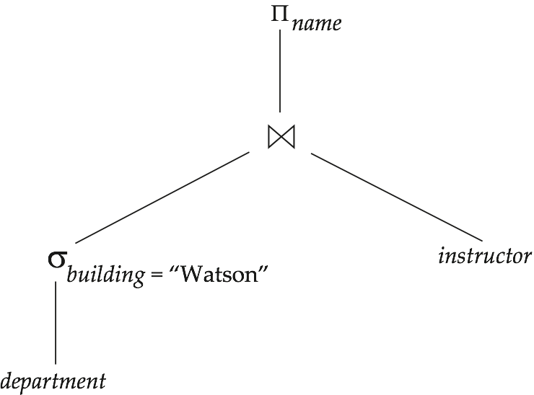
(1) Materialization
Materialized evaluation: evaluate one operation at a time, starting at the lowest-level. Use intermediate results materialized into temporary relations to evaluate next-level operations.
E.g., in figure below, compute and store
then compute the store its join with instructor, and finally compute the projection on name.
temp
temp

Slide 70
Materialization (cont.)
Materialized evaluation is always applicable
Cost of writing results to disk and reading them back can be quite expensive.
  Our cost formulas for operations ignore cost of writing results to disk, so
    Overall cost = Sum of costs of individual operations +
    cost of writing intermediate results to disk
(改进) Double buffering: use two output buffers for each operation, when one is full write it to disk while the other is getting filled
  Allows overlap of disk writes with computation and reduces execution time

Slide 71
(2) Pipelining
Pipelined evaluation : evaluate several operations simultaneously, passing the results of one operation on to the next.
E.g., in previous expression tree, don’t store the result of selection. Instead, pass tuples directly to the join. Similarly, don’t store result of join, pass tuples directly to projection.

Slide 72
(2) Pipelining (cont.)
Much cheaper than materialization: no need to store a temporary relation to disk.
Pipelining may not always be possible. (depend on the type of next operations, and whether the output is sorted, etc.)
For pipelining to be effective, use evaluation algorithms that generate output tuples even as tuples are received for inputs to the next operation.
Pipelines can be executed in two ways: demand driven and producer driven
（需求驱动流水线、生产者驱动流水线）
由上而下吸引
由下而上的推动

Slide 73
*Pipelining (cont.)
In demand driven or lazy evaluation
  system repeatedly requests next tuple from top level operation
  Each operation requests next tuple from children operations as required, in order to output its next tuple
  In between calls, operation has to maintain “state” so it knows what to return next
  Each operation is implemented as an iterator (迭代器) implementing the following operations

Slide 74
*Pipelining (cont.)
    open()
      E.g. file scan: initialize file scan, store pointer to beginning of file as state
      E.g.merge join: sort relations and store pointers to beginning of sorted relations as state
    next()
      E.g. for file scan: Output next tuple, and advance and store file pointer
      E.g. for merge join: continue with merge from earlier state till next output tuple is found. Save pointers as iterator state.
    close()

Slide 75
*Pipelining (cont.)
In produce-driven or eager pipelining
  Operators produce tuples eagerly and pass them up to their parents
    Buffer maintained between operators, child puts tuples in buffer, parent removes tuples from buffer
    if buffer is full, child waits till there is space in the buffer, and then generates more tuples
  System schedules operations that have space in output buffer and can process more input tuples

Slide 76
*Evaluation Algorithms for Pipelining
Some algorithms are not able to output results even as they get input tuples
  E.g. merge join, or hash join
  These result in intermediate results being written to disk and then read back always
Algorithm variants are possible to generate (at least some) results on the fly, as input tuples are read in

Slide 77
*Evaluation Algorithms for Pipelining
  E.g. hybrid hash join generates output tuples even as probe relation tuples in the in-memory partition (partition 0) are read in
  Pipelined join technique: Hybrid hash join, modified to buffer partition 0 tuples of both relations in-memory, reading them as they become available, and output results of any matches between partition 0 tuples
    When a new r₀ tuple is found, match it with existing s₀ tuples, output matches, and save it in r₀
    Symmetrically for s₀ tuples

Slide 78
*Complex Joins
Join involving three relations: course teaches section
Strategy 1. Compute section course; use result to compute teaches ( section course)
Strategy 2. Compute section teaches first, and then join the result with course.
Strategy 3. Perform the pair of joins at once. Build and index on course for course_id, and on section for sec_id.
  For each tuple t in course, look up the corresponding tuples in section and the corresponding tuples in teaches.
  Each tuple of course is examined exactly once.
Strategy 3 combines two operations into one special-purpose operation that is more efficient than implementing two joins of two relations.

Slide 79
example
Given tables:
T1(bno, type, title, press, year);
T2(id, bno, date1, date2); // bno is foreign key referencing T1
T1 has 20,000 tuples, T2 has 45,000 tuples. 25 tuples of T1 fit in one block, 30 tuples of T2 fit in one block.
T1 has a primary B+-tree index on primary key attribute bno, which contains maximal 60 entries in each index node(I.t. n=60). Assume the allowed memory is in worst case. Compute the cost of the join operation for T1 and T2:
(1) Block nested-loop join
(2) index nested-loop join
b₁=20000/25=800, b₂=45000/30=1500, log_{60/2}20000≈3
(1) BT costs=800 x 1500 + 800=1200800, seeks=2*800
(2) BT costs=45000 x (3 + 1) + 1500=181500, seeks=181500 (T2 is outer, T1 is inner relation)

Slide 80
7th Edition： Ex. 15.2, 15.3, 15.5

