Slide 1
Chapter 16: Query Optimization
Introduction
Transformation of Relational Expressions
Statistical Information for Cost Estimation
Dynamic Programming for Choosing Evaluation Plans
Materialized views and view maintenance

Slide 2


1 Introduction
a) Alternative ways of evaluating a given query:
  Equivalent expressions, e.g. σ_{r.A = s.A} (r X s) ⬄ r s; (r₁ r₂) r₃ ⬄ r₁ (r₂ r₃ )
  Different algorithms for each operation (Chapter 13)
  Cost difference between a good and a bad way of evaluating a query can be enormous
    Example: performing a σ_{r.A = s.A} (r X s) is much slower than performing a join r s on the same condition

Slide 3

1 Introduction (cont.)
Alternative ways of evaluating a given query
  Equivalent expressions
  Different algorithms for each operation

Slide 4
1 Introduction (cont.)
b) In order to estimate the cost of an operation, we need to know the size info:
  1) Need to know the statistical information about relations which the database must maintain
    E.g. number of tuples, number of distinct values for join attributes, etc.
  2) Need to estimate statistics for intermediate results to compute cost of complex expressions
Join: BT Cost = n_{r} ∗ c + b_{r} (nested-loop join)
=b_{r} ∗ b_{s} + b_{r} (block nested-loop join)

Slide 5
Introduction (cont.)
--the work of optimizer
Generation of query-evaluation plans (查询执行计划) for an expression involves several steps:
  Generating logically equivalent expressions
    Use equivalence rules (等价规则) to transform an expression into an equivalent one
  Annotating resultant expressions to get alternative query plans
  Choosing the cheapest plan based on estimated cost
The overall process is called cost based optimization (基于代价的优化).

Slide 6
2 Transformation of Relational Expressions
Two relational algebra expressions are said to be equivalent if on every legal database instance the two expressions generate the same set of tuples
  Note: order of tuples is irrelevant
  ∵ In SQL, inputs and outputs are multisets of tuples. (p143, duplicates, ∏, σ, x also support multiset version)
  ∴ Two expressions in the multiset version of the relational algebra are said to be equivalent if on every legal database instance the two expressions generate the same multiset of tuples
An equivalence rule says that expressions of two forms are equivalent
  Can replace expression of first form by second, or vice versa

Slide 7
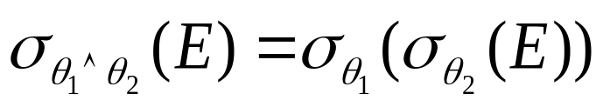
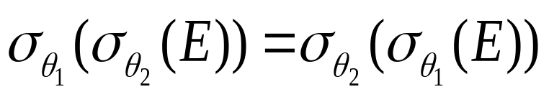
(1) Equivalence Rules
1. Conjunctive selection operations can be deconstructed into a sequence of individual selections.
2. Selection operations are commutative(选择操作的交换律).
3. Only the last in a sequence of projection operations is needed, the others can be omitted.
4. Selection on multi relations can be combined with Cartesian products and theta joins.
  σ_{θ}(E₁ X E₂) = E₁ _{θ} E₂
  σ_{θ1}(E₁ _{θ2} E₂) = E₁ _{θ1∧ θ2} E₂

Slide 8
Equivalence Rules (cont.)
5. Theta-join operations (and natural joins) are commutative (连接操作的交换律).
E_{1 θ} E₂ = E₂ _{θ} E₁
6. (a) Natural join operations are associative(自然连接的结合律):
(E₁ E₂ ) E₃ = E₁ (E₂ E₃)
(b) Theta joins are associative in the following manner:
(E_{1 θ1} E₂) _{θ2 ∧ θ3} E₃ = E_{1 θ1∧ θ3} (E₂ _{θ2} E₃)
where θ₂ involves attributes from only E₂ and E₃.

Slide 9
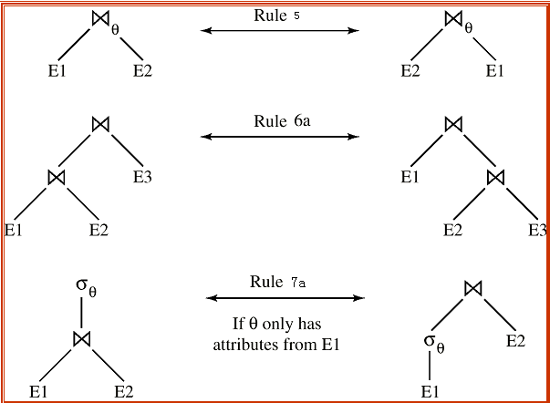
Pictorial Depiction of Equivalence Rules

Slide 10
Equivalence Rules (cont.)
7. The selection operation distributes over the theta join operation under the following two conditions: (选择操作的分配律：先连后选＝>先选后连)
(a) When all the attributes in θ₀ involve only the attributes of one of the expressions (e.g. E₁) being joined.
σ_{θ0}(E₁ _{θ} E₂) = (σ_{θ0}(E₁)) _{θ} E₂
(b) When θ₁ involves only the attributes of E₁ and θ₂ involves only the attributes of E₂.
σ_{θ1}∧_{θ2} (E₁ _{θ} E₂) = (σ_{θ1}(E₁)) _{θ} (σ_{θ2} (E₂))
  Performing the selection as early as possible reduces the size of the relation to be joined !!!

Slide 11
Equivalence Rules (cont.)
8. The projections operation distributes over the theta join operation as follows: (投影操作在下面二个条件下对θ连接运算具有分配律：先连后投=►先投后连)
(a) if  involves only attributes from L₁ ∪ L_{2 ,}and L₁∈E_{1 ，}L₂ ∈ E₂ ,
then:
(b) Consider a join E_{1 θ} E₂.
  Let L₁ and L₂ be sets of attributes from E₁ and E₂, respectively.
  Let L₃ be attributes of E₁ that are involved in join condition θ, but are not in L₁ ∪ L₂, and
  let L₄ be attributes of E₂ that are involved in join condition θ, but are not in L₁ ∪ L₂. （先连后投=>先投后连，再投影）
∏
(
E
E
)
=
(
∏
(
E
))
(
∏
(
E
))
L
∪
L
1
θ
2
L
1
θ
L
2
1
2
1
2
∏
(
E
E
)
=
∏
((
∏
(
E
))
(
∏
(
E
)))
L
∪
L
1
θ
2
L
∪
L
L
∪
L
1
θ
L
∪
L
2
1
2
1
2
1
3
2
4

Slide 12
Equivalence Rules (cont.)
9. The set operations union and intersection are commutative
E₁ ∪ E₂ = E₂ ∪ E₁
E₁ ∩ E₂ = E₂ ∩ E₁
  (set difference is not commutative)
Set union and intersection are associative.
(E₁ ∪ E₂) ∪ E₃ = E₁ ∪ (E₂ ∪ E₃)
(E₁ ∩ E₂) ∩ E₃ = E₁ ∩ (E₂ ∩ E₃)
11. The selection operation distributes over ∪, ∩ and –.
σ_{θ} (E₁ – E₂) = σ_{θ} (E₁) – σ_{θ}(E₂)
σ_{θ} (E₁ ∪ E₂) = σ_{θ} (E₁) ∪ σ_{θ}(E₂), σ_{θ} (E₁ ∩ E₂) = σ_{θ} (E₁) ∩ σ_{θ}(E₂)
Also: σ_{θ} (E₁ – E₂) = σ_{θ}(E₁) – E₂
σ_{θ} (E₁ ∩ E₂) = σ_{θ}(E₁) ∩ E₂ but not for ∪
12. The projection operation distributes over union
Π_{L}(E₁ ∪ E₂) = (Π_{L}(E₁)) ∪ (Π_{L}(E₂))

Slide 13
E₁
E₂
E₁
E₂
θ
θ
σ_{θ} (E₁ – E₂)
σ_{θ}(E₁) – E₂

Slide 14

(2) Transformation Example
Query: Find the names of all instructors in the Music department, along with the titles of the courses that they teach
  Π_{name, title}(σ_{dept_name= “Music”}
  (instructor (teaches Π_{course_id, title} (course))))
Transformation using rule 7a.
  Π_{name, title}((σ_{dept_name= “Music”}(instructor))
  (teaches Π_{course_id, title} (course)))
Performing the selection as early as possible reduces the size of the relation to be joined.

Slide 15
Example with Multiple Transformations
Query: Find the names of all instructors in the Music department who have taught a course in 2009, along with the titles of the courses that they taught
  Π_{name, title}(σ_{dept_name= “Music”∧year = 2009}
  (instructor (teaches Π_{course_id, title} (course))))
Transformation using join associatively (Rule 6a):
  Π_{name, title}(σ_{dept_name= “Music”∧year = 2009}
  ((instructor teaches) Π_{course_id, title} (course)))
Second form provides an opportunity to apply the “perform selections early” rule, resulting in the subexpression
σ_{dept_name = “Music”} (instructor) σ _{year = 2009} (teaches)
√

Slide 16

Multiple Transformations (cont.)

Slide 17
Projection Operation Example
Exmp3:
Consider: Π_{name, title} (( σ_{dept_name= “Music”} (instructor) teaches)
Π_{course_id, title} (course))
When we compute
(σ_{dept_name = “Music”} (instructor） teaches)
we obtain a relation whose schema is:
(ID, name, dept_name, salary, course_id, sec_id, semester, year)
Push projections using equivalence rules 8a and 8b; eliminate unneeded attributes from intermediate results to get:
Π_{name, title} ( Π_{name, course_id} (
σ_{dept_name= “Music”} (instructor) teaches)
Π_{course_id, title} (course))
Performing the projection as early as possible reduces the size of the relation to be joined.

Slide 18
(3) Join Ordering
The ordering of join is important for reducing the size of temporary results.
For all relations r_{1,} r_{2,} and r₃, according to rule 6a)
(r₁ r₂) r₃ = r₁ (r₂ r₃ )
  If r₂ r₃ is quite large and r₁ r₂ is small, we choose
(r₁ r₂) r₃
so that we compute and store a smaller temporary relation.
让连接结果较小的连接运算先进行。

Slide 19
Join Ordering Example (cont.)
Consider the expression
Π_{name, title}(σ_{dept_name= “Music”} (instructor) teaches)
Π_{course_id, title} (course)
Could compute teaches Π_{course_id, title} (course) first, and join result with
σ_{dept_name= “Music”} (instructor)
but the result of the first join is likely to be a large relation.
Only a small fraction of the university’s instructors are likely to be from the Music department
  it is better to compute
σ_{dept_name= “Music”} (instructor) teaches
first.

Slide 20
(4) Enumeration of Equivalent Expressions (等价表达式的枚举)
Query optimizers use equivalence rules to systematically generate expressions equivalent to the given expression
Can generate all equivalent expressions as follows:
  Repeat
    apply all applicable equivalence rules on every subexpression of every equivalent expression found so far
    add newly generated expressions to the set of equivalent expressions
    Until no new equivalent expressions are generated above
The above approach is very expensive in space and time

Slide 21
(4) Enumeration of Equivalent Expressions (cont.)
Space requirements reduced by sharing common sub-expressions:
  when an expression is generated from another expression by an equivalence rule, usually only the top level of the two are different, subtrees below are the same and can be shared using pointers
    E.g. when applying join commutativity
  Same sub-expression may get generated multiple times
    Detect duplicate sub-expressions and share one copy
Time requirements are reduced by not generating all expressions
  Dynamic programming
    We will study only the special case of dynamic programming for join order optimization
E1
E2

Slide 22
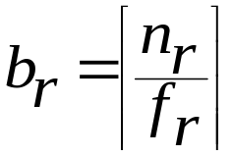
3 Statistical Information for Cost Estimation
(1) Catalog Information about relation
n_{r}: number of tuples in a relation r.
b_{r}: number of blocks containing tuples of r.
f_{r}: blocking factor of r - i.e., the number of tuples of r that fit into one block.
  If tuples of r are stored together physically in a file, then:
l_{r}: number of bytes for a tuple in r
l_{s}: number of bytes for a tuple in s
V(A, r): number of distinct values that appear in r for attribute A; same as the size of ∏_{A}(r).
SC(A, r): selection cardinality of attribute A of relation r ; average number of records that satisfy equality on A.
∴ n_{r} / V(A, r) => SC(A, r)

Slide 23
Statistical Information for Examples
f_{instructor} = 20 (20 tuples of instructor fit in one block)
n_{instructor} = 10000 (instructor has 10,000 tuples)
V(dept-name, instructor) = 50 (has 50 branches)
V(salary, instructor) = 500
SC(dept-name, instructor)≈ 10000/50=200
Assume the following indices exist on instructor:
  A primary index, B⁺-tree index for attribute dept-name
  A secondary index, B⁺-tree index for attribute salary

Slide 24
(2) Catalog Information about Indices
F_{i} : average fan-out of internal nodes of index i, for tree-structured indices such as B+-trees.
Ht_{i} : number of levels in index i — i.e., the height of index i.
  For a balanced tree index (such as B+-tree) on attribute A of relation r, HT_{i} = ⎡log_{Fi} (V(A,r))⎤.
  For a hash index, HT_{i} is 1.

Slide 25
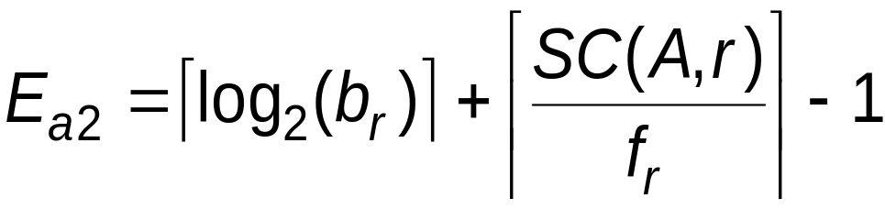
(3) Estimate the Size of Selection
(3.a) Equality Selection
Equality selection σ_{A=v}(r)
    SC(A, r) : number of records that will satisfy the selection
    ⎡SC(A, r)/f_{r}⎤ — number of blocks that the records satisfying the selection will occupy
    E.g. Binary search cost estimate becomes
    Equality condition on a key attribute: SC(A,r)=1

Slide 26
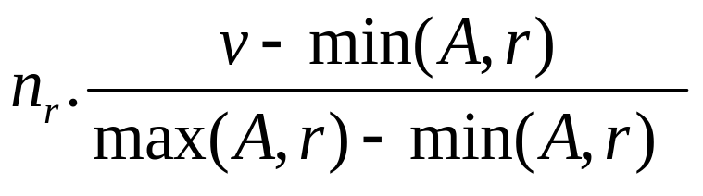
(3.b) Selections Involving Comparisons
Selections of the form σ_{A≤V} ：【the case of σ_{A ≥ V}(r) is symmetric】
  Let c denote the estimated number of tuples satisfying the condition.
  If min(A,r) and max(A,r) are available in catalog
    C = 0 if v < min(A,r)
    C =
  In absence of statistical information, (e.g v is not available at the time of optimization) c is assumed to be n_{r} / 2.
  (设min(A,r)是r中属性A的最小值，max(A,r)是最大值)
Assume the values are uniformly distributed

Slide 27
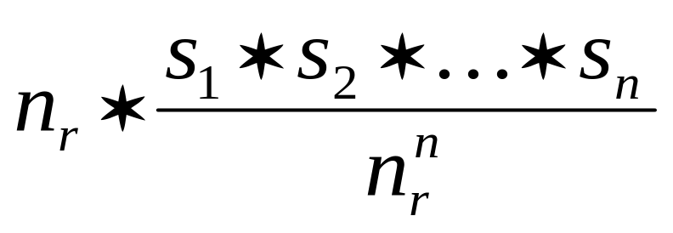
(3.c) Complex Selections
The selectivity of a condition θ_{i} (选择σ_{θi}的中选率) is the probability (概率) of which a tuple in the relation r satisfies θ_{i} . Assume S_{i} is the number of tuples in r that satisfy θ_{i} , the selectivity of θ_{i} is S_{i} / n_{r}
Conjunction: σ_{θ1∧ θ2∧. . . ∧ θn} (r). The estimate for number of tuples in the result is:
【Note the meaning of S_{i} ≈ to SC(A, r) 】
多条件合取的中选率= 各θ_{i} 单独起作用时的中选率之积
σ_{θ2}的中选率
σ_{θ1}的中选率

Slide 28
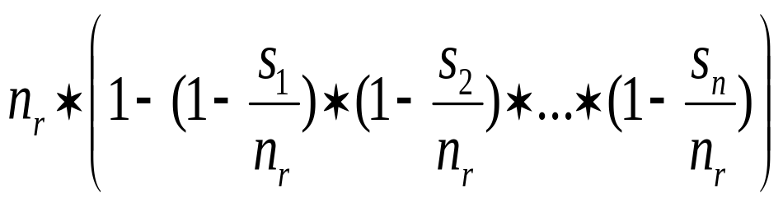
(3.c) Complex Selections
Negation: σ_{¬θ}(r).
Estimated number of tuples:
n_{r} –size(σ_{θ} (r)) = n_{r} .(1 - S_{i} /n_{r} )
Disjunction:σ_{θ1∨} _{θ2 ∨. . . ∨} _{θn} (r).
Estimated number of tuples:
σ_{¬θ} 的中选率
θ₁ v θ₂ = ¬(¬ θ₁ ∧ ¬ θ₂ ) , σ_{¬θi} = n_{r} .(1-S_{i} / n_{r} )
¬θ₁ 的中选率

Slide 29
(4) Estimation of the Size of Joins
1) The Cartesian product r x s produces n_{r} .n_{s} tuples; each tuple occupies l_{r} + l_{s} bytes.
●If R ∩ S = ∅, then r s is the same as r x s.
2) If R ∩ S is a key for r, then a tuple of s will join with at most one tuple from r. (symmetric for s)
  therefore, the number of tuples in r s is no greater than the number of tuples in s. (若连接属性是r的候选码，则连接结果得到的行数≤s的行数)

Slide 30
(4) Estimation of the Size of Joins (cont.)
3) If R ∩ S forms a foreign key in r, referencing s, then the number of tuples in
r s is exactly the same as the number of tuples in r. (若连接属性是r的外码并参照s，则结果行数＝r的行数, 即结果行数通常等于参照关系的行数。)
    The case for R ∩ S being a foreign key referencing r is symmetric.
In the example query, teaches instructor, the join attr. ID in teaches is a foreign key referencing instructor,
  hence, the result = n_{teaches} tuples, which is 5000

Slide 31
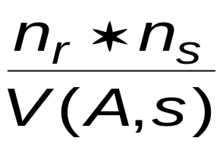
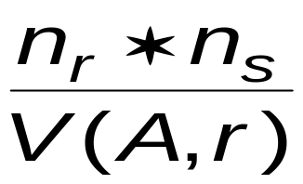
Estimation of the Size of Joins (cont.)
4) If R ∩ S = {A} is not a key for R nor S.
If we assume that each value of A appears with equal probability, then every tuple t in R produces tuples in R S, the number of tuples in R S is estimated to be:
● If the reverse is true, the estimate obtained will be:
● If V(A, r) ≠ V(A, s), （存在悬空的元组即不匹配的元组） the lower of these two estimates is probably the more accurate one.（取二者中较小的）
平均中选几率
属性A是连接属性。当V(A,s)＝n_{s}时, 即3)

Slide 32
Example: Estimation of the Size of Joins
Compute the size estimates for takes student without using information about foreign keys:
  V(ID, takes) = 2500, and //一共10,000条//
  V(ID, student) = 5000 //一共5,000条//
  The two estimates are 5000 * 10000/2500 = 20,000 and 5000 * 10000/5000 = 10,000
  We choose the lower estimate, which in this case, is the same as our earlier computation using foreign keys.

Slide 33
Example: Estimation of the Size of Joins
b_{r}=20000/25=800, b_{s}= 45000/30=1500,
BT: 800 x 1500 + 800= 1,200,800; ST: 2 x 800=1600
(2) log_{60/2} 20000 ≈ 3, BT=ST=45000 x (3+1) + 1500 =181,500
(3) Size = 45000
Example2: Given:
lib_card(cno, name, depart, type),
borrow(cno, bno, borrow_date, return_date).
n_{lib}=20,000, f_{lib} = 25; n_{borrow}=45,000, f_{borrow}=30
The relation lib_card has B⁺-tree index on primary key cno, (assume its fan-out n = 60 ); the cno of borrow references the cno of lib_cad.
Assume the allowed memory is in the worst case. Please estimate the cost of the join operation lib_card borrow using :
(1) Block nested-loop join strategy
(2) Indexed nested-loop join strategy
(3) Estimate the size of the join.

Slide 34
(5) Size Estimation for Other Operations
Projection: estimated size of ∏_{A}(r) = V(A,r)
Aggregation : estimated size of _{A}g_{F}(r) = V(A,r)
Set operations
  For unions/intersections of selections on the same relation: rewrite and use size estimate for selections
    E.g. σ_{θ1} (r) ∩ σ_{θ2} (r) can be rewritten as σ_{θ1 ∧ θ2} (r)
    σ_{θ1} (r) ∪ σ_{θ2} (r) => σ_{θ1 v θ2} (r)
  For operations on different relations:
    estimated size of r ∪ s = size of r + size of s.
    estimated size of r ∩ s = minimum size of r and size of s.
    estimated size of r – s = r.
    All the three estimates may be quite inaccurate, but provide upper bounds on the sizes.

Slide 35
Size Estimation (cont.)
Outer join:
  Estimated size of r s = size of r s + size of r
    Case of right outer join is symmetric
  Estimated size of r s = size of r s + size of r + size of s
    All these estimates may be quite inaccurate, but provide upper bounds on the sizes.

Slide 36
(6) Estimation of Number of Distinct Values
a) Selections: σ_{θ} (r)
If θ forces A to take a specified value: V(A, σ_{θ} (r)) = 1.
    e.g. V(A, σ_{A = 3} (r)) must be 1
If θ forces A to take on one of a specified set of values:
V(A,σ_{θ} (r)) = number of specified values.
    e.g., θ = (A = 1 V A = 3 V A = 4 ), V(A,σ_{θ} (r))=3
If the selection condition θ is of the form A op v
estimated V(A,σ_{θ} (r)) = V(A, r) * s
    where s is the selectivity of the selection σ_{θ} .
In all the other cases: use approximate estimate of
min(V(A,r), n(σ_{θ} (r)))
  More accurate estimate can be got using probability theory, but this one works fine generally
>, <, >=, <=, <>

Slide 37
(6) Estimation of Distinct Values (cont.)
b) Joins: r s
If all attributes in A are from r
estimated V(A, r s) = min (V(A, r), n _{r s} )
If A contains attributes A1 from r and A2 from s, then estimated V(A, r s) =
min{ V(A1,r) * V(A2 – A1,s),
V(A1 – A2,r)*V(A2,s),
n_{r s} }
(∵ A = A1 U A2, 二者有可能重叠 A1 ∩ A2 ≠ ∅)
  More accurate estimate can be got using probability theory, but this one works fine generally
Using method in (4)

Slide 38
Estimation of Distinct Values (cont.)
c) projection ∏_{A} (r)
Estimation of distinct values are straightforward for projections.
  They are the same in ∏_{A} (r) as in r : V(A, ∏_{A} (r))= V(A, r).
  The same holds for grouping attributes of aggregation.
d) Aggregated values
  For the results of sum, count, and average, we can assume that all aggregate values are distinct, and use V(G,r) where G denotes grouping attributes.
  For min(A) and max(A), the number of distinct values can be estimated as min(V(A,r), V(G,r)) where G denotes grouping attributes.

Slide 39

4 Choice of Evaluation Plan
An evaluation plan defines exactly ① what algorithm is used for each operation (e.g.scan, index, merge-join), and ②how the execution of the operations is coordinated (e.g. pipeline).
Join by course_id
Materialized and ordering
Join by ID
sorted on ID
Create index idx1 on instructor (ID, dept-name)

Slide 40
Choice of Evaluation Plans
③Must consider the interaction of evaluation techniques when choosing evaluation plans: choosing the cheapest algorithm for each operation independently may not yield best overall algorithm. E.g:
  merge-join may be costlier than hash-join, but may provide a sorted output which reduces the cost for an outer level aggregation.
  nested-loop join may provide opportunity for pipelining(流水线)
Practical query optimizers incorporate elements of the following two broad approaches:
  1. Search all the plans and choose the best plan in a
  cost-based fashion.
  2. Uses heuristics (启发式) to choose a plan.

Slide 41
(1) Cost-Based Optimization
(a) Join order optimization
Eg: Consider finding the best join-order for r₁ r₂ . . . r_{n}.
  There are (2(n – 1))! / (n – 1)! different join orders for above expression. With n = 3, the number is 12, with n = 7, the number is 665280, with n = 10, the number is greater than 176 billion!
r1 ▷◁(r2 ▷◁r3 ), r1 ▷◁(r3 ▷◁r2 ), (r2 ▷◁r3 ) ▷◁ r1, (r3 ▷◁r2 ) ▷◁ r1
r2 ▷◁(r1 ▷◁r3 ), r2 ▷◁(r3 ▷◁r1 ), (r1 ▷◁r3 ) ▷◁ r2, (r3 ▷◁r1 ) ▷◁ r2
r3 ▷◁(r2 ▷◁r1 ), r3 ▷◁(r1 ▷◁r2 ), (r2 ▷◁r1 ) ▷◁ r3, (r1 ▷◁r2 ) ▷◁ r3
No need to generate all the join orders. Using dynamic programming, the least-cost join order for any subset of
{r₁, r₂, . . . r_{n}} is computed only once and stored for future use.
E.g. (r1 ▷◁ r2 ▷◁r3 ) ▷◁ r4 ▷◁r5 , 12 * 12 = 144, 12 + 12 = 24
E.g r1 r2 r3
12
12

Slide 42
Dynamic Programming in Optimization
To find best join tree for a set of n relations:
  To find best plan for a set S of n relations, consider all possible plans of the form: S₁ (S – S₁) where S₁ is any non-empty subset of S.
  Recursively compute costs for joining subsets of S to find the cost of each plan. Choose the cheapest of the 2^{n} – 1 alternatives. (The number of subsets of n relations is 2^{n})
  When plan for any subset is computed, store it and reuse it when it is required again, instead of re-computing it
    Dynamic programming

Slide 43
Join Order Optimization Algorithm
(连接顺序优化的动态规划算法思路)
procedure findbestplan(S)
if (bestplan[S].cost ≠ ∞)
return bestplan[S]
// else bestplan[S] has not been computed earlier, compute it now
if (S contains only 1 relation)
set bestplan[S].plan and bestplan[S].cost based on the best way
of accessing S /* Using selections on S and indices on S */
else for each non-empty subset S1 of S such that S1 ≠ S
P1= findbestplan(S1)
P2= findbestplan(S - S1)
A = best algorithm for joining results of P1 and P2
cost = P1.cost + P2.cost + cost of A
if cost < bestplan[S].cost
bestplan[S].cost = cost
bestplan[S].plan = “execute P1.plan; execute P2.plan;
join results of P1 and P2 using A”
return bestplan[S]
* Some modifications to allow indexed nested loops joins on relations that have
selections (see book)

Slide 44
Cost of Optimization
With dynamic programming time complexity of optimization is O(3^{n}).
  With n = 10, this number is 59000 instead of 176 billion!
Space complexity is O(2^{n})
Cost-based optimization is expensive, but worthwhile for queries on large datasets (typical queries have small n, generally < 10)

Slide 45
(b) Interesting Orders in Cost-Based Optimization
Consider the expression (r₁ r₂ r₃) r₄ r₅
An interesting sort order (感兴趣的排序顺序) is a particular sort order of tuples that could be useful for a later operation.
  Generating the result of r₁ r₂ r₃ sorted on the attributes common with r₄ or r₅ may be useful, but generating it sorted on the attributes common only r₁ and r₂ is not useful.
  Using merge-join to compute r₁ r₂ r₃ may be costlier, but may provide an output sorted in an interesting order.

Slide 46
Interesting Orders in Cost-Based Optimization
Not sufficient to find the best join order for each subset of the set of n given relations; must find the best join order for each subset, and for each interesting sort order
  Simple extension of earlier dynamic programming algorithms
  Usually, the number of interesting sort orders is quite small and does not affect time/space complexity significantly
【不仅要考虑每个子集的各种连接顺序，还要考虑连接结果的感兴趣的排列顺序】

Slide 47
(2) Heuristic Optimization
Cost-based optimization is expensive, even with dynamic programming.
Systems may use heuristics (启发式规则) to reduce the number of choices that must be made in a cost-based fashion.
Heuristic optimization transforms the query-tree by using a set of rules that typically (but not in all cases) improve execution performance:
  Perform selection early (reduces the number of tuples for next ops)
  Perform projection early (reduces the number of attributes)
  Perform most restrictive selection and restrictive join operations before other similar operations.
  Some systems use only heuristics, others combine heuristics with partial cost-based optimization.

Slide 48
Steps in Typical Heuristic Optimization
1. Deconstruct conjunctive selections into a sequence of single selection operations (Equiv. rule 1.).
2. Move selection operations down the query tree for the earliest possible execution (Equiv. rules 2, 7a, 7b, 11).
3. Execute first those selection and join operations that will produce the smallest relations (Equiv. rule 6).
4. Replace Cartesian product operations that are followed by a selection condition by join operations (Equiv. rule 4a).
5. Deconstruct and move as far down the tree as possible lists of projection attributes, creating new projections where needed (Equiv. rules 3, 8a, 8b, 12).
6. Identify those subtrees whose operations can be pipelined, and execute them using pipelining.

Slide 49
*(3) Structure of Query Optimizers
The System R/Starburst optimizer considers only left-deep join orders. This reduces optimization complexity and generates plans amenable to pipelined evaluation.
System R/Starburst also uses heuristics to push selections and projections down the query tree.
Heuristic optimization used in some versions of Oracle:
  Repeatedly pick “best” relation to join next
    Starting from each of n starting points. Pick best among these.
For scans using secondary indices, some optimizers take into account the probability that the page containing the tuple is in the buffer.
Intricacies of SQL complicate query optimization
  E.g. nested subqueries

Slide 50
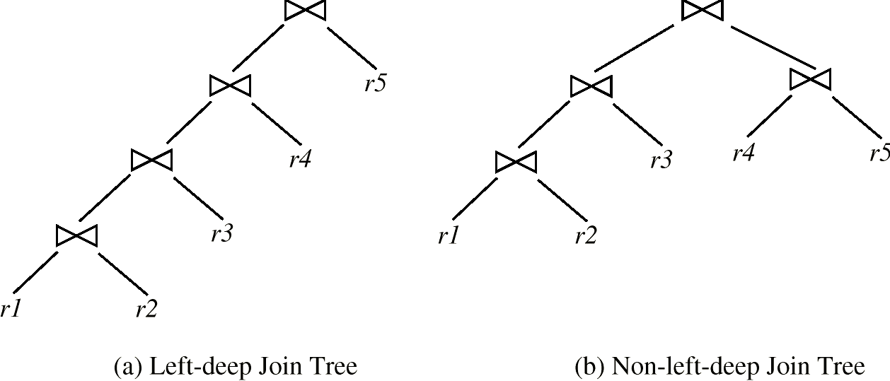
Left Deep Join Trees (左深连接树)
In system R optimizer, only use left-deep join orders, the right-hand-side input for each join is a relation, not the result of an intermediate join.

Slide 51
Structure of Query Optimizers (cont.)
Some query optimizers integrate heuristic selection and the generation of alternative access plans.
  System R and Starburst use a hierarchical procedure based on the nested-block concept of SQL: heuristic rewriting followed by cost-based join-order optimization.
Even with the use of heuristics, cost-based query optimization imposes a substantial overhead.
To find best left-deep join tree for a set of n relations:
  Consider n alternatives with one relation as right-hand side input and the other relations as left-hand side input.
  Using (recursively computed and stored) least-cost join order for each alternative on left-hand-side, choose the cheapest of the n alternatives.
If only left-deep trees are considered, time complexity of finding best join order is O(n 2^{n})
  Space complexity remains at O(2^{n})

Slide 52
*(4) Optimizing Nested Subqueries
SQL conceptually treats nested subqueries in the where clause as functions that take parameters and return a single value or set of values
  Parameters are variables from outer level query that are used in the nested subquery; such variables are called correlation variables
E.g.
select name
from instructor
where exists (select *
from teaches
where instructor.ID = teaches.ID and teaches.year = 2007)
Conceptually, nested subquery is executed once for each tuple in the cross-product generated by the outer level from clause
  Such evaluation is called correlated evaluation(相关执行)
  Note: other conditions in where clause may be used to compute a join (instead of a cross-product) before executing the nested subquery

Slide 53
Optimizing Nested Subqueries (cont.)
Correlated evaluation may be quite inefficient since
  a large number of calls may be made to the nested query
  there may be unnecessary random I/O as a result
SQL optimizers attempt to transform nested subqueries to joins where possible, enabling use of efficient join techniques
E.g.: earlier nested query can be rewritten as
select name
from instructor, teaches
where instructor.ID = teaches.ID and teaches.year = 2007
  Note: above query doesn’t correctly deal with duplicates, can be modified to do so as we will see
In general, it is not possible/straightforward to move the entire nested subquery from clause into the outer level query from clause
  A temporary relation is created instead, and used in body of outer level query

Slide 54
Optimizing Nested Subqueries (cont.)
In general, SQL queries of the form below can be rewritten as shown
Rewrite: select …
from L₁
where P₁ and exists (select *
from L₂
where P₂)
To: create table t₁ as
select distinct V
from L₂
where P₂¹
select …
from L₁, t₁
where P₁ and P₂²
  P₂¹ contains predicates in P₂ that do not involve any correlation variables
  P₂² reintroduces predicates involving correlation variables, with
  relations renamed appropriately
  V contains all attributes used in predicates with correlation variables

Slide 55
Optimizing Nested Subqueries (cont.)
In our example, the original nested query would be transformed to
create table t₁ as
select distinct ID
from teaches
where year = 2007
select name
from instructor, t₁
where t₁.ID = instructor.ID
The process of replacing a nested query by a query with a join (possibly with a temporary relation) is called decorrelation.
Decorrelation is more complicated when
  the nested subquery uses aggregation, or
  when the result of the nested subquery is used to test for equality, or
  when the condition linking the nested subquery to the other
  query is not exists,
  and so on.

Slide 56
13.5 Materialized Views (实体化视图)
A materialized view is a view whose contents are computed and stored.
Consider the view
create view department_total_salary(dept_name, total_salary) as
select dept_name, sum(salary)
from instructor
group by dept_name
Materializing the above view would be very useful if the total loan amount is required frequently
  Saves the effort of finding multiple tuples and adding up their amounts

Slide 57
Materialized View Maintenance (实体化视图维护)
The task of keeping a materialized view up-to-date with the underlying data is known as materialized view maintenance
Materialized views can be maintained by recomputation on every update on related data.
A better option is to use incremental view maintenance (增量式视图维护)
  Changes to database relations are used to compute changes to materialized view, which is then updated
View maintenance can be done by
  Manually defining triggers on insert, delete, and update of each relation in the view definition
  Manually written code to update the view whenever database relations are updated
  Supported directly by the DBMS

Slide 58
*Incremental View Maintenance
The changes (inserts and deletes) to a relation or expressions are referred to as its differential
  Set of tuples inserted to and deleted from r are denoted i_{r} and d_{r}
To simplify our description, we only consider inserts and deletes
  We replace updates to a tuple by deletion of the tuple followed by insertion of the update tuple
We describe how to compute the change to the result of each relational operation, given changes to its inputs
We then outline how to handle relational algebra expressions

Slide 59
*Incremental View Maintenance
-–for Join Operation
Consider the materialized view v = r s and an update to r.
Let r^{old} and r^{new} denote the old and new states of relation r
Consider the case of an insert to r:
  We can write r^{new} s as (r^{old} ∪ i_{r}) s
  And rewrite the above to (r^{old} s) ∪ (i_{r} s)
  But (r^{old} s) is simply the old value of the materialized view, so the incremental change to the view is just i_{r} s
Thus, for inserts v^{new} = v^{old} ∪(i_{r} s)
Similarly for deletes v^{new} = v^{old} – (d_{r} s)

Slide 60
*Incremental View Maintenance--- for Selection and Projection Operations
Selection: Consider a view v = σ_{θ}(r).
  v^{new} = v^{old} ∪σ_{θ}(i_{r})
  v^{new} = v^{old} - σ_{θ}(d_{r})
Projection is a more difficult operation
  R = (A,B), and r(R) = { (a,2), (a,3)}
  ∏_{A}(r) has a single tuple (a).
  If we delete the tuple (a,2) from r, we should not delete the tuple (a) from ∏_{A}(r), but if we then delete (a,3) as well, we should delete the tuple
For each tuple in a projection ∏_{A}(r) , we will keep a count of how many times it was derived
  On insert of a tuple to r, if the resultant tuple is already in ∏_{A}(r) we increment its count, else we add a new tuple with count = 1
  On delete of a tuple from r, we decrement the count of the corresponding tuple in ∏_{A}(r)
    if the count becomes 0, we delete the tuple from ∏_{A}(r)

Slide 61
*Aggregation Operations---
Incremental View Maintenance
count : v = _{A}g_{count(B)}^{(r)}.
  When a set of tuples i_{r} is inserted
    For each tuple i_{r} in r, if the corresponding group is already present in v, we increment its count, else we add a new tuple with count = 1
  When a set of tuples d_{r} is deleted
    for each tuple t in i_{r.}we look for the group t.A in v, and subtract 1 from the count for the group.
      If the count becomes 0, we delete from v the tuple for the group t.A
sum: v = _{A}g_{sum (B)}^{(r)}
  We maintain the sum in a manner similar to count, except we add/subtract the B value instead of adding/subtracting 1 for the count
  Additionally we maintain the count in order to detect groups with no tuples. Such groups are deleted from v
    Cannot simply test for sum = 0 (why?)
To handle the case of avg, we maintain the sum and count
aggregate values separately, and divide at the end

Slide 62
*Aggregation Operations---
Incremental View Maintenance (Cont.)
min, max: v = _{A}g_{min (B)} (r).
  Handling insertions on r is straightforward.
  Maintaining the aggregate values min and max on deletions may be more expensive. We have to look at the other tuples of r that are in the same group to find the new minimum

Slide 63
*Other Operations---
Incremental View Maintenance
Set intersection: v = r ∩ s
  when a tuple is inserted in r we check if it is present in s, and if so we add it to v.
  If the tuple is deleted from r, we delete it from the intersection if it is present.
  Updates to s are symmetric
  The other set operations, union and set difference are handled in a similar fashion.
Outer joins are handled in much the same way as joins but with some extra work
  we leave details to you.

Slide 64
*Handling Expressions--- Incremental View Maintenance
To handle an entire expression, we derive expressions for computing the incremental change to the result of each sub-expressions, starting from the smallest sub-expressions.
E.g. consider E₁ E₂ where each of E₁ and E₂ may be a complex expression
  Suppose the set of tuples to be inserted into E₁ is given by D₁
    Computed earlier, since smaller sub-expressions are handled first
  Then the set of tuples to be inserted into E₁ E₂ is given by
  D₁ E₂
    This is just the usual way of maintaining joins

Slide 65
Query Optimization and Materialized Views
Rewriting queries to use materialized views:
  A materialized view v = r s is available
  A user submits a query r s t
  We can rewrite the query as v t
    Whether to do so depends on cost estimates for the two alternative
Replacing a use of a materialized view by the view definition:
  A materialized view v = r s is available, but without any index on it
  Suppose user submits a query σ_{A=10}(v).
  Suppose also that s has an index on the common attribute B, and r has an index on attribute A.
  The best plan for this query may be to replace v by r s, which can lead to the query plan σ_{A=10}(r) s
Query optimizer should be extended to consider all above
alternatives and choose the best overall plan

Slide 66
Materialized View Selection
Materialized view selection: “What is the best set of views to materialize?”.
  This decision must be made on the basis of the system workload
Indices are just like materialized views, problem of index selection is closely related, to that of materialized view selection, although it is simpler.
Some database systems, provide tools to help the database administrator with index and materialized view selection.

Slide 67
End of Chapter
7th Edition: Ex 16.5, 16.6, 16.7

